Slide 1

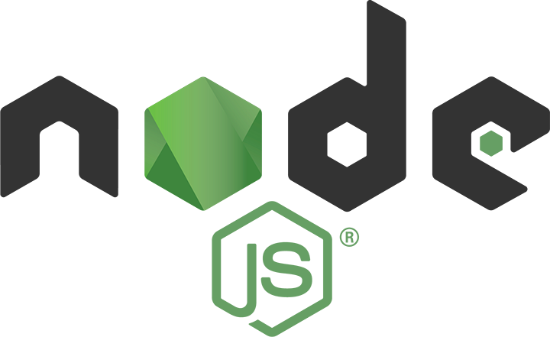
Dev-Pro Node.js
Advanced Flow
Lesson 9. Errors and debugging

Slide 2

Agenda:
Node.js Exceptions
Catch and Exception propagation
Node callback function error and Error classes
Main System Errors
Debugger
Watchers
Break points
Integration V8 inspector to Node.js

Slide 3
Main Node.js error types
Standard JavaScript Errors
EvalError: throws when eval() fail
SyntaxError: throws when JS has invalid syntax
RangeError: throws when value is not in the range
ReferenceError: throws when undefined values are using
TypeError: throws when variables has wrong type
URIError: throws when you don't use global URI handler function
System errors
Custom errors
Assertion Errors. Generated by the assert module

Slide 4
Assert module
The module assert was created for node.js internal using. BUT it can invoke as require(‘assert’) method. BUT assert – this is not tested framework. It is not created for using as the main test library.

Slide 5
Catch and error propagation

Slide 6
Error handling in blocking methods
Synchronous API (any blocking method without callback function f.e. fs.readFileSync) throws an error for creating exception report.

Slide 7
Error handling in synchronous methods

Slide 8
Error handling in synchronous methods

Slide 9
Using ‘error’ event
Using ‘error' event is main for APIs based on streems and event emmiters. Hey can imagine as asyncronous operations chain as opposite one single operation that can be successful or not.

Slide 10
Using ‘error’ event
For all EventEmitter objects is working the rule: if it does not have ‘error' handler, Node.js process throws the unhanded error and “break"; in opposite case using module domain or registering handler for process.on('uncaughtException').

Slide 11
Using ‘error’ event

Slide 12
Callback function in the node style

Slide 13
Callback function in the node style

Slide 14
Class Error
new Error(message)
Error.captureStackTrace(targetObject[, constructorOpt])
Error.stackTraceLimit
error.message
error.stack

Slide 15
Capture Stack Trace

Slide 16
Error stack

Slide 17
Line of placing
native, if frame is internal call of V8 (as is [].forEach)
plain-filename.js:line:column, if frame is internal call of Node.js
/absolute/path/to/file.js:line:column, if frame is invoke in the user application of its dependency.

Slide 18
Class RangeError

Slide 19
Class SyntaxError

Slide 20
Class TypeError

Slide 21
Class System Error
error.code
error.errno
error.syscall
error.message
error.stack

Slide 22
Main System Error
EACCES
EADDRINUSE
ECONNREFUSED
ECONNRESET
EEXIST
EISDIR
EMFILE
ENOENT
ENOTDIR
ENOTEMPTY
EPERM
EPIPE
ETIMEDOUT

Slide 23
Debugger

Slide 24
Debugger

Slide 25
Watchers. Steps
cont, c – Continue execution
next, n – Next Step
step, s – Dive into
out, o – Out from
pause – Stop Code Execution

Slide 26
Watchers. Break Points
setBreakpoint(), sb() – set breakpoint in current line
setBreakpoint(line), sb(line) – set breakpoint in the line.
setBreakpoint('fn()'), sb(...) – set breakpoint in the first expression of function body
setBreakpoint('script.js', 1), sb(...) – set breakpoint in the first line of script.js
clearBreakpoint('script.js', 1), cb(...) – remove breakpoint in the first line of script.js

Slide 27
Watchers. Set Break Points

Slide 28
Watchers. Information
backtrace, bt – trace current frame
list(5) – list of scripts in 5 line context (5 line before and 5 after)
watch(expr) – add expression in watch list
unwatch(expr) – remove expression in watch list
watchers – list of all watchers (automatically retrieves in each breakpoint)
repl – open repl in debugger in connect debug script
exec expr – execute expression in context debug script

Slide 29
Watchers. Execution Control
run – run the script (automatically runs after debugger start )
restart – restart script
kill – finish script

Slide 30
Watchers. Advanced Using
scripts – list of all loaded scripts
version – V8 version
node debug -p – connection with process via pid
node debug – connection with process via URI (f.e. localhost:5858)

Slide 31
Integration V8 inspector to Node.js
Integration V8 Inspector allows to add Chrome DevTools in Node.js instances for debugging and profiling.
V8 Inspector turn-on if you path flag --inspect . Alsг you can create custom port with such flag f.e. : --inspect=9222 allows create connection with DevTools on port 9222.
For finalize on the first line of application code, add flag --debug-brk in addition for --inspect.

Slide 32
Thank you for attention

