Slide 1


VT Cappers
Team Members
Ben Moliterno, Lance Church, Nick Polidoro, Blake Feichtl

Slide 2
Project Overview
Capital One API for collection
Data simulation
Data encryption / decryption process
Remote system storage
Client analytics
Capital One summary analytics
HTML output of graphs

Slide 3
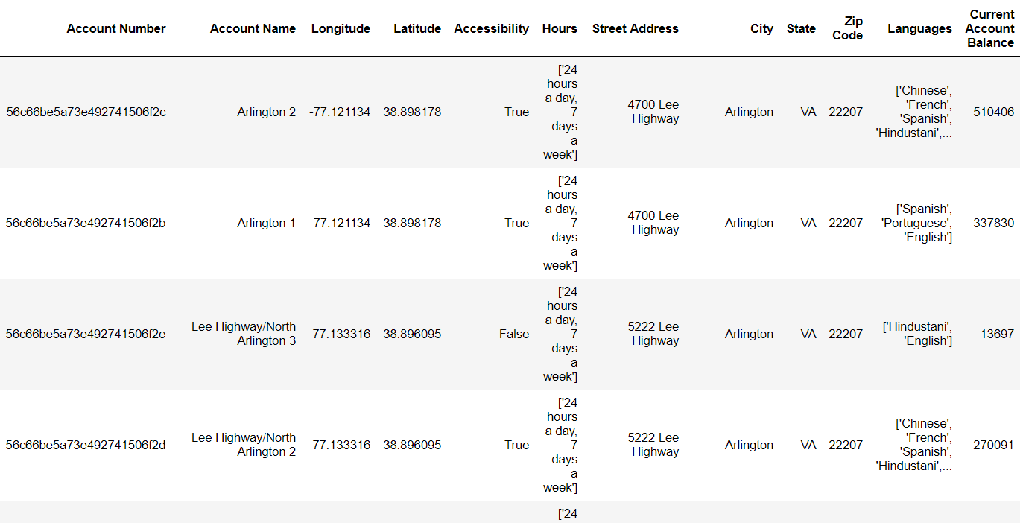
Capital One API for collection and Data Simulation
Utilize Capital One “Nessie” API
Pulled 632 client data records
Simulated 5 years worth of data deposit, withdrawal, and loan transactions using a bi weekly period of time per transaction (24 periods per year; 120 total periods)
120 X 632 = 75840 total transactions tracked for the data set

Slide 4
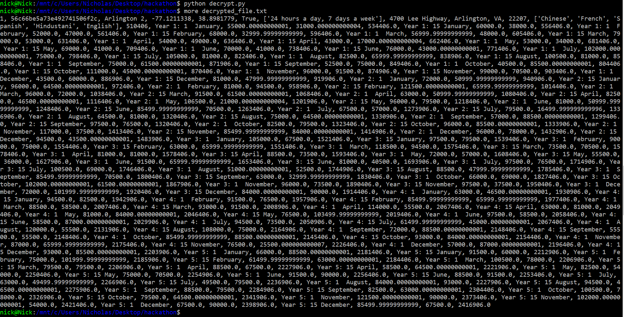
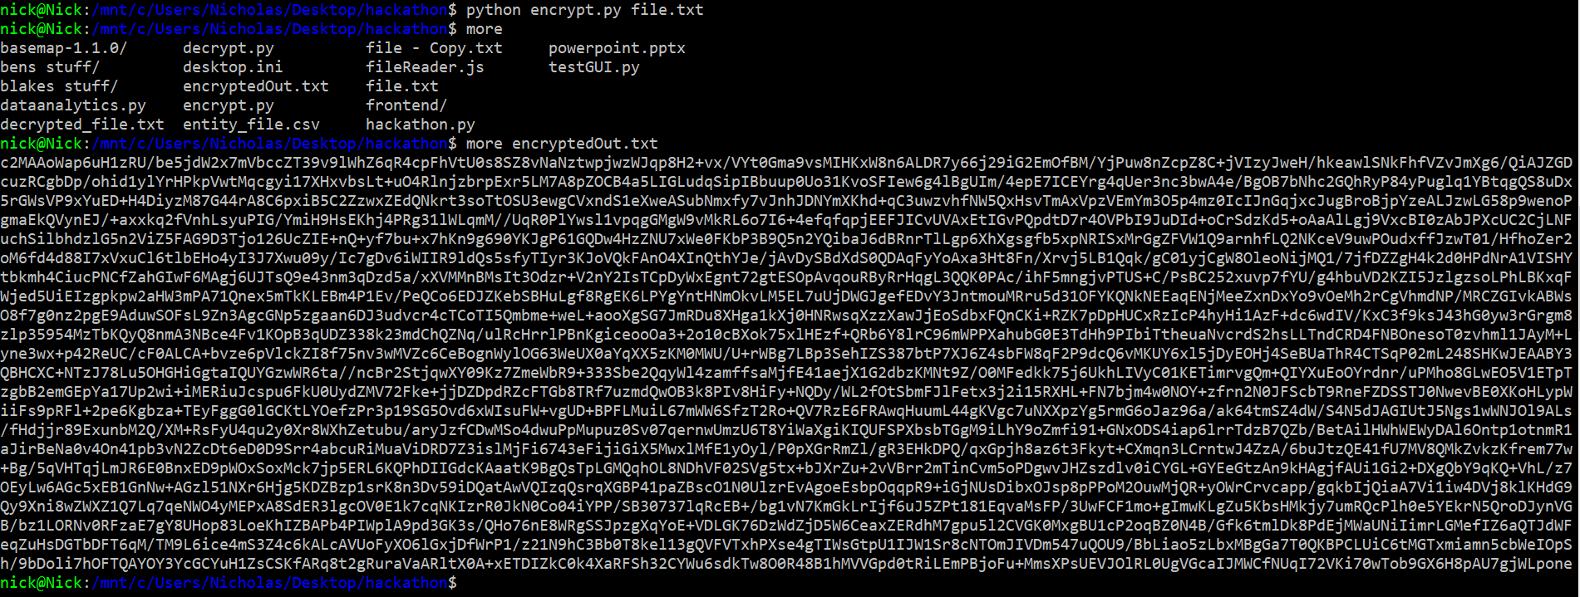
Data encryption / decryption process
Python scripts to encrypt/decrypt .txt files into AES256 given a secret private key
Encrypted files sent through ftp to a personal remote server with drive redundancy

Slide 5
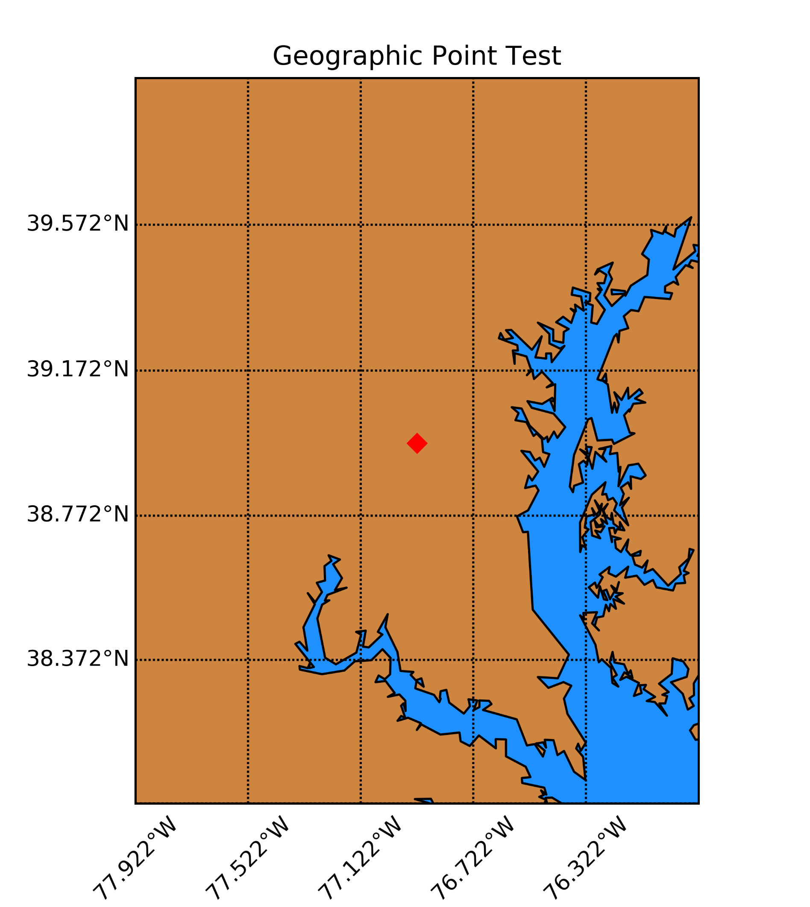
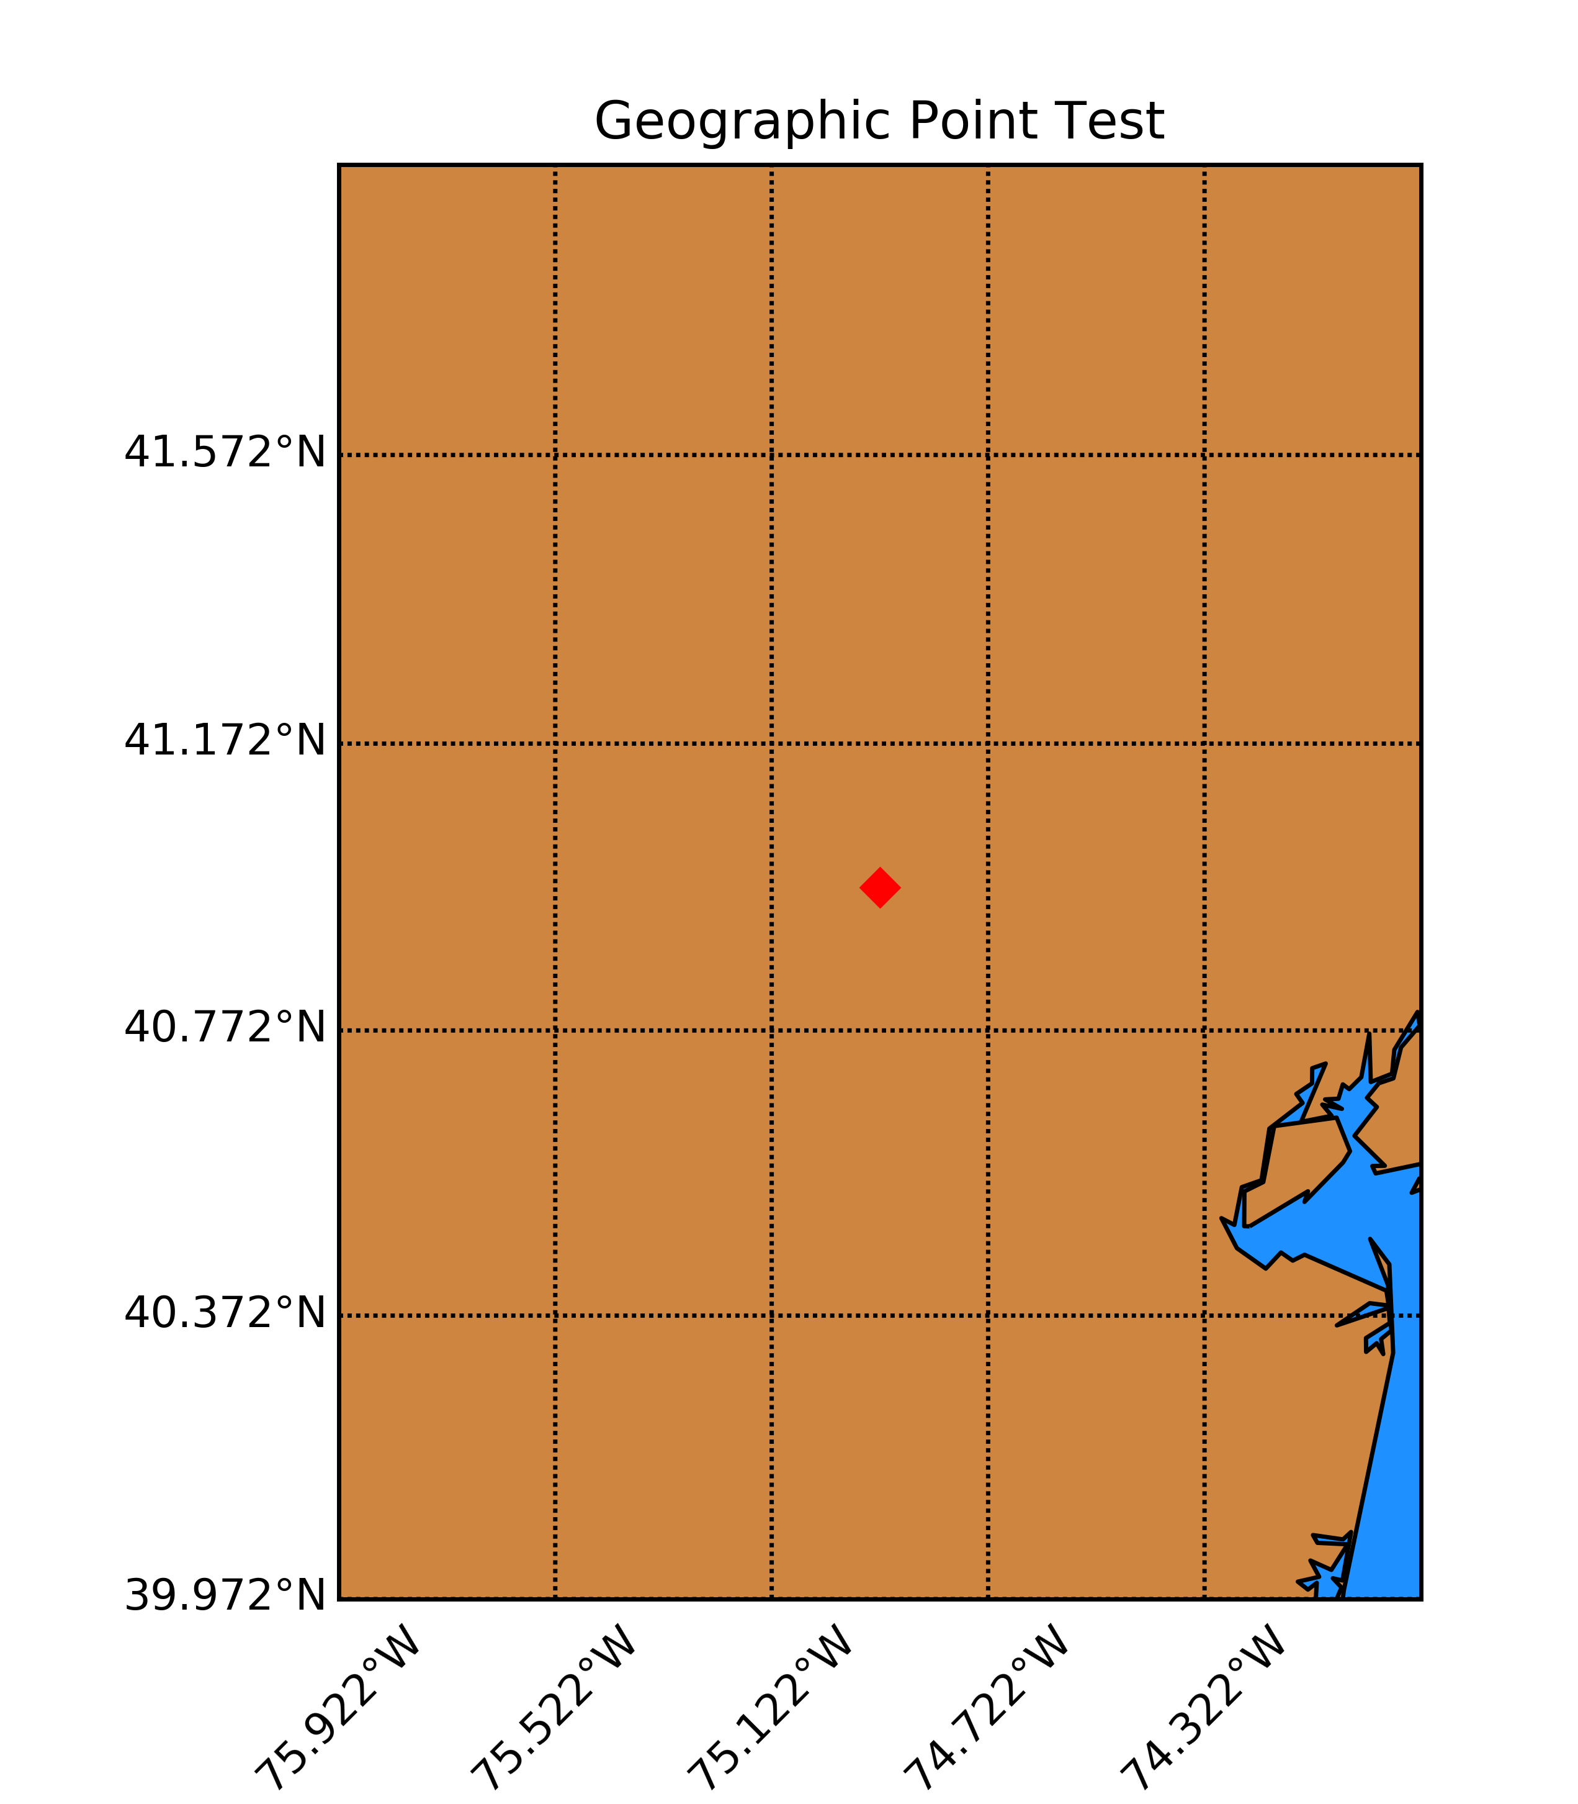
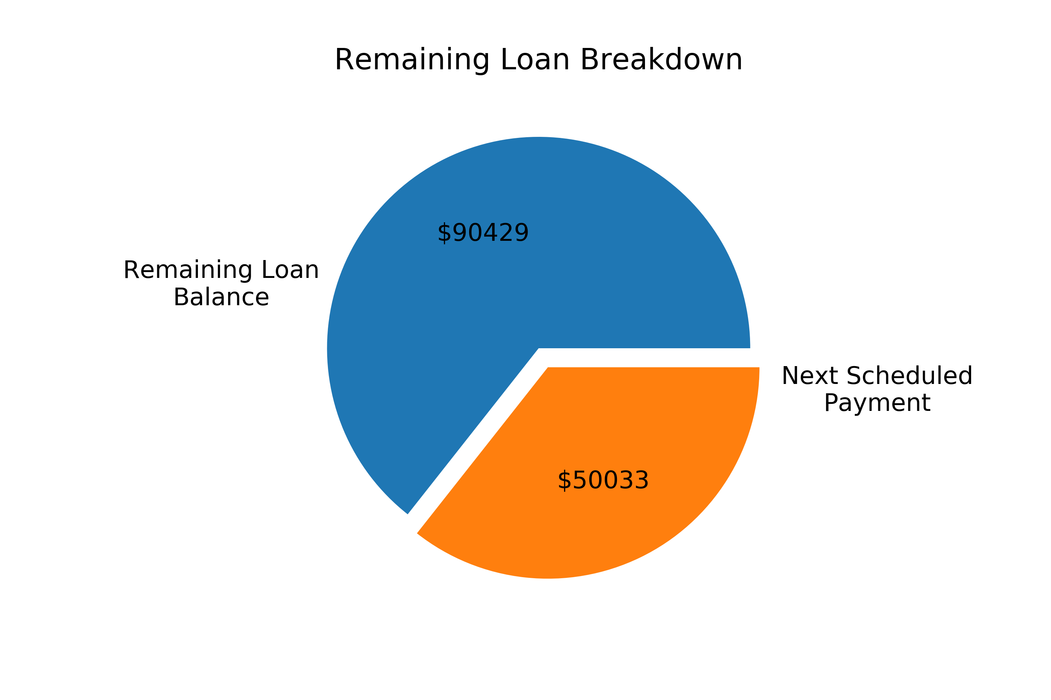
Client Data Analytics
Capital One summary page
Total scheduled payments for this period
Total amount loaned out
Estimated amount left after payment
Average loan interest rate
Total amount in client accounts
Total client deposits this period
Total client withdrawals this period

