Slide 1
Comparison of bioinformatics workflows: nf-core/tfactivity, TF-Prioritizer, & diffTF
Nick Huynh
1

Slide 2
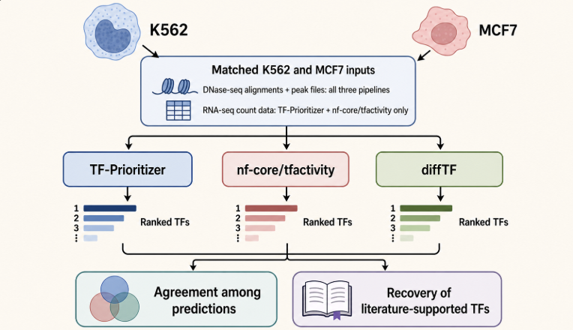
Biological Question?
How consistently do nf-core/tfactivity, TF-Prioritizer, and diffTF prioritize transcription factors that distinguish K562 and MCF7?
2
Notes:
K562 and MCF7 represent two biologically different cancer cell lines. My main question was whether the three computational workflows would identify transcription factors associated with these different regulatory states. I also wanted to determine how much their predictions agreed and whether they recovered regulators already reported in the literature

Slide 3
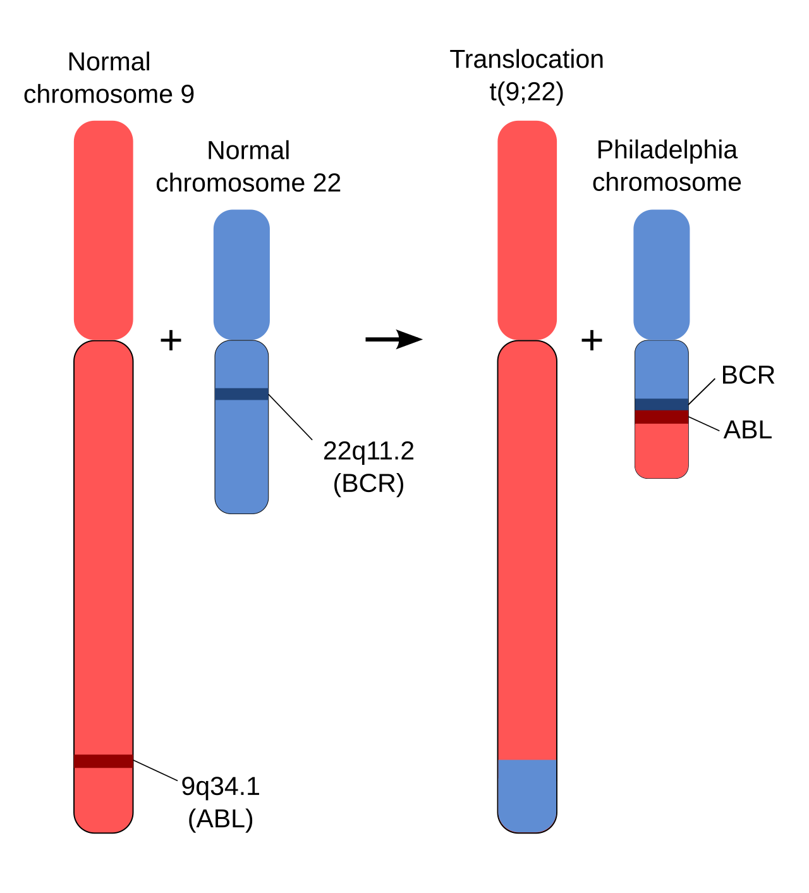
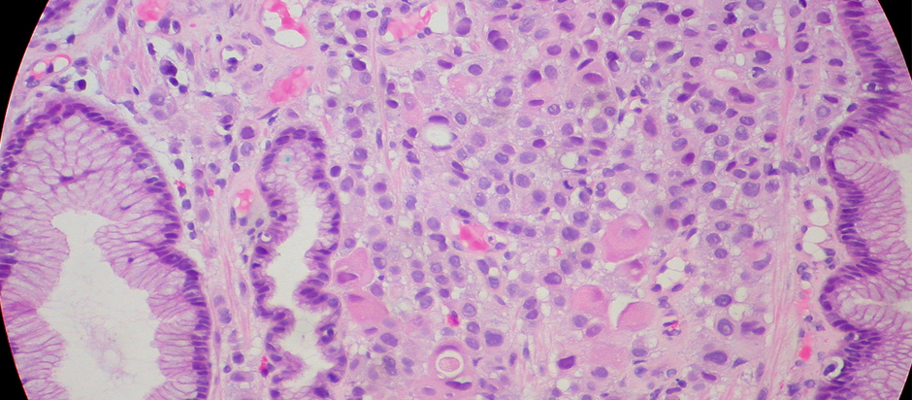
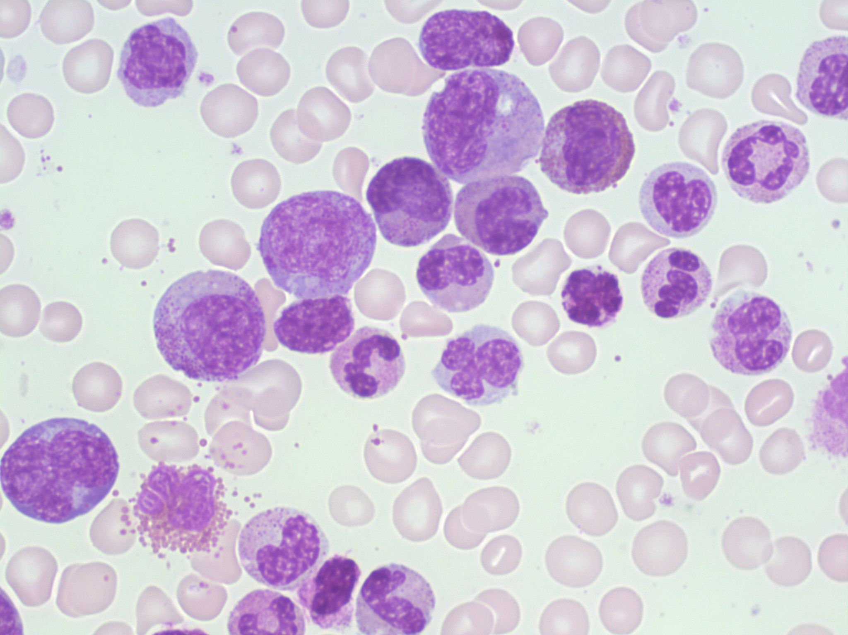
K562
Obtained from the pleural effusion of a 53 year old female
Represents the prototypical cell culture model of chronic myeloid leukemia (CML)
Philadelphia chromosome positive
  Translocation of chromosome 9 & 22
MCF7
Obtained from the pleural effusion from a 69 year old female
Used as an in vitro model for studying breast cancer biology
Maintain a number of characteristics similar to mammary epithelium
3
Notes:
What makes cell lines untrustworthy???
They are from individual cancers.
They don’t represent the full tumor environment or the diversity among patients
The datasets used are from just each cell line nothing else.
Cell lines can change overtime from culture to culture
Should not be generalized into CML or breast cancer overall

Slide 4
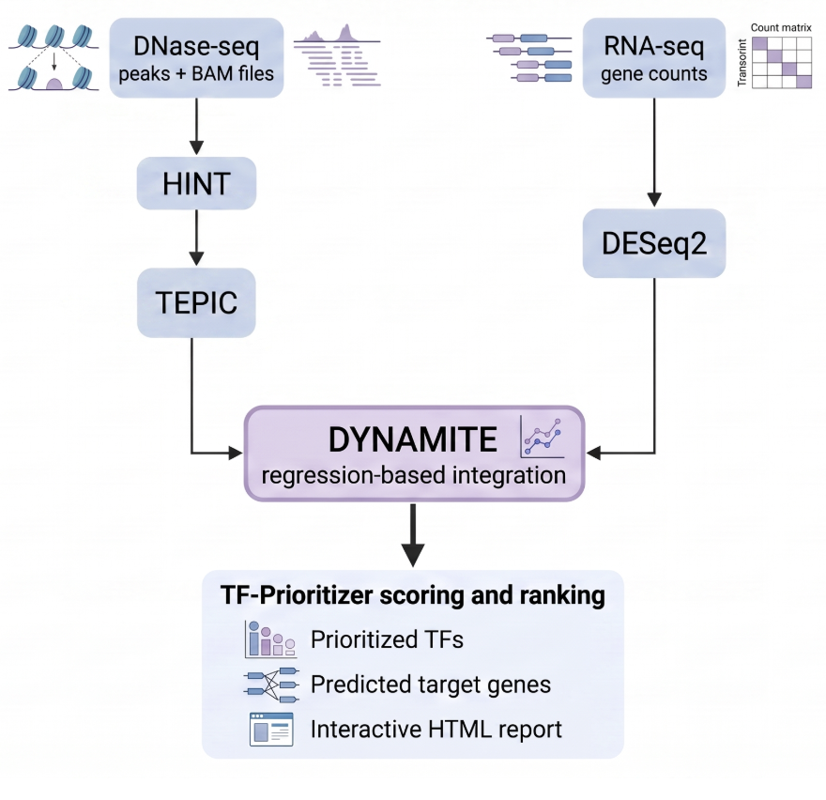
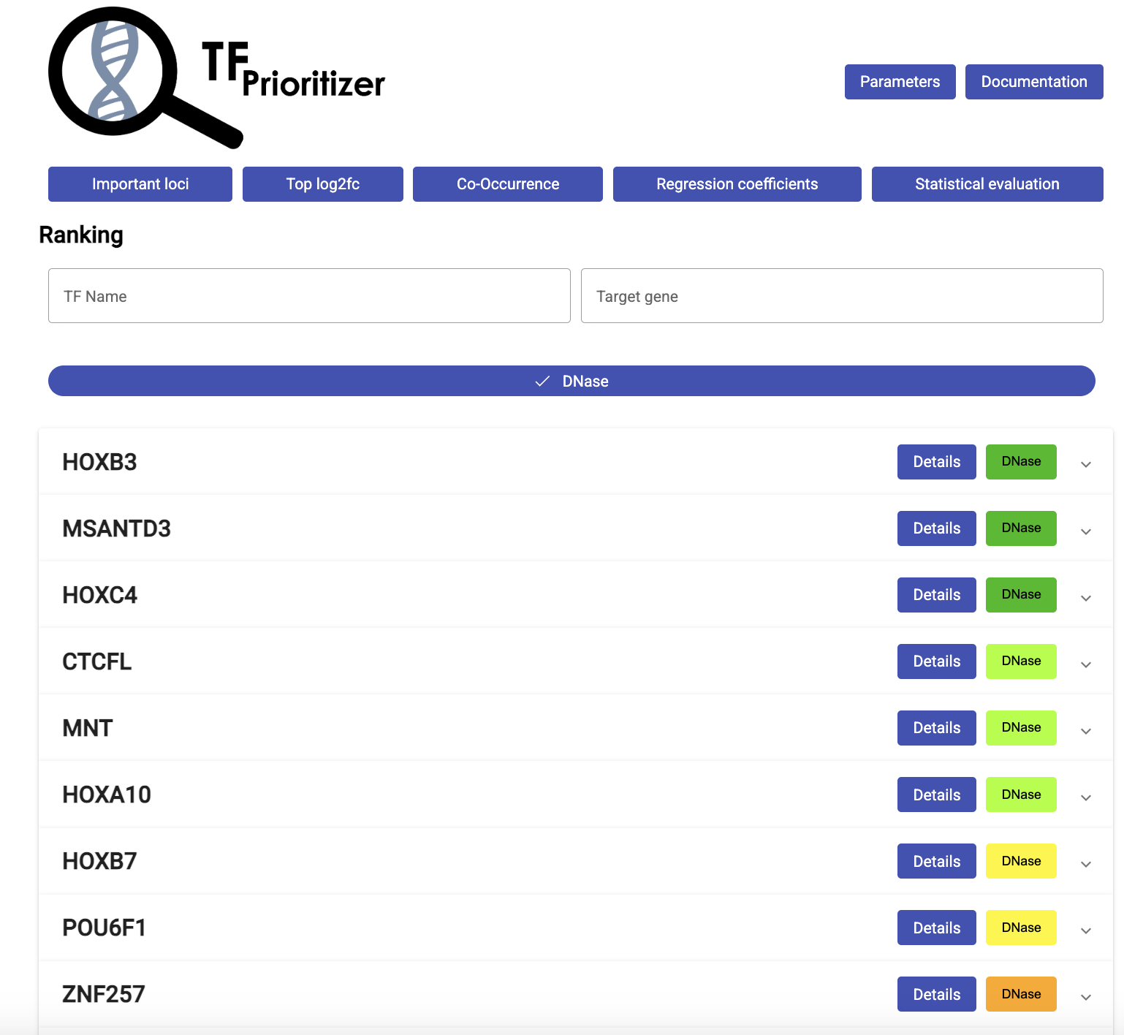
TF-Prioritizer
Primarily a Java-based pipeline
Combines chromatin accessibility with gene expression to identify transcription factors that may contribute to differences between conditions
The analysis compared K562 and MCF7 using DNase-seq accessibility data and RNA-seq gene counts
4
Notes:
TF-Prioritizer connects chromatin accessibility with gene expression through three main tools.
HINT examines the DNase-seq read signal and predicts footprints, which are short protected regions within accessible chromatin that may indicate TF binding.
TEPIC scans these regions for known TF motifs, estimates how strongly each TF could bind and connects the regions to potential target genes.
DYNAMITE then uses regression to determine which TF–gene relationships best explain the expression differences measured from RNA-seq.
Compares the scores between cell lines and produces a table where each row is gene and each column is TF
Each gene then labeled whether its expression is higher in one cell line than the other
The regression model looks across all genes to determine which changes in TF-gene scores are most associated with the rna-seq expression labels
Gives each TF a weight (Coefficient) based on how useful its score changes are for predicting the direction of gene expression change
Removes weak coefficients by setting them to 0, larger nonzero coefficients are predicted to be more useful
TF-Prioritizer combines binding affinity, regression coefficients and target-gene expression changes to rank the transcription factors most likely to contribute to the differences between K562 and MCF7.
Know each step and what it does

Slide 5
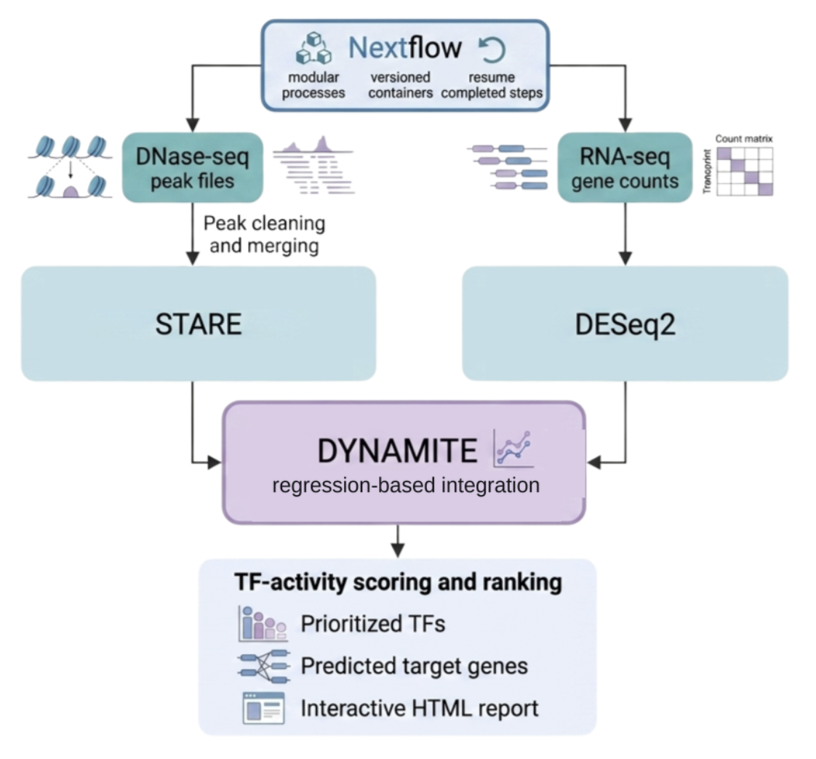
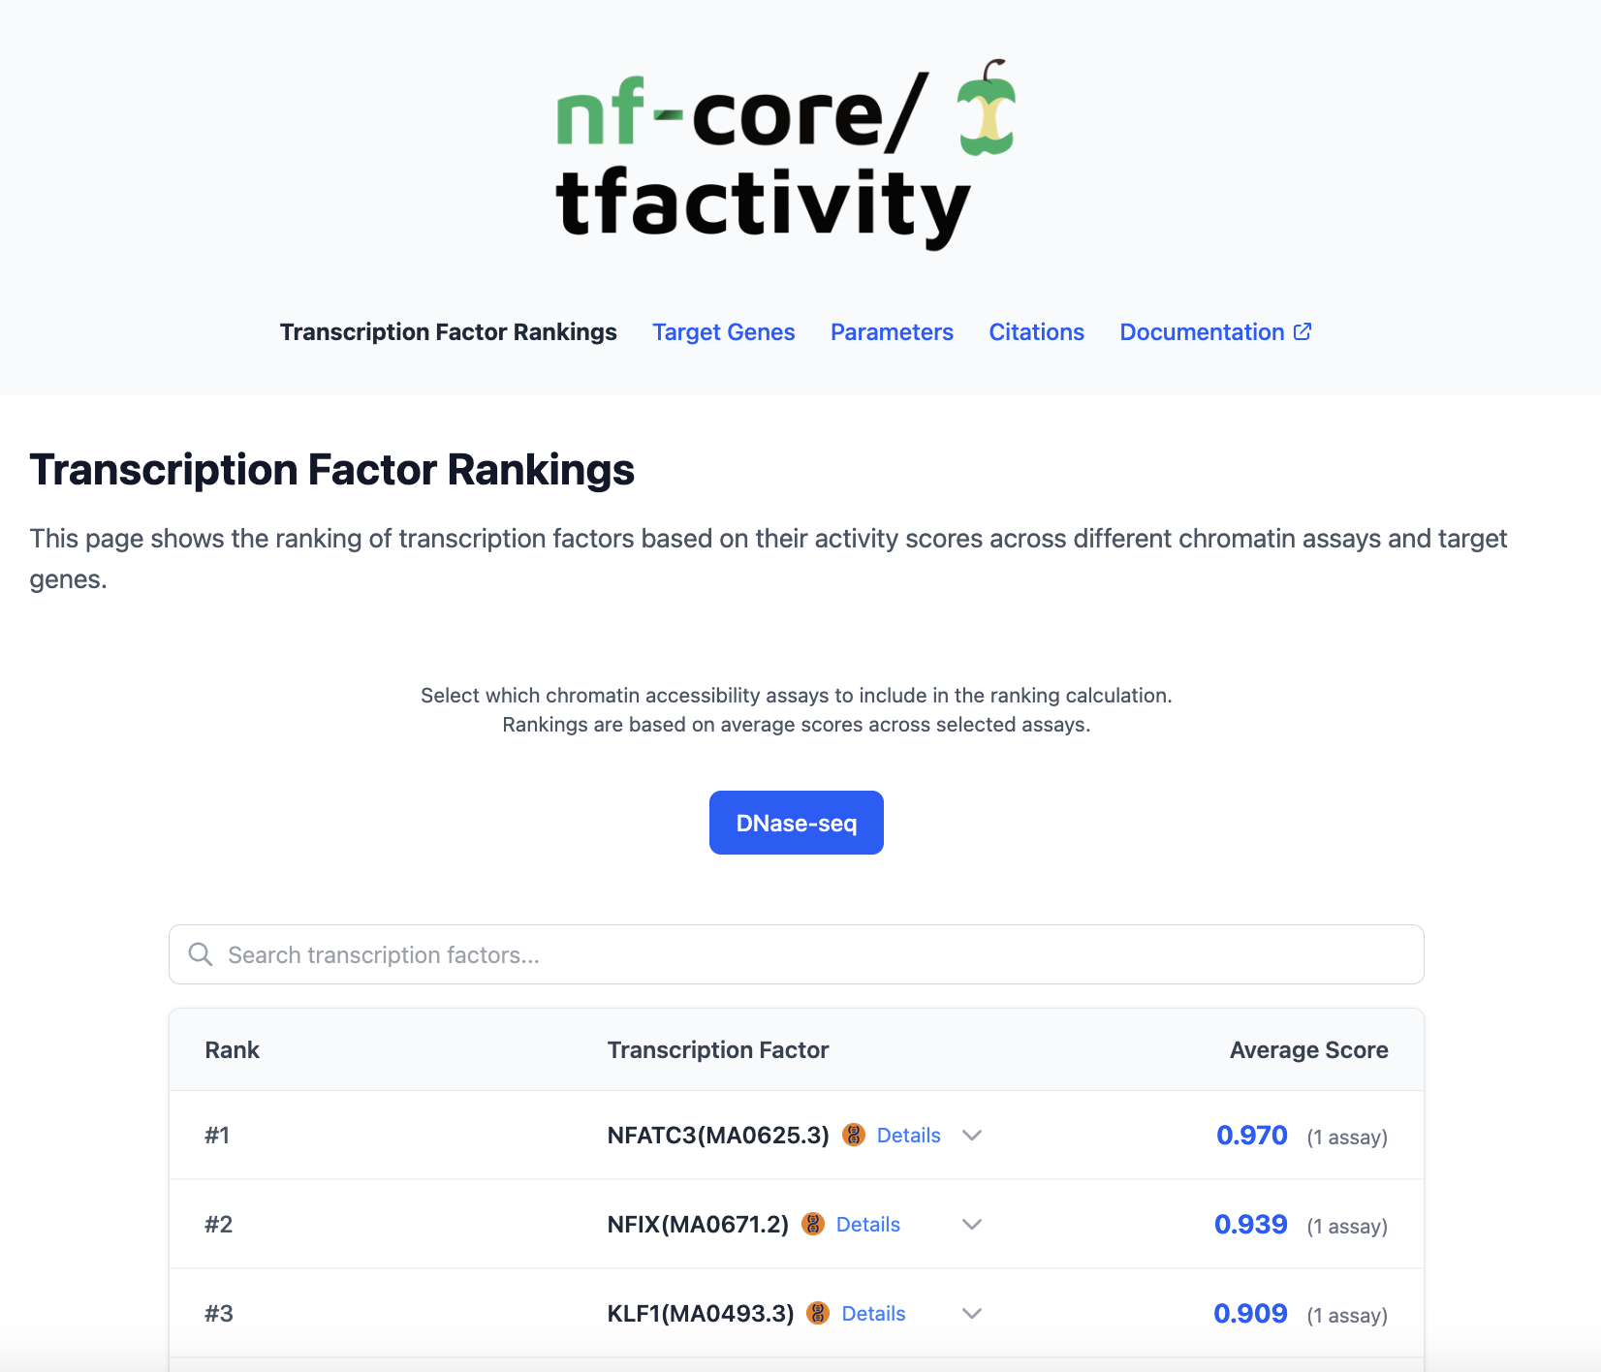
nf-core/tfactivity
Nextflow-based pipeline derived from TF-Prioritizer
  Nextflow makes the workflow modular and allows interrupted runs to resume from completed steps.
Analysis compared K562 and MCF7 using the same ten DNase-seq peak samples and RNA-seq gene counts
5
Notes:
nf-core/tfactivity follows the same general approach as TF-Prioritizer by combining accessible chromatin with gene expression to rank transcription factors. Unlike TF-Prioritizer’s HINT–TEPIC route, tfactivity used STARE
The main difference is that tfactivity is built with Nextflow. Nextflow divides the workflow into separate processes, assigns resources to each process and records their inputs, outputs and software versions. If a run is interrupted, completed processes can usually be reused instead of repeating the entire analysis.
Know each step and what it does

Slide 6
STARE
Used by nf-core/tfactivity
Processed DNase-seq peaks were passed directly to STARE without footprint detection
STARE calculated TF affinities across the entire sequence of each peak
HINT + TEPIC
Used by TF-Prioritizer
HINT used a hidden Markov model to detect protected footprints from DNase-seq cut patterns
TEPIC calculated TF affinities within each footprint sequence
Both tools calculated regional TF affinity similarly:
Extract the selected peak or footprint sequence from the reference genome
Compare positions throughout the sequence with known TF-binding motifs
Combine the predicted binding contributions into a regional TF-affinity score
Because complete peaks are typically longer and may contain more possible motif occurrences than footprints, the resulting TF-gene affinity scores can differ.
6
Notes:
STARE and TEPIC have the same general purpose: scan regulatory DNA for known TF motifs, estimate TF-binding affinities using a biophysical model, and produce TF–gene affinity scores.
TF-Prioritizer → TEPIC used the smaller footprint regions identified by HINT
HINT: Hidden Markov Model → stat model that divides sequential data into states that cannot be observed directly (DNase cut patterns)
TEPIC: receives footprint coordinates by HINT and extracts DNA sequence from reference genome
nf-core/tfactivity → STARE analyzed processed DNase-seq peaks directly
Uses the DNA sequence across that entire peak

Slide 7
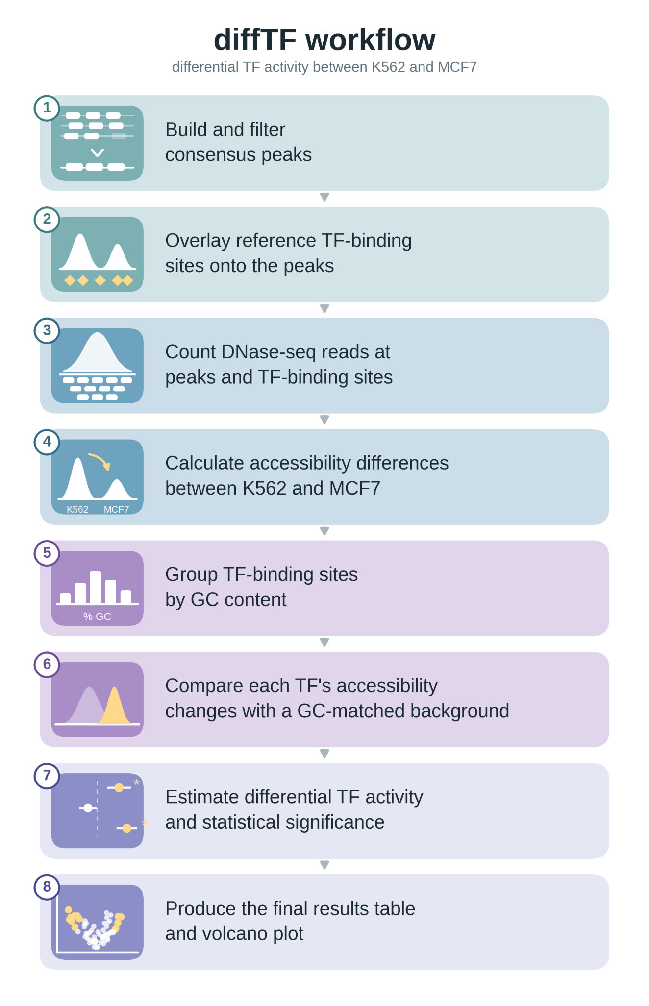
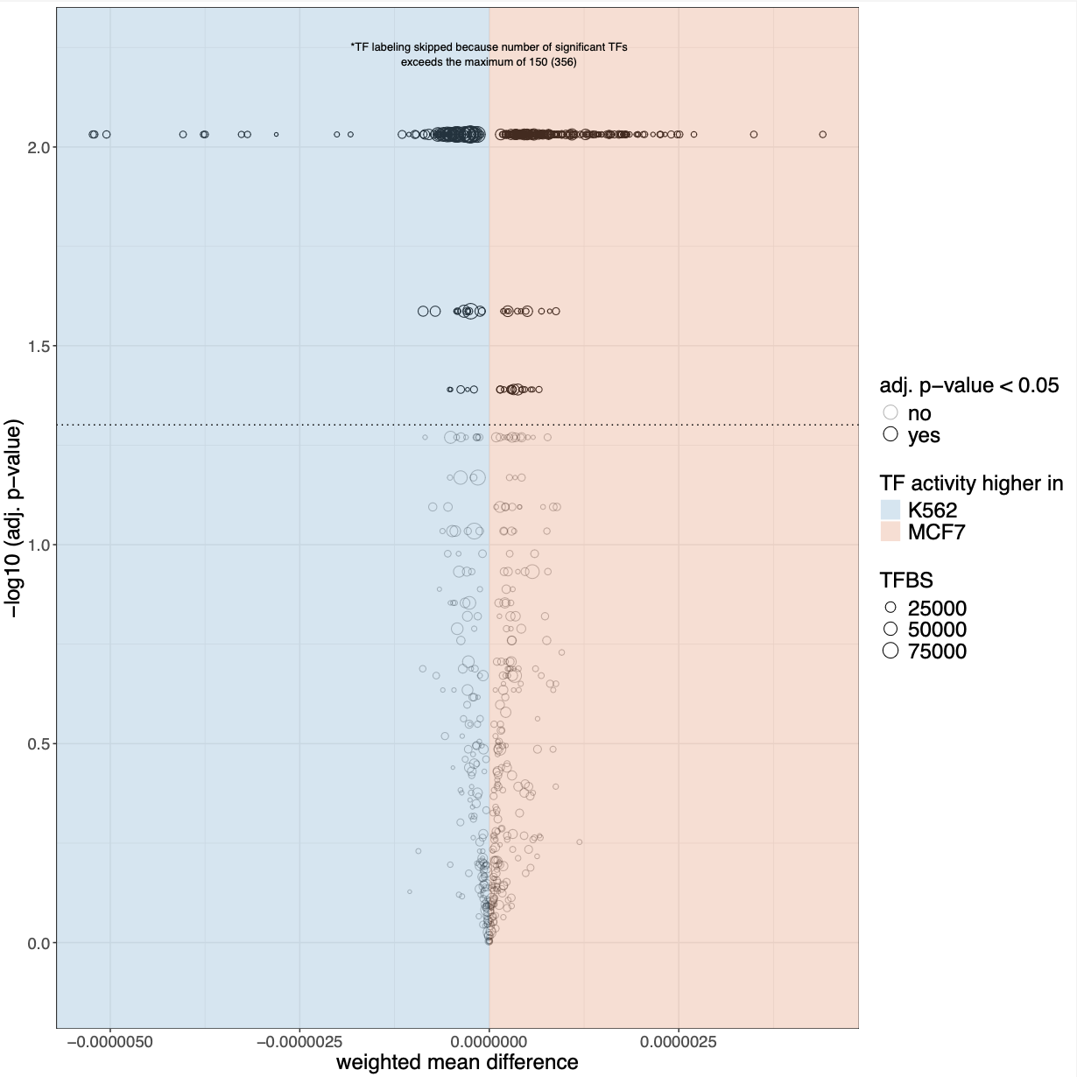
diffTF
Snakemake/R-based pipeline
Measures chromatin accessibility around predicted TF-binding sites
Greater accessibility suggests greater TF activity
Produces differential TF-activity scores and statistical significance
Optional Classification Mode:
  Can integrate RNA-seq to classify TFs as possible activators/repressors
7
Notes:
Combines all peak files to create a common set of accessible regions.
Overlaps these regions with reference-predicted binding sites for each TF.
Counts DNase-seq reads and calculates whether each region is more accessible in K562 or MCF7.
Groups the accessibility changes from all predicted sites belonging to the same TF.
Compares each TF’s changes with background binding sites having similar GC content.
Calculates the TF-activity score as the weighted average of the TF-specific change minus the background change.
Rearranges the K562 and MCF7 sample labels and repeats the calculation to determine whether the real score could occur by chance.
Adjusts the p-values because hundreds of TFs are tested.
In short: looks across all predicted sites for each TF and asks whether those sites consistently become more accessible in one cell line than expected from comparable background sites
Unlike the other two RNA-seq was not used in this analysis because I used basic mode
Classification mode can use rna-seq to classify TFs as possible activators/repressors/unknown
Know each step and what it does

Slide 8
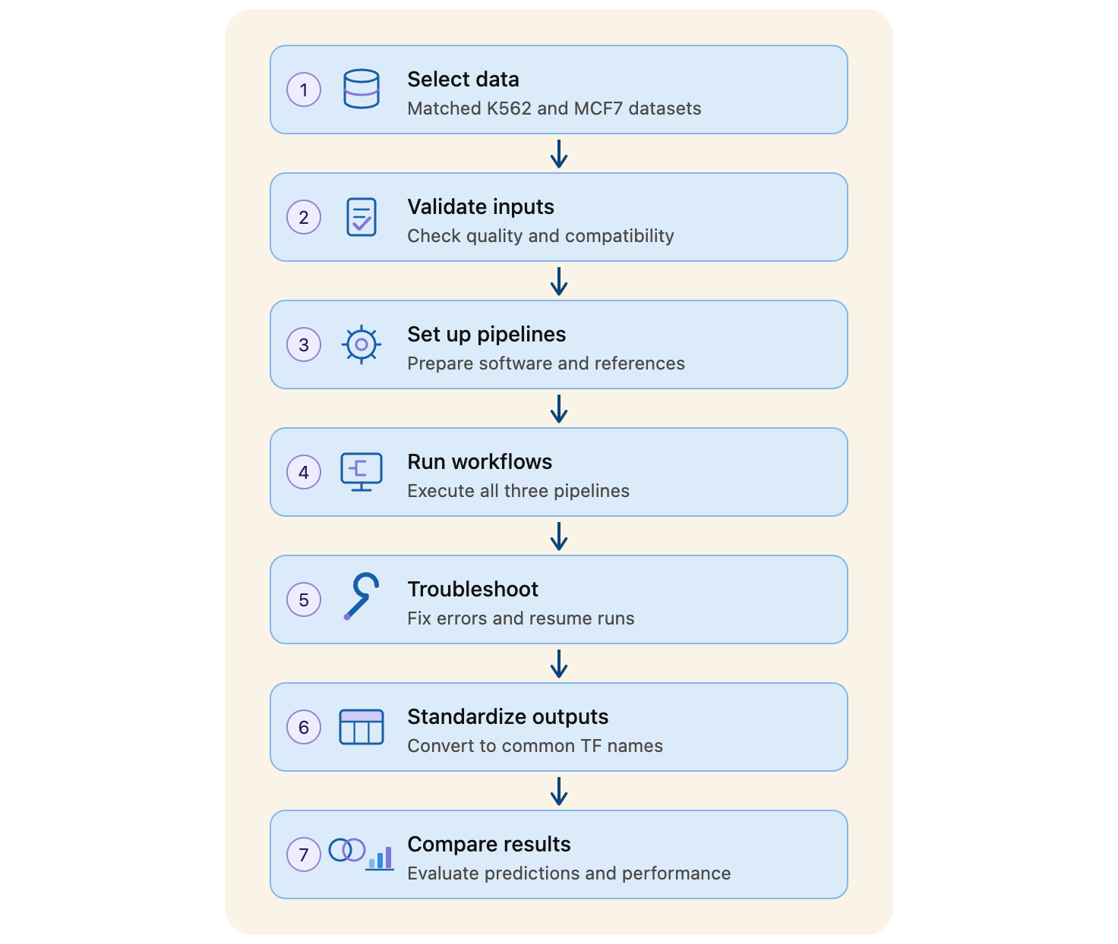
Project
Workflow
8
Notes:
Data Requirements:
Prio: ATAC/DNase/ChIP, rna, peak files
Act: same^
Diff: atac/dnase, rna, peak files
Pipeline setup: Sample sheets, configuration files, reference data, software requirements
Outputs: Converting identifiers into common tf gene names
Comparison: literature review, runtime, storage, comparing predictions

Slide 9
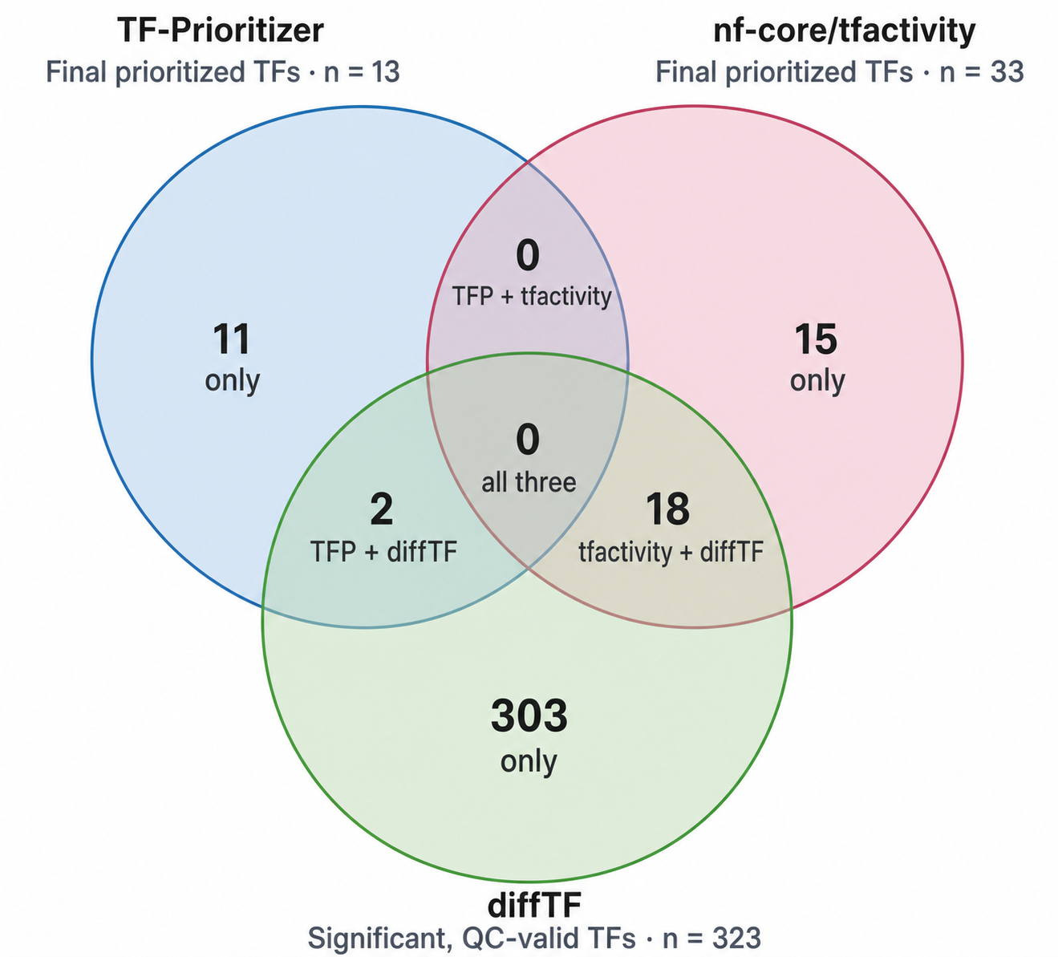
Biological Results
Recovery of Literature Supported TFs in the Top 13 Results
Pipeline | K562 | MCF7
diffTF | GATA1⁷, GATA2⁸, TAL1⁷, KLF1⁹ | FOXA1¹⁰, GRHL2¹¹
nf-core/tfactivity | KLF1⁹ | NFATC3¹⁶, NFIX¹⁷, ELF3¹⁵
TF-Prioritizer | CTCFL¹², PLAG1¹³ | HOXA10¹⁴
Not reported | RUNX1⁹ | ESR1¹⁰
Superscripts correspond to references 7–17 on the References slide.
Selection criteria: TFs were selected from the combined top 13 results if literature supported their association with K562 or MCF7. RUNX1 and ESR1 were included as examples that weren’t reported.
9
Notes:
The Venn Diagram compares the complete final TF lists after TF names were standardized
TF-Prioritizer reported 13 TFs, nf-core/tfactivity reported 33 TFs, and diffTF reported 323 significant
The difference in list sizes is partly caused by how the pipelines select their final results.
RUNX1 and ESR1 were included as additional examples that weren’t found

Slide 10
Practical Results
Pipeline | Runtime | Storage | Output
nf-core/tfactivity | 17h 46min | 3.9GB | Interactive HTML Report
TF-Prioritizer | 20h 41min | 48GB | Interactive HTML Report
diffTF | 80h 39min | 9.1GB | TSV Tables and PDF Plots
10
Notes:
nf-core/tfactivity had the shortest successful runtime and used the least storage. Nextflow also tracked completed processes, allowing interrupted runs to resume without repeating every step.
TF-Prioritizer required a Singularity container because of its older software requirements and produced the largest output directory. However, its interactive report made the final results easier to explore.
diffTF took the longest because it evaluated hundreds of TF motifs across many permutations. Its first major run reached the 48-hour job limit, but Snakemake preserved completed results and allowed the workflow to resume. Its tables and PDF plots also required more manual interpretation.
Overall, nf-core/tfactivity was the fastest and most storage-efficient pipeline. It also provided strong restart support and an interactive report, making it the most practical workflow in this comparison.

Slide 11
Conclusions
Biological
The top 13 TF lists from each pipeline did not overlap, showing each pipeline prioritized a different set of TFs
nf-core/tfactivity shared 18 TFs with diffTF, compared with 2 TFs from TF-Prioritizer in their complete list
diffTF recovered the largest number of the selected literature supported TFs but it also reported a larger final list
Technical
nf-core/tfactivity was fastest and used the least storage
TF-Prioritizer produced the largest results directory
diffTF took the longest and required more manual interpretation due to no interactive report
The nf-core/tfactivity pipeline provided practical improvements, but the three pipelines prioritized different TFs. These results suggest that the three pipelines provide different perspectives on TF activity rather than the same predictions.
11
Notes:
Although the three pipelines addressed the same biological comparison, they produced substantially different final TF lists.
They evaluate different regulatory signals and apply different final filters.
TF-Prioritizer and nf-core/tfactivity integrate chromatin accessibility with gene expression, but they define and score regulatory regions differently.
diffTF instead tests accessibility changes around predicted TF-binding sites and produces a much larger significant TF list.

Slide 12
Challenges
Different input and configuration requirements across pipelines
Older/Missing software dependencies
Software version incompatibilities
File format and read layout differences
Expanse server availability
Long runtimes and job limits
12
Notes:
Input formats were different for each, and different reference data formats, different config files
Tf-prioritizer had older software dependencies and was run in a singularity container
DiffTF required a separate conda environment for snakemake, r, other packages
One K562 BAM had an inconsistent read layout because it contained records marked as both paired-end and single-end so it had to be converted to only have single-end data
Expanse server was down for a period of time
diffTF reached the time limit and had to be resumed with more parallel processing to speed things up

Slide 13
Future Work
Repeat the comparison using ATAC-seq data
Validate predicted TF activity using independent ChIP-seq evidence
Include additional cell types and biological comparisons
Examine how regulatory region definitions, gene linking, and final filtering affect pipeline agreement
13
Notes:
This benchmark was limited to DNase-seq data from K562 and MCF7 cells.
Testing the pipelines under more closely matched settings could help identify whether disagreement is caused by regulatory-region selection, gene linking, TF activity calculations, or final filtering.

Slide 14
References
1. Karagiannis TC, Wall M, Ververis K, Pitsillou E, Tortorella SM, Wood PA, Rafehi H, Khurana I, Maxwell SS, Hung A, Vongsvivut J, El-Osta A. Characterization of K562 cells: uncovering novel chromosomes, assessing transferrin receptor expression, and probing pharmacological therapies. Cell Mol Life Sci. 2023 Aug 14;80(9):248. doi: 10.1007/s00018-023-04905-6. PMID: 37578596; PMCID: PMC11072675.
2. European Collection of Authenticated Cell Cultures. (n.d.). Cell line profile MCF7 (ECACC catalogue no. 86012803). UK Health Security Agency. Retrieved August 14, 2026, from https://www.culturecollections.org.uk/products/cell-cultures/ecacc-cell-line-profiles/mcf7/
3. Hoffmann M, Trummer N, Schwartz L, Jankowski J, Lee HK, Willruth LL, Lazareva O, Yuan K, Baumgarten N, Schmidt F, Baumbach J, Schulz MH, Blumenthal DB, Hennighausen L, List M. TF-Prioritizer: a Java pipeline to prioritize condition-specific transcription factors. Gigascience. 2022 Dec 28;12:giad026. doi: 10.1093/gigascience/giad026. Epub 2023 May 3. PMID: 37132521; PMCID: PMC10155229.
4. Berest I, Arnold C, Reyes-Palomares A, Palla G, Rasmussen KD, Giles H, Bruch PM, Huber W, Dietrich S, Helin K, Zaugg JB. Quantification of Differential Transcription Factor Activity and Multiomics-Based Classification into Activators and Repressors: diffTF. Cell Rep. 2019 Dec 3;29(10):3147-3159.e12. doi: 10.1016/j.celrep.2019.10.106. PMID: 31801079.
5. Dennis Hecker, Fatemeh Behjati Ardakani, Alexander Karollus, Julien Gagneur, Marcel H Schulz, The adapted Activity-By-Contact model for enhancer–gene assignment and its application to single-cell data, Bioinformatics, Volume 39, Issue 2, February 2023, btad062, https://doi.org/10.1093/bioinformatics/btad062
6. Schmidt F, Kern F, Ebert P, Baumgarten N, Schulz MH. TEPIC 2-an extended framework for transcription factor binding prediction and integrative epigenomic analysis. Bioinformatics. 2019 May 1;35(9):1608-1609. doi: 10.1093/bioinformatics/bty856. PMID: 30304373; PMCID: PMC6499243.
7. Won Ju Yun, Yea Woon Kim, Yujin Kang, Jungbae Lee, Ann Dean, AeRi Kim, The hematopoietic regulator TAL1 is required for chromatin looping between the β-globin LCR and human γ-globin genes to activate transcription, Nucleic Acids Research, Volume 42, Issue 7, 1 April 2014, Pages 4283–4293, https://doi.org/10.1093/nar/gku072
8. Guo Y, Fu X, Huo B, Wang Y, Sun J, Meng L, Hao T, Zhao ZJ, Hu X. GATA2 regulates GATA1 expression through LSD1-mediated histone modification. Am J Transl Res. 2016 May 15;8(5):2265-74. PMID: 27347333; PMCID: PMC4891438.
9. Olga N. Kuvardina, Julia Herglotz, Stephan Kolodziej, Nicole Kohrs, Stefanie Herkt, Bartosch Wojcik, Thomas Oellerich, Jasmin Corso, Kira Behrens, Ashok Kumar, Helge Hussong, Henning Urlaub, Joachim Koch, Hubert Serve, Halvard Bonig, Carol Stocking, Michael A. Rieger, Jörn Lausen; RUNX1 represses the erythroid gene expression program during megakaryocytic differentiation. Blood 2015; 125 (23): 3570–3579. doi: https://doi.org/10.1182/blood-2014-11-610519
10. Gina M. Bernardo, Kristen L. Lozada, John D. Miedler, Gwyndolen Harburg, Sylvia C. Hewitt, Jonathan D. Mosley, Andrew K. Godwin, Kenneth S. Korach, Jane E. Visvader, Klaus H. Kaestner, Fadi W. Abdul-Karim, Monica M. Montano, Ruth A. Keri; FOXA1 is an essential determinant of ERα expression and mammary ductal morphogenesis. Development 15 June 2010; 137 (12): 2045–2054. doi: https://doi.org/10.1242/dev.043299
11. Wang Z, et al. GRHL2-controlled gene expression networks in luminal breast cancer. Cell Communication and Signaling. 2023;21:15. https://doi.org/10.1186/s12964-022-01029-5
12. Teplyakov E, Wu Q, Liu J, Pugacheva EM, Loukinov D, Boukaba A, Lobanenkov V, Strunnikov A. The downregulation of putative anticancer target BORIS/CTCFL in an addicted myeloid cancer cell line modulates the expression of multiple protein coding and ncRNA genes. Oncotarget. 2017 Sep 2;8(43):73448-73468. doi: 10.18632/oncotarget.20627. PMID: 29088719; PMCID: PMC5650274.
13. Belew MS, Bhatia S, Keyvani Chahi A, Rentas S, Draper JS, Hope KJ. PLAG1 and USF2 Co-regulate Expression of Musashi-2 in Human Hematopoietic Stem and Progenitor Cells. Stem Cell Reports. 2018 Apr 10;10(4):1384-1397. doi: 10.1016/j.stemcr.2018.03.006. PMID: 29641991; PMCID: PMC5998603.
14. Chu MC, Selam FB, Taylor HS. HOXA10 regulates p53 expression and matrigel invasion in human breast cancer cells. Cancer Biol Ther. 2004 Jun;3(6):568-72. doi: 10.4161/cbt.3.6.848. Epub 2004 Jun 15. PMID: 15044858.
15. Prescott JD, Poczobutt JM, Tentler JJ, Walker DM, Gutierrez-Hartmann A. Mapping of ESE-1 subdomains required to initiate mammary epithelial cell transformation via a cytoplasmic mechanism. Mol Cancer. 2011 Aug 28;10:103. doi: 10.1186/1476-4598-10-103. PMID: 21871131; PMCID: PMC3183030.
16. X. Ma, Z. Chen, D. Hua, D. He, L. Wang, P. Zhang, J. Wang, Y. Cai, C. Gao, X. Zhang, F. Zhang, T. Wang, T. Hong, L. Jin, X. Qi, S. Chen, X. Gu, D. Yang, Q. Pan, Y. Zhu, Y. Chen, D. Chen, L. Jiang, X. Han, Y. Zhang, J. Jin, & X. Yao, Essential role for TrpC5-containing extracellular vesicles in breast cancer with chemotherapeutic resistance, Proc. Natl. Acad. Sci. U.S.A. 111 (17) 6389-6394, https://doi.org/10.1073/pnas.1400272111 (2014).
17. Ma HY, Sun R, Tian T, Zhou XJ, Chen ZH, Cao XC, Yu Y, Wang X. NFIX suppresses breast cancer cell proliferation by delaying mitosis through downregulation of CDK1 expression. Cell Death Discov. 2025 Feb 25;11(1):77. doi: 10.1038/s41420-025-02361-8. PMID: 40000619; PMCID: PMC11861311.
14

