Slide 1
Instance Variables and Interactive Graphics Programs
Reading:
Art & Science of Java, Ch. 10.1-10.4

Slide 2
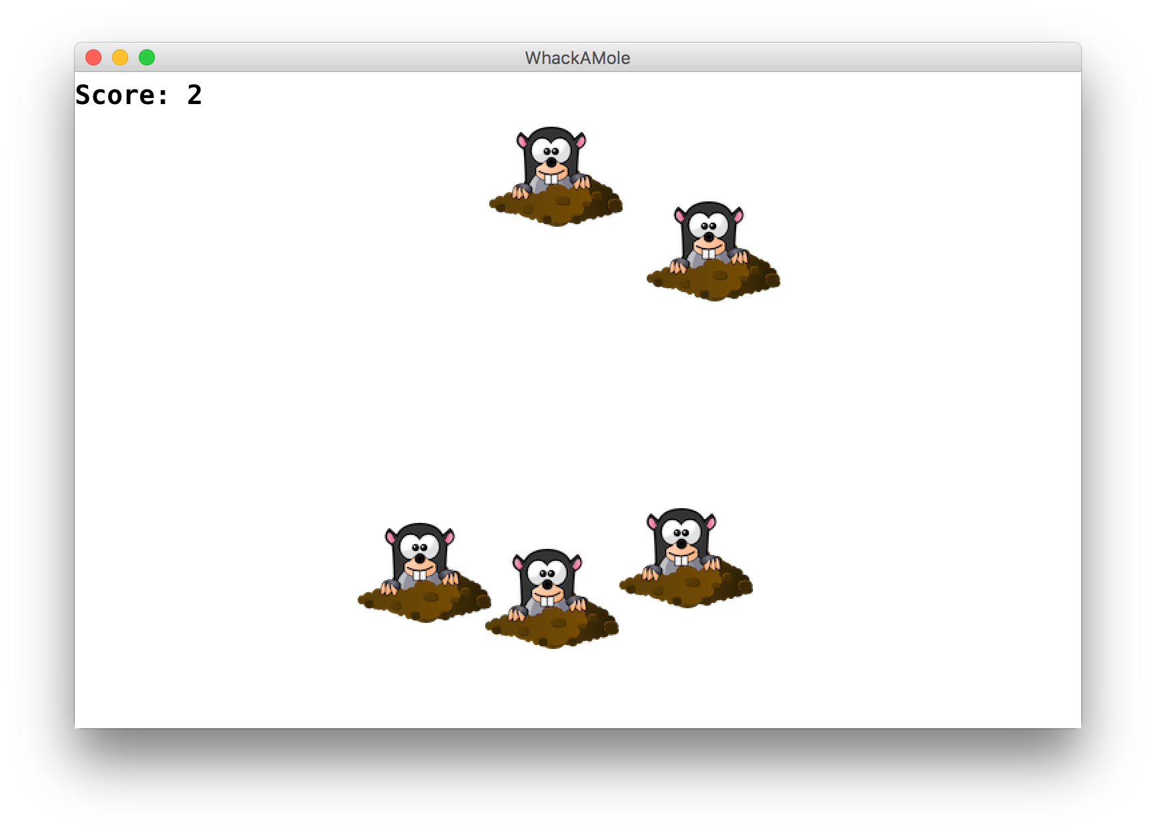
Learning Goals
Be able to respond to mouse events in GraphicsPrograms
Be able to use instance variables to store information outside of methods

Slide 3
Plan for today
Announcements
Review: Animation
Null
Event-driven programming
Instance Variables

Slide 4
Null
null: A special constant value meaning, "no object."
getElementAt returns null if no object is at that position.
You can check for null using the == and != operators.
GObject mole = getElementAt(x, y);
if (mole != null) {
remove(mole);
}

Slide 5
Events
Program launches
Notes:
When that event happens, Java looks for a method in your program called public void run and executes the code there. Today, we’re going to learn about other types of events besides your program launching. There are lots of them! And it turns out you can also have Java run certain code when those things happen, too.

Slide 6
Events
Program launches
Mouse motion
Mouse clicking
Keyboard keys pressed
Device rotated
Device moved
GPS location changed
and more…
Notes:
These are events triggered by the user – like mouse clicks, or mouse drags. On mobile devices, there are even more.

Slide 7
Events
Program launches
Mouse motion
Mouse clicking
Keyboard keys pressed
Device rotated
Device moved
GPS location changed
and more…
Notes:
We’re just going to focus on the mouse today.
These can happen in any order – mouse events even after run finishes!

Slide 8
Events
public void run() {
// Java runs this when program launches
}
Notes:
The rule in Java though is that the code for each event needs to go in its own method. That way Java knows what to execute for each event. They also have to be named exactly how Java wants, so it knows where to look. So we have a method for the code that should be run when the program launches (public void run()). And we also will have a method for the code that should run when the user clicks the mouse, and a method that should run when the user drags the mouse, etc.

Slide 9
Events
public void run() {
// Java runs this when program launches
}
public void mouseClicked(MouseEvent event) {
// Java runs this when mouse is clicked
}
Notes:
these new methods also have to be specifically named.

Slide 10
Events
public void run() {
// Java runs this when program launches
}
public void mouseClicked(MouseEvent event) {
// Java runs this when mouse is clicked
}
public void mouseMoved(MouseEvent event) {
// Java runs this when mouse is moved
}
Notes:
these new methods also have to be specifically named.

Slide 11
Example: ClickForFace
import acm.program.*;
import acm.graphics.*;
import java.awt.*;
import java.awt.event.*; // NEW
public class ClickForFace extends GraphicsProgram {
// Add a face at 50, 50 on mouse click
public void mouseClicked(MouseEvent event) {
GImage face = new GImage("res/martyFace.png",
50, 50);
add(face);
}
}
Notes:
No run method!
Make sure prototype is exact!
This is nice, but not very exciting if we can only add a face at one location. It would be cool if we could get information about the event that just happened. Luckily, we can! You’ll notice something different here from run() – it takes a parameter! This is because when an event happens, Java will call our method and pass us some information about the event in this parameter.

Slide 12
MouseEvent objects
A MouseEvent contains information about the event that just occurred:
Method | Description
e.getX() | the x-coordinate of mouse cursor in the window
e.getY() | the y-coordinate of mouse cursor in the window

Slide 13
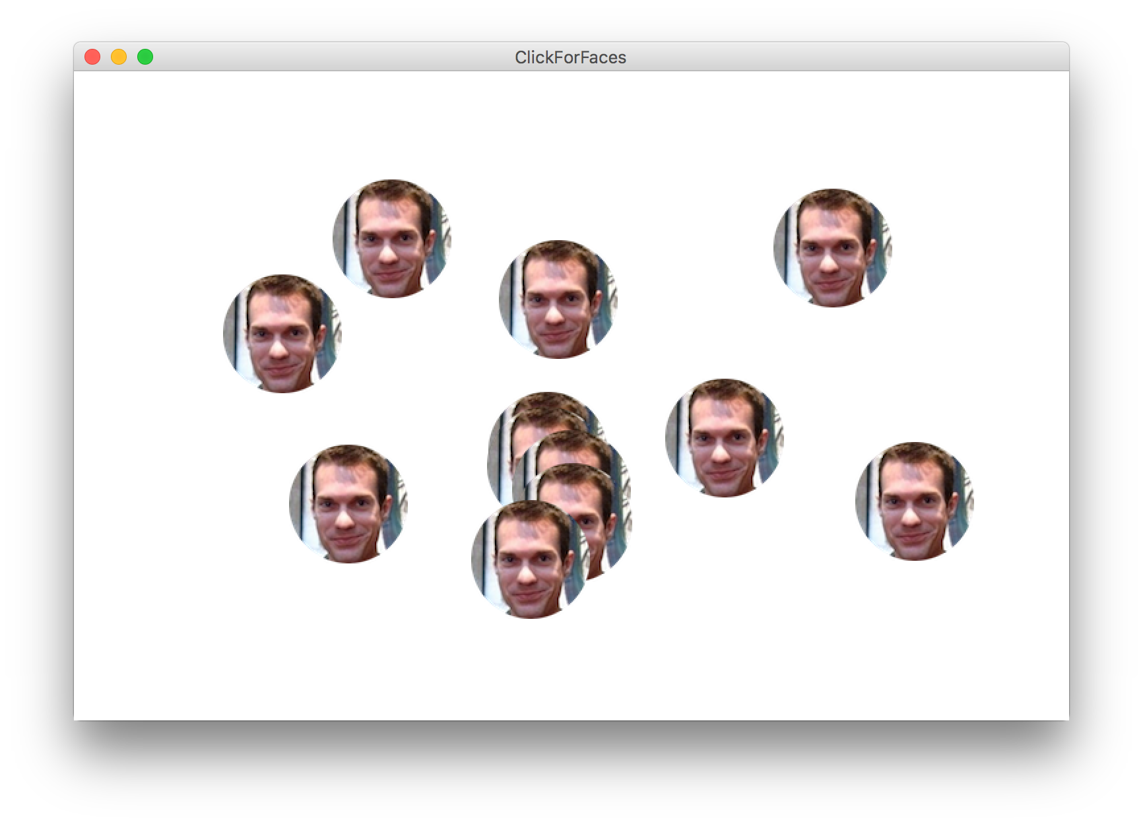
Example: ClickForFaces
Notes:
Let’s try to use this parameter to make our ClickForFace program better – let’s add a face wherever the user clicks the mouse!

Slide 14
Example: ClickForFaces
public class ClickForFaces extends GraphicsProgram {
// Add a face at where the user clicks
public void mouseClicked(MouseEvent event) {
// Get information about the event
double mouseX = event.getX();
double mouseY = event.getY();
// Add a face at the mouse location
GImage face = new GImage("res/martyFace.png",
mouseX, mouseY);
add(face);
}
}

Slide 15
Example: ClickForFaces
public class ClickForFaces extends GraphicsProgram {
// Add a face at where the user clicks
public void mouseClicked(MouseEvent event) {
// Get information about the event
double mouseX = event.getX();
double mouseY = event.getY();
// Add a face at the mouse location
GImage face = new GImage("res/martyFace.png",
mouseX, mouseY);
add(face);
}
}

Slide 16
Event methods
There are many different types of mouse events.
Each takes the form: public void eventMethodName(MouseEvent event) { ...
Method | Description
mouseMoved | mouse cursor moves
mouseDragged | mouse cursor moves while button is held down
mousePressed | mouse button is pressed down
mouseReleased | mouse button is lifted up
mouseClicked | mouse button is pressed and then released
mouseEntered | mouse cursor enters your program's window
mouseExited | mouse cursor leaves your program's window
Notes:
We’ve just talked about mouseClicked – there are many other types of mouse events you can react to!
mouse dragged called many times while mouse is dragged

Slide 17
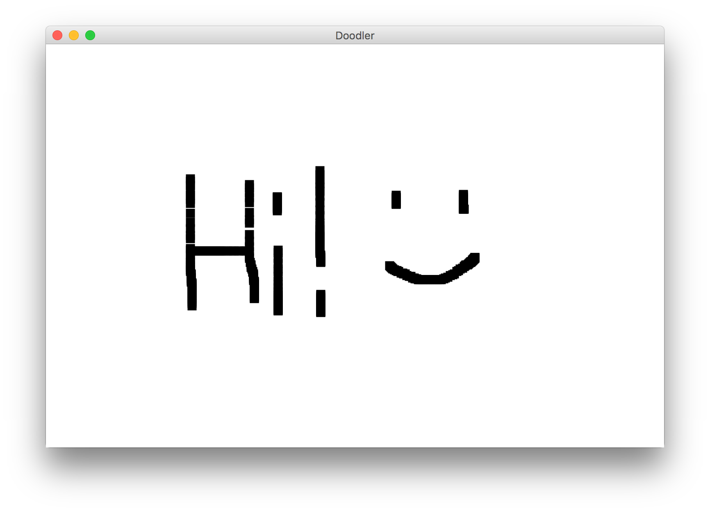
Example: Doodler
Notes:
Let’s look at an example with mouseDragged – let’s write a program that lets the user drag the mouse and draw
Live code

Slide 18
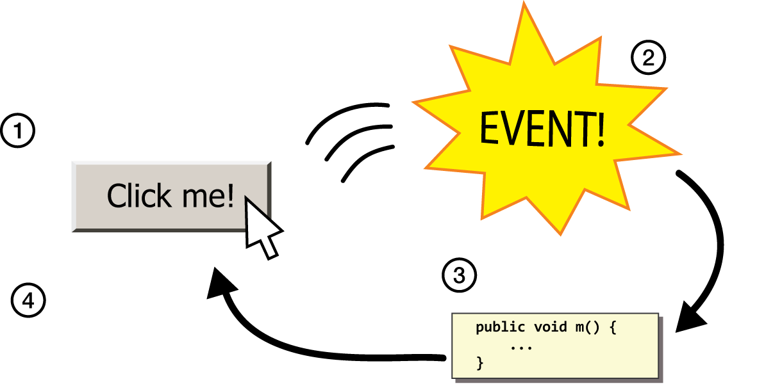
The event cycle
1) User performs some action, like moving / clicking the mouse.
2) This causes an event to occur.
3) Java executes a particular method to handle that event.
4) The method's code updates the screen appearance in some way.
Notes:
This whole concept is called event-driven programming, and is a common way to write Graphics programs, since users can interact with them and you want to do things when they interact with them.
This is different from how we have programmed so far, because unlike with run() we don’t know when our code will execute! It could be in any order.

Slide 19
Revisiting Doodler
public void mouseDragged(MouseEvent event) {
double mouseX = event.getX();
double mouseY = event.getY();
double rectX = mouseX – SIZE / 2.0;
double rectY = mouseY – SIZE / 2.0;
GRect rect = new GRect(rectX, rectY, SIZE,
SIZE);
rect.setFilled(true);
add(rect);
}
What if we wanted the same GRect to track the mouse, instead of making a new one each time?
Notes:
No way to do this! We can’t pass parameters since we don’t call mouse event methods

Slide 20
Plan for today
Graphics review
Event-driven programming
Announcements
Fields
Notes:
I want the same rectangle to track the mouse around the screen

Slide 21
Instance Variables
private type name; // declared outside of any method
Instance variable: A variable that lives outside of any method.
The scope of an instance variable is throughout an entire file (class).
Useful for data that must persist throughout the program, or that cannot be stored as local variables or parameters (event handlers).
Overuse of instance variables: Because they have a large scope, it is considered bad style to use too many instance variables, or to make something an instance variable that could instead be a local variable, parameter, return, etc.
DO NOT USE INSTANCE VARIABLES ON HANGMAN!!

Slide 22
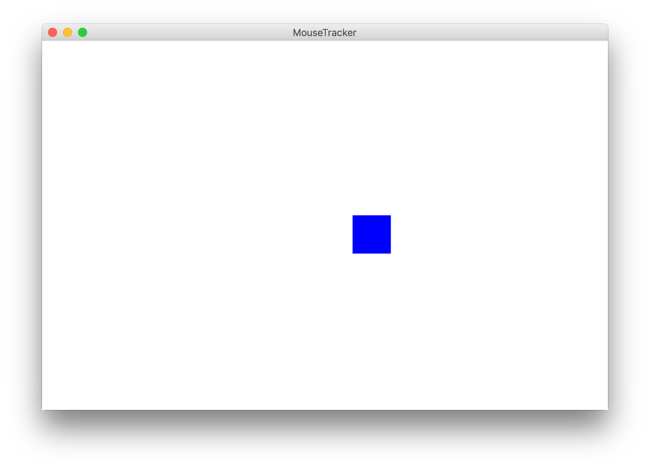
Example: MouseTracker
Notes:
Write mouseTracker with creating Grect in run, moving grect in mouse moved. Then, show that we can’t access Grect in mouse moved. We need a field! Show code, add field.

Slide 23
Putting it all together

Slide 24
Whack-A-Mole
Let’s use instance variables and mouse events to make Whack-A-Mole!
A mole should appear every second at a random location
If the user clicks a mole, remove it and increase their score by 1
There should be a GLabel in the left corner showing their score

Slide 25
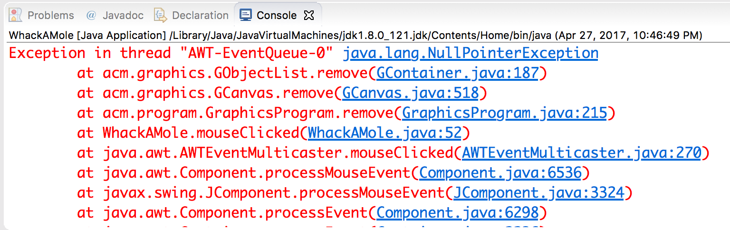
Exception
If the user clicks an area with no mole, the program crashes.
A program crash in Java is called an exception.
When you get an exception, Eclipse shows red error text.
The error text shows the line number where the error occurred.
Why did this error happen?
How can we avoid this?
Notes:
How to interpret crash messages

