Slide 1
CS 106A, Lecture 27 Final Exam Review 1

Slide 2
Plan for today
Announcements/Exam logistics
Graphics, Animation, Events
1D Arrays
2D Arrays
ArrayList

Slide 3
Plan for today
Announcements/Exam logistics
Graphics, Animation, Events
1D Arrays
2D Arrays
ArrayList

Slide 4

Final exam
Is the final exam cumulative?
What will be tested on the final exam?
What about all this stuff you aren’t covering today?
Expressions and Variables
Java Control Statements
Console Programs
Methods, parameters, returns
Randomness
Strings and chars
Scanners and file processing
Memory
Is the final exam going to be difficult/curved?
How can I practice for the final?
Midterm review session was the recorded section on Friday of Week 4
Notes:
While we will emphasize material covered after the midterm, programming by its nature is cumulative.
We are aiming for the practice materials this time around to be reflective of the difficulty of the final exam.

Slide 5
Practicing for the final
Review concepts you’re unsure of
Review concepts from previous assignments
Do section problems
Do practice final under real conditions
codestepbystep.com

Slide 6
Plan for today
Announcements/Exam logistics
Graphics, Animation, Events
1D Arrays
2D Arrays
ArrayList

Slide 7
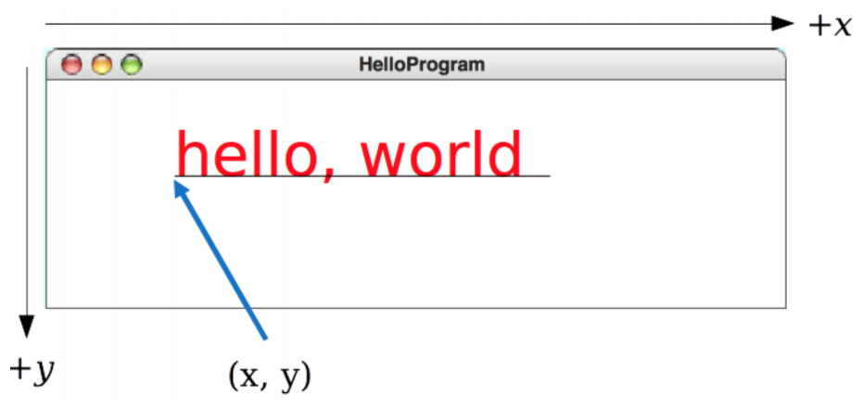
Graphics
Look at lecture slides for lists of different GObject types and their methods
Remember: the x and y of GRect, GOval, etc. Is their upper left corner, but the x and y of GLabel is its leftmost baseline coordinate.
Remember for labels: getHeight() = getAscent() + getDescent().

Slide 8
Animation
Standard format for animation code:
while (condition) {
update graphics
perform checks
pause(PAUSE_TIME);
}

Slide 9
Events
Two ways for Java to run your code: from run() and from event handlers (mouseClicked, mouseMoved, actionPerformed, etc.)
Event handlers must have exactly the specified signature otherwise they won’t work!
e.g. public void mouseClicked(MouseEvent e)
If you need to modify something in an event handler that you use elsewhere in your code, it should be an instance variable (e.g. paddle in Breakout!)

Slide 10
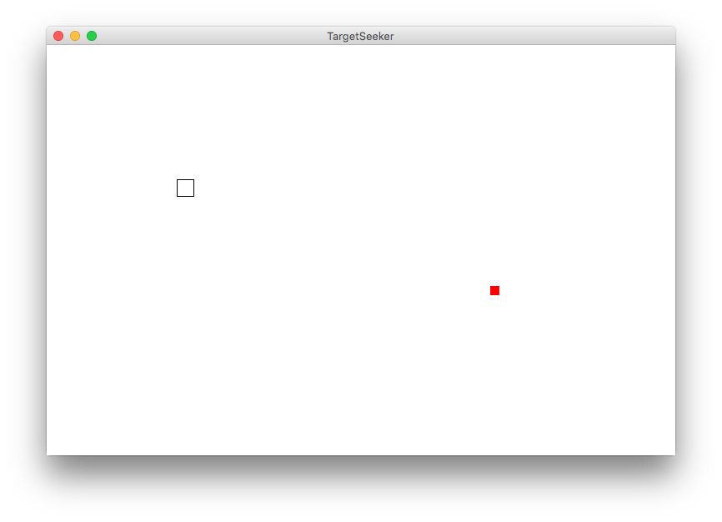
Demo: Seeker

Slide 11



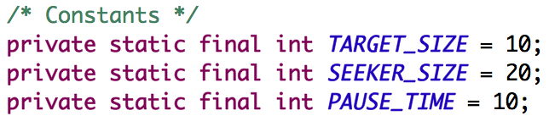
Seeker
Red square is the target
Transparent square is the seeker
The seeker should move towards and engulf the target
Can change target location by clicking on the screen

Slide 12
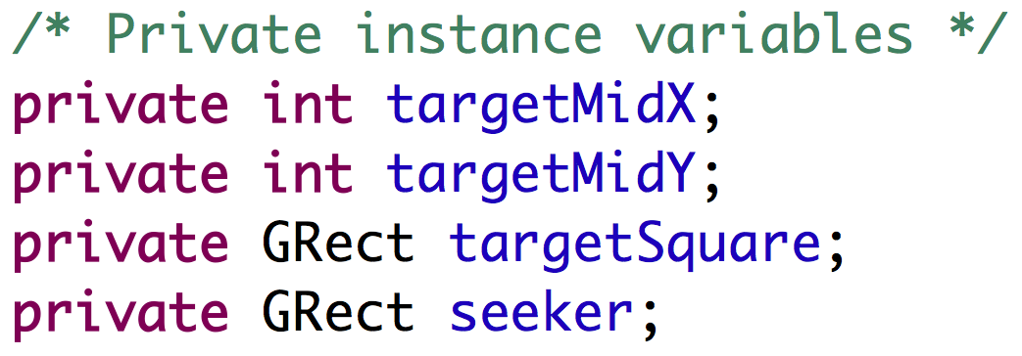
Instance variables

Slide 13
run()
public void run() {
initTarget();
initSeeker();
// Always keep seeking the target
while (true) {
seek();
pause(PAUSE_TIME);
}
}

Slide 14
run()
public void run() {
initTarget();
initSeeker();
// Always keep seeking the target
while (true) {
seek();
pause(PAUSE_TIME);
}
}

Slide 15
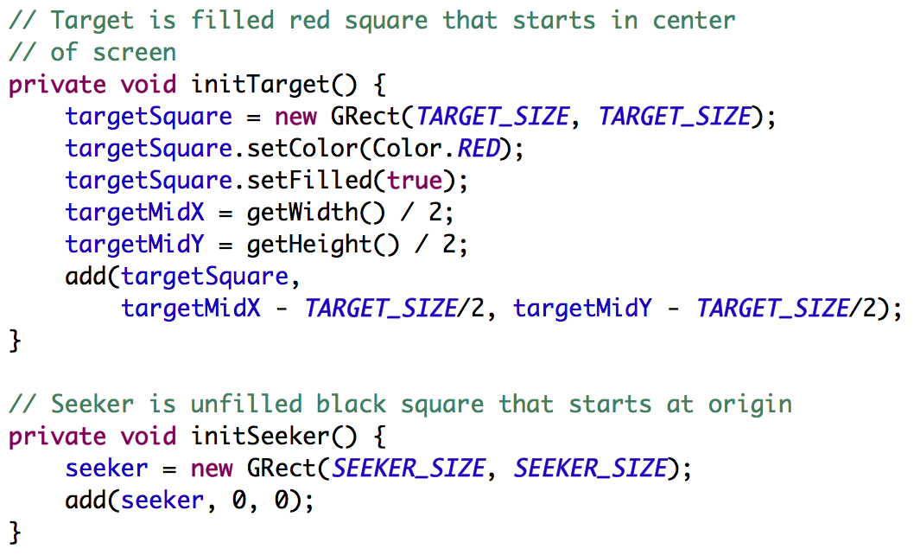
initTarget() and initSeeker()

Slide 16
initSeeker()

Slide 17
run()
public void run() {
initTarget();
initSeeker();
// Always keep seeking the target
while (true) {
seek();
pause(PAUSE_TIME);
}
}

Slide 18
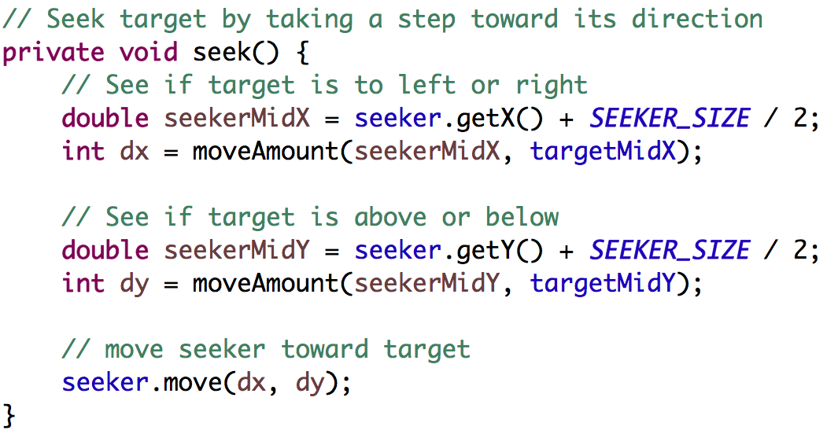
seek()

Slide 19
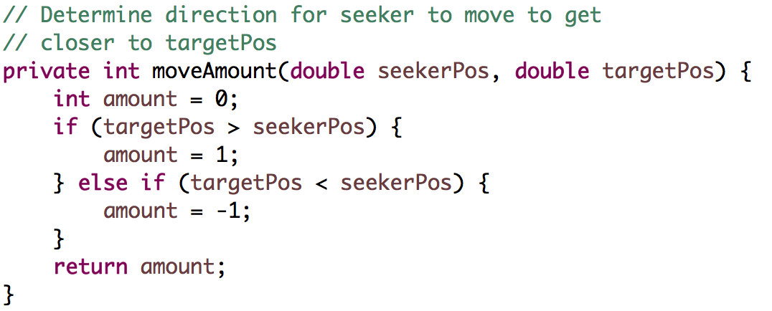
moveAmount()

Slide 20
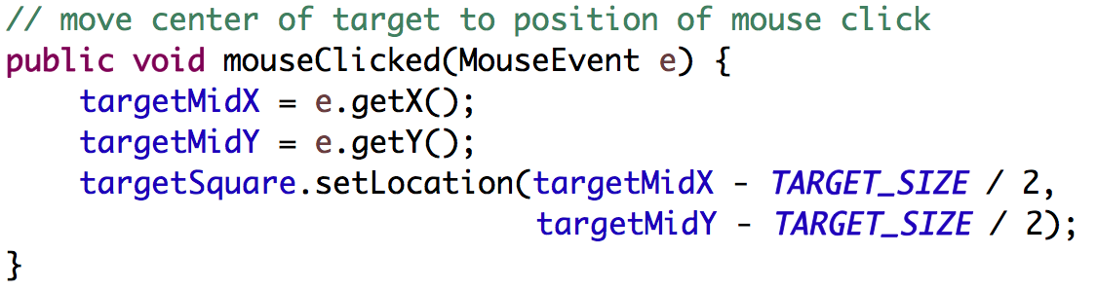
mouseClicked()

Slide 21
Plan for today
Announcements/Exam logistics
Graphics, Animation, Events
1D Arrays
2D Arrays
ArrayList

Slide 22
1D Arrays
An array is a fixed-length list of a single type of thing.
An array can store primitives and objects.
You cannot call methods on arrays i.e. no myArray.contains().
Get the length by saying myArray.length. (No parentheses!)
Print array with Arrays.toString(myArray), not println(myArray)!
[2, 4, 6, 8] [I@4ddced80

Slide 23
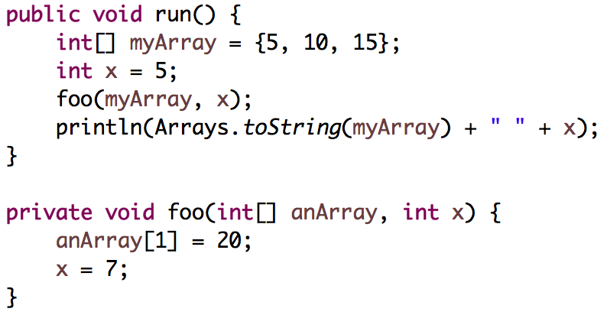
Program traces
Local variables are separate across methods
Parameters are just assigned names by the order in which they’re passed
Draw changes to variables as you go through the program
Objects vs primitive behavior for parameters
A. Prints [5, 10, 15] 3
B. Prints [5, 10, 15] 7
C. Prints [5, 20, 15] 5
D. Prints [5, 20, 15] 7
Notes:
If you have a method called foo with 3 int parameters and they have different names in run and in foo, look at the order to avoid getting confused.

Slide 24
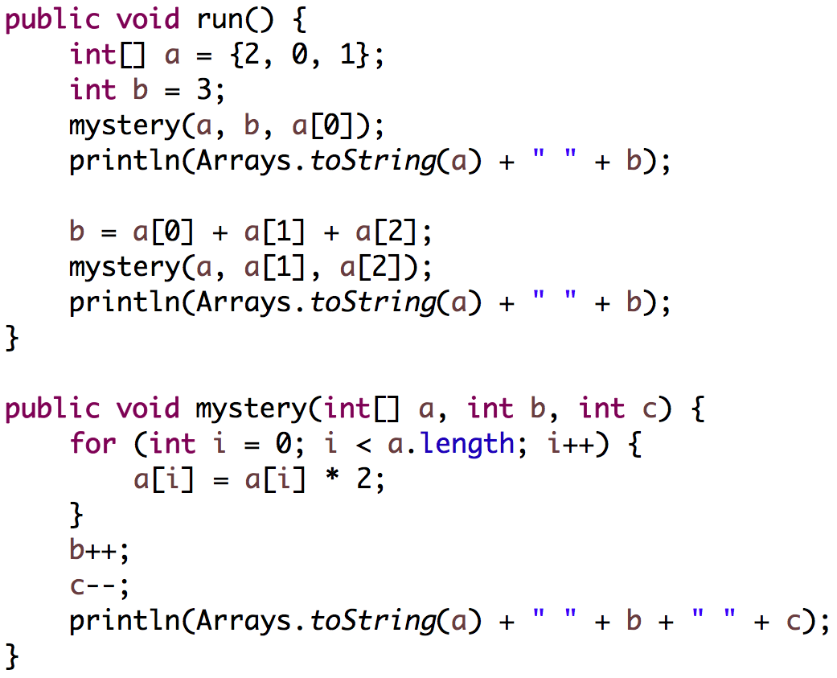
Trace

Slide 25
Trace
Output:
[4, 0, 2] 4 1
[4, 0, 2] 3
[8, 0, 4] 1 1
[8, 0, 4] 6

Slide 26
Extra 1D Array problem
Write the method int longestSortedSequence(int[] array)
e.g. int[] array = {3, 8, 10, 1, 9, 14, -3, 0, 14, 207, 56, 98, 12}
Sorted in this case means nondecreasing, so a sequence could contain duplicates:
e.g. int[] array = {17, 42, 3, 5, 5, 5, 8, 2, 4, 6, 1, 19}
Link: http://www.codestepbystep.com/problem/view/java/arrays/longestSortedSequence
3
3
4
2
1
2
5
3
2

Slide 27
Plan for today
Announcements/Exam logistics
Graphics, Animation, Events
1D Arrays
2D Arrays
ArrayList

Slide 28
2D Arrays = Arrays of Arrays!
int[][] a = new int[3][4];
Outer array
a[0][0] | a[0][1] | a[0][2] | a[0][3]
a[1][0] | a[1][1] | a[1][2] | a[1][3]
a[2][0] | a[2][1] | a[2][2] | a[2][3]

Slide 29
Chess
Knight: moves in an ”L”-shape (two steps in one direction, one step in a perpendicular direction)

Slide 30
knightCanMove()
boolean knightCanMove(String[][] board,
int startRow, int startCol,
int endRow, int endCol)
(startRow, startCol) must contain a knight
(endRow, endCol) must be empty
(endRow, endCol) must be reachable from (startRow, startCol) in a single move
Assume that (startRow, startCol) and (endRow, endCol) are within bounds of array

Slide 31
knightCanMove()
 | 0 | 1 | 2 | 3 | 4 | 5 | 6 | 7
0 |  |  |  |  | ”king”
1 |  |  | ”knight”
2
3 |  | ”rook”
4
5
6
7

Slide 32
knightCanMove()
knightCanMove(board, 2, 2, 3, 4)
returns false
 | 0 | 1 | 2 | 3 | 4 | 5 | 6 | 7
0 |  |  |  |  | ”king”
1 |  |  | ”knight”
2
3 |  | ”rook”
4
5
6
7
 | 0 | 1 | 2 | 3 | 4 | 5 | 6 | 7
0 |  |  |  |  | ”king”
1 |  |  | ”knight”
2
3 |  | ”rook”
4
5
6
7
No knight at (2, 2)

Slide 33
knightCanMove()
knightCanMove(board, 1, 2, 0, 4)
returns false
 | 0 | 1 | 2 | 3 | 4 | 5 | 6 | 7
0 |  |  |  |  | ”king”
1 |  |  | ”knight”
2
3 |  | ”rook”
4
5
6
7
 | 0 | 1 | 2 | 3 | 4 | 5 | 6 | 7
0 |  |  |  |  | ”king”
1 |  |  | ”knight”
2
3 |  | ”rook”
4
5
6
7
Space occupied

Slide 34
knightCanMove()
knightCanMove(board, 1, 2, 3, 2)
returns false
 | 0 | 1 | 2 | 3 | 4 | 5 | 6 | 7
0 |  |  |  |  | ”king”
1 |  |  | ”knight”
2
3 |  | ”rook”
4
5
6
7
(1, 2) to (3, 2) is not a valid move

Slide 35
knightCanMove()
knightCanMove(board, 1, 2, 3, 3)
returns true
 | 0 | 1 | 2 | 3 | 4 | 5 | 6 | 7
0 |  |  |  |  | ”king”
1 |  |  | ”knight”
2
3 |  | ”rook”
4
5
6
7
Knight is at (1, 2) and (3, 3) is empty
and (1, 2) -> (3, 3) is a valid move

Slide 36
knightCanMove()
// This method returns true if the starting square contains a knight,
// the end square is empty, and the knight can legally move from the
// start square to the end square.
private boolean knightCanMove(String[][] board, int startRow,
int startCol, int endRow, int endCol) {
}

Slide 37
knightCanMove()
// This method returns true if the starting square contains a knight,
// the end square is empty, and the knight can legally move from the
// start square to the end square.
private boolean knightCanMove(String[][] board, int startRow,
int startCol, int endRow, int endCol) {
if (board[startRow][startCol].equals("knight")) {
}
}

Slide 38
knightCanMove()
// This method returns true if the starting square contains a knight,
// the end square is empty, and the knight can legally move from the
// start square to the end square.
private boolean knightCanMove(String[][] board, int startRow,
int startCol, int endRow, int endCol) {
if (board[startRow][startCol].equals("knight")) {
if (board[endRow][endCol].equals("")) {
}
}
}

Slide 39
knightCanMove()
// This method returns true if the starting square contains a knight,
// the end square is empty, and the knight can legally move from the
// start square to the end square.
private boolean knightCanMove(String[][] board, int startRow,
int startCol, int endRow, int endCol) {
if (board[startRow][startCol].equals("knight")) {
if (board[endRow][endCol].equals("")) {
int rowDifference = Math.abs(startRow - endRow);
int colDifference = Math.abs(startCol - endCol);
if ((rowDifference == 1 && colDifference == 2) ||
(rowDifference == 2 && colDifference == 1)) {
return true;
}
}
}
}

Slide 40
knightCanMove()
// This method returns true if the starting square contains a knight,
// the end square is empty, and the knight can legally move from the
// start square to the end square.
private boolean knightCanMove(String[][] board, int startRow,
int startCol, int endRow, int endCol) {
if (board[startRow][startCol].equals("knight")) {
if (board[endRow][endCol].equals("")) {
int rowDifference = Math.abs(startRow - endRow);
int colDifference = Math.abs(startCol - endCol);
if ((rowDifference == 1 && colDifference == 2) ||
(rowDifference == 2 && colDifference == 1)) {
return true;
}
}
}
return false;
}
Notes:
For extra credit, you could implement this so it also does bounds checking.

Slide 41
Plan for today
Announcements/Exam logistics
Graphics, Animation, Events
1D Arrays
2D Arrays
ArrayList

Slide 42
ArrayList
An ArrayList is a flexible-length list of a single type of thing.
An ArrayList can only store objects.
For primitives use e.g. ArrayList<Integer> instead of ArrayList<int>. (Integer is a wrapper class for int)
Other wrapper classes: Double instead of double, Character instead of char, Boolean instead of boolean.
An ArrayList has a variety of methods you can use like .contains, .get, .add, .remove, .size, etc.

Slide 43
Array vs ArrayList
Array
Fixed size
Efficient (not a concern in this class)
No methods, can only use myArray.length (no parentheses!)
Can store any object or primitive
ArrayList
Expandable
Less efficient than Array (not a concern in this class)
Convenient methods like .add(), .remove(), .contains()
Cannot store primitives, so use their wrapper classes instead

Slide 44
deleteDuplicates()
private void deleteDuplicates(ArrayList<String> list)
Guaranteed that list is in sorted order
{"be", "be", "is", "not", "or", "question", "that", "the", "to", "to"} becomes {“be”, “is”, “not”, “or”, “question”, “that”, “the”, “to”}
Solution strategy:
Loop through ArrayList
Compare pairs of elements
If element.equals(nextElement), remove element from the list

Slide 45
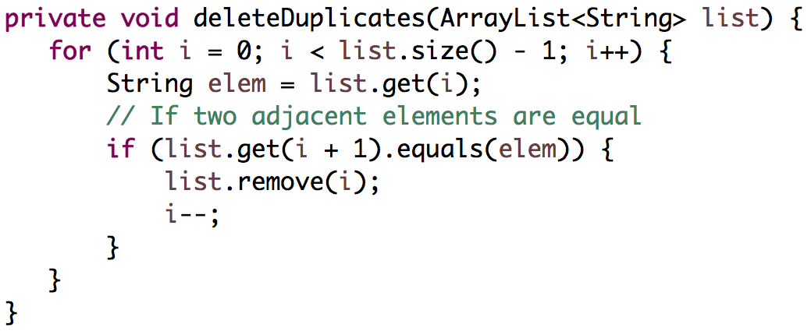
deleteDuplicates
Loop through ArrayList
Compare pairs of elements
If element.equals(nextElement), remove element from the list

Slide 46
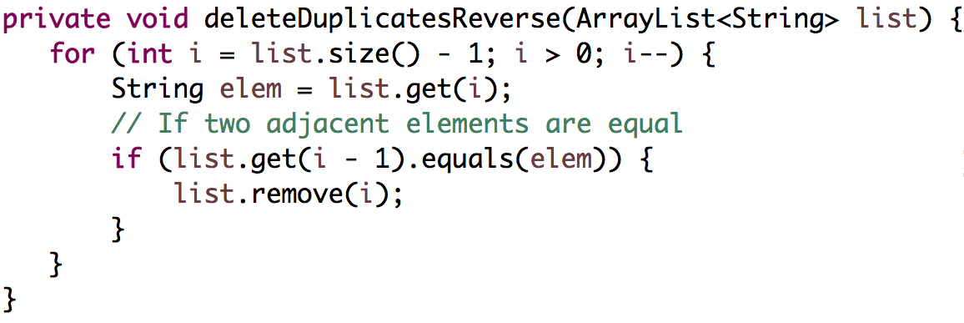
deleteDuplicatesReverse
Loop through ArrayList in reverse
Compare pairs of elements
If element.equals(previousElement), remove element from the list

Slide 47
Recap
Announcements/Exam logistics
Graphics, Animation, Events
1D Arrays
2D Arrays
ArrayList
Next time: Final Exam Review 2

