Slide 1
CS 106A, Lecture 22 Interactors
suggested reading:
Java Ch. 10.5-10.6

Slide 2
Plan for today
Recap: Inheritance
Extending GCanvas
Example: Aquarium
Interactors
JButton
JLabel
JTextField
Example: TipCalculator

Slide 3
Plan for today
Recap: Inheritance
Extending GCanvas
Example: Aquarium
Interactors
JButton
JLabel
JTextField
Example: TipCalculator

Slide 4
Inheritance
Inheritance lets us relate our variable types to one another.

Slide 5
Inheritance
Variable types can seem to “inherit” from each other. We don’t want to have to duplicate code for each one!
Employee
Programmer
Karel Programmer

Slide 6
Using Inheritance
public class Name extends Superclass {
Example:
public class Programmer extends Employee {
...
}
By extending Employee, this tells Java that Programmer can do everything an Employee can do, plus more.
Programmer automatically inherits all of the code from Employee!
The superclass is Employee, the subclass is Programmer.

Slide 7
Example: Programmer
public class Programmer extends Employee {
private int timeCoding;
...
public void code() { timeCoding += 10;
}
}
...
Programmer rishi = new Programmer(“Rishi”);
rishi.code(); // from Programmer
rishi.promote(); // from Employee!
Notes:
If you add functionality to Employee it adds everywhere

Slide 8
Example: KarelProgrammer
public class KarelProgrammer extends Programmer {
private int numBeepersPicked();
...
public void pickBeepers() { numBeepersPicked += 2;
}
}
...
KarelProgrammer nick = new KarelProgrammer(“Nick”);
nick.pickBeepers(); // from KarelProgrammer
nick.code(); // from Programmer!
nick.promote(); // From Employee!

Slide 9
Plan for today
Recap: Inheritance
Extending GCanvas
Example: Aquarium
Interactors
JButton
JLabel
JTextField
Example: TipCalculator

Slide 10
GCanvas
A GCanvas is the canvas area that displays all graphical objects in a GraphicsProgram.
When you create a GraphicsProgram, it automatically creates a GCanvas for itself, puts it on the screen, and uses it to add all graphical shapes.
GCanvas is the one that contains methods like:
getElementAt
add
getWidth
getHeight
…

Slide 11
GCanvas
public class Graphics extends GraphicsProgram {
public void run() { // A GCanvas has been created for us! GRect rect = new GRect(50, 50);
add(rect); // adds to the GCanvas!
...
// Checks our GCanvas for elements!
GObject obj = getElementAt(25, 25);
}
}

Slide 12
Extending GCanvas
public class Graphics extends Program {
public void run() { // We have to make our own GCanvas now
MyCanvas canvas = new MyCanvas();
add(canvas);
// Operate on this canvas
GObject obj = canvas.getElementAt(…);
}
}
Notes:
We CAN say canvas.getElementAt, but we want to decompose all our graphics code out into the MyCanvas file

Slide 13
Extending GCanvas
public class MyCanvas extends GCanvas {
public void addCenteredSquare(int size) {
GRect rect = new GRect(size, size);
int x = getWidth() / 2.0 –
rect.getWidth() / 2.0;
int y = getHeight() / 2.0 –
rect.getHeight() / 2.0;
add(rect, x, y);
}
}

Slide 14
Extending GCanvas
public class Graphics extends Program {
public void run() { // We have to make our own GCanvas now
MyCanvas canvas = new MyCanvas();
add(canvas);
canvas.addCenteredSquare(20);
}
}

Slide 15
Extending GCanvas
Sometimes, we want to be able to have all of our graphics-related code in a separate file.
To do this, instead of using the provided GraphicsProgram canvas, we define our own subclass of GCanvas, have our program extend Program, and add our own canvas ourselves.
Then, all graphics-related code can go in our GCanvas subclass.

Slide 16
The init method
init is a special public method, like run, that is called when your program is being initialized.
Unlike run, however, it is called before your program launches, letting you do any initialization you need.
public class MyProgram extends GraphicsProgram { public void init() {
// executed before program launches
}
public void run() {
// executed after program launches
}
}

Slide 17
The init method
init is typically used to initialize graphical components, such as adding a custom GCanvas to the screen.
public class MyProgram extends Program {
private MyCanvas canvas; public void init() {
canvas = new MyCanvas();
add(canvas);
}
public void run() {
canvas.addCenteredSquare(20);
}
}

Slide 18
Common Bugs
When you are using a custom canvas, make sure to not call getWidth or getHeight on the canvas until it is shown onscreen!
public class MyProgram extends Program {
private MyCanvas canvas; public void init() {
// canvas not created yet!
canvas = new MyCanvas();
// canvas not added yet!
add(canvas);
// window not showing yet!
}
public void run() {
// good to go
}
}

Slide 19
Plan for today
Recap: Inheritance
Extending GCanvas
Example: Aquarium
Interactors
JButton
JLabel
JTextField
Example: TipCalculator

Slide 20
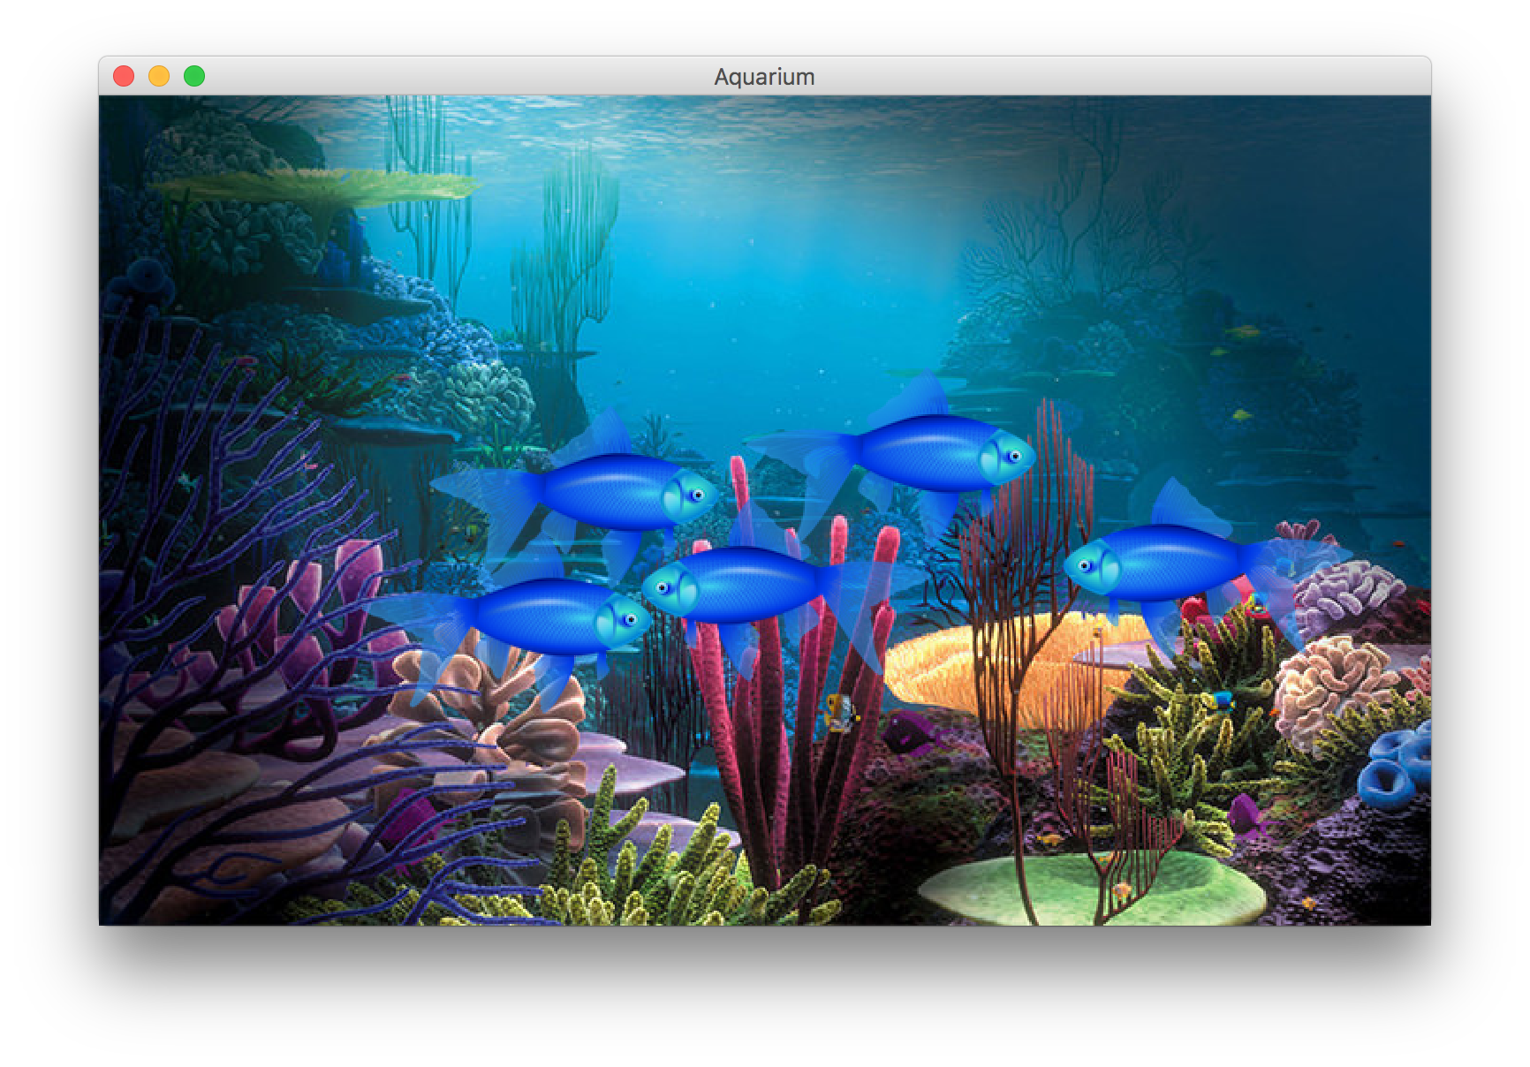
Example: Aquarium
Let’s write a graphical program called Aquarium that simulates fish swimming around.
To decompose our code, we can make our own GCanvas subclass.

Slide 21
Plan for today
Recap: Inheritance
Extending GCanvas
Example: Aquarium
Interactors
JButton
JLabel
JTextField
Example: TipCalculator

Slide 22
Interactive Programs
So far, we have learned about two ways of making interactive programs:
Reading user input in ConsolePrograms
Detecting mouse events in GraphicsPrograms
Today, we’re going to learn about a third: interactors.

Slide 23
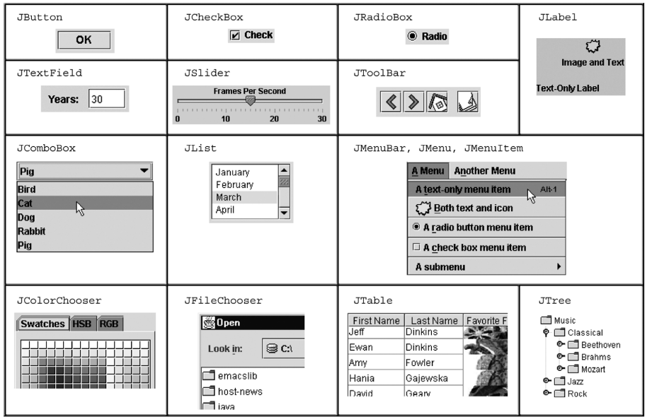
Interactors
Notes:
Going to focus on 3

Slide 24
Interactors
JComponent
JButton
JTextField
JLabel

Slide 25
Plan for today
Recap: Inheritance
Extending GCanvas
Example: Aquarium
Interactors
JButton
JLabel
JTextField
Example: TipCalculator

Slide 26
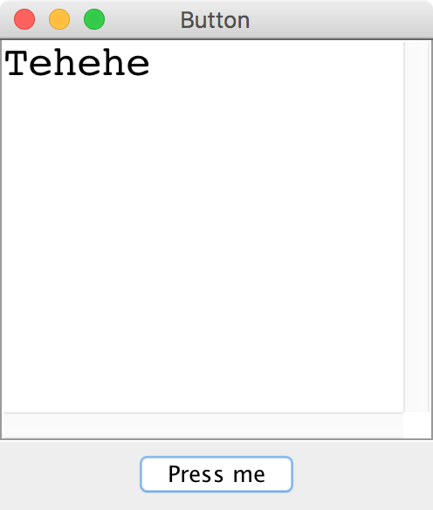
JButton

Slide 27
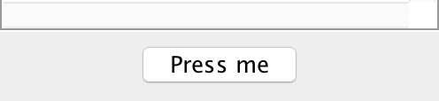
JButton
import java.awt.event.*;
import javax.swing.*;
JButton button = new JButton(“Press me”);
add(button, SOUTH);

Slide 28
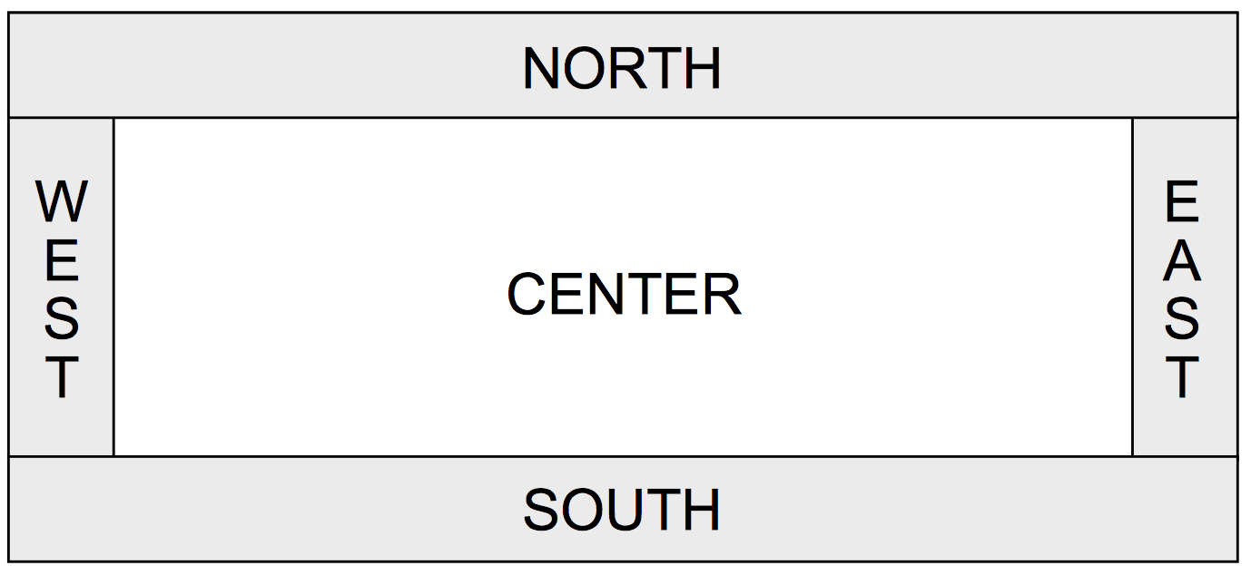
Window Regions
In graphics or console programs, the window is divided into five regions:
The CENTER region is typically where the action happens.
ConsoleProgram adds a console there
GraphicsProgram puts a GCanvas there
Other regions are visible only if you add an interactor to them using add(component, REGION);
Interactors are automatically centered within each region.

Slide 29
Responding To Button Clicks
To respond to events from interactors, we must do the following:
Call addActionListeners() at the end of init, once we are done adding buttons. This tells Java to let us know if any of the previous buttons were clicked.
Implement the public actionPerformed method. This method is called whenever a button is clicked.
Notes:
Only once all buttons are added!

Slide 30
JButton Example
public class Interactors extends ConsoleProgram {
public void init() { JButton yayButton = new JButton("Yay");
add(yayButton, SOUTH);
JButton nayButton = new JButton("Nay");
add(nayButton, SOUTH);
addActionListeners();
}
public void actionPerformed(ActionEvent event) {
... // ?
}
}

Slide 31
ActionEvent
The ActionEvent parameter contains useful event information.
Use getSource or getActionCommand to figure out what button or component was interacted with.
public void actionPerformed(ActionEvent event) {
String command = event.getActionCommand();
if (command.equals("Save File")) {
// user clicked the Save File button
...
}
}
Method | Description
e.getActionCommand() | a text description of the event (e.g. the text of the button clicked)
e.getSource() | the interactor that generated the event

Slide 32
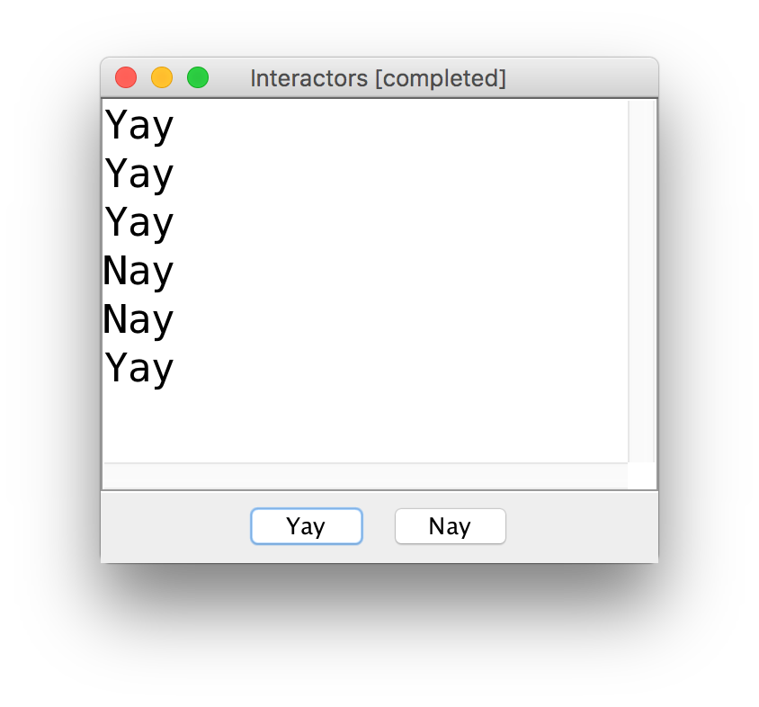
JButton Example

Slide 33
JButton Example
public class Interactors extends ConsoleProgram {
private JButton yayButton;
private JButton nayButton;
public void init() { yayButton = new JButton("Yay");
add(yayButton, SOUTH);
nayButton = new JButton("Nay");
add(nayButton, SOUTH);
addActionListeners();
}
public void actionPerformed(ActionEvent event) {
if (event.getSource() == yayButton) {
println("Yay");
} else if (event.getSource() == nayButton) {
println("Nay");
}
}
}

Slide 34
JButton Example
public class Interactors extends ConsoleProgram {
private JButton yayButton;
private JButton nayButton;
public void init() { yayButton = new JButton("Yay");
add(yayButton, SOUTH);
nayButton = new JButton("Nay");
add(nayButton, SOUTH);
addActionListeners();
}
public void actionPerformed(ActionEvent event) {
if (event.getSource() == yayButton) {
println("Yay");
} else if (event.getSource() == nayButton) {
println("Nay");
}
}
}

Slide 35
JButton Example
public class Interactors extends ConsoleProgram {
private JButton yayButton;
private JButton nayButton;
public void init() { yayButton = new JButton("Yay");
add(yayButton, SOUTH);
nayButton = new JButton("Nay");
add(nayButton, SOUTH);
addActionListeners();
}
public void actionPerformed(ActionEvent event) {
if (event.getSource() == yayButton) {
println("Yay");
} else if (event.getSource() == nayButton) {
println("Nay");
}
}
}

Slide 36
JButton Example
public class Interactors extends ConsoleProgram {
private JButton yayButton;
private JButton nayButton;
public void init() { yayButton = new JButton("Yay");
add(yayButton, SOUTH);
nayButton = new JButton("Nay");
add(nayButton, SOUTH);
addActionListeners();
}
public void actionPerformed(ActionEvent event) {
if (event.getSource() == yayButton) {
println("Yay");
} else if (event.getSource() == nayButton) {
println("Nay");
}
}
}

Slide 37
JButton Example
public class Interactors extends ConsoleProgram {
private JButton yayButton;
private JButton nayButton;
public void init() { yayButton = new JButton("Yay");
add(yayButton, SOUTH);
nayButton = new JButton("Nay");
add(nayButton, SOUTH);
addActionListeners();
}
public void actionPerformed(ActionEvent event) {
if (event.getSource() == yayButton) {
println("Yay");
} else if (event.getSource() == nayButton) {
println("Nay");
}
}
}

Slide 38
JButton Example
public class Interactors extends ConsoleProgram {
private JButton yayButton;
private JButton nayButton;
public void init() { yayButton = new JButton("Yay");
add(yayButton, SOUTH);
nayButton = new JButton("Nay");
add(nayButton, SOUTH);
addActionListeners();
}
public void actionPerformed(ActionEvent event) {
if (event.getSource() == yayButton) {
println("Yay");
} else if (event.getSource() == nayButton) {
println("Nay");
}
}
}

Slide 39
JButton Example #2
public class Interactors extends ConsoleProgram {
private JButton yayButton;
private JButton nayButton;
public void init() { JButton yayButton = new JButton("Yay");
add(yayButton, SOUTH);
JButton nayButton = new JButton("Nay");
add(nayButton, SOUTH);
addActionListeners();
}
public void actionPerformed(ActionEvent event) {
if (event.getActionCommand().equals("Yay")) {
println("Yay");
} else if (event.getActionCommand().equals("Nay")) {
println("Nay");
}
}
}

Slide 40
JButton Example #2
public class Interactors extends ConsoleProgram {
private JButton yayButton;
private JButton nayButton;
public void init() { JButton yayButton = new JButton("Yay");
add(yayButton, SOUTH);
JButton nayButton = new JButton("Nay");
add(nayButton, SOUTH);
addActionListeners();
}
public void actionPerformed(ActionEvent event) {
println(event.getActionCommand());
}
}
Notes:
Less hassle – no ivars!

Slide 41
Plan for today
Recap: Inheritance
Extending GCanvas
Example: Aquarium
Interactors
JButton
JLabel
JTextField
Example: TipCalculator

Slide 42
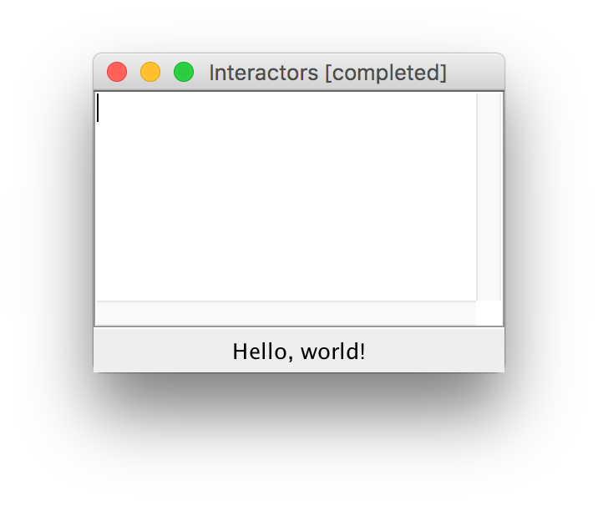
JLabel
JLabel label = new JLabel("Hello, world!");
add(label, SOUTH);

Slide 43
Plan for today
Recap: Inheritance
Extending GCanvas
Example: Aquarium
Interactors
JButton
JLabel
JTextField
Example: TipCalculator

Slide 44
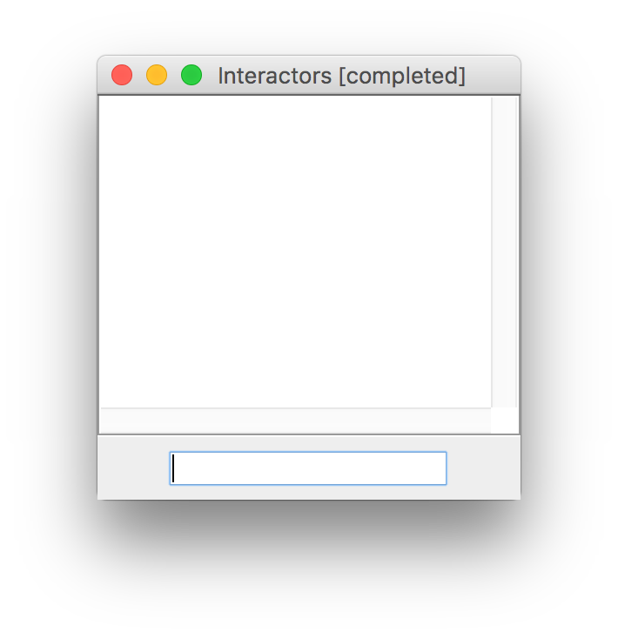
JTextField
JTextField field = new JTextField(10);
add(field, SOUTH);

Slide 45
JTextField
JTextField field = new JTextField(10);
add(field, SOUTH);
// Set the text in the text field
field.setText("Hello!");
// Get the text currently in the text field
String text = field.getText();

Slide 46
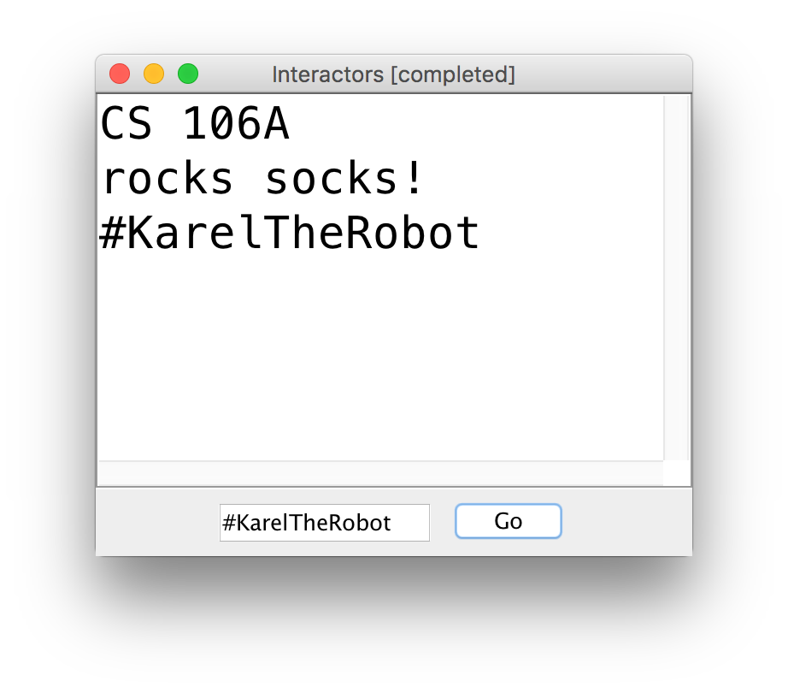
JTextField Example

Slide 47
JTextField Example
public class Interactors extends ConsoleProgram {
private JTextField textField;
public void init() {
textField = new JTextField(10);
add(textField, SOUTH); JButton goButton = new JButton("Go");
add(goButton, SOUTH);
addActionListeners();
}
public void actionPerformed(ActionEvent event) {
println(textField.getText());
}
}
Notes:
But what if we want to detect ENTER too?

Slide 48
Detecting ENTER Pressed
Detecting the ENTER key pressed in a JTextField requires extra work.
JTextField field = new JTextField(10);
// Tells Java to listen for ENTER on the text field
field.addActionListener(this);
// Sets the action command (like JButtons) to “Go”
field.setActionCommand("Go");
add(field, SOUTH);
Notes:
Not the default

Slide 49
Detecting ENTER Pressed
Detecting the ENTER key pressed in a JTextField requires extra work.
JTextField field = new JTextField(10);
field.addActionListener(this);
field.setActionCommand("Go");
add(field, SOUTH);
...
public void actionPerformed(ActionEvent event) {
if (event.getActionCommand().equals(“Go”)) {
...
}
}
Notes:
Can also check using e.getSource, but this is easier – why?

Slide 50
getActionCommand
Oftentimes, a text field has a “corresponding” button that takes action with the entered text. If we set the text field’s action command to be the same as its corresponding button, we can check for both a click and ENTER at once!

Slide 51
getActionCommand
public void init() {
JButton button = new JButton("Go");
add(button, SOUTH);
JTextField field = new JTextField(10);
field.addActionListener(this);
field.setActionCommand("Go");
add(field, SOUTH);
addActionListeners();
}
public void actionPerformed(ActionEvent event) {
if (event.getActionCommand().equals(“Go”)) {
...
}
}

Slide 52
getActionCommand
public void init() {
JButton button = new JButton("Go");
add(button, SOUTH);
JTextField field = new JTextField(10);
field.addActionListener(this);
field.setActionCommand("Go");
add(field, SOUTH);
addActionListeners();
}
public void actionPerformed(ActionEvent event) {
if (event.getActionCommand().equals(“Go”)) {
...
}
}

Slide 53
Plan for today
Recap: Inheritance
Extending GCanvas
Example: Aquarium
Interactors
JButton
JLabel
JTextField
Example: TipCalculator

Slide 54
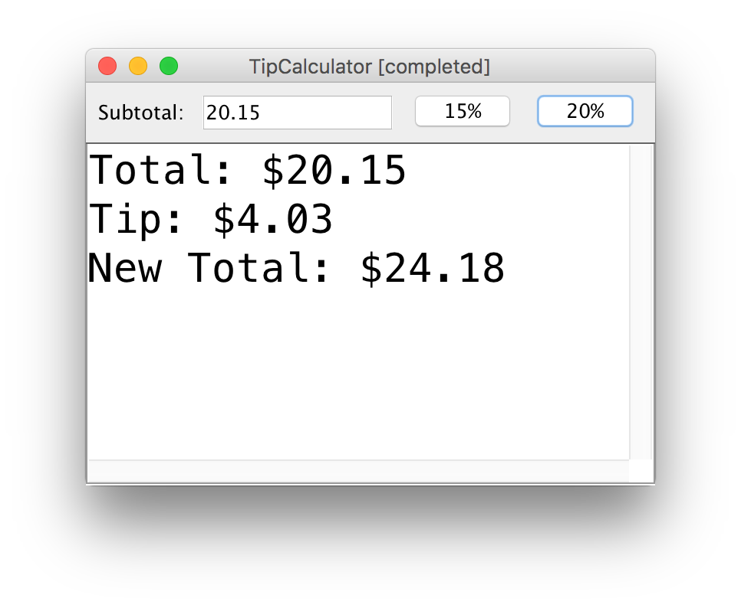
Practice: TipCalculator
Let’s write a program called TipCalculator that uses interactors to calculate the tip for a bill.

Slide 55
Practice: TipCalculator
Let’s write a program called TipCalculator that uses interactors to calculate the tip for a bill.
The program should calculate the appropriate tip depending on the button the user clicks on
The console should clear when a new tip is calculated (hint: use clearConsole()).
Convert a string into a double using Double.parseDouble(str);

Slide 56
Recap
Recap: Inheritance
Extending GCanvas
Example: Aquarium
Interactors: JButton, JLabel, JTextField
Example: TipCalculator
Next time: NameSurfer overview

