Slide 1
CS 106A, Lecture 6 Control Flow, Scope and Parameters
suggested reading:
Java Ch. 5.1-5.4

Slide 2
Plan For Today
Announcements
Recap: If and While in Java
For Loops in Java
Methods in Java
Scope
Parameters
HW2 Cutoff
Notes:
HW2 out
Eclipse FAQ

Slide 3
Plan For Today
Announcements
Recap: If and While in Java
For Loops in Java
Methods in Java
Scope
Parameters

Slide 4
Conditions in Java
while(condition) {
body
}
if(condition) {
body
}
The condition should be a “boolean” which is either true or false

Slide 5
Booleans
1 < 2
true

Slide 6
Relational Operators
Operator | Meaning | Example | Value
== | equals | 1 + 1 == 2 | true
!= | does not equal | 3.2 != 2.5 | true
< | less than | 10 < 5 | false
> | greater than | 10 > 5 | true
<= | less than or equal to | 126 <= 100 | false
>= | greater than or equal to | 5.0 >= 5.0 | true
* All have equal precedence

Slide 7
Relational Operators
if (1 < 2) {
println("1 is less than 2!");
}
int num = readInt("Enter a number: ");
if (num == 0) { println("That number is 0!");
} else {
println("That number is not 0.");
}

Slide 8
Practice: Sentinel Loops
sentinel: A value that signals the end of user input.
sentinel loop: Repeats until a sentinel value is seen.
Example: Write a program that prompts the user for numbers until the user types -1, then output the sum of the numbers.
In this case, -1 is the sentinel value.
Type a number: 10
Type a number: 20
Type a number: 30
Type a number: -1
Sum is 60
Notes:
11:45AM
Think pair share (hint: fencepost)

Slide 9
Practice: Sentinel Loops
// fencepost problem!
// ask for number - post
// add number to sum - fence
int sum = 0;
int num = readInt("Enter a number: ");
while (num != -1) {
sum += num;
num = readInt("Enter a number: ");
}
println("Sum is " + sum);

Slide 10
Practice: Sentinel Loops
// Solution #2 (ok, but #1 is better)
int sum = 0;
while (true) {
int num = readInt("Enter a number: ");
if (num == -1) {
break; // immediately exits loop
}
sum += num;
}
println("Sum is " + sum);
Notes:
Break exits the closest loop it is in
”Loop and a half” – not as good style
You can have more complex conditions if you want…

Slide 11
Compound Expressions
In order of precedence:
Operator | Description | Example | Result
! | not | !(2 == 3) | true
&& | and | (2 == 3) && (-1 < 5) | false
|| | or | (2 == 3) || (-1 < 5) | true
Cannot "chain" tests as in algebra; use && or || instead
// assume x is 15 // correct version
2 <= x <= 10 2 <= x && x <= 10
true <= 10 true && false
Error! false

Slide 12
Boolean Variables
// Store expressions that evaluate to true/false
boolean x = 1 < 2; // true
boolean y = 5.0 == 4.0; // false
// Directly set to true/false
boolean isFamilyVisiting = true;
boolean isRaining = false;
// Ask the user a true/false (yes/no) question
boolean playAgain = readBoolean("Play again?”, "y", "n");
if (playAgain) {
...
Notes:
Note: does not store the whole expression – just the value.
Note – we don’t need to check if it’s true

Slide 13
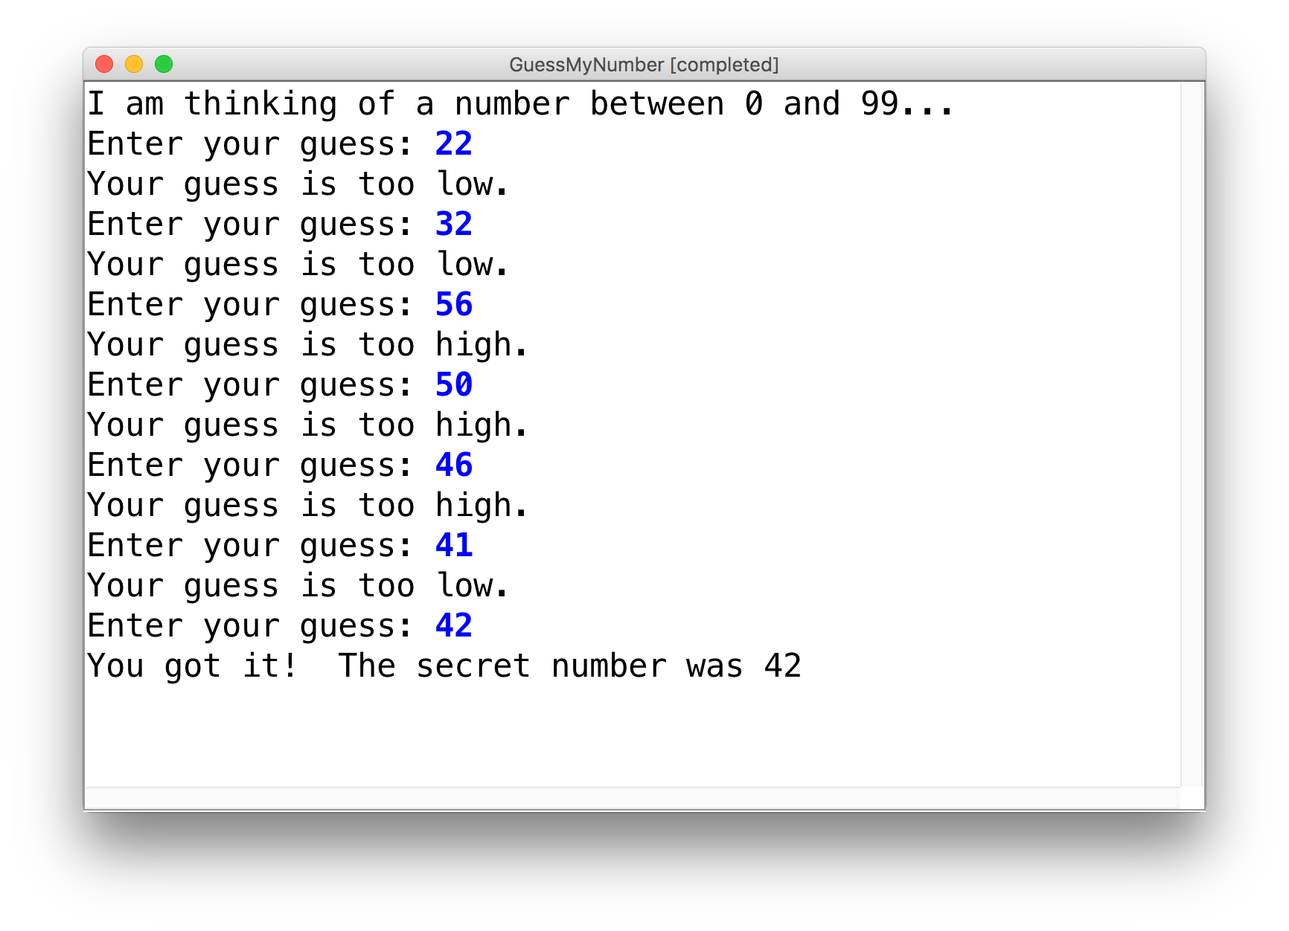
Practice: GuessMyNumber
We wrote a program called GuessMyNumber that prompts the user for a number until they guess our secret number.
If a guess is incorrect, the program provides a hint; specifically, whether the guess is too high or too low.
Notes:
While loop + if statements

Slide 14
If/Else If/Else
if (condition1) {
...
} else if (condition2) { // NEW
...
} else {
...
}
Runs the first group of statements if condition1 is true; otherwise, runs the second group of statements if condition2 is true; otherwise, runs the third group of statements.
You can have multiple else if clauses together.

Slide 15
If/Else If/Else
int num = readInt("Enter a number: ");
if (num > 0) {
println("Your number is positive");
} else if (num < 0) {
println("Your number is negative");
} else {
println("Your number is 0");
}
Notes:
No redundant conditions

Slide 16
Plan For Today
Announcements
Recap: If and While in Java
For Loops in Java
Methods in Java
Scope
Parameters

Slide 17
For Loops in Java
Repeats the loop if this condition passes
This code is run each time the code gets to the end of the ‘body’
This code is run once, just before the for loop starts
for (int i = 0; i < 3; i++) {
println("I love CS 106A!");
}

Slide 18
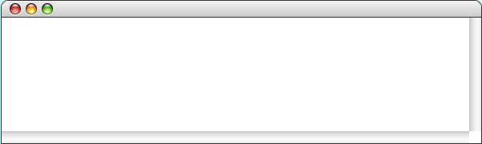
For Loops in Java
for (int i = 0; i < 3; i++) {
println("I love CS 106A!");
}
For Loop Redux

Slide 19
For Loops in Java
i
0
for (int i = 0; i < 3; i++) {
println("I love CS 106A!");
}
For Loop Redux

Slide 20
For Loops in Java
i
0
for (int i = 0; i < 3; i++) {
println("I love CS 106A!");
}
For Loop Redux

Slide 21
For Loops in Java
i
0
for (int i = 0; i < 3; i++) {
println("I love CS 106A!");
}
For Loop Redux
I love CS 106A!

Slide 22
For Loops in Java
i
0
for (int i = 0; i < 3; i++) {
println("I love CS 106A!");
}
For Loop Redux
I love CS 106A!

Slide 23
For Loops in Java
i
1
for (int i = 0; i < 3; i++) {
println("I love CS 106A!");
}
For Loop Redux
I love CS 106A!

Slide 24
For Loops in Java
i
1
for (int i = 0; i < 3; i++) {
println("I love CS 106A!");
}
For Loop Redux
I love CS 106A!

Slide 25
For Loops in Java
i
1
for (int i = 0; i < 3; i++) {
println("I love CS 106A!");
}
For Loop Redux
I love CS 106A!
I love CS 106A!

Slide 26
For Loops in Java
i
2
for (int i = 0; i < 3; i++) {
println("I love CS 106A!");
}
For Loop Redux
I love CS 106A!
I love CS 106A!

Slide 27
For Loops in Java
i
2
for (int i = 0; i < 3; i++) {
println("I love CS 106A!");
}
For Loop Redux
I love CS 106A!
I love CS 106A!

Slide 28
For Loops in Java
i
2
for (int i = 0; i < 3; i++) {
println("I love CS 106A!");
}
For Loop Redux
I love CS 106A!
I love CS 106A!
I love CS 106A!

Slide 29
For Loops in Java
i
3
for (int i = 0; i < 3; i++) {
println("I love CS 106A!");
}
For Loop Redux
I love CS 106A!
I love CS 106A!
I love CS 106A!

Slide 30
For Loops in Java
i
3
for (int i = 0; i < 3; i++) {
println("I love CS 106A!");
}
For Loop Redux
I love CS 106A!
I love CS 106A!
I love CS 106A!

Slide 31
For Loops in Java
for (int i = 0; i < 3; i++) {
println("I love CS 106A!");
}
For Loop Redux
I love CS 106A!
I love CS 106A!
I love CS 106A!

Slide 32
For Loops in Java
for (int i = 0; i < 3; i++) {
println("I love CS 106A!");
}
For Loop Redux
I love CS 106A!
I love CS 106A!
I love CS 106A!
Notes:
We can take advantage of the for loop variable!

Slide 33
Using the For Loop Variable
// prints the first 100 even numbers
for(int i = 0; i < 100; i++) {
println(i * 2);
}

Slide 34
Using the For Loop Variable
// Launch countdown
for(int i = 10; i >= 1; i--) {
println(i);
}
println("Blast off!");
Output:
10
9
8
…
Blast off!

Slide 35
Using the For Loop Variable
// Adds up 1 + 2 + ... + 99 + 100
int sum = 0;
for(int i = 1; i <= 100; i++) {
sum += i;
}
println("The sum is " + sum);
Notes:
You can also have for loops inside for loops

Slide 36
Nested loops
nested loop: A loop placed inside another loop.
for (int i = 0; i < 5; i++) {
for (int j = 0; j < 10; j++) {
print("*");
}
println(); // to end the line
}
Output:
**********
**********
**********
**********
**********
The outer loop repeats 5 times; the inner one 10 times.
Notes:
Let’s put these together – nested loops + using the I variable

Slide 37
Nested loop question
Q: What output is produced by the following code?
for (int i = 0; i < 5; i++) {
for (int j = 0; j < i + 1; j++) {
print("*");
}
println();
}
A. B. C. D. E.
***** ***** * 1 12345
***** **** ** 22
***** *** *** 333
***** ** **** 4444
***** * ***** 55555
(How would you modify the code to produce each output above?)
Notes:
Think – pair - share
answer: C
Trick – think about how inner loop relates to outer loop

Slide 38
Nested loop question 2
How would we produce the following output?
....1
...22
..333
.4444
55555

Slide 39
Nested loop question 2
How would we produce the following output?
....1
...22
..333
.4444
55555
Answer:
for (int i = 0; i < 5; i++) {
}

Slide 40
Nested loop question 2
How would we produce the following output?
....1
...22
..333
.4444
55555
Answer:
for (int i = 0; i < 5; i++) {
for (int j = 0; j < 5 – i - 1; j++) {
print(".");
}
}

Slide 41
Nested loop question 2
How would we produce the following output?
....1
...22
..333
.4444
55555
Answer:
for (int i = 0; i < 5; i++) {
for (int j = 0; j < 5 – i - 1; j++) {
print(".");
}
for (int j = 0; j <= i; j++) {
print(i + 1);
}
}

Slide 42
Nested loop question 2
How would we produce the following output?
....1
...22
..333
.4444
55555
Answer:
for (int i = 0; i < 5; i++) {
for (int j = 0; j < 5 – i - 1; j++) {
print(".");
}
for (int j = 0; j <= i; j++) {
print(i + 1);
}
println();
}

Slide 43
Plan For Today
Announcements
Recap: If and While in Java
For Loops in Java
Methods in Java
Scope
Parameters

Slide 44
Defining New Commands in Karel
We can make new commands (or methods) for Karel. This lets us decompose our program into smaller pieces that are easier to understand.
private void name() {
statement;
statement;
...
}
For example:
private void turnRight() {
turnLeft();
turnLeft();
turnLeft();
}
Notes:
But what about java? The same!

Slide 45
Methods in Java
We can define new methods in Java just like in Karel:
private void name() {
statement;
statement;
...
}
For example:
private void printGreeting() {
println("Hello world!");
println("I hope you have a great day.");
}
Notes:
Use to factor out duplicated code

Slide 46
Methods in Java
public void run() {
int x = 2;
printX();
}
private void printX() {
// ERROR! "Undefined variable x"
println("X has the value " + x);
}
Notes:
But….methods can’t share variables! Why? SCOPE

Slide 47
Plan For Today
Announcements
Recap: If and While in Java
For Loops in Java
Methods in Java
Scope
Parameters
Notes:
HW2 out
Eclipse FAQ

Slide 48

By Chris Piech

Slide 49
Once upon a time…

Slide 50

…x was looking for love!
int x = 5;
if(lookingForLove()) {
int y = 5;
}
println(x + y);
5
x

Slide 51
…x was looking for love!
int x = 5;
if(lookingForLove()) {
int y = 5;
}
println(x + y);
x was definitely
looking for love
5
x

Slide 52
And met y.
int x = 5;
if(lookingForLove()) {
int y = 5;
}
println(x + y);
5
5
x
y

Slide 53
And met y.
int x = 5;
if(lookingForLove()) {
int y = 5;
}
println(x + y);
5
5
Hi, I’m y
x
y

Slide 54
“Wow!”

Slide 55
And met y.
int x = 5;
if(lookingForLove()) {
int y = 5;
}
println(x + y);
Wow
5
5
x
y

Slide 56
And met y.
int x = 5;
if(lookingForLove()) {
int y = 5;
}
println(x + y);
5
5
We have so much in common
x
y

Slide 57
And met y.
int x = 5;
if(lookingForLove()) {
int y = 5;
}
println(x + y);
5
5
We both have value 5!
x
y

Slide 58
And met y.
int x = 5;
if(lookingForLove()) {
int y = 5;
}
println(x + y);
5
5
Maybe sometime we can…
x
y

Slide 59
And met y.
int x = 5;
if(lookingForLove()) {
int y = 5;
}
println(x + y);
5
5
println together?
x
y

Slide 60
And met y.
int x = 5;
if(lookingForLove()) {
int y = 5;
}
println(x + y);
5
5
x
y

Slide 61
It was a beautiful match…

Slide 62
…but then tragedy struck.

Slide 63
Tragedy Strikes
int x = 5;
if(lookingForLove()) {
int y = 5;
}
println(x + y);
5
5
x
y

Slide 64

Tragedy Strikes
int x = 5;
if(lookingForLove()) {
int y = 5;
}
println(x + y);
5
x

Slide 65
Noooooooooooooooo!

Slide 66
You see…
when a program exits a code block,
all variables declared inside that block go away!

Slide 67
Since y is inside the if-block…
int x = 5;
if(lookingForLove()) {
int y = 5;
}
println(x + y);
5
x

Slide 68
…it goes away here…
int x = 5;
if(lookingForLove()) {
int y = 5;
}
println(x + y);
5
x

Slide 69
…and doesn’t exist here.
int x = 5;
if(lookingForLove()) {
int y = 5;
}
println(x + y);
Error. Undefined variable y.
5
x

Slide 70
The End

Slide 71
Sad times ☹

Slide 72
Variable Scope
Variables have a lifetime (called scope):
public void run(){
double v = 8;
if(condition){
v = 4;
… some code
}
… some other code
}

Slide 73
Variable Scope
Variables have a lifetime (called scope):
public void run(){
double v = 8;
if(condition){
v = 4;
… some code
}
… some other code
}

Slide 74
Variable Scope
Variables have a lifetime (called scope):
public void run(){
double v = 8;
if(condition){
v = 4;
… some code
}
… some other code
}
Comes to life here
8
v

Slide 75
Variable Scope
Variables have a lifetime (called scope):
public void run(){
double v = 8;
if(condition){
v = 4;
… some code
}
… some other code
}
This is the inner most
code block in which it was
declared….
4
v

Slide 76
Variable Scope
Variables have a lifetime (called scope):
public void run(){
double v = 8;
if(condition){
v = 4;
… some code
}
… some other code
}
Still alive here…
4
v

Slide 77
Variable Scope
Variables have a lifetime (called scope):
public void run(){
double v = 8;
if(condition){
v = 4;
… some code
}
… some other code
}
4
v
It goes away here (at the end of its code block)

Slide 78

Variable Scope
Variables have a lifetime (called scope):
public void run(){
double v = 8;
if(condition){
v = 4;
… some code
}
… some other code
}
It goes away here (at the end of its code block)

Slide 80
Variable Scope
Variables have a lifetime (called scope):
public void run(){
… some code
if(condition){
int w = 4;
… some code
}
… some other code
}
This is the scope of w

Slide 81
Variable Scope
Variables have a lifetime (called scope):
public void run(){
… some code
if(condition){
int w = 4;
… some code
}
… some other code
}
w is created here
w goes away here (at the end of its code block)

Slide 82
Variable Scope
public void run() {
int x = 2;
printX();
}
private void printX() {
// ERROR! "Undefined variable x"
println("X has the value " + x);
}
Notes:
But….methods can’t share variables! Why? SCOPE

Slide 83
Chapter 2
By Chris

Slide 84
The programmer fixed the bug

Slide 85
…x was looking for love!
int x = 5;
if(lookingForLove()) {
int y = 5;
println(x + y);
}
5
x

Slide 86
…x was looking for love!
int x = 5;
if(lookingForLove()) {
int y = 5;
println(x + y);
}
x was definitely
looking for love
5
x

Slide 87
And met y.
int x = 5;
if(lookingForLove()) {
int y = 5;
println(x + y);
}
5
5
x
y

Slide 88
Since they were both “in scope”…
int x = 5;
if(lookingForLove()) {
int y = 5;
println(x + y);
}
5
5
x
y

Slide 89
…they lived happily ever after.
The end.

Slide 90
Variable Scope
The scope of a variable refers to the section of code where a variable can be accessed.
Scope starts where the variable is declared.
Scope ends at the termination of the code block in which the variable was declared.
A code block is a chunk of code between { } brackets
Notes:
Applies to methods and control flow

Slide 91
Variable Scope
You cannot have two variables with the same name in the same scope.
for (int i = 1; i <= 100 * line; i++) {
int i = 2; // ERROR
print("/");
}

Slide 92
Variable Scope
You can have two variables with the same name in different scopes.
private void run() {
int num = 5;
cow();
println(num);
}
private void cow() {
int num = 10;
println(num);
}

Slide 93
Variable Scope
You can have two variables with the same name in different scopes.
private void run() {
int num = 5;
cow();
println(num); // prints 5
}
private void cow() {
int num = 10;
println(num); // prints 10
}

Slide 94
Variable Scope
You can have two variables with the same name in different scopes.
private void run() {
int num = 5;
cow();
println(num); // prints 5
}
private void cow() {
int num = 10;
println(num); // prints 10
}

Slide 95
Revisiting Sentinel Loops
// sum must be outside the while loop!
// Otherwise it will be redeclared many times.
int sum = 0;
int num = readInt("Enter a number: ");
while (num != -1) {
sum += num;
num = readInt("Enter a number: ");
}
println("Sum is " + sum);
Notes:
So is there a way to have methods share information or communicate?

Slide 96
Plan For Today
Announcements
Recap: If and While in Java
For Loops in Java
Methods in Java
Scope
Parameters

Slide 97
Parameters
Parameters let you provide a method some information when you are calling it.
Notes:
Calling just means executing it

Slide 98

Methods = Toasters
Notes:
What if toasters could only toast one thing – no slits!
More useful if you give it something and it toasts it.
This is how println works!

Slide 99

Methods = Toasters
parameter

Slide 100

Methods = Toasters
parameter

Slide 101

Methods = Toasters
parameter

Slide 102
Methods = Toasters
parameter

Slide 103
Methods = Toasters
Invalid parameter

Slide 104
Methods = Toasters

Slide 105
Drawing boxes
Consider the task of printing the following boxes:
**********
* *
* *
**********
*******
* *
* *
* *
* *
*******
The code to draw each box will be very similar.
Would variables help? Would constants help?
Notes:
What command would be nice to have?

Slide 106
Wouldn’t it be nice if…
drawBox(10, 4);
Notes:
How do we define a command, or method, like this?
Finally time to learn about what is inside parentheses…

Slide 107
Methods with Parameters
private void drawBox(int width, int height) {
// use width and height to draw box
}
Notes:
Comma delimited

Slide 108
Methods with Parameters
public void run() {
printGreeting(5);
}
private void printGreeting(int times) {
for (int i = 0; i < times; i++) {
println("Hello world!");
}
}

Slide 109
Methods with Parameters
public void run() {
printGreeting(5);
}
private void printGreeting(int times) {
for (int i = 0; i < times; i++) {
println("Hello world!");
}
}

Slide 110
Methods with Parameters
public void run() {
int repeats = 5;
printGreeting(repeats);
}
private void printGreeting(int times) {
for (int i = 0; i < times; i++) {
println("Hello world!");
}
}
Notes:
The variable names are separate – separate scope!

Slide 111
Methods with Parameters
public void run() {
int times = 5;
printGreeting(repeats);
}
private void printGreeting(int times) {
for (int i = 0; i < times; i++) {
println("Hello world!");
}
}
Parameter names do not affect how the program runs!
Notes:
Names don’t matter

Slide 112
Parameters
parameter: A value passed to a method by its caller.
Write a method box to draw a box of any size.
When declaring the method, we will state that it requires the caller to tell it the width and height of the box.
When calling the method, we will specify the width and height to use.
**********
* *
* *
**********
10, 4
run
box
7, 5
box
*******
* *
* *
* *
*******

Slide 113
Declaring a parameter
Stating that a method requires a parameter in order to run
public void name(type name) {
statements;
}
Example:
public void password(int code) {
println("The password is: " + code);
}
When password is called, the caller must specify the integer code to print.

Slide 114
Multiple parameters
A method can accept multiple parameters separated by commas: ,
When calling it, you must pass values for each parameter.
Declaration:
public void name(type name, ..., type name) {
statements;
}
Call:
name(value, value, ..., value);

Slide 115
Passing a parameter
Calling a method and specifying values for its parameters
methodName(expression);
Example:
public void run() {
password(42);
password(12345);
}
Output:
The password is 42
The password is 12345
Illegal to call without passing an int for that parameter.
password(); // Error
password(3.7); // Error

Slide 116
How params are passed
When the method is called:
The value is stored into the parameter variable.
The method's code executes using that value.
public void run() {
chant(7);
}
public void chant(int times) {
for (int i = 0; i < times; i++) {
println("Java is great!");
}
}
7

Slide 117
Parameters are Copies
// NOTE: This program is buggy!!
private void addFive(int x) {
x += 5;
}
public void run() {
int x = 3;
addFive(x);
println("x = " + x);
}
Notes:
What is printed out here?

Slide 118
Parameters are Copies
// NOTE: This program is buggy!!
private void addFive(int x) {
x += 5;
}
public void run() {
int x = 3;
addFive(x);
println("x = " + x); // prints "x = 3"!
}

Slide 119
Drawing boxes
Lets write a program that uses methods and parameters to print the following boxes:
**********
* *
* *
**********
*******
* *
* *
* *
* *
*******
Note: the code to draw each box will be very similar!
Notes:
What command would be nice to have?

Slide 120
Recap
Announcements
Recap: If and While in Java
For Loops in Java
Methods in Java
Scope
Parameters
Next time: Methods and return

