Slide 1
CS 106A, Lecture 7 Parameters and Return
suggested reading:
Java Ch. 5.1-5.4

Slide 2
Plan For Today
Announcements
Recap: For Loops
Scope
Parameters
Return

Slide 3
For Loops in Java
Repeats the loop if this condition passes
This code is run each time the code gets to the end of the ‘body’
This code is run once, just before the for loop starts
for (int i = 0; i < 3; i++) {
println("I love CS 106A!");
}

Slide 4
Nested loops
nested loop: A loop placed inside another loop.
for (int i = 0; i < 5; i++) {
for (int j = 0; j < 10; j++) {
print("*");
}
println(); // to end the line
}
Output:
**********
**********
**********
**********
**********
The outer loop repeats 5 times; the inner one 10 times.
Notes:
Let’s put these together – nested loops + using the I variable

Slide 5
Nested loop question 2
How would we produce the following output?
....1
...22
..333
.4444
55555
Answer:
for (int i = 0; i < 5; i++) {
for (int j = 0; j < 5 – i - 1; j++) {
print(".");
}
for (int j = 0; j <= i; j++) {
print(i + 1);
}
println();
}

Slide 6
Methods in Java
We can define new methods in Java just like in Karel:
private void name() {
statement;
statement;
...
}
For example:
private void printGreeting() {
println("Hello world!");
println("I hope you have a great day.");
}
Notes:
Use to factor out duplicated code

Slide 7
Methods in Java
public void run() {
int x = 2;
printX();
}
private void printX() {
// ERROR! "Undefined variable x"
println("X has the value " + x);
}
Notes:
But….methods can’t share variables! Why? SCOPE

Slide 8

By Chris Piech

Slide 9
Variable Scope
The scope of a variable refers to the section of code where a variable can be accessed.
Scope starts where the variable is declared.
Scope ends at the termination of the code block in which the variable was declared.
A code block is a chunk of code between { } brackets
Notes:
Applies to methods and control flow

Slide 10
Variable Scope
You cannot have two variables with the same name in the same scope.
for (int i = 1; i <= 100 * line; i++) {
int i = 2; // ERROR
print("/");
}

Slide 11
Variable Scope
You can have two variables with the same name in different scopes.
private void run() {
int num = 5;
cow();
println(num); // prints 5
}
private void cow() {
int num = 10;
println(num); // prints 10
}

Slide 12
Parameters
Parameters let you provide a method some information when you are calling it.
Notes:
Calling just means executing it

Slide 13

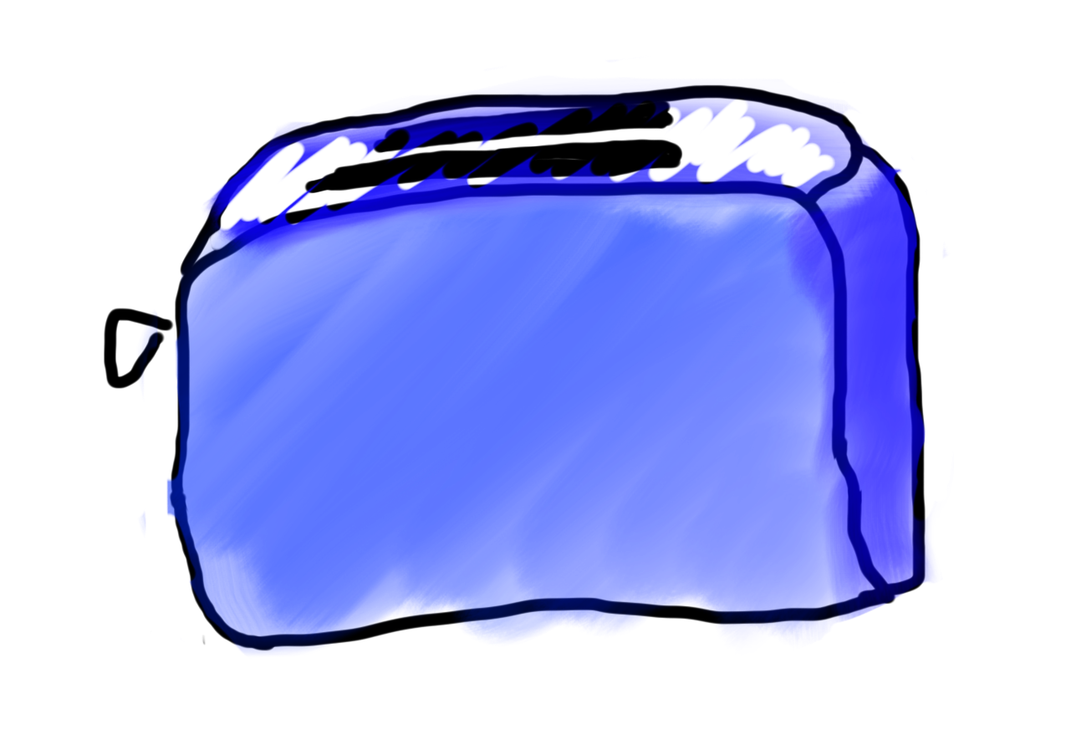
Methods = Toasters
parameter

Slide 14
Drawing boxes
Consider the task of printing the following boxes:
**********
* *
* *
**********
*******
* *
* *
* *
* *
*******
The code to draw each box will be very similar.
Would variables help? Would constants help?
Notes:
What command would be nice to have?

Slide 15
Wouldn’t it be nice if…
drawBox(10, 4);
Notes:
How do we define a command, or method, like this?
Finally time to learn about what is inside parentheses…

Slide 16
Methods with Parameters
private void drawBox(int width, int height) {
// use width and height to draw box
}
Notes:
Comma delimited

Slide 17
Methods with Parameters
public void run() {
printGreeting(5);
}
private void printGreeting(int times) {
for (int i = 0; i < times; i++) {
println("Hello world!");
}
}

Slide 18
Methods with Parameters
public void run() {
printGreeting(5);
}
private void printGreeting(int times) {
for (int i = 0; i < times; i++) {
println("Hello world!");
}
}

Slide 19
Methods with Parameters
public void run() {
int repeats = 5;
printGreeting(repeats);
}
private void printGreeting(int times) {
for (int i = 0; i < times; i++) {
println("Hello world!");
}
}
Notes:
The variable names are separate – separate scope!

Slide 20
Methods with Parameters
public void run() {
int times = 5;
printGreeting(repeats);
}
private void printGreeting(int times) {
for (int i = 0; i < times; i++) {
println("Hello world!");
}
}
Parameter names do not affect how the program runs!
Notes:
Names don’t matter

Slide 21
Parameters
parameter: A value passed to a method by its caller.
Write a method box to draw a box of any size.
When declaring the method, we will state that it requires the caller to tell it the width and height of the box.
When calling the method, we will specify the width and height to use.
**********
* *
* *
**********
10, 4
run
box
7, 5
box
*******
* *
* *
* *
*******

Slide 22
Declaring a parameter
Stating that a method requires a parameter in order to run
public void name(type name) {
statements;
}
Example:
public void password(int code) {
println("The password is: " + code);
}
When password is called, the caller must specify the integer code to print.

Slide 23
Multiple parameters
A method can accept multiple parameters separated by commas: ,
When calling it, you must pass values for each parameter.
Declaration:
public void name(type name, ..., type name) {
statements;
}
Call:
name(value, value, ..., value);

Slide 24
Passing a parameter
Calling a method and specifying values for its parameters
methodName(expression);
Example:
public void run() {
password(42);
password(12345);
}
Output:
The password is 42
The password is 12345
Illegal to call without passing an int for that parameter.
password(); // Error
password(3.7); // Error

Slide 25
How params are passed
When the method is called:
The value is stored into the parameter variable.
The method's code executes using that value.
public void run() {
chant(7);
}
public void chant(int times) {
for (int i = 0; i < times; i++) {
println("Java is great!");
}
}
7

Slide 26
Parameters are Copies
// NOTE: This program is buggy!!
private void addFive(int x) {
x += 5;
}
public void run() {
int x = 3;
addFive(x);
println("x = " + x); // prints "x = 3"!
}

Slide 27
Drawing boxes
Lets write a program that uses methods and parameters to print the following boxes:
**********
* *
* *
**********
*******
* *
* *
* *
* *
*******
Note: the code to draw each box will be very similar!
Notes:
What command would be nice to have?

