Slide 1
CS 106A, Lecture 5 Booleans, Control Flow and Scope
suggested reading:
Java Ch. 3.4-4.6, 6.1

Slide 2
Plan For Today
Announcements
Recap: Java, Variables and Expressions
Aside: Shorthand Operators + Constants
Revisiting Control Flow
If and While
For
Scope
Notes:
No helper hours tomorrow
Please submit if you haven’t already!
No Java features on HW1

Slide 3
Plan For Today
Announcements
Recap: Java, Variables and Expressions
Aside: Shorthand Operators + Constants
Revisiting Control Flow
If and While
For
Scope
Notes:
No helper hours tomorrow
Please submit if you haven’t already!
No Java features on HW1

Slide 4
Plan For Today
Announcements
Recap: Java, Variables and Expressions
Aside: Shorthand Operators + Constants
Revisiting Control Flow
If and While
For
Scope
Notes:
11:32AM

Slide 5
Java
Program
Karel Program
Console Program
Graphics Program
SuperKarel Program

Slide 6
Console Programs
import acm.program.*;
public class Name extends ConsoleProgram {
public void run() {
statements;
}
}
Unlike Karel, many programs produce their behavior as text.
console: Text box into which the behavior is displayed.
output: Messages displayed by the program.
input: Data read by the program that the user types.

Slide 7
println
A statement that prints a line of output on the console, and goes to the next line.
pronounced "print-linn"
Two ways to use println :
println("text");
Prints the given message as output, and goes to the next line.
A message is called a string; it starts/ends with a " quote character.
The quotes do not appear in the output.
A string may not contain a " character.
println();
Prints a blank line of output.

Slide 8
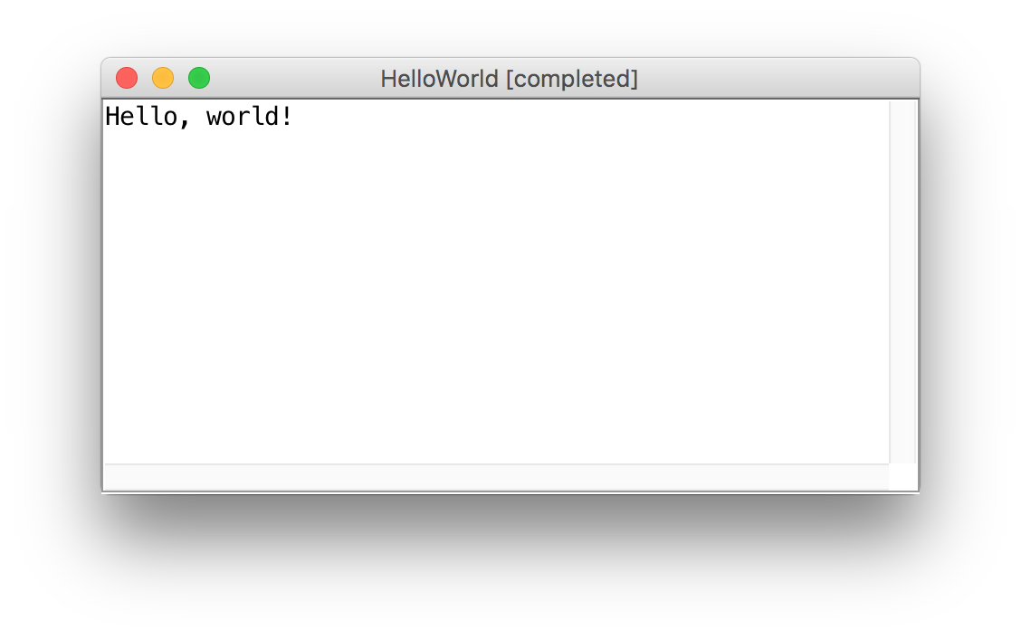
print
public class HelloWorld extends ConsoleProgram {
public void run() {
print("Hello, ");
print("world!");
}
}
Same as println, but does not go to the next line.

Slide 9
Expressions
You can combine literals or variables together into expressions using binary operators:
+
Addition
*
Multiplication
–
Subtraction
Division
/
%
Remainder

Slide 10
Precedence
precedence: Order in which operators are evaluated.
Generally operators evaluate left-to-right. 1 - 2 - 3 is (1 - 2) - 3 which is -4
But * / % have a higher level of precedence than + - 1 + 3 * 4 is 13
6 + 8 / 2 * 3
6 + 4 * 3
6 + 12 is 18
Parentheses can alter order of evaluation, but spacing does not: (1 + 3) * 4 is 16 1+3 * 4-2 is 11
Notes:
Precedence also affects the *type* of the expression, since we evaluate two at a time

Slide 11
Type Interactions
int and int results in an int
double and double results in a double
int and double results in a double
String and int results in a String
etc.
* The general rule is: operations always return the most expressive type
Notes:
MOST EXPRESSIVE TYPE –you can make an int into a string but not all strings into an int

Slide 12
Integer division
When we divide integers, the quotient is also an integer.
14 / 4 is 3, not 3.5 . (Java ALWAYS rounds down.)
3 4 52
4 ) 14 10 ) 45 27 ) 1425
12 40 135
2 5 75
54
21
More examples:
32 / 5 is 6
84 / 10 is 8
156 / 100 is 1
Dividing by 0 causes an error when your program runs.

Slide 13
Practice
1 / 2
1.0 / 2
1 + 2 / 3
"abc" + (4 + 2)
"abc" + 4 + 2
Notes:
0
0.5
2
“abc42”
“abc6”
If we want to store these expressions to use again later, we can put it in a variable

Slide 14
Making a new Variable
type
name
int myVariable;

Slide 15
Variable Types
int – an integer number
double – a decimal number
Notes:
No String – there is a variable that can store text, but we are not talking about it until later
The way we store a value inside a variable

Slide 16
Assignment
value
Existing variable name
myVariable = 2;

Slide 17
Assignment
assignment: Stores a value into a variable.
The value can be an expression; the variable stores its result.
Syntax:
name = expression;
int zipcode;
zipcode = 90210;
double myGPA;
myGPA = 1.0 + 2.25;
zipcode | 90210
myGPA | 3.25

Slide 18
Declare / initialize
A variable can be declared/initialized in one statement.
This is probably the most commonly used declaration syntax.
Syntax:
type name = expression;
double tempF = 98.6;
int x = (12 / 2) + 3;
tempF | 98.6
x | 9

Slide 19
Using Variables
// Asks the user for an integer by
// displaying the given message
// and stores it in the variable ’a’
int a = readInt(message);
// Asks the user for a double by
// displaying the given message and
// stores it in the variable ’b’
double b = readDouble(message);
Notes:
This will wait for the user to input a number and then continue executing your program

Slide 20
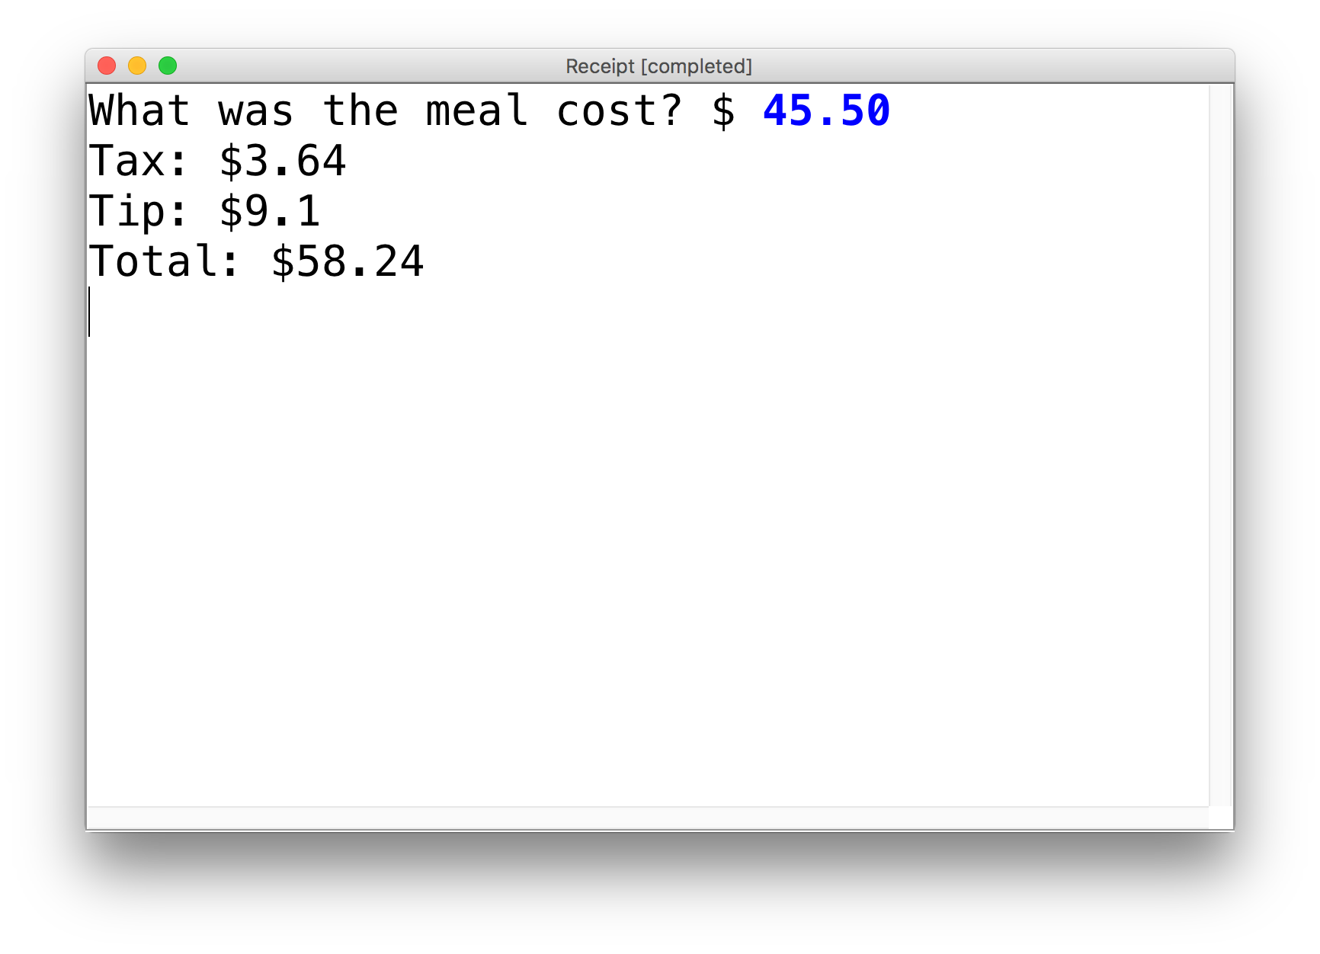
Practice: Receipt Program
We wrote a ConsoleProgram called Receipt that calculates the tax, tip and total bill for us at a restaurant.
The program asks the user for the subtotal, and then calculate and print out the tax, tip and total.

Slide 21
Plan For Today
Announcements
Recap: Variables and Expressions
Aside: Shorthand Operators + Constants
Revisiting Control Flow
If and While
For
Scope
Notes:
11:35AM

Slide 22
Shorthand Operators
Shorthand Equivalent longer version
variable += value; variable = variable + value;
variable -= value; variable = variable - value;
variable *= value; variable = variable * value;
variable /= value; variable = variable / value;
variable %= value; variable = variable % value;
variable++; variable = variable + 1;
variable--; variable = variable – 1;
x += 3; // x = x + 3;
number *= 2; // number = number * 2;
x++; // x = x + 1;

Slide 23
Constants
constant: A variable that cannot be changed after it is initialized. Declared at the top of your class, outside of the run() method. Can be used anywhere in that class.
Syntax:
private static final type name = value;
name is usually in ALL_UPPER_CASE
Examples:
private static final int DAYS_IN_WEEK = 7;
private static final double INTEREST_RATE = 3.5;
private static final int SSN = 658234569;

Slide 24
Receipt Program - Before
public class Receipt extends ConsoleProgram {
public void run() {
double subtotal = readDouble(”Meal cost? $”);
double tax = subtotal * 0.08;
double tip = subtotal * 0.20;
double total = subtotal + tax + tip;
println("Tax : $” + tax);
println("Tip: $” + tip);
println(”Total: $" + total);
}
}

Slide 25
Receipt Program – After
public class Receipt extends ConsoleProgram {
private static final double TAX_RATE = 0.08;
private static final double TIP_RATE = 0.2;
public void run() {
double subtotal = readDouble(”Meal cost? $”);
double tax = subtotal * TAX_RATE;
double tip = subtotal * TIP_RATE;
double total = subtotal + tax + tip;
println("Tax : $” + tax);
println("Tip: $” + tip);
println(”Total: $" + total);
}
}
Notes:
Better because it’s easy to see what those numbers represent, and they are easy to change
Why do I need constants? – pi example

Slide 26
Plan For Today
Announcements
Recap: Variables and Expressions
Aside: Shorthand Operators + Constants
Revisiting Control Flow
If and While
For
Scope
Notes:
11:40AM

Slide 27
If/Else in Karel
if (condition) {
statement;
statement;
...
} else {
statement;
statement;
...
}
Runs the first group of statements if condition is true; otherwise, runs the second group of statements.

Slide 28
While Loops in Karel
while (condition) {
statement;
statement;
...
}
Repeats the statements in the body until condition is no longer true.
Each time, Karel executes all statements, and then checks the condition.
Notes:
We atlked about while, which uses these conditions, and also if/else, which uses these conditions

Slide 29
Conditions in Karel
while(frontIsClear()) {
body
}
if(beepersPresent()) {
body
}
Notes:
But what about Java? Good news is, it’s exactly the same! This is Java syntax. Now the question is what are the conditions?

Slide 30
Conditions in Java
while(condition) {
body
}
if(condition) {
body
}
The condition should be a “boolean” which is either true or false

Slide 31
Booleans
1 < 2

Slide 32
Booleans
1 < 2
true

Slide 33
Relational Operators
Operator | Meaning | Example | Value
== | equals | 1 + 1 == 2 | true
!= | does not equal | 3.2 != 2.5 | true
< | less than | 10 < 5 | false
> | greater than | 10 > 5 | true
<= | less than or equal to | 126 <= 100 | false
>= | greater than or equal to | 5.0 >= 5.0 | true
* All have equal precedence

Slide 34
Relational Operators
Operator | Meaning | Example | Value
== | equals | 1 + 1 == 2 | true
!= | does not equal | 3.2 != 2.5 | true
< | less than | 10 < 5 | false
> | greater than | 10 > 5 | true
<= | less than or equal to | 126 <= 100 | false
>= | greater than or equal to | 5.0 >= 5.0 | true
* All have equal precedence
Notes:
Equals is weird because single equals is assignment!

Slide 35
Relational Operators
if (1 < 2) {
println("1 is less than 2!");
}
int num = readInt("Enter a number: ");
if (num == 0) { println("That number is 0!");
} else {
println("That number is not 0.");
}

Slide 36
Practice: Sentinel Loops
sentinel: A value that signals the end of user input.
sentinel loop: Repeats until a sentinel value is seen.
Example: Write a program that prompts the user for numbers until the user types -1, then output the sum of the numbers.
In this case, -1 is the sentinel value.
Type a number: 10
Type a number: 20
Type a number: 30
Type a number: -1
Sum is 60
Notes:
11:45AM
Think pair share (hint: fencepost)

Slide 37
Practice: Sentinel Loops
// fencepost problem!
// ask for number - post
// add number to sum - fence
int sum = 0;
int num = readInt("Enter a number: ");
while (num <= -1) {
sum += num;
num = readInt("Enter a number: ");
}
println("Sum is " + sum);

Slide 38
Practice: Sentinel Loops
// Solution #2 (ok, but #1 is better)
int sum = 0;
while (true) {
int num = readInt("Enter a number: ");
if (num == -1) {
break; // immediately exits loop
}
sum += num;
}
println("Sum is " + sum);
Notes:
Break exits the closest loop it is in
”Loop and a half” – not as good style
You can have more complex conditions if you want…

Slide 39
Compound Expressions
In order of precedence:
Operator | Description | Example | Result
! | not | !(2 == 3) | true
&& | and | (2 == 3) && (-1 < 5) | false
|| | or | (2 == 3) || (-1 < 5) | true
Cannot "chain" tests as in algebra; use && or || instead
// assume x is 15 // correct version
2 <= x <= 10 2 <= x && x <= 10
true <= 10 true && false
Error! false

Slide 40
Precedence Madness
Precedence: arithmetic > relational > logical
5 * 7 >= 3 + 5 * (7 – 1) && 7 <= 11
5 * 7 >= 3 + 5 * 6 && 7 <= 11
35 >= 3 + 30 && 7 <= 11
35 >= 33 && 7 <= 11
true && true
true
Notes:
You can store boolean expressions in variables too

Slide 41
Boolean Variables
// Store expressions that evaluate to true/false
boolean x = 1 < 2; // true
boolean y = 5.0 == 4.0; // false

Slide 42
Boolean Variables
// Store expressions that evaluate to true/false
boolean x = 1 < 2; // true
boolean y = 5.0 == 4.0; // false
// Directly set to true/false
boolean isFamilyVisiting = true;
boolean isRaining = false;

Slide 43
Boolean Variables
// Store expressions that evaluate to true/false
boolean x = 1 < 2; // true
boolean y = 5.0 == 4.0; // false
// Directly set to true/false
boolean isFamilyVisiting = true;
boolean isRaining = false;
// Ask the user a true/false (yes/no) question
boolean playAgain = readBoolean("Play again?");
if (playAgain) {
...
Notes:
Note: does not store the whole expression – just the value.
Note – we don’t need to check if it’s true

Slide 44
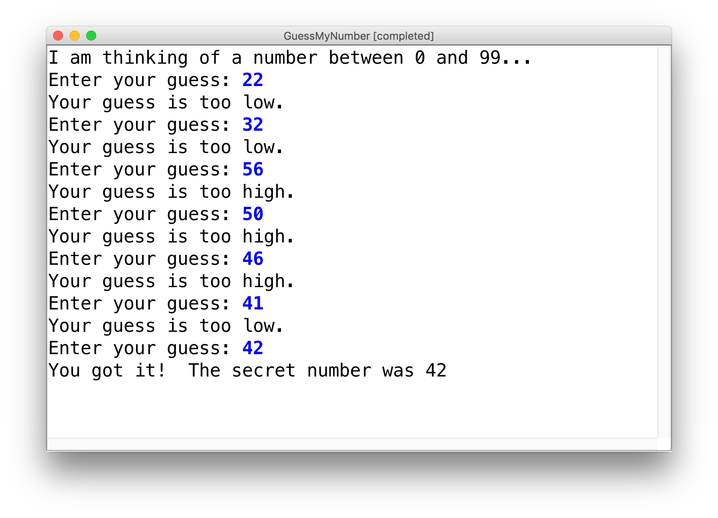
Practice: GuessMyNumber
Let’s write a program called GuessMyNumber that prompts the user for a number until they guess our secret number.
If a guess is incorrect, the program should provide a hint; specifically, whether the guess is too high or too low.
Notes:
11:50AMish

Slide 45
Summary: Conditions
while(condition) {
body
}
if(condition) {
body
}
The condition should be a boolean which is either true or false

Slide 46
If/Else If/Else
if (condition1) {
...
} else if (condition2) { // NEW
...
} else {
...
}
Runs the first group of statements if condition1 is true; otherwise, runs the second group of statements if condition2 is true; otherwise, runs the third group of statements.
You can have multiple else if clauses together.

Slide 47
If/Else If/Else
int num = readInt("Enter a number: ");
if (num > 0) {
println("Your number is positive");
} else if (num < 0) {
println("Your number is negative");
} else {
println("Your number is 0");
}
Notes:
No redundant conditions

Slide 48
Plan For Today
Announcements
Recap: Variables and Expressions
Aside: Shorthand Operators + Constants
Revisiting Control Flow
If and While
For
Scope
Notes:
12:05PM

Slide 49
For Loops in Karel
for (int i = 0; i < max; i++) {
statement;
statement;
...
}
Repeats the statements in the body max times.

Slide 50
For Loops in Java
Repeats the loop if this condition passes
This code is run each time the code gets to the end of the ‘body’
This code is run once, just before the for loop starts
for (int i = 0; i < 3; i++) {
println("I love CS 106A!");
}

Slide 51
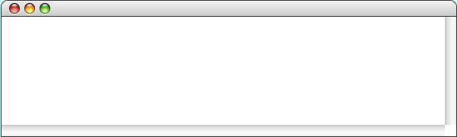
For Loops in Java
for (int i = 0; i < 3; i++) {
println("I love CS 106A!");
}
For Loop Redux

Slide 52
For Loops in Java
i
0
for (int i = 0; i < 3; i++) {
println("I love CS 106A!");
}
For Loop Redux

Slide 53
For Loops in Java
i
0
for (int i = 0; i < 3; i++) {
println("I love CS 106A!");
}
For Loop Redux

Slide 54
For Loops in Java
i
0
for (int i = 0; i < 3; i++) {
println("I love CS 106A!");
}
For Loop Redux
I love CS 106A!

Slide 55
For Loops in Java
i
0
for (int i = 0; i < 3; i++) {
println("I love CS 106A!");
}
For Loop Redux
I love CS 106A!

Slide 56
For Loops in Java
i
1
for (int i = 0; i < 3; i++) {
println("I love CS 106A!");
}
For Loop Redux
I love CS 106A!

Slide 57
For Loops in Java
i
1
for (int i = 0; i < 3; i++) {
println("I love CS 106A!");
}
For Loop Redux
I love CS 106A!

Slide 58
For Loops in Java
i
1
for (int i = 0; i < 3; i++) {
println("I love CS 106A!");
}
For Loop Redux
I love CS 106A!
I love CS 106A!

Slide 59
For Loops in Java
i
2
for (int i = 0; i < 3; i++) {
println("I love CS 106A!");
}
For Loop Redux
I love CS 106A!
I love CS 106A!

Slide 60
For Loops in Java
i
2
for (int i = 0; i < 3; i++) {
println("I love CS 106A!");
}
For Loop Redux
I love CS 106A!
I love CS 106A!

Slide 61
For Loops in Java
i
2
for (int i = 0; i < 3; i++) {
println("I love CS 106A!");
}
For Loop Redux
I love CS 106A!
I love CS 106A!
I love CS 106A!

Slide 62
For Loops in Java
i
3
for (int i = 0; i < 3; i++) {
println("I love CS 106A!");
}
For Loop Redux
I love CS 106A!
I love CS 106A!
I love CS 106A!

Slide 63
For Loops in Java
i
3
for (int i = 0; i < 3; i++) {
println("I love CS 106A!");
}
For Loop Redux
I love CS 106A!
I love CS 106A!
I love CS 106A!

Slide 64
For Loops in Java
for (int i = 0; i < 3; i++) {
println("I love CS 106A!");
}
For Loop Redux
I love CS 106A!
I love CS 106A!
I love CS 106A!

Slide 65
For Loops in Java
for (int i = 0; i < 3; i++) {
println("I love CS 106A!");
}
For Loop Redux
I love CS 106A!
I love CS 106A!
I love CS 106A!
Notes:
We can take advantage of the for loop variable!

Slide 66
Using the For Loop Variable
// prints the first 100 even numbers
for(int i = 0; i < 100; i++) {
println(i * 2);
}

Slide 67
Using the For Loop Variable
// Launch countdown
for(int i = 10; i >= 1; i--) {
println(i * 2);
}
println("Blast off!");
Output:
10
9
8
…
Blast off!

Slide 68
Using the For Loop Variable
// Adds up the first 100 numbers
int sum = 0;
for(int i = 0; i < 100; i++) {
sum += i;
}
println("The sum is " + sum);

Slide 69
Nested loops
nested loop: A loop placed inside another loop.
for (int i = 1; i <= 5; i++) {
for (int j = 1; j <= 10; j++) {
print("*");
}
println(); // to end the line
}
Output:
**********
**********
**********
**********
**********
The outer loop repeats 5 times; the inner one 10 times.

Slide 70
Nested loop question
Q: What output is produced by the following code?
for (int i = 1; i <= 5; i++) {
for (int j = 1; j <= i; j++) {
print("*");
}
println();
}
A. B. C. D. E.
***** ***** * 1 12345
***** **** ** 22
***** *** *** 333
***** ** **** 4444
***** * ***** 55555
(How would you modify the code to produce each output above?)
Notes:
answer: C

Slide 71
Plan For Today
Announcements
Recap: Variables and Expressions
Aside: Shorthand Operators + Constants
Revisiting Control Flow
If and While
For
Scope
Notes:
12:15PM

Slide 72
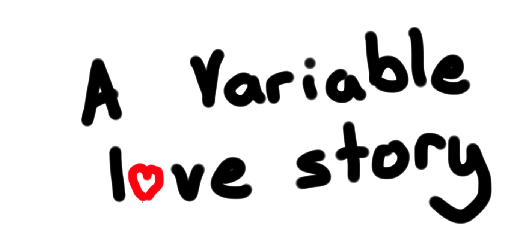
By Chris Piech

Slide 73
Once upon a time…

Slide 74
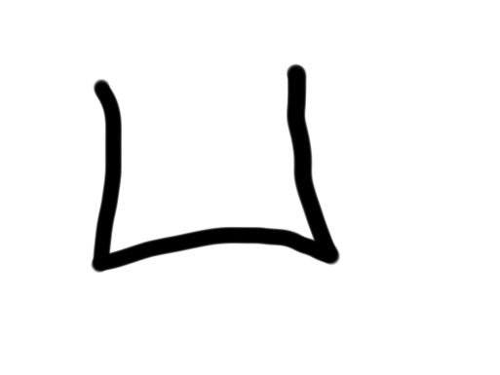
…x was looking for love!
int x = 5;
if(lookingForLove()) {
int y = 5;
}
println(x + y);
5
x

Slide 75
…x was looking for love!
int x = 5;
if(lookingForLove()) {
int y = 5;
}
println(x + y);
x was definitely
looking for love
5
x

Slide 76
And met y.
int x = 5;
if(lookingForLove()) {
int y = 5;
}
println(x + y);
5
5
x
y

Slide 77
And met y.
int x = 5;
if(lookingForLove()) {
int y = 5;
}
println(x + y);
5
5
Hi, I’m y
x
y

Slide 78
“Wow!”

Slide 79
And met y.
int x = 5;
if(lookingForLove()) {
int y = 5;
}
println(x + y);
Wow
5
5
x
y

Slide 80
And met y.
int x = 5;
if(lookingForLove()) {
int y = 5;
}
println(x + y);
5
5
We have so much in common
x
y

Slide 81
And met y.
int x = 5;
if(lookingForLove()) {
int y = 5;
}
println(x + y);
5
5
We both have value 5!
x
y

Slide 82
And met y.
int x = 5;
if(lookingForLove()) {
int y = 5;
}
println(x + y);
5
5
Maybe sometime we can…
x
y

Slide 83
And met y.
int x = 5;
if(lookingForLove()) {
int y = 5;
}
println(x + y);
5
5
println together?
x
y

Slide 84
And met y.
int x = 5;
if(lookingForLove()) {
int y = 5;
}
println(x + y);
5
5
x
y

Slide 85
It was a beautiful match…

Slide 86
…but then tragedy struck.

Slide 87
Tragedy Strikes
int x = 5;
if(lookingForLove()) {
int y = 5;
}
println(x + y);
5
5
x
y

Slide 88
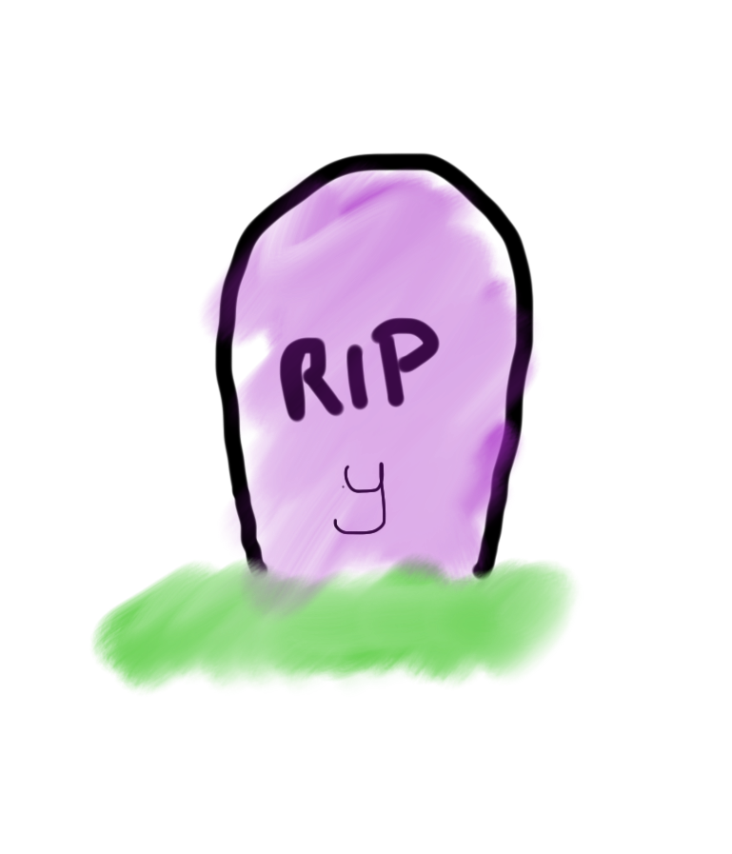
Tragedy Strikes
int x = 5;
if(lookingForLove()) {
int y = 5;
}
println(x + y);
5
x

Slide 89
Noooooooooooooooo!

Slide 90
You see…
when a program exits a code block,
all variables declared inside that block go away!

Slide 91
Since y is inside the if-block…
int x = 5;
if(lookingForLove()) {
int y = 5;
}
println(x + y);
5
x

Slide 92
…it goes away here…
int x = 5;
if(lookingForLove()) {
int y = 5;
}
println(x + y);
5
x

Slide 93
…and doesn’t exist here.
int x = 5;
if(lookingForLove()) {
int y = 5;
}
println(x + y);
Error. Undefined variable y.
5
x

Slide 94
The End

Slide 95
Sad times ☹

Slide 96
Variable Scope
Variables have a lifetime (called scope):
public void run(){
double v = 8;
if(condition){
v = 4;
… some code
}
… some other code
}

Slide 97
Variable Scope
Variables have a lifetime (called scope):
public void run(){
double v = 8;
if(condition){
v = 4;
… some code
}
… some other code
}

Slide 98
Variable Scope
Variables have a lifetime (called scope):
public void run(){
double v = 8;
if(condition){
v = 4;
… some code
}
… some other code
}
Comes to life here
8
v

Slide 99
Variable Scope
Variables have a lifetime (called scope):
public void run(){
double v = 8;
if(condition){
v = 4;
… some code
}
… some other code
}
This is the inner most
code block in which it was
declared….
4
v

Slide 100
Variable Scope
Variables have a lifetime (called scope):
public void run(){
double v = 8;
if(condition){
v = 4;
… some code
}
… some other code
}
Still alive here…
4
v

Slide 101
Variable Scope
Variables have a lifetime (called scope):
public void run(){
double v = 8;
if(condition){
v = 4;
… some code
}
… some other code
}
4
v
It goes away here (at the end of its code block)

Slide 102

Variable Scope
Variables have a lifetime (called scope):
public void run(){
double v = 8;
if(condition){
v = 4;
… some code
}
… some other code
}
It goes away here (at the end of its code block)

Slide 104
Variable Scope
Variables have a lifetime (called scope):
public void run(){
… some code
if(condition){
int w = 4;
… some code
}
… some other code
}
This is the scope of w

Slide 105
Variable Scope
Variables have a lifetime (called scope):
public void run(){
… some code
if(condition){
int w = 4;
… some code
}
… some other code
}
w is created here
w goes away here (at the end of its code block)

Slide 106
Chapter 2
By Chris

Slide 107
The programmer fixed their bug

Slide 108
…x was looking for love!
int x = 5;
if(lookingForLove()) {
int y = 5;
println(x + y);
}
5
x

Slide 109
…x was looking for love!
int x = 5;
if(lookingForLove()) {
int y = 5;
println(x + y);
}
x was definitely
looking for love
5
x

Slide 110
And met y.
int x = 5;
if(lookingForLove()) {
int y = 5;
println(x + y);
}
5
5
x
y

Slide 111
Since they were both “in scope”…
int x = 5;
if(lookingForLove()) {
int y = 5;
println(x + y);
}
5
5
x
y

Slide 112
…they lived happily ever after.
The end.

Slide 113
Variable Scope
The scope of a variable refers to the section of code where a variable can be accessed.
Scope starts where the variable is declared.
Scope ends at the termination of the code block in which the variable was declared.
A code block is a chunk of code between { } brackets

Slide 114
Recap
Announcements
Recap: Variables and Expressions
Aside: Shorthand Operators + Constants
Revisiting Control Flow
If and While
For
Scope
Next time: Methods in Java
Notes:
No helper hours tomorrow
Please submit if you haven’t already!
No Java features on HW1

