Slide 1
CS 106A, Lecture 22 More Classes
suggested reading:
Java Ch. 6

Slide 2
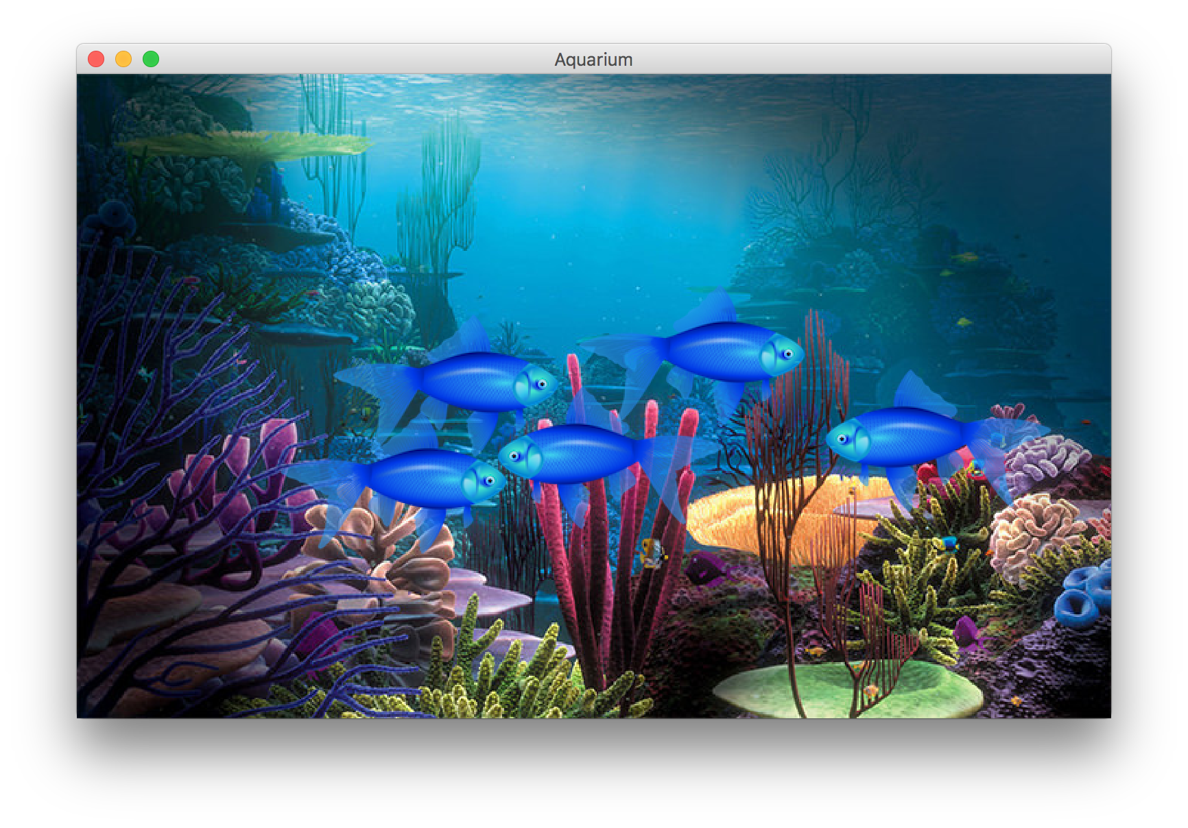
Learning Goals
Know how to define our own variable types
Know how to define variable types that inherit from other types
Be able to write programs consisting of multiple classes

Slide 3
Plan for today
Recap: Classes
toString
this
Example: Employee
Inheritance
Example: Aquarium

Slide 4
Plan for today
Recap: Classes
toString
this
Example: Employee
Inheritance
Example: Aquarium

Slide 5
What Is A Class?
A class defines a new variable type.

Slide 6


Classes Are Like Blueprints
iPod blueprint (class)
state: current song volume battery life
behavior: power on/off change station/song change volume choose random song
constructs
iPod (variable) #1
state: song = "1,000,000 Miles" volume = 17 battery life = 2.5 hrs
behavior: power on/off change station/song change volume choose random song
iPod (variable) #2
state: song = "Letting You" volume = 9 battery life = 3.41 hrs
behavior: power on/off change station/song change volume choose random song
iPod (variable) #3
state: song = "Discipline" volume = 24 battery life = 1.8 hrs
behavior: power on/off change station/song change volume choose random song

Slide 7
What if…
What if we could write a program like this:
BankAccount nickAccount = new BankAccount();
nickAccount.setName(“Nick”);
nickAccount.deposit(50);
BankAccount rishiAccount = new BankAccount();
rishiAccount.setName(“Rishi”);
rishiAccount.deposit(50);
boolean success = rishiAccount.withdraw(10);
if (success) {
println(“Rishi withdrew $10.”);
}

Slide 8
Creating A New Class
What information is inside this new variable type? These are its private instance variables.

Slide 9
Example: BankAccount
// In file BankAccount.java
public class BankAccount {
// Step 1: the data inside a BankAccount
private String name;
private double balance;
}
Each BankAccount object has its own copy
of all instance variables.
Notes:
Not really useful if we can’t do anything with this though!

Slide 10
Creating A New Class
What information is inside this new variable type? These are its instance variables.
What can this new variable type do? These are its public methods.

Slide 11
Example: BankAccount
public class BankAccount {
// Step 1: the data inside a BankAccount
private String name;
private double balance;
// Step 2: the things a BankAccount can do
public void deposit(double amount) {
balance += amount;
}
public boolean withdraw(double amount) {
if (balance >= amount) {
balance -= amount;
return true;
}
return false;
}
}
Notes:
Methods are public so other files can access them

Slide 12
Defining Methods In Classes
ba1
Methods defined in classes can be called
on an instance of that class.
When one of these methods executes,
it can reference that object’s copy of
instance variables.
ba1.deposit(0.20);
ba2.deposit(1000.00);
This means calling one of these methods on different objects has
different effects.
name = "Marty"
balance = 1.45
deposit(amount) {
balance += amount;
}
ba2
name = "Mehran"
balance = 901000.00
deposit(amount) {
balance += amount;
}

Slide 13
Getters and Setters
Instance variables in a class should always be private. This is so only the object itself can modify them, and no-one else.
To allow the client to reference them, we define public methods in the class that set an instance variable’s value and get (return) an instance variable’s value. These are commonly known as getters and setters.
account.setName(“Nick”);
String accountName = account.getName();
Getters and setters prevent instance variables from being tampered with.

Slide 14
Example: BankAccount
public class BankAccount {
private String name;
private double balance;
...
public void setName(String newName) {
if (newName.length() > 0) {
name = newName;
}
}
public String getName() {
return name;
}
}

Slide 15
Creating A New Class
What information is inside this new variable type? These are its instance variables.
What can this new variable type do? These are its public methods.
How do you create a variable of this type? This is the constructor.

Slide 16
Constructors
BankAccount ba1 = new BankAccount();
BankAccount ba2 = new BankAccount(“Nick”, 50);
The constructor is executed when a new object is created.

Slide 17
Example: BankAccount
public class BankAccount {
// Step 1: the data inside a BankAccount
private String name;
private double balance;
// Step 2: the things a BankAccount can do (omitted)
// Step 3: how to create a BankAccount
public BankAccount(String accountName, double startBalance) {
name = accountName;
balance = startBalance;
}
public BankAccount(String accountName) {
name = accountName;
balance = 0;
}
}
Notes:
Methods are public so other files can access them

Slide 18
Using Constructors
ba1
BankAccount ba1 =
new BankAccount("Marty", 1.25);
BankAccount ba2 =
new BankAccount("Mehran", 900000.00);
When you call a constructor (with new):
Java creates a new object of that class.
The constructor runs, on that new object.
The newly created object is returned to your program.
name = "Marty"
balance = 1.25
BankAccount(nm, bal) {
name = nm;
balance = bal;
}
ba2
name = "Mehran"
balance = 900000.00
BankAccount(nm, bal) {
name = nm;
balance = bal;
}

Slide 19
Plan for today
Recap: Classes
toString
this
Example: Employee
Inheritance
Example: Aquarium

Slide 20
Printing Variables
By default, Java doesn't know how to print objects.
// ba1 is BankAccount@9e8c34
BankAccount ba1 = new BankAccount("Marty", 1.25);
println("ba1 is " + ba1);
// better, but cumbersome to write
// ba1 is Marty with $1.25
println("ba1 is " + ba1.getName() + " with $"
+ ba1.getBalance());
// desired behavior
println("b1 is " + ba1); // ba1 is Marty with $1.25

Slide 21
The toString Method
A special method in a class that tells Java how to convert an object
into a string.
BankAccount ba1 = new BankAccount("Marty", 1.25);
println("ba1 is " + ba1);
// the above code is really calling the following:
println("ba1 is " + ba1.toString());
Every class has a toString, even if it isn't in your code.
Default: class's name @ object's memory address (base 16)
BankAccount@9e8c34

Slide 22
The toString Method
public String toString() {
code that returns a String
representing this object;
}
Method name, return, and parameters must match exactly.
Example:
// Returns a String representing this account.
public String toString() {
return name + " has $" + balance;
}

Slide 23
Plan for today
Recap: Classes
toString
this
Example: Employee
Inheritance
Example: Aquarium

Slide 24
The “this” Keyword
this: Refers to the object on which a method is currently being called
BankAccount ba1 = new BankAccount();
ba1.deposit(5);
// in BankAccount.java
public void deposit(double amount) {
// for code above, “this” -> ba1
...
}

Slide 25
Using “this”
Sometimes we want to name parameters the same as instance variables.
public class BankAccount {
private double balance;
private String name;
...
public void setName(String newName) {
name = newName;
}
}
Here, the parameter to setName is named newName to be distinct from the object's field name .

Slide 26
Using “this”
public class BankAccount {
private double balance;
private String name;
...
public void setName(String name) {
name = name;
}
}

Slide 27
Using “this”
We can use “this” to specify which one is the instance variable
and which one is the local variable.
public class BankAccount {
private double balance;
private String name;
...
public void setName(String name) {
this.name = name;
}
}

Slide 28
Plan for today
Recap: Classes
toString
this
Example: Employee
Inheritance
Example: Aquarium

Slide 29
Practice: Employee
Let’s define a new variable type called Employee that represents a single Employee.
What information would an Employee store?
What could an Employee do?
How would you create a new Employee variable?

Slide 30
Plan for today
Recap: Classes
toString
this
Example: Employee
Inheritance
Example: Aquarium

Slide 31
Inheritance
Inheritance lets us relate our variable types to one another.

Slide 32
Inheritance
Variable types can seem to “inherit” from each other. We don’t want to have to duplicate code for each one!
Employee
Programmer
Karel Programmer

Slide 33
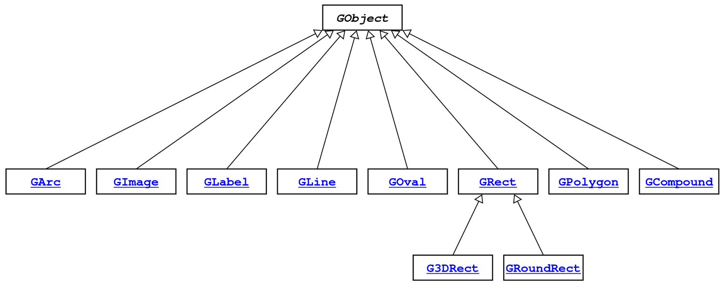
Example: GObjects
The Stanford library uses an inheritance hierarchy of graphical objects based on a common superclass named GObject.

Slide 34
Example: GObjects
GObject defines the state and behavior common to all shapes:
contains(x, y)
getColor(), setColor(color)
getHeight(), getWidth(), getLocation(), setLocation(x, y)
getX(), getY(), setX(x), setY(y), move(dx, dy)
setVisible(visible), sendForward(), sendBackward()
toString()
The subclasses add state and behavior unique to them:
GLabel GLine GPolygon
get/setFont get/setStartPoint addEdge
get/setLabel get/setEndPoint addVertex
get/setFillColor
... ... ..

Slide 35
Using Inheritance
public class Name extends Superclass {
Example:
public class Programmer extends Employee {
...
}
By extending Employee, this tells Java that Programmer can do everything an Employee can do, plus more.
Programmer automatically inherits all of the code from Employee!
The superclass is Employee, the subclass is Programmer.

Slide 36
Example: Programmer
public class Programmer extends Employee {
private int timeCoding;
public void code() { timeCoding += 10;
}
}
...
Programmer rishi = new Programmer(“Rishi”);
rishi.code(); // from Programmer
rishi.promote(); // from Employee!
Notes:
If you add functionality to Employee it adds everywhere

Slide 37
Example: KarelProgrammer
public class KarelProgrammer extends Programmer {
private int numBeepersPicked();
public void pickBeepers() { numBeepersPicked += 2;
}
}
...
KarelProgrammer nick = new KarelProgrammer(“Nick”);
nick.pickBeepers(); // from KarelProgrammer
nick.code(); // from Programmer!
nick.promote(); // From Employee!

Slide 38
GCanvas
A GCanvas is the canvas area that displays all graphical objects in a GraphicsProgram.
When you create a GraphicsProgram, it automatically creates a GCanvas for itself, puts it on the screen, and uses it to add all graphical shapes.
GCanvas is the one that contains methods like:
getElementAt
add
remove
getWidth
getHeight
…

Slide 39
GCanvas
public class Graphics extends GraphicsProgram {
public void run() { // A GCanvas has been created for us! GRect rect = new GRect(50, 50);
add(rect); // adds to the GCanvas!
...
// Checks our GCanvas for elements!
GObject obj = getElementAt(25, 25);
}
}

Slide 40
Extending GCanvas
public class Graphics extends Program {
public void run() { // We have to make our own GCanvas now
MyCanvas canvas = new MyCanvas();
add(canvas);
// Can’t do this anymore, because we are
// not using GraphicsProgram’s provided
// canvas
GObject obj = getElementAt(…);
}
}
Notes:
We CAN say canvas.getElementAt, but we want to decompose all our graphics code out into the MyCanvas file

Slide 41
Extending GCanvas
public class MyCanvas extends GCanvas {
public void addCenteredSquare(int size) {
GRect rect = new GRect(size, size);
int x = getWidth() / 2.0 –
rect.getWidth() / 2.0;
int y = getHeight() / 2.0 –
rect.getHeight() / 2.0;
add(rect, x, y);
}
}

Slide 42
Extending GCanvas
public class Graphics extends Program {
public void run() { // We have to make our own GCanvas now
MyCanvas canvas = new MyCanvas();
add(canvas);
canvas.addCenteredSquare(20);
}
}

Slide 43
Extending GCanvas
Sometimes, we want to be able to have all of our graphics-related code in a separate file.
To do this, instead of using the provided GraphicsProgram canvas, we define our own subclass of GCanvas, have our program extend Program, and add our own canvas ourselves.
Then, all graphics-related code can go in our GCanvas subclass.

Slide 44
Plan for today
Recap: Classes
toString
this
Example: Employee
Inheritance
Example: Aquarium

Slide 45
Example: Aquarium
Let’s write a graphical program called Aquarium that simulates fish swimming around.
To decompose our code, we can make our own GCanvas subclass.

Slide 46
Recap
Classes let us define our own variable types, with their own instance variables, methods and constructors.
We can relate our variable types to one another by using inheritance. One class can extend another to inherit its behavior.
We can extend GCanvas in a graphical program to decompose all of our graphics-related code in one place.
Next time: Interactors and GUIs

Slide 47
Plan for today
Recap: Classes
toString
this
Example: Employee
Inheritance
Example: Aquarium

