Slide 1
CS 106A, Lecture 13 Animation
reading:
Art & Science of Java, Ch. 9

Slide 2
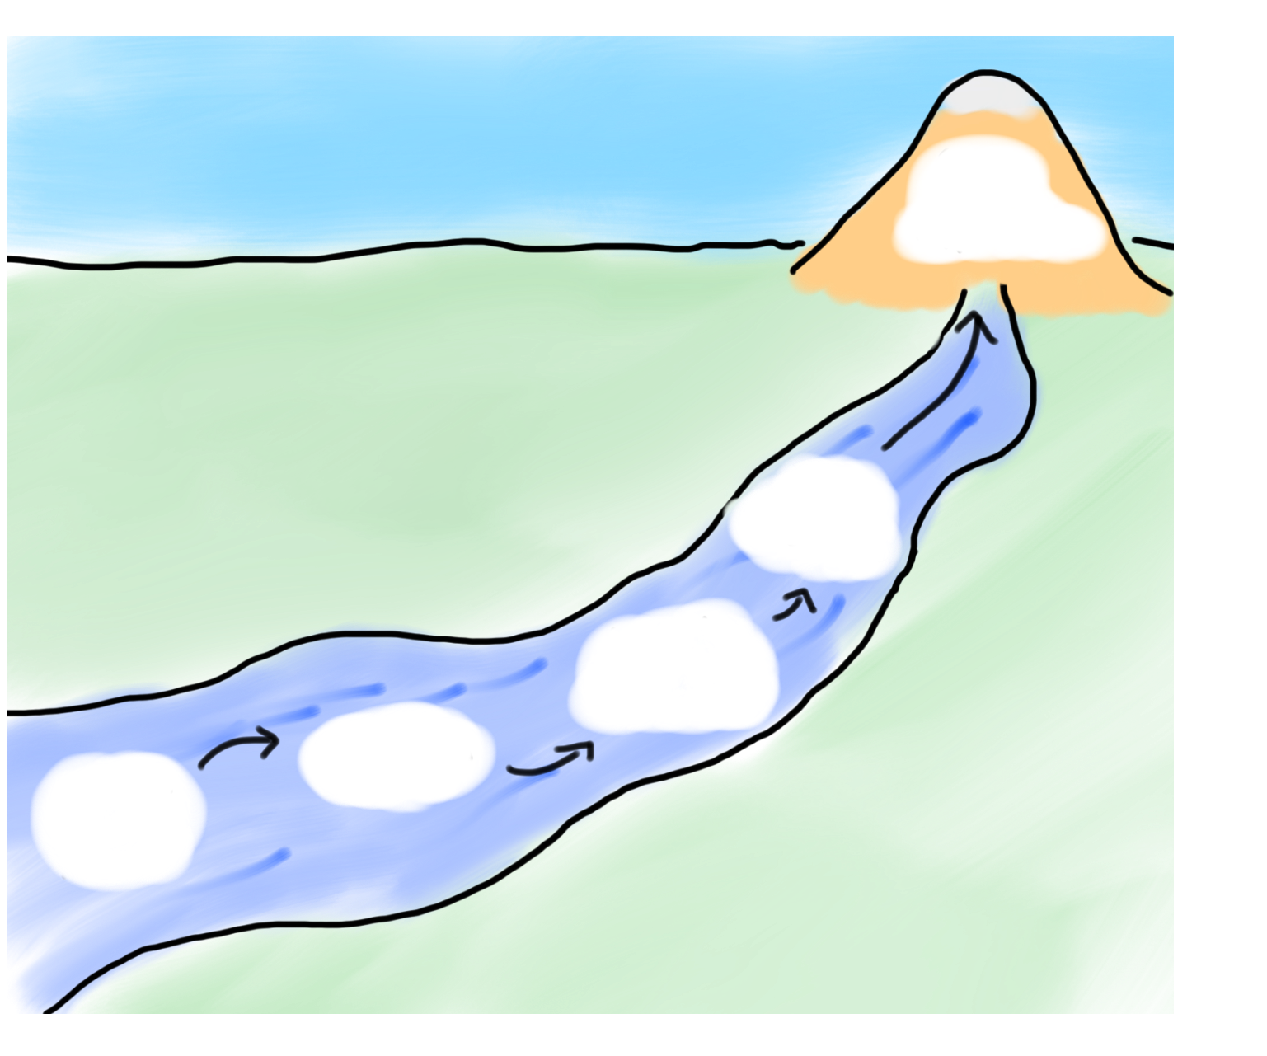
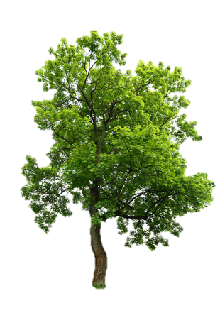
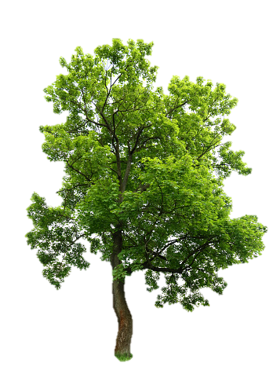

HW4:
Breakout
Memory
The River of Java
You are here
Events
Animation
Graphics
Programs

Slide 3
Plan For Today
Announcements
Midterm
Animation
Practice: Animated Square
Practice: DribbleCastle

Slide 4
Plan For Today
Announcements
Midterm
Animation
Practice: Animated Square
Practice: DribbleCastle

Slide 5
Plan For Today
Announcements
Midterm
Animation
Practice: Animated Square
Practice: DribbleCastle

Slide 6
Simple animation
A Graphics program can be made to animate with a loop such as:
public void run() {
...
while (test) {
update the position of shapes;
pause(milliseconds);
}
}
The best number of ms to pause depends on the program.
most video games ~= 50 frames/sec = 25ms pause

Slide 7
Graphical methods
These methods in graphical objects can be useful for animation:
The GraphicsProgram itself has these methods, too:
Method | Description
obj.getX() | the left x-coordinate of the shape
obj.getY() | the top y-coordinate of the shape
obj.getWidth() | number of pixels wide the shape is
obj.getHeight() | number of pixels tall the shape is
obj.move(dx, dy); | adjusts location by the given amount
obj.setLocation(x, y); | change the object's x/y position
obj.setSize(w, h); | change the object's width*height size
getWidth() | number of pixels wide the window is
getHeight() | number of pixels tall the window is
setSize(w, h) | change the window's width*height size

Slide 8
Plan For Today
Announcements
Midterm
Animation
Practice: Animated Square
Practice: DribbleCastle

Slide 9
Recap
Announcements
Midterm
Animation
Practice: Animated Square
Practice: DribbleCastle
Next Time: Interactive Graphics Programs

