Slide 1
CS 106A, Lecture 2 Programming with Karel
suggested reading:
Karel, Ch. 3-4

Slide 2

Plan For Today
Announcements
(Re)Meet Karel the Robot
Control Flow
For loops
While loops
If/else statements

Slide 3

Plan For Today
Announcements
(Re)Meet Karel the Robot
Control Flow
For loops
While loops
If/else statements

Slide 4
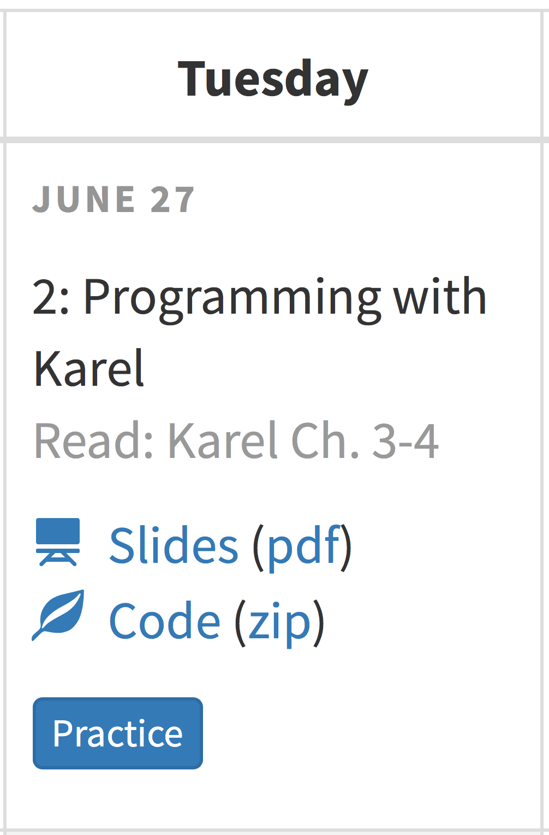
Announcements
Section assignments
Office Hours
Karel Handout (#3)
Lecture Feedback
Extra Practice

Slide 5
Plan For Today
Announcements
(Re)Meet Karel the Robot
Control Flow
For loops
While loops
If/else statements

Slide 6
Meet Karel the Robot!
Notes:
Karel – from Karel Chopek, who invented the word “robot”
Old Mac with leg out its back

Slide 7
Meet Karel the Robot!
Hello, world!
Notes:
Karel speaks Java! (not english)

Slide 8
Karel's World
3
.
.
.
.
.
2
.
.
.
.
.
1
.
.
.
.
.
1
2
3
4
5

Slide 9
Streets (rows)
3
.
.
.
.
.
2
.
.
.
.
.
1
.
.
.
.
.
1
2
3
4
5
Each row is called a street.

Slide 10
Avenues (columns)
3
.
.
.
.
.
2
.
.
.
.
.
1
.
.
.
.
.
1
2
3
4
5
Each column is called an avenue.

Slide 11
Corners (locations)
3
.
.
.
.
.
2
.
.
.
.
.
1
.
.
.
.
.
The intersection of a street and an avenue is a corner.
1
2
3
4
5

Slide 12
Walls
3
.
.
.
.
.
2
.
.
.
.
.
1
.
.
.
.
.
1
2
3
4
5
Karel cannot move through walls.

Slide 13
Beepers
3
.
.
.
.
.
2
.
.
.
.
.
1
.
.
.
.
.
Beepers mark locations in Karel's world. Karel can pick them up and put them down.
1
2
3
4
5

Slide 14

Karel Knows 4 Commands
move
turnLeft
putBeeper
pickBeeper

Slide 15
Karel Knows 4 Commands
move
turnLeft
“methods”
putBeeper
pickBeeper

Slide 16
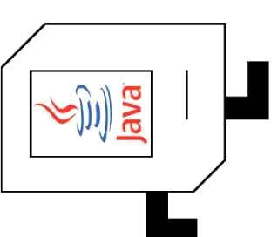
Commands: move
move makes Karel move forward one square in the direction it is facing.
Karel Commands
3
.
.
.
.
.
move
turnLeft
pickBeeper
putBeeper
2
.
.
.
.
.
1
.
.
.
.
.
.
1
2
3
4
5

Slide 17
Commands: move
move makes Karel move forward one square in the direction it is facing.
Karel Commands
3
.
.
.
.
.
move
turnLeft
pickBeeper
putBeeper
2
.
.
.
.
.
1
.
.
.
.
.
.
1
2
3
4
5

Slide 18
Commands: turnLeft
turnLeft makes Karel rotate 90° counter-clockwise.
There is no turnRight command. (Why not?)
Karel Commands
3
.
.
.
.
.
move
turnLeft
pickBeeper
putBeeper
2
.
.
.
.
.
1
.
.
.
.
.
.
1
2
3
4
5

Slide 19
Commands: turnLeft
turnLeft makes Karel rotate 90° counter-clockwise.
There is no turnRight command. (Why not?)
Karel Commands
3
.
.
.
.
.
move
turnLeft
pickBeeper
putBeeper
2
.
.
.
.
.
1
.
.
.
.
.
.
1
2
3
4
5

Slide 20
Commands: pickBeeper
pickBeeper makes Karel pick up the beeper at the current corner. Karel can hold multiple beepers at a time in its "beeper bag".
Karel Commands
3
.
.
.
.
.
move
turnLeft
pickBeeper
putBeeper
2
.
.
.
.
.
1
.
.
.
.
.
.
1
2
3
4
5

Slide 21
Commands: pickBeeper
pickBeeper makes Karel pick up the beeper at the current corner. Karel can hold multiple beepers at a time in its "beeper bag".
Karel Commands
3
.
.
.
.
.
move
turnLeft
pickBeeper
putBeeper
2
.
.
.
.
.
1
.
.
.
.
.
.
1
2
3
4
5

Slide 22
Commands: putBeeper
putBeeper makes Karel put a beeper down at its current location.
pickBeeper and putBeeper are used to move beepers around.
Karel Commands
3
.
.
.
.
.
move
turnLeft
pickBeeper
putBeeper
2
.
.
.
.
.
1
.
.
.
.
.
.
1
2
3
4
5
Notes:
beeper bag

Slide 23
Commands: putBeeper
putBeeper makes Karel put a beeper down at its current location.
pickBeeper and putBeeper are used to move beepers around.
Karel Commands
3
.
.
.
.
.
move
turnLeft
pickBeeper
putBeeper
2
.
.
.
.
.
1
.
.
.
.
.
.
1
2
3
4
5
Notes:
beeper bag

Slide 24
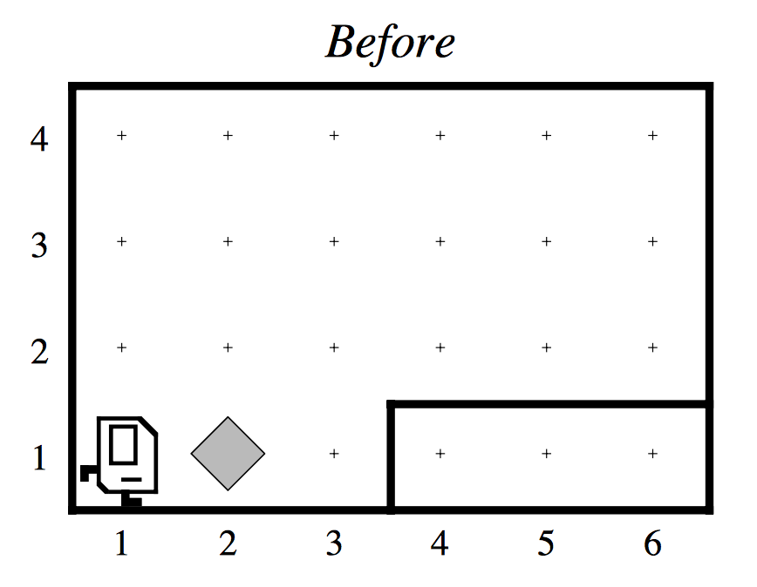
Our First Karel Program

Slide 25
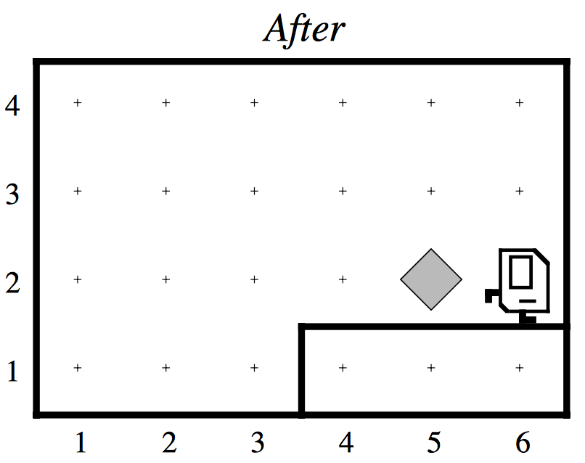
Our First Karel Program

Slide 26
Demo

Slide 27
Defining New Commands
We can make new commands (or methods) for Karel. This lets us decompose our program into smaller pieces that are easier to understand.
private void name() {
statement;
statement;
...
}
For example:
private void turnRight() {
turnLeft();
turnLeft();
turnLeft();
}

Slide 28
Plan For Today
Announcements
(Re)Meet Karel the Robot
Control Flow
For loops
While loops
If/else statements

Slide 29
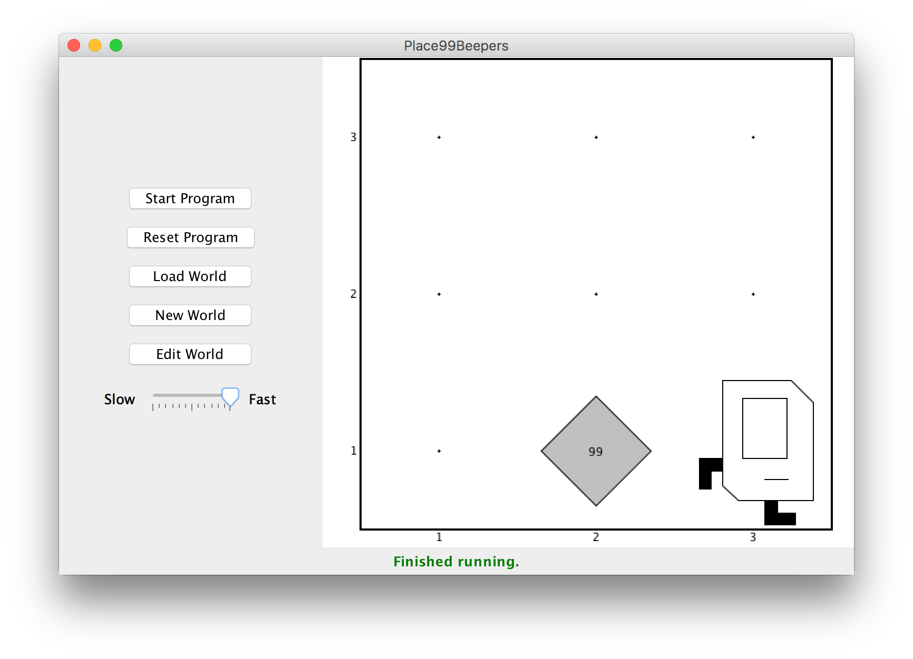
Control Flow: For Loops
I want to make Karel put 99 beepers down on a corner. How do I do this?

Slide 30
Control Flow: For Loops
Can’t just say:
move();
putBeeper();
putBeeper();
putBeeper();
...
move();
This is too repetitive! Plus, it’s difficult to change (e.g. to 25 beepers).

Slide 31
Control Flow: For Loops
Instead, use a for loop:
for (int i = 0; i < max; i++) {
statement;
statement;
...
}
Repeats the statements in the body max times.
Notes:
Executes statements in order – NOT repeating each one individually

Slide 32
Control Flow: For Loops
Now we can say:
move();
for (int i = 0; i < 99; i++) {
putBeeper();
}
move();
This is less repetitive, and is easier to change (e.g. to 25 beepers).

Slide 33
Control Flow: For Loops
Some examples of using for loops:
// turns Karel right
for (int i = 0; i < 3; i++) {
turnLeft();
}
// Moves Karel in a square
for (int i = 0; i < 4; i++) {
move();
turnLeft();
}

Slide 34
Plan For Today
Announcements
(Re)Meet Karel the Robot
Control Flow
For loops
While loops
If/else statements

Slide 35
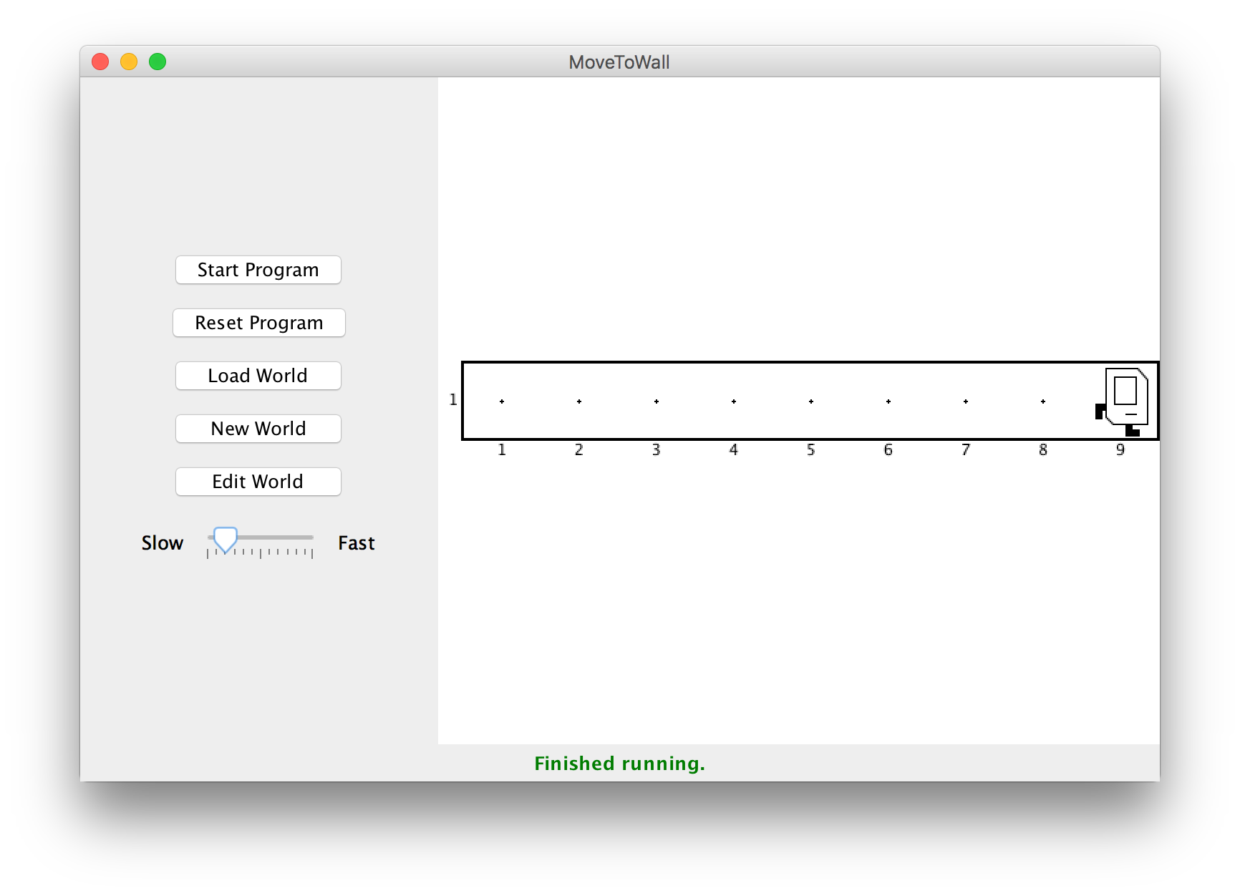
Control Flow: While Loops
I want Karel to move until it gets to a wall. How do I do this?

Slide 36
Control Flow: While Loops
Can’t just say:
move();
move();
move();
move();
...
This is too repetitive! Also, we might not know how far away a wall is. Plus, we want our program to be as generalized as possible and work in many different worlds.

Slide 37
Control Flow: While Loops
Instead, use a while loop:
while (condition) {
statement;
statement;
...
}
Repeats the statements in the body until condition is no longer true.
Each time, Karel executes all statements, and then checks the condition.
Notes:
Karel can ask some questions about its world / surroundings

Slide 38
Possible Conditions
Test | Opposite | What it checks
frontIsClear() | frontIsBlocked() | Is there a wall in front of Karel?
leftIsClear() | leftIsBlocked() | Is there a wall to Karel’s left?
rightIsClear() | rightIsBlocked() | Is there a wall to Karel’s right?
beepersPresent() | noBeepersPresent() | Are there beepers on this corner?
beepersInBag() | noBeepersInBag() | Any there beepers in Karel’s bag?
facingNorth() | notFacingNorth() | Is Karel facing north?
facingEast() | notFacingEast() | Is Karel facing east?
facingSouth() | notFacingSouth() | Is Karel facing south?
facingWest() | notFacingWest() | Is Karel facing west?
This is Table 1 on page 18 of the Karel coursereader.

Slide 39
Control Flow: While Loops
Now we can say:
while (frontIsClear()) {
move();
}
This is less repetitive, and it works in any size world!

Slide 40
Control Flow: While Loops
while loops can have compound conditions as well:
// “and”
while (frontIsClear() && beepersPresent()) {
...
}
// “or”
while (leftIsClear() || rightIsClear()) {
...
}
Notes:
Karel can ask some questions about its world / surroundings

Slide 41
Loops Overview
I want Karel to repeat some commands!
Know how many times
Don’t know how many times
for loop
while loop
Notes:
E.g. “pick up all the beepers on this square”
E.g. “turn until you’re facing west”
E.g. “put down 5 beepers”

Slide 42
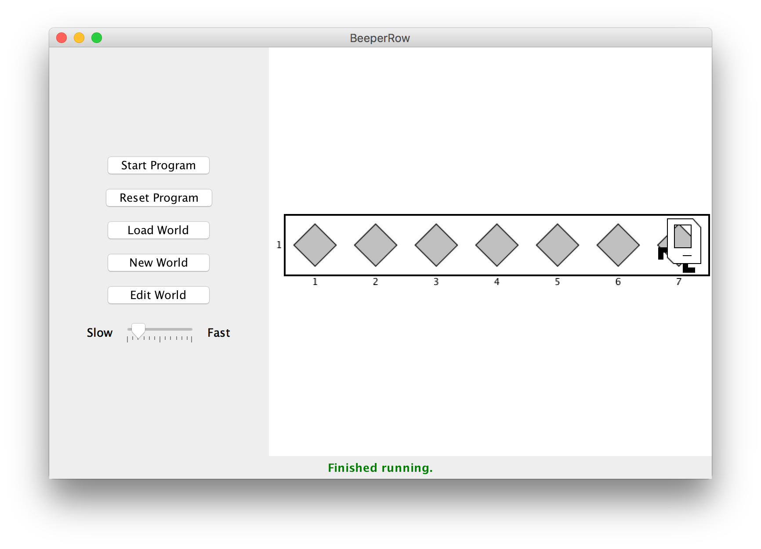
Loops Overview
I want Karel to put down a row of beepers until it reaches a wall. How do I do this?

Slide 43
Demo

Slide 44

Fencepost Problem
8 fence segments, but 9 posts!

Slide 45
Fencepost Structure
The fencepost structure is useful when you want to loop a set of statements, but do one part of that set 1 additional time.
putBeeper(); // post
while (frontIsClear()) {
move(); // fence
putBeeper(); // post
}
while (frontIsClear()) {
putBeeper(); // post
move(); // fence
}
putBeeper(); // post

Slide 46
Plan For Today
Announcements
(Re)Meet Karel the Robot
Control Flow
For loops
While loops
If/else statements

Slide 47
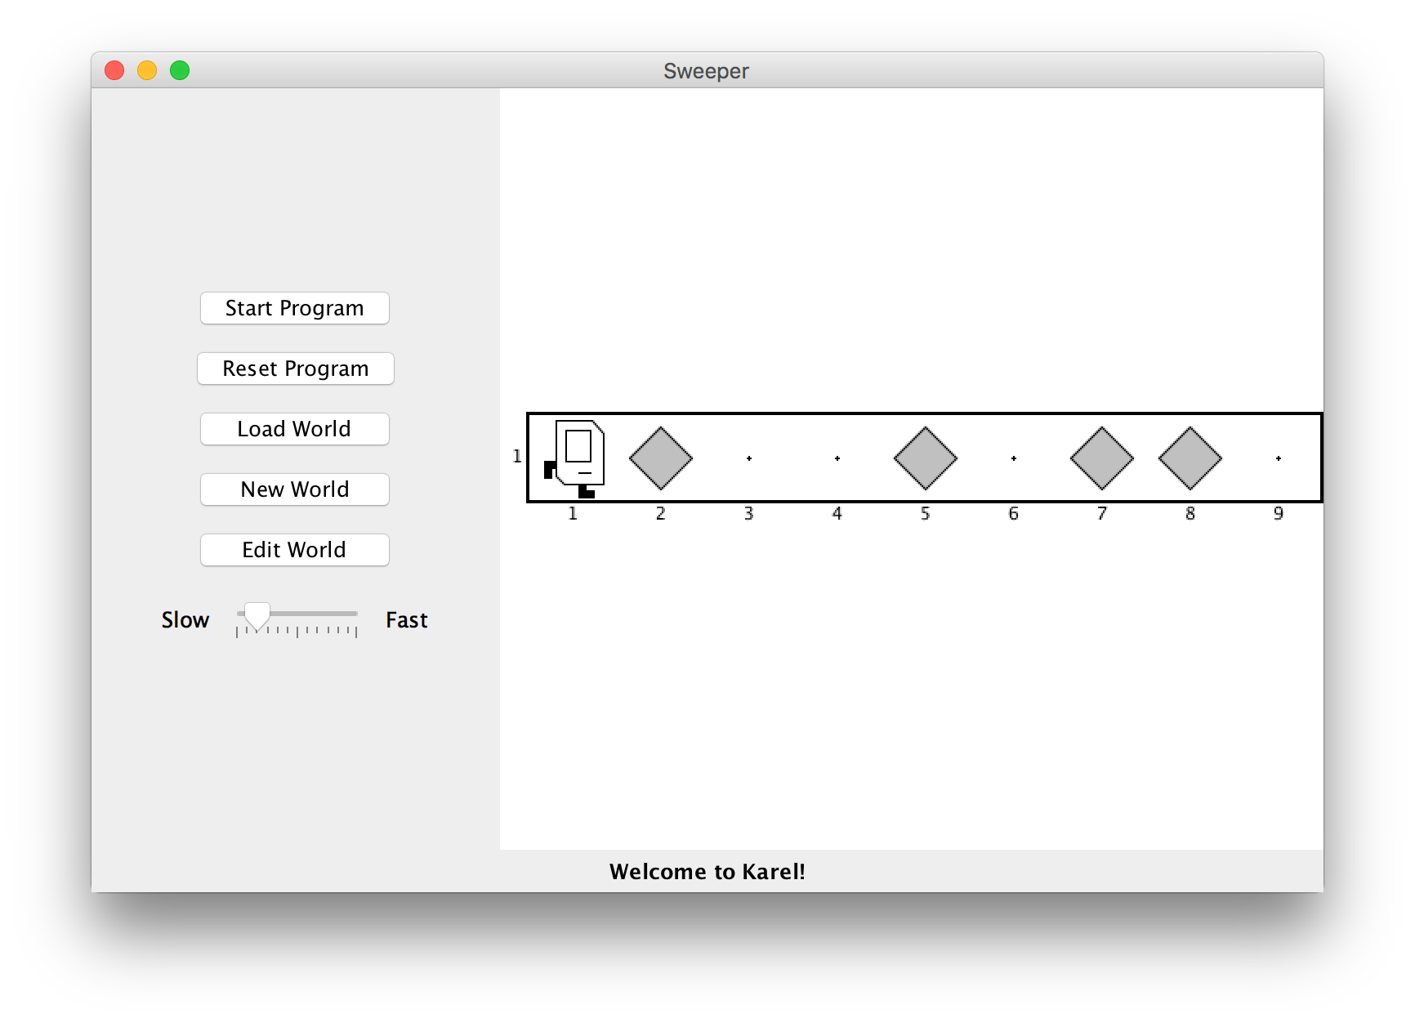
If/Else Statements
I want to make Karel clean up all beepers in front of it until it reaches a wall. How do I do this?

Slide 48
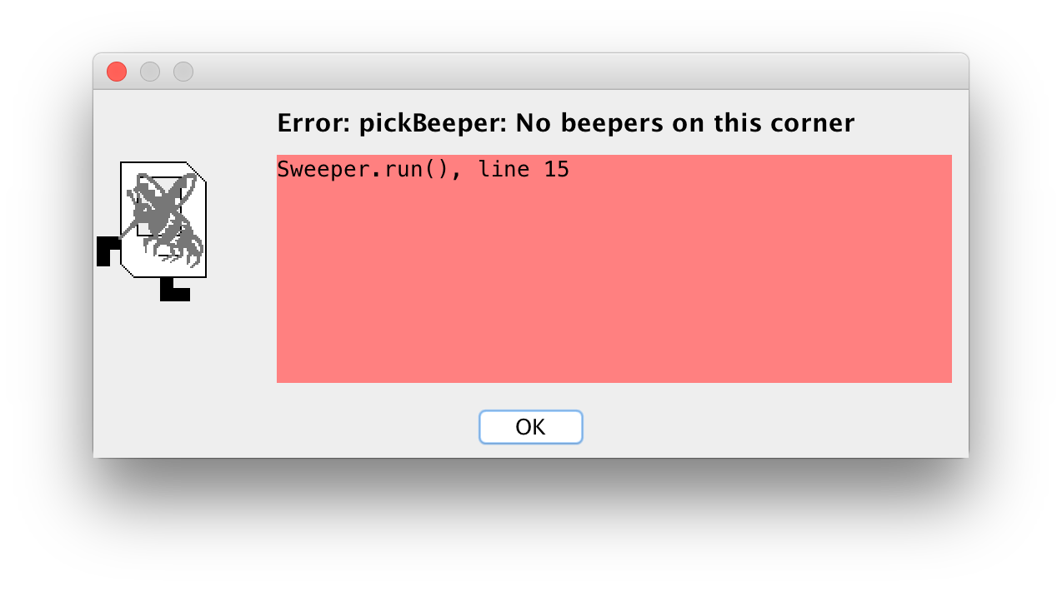
If/Else Statements
Can’t just say:
while (frontIsClear()) {
move();
pickBeeper();
}
This may crash, because Karel cannot pick up beepers if there aren’t any. We don’t always want Karel to pick up beepers; just when there is a beeper to pick up.

Slide 49
If/Else Statements
Instead, use an if statement:
if (condition) {
statement;
statement;
...
}
Runs the statements in the body once if condition is true.
Notes:
Karel can ask some questions about its world / surroundings

Slide 50
If/Else Statements
You can also add an else statement:
if (condition) {
statement;
statement;
...
} else {
statement;
statement;
...
}
Runs the first group of statements if condition is true; otherwise, runs the second group of statements.
Notes:
Karel can ask some questions about its world / surroundings

Slide 51
If/Else Statements
Now we can say:
while (frontIsClear()) {
if (beepersPresent()) {
pickBeeper();
}
}
Now, Karel won’t crash because it will only pickBeeper if there is one.

Slide 52
Recap
Announcements
(Re)Meet Karel the Robot
Control Flow
For loops
While loops
If/else statements
Next time: Karel Problem-Solving

