Slide 1
CS 106A, Lecture 3 Problem-solving with Karel
suggested reading:
Karel, Ch. 5-6

Slide 2

Plan For Today
Announcements
Recap: Control Flow
Demo: HurdleJumper
Decomposition
Practice: Roomba
Debugging

Slide 3
Plan For Today
Announcements
Recap: Control Flow
Demo: HurdleJumper
Decomposition
Practice: Roomba
Debugging

Slide 4

Karel Knows 4 Commands
move
turnLeft
putBeeper
pickBeeper

Slide 5
Karel Knows 4 Commands
move
turnLeft
“methods”
putBeeper
pickBeeper

Slide 6
Defining New Commands
We can make new commands (or methods) for Karel. This lets us decompose our program into smaller pieces that are easier to understand.
private void name() {
statement;
statement;
...
}
For example:
private void turnRight() {
turnLeft();
turnLeft();
turnLeft();
}

Slide 7
Control Flow: For Loops
for (int i = 0; i < max; i++) {
statement;
statement;
...
}
Repeats the statements in the body max times.
Notes:
Executes statements in order – NOT repeating each one individually

Slide 8
Control Flow: While Loops
while (condition) {
statement;
statement;
...
}
Repeats the statements in the body until condition is no longer true.
Each time, Karel executes all statements, and then checks the condition.
Notes:
Karel can ask some questions about its world / surroundings

Slide 9
Possible Conditions
Test | Opposite | What it checks
frontIsClear() | frontIsBlocked() | Is there a wall in front of Karel?
leftIsClear() | leftIsBlocked() | Is there a wall to Karel’s left?
rightIsClear() | rightIsBlocked() | Is there a wall to Karel’s right?
beepersPresent() | noBeepersPresent() | Are there beepers on this corner?
beepersInBag() | noBeepersInBag() | Any there beepers in Karel’s bag?
facingNorth() | notFacingNorth() | Is Karel facing north?
facingEast() | notFacingEast() | Is Karel facing east?
facingSouth() | notFacingSouth() | Is Karel facing south?
facingWest() | notFacingWest() | Is Karel facing west?
This is Table 1 on page 18 of the Karel coursereader.

Slide 10
Loops Overview
I want Karel to repeat some commands!
Know how many times
Don’t know how many times
for loop
while loop
Notes:
E.g. “pick up all the beepers on this square”
E.g. “turn until you’re facing west”
E.g. “put down 5 beepers”

Slide 11
Fencepost Structure
The fencepost structure is useful when you want to loop a set of statements, but do one part of that set 1 additional time.
putBeeper(); // post
while (frontIsClear()) {
move(); // fence
putBeeper(); // post
}
while (frontIsClear()) {
putBeeper(); // post
move(); // fence
}
putBeeper(); // post

Slide 12
If/Else Statements
if (condition) {
statement;
statement;
...
} else {
statement;
statement;
...
}
Runs the first group of statements if condition is true; otherwise, runs the second group of statements.
Notes:
Karel can ask some questions about its world / surroundings

Slide 13
Infinite Loops

Slide 14
Infinite Loops
Rinse
Lather
Repeat

Slide 15

Infinite Loops
private void turnToWall() {
while(leftIsClear()) {
turnLeft();
}
}

Slide 16
Infinite Loops
private void turnToWall() {
while(leftIsClear()) {
turnLeft();
}
}

Slide 17
Infinite Loops
private void turnToWall() {
while(leftIsClear()) {
turnLeft();
}
}

Slide 18
Infinite Loops
private void turnToWall() {
while(leftIsClear()) {
turnLeft();
}
}

Slide 19
Infinite Loops
// Karel will keep turning left forever!
private void turnToWall() {
while(leftIsClear()) {
turnLeft();
}
}

Slide 20
Infinite Loops
private void turnToWall() {
while(leftIsClear()) {
if (frontIsBlocked()) {
turnLeft();
}
}
}

Slide 21
Infinite Loops
// Karel will be stuck in this loop forever!
private void turnToWall() {
while(leftIsClear()) {
if (frontIsBlocked()) {
turnLeft();
}
}
}

Slide 22
Plan For Today
Announcements
Recap: Control Flow
Demo: HurdleJumper
Decomposition
Practice: Roomba
Debugging

Slide 23
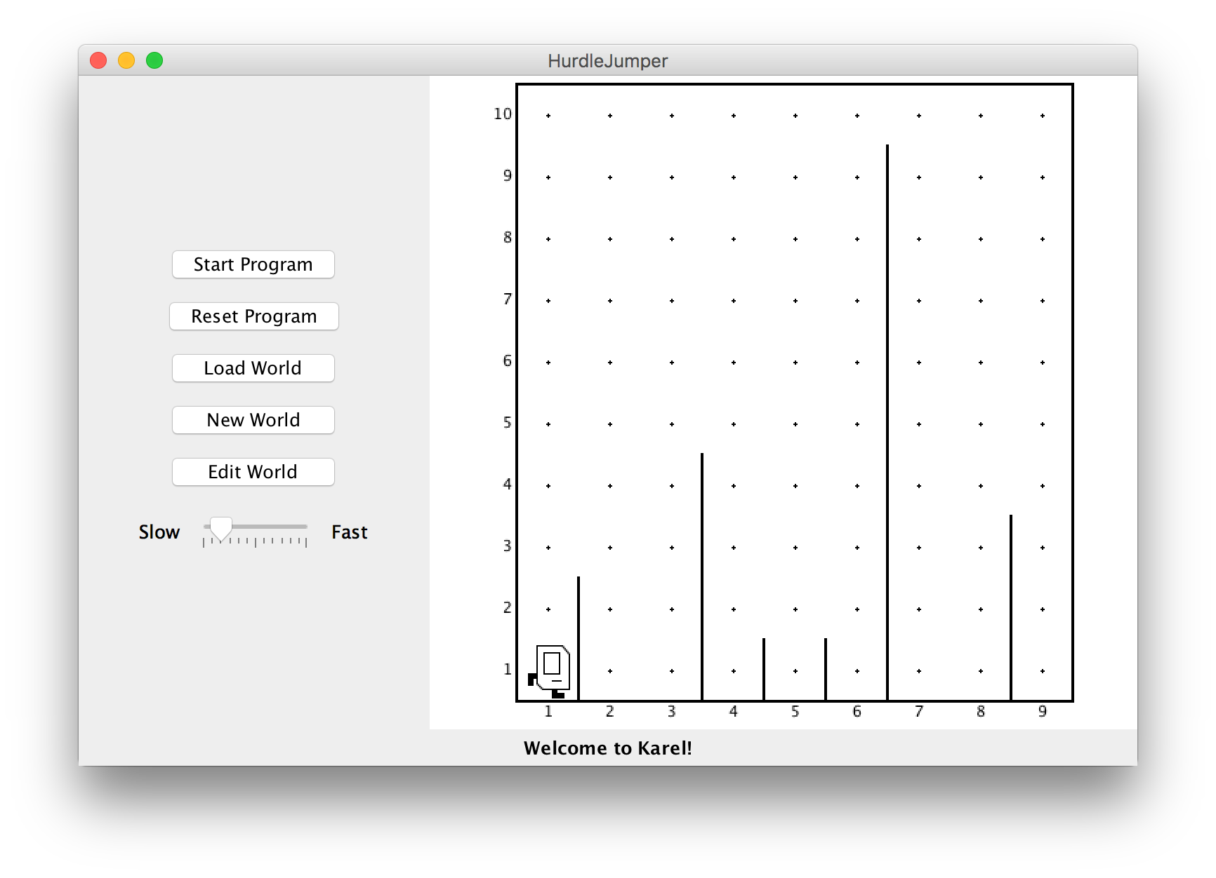
HurdleJumper
We want to write a Karel program that hops hurdles.
Karel starts at (1,1) facing East, and should end up at the end of row 1 facing east.
The world has 9 columns.
There are an unknown number of ”hurdles” (walls) of varying heights that Karel must ascend and descend to get to the other side.

Slide 24
HurdleJumper
Demo

Slide 25
Pre/post comments
precondition: Something you assume is true at the start of a method.
postcondition: Something you promise is true at the end of a method.
pre/post conditions should be documented using comments.
/*
* Jumps Karel over one hurdle of arbitrary height.
* Pre: Karel is facing east, next to a hurdle.
* Post: Karel is facing east at the bottom of the other
* side of the hurdle.
*/
public void jumpHurdle() {
ascendHurdle();
move();
descendHurdle();
}

Slide 26
Plan For Today
Announcements
Recap: Control Flow
Demo: HurdleJumper
Decomposition
Practice: Roomba
Debugging

Slide 27
Decomposition
Breaking down problems into smaller, more approachable sub-problems (e.g. our own Karel commands)
Each piece should solve one problem/task (< ~ 20 lines of code)
Descriptively-named
Well-commented!
E.g. getting up in the morning:
Wake up
Brush teeth
Put toothpaste on toothbrush
Insert toothbrush into mouth
Move toothbrush against teeth
…
…

Slide 28
Top-Down Design
Start from a large task and break it up into smaller pieces
Ok to write your program in terms of commands that don’t exist yet
E.g. HurdleJumper

Slide 29
Plan For Today
Announcements
Recap: Control Flow
Demo: HurdleJumper
Decomposition
Practice: Roomba
Debugging

Slide 30
Practice: Roomba
Write a Roomba Karel that sweeps the entire world of all beepers.
Karel starts at (1,1) facing East.
The world is rectangular, and some squares contain beepers.
There are no interior walls.
When the program is done, the world should contain 0 beepers.
Karel's ending location does not matter.
How should we approach this tricky problem?
8
.
.
.
.
.
.
.
.
7
.
.
.
.
.
.
.
.
6
.
.
.
.
.
.
.
.
5
.
.
.
.
.
.
.
.
4
.
.
.
.
.
.
.
.
3
.
.
.
.
.
.
.
.
2
.
.
.
.
.
.
.
.
1
.
.
.
.
.
.
.
.
1
2
3
4
5
6
7
8

Slide 31
Possible algorithm 1
8
.
.
.
.
.
.
.
.
7
.
.
.
.
.
.
.
.
6
.
.
.
.
.
.
.
.
5
.
.
.
.
.
.
.
.
4
.
.
.
.
.
.
.
.
3
.
.
.
.
.
.
.
.
2
.
.
.
.
.
.
.
.
1
.
.
.
.
.
.
.
.
1
2
3
4
5
6
7
8

Slide 32
Possible algorithm 2
8
.
.
.
.
.
.
.
.
7
.
.
.
.
.
.
.
.
6
.
.
.
.
.
.
.
.
5
.
.
.
.
.
.
.
.
4
.
.
.
.
.
.
.
.
3
.
.
.
.
.
.
.
.
2
.
.
.
.
.
.
.
.
1
.
.
.
.
.
.
.
.
1
2
3
4
5
6
7
8

Slide 33
Possible algorithm 3
8
.
.
.
.
.
.
.
.
7
.
.
.
.
.
.
.
.
6
.
.
.
.
.
.
.
.
5
.
.
.
.
.
.
.
.
4
.
.
.
.
.
.
.
.
3
.
.
.
.
.
.
.
.
2
.
.
.
.
.
.
.
.
1
.
.
.
.
.
.
.
.
1
2
3
4
5
6
7
8

Slide 34
Possible algorithm 4
8
.
.
.
.
.
.
.
.
7
.
.
.
.
.
.
.
.
6
.
.
.
.
.
.
.
.
5
.
.
.
.
.
.
.
.
4
.
.
.
.
.
.
.
.
3
.
.
.
.
.
.
.
.
2
.
.
.
.
.
.
.
.
1
.
.
.
.
.
.
.
.
1
2
3
4
5
6
7
8

Slide 35
Roomba
Demo

Slide 36
Recap
Announcements
Recap: Control Flow
Demo: HurdleJumper
Decomposition
Practice: Roomba
Next time: An introduction to Java

Slide 37
Plan For Today
Announcements
Recap: Control Flow
Demo: HurdleJumper
Decomposition
Practice: Roomba
Debugging

Slide 38
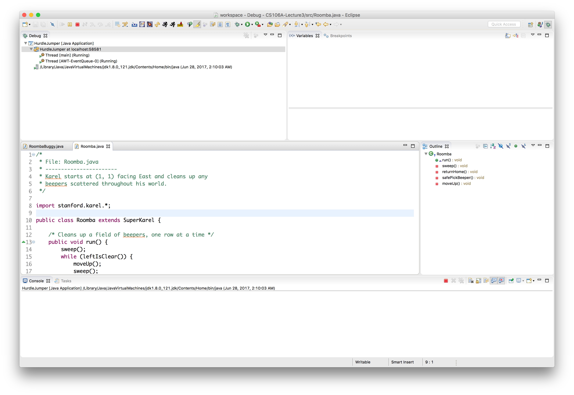
Debugging
Finding and fixing unintended behavior in your programs.
Try to narrow down where in your code you think the bug is occurring. (E.g. what command or set of commands)
We can use Eclipse to help us figure out what our program is doing.

Slide 39
BuggyRoomba
Demo

Slide 40
Recap
Announcements
Recap: Control Flow
Demo: HurdleJumper
Decomposition
Practice: Roomba
Debugging
Next time: An introduction to Java

