Slide 1
CS 106A, Lecture 2 Programming with Karel
suggested reading:
Karel, Ch. 3-4

Slide 2
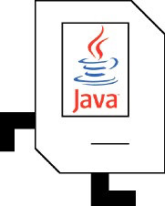
Plan For Today
Meet Karel the Robot
Control Flow
Karel Practice

Slide 3
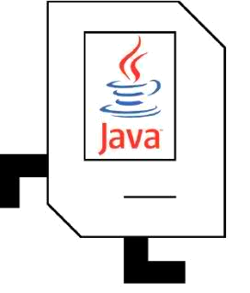
Meet Karel the Robot!
Notes:
Karel – from Karel Chopek, who invented the word “robot”
Old Mac with leg out its back

Slide 4
Meet Karel the Robot!
Hello, world!
Notes:
Karel speaks Java! (not english)

Slide 5
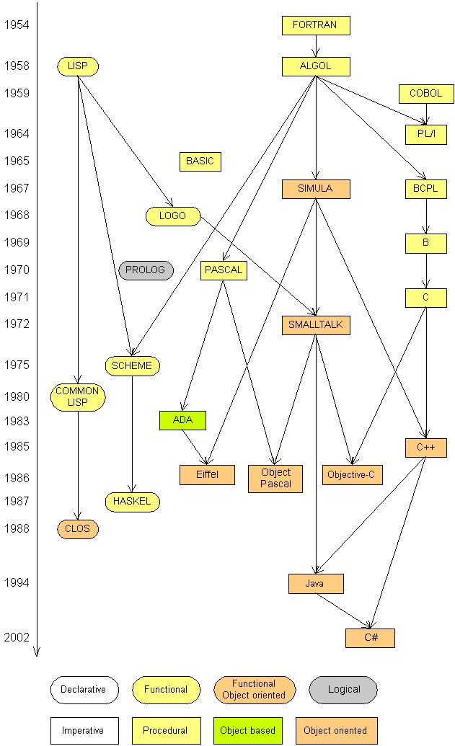
Programming languages
procedural languages: programs are a series of commands
Pascal (1970): designed for education
C (1972): low-level operating systems and devices
functional programming: functions map inputs to outputs
Lisp (1958) / Scheme (1975), ML (1973), Haskell (1990)
object-oriented languages: programs use interacting "objects"
Smalltalk (1980): first major object-oriented language
C++ (1985): "object-oriented" improvements to C
successful in industry; used to build OSes such as Windows
Java (1995): designed for embedded systems, web apps
Runs on many platforms (Windows, Mac, Linux, cell phones...)
The language taught in this course and our textbook
Notes:
Javascript
Swift
Android runs on Java

Slide 6
Karel's World
3
.
.
.
.
.
2
.
.
.
.
.
1
.
.
.
.
.
1
2
3
4
5

Slide 7
Karel's World
3
.
.
.
.
.
2
.
.
.
.
.
1
.
.
.
.
.
1
2
3
4
5

Slide 8
Karel's World
3
.
.
.
.
.
2
.
.
.
.
.
Hello, world!
1
.
.
.
.
.
1
2
3
4
5

Slide 9
Karel's World
3
.
.
.
.
.
2
.
.
.
.
.
1
.
.
.
.
.
1
2
3
4
5

Slide 10
Streets (rows)
3
.
.
.
.
.
2
.
.
.
.
.
1
.
.
.
.
.
1
2
3
4
5
Each row is called a street.

Slide 11
Avenues (columns)
3
.
.
.
.
.
2
.
.
.
.
.
1
.
.
.
.
.
1
2
3
4
5
Each column is called an avenue.

Slide 12
Corners (locations)
3
.
.
.
.
.
2
.
.
.
.
.
1
.
.
.
.
.
The intersection of a street and an avenue is a corner.
1
2
3
4
5

Slide 13
Walls
3
.
.
.
.
.
2
.
.
.
.
.
1
.
.
.
.
.
1
2
3
4
5
Karel cannot move through walls.

Slide 14
Beepers
3
.
.
.
.
.
2
.
.
.
.
.
1
.
.
.
.
.
Beepers mark locations in Karel's world. Karel can pick them up and put them down.
1
2
3
4
5

Slide 15

Karel Knows 4 Commands
move
turnLeft
putBeeper
pickBeeper

Slide 16
Karel commands: move
move makes Karel move forward one square in the direction it is facing.
Karel Commands
3
.
.
.
.
.
move
turnLeft
pickBeeper
putBeeper
2
.
.
.
.
.
1
.
.
.
.
.
.
1
2
3
4
5

Slide 17
Commands: turnLeft
turnLeft makes Karel rotate 90° counter-clockwise.
There is no turnRight command. (Why not?)
Karel Commands
3
.
.
.
.
.
move
turnLeft
pickBeeper
putBeeper
2
.
.
.
.
.
1
.
.
.
.
.
.
1
2
3
4
5

Slide 18
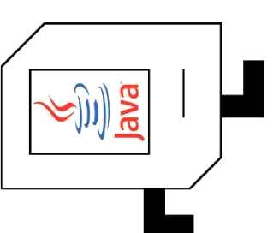
Commands: pickBeeper
pickBeeper makes Karel pick up the beeper at the current corner. Karel can hold multiple beepers at a time in its "beeper bag".
Karel Commands
3
.
.
.
.
.
move
turnLeft
pickBeeper
putBeeper
2
.
.
.
.
.
1
.
.
.
.
.
.
1
2
3
4
5

Slide 19
Commands: putBeeper
putBeeper makes Karel put a beeper down at its current location.
pickBeeper and putBeeper are used to move beepers around.
Karel Commands
3
.
.
.
.
.
move
turnLeft
pickBeeper
putBeeper
2
.
.
.
.
.
1
.
.
.
.
.
.
1
2
3
4
5
Notes:
beeper bag

Slide 20
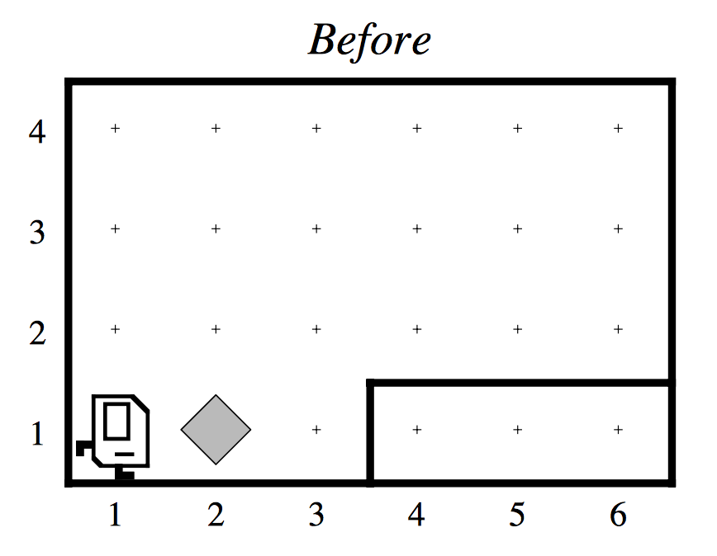
Our First Karel Program

Slide 21
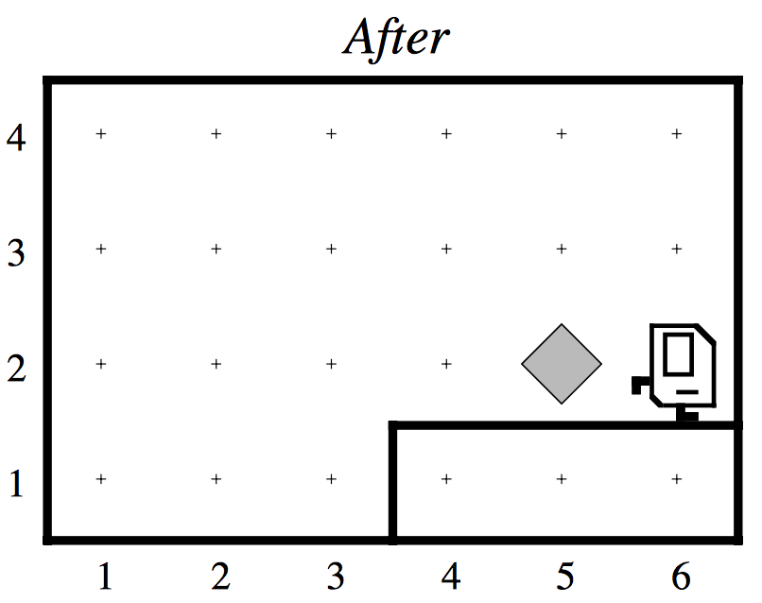
Our First Karel Program

Slide 22
Karel Summary
Karel lives in a grid world with walls and beepers.
4 commands: move, turnLeft, pickBeeper and putBeeper.
Seems simple; but you can do amazing things with Karel!

