Slide 1

Devops_week2
https://github.com/Nicky-Dar/devops_week2

Slide 2
Install ubuntu with WSL
Enabling WSL in Windows 10
Before you can install Ubuntu on WSL, WSL has to be enabled in one of the following ways:
Using the GUI for enabling Windows features :
Open the Start Menu and search Turn Windows features on or off
Select Windows Subsystem for Linux
Click OK
Restart your computer when prompted

Slide 3
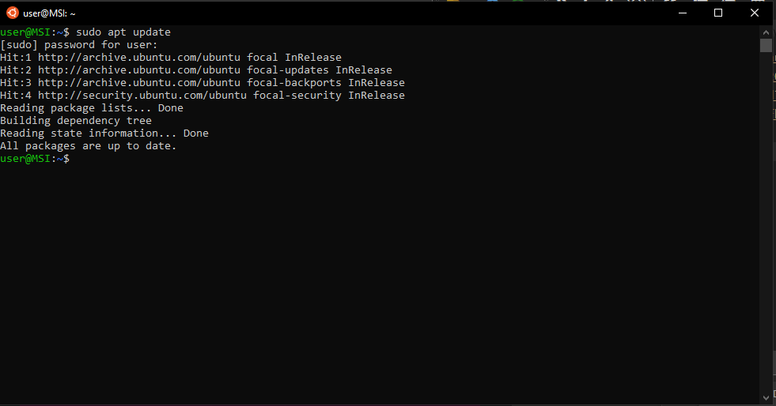
next after installation we can check for updates:
sudo apt update
Install your Linux distribution of choice
Open the Microsoft Store and select your favorite Linux distribution.
Install your Linux distribution.
Starting Ubuntu on WSL
next after installation we can check for updates:
sudo apt update

Slide 4
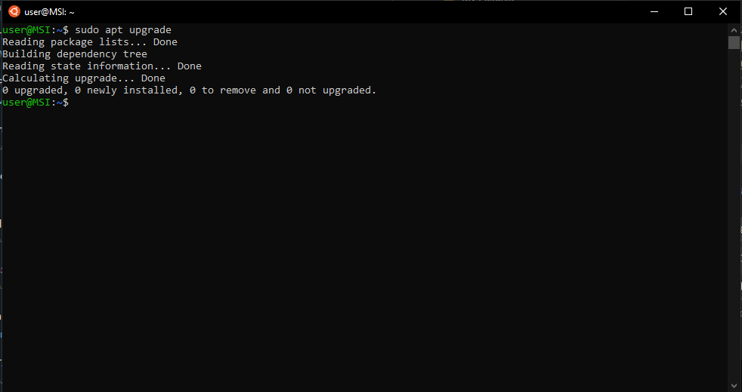
Sudo apt upgrade

Slide 5
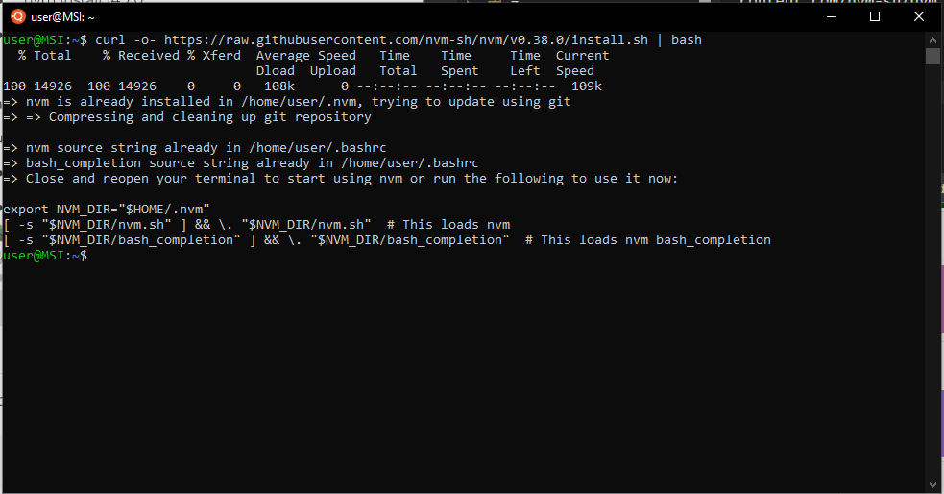
Node.js Installation & Config
Open your Terminal
To install node.js use the following command:
curl -o- https://raw.githubusercontent.com/nvm-sh/nvm/v0.38.0/install.sh | bash

Slide 6
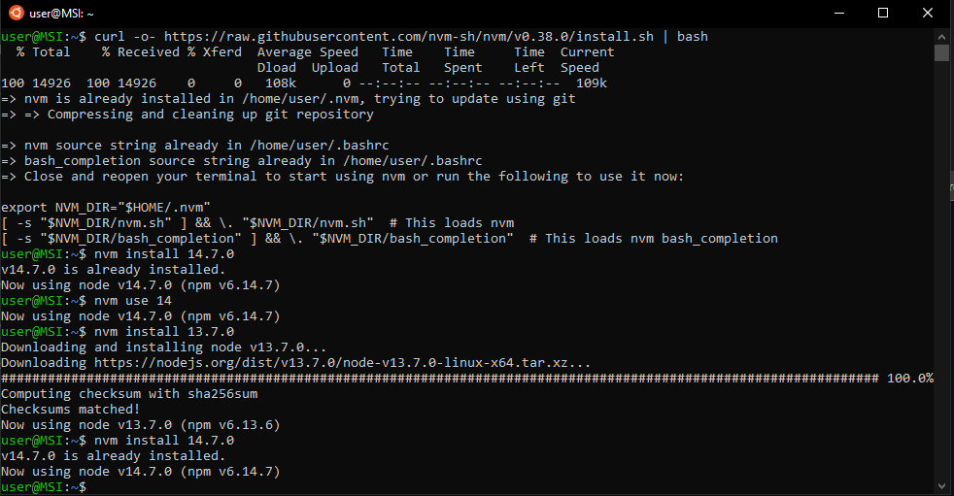
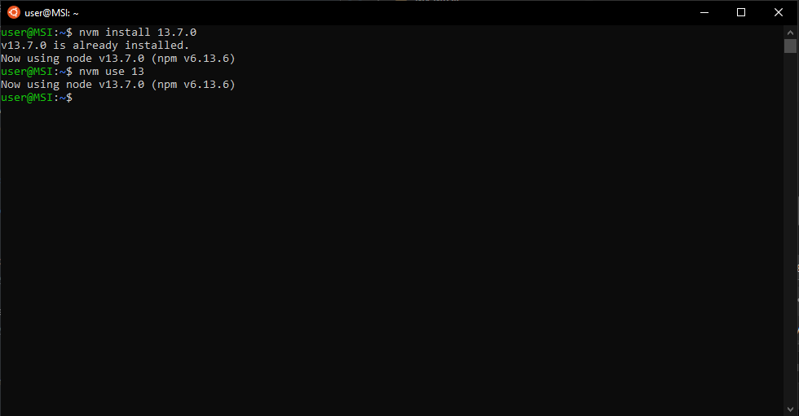
Install NVM version 13
Use the nvm version 13

Slide 7
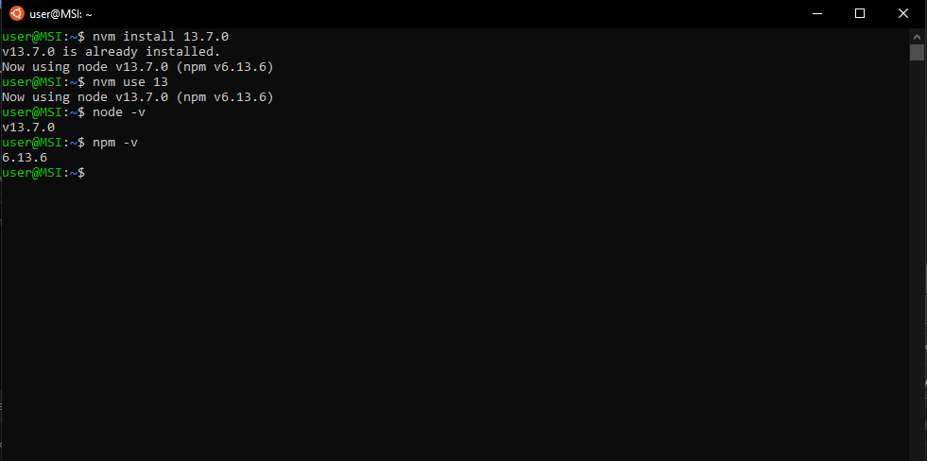
verify it by checking the installed version using the following command:
node –v
npm -v

Slide 8
To collect all node.js files we can create a folder named myapp-nodejs. Go to the directory.
> mkdir myapp-nodejs
> cd myapp-nodejs
Create a .json package file.
> npm init-y

Slide 9
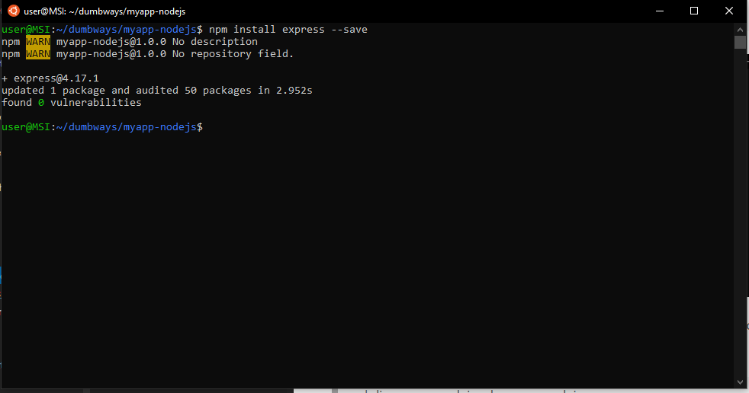
Install the node.js framework. There are several node.js open source frameworks such as Express.js, Socket.io, Meteor.JS, Koa.js, and Sail.js. In here we use express.js package
npm install express --save

Slide 10
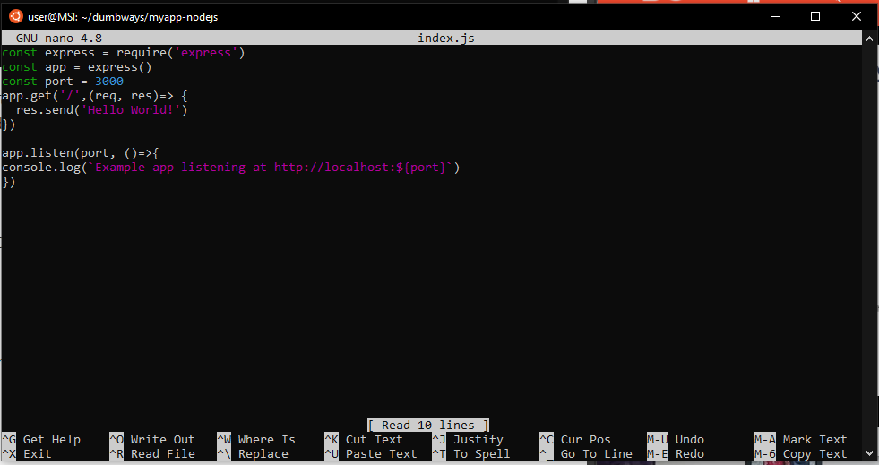
Create and config file named index.js:
nano index.js

Slide 11
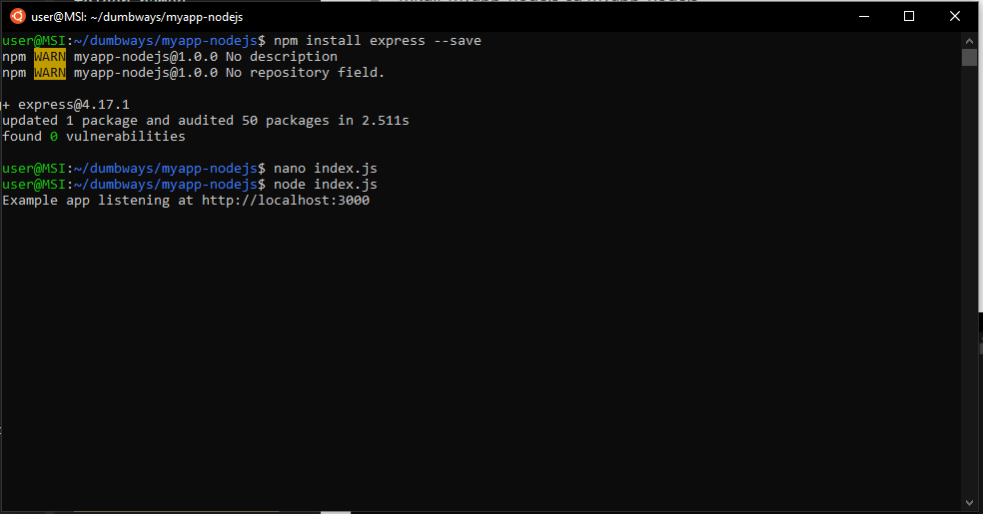
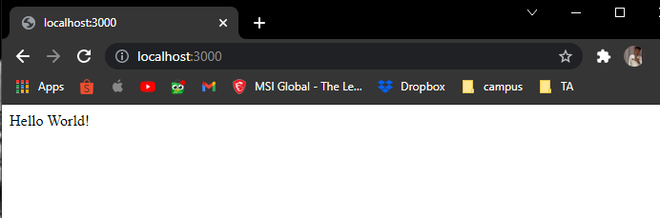
To save and overwrite index.js you can enter command ctrl+O.
To exit index.js you can enter command ctrl+X
After index.js is configured. Next index.js can be run with the following command:
node index.js

Slide 12
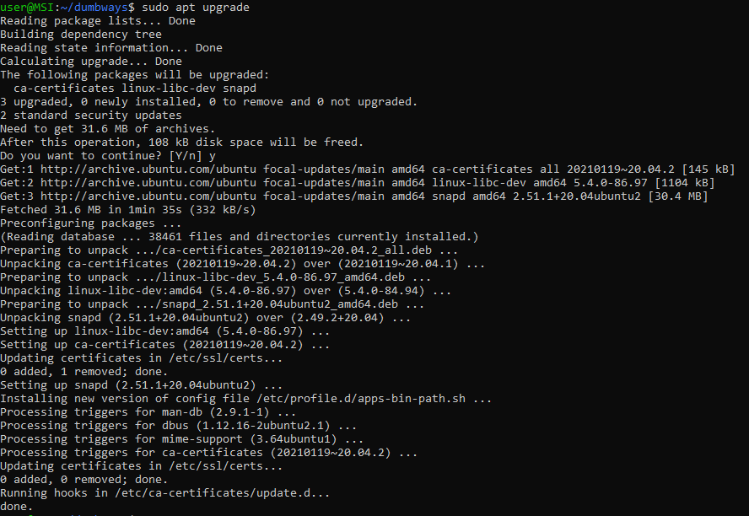
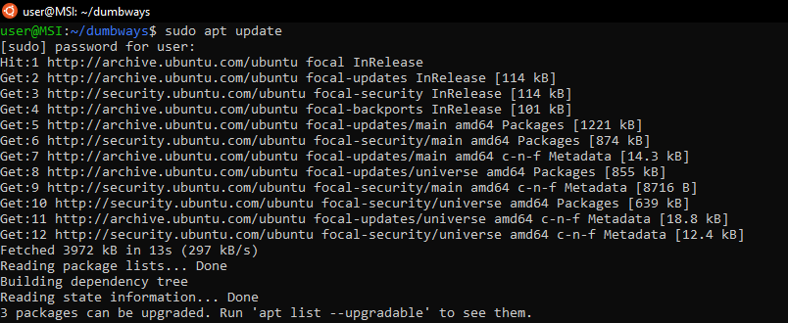
Python Installation & Config
Python installation steps, enter the following command:
Perform system updates & upgrade:

Slide 13
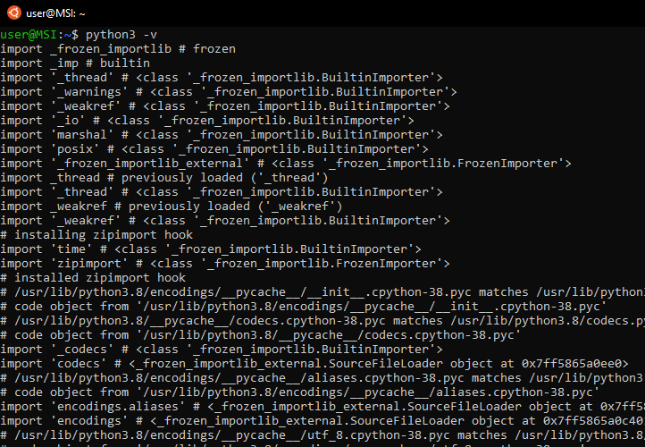
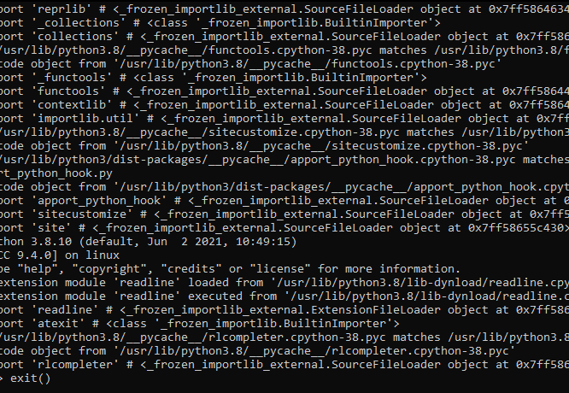
Python already exists by default. To check the version
> python3 -v

Slide 14
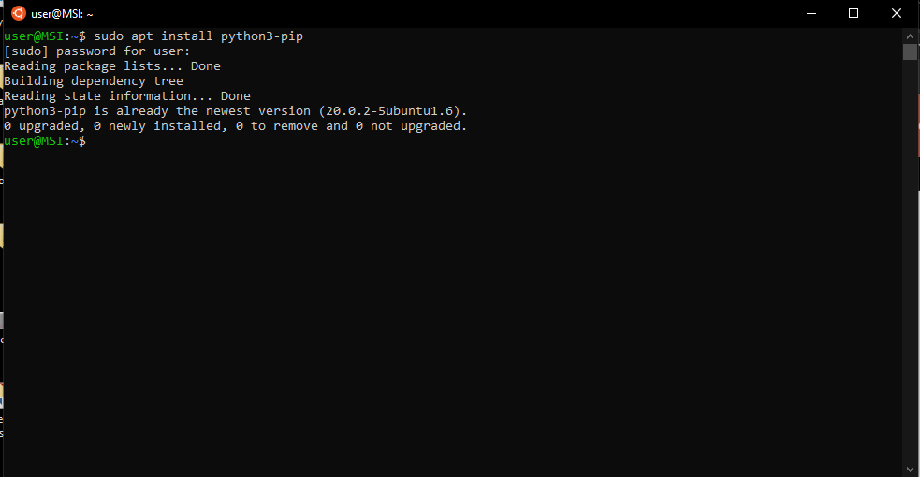
Install the python package manager:
sudo apt install python3-pip

Slide 15
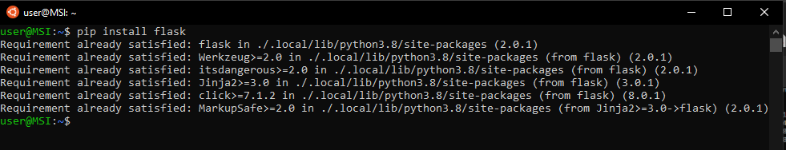
Install Python framework.
> pip install flask

Slide 16
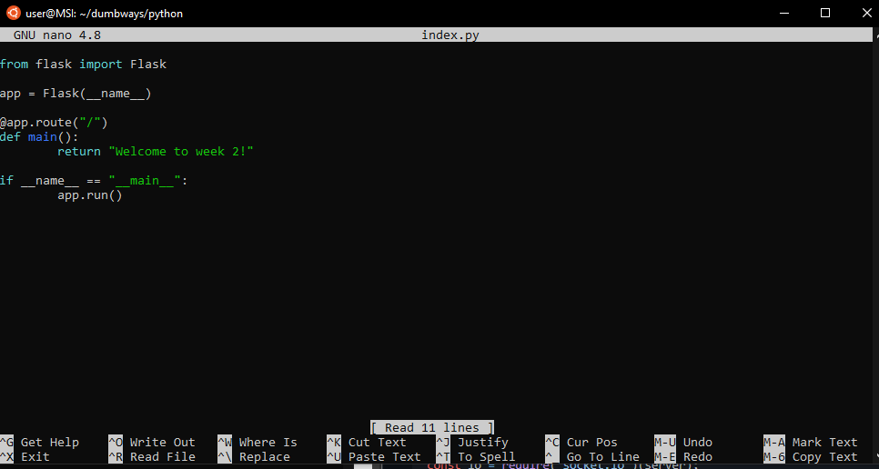
Create and configure index.py
> nano index.py

Slide 17
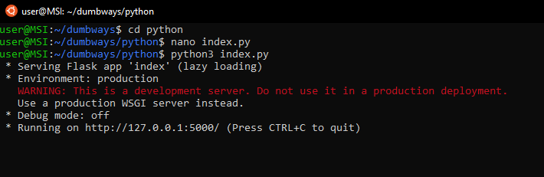
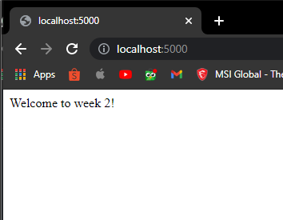
After index.py is configured. Next index.py can be run with the following command
> python3 index.py

Slide 18
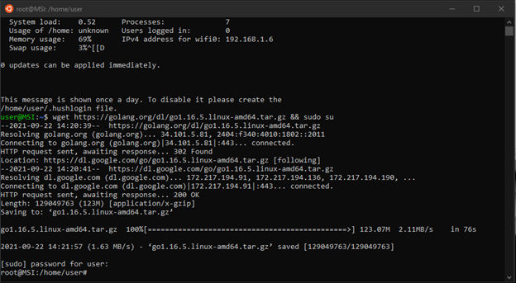
Golang Installation & Config
Download go package:
wget -c https://dl.google.com/go/go1.16.5.linux-amd64.tar.gz && sudo su

Slide 19
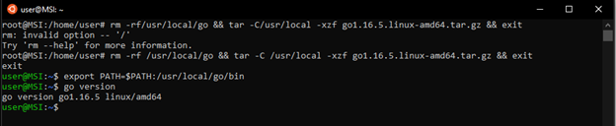
Enter path go in bashrc
export PATH=$PATH:/usr/local/go/bin
Installation verification:
go version
extract and copy data
> rm -rf /usr/local/go && tar -C /usr/local -xfz go1.16.5.linux-amd64.tar.gz && exit
Enter path go in bashrc
> export PATH=$PATH:/usr/local/go/bin
Installation verification:
> go version

Slide 20
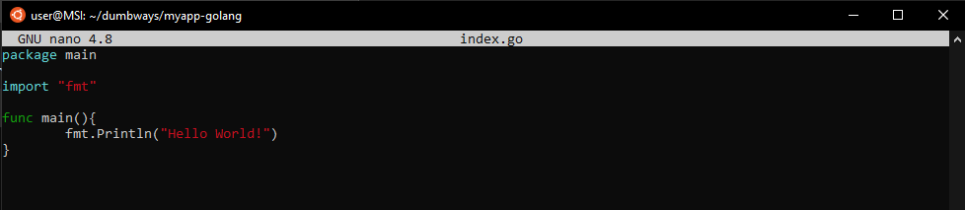
Create and configure index.go
> nano index.go

Slide 21
run golang application:
> go run index.go
if you want to build:
> go build index.go
to run the already built app:
> ./index.go

Slide 22
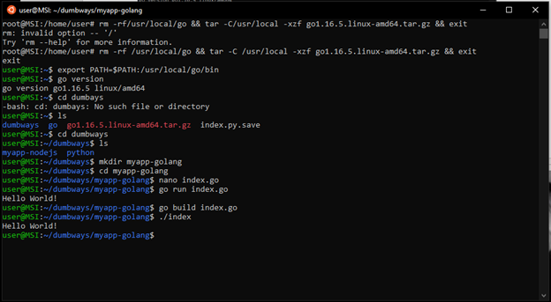

Slide 23
Service Management
Systemd is a service manager and init software package specially designed for Linux. systemd is compatible with the traditional sysvinit and BSD rc.d init scripts, but the software is intended to replace the old traditional init way of running Linux. For example:
sudo apt install ngix

Slide 24
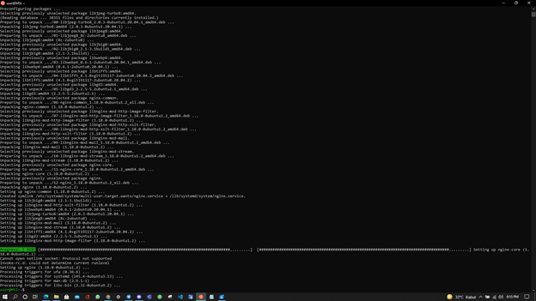

Slide 25
Memory & Storage
Memory (RAM) Random Access Memory is temporary storage for running applications. On the Linux operating system, there is a Swap in addition to a temporary memory reserve if the main memory is full.
To check memory usage, run the following command:
> sudo apt install htop
> htop

Slide 26
