Slide 1

GitHub Version Control
Python Module of the Month | 24/07/2020 | Riccardo & Niclas

Slide 2

Great Reference
Git Bible: ProGit
Clean and neat
Online on: https://git-scm.com/book/en/v2
Presentation entirely based on first few chapters

Slide 3

Errors welcome!

Slide 4
Outline
Some Background
Getting started
Basics
Branching ← (hot hot hot!)

Slide 5
Background

Slide 6



About Version Control
Local
Centralised
Distributed

Slide 7
About Version Control
Local
Centralised
Distributed
GitHub

Slide 8

The Three States
Git has three main states that your files can reside in:
Modified: you have changed the file but have not committed it to your data base yet
Staged: you have marked a modified file in its current version to go into your next commit snapshot
Committed: the data is safely stored in your local database
Working Directory: single checkout of one version of the project
Staging Area: a file that stores information about what will go into your next commit
Git directory: where Git stores the metadata and object database of your project

Slide 9
Getting started

Slide 10
Getting started
Account on www.github.com ?
Git installed?
Otherwise try:
  Linux:
  MacOS:
  Apple Git
  Official Git
  install homebrew:
  set path to local git distro:
  to update in the future:
  Windows: https://git-scm.com/download/win
$ git --version
$ sudo apt install git-all
$ git --version
$ ruby -e "$(curl -fsSL https://raw.githubusercontent.com/Homebrew/install/master/install)"
$ brew install git
$ export PATH=/usr/local/bin:$PATH
$ brew upgrade git

Slide 11
First-Time Git Setup
Customize your Git environment
To check current configuration settings
Getting help
$ git config --global user.name “<your name>”
$ git config --global user.email <your email>
$ git config --list --show-origin
$ git <verb> --help
$ git <verb> -h

Slide 12
Getting a Git Repository
Initializing a repository in an existing directory
Cloning an existing repository
  Python Module of the Monthhttps://github.com/NiclasRieger/PythonModuleoftheMonth.git
$ cd home/<user>/my_project
$ git init
$ git clone <link> (<name>)

Slide 13
Recording Changes to the Repository
Checking the status of your files
Tracking new files (staging)
Checking what has changed …
  … but not yet staged
  … and staged (add)
Committing your changes
Removing files
Moving/Renaming files
$ git status
$ git add <file>
$ git diff
$ git diff --staged
$ git commit -m “<description of your changes>”
$ git rm (--cached) <file>
$ git mv <fileName1> <fileName2>

Slide 14
Viewing the Commit History
General commit history
Simplified overview
… and lots more: https://git-scm.com/book/en/v2/Git-Basics-Viewing-the-Commit-History
$ git log
$ git log --oneline

Slide 15
Undoing things
You commit too early and forgot to add some files?
Unstaging a staged file
Unmodifying a modified file
$ git commit -m ‘Initial commit’
$ git add <forgotten file>
$ git commit --amend
$ git add <wrong file>
$ git reset <wrong file>
$ git checkout -- <modified file>

Slide 16
Working with remote repositories
Showing your remotes (where you can pull from)
Adding remote repositories
  Implicitly
  Explicitly (typically: shortname = origin)
Fetching and pulling from your remotes
  Download only
  Check for differences
  If you want to merge data
  Shortcut: download and (try to) merge
Pushing to your remotes
(To those you have write access, e.g. your own GitHub Account)
$ git remote (-v)
$ git clone <url>
$ git remote add <shortname> <url>
$ git fetch origin
$ git diff ...origin
$ git merge
$ git pull origin
$ git push origin master

Slide 17
Working with remote repositories
Inspect a remote
Renaming/removing remotes
$ git remote show origin
$ git remote rename <name1> <name2>
$ git remote remove <name>

Slide 18

Branching
… for Pedro

Slide 19
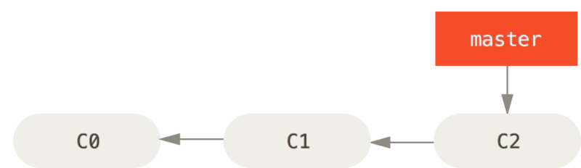
Idea of Branching

Slide 20
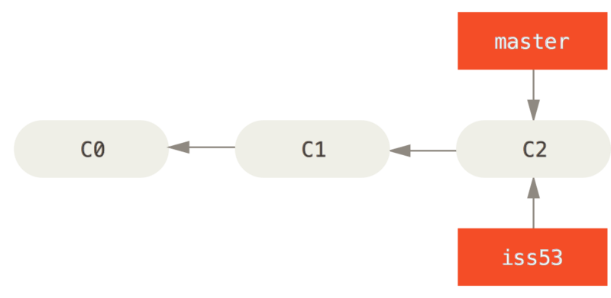
Idea of Branching

Slide 21
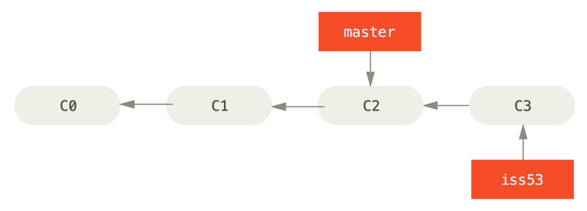
Idea of Branching

Slide 22
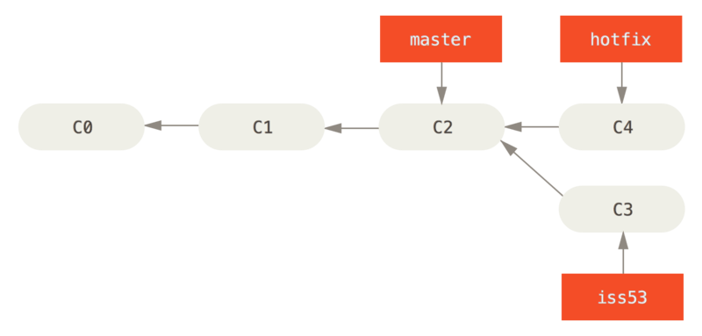
Idea of Branching

Slide 23
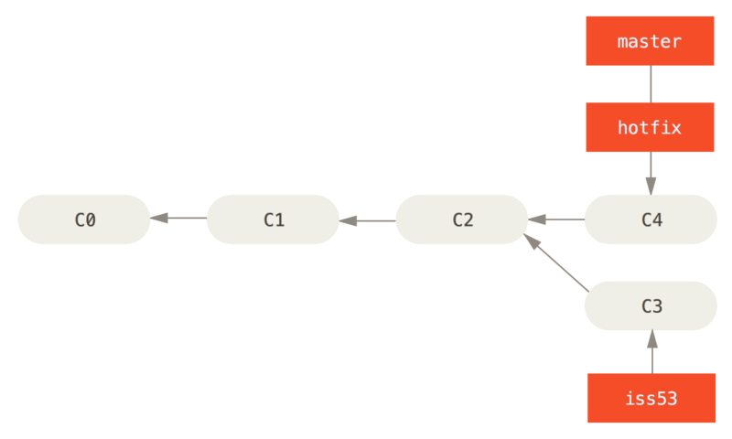
Idea of Branching

Slide 24
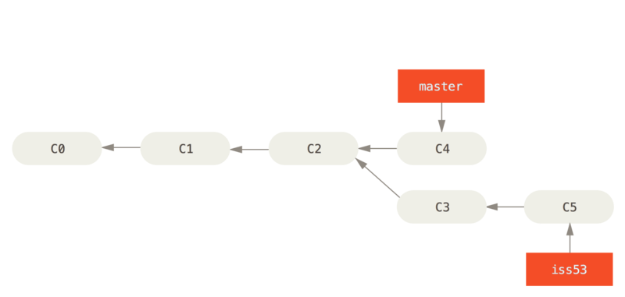
Idea of Branching

Slide 25
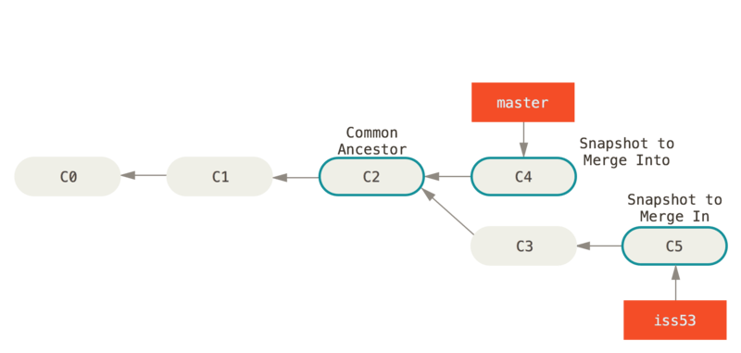
Idea of Branching

Slide 26
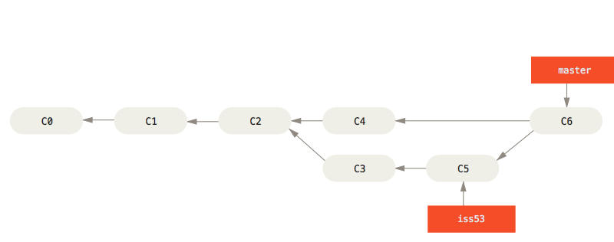
Idea of Branching

Slide 27
Branches in a Nutshell
Creating a new branch
Switching branches (move the pointer HEAD)
Shortcut (creating + switching)
Merging current HEAD with another branch
Deleting branches
$ git branch myBranch
$ git checkout myBranch
$ git checkout master
$ git checkout -b myBranch
$ git merge myBranch
$ git branch -d myBranch

Slide 28
Basic Merge Conflict
You change some part of a file on a BRANCH, and before committing, you change the same part of the same file on MASTER, you run into a merge conflict
git merge BRANCH will throw an error, nothing will be merged or overwritten → your code is save
Solve the conflict by inspecting the files directly (git will add conflict-resolution markers or alternatively use a graphical solution via git mergetool
$ git merge myBranch
$ git mergetool

Slide 29
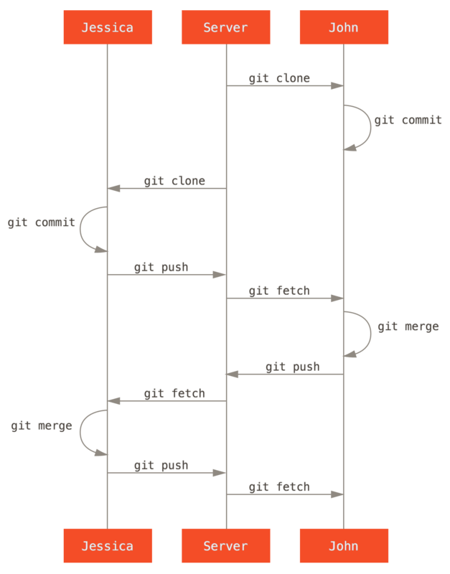

Slide 30
For those who want to go a bit deeper...
Tagging: https://git-scm.com/book/en/v2/Git-Basics-Tagging
Aliases (personal shortcuts): https://git-scm.com/book/en/v2/Git-Basics-Git-Aliases
Forking and Pull-Requests (for contributing to larger projects e.g. numpy): https://git-scm.com/book/en/v2/Distributed-Git-Contributing-to-a-Project

