Slide 1
Bipolar Junction Transistors
Peng Mei
Department of Electronic Systems
Email: mei@es.aau.dk

Slide 2
Learning objectives:
Physical structure of a NPN transistor
Three basic circuit types of a NPN transistor
Current components of a NPN transistor
I-V characteristic

Slide 3
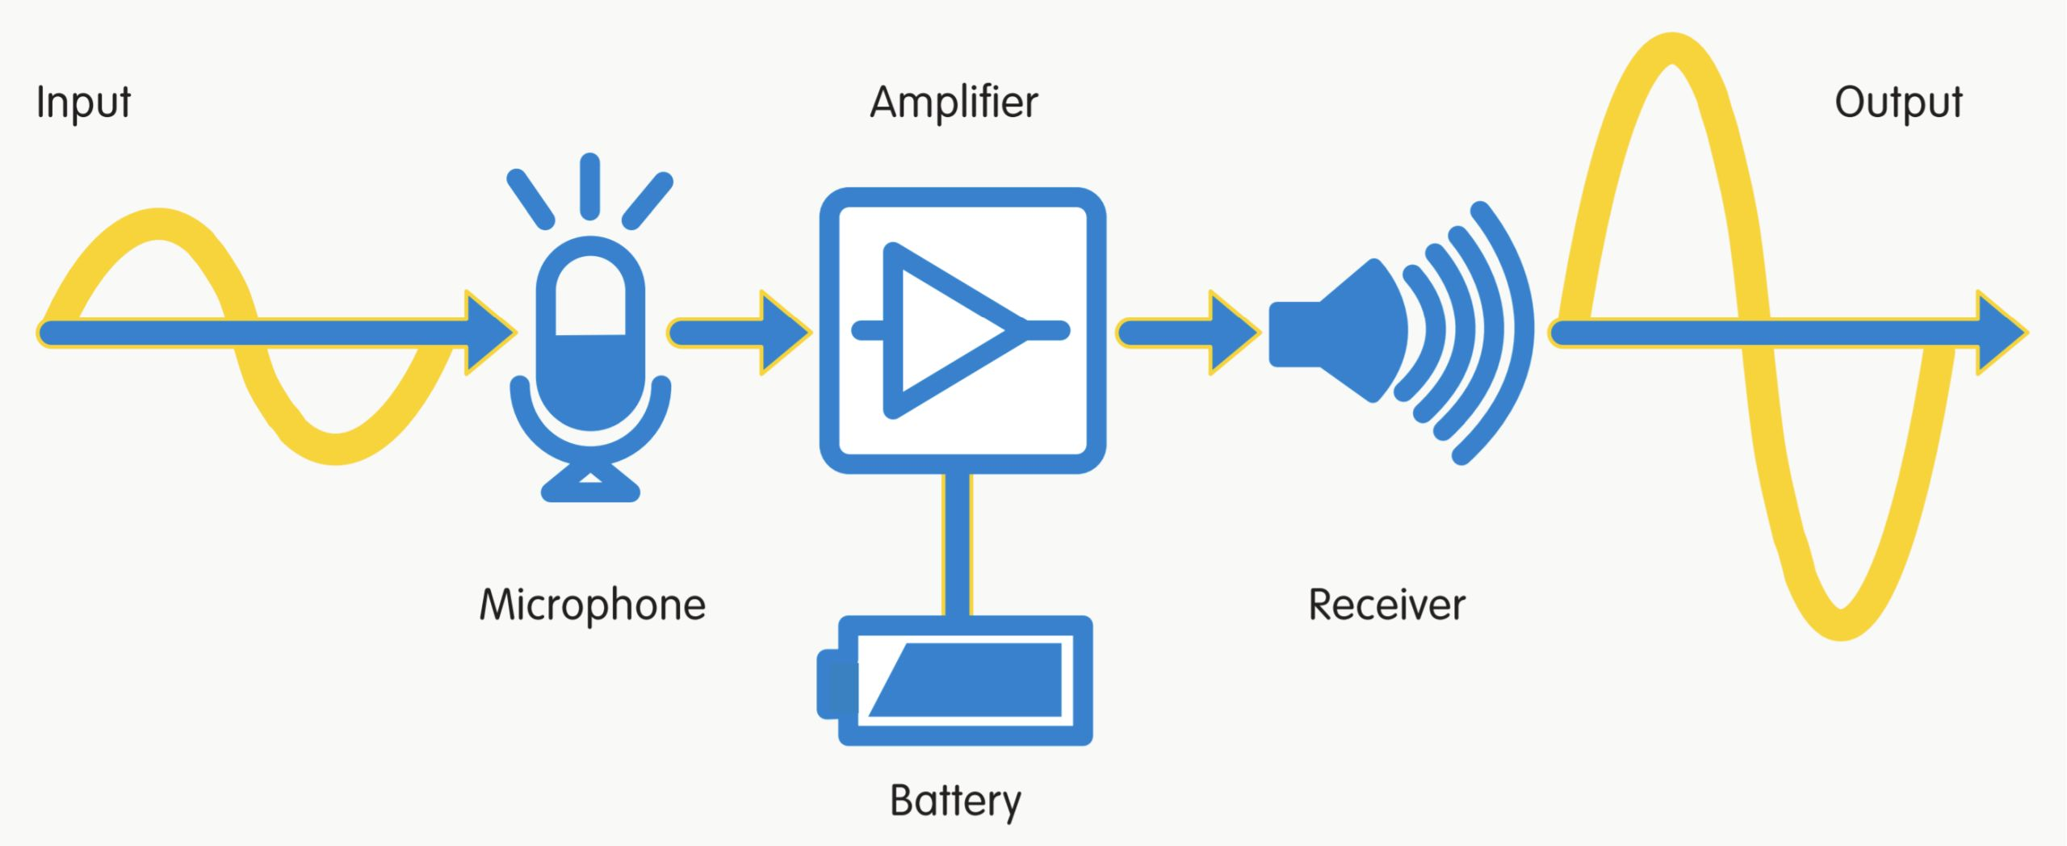
Notes:
Energy of conservation.
The frequency of the signal is the same. (no frequency conversion)

Slide 4
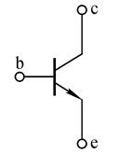

Slide 6
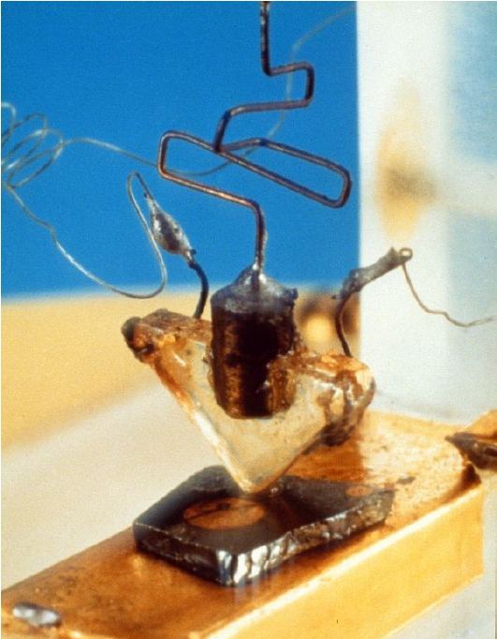
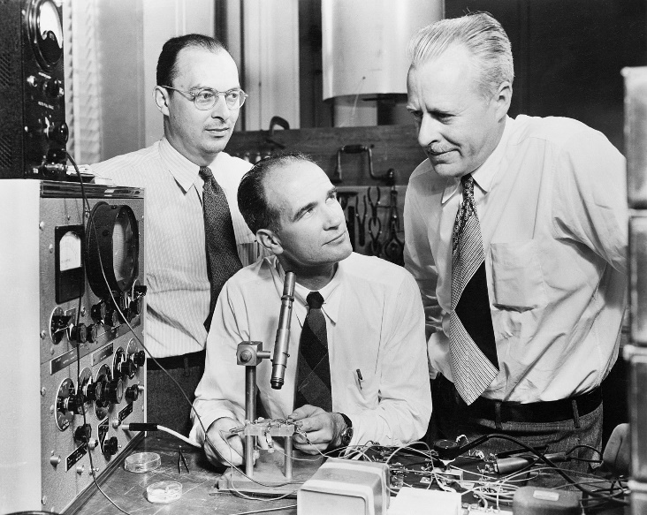
First BJT in 1948 at the Bell Telephone Lab
John Bardeen
William Schockley
Walter Brattain
Notes:
Can you identify which is collect lead, which is emitter lead, and which is base lead

Slide 7
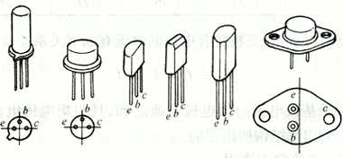
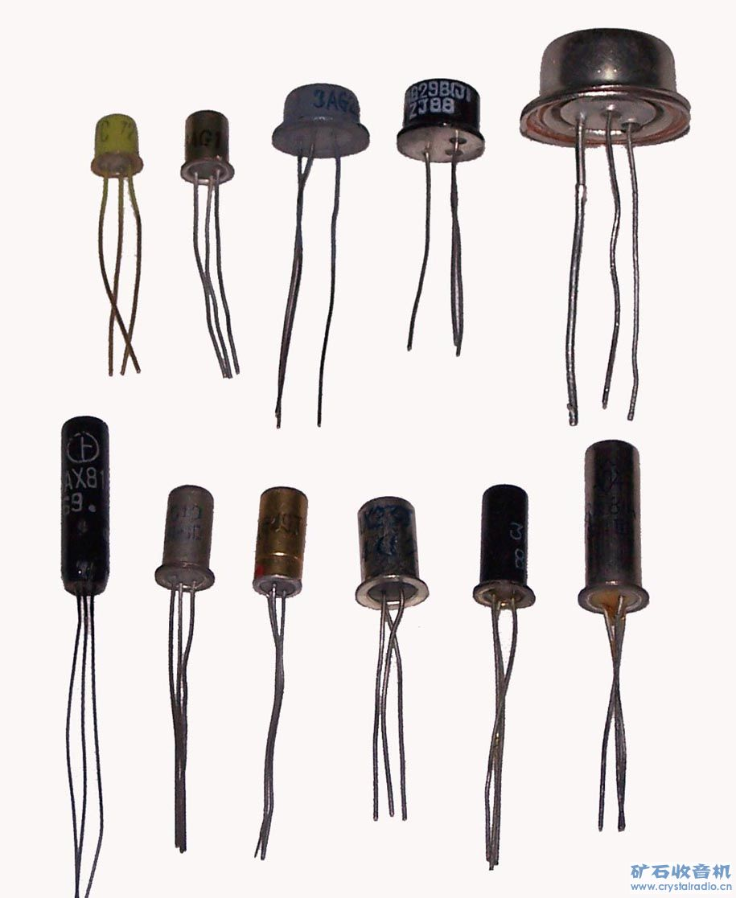
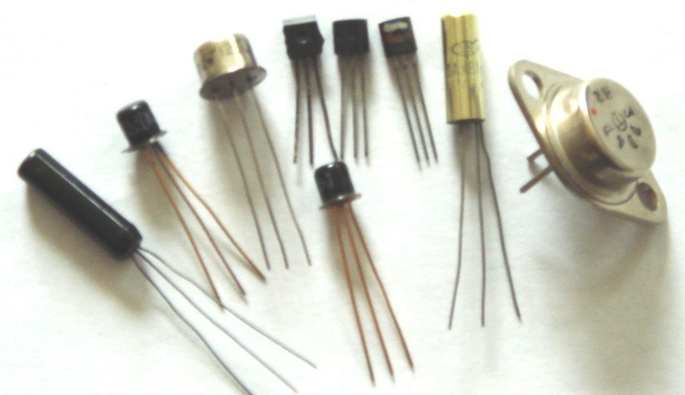
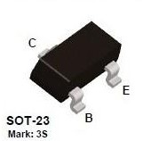

Slide 8
First BJT in 1948 at the Bell Telephone Lab
John Bardeen
William Schockley
Walter Brattain
Emitter
lead
Collector
lead
Base lead

Slide 9
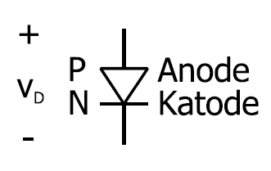
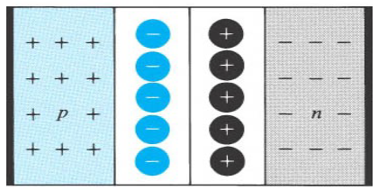
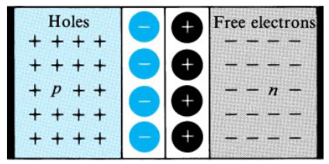
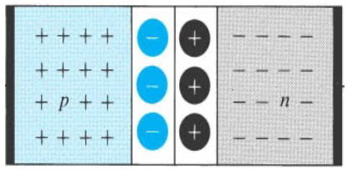



Depletion
region
Depletion
region
Depletion
region

Slide 10
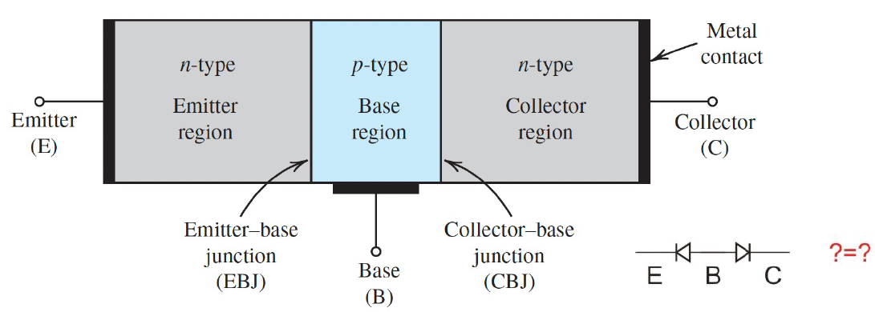
Notes:
Base región is quite narrow in NPN BJT, while it is quite wide in PN diode. Otherwise, the current cannot flow from collector to emitter.

Slide 11
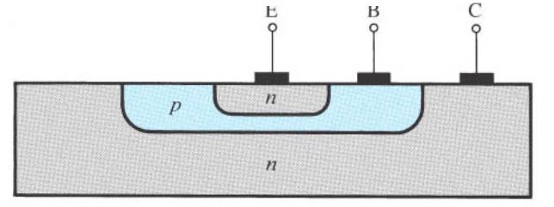
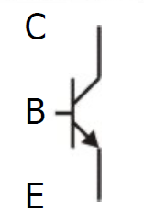
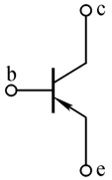
E
B
C
3 areas, each with its own contact:
N-doped area: “Emitter (E or e)”
P-doped area: “Base (B or b)”
N-doped area: “Collector (C or c)”
Emitter area: highly doped density
Collector area: low doped density and large area
Base area: thin, around 1 – 2 um, lowest doped density
NPN
PNP

Slide 12
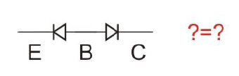
Notes:
Base región is quite narrow in NPN BJT, while it is quite wide in PN diode. Otherwise, the current cannot flow from collector to emitter.

Slide 13
Common emitter
Common base
Common collector
Quite similar

Slide 14
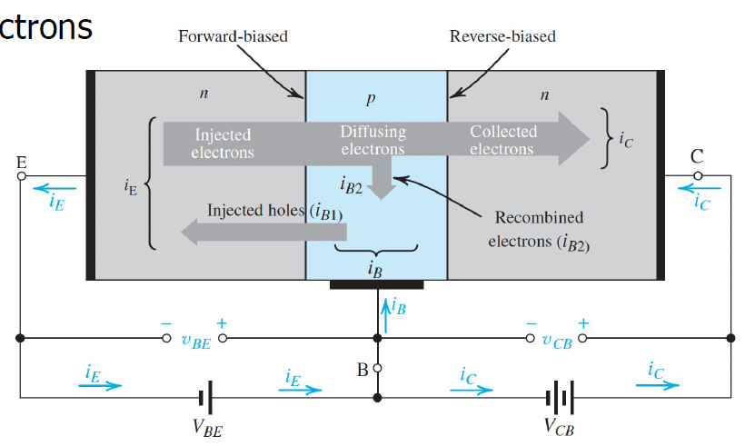
Emitter: Emits electrons;
Collector: Collects electrons;
What is forward biased
and reverse biased?
Current components:
Electrons E B C => Collector current (i_{C}) (BE voltage controls the current)
Electrons E B => Base current (i_{B})
Holes B E => Base current (i_{B})
How about emitter current (i_{E})?
Notes:
KCL(Kirchhoff’s current law): the current flowing into a node (or a junction) must be equal to the current flowing out of it.
Ie = Ib + Ic

Slide 15
Mode | EBJ | CBJ
Cutoff | Reverse | Reverse
Active | Forward | Reverse
Saturation | Forward | Forward
Notes:
When different voltages are applied to the EB and CB, the NPN transistor Will work at different modes.

Slide 16
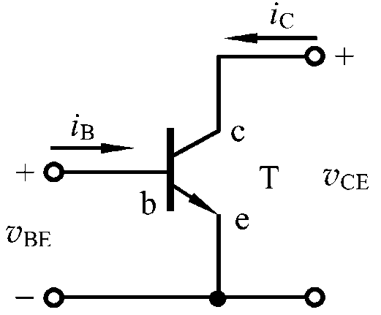
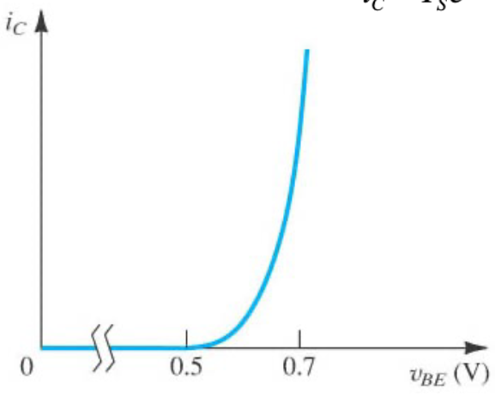
i_{C} ~ υ_{BE} curve:
At active mode
A_{E}: cross-sectional area of emitter area
q : electron charge = 1.6 * 10 ⁻¹⁹ C
D_{n}: diffusivity of electrons
n_{i} : number of thermally generated electrons
N_{B}: doping density in base
W_{B}: the width of base
T : absolute temperature
Could be controlled by manufacturing.
Temperature dependent

Slide 17
How much does i_{C} change if v_{BE} increases by 60mv?
A

Slide 18
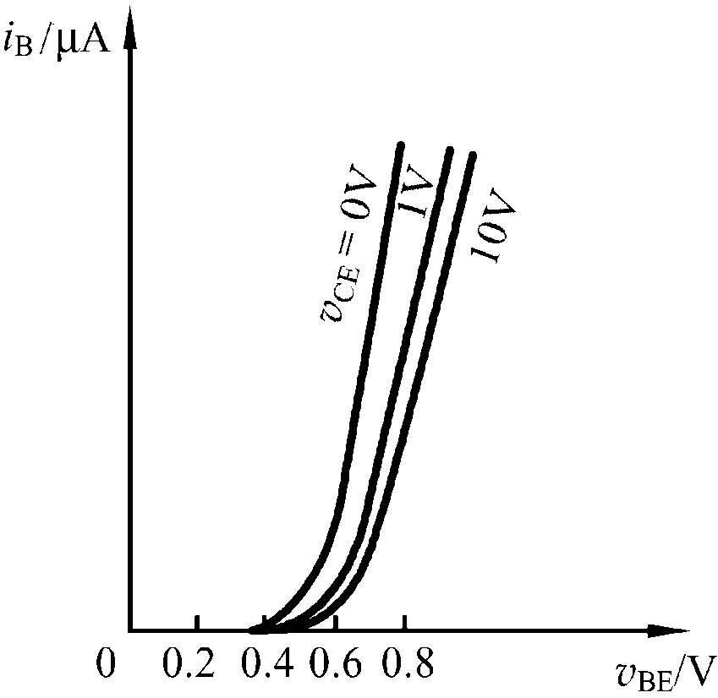
i_{B} ~ υ_{BE} curve:
Active mode:
Emitter forward biased;
Collector reverse biased;
υ_{CE} > υ_{BE}
Similar to a
PN junction
Uon
Si: 0.5 – 0.7 V
Ge: 0.1 – 0.3 V
Notes:
Si: silicon
Ge: Germanium
Why the curve is shifting towards right when vce increase?

Slide 19
The analytical relationship between υ_{BE} and i_{B}
(forget details)
Holes from
B to E
Electrons from
E to B
(forget details)
Electrons E B => Base current (i_{B})
Holes B E => Base current (i_{B})
Big β, if:
W is small
N_{A} << N_{D}
Typically: 10 < β < 1000
Notes:
Ic curve should be plot here.
Why ic is controlled by VBE rather tan VCE?

Slide 20
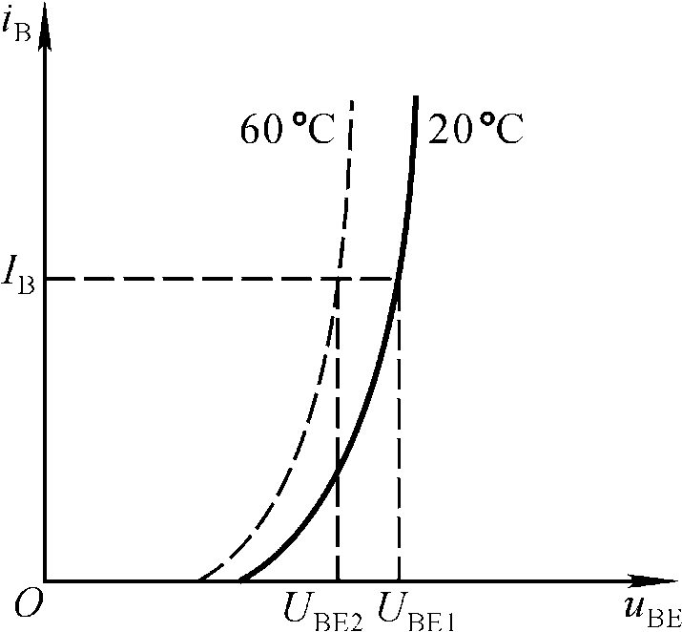
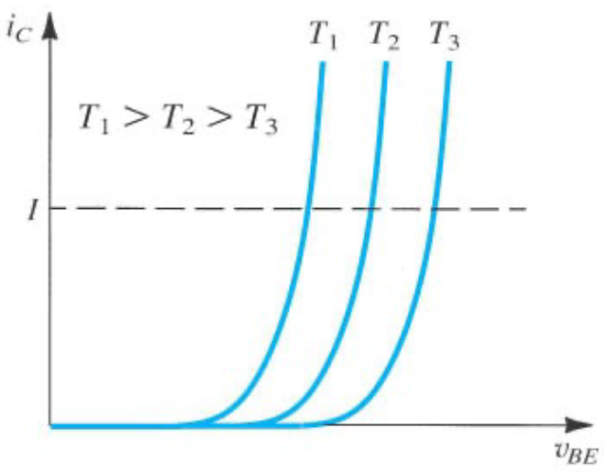
Temperature effects on I-V curves

Slide 21
Thanks

