Slide 1
Bipolar Junction Transistors
Peng Mei
Department of Electronic Systems
Email: mei@es.aau.dk

Slide 2
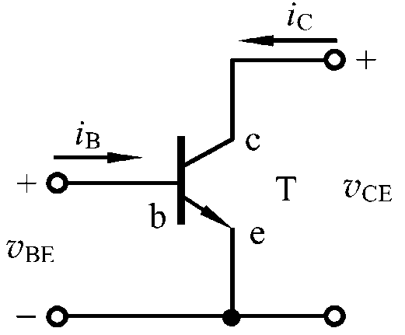
Learning objectives:
Simple NPN transistor model
Concept of transconductance
Large-signal and small-signal model

Slide 3
Current gain

Slide 4
According to KCL:
or

Slide 5
Can we simplify this circuit model?

Slide 6
Simple bipolar transistor model
Voltage controlled
current source

Slide 7
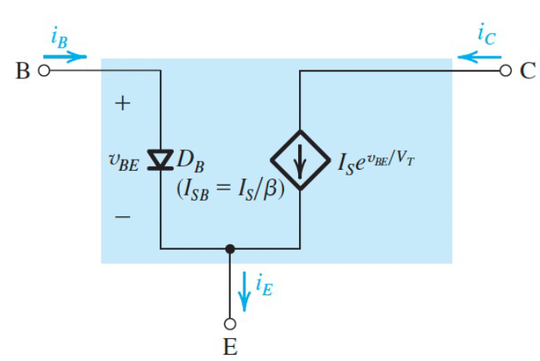
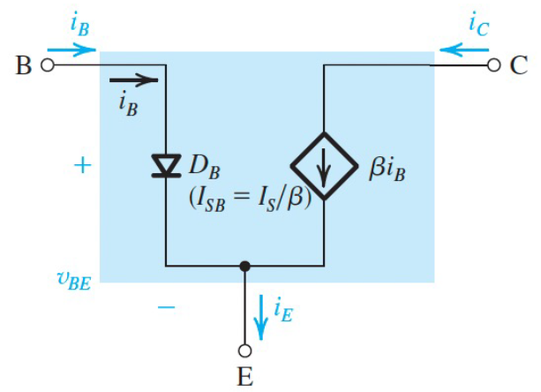
Simple bipolar transistor model
Application of a simple bipolar transistor model

Slide 8
Application of a simple bipolar transistor model
Calculate i_{c} ?
Vo = 5V, V_{CE} = 12V, Ro = 100 Ω

Slide 9
Application of a simple bipolar transistor model
Vo = 5V, V_{CE} = 12V, Ro = 100 Ω

Slide 10
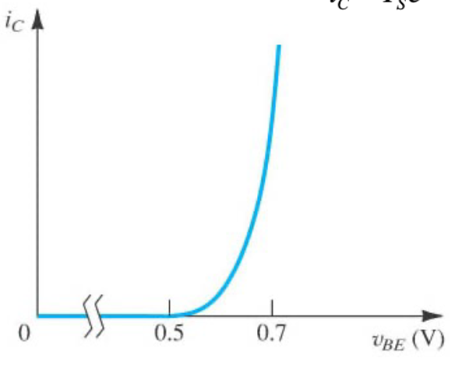
Concept of transconductance:
When v_{BE} has a fluctuation, how will it affect i_{C}?

Slide 11
Concept of transconductance:

Slide 12
Large-signal and small-signal model:
Large-signal: the signal is arbitrarily large
Small-signal: the signal perturbs the bias point by only a small amount
(small compared to V_{T})

Slide 13
i_{C}
i_{B}
V_{in}

Slide 14
i_{C}
i_{B}
V_{in}
V_{in}
In small-signal model:
DC sources are short.

Slide 15
V_{in}
V_{in}
V_{in}

Slide 16
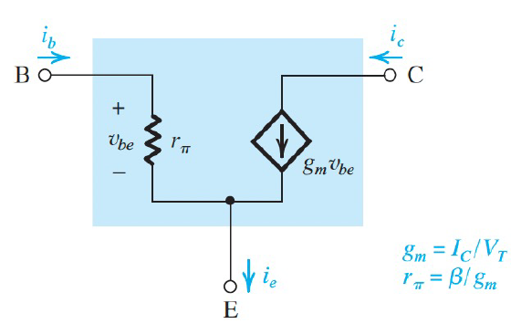

Slide 17
Draw the large-signal and small-signal models?

Slide 18
Thanks

