Slide 1
Update

Slide 2
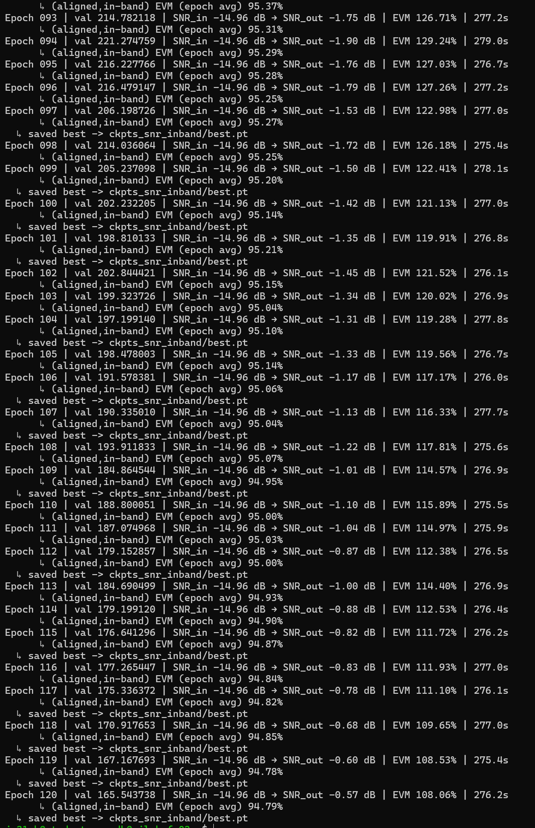
TCN Model current training update last 40 epochs
This is the current regression model based on a TCN architecture. This was chosen as its ideally really good for recreating realtime signals like audio or in this case GNSS signals. We have had a model where we could improve the snr further than at around 0 db but that dataset was a lot easier than this one as it started around -2 dB snr instead of -14 dB so we are maybe hitting model complexity issues at the moment. We are trying different schedulers, weights, penalty functions like L1, L2, dropout. We have done a small signal processing chain infront to help the model aswell a small notch filter that should hit most of the energy in the jamming signal and then let the model remove the rest of the signal after the notch filter.

Slide 3
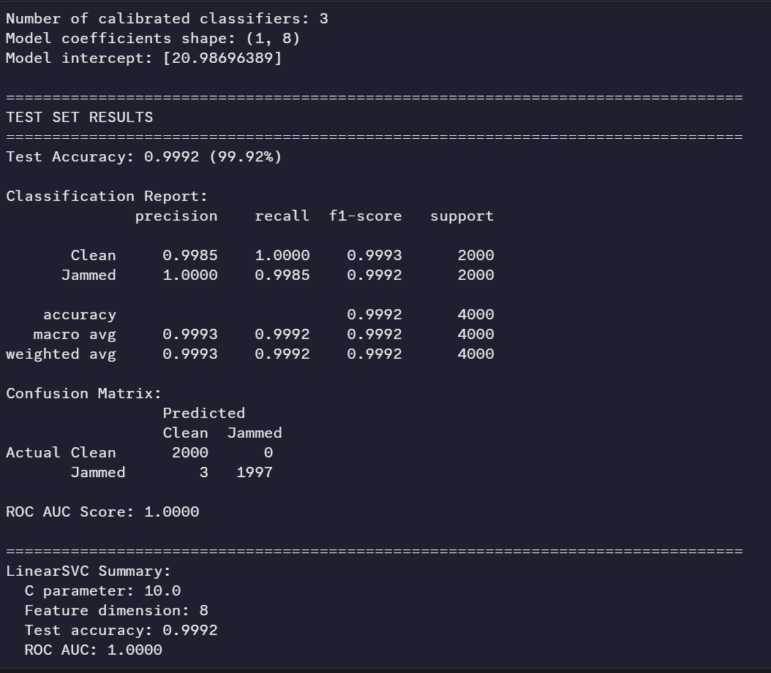
Classification model
Classification model is really good as you can see from the results and the typical classification metrics used. The model is based on a SVM architecture which proved most efficient given its size and computation load when running. AS the focus for the entire chain is still running in real time on a jetson nano on a larger drone like a recon drone.

Slide 4
Dataset
The dataset is synthetically generated GPS L1 C/A code with a SNR value of -15 dB and a mix of jamming intensity between -10 and 20 dB compared to the signal power. So the jammer can be quite powerful and be quite negliable to simulate real world conditions in the testing conditions. The jammer type chosen is a Sweepen CW with a very wide bandwidth as that is most often used according to the literature we have read see the report for more info on this. The bandwidth is half the entire band so it infiltrates a lot of the signal which make the problem of cleaning the signal and detecting a lot harder than a simple narrow band cw.

