Slide 1



The rising open-source movement in China, China Open Source White Paper 2020
TAKASU Masakazu Nico-Tech Shenzhen
Switch Science
KaiYuenShe

Slide 2
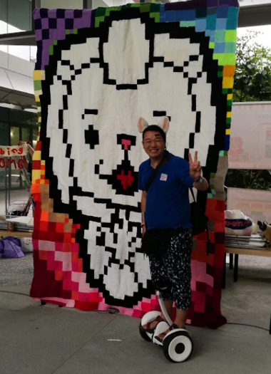
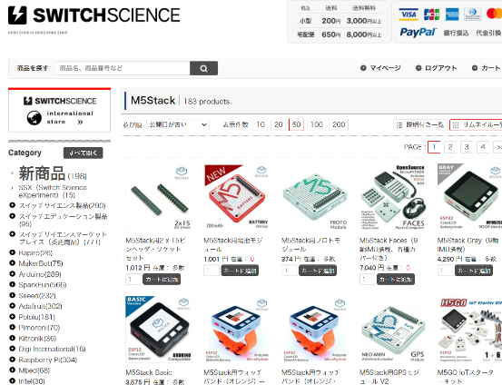
About me
TAKASU, I had been 38 cities 112 Maker event.
I hope to connect Maker`s community in Asia. Based in Shenzhen China.
I still keeping connection with Maker Faire Singapore(Extrabaganza)
Our company Switch Science is Open Source Hardware Market place.
Notes:
Wǒ shì yàzhōu chuàng kè shènghuì zhōng zuì yǒu jīngyàn de rénwù.
我是亚洲创客盛会中最有经验的人物。

Slide 3
Overview
China Open Source grow rapidly
User community
Grow the community rapidly everywhere, even in China.
Students and Full-time engineers join every day.
Culture is also increasing.
Company
Company Strategy forced to Open Source
Big tech company built open source division and hired professional.
Fundraising open source-based startup company
Government
-forced open source governance to be officially in china
-New Permissive license arrowed by OSI, English/Chinese compatible.
-Open Atom Foundation

Slide 4
User community

Slide 5
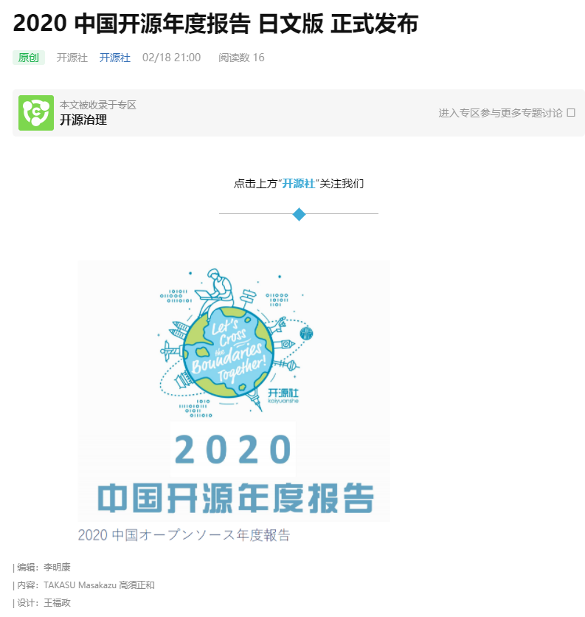

開源社(KaiYuanShe China Open Source Alliance)
China Open Source report
In Chinese and Japanese
COSCON`20(China Open Source CONference 2020)and Apache Roadshow

Slide 6
China Open Source report In Chinese and Japanese
This Report China Open Source Report 2020 is the evidence about the glowing Open source scene in China. That glow in 2020 means all aspects, include more popular, higher technology, more transparency, community, and business. All projects got more diverse, and also a higher level. Some projects you can see in Gitee, these IoT and embedded software categories, China will lead the others in the world. Also, non-technology topics are memorable. Such as community governance, own a license for Chinese society, glow the official community, and investment from VC. KaiYuanShe(China Open Source Alliance) is the international community, but for the Chinese speaker. I`m an official member of Kaiyuanshe from 2021. KaiYuanShe will contribute to the world.

Slide 7
China Open Source report In Chinese and Japanese
この「中国开源年度报告」は中国オープンソースコミュニティが、制度、技術、,コミュニティ、ビジネスのどの方面でも、2020年の1年間で大きく成長し、今後さらなる急成長が見込めることの証明です。2019年のものと比べ、プロジェクトはさらに多様でハイレベルになりました。そのなかにはGiteeに多く見られる組み込み系など、中国が世界に先駆ける可能性を秘めたものもあります。
また、オープンソースコミュニティのガバナンスについても進化し、中国国内で通用しやすい独自のオープンソースライセンスや公的なコミュニティが拡大し、投資についても伸びているのも、注目すべき傾向です。
様々な国からの参加者を集める、中国を代表するオープンソース・アライアンス開源社ですが、公用語が中国語のため、基本的に中国語圏のメンバーのみで運営されていました。2021年度から、日本人の僕も正式メンバーとなりました。2021年度の中国オープンソースは、更に世界への貢献を大きくしていくでしょう

Slide 8
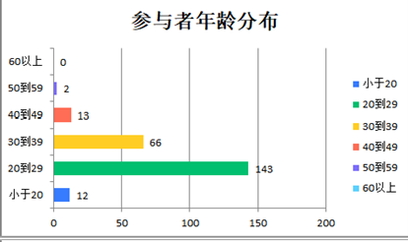
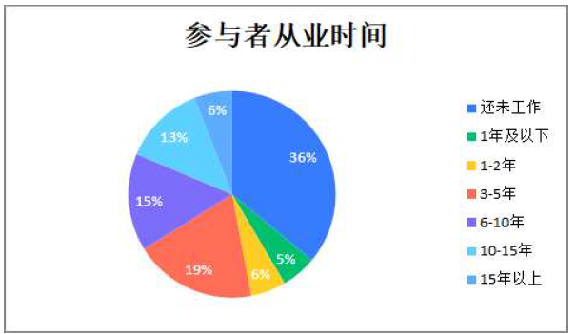
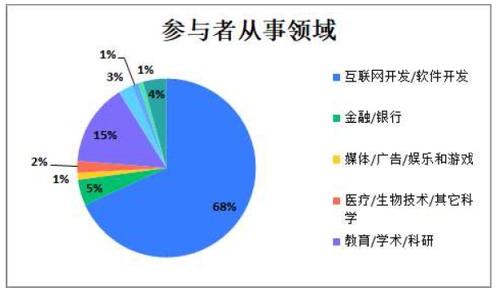
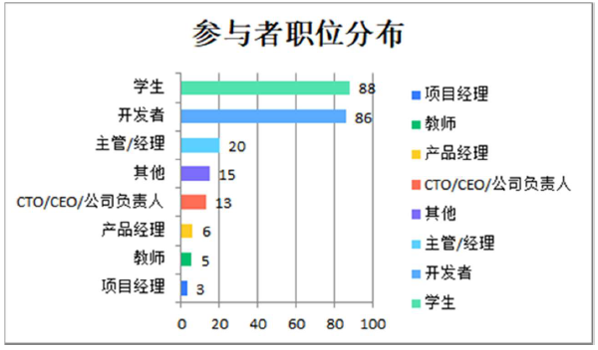
Age of open-source developer community.
Almost all developers are 20th-30th ages born after the 1980s.
Continuous joining new young members, particularly students.

Slide 9
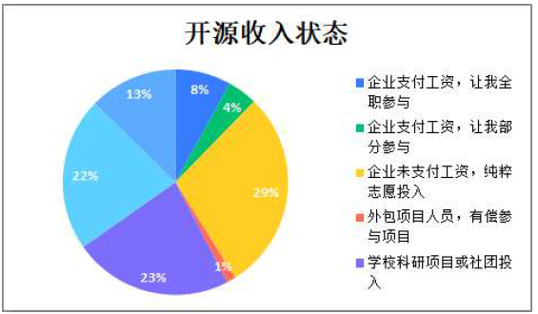
Full-time engineers also join a lot.
How you earn money for open-source development?
Company, full-time development
Company, full-time development
Volunteer
Paid Volunteer
Student and teacher

Slide 10
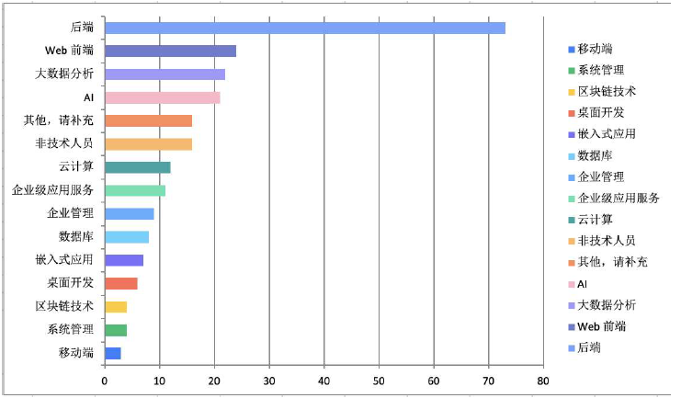
Full-time engineers also join a lot.
Backend
Web-Frontend
Data-Analysis
Others
Non-Tech
Cloud computing
Corporate software develop
Management
Database
Embedded
Desktop App
BlockChain
System Admin
Telecommunicaion

Slide 11
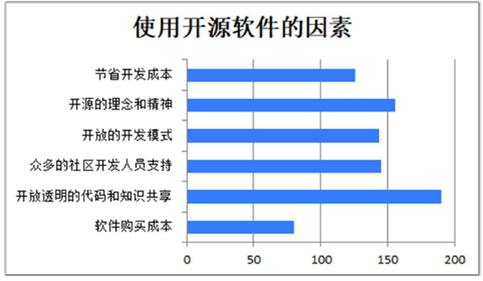
Culture is also increasing.
Why you use Open Source Software?
Company, full-time development
Save the money
Company, full-time development
Philosophy
Volunteer
Better way to develop
Community
Paid Volunteer
Transparency
Save the money
Student and teacher

Slide 12
Company

Slide 13
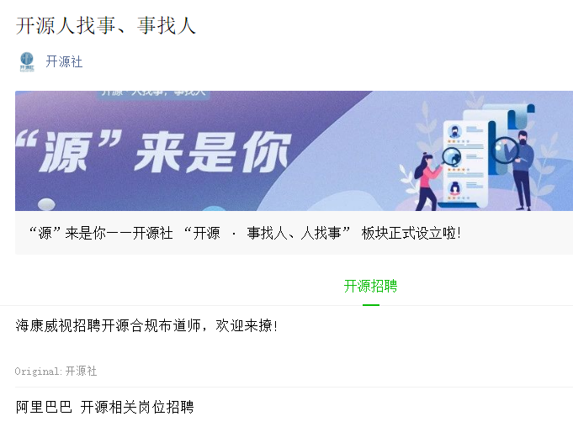
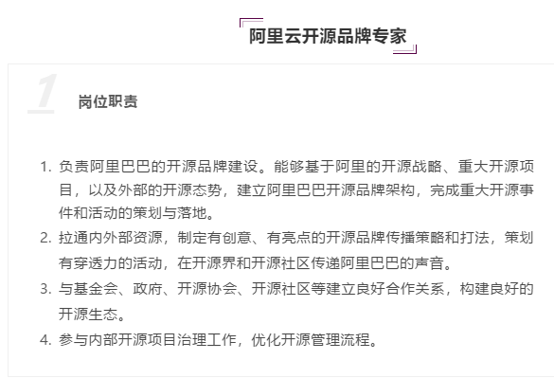
Big tech company built open-source division
and hired professional.
Alibaba Cloud open-source headquarter, advocate, promotion, for building the community...
Hired open-source enthusiast by
Alibaba, OPPO, Huawei, JD.com..

Slide 14


example open-source software by Chinese
Vue.js, famous in Japan, I saw 14 books about Vue.js in Amazon Japan.
AntDesign, React based UI toolkit, 4,400 Star on GitHub

Slide 15
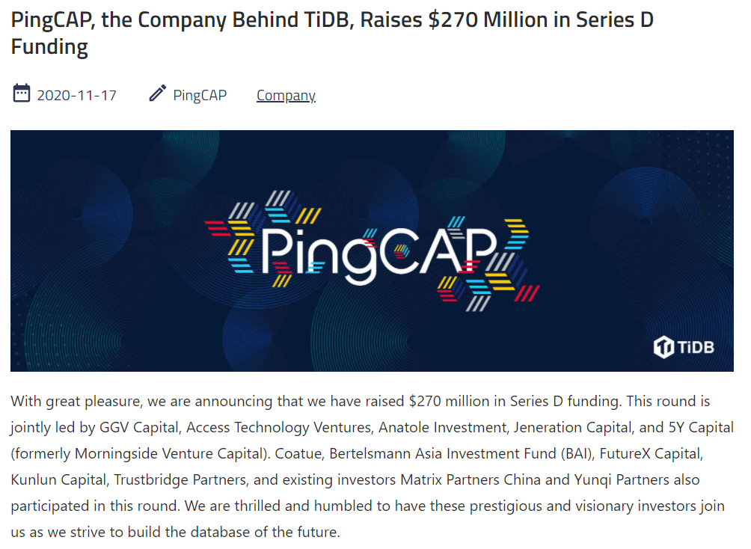
open-source Based Startup company

Slide 16
Goverment

Slide 17

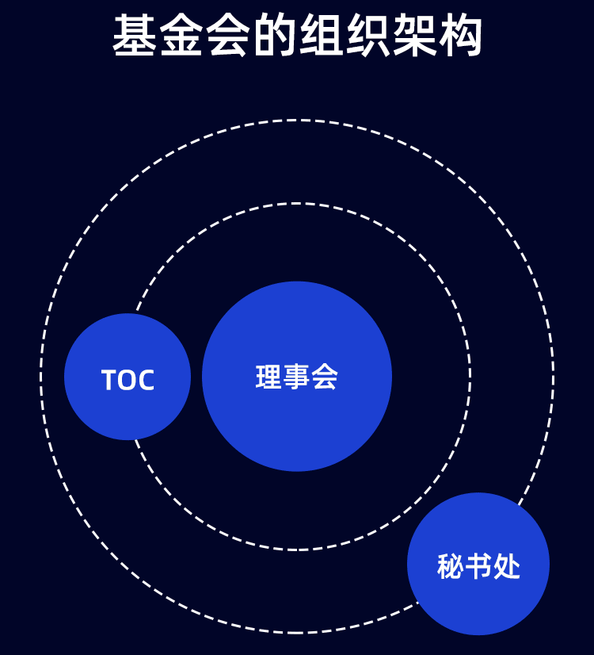
Open Atom Foundation 中国政府工信部
Build the license, Incubate open-source software from China,
Push open-source culture from the government.

Slide 18
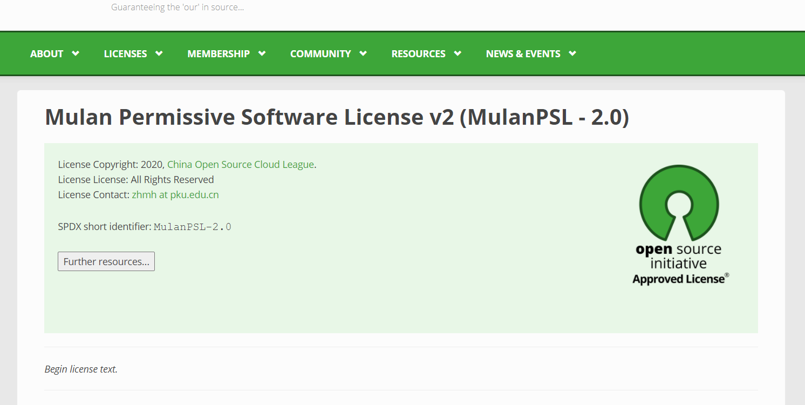
Mulan Permissive Software License v2 (MulanPSL - 2.0)
In English and Chinese, Open Source initiative Authorized
6. Language
THIS LICENSE IS WRITTEN IN BOTH CHINESE AND ENGLISH, AND THE CHINESE VERSION AND ENGLISH VERSION SHALL HAVE THE SAME LEGAL EFFECT. IN THE CASE OF DIVERGENCE BETWEEN THE CHINESE AND ENGLISH VERSIONS, THE CHINESE VERSION SHALL PREVAIL.

Slide 19

Thanks for Attention.
Contact：
TAKASU info@takasumasakazu.net
Twitter: @tks
Facebook: https://fb.me/takasuinfo
WeChat:takasumasakazu
My Wechat/微信
Notes:
Gǎnxiè nín de guānzhù.
感谢您的关注。

