Slide 1
Computer Graphics
Lecture 1 – Introduction, Overview
John Shearer
Culture Lab – space 2
john.shearer@ncl.ac.uk
http://di.ncl.ac.uk/teaching/csc3201/
Computer Graphics
Notes:
Computer Graphics - Newcastle University
Computer Graphics - Newcastle University

Slide 2
Overview
Ed Angel, Interactive Computer Graphics, A Top-down Approach with OpenGL (Fifth Edition), Addison-Wesley – ISBN 0321535863
  Previous editions should be ok.
  Paperback edition recently published
These lectures cover
  Chapters 1-7
Computer Graphics
Notes:
Computer Graphics - Newcastle University
Computer Graphics - Newcastle University

Slide 3
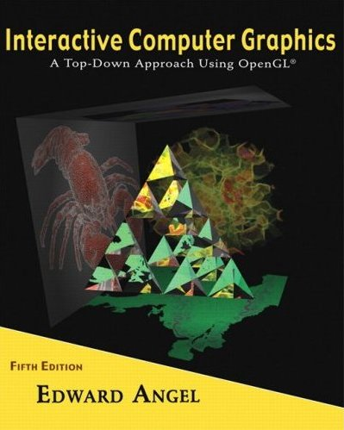
Acknowledgements
Lecture course based on lecture slides by Ed Angel of the University of New Mexico to accompany Interactive Computer Graphics, A Top-down Approach with OpenGL
Computer Graphics
Notes:
Computer Graphics - Newcastle University
Computer Graphics - Newcastle University

Slide 4
Objectives
Broad introduction to Computer Graphics
  Software
  Hardware
  Applications
Top-down approach
OpenGL
Computer Graphics
Notes:
Computer Graphics - Newcastle University
Computer Graphics - Newcastle University

Slide 5
Prerequisites
Programming skills in Java
Basic Data Structures
  Linked lists
  Arrays
Geometry
Simple Linear Algebra
Computer Graphics
Notes:
Computer Graphics - Newcastle University
Computer Graphics - Newcastle University

Slide 6
Course examination
csc3201
  80% - 90 minute Written Examination end of Semester 1
  20% - coursework during Semester 1
    One piece of work (programming)
    Submission of working program, source code, (short) video, and documentation
  We're in the process of changing this to 50%-50%, but this is only provisional
Computer Graphics
Notes:
Computer Graphics - Newcastle University
Computer Graphics - Newcastle University

Slide 7
Resources
Can run OpenGL on any system
  Windows
  Linux
  Mac
Using any programming language
  C
  C++
  Java (csc3201) – with Lightweight Java Graphics Library (http://lwjgl.org/)
  Python
  …
Computer Graphics
Notes:
Computer Graphics - Newcastle University
Computer Graphics - Newcastle University

Slide 8
Resources (2)
Handouts in practical sessions for getting a base system working
  Practicals start next week – twice a week
Computer Graphics
Notes:
Computer Graphics - Newcastle University
Computer Graphics - Newcastle University

Slide 9
References
Other helpful references
  OpenGL: A Primer, Ed Angel, Addison-Wesley, (Third Edition), 2008
    Designed for students who need more programming information
  The OpenGL Programmer’s Guide (the Redbook) and the OpenGL Reference Manual (The Blue book), Addison-Wesley,
      The definitive references
Computer Graphics
Notes:
Computer Graphics - Newcastle University
Computer Graphics - Newcastle University

Slide 10
Web Resources
www.opengl.org
http://lwjgl.org/
http://nehe.gamedev.net/
http://stackoverflow.com/questions/62540/learning-opengl
http://fly.cc.fer.hr/~unreal/theredbook/ Version 1.1
http://www.videotutorialsrock.com/
…
google
Computer Graphics
Notes:
Computer Graphics - Newcastle University
Computer Graphics - Newcastle University

Slide 11
Outline: Part 1 - Introduction
Text: Chapter 1
Lectures 1-4 (angel 0-3)
  What is Computer Graphics?
  Applications Areas
  History
  Image formation
  Basic Architecture
Computer Graphics
Notes:
Computer Graphics - Newcastle University
Computer Graphics - Newcastle University

Slide 12
Outline: Part 2 - Basic OpenGL
Text: Chapters 2-3
Lectures 5-10 (angel 4-9)
  Architecture
  GLUT
  Simple programs in two and three dimensions
  Interaction
Computer Graphics
Notes:
Computer Graphics - Newcastle University
Computer Graphics - Newcastle University

Slide 13
Outline: Part 3 - Three-Dimensional Graphics
Text: Chapters 4-6
Lectures 11-17 (angel 10-20)
  Geometry – less than is in textbook
  Transformations
  Homogeneous Coordinates
  Viewing
  Shading
Computer Graphics
Notes:
Computer Graphics - Newcastle University
Computer Graphics - Newcastle University

Slide 14
Outline: Part 4 – Implementation
Text: Chapter 7
Lectures: 18-22 (angel 21-23)
  Approaches (object vs. image space)
  Implementing the pipeline
  Clipping
  Line drawing
  Polygon Fill
  Display issues (color)
Computer Graphics
Notes:
Computer Graphics - Newcastle University
Computer Graphics - Newcastle University

Slide 15
Outline: Review, revision
Lectures: 23-24
  Review
  Revision
  Questions
  Etc.
Computer Graphics
Notes:
Computer Graphics - Newcastle University
Computer Graphics - Newcastle University

Slide 16
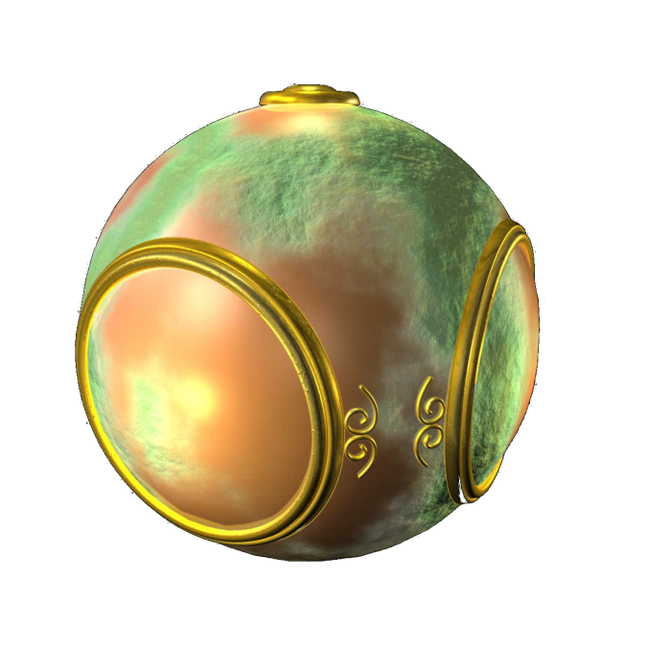

WHY?
Example computer graphics. Some state of the art
Computer Graphics
Notes:
Computer Graphics - Newcastle University
Computer Graphics - Newcastle University

Slide 17
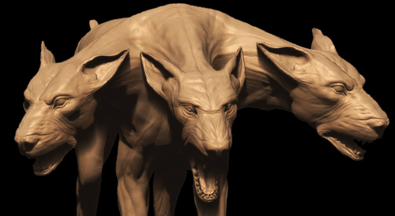
WHY? 2
Example computer graphics. Some state of the art
Motivation, etc etc
Computer Graphics
Notes:
Computer Graphics - Newcastle University
Computer Graphics - Newcastle University

Slide 18

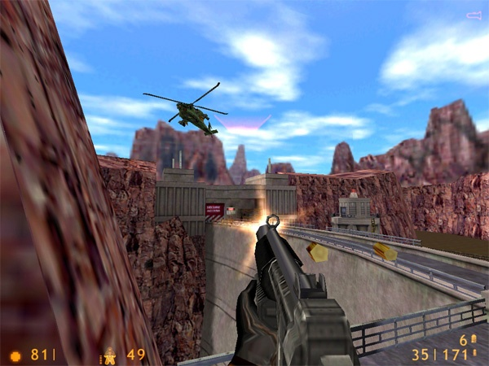
WHY? 3
FarCry, Half-Life
Computer Graphics
Notes:
Computer Graphics - Newcastle University
Computer Graphics - Newcastle University

Slide 19
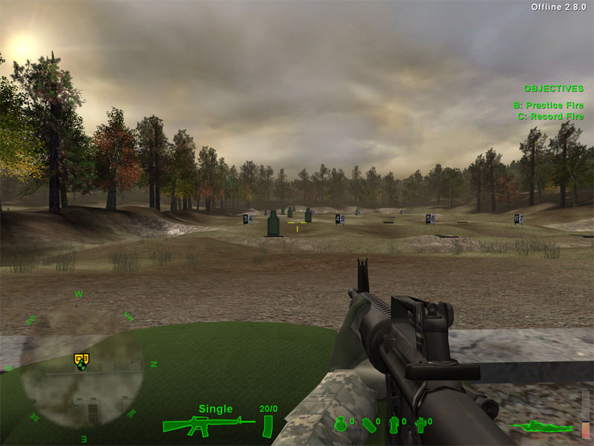
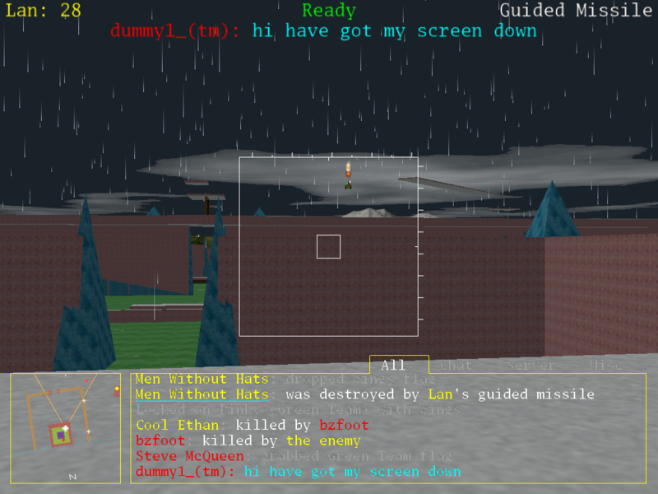
WHY? 4
America’s Army, BZflag
Computer Graphics
Notes:
Computer Graphics - Newcastle University
Computer Graphics - Newcastle University

Slide 20
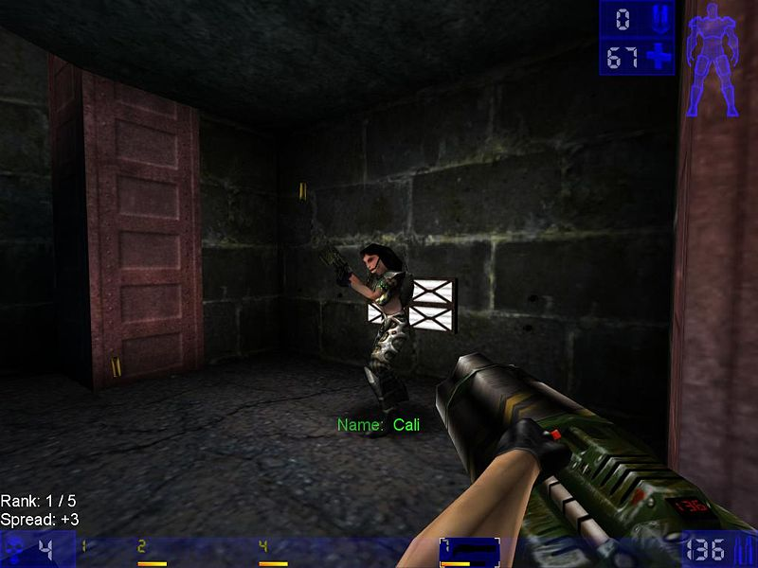
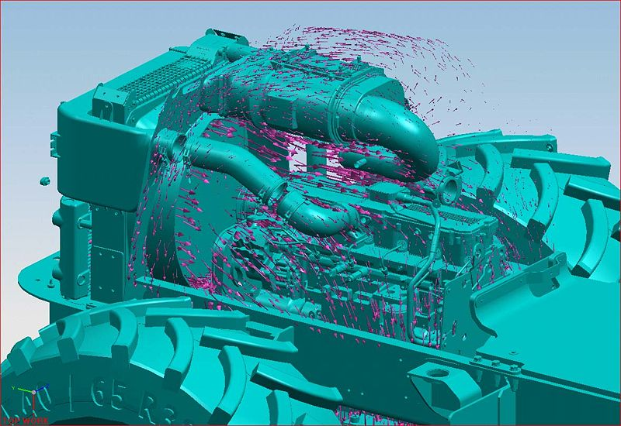
WHY? 5
Unreal Tournament, CAD - airflow
Computer Graphics
Notes:
Computer Graphics - Newcastle University
Computer Graphics - Newcastle University

Slide 21
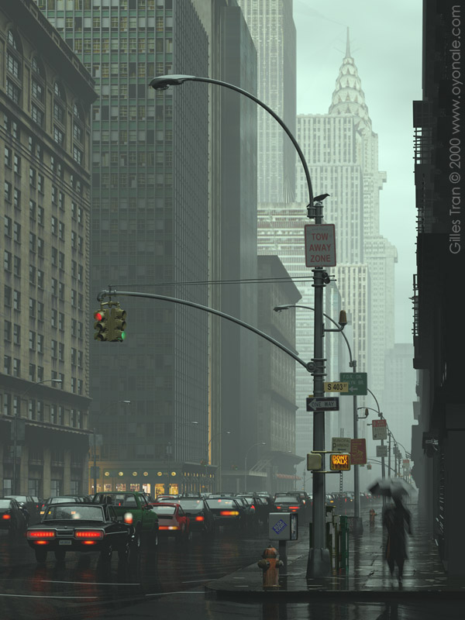
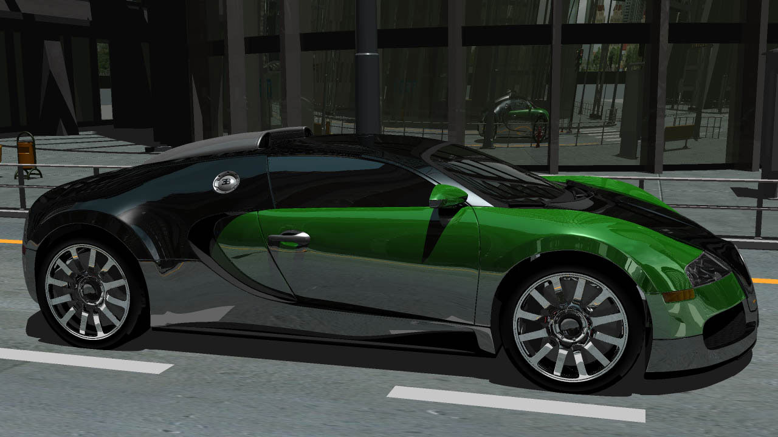
WHY? 6 - The Future
Computer Graphics
Notes:
Computer Graphics - Newcastle University
Computer Graphics - Newcastle University

Slide 22
Extra if we have time
Text: Chapter 8
  Texture Mapping
Computer Graphics
Notes:
Computer Graphics - Newcastle University
Computer Graphics - Newcastle University

