Slide 1
Computer Graphics
Lecture 5 - Programming with OpenGL
John Shearer
Culture Lab – space 2
john.shearer@ncl.ac.uk
http://di.ncl.ac.uk/teaching/csc3201/
Computer Graphics
Notes:
Computer Graphics - Newcastle University
Computer Graphics - Newcastle University

Slide 2
Objectives
Development of the OpenGL API
OpenGL Architecture
  OpenGL as a state machine
Functions
  Types
  Formats
Fundamental OpenGL primitives
Attributes
Simple program
Computer Graphics
Notes:
Computer Graphics - Newcastle University
Computer Graphics - Newcastle University

Slide 3
Early History of APIs
IFIPS (1973) formed two committees to come up with a standard graphics API
  Graphical Kernel System (GKS)
    2D but contained good workstation model
  Core
    Both 2D and 3D
  GKS adopted as IS0 and later ANSI standard (1980s)
GKS not easily extended to 3D (GKS-3D)
  Far behind hardware development
Computer Graphics
Notes:
Computer Graphics - Newcastle University
Computer Graphics - Newcastle University

Slide 4
PHIGS and X
Programmers Hierarchical Graphics System (PHIGS)
  Arose from CAD community
  Database model with retained graphics (structures)
X Window System
  DEC/MIT effort
  Client-server architecture with graphics
PEX combined the two
  Not easy to use (all the defects of each)
Computer Graphics
Notes:
Computer Graphics - Newcastle University
Computer Graphics - Newcastle University

Slide 5
SGI and GL
Silicon Graphics (SGI) revolutionized the graphics workstation by implementing the pipeline in hardware (1982)
To access the system, application programmers used a library called GL
With GL, it was relatively simple to program three dimensional interactive applications
Computer Graphics
Notes:
Computer Graphics - Newcastle University
Computer Graphics - Newcastle University

Slide 6
OpenGL
The success of GL lead to OpenGL (1992), a platform-independent API that was
  Easy to use
  Close enough to the hardware to get excellent performance
  Focus on rendering
  Omitted windowing and input to avoid window system dependencies
Computer Graphics
Notes:
Computer Graphics - Newcastle University
Computer Graphics - Newcastle University

Slide 7
OpenGL Evolution
Originally controlled by an Architectural Review Board (ARB)
  Members included SGI, Microsoft, Nvidia, HP, 3DLabs, IBM,…….
  Relatively stable
    Though recent changes have caused some disruption
    Evolution reflects new hardware capabilities
      3D texture mapping and texture objects
      Vertex programs
  Allows for platform specific features through extensions
  ARB replaced by Kronos
Computer Graphics
Notes:
Computer Graphics - Newcastle University
Computer Graphics - Newcastle University

Slide 8
Kronos
The Khronos Group was founded in January 2000 by a number of leading media-centric companies, including 3Dlabs, ATI, Discreet, Evans & Sutherland, Intel, NVIDIA, SGI and Sun Microsystems, dedicated to creating open standard APIs to enable the authoring and playback of rich media on a wide variety of platforms and devices.
Standards include:
  OpenGL (2D & 3D graphics)
  COLLADA (digital asset exchange)
  glFX (run-time effects API for OpenGL)
  OpenGL ES (Embedded 3D graphics)
  …
Computer Graphics
Notes:
Computer Graphics - Newcastle University
Computer Graphics - Newcastle University

Slide 9
OpenGL Libraries
OpenGL core library
  OpenGL32.dll on Windows
  GL on most unix/linux systems (libGL.a)
OpenGL Utility Library (GLU)
  Provides functionality in OpenGL core but avoids having to rewrite code
Links with window system
  GLX for X window systems
  WGL for Windows
  AGL for Macintosh
Computer Graphics
Notes:
Computer Graphics - Newcastle University
Computer Graphics - Newcastle University

Slide 10
GLUT
OpenGL Utility Toolkit (GLUT)
  Provides functionality common to all window systems
    Open a window
    Get input from mouse and keyboard
    Menus
    Event-driven
  Code is portable but GLUT lacks the functionality of a good toolkit for a specific platform
    No slide bars
Computer Graphics
Notes:
Computer Graphics - Newcastle University
Computer Graphics - Newcastle University

Slide 11
Software Organization
application program
OpenGL Motif
widget or similar
GLUT
GLX, AGL
or WGL
GLU
X, Win32, Mac O/S
GL
software and/or hardware
Computer Graphics
Notes:
Computer Graphics - Newcastle University
Computer Graphics - Newcastle University

Slide 12
OpenGL Architecture
geometry
pipeline
Immediate Mode
Per Vertex
Operations &
Primitive
Assembly
Polynomial
Evaluator
CPU
Display
List
Rasterization
Per Fragment
Operations
Frame
Buffer
Texture
Memory
Pixel
Operations
Computer Graphics
Notes:
Computer Graphics - Newcastle University
Computer Graphics - Newcastle University

Slide 13
OpenGL Functions
Primitives
  Points
  Line Segments
  Polygons
Attributes
Transformations
  Viewing
  Modeling
Control (GLUT / org.lwjgl.opengl )
Input (GLUT / org.lwjgl.input )
Query
Computer Graphics
Notes:
Computer Graphics - Newcastle University
Computer Graphics - Newcastle University

Slide 14
OpenGL State
OpenGL is a state machine
OpenGL functions are of two types
  Primitive generating
    Can cause output if primitive is visible
    How vertices are processed and appearance of primitive are controlled by the state
  State changing
    Transformation functions
    Attribute functions
Computer Graphics
Notes:
Computer Graphics - Newcastle University
Computer Graphics - Newcastle University

Slide 15
Lack of Object Orientation
OpenGL is not object oriented so that there are multiple functions for a given logical function
  glVertex3f – 3 FLOATS
  glVertex2i – 2 INTEGERS
  glVertex3dv
    a vector (pointer to) 3 DOUBLES (in C/C++
    glVertexPointer(int size, int stride, java.nio.FloatBuffer pointer)
Underlying storage mode is the same
Easy to create overloaded functions but issue is efficiency
The OpenGL API is a C API, but in practice most implementations (NVidia, AMD/ATI) are written in C++.
Computer Graphics
Notes:
Computer Graphics - Newcastle University
Computer Graphics - Newcastle University

Slide 16
OpenGL function format
function name
dimensions
glVertex3f(x,y,z)
x,y,z are floats
belongs to GL library
glVertex3fv(p)
p is a pointer to an array
Computer Graphics
Notes:
Computer Graphics - Newcastle University
Computer Graphics - Newcastle University

Slide 17
OpenGL defines
Most constants are defined in the package org.lwjgl.opengl.GL11
Examples
  glBegin(GL_POLYGON)
  glClear(GL_COLOR_BUFFER_BIT)
include files or org.lwjgl.opengl.GL11 package in LWJGL, also define OpenGL data types: GLfloat, GLdouble,….
Computer Graphics
Notes:
Computer Graphics - Newcastle University
Computer Graphics - Newcastle University

Slide 18
Coordinate Systems
The units in glVertex are determined by the application and are called object or problem coordinates
The viewing specifications are also in object coordinates and it is the size of the viewing volume that determines what will appear in the image
Internally, OpenGL will convert to camera (eye) coordinates and later to screen coordinates
OpenGL also uses some internal representations that usually are not visible to the application
Computer Graphics
Notes:
Computer Graphics - Newcastle University
Computer Graphics - Newcastle University

Slide 19
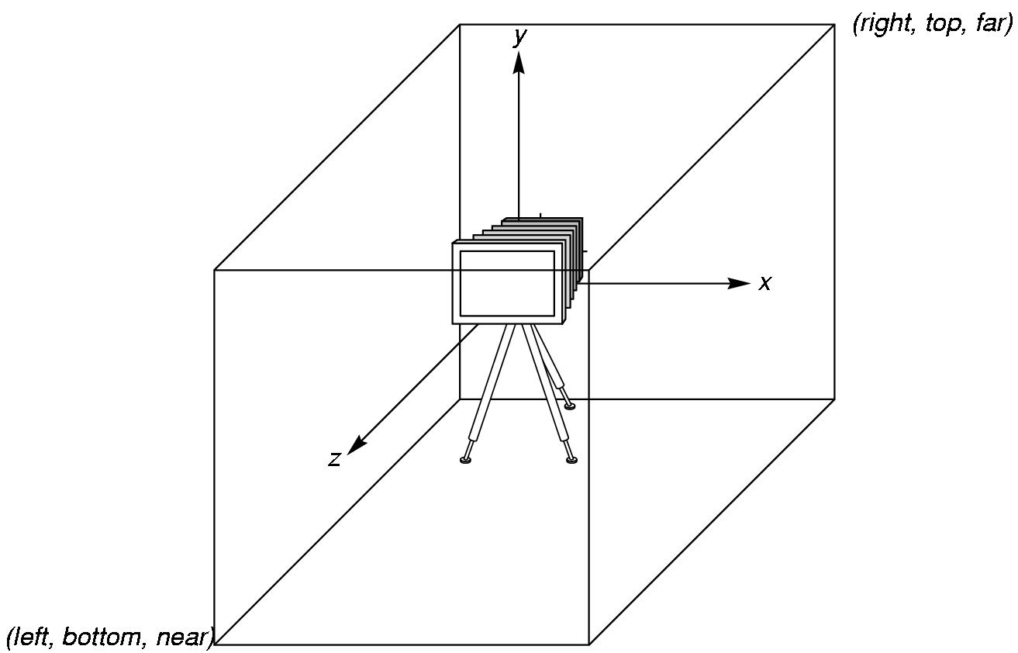
OpenGL Camera
OpenGL places a camera at the origin in object space pointing in the negative z direction
The default viewing volume
is a box centered at the
origin with a side of
length 2
Computer Graphics
Notes:
Computer Graphics - Newcastle University
Computer Graphics - Newcastle University

Slide 20
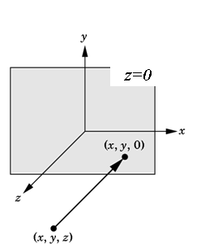
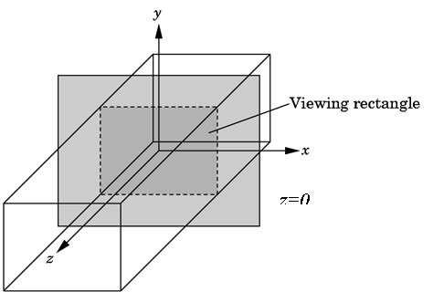
Orthographic Viewing
In the default orthographic view, points are
projected forward along the z axis onto the
plane z=0
Computer Graphics
Notes:
Computer Graphics - Newcastle University
Computer Graphics - Newcastle University

Slide 21
Transformations and Viewing
In OpenGL, projection is carried out by a projection matrix (transformation)
There is only one set of transformation functions so we must set the matrix mode first
glMatrixMode (GL_PROJECTION)
Transformation functions are incremental so we start with an identity matrix and alter it with a projection matrix that gives the view volume
glLoadIdentity();
glOrtho(-1.0, 1.0, -1.0, 1.0, -1.0, 1.0);
Computer Graphics
Notes:
Computer Graphics - Newcastle University
Computer Graphics - Newcastle University

Slide 22
Projection matrix & Modelview matrix
OpenGL uses two matrices (projection & modelview) to make life simpler. A single matrix could be used (as two matrices can be multiplied together to create just one).
In most scenarios the projection the user/programmer wants is rarely changed, so the projection matrix is used for this and isn't changed often
The modelview matrix is used to transform the position, orientation, etc of objects in the real world and so is changed very frequently (when objects move, but more importantly, it is different for each object).
Computer Graphics
Notes:
Computer Graphics - Newcastle University
Computer Graphics - Newcastle University

Slide 23
GL_PROJECTION
glMatrixMode(GL_PROJECTION);
glLoadIdentity();
glOrtho(-1, 1, -1, 1, -1.0, 1.0);
glTranslate( 100, 100, 100 );
glRotateF( 45, 1, 0, 0 );
Really means:
GL_PROJECTION_MATRIX =
IDENTITY
* ORTHOGRAPHIC_MATRIX
* TRANSLATION_MATRIX
* ROTATION_MATRIX
Computer Graphics
Notes:
Computer Graphics - Newcastle University
Computer Graphics - Newcastle University

Slide 24
GL_MODELVIEW
glMatrixMode(GL_MODELVIEW);
glLoadIdentity();
glTranslate( 100, 100, 100 );
glRotateF( 45, 1, 0, 0 );
glPushMatrix();
  glTranslate( carx, cary, carz );
  // draw car here, by specifying various gl vertices
glPopMatrix();
glPushMatrix();
  glTranslate( battleshipx, battleshipy, battleshipz );
  // draw battleship here, by specifying various gl vertices
glPopMatrix();
car_vertice_matrix = projection_ortho_matrix * projection_translation * car_translation_matrix
battleship_vertice_matrix = projection_ortho_matrix * projection_translation * battleship_translation_matrix
Computer Graphics
Notes:
Computer Graphics - Newcastle University
Computer Graphics - Newcastle University

Slide 25
Two- and three-dimensional viewing
In glOrtho(left, right, bottom, top, near, far) the near and far distances are measured from the camera
Two-dimensional vertex commands place all vertices in the plane z=0
If the application is in two dimensions, we can use the function
gluOrtho2D(left, right,bottom,top)
In two dimensions, the view or clipping volume becomes a clipping window
Computer Graphics
Notes:
Computer Graphics - Newcastle University
Computer Graphics - Newcastle University

Slide 26
OpenGL Primitives
GL_POINTS
GL_POLYGON
GL_LINE_STRIP
GL_LINE_LOOP
GL_TRIANGLES
GL_QUAD_STRIP
GL_TRIANGLE_STRIP
GL_TRIANGLE_FAN
Any missing?
Computer Graphics
Notes:
Computer Graphics - Newcastle University
Computer Graphics - Newcastle University

Slide 27
Polygon Issues
OpenGL will only display polygons correctly that are
  Simple: edges cannot cross
  Convex: All points on line segment between two points in a polygon are also in the polygon
  Flat: all vertices are in the same plane
User program can check if above true
  OpenGL will produce output if these conditions are violated but it may not be what is desired
Triangles satisfy all conditions
nonsimple polygon
nonconvex polygon
Computer Graphics
Notes:
Computer Graphics - Newcastle University
Computer Graphics - Newcastle University

Slide 28
Attributes
Attributes are part of the OpenGL state and determine the appearance of objects
  Color (points, lines, polygons)
  Size and width (points, lines)
  Stipple pattern (lines, polygons)
  Polygon mode
    Display as filled: solid color or stipple pattern
    Display edges
    Display vertices
Computer Graphics
Notes:
Computer Graphics - Newcastle University
Computer Graphics - Newcastle University

Slide 29
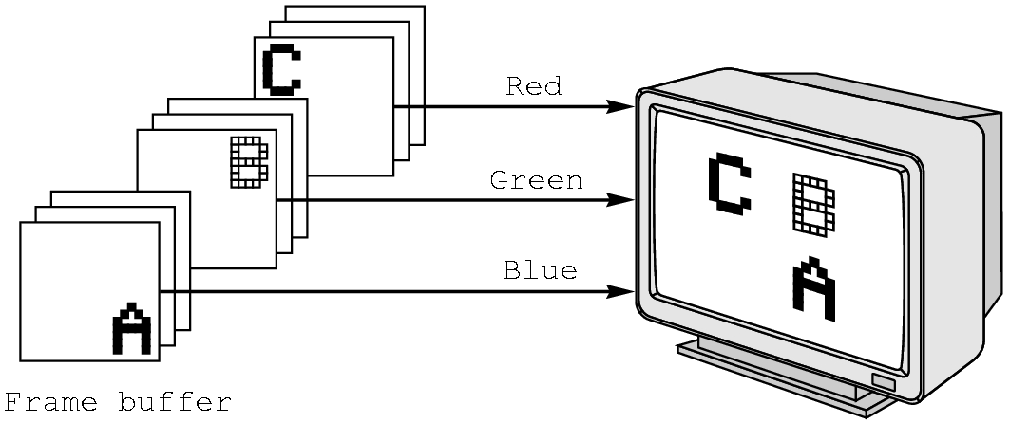
RGB color
Each color component is stored separately in the frame buffer
Usually 8 bits per component in buffer
Note in glColor3f the color values range from 0.0 (none) to 1.0 (all), whereas in glColor3ub the values range from 0 to 255
Computer Graphics
Notes:
Computer Graphics - Newcastle University
Computer Graphics - Newcastle University

Slide 30
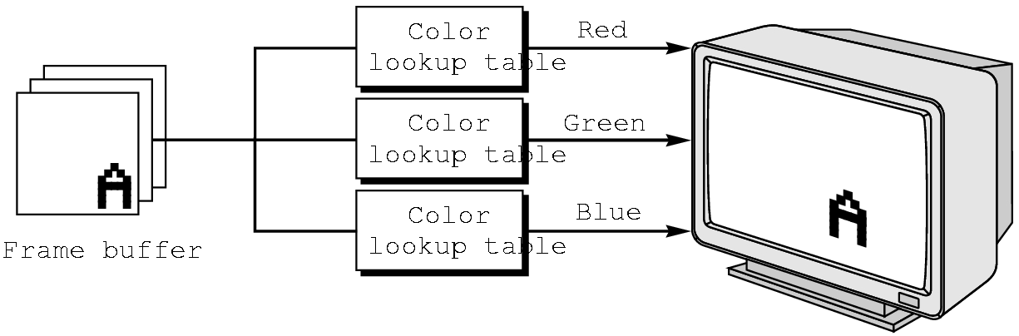
Indexed Color
Colors are indices into tables of RGB values
Requires less memory
  indices usually 8 bits
  not as important now
    Memory inexpensive
    Need more colors for shading
Computer Graphics
Notes:
Computer Graphics - Newcastle University
Computer Graphics - Newcastle University

Slide 31
Color and State
The color as set by glColor becomes part of the state and will be used until changed
  Colors and other attributes are not part of the object but are assigned when the object is rendered
We can create conceptual vertex colors by code such as
glColor
glVertex
glColor
glVertex
Computer Graphics
Notes:
Computer Graphics - Newcastle University
Computer Graphics - Newcastle University

Slide 32
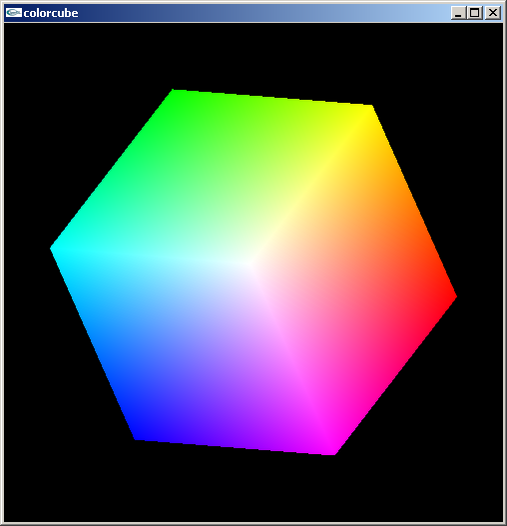
Smooth Color
Default is smooth shading
  OpenGL interpolates vertex colors across visible polygons
Alternative is flat shading
  Color of first vertex
  determines fill color
glShadeModel
  (GL_SMOOTH)
  or GL_FLAT
Computer Graphics
Notes:
Computer Graphics - Newcastle University
Computer Graphics - Newcastle University

Slide 33
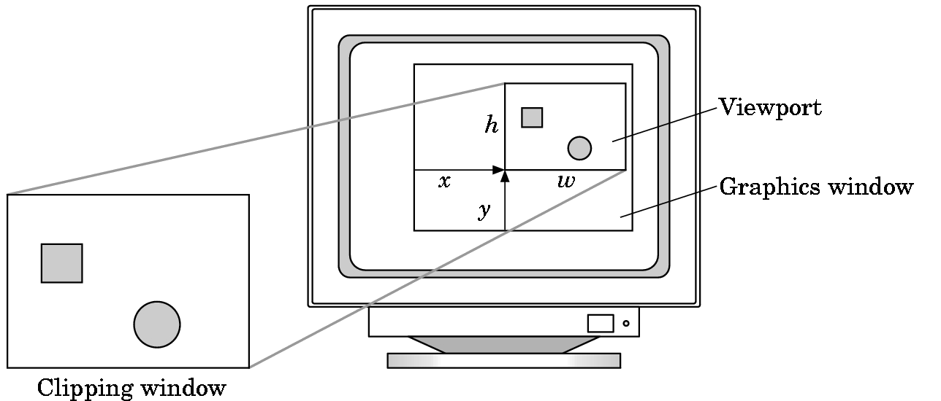
Viewports
Do not have use the entire window for the image: glViewport(x,y,w,h)
Values in pixels (screen coordinates)
Computer Graphics
Notes:
Computer Graphics - Newcastle University
Computer Graphics - Newcastle University

