Slide 1
Computer Graphics
Lecture 3 - Image Formation
John Shearer
Culture Lab – space 2
john.shearer@ncl.ac.uk
http://di.ncl.ac.uk/teaching/csc3201/
Computer Graphics
Notes:
Computer Graphics - Newcastle University

Slide 2
Book
Lecture 1 introduced the text for the course
Ed Angel, Interactive Computer Graphics, A Top-down Approach with OpenGL (Fifth Edition), Addison-Wesley – ISBN 0321535863
All lecture content for this module is based on the book
It is HIGHLY recommended that you get hold of a copy
Computer Graphics
Notes:
Computer Graphics - Newcastle University

Slide 3
Objectives
Fundamental imaging notions
Physical basis for image formation
  Light
  Color
  Perception
Synthetic camera model
Other models
Computer Graphics
Notes:
Computer Graphics - Newcastle University

Slide 4
Image Formation
In computer graphics, we form images which are generally two dimensional using a process analogous to how images are formed by physical imaging systems
  Cameras
  Microscopes
  Telescopes
  Human visual system
Computer Graphics
Notes:
Computer Graphics - Newcastle University

Slide 5
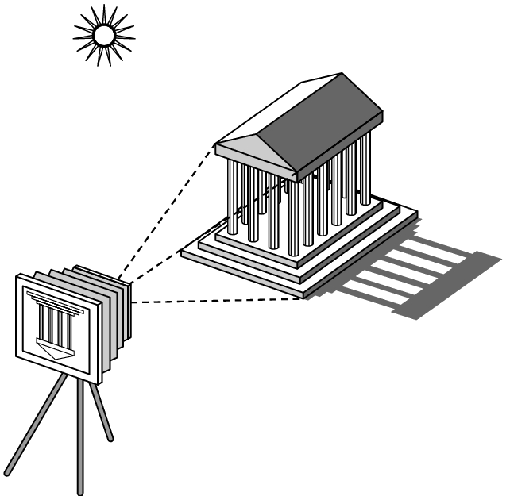
Elements of Image Formation
Objects
Viewer
Light source(s)
Attributes that govern how light interacts with the materials in the scene
Note the independence of the objects, the viewer, and the light source(s)
Computer Graphics
Notes:
Computer Graphics - Newcastle University

Slide 6
Light
Light is the part of the electromagnetic spectrum that causes a reaction in our visual systems
Generally these are wavelengths in the range of about 350-750 nm (nanometers)
Long wavelengths appear as reds and short wavelengths as blues
Computer Graphics
Notes:
Computer Graphics - Newcastle University

Slide 7
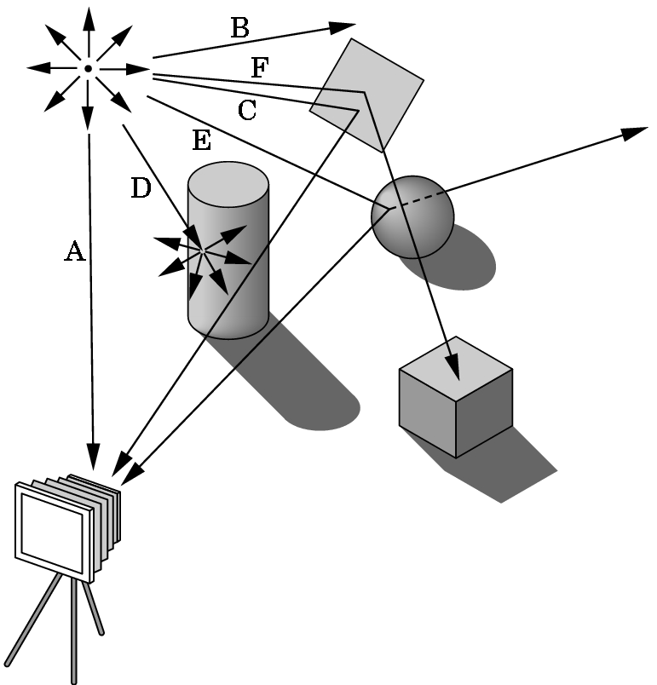
Ray Tracing and Geometric Optics
One way to form an image is to follow rays of light from a point source finding which rays enter the lens of the camera.
However, each ray of light may have multiple interactions with objects before being absorbed or going to infinity.
Computer Graphics
Notes:
Computer Graphics - Newcastle University

Slide 8
Luminance and Color Images
Luminance Image
  Monochromatic
  Values are gray levels
  Analogous to working with black and white film or television
Color Image
  Has perceptional attributes of hue, saturation, and lightness
  Do we have to match every frequency in visible spectrum? No!
Computer Graphics
Notes:
Computer Graphics - Newcastle University

Slide 9
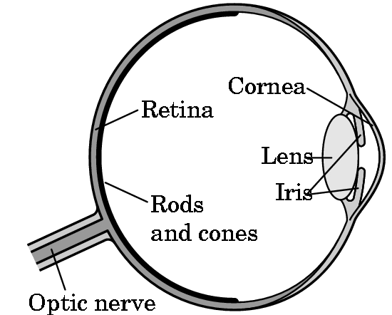
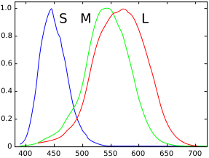
Three-Color Theory
Human visual system has two types of sensors
  Rods: monochromatic, night vision
  Cones
    Color sensitive
    Three types of cones
    Only three values (the tristimulus
    values) are sent to the brain
Need only match these three values
  Need only three primary colors
Computer Graphics
Notes:
Computer Graphics - Newcastle University

Slide 10
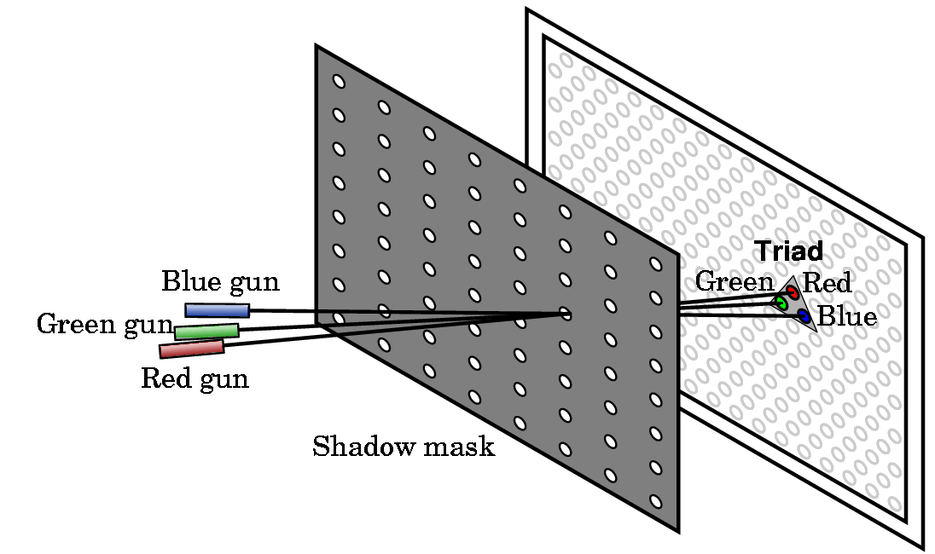
Shadow Mask CRT
Computer Graphics
Notes:
Computer Graphics - Newcastle University

Slide 11
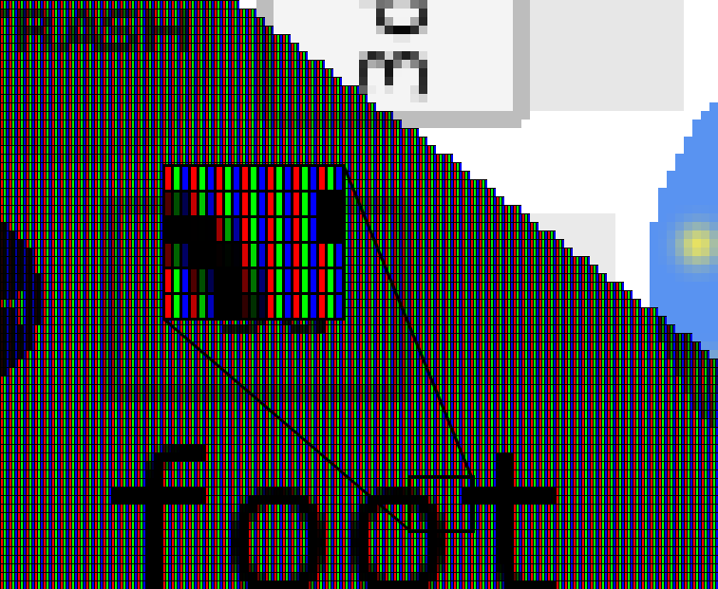
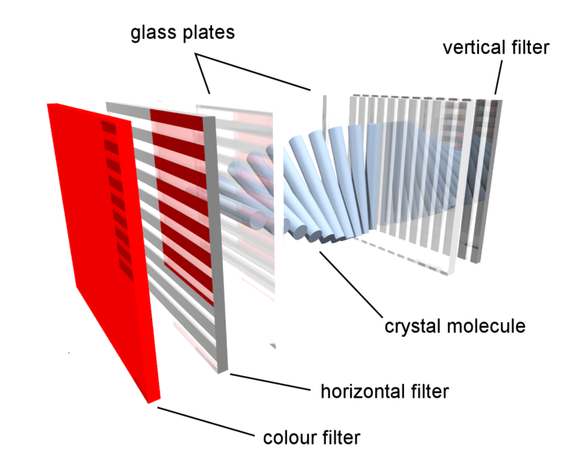
Colour LCD
Computer Graphics
Notes:
Computer Graphics - Newcastle University

Slide 12
Additive and Subtractive Color
Additive color
  Form a color by adding amounts of three primaries
    CRTs, projection systems, positive film
  Primaries are Red (R) (#FF0000), Green (G) (#00FF00) , Blue (B) (#0000FF)
Subtractive color
  Form a color by filtering white light with cyan (C) #00FFFF), Magenta (M) (#FF00FF), and Yellow (Y) (#FFFF00)) filters
    Light-material interactions
    Printing
    Negative film
Computer Graphics
Notes:
Computer Graphics - Newcastle University

Slide 13
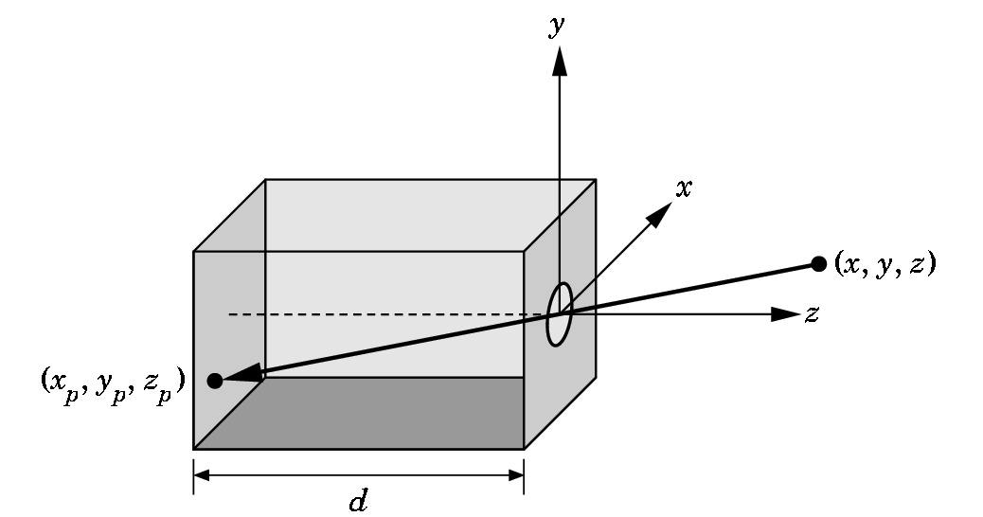
Pinhole Camera
Use trigonometry to find projection of point at (x,y,z)
x_{p}= -x/z/d
y_{p}= -y/z/d
z_{p}= d
These are equations of simple perspective
Computer Graphics
Notes:
Computer Graphics - Newcastle University

Slide 14
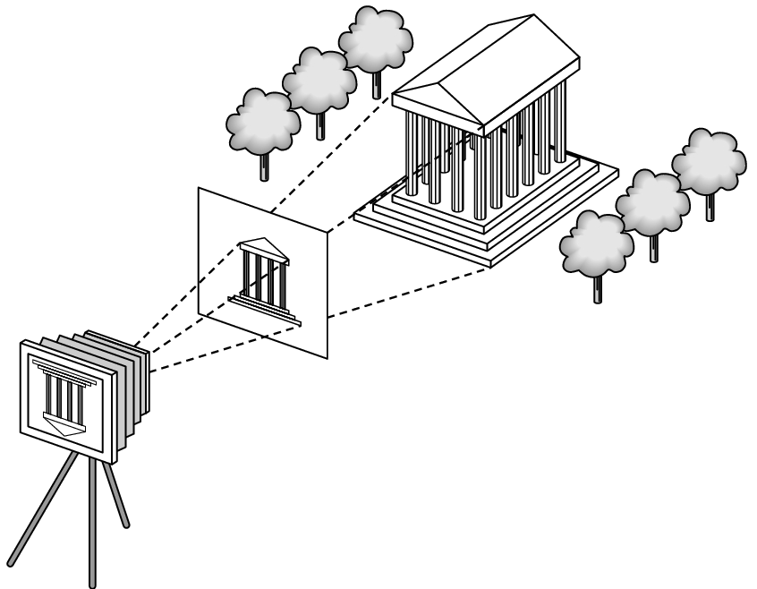
Synthetic Camera Model
projector
p
image plane
projection of p
center of projection
Computer Graphics
Notes:
Computer Graphics - Newcastle University

Slide 15
Advantages
Separation of objects, viewer, light sources
Two-dimensional graphics is a special case of three-dimensional graphics
Leads to simple software API
  Specify objects, lights, camera, attributes
  Let implementation determine image
Leads to fast hardware implementation
Computer Graphics
Notes:
Computer Graphics - Newcastle University

Slide 16
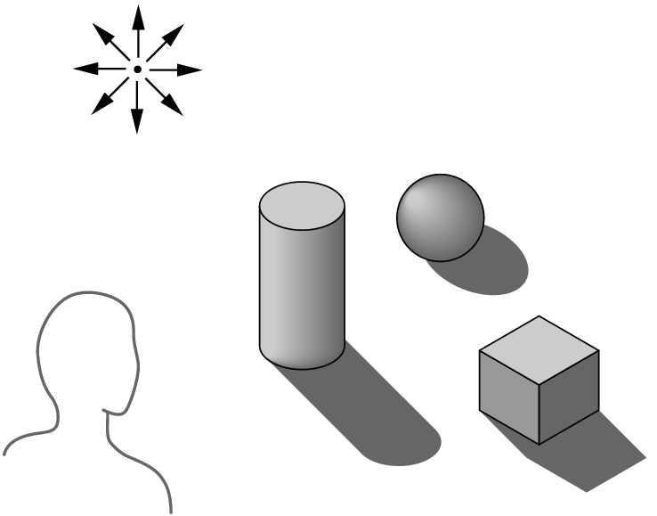
Global vs Local Lighting
Cannot compute color or shade of each object independently
  Some objects are blocked from light
  Light can reflect from object to object
  Some objects might be translucent
Computer Graphics
Notes:
Computer Graphics - Newcastle University

Slide 17
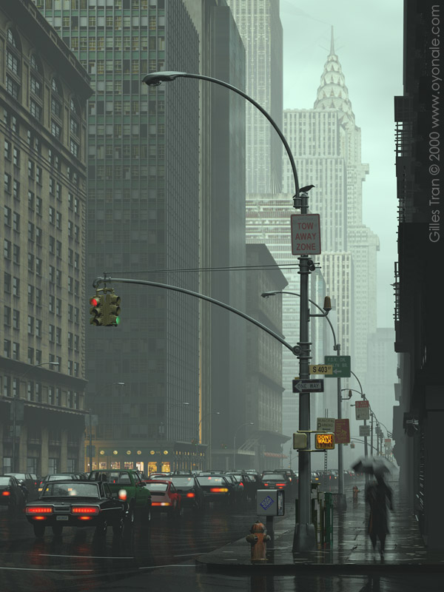
Why not ray tracing?
Ray tracing seems more physically based so why don’t we use it to design a graphics system?
Possible and is actually simple for simple objects such as polygons and quadrics with simple point sources
In principle, can produce global lighting effects such as shadows and multiple reflections but ray tracing is slow and not well-suited for interactive applications
Computer Graphics
Notes:
Computer Graphics - Newcastle University
Image from http://www.oyonale.com/image.php?code=464
State of the art:
http://santyhammer.blogspot.com/2008/02/current-state-of-ray-tracing.html
http://scidok.sulb.uni-saarland.de/volltexte/2008/1404/pdf/Dissertation_1986_Pomi_Andr_2005.pdf
http://www.hothardware.com/News/NVIDIA-Shows-Interactive-Ray-Tracing-on-GPUs/

