Slide 1
Computer Graphics
Programming with OpenGL
Three Dimensions – 2
Lecture 7
John Shearer
Culture Lab – space 2
john.shearer@ncl.ac.uk
http://di.ncl.ac.uk/teaching/csc3201/
Computer Graphics
Notes:
Computer Graphics - Newcastle University

Slide 2
Objectives
Extend Sierpinski gasket to 3D
Other ways of making Sierpinski gasket
Computer Graphics
Notes:
Computer Graphics - Newcastle University

Slide 3
Moving to 3D
We can easily make the program three-dimensional by using
  glVertex3f
  glOrtho
But that would not be very interesting
  The gasket is still a 2D object
Instead, we can start with a tetrahedron
Computer Graphics
Notes:
Computer Graphics - Newcastle University

Slide 4
3D Sierpinski Gasket
Tetrahedron / Triangle-based pyramid
  Polyhedron composed of four triangular faces
  Three of which meet at each vertex
Either:
  Slice through the tetrahedron with the points through the bisectors of each side
  Subdivide each of the four faces
Computer Graphics
Notes:
Computer Graphics - Newcastle University

Slide 5
3D Sierpinski Gasket 2
Appears as if we remove a solid tetrahedron from the center leaving four smaller tetrahedra
Computer Graphics
Notes:
Computer Graphics - Newcastle University

Slide 6
divideTriangle
pseudocode
divideTriangle(vector2f a, vector2f b, vector2f c, int m)
{
// triangle subdivision using vertex numbers
vector2f v0, v1, v2;
if(m>0)
{
v0.x = (a.x +_b.x) / 2;
v0.y = (a.y +_b.y) / 2;
v1.x = (b.x +_c.x) / 2;
v1.y = (b.y +_c.y) / 2;
v2.x = (c.x +_a.x) / 2;
v2.y = (c.y +_a.y) / 2;
divide_triangle(a, v0, v1, m-1);
divide_triangle(c, v1, v2, m-1);
divide_triangle(b, v2, v0, m-1);
}
else(triangle(a,b,c));
// draw triangle at end of recursion
}
Computer Graphics
Notes:
Computer Graphics - Newcastle University

Slide 7
Subdividing triangular faces
Use divideTriangle from 2D
How to apply to a tetrahedron?
Computer Graphics
Notes:
Computer Graphics - Newcastle University

Slide 8
Subdividing triangular faces 2
Use divideTriangle from 2D
How to apply to a tetrahedron?
void tetrahedron( int m)
{
glColor3f(1.0,0.0,0.0);
divide_triangle(v[0], v[1], v[2], m);
glColor3f(0.0,1.0,0.0);
divide_triangle(v[3], v[2], v[1], m);
glColor3f(0.0,0.0,1.0);
divide_triangle(v[0], v[3], v[1], m);
glColor3f(0.0,0.0,0.0);
divide_triangle(v[0], v[2], v[3], m);
}
Computer Graphics
Notes:
Computer Graphics - Newcastle University

Slide 9
Almost Correct 1
The triangles are drawn in the order they are defined in the program, so the front triangles are not always rendered in front of triangles behind them
…
Computer Graphics
Notes:
Computer Graphics - Newcastle University

Slide 10
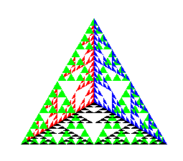
Almost Correct 2 – what we get
Computer Graphics
Notes:
Computer Graphics - Newcastle University

Slide 11
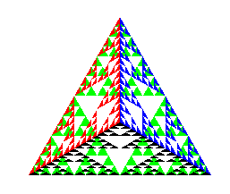
Almost Correct 3 – what we want
Computer Graphics
Notes:
Computer Graphics - Newcastle University

Slide 12
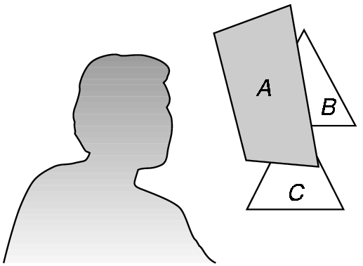
Hidden-Surface Removal
We want to see only those surfaces in front of other surfaces
OpenGL uses a hidden-surface method called the z-buffer algorithm that saves depth information as objects are rendered so that only the front objects appear in the image
Computer Graphics
Notes:
Computer Graphics - Newcastle University

Slide 13
Using the z-buffer algorithm
The algorithm uses an extra buffer, the z-buffer, to store depth information as geometry travels down the pipeline
It must be
  Lwjgl have z-buffer enabled by default
  Enabled in init
    glEnable(GL_DEPTH_TEST)
  Cleared in the display callback
    glClear(GL_COLOR_BUFFER_BIT |
    GL_DEPTH_BUFFER_BIT)
Computer Graphics
Notes:
Computer Graphics - Newcastle University

Slide 14
Surface vs Volume Subdvision
In our example, we divided the surface of each face
We could also divide the volume using the same midpoints
The midpoints define four smaller tetrahedrons, one for each vertex
Keeping only these tetrahedrons removes a volume in the middle
Computer Graphics
Notes:
Computer Graphics - Newcastle University

Slide 15
Volume Subdvision
What functions do we need?
Computer Graphics
Notes:
Computer Graphics - Newcastle University

Slide 16
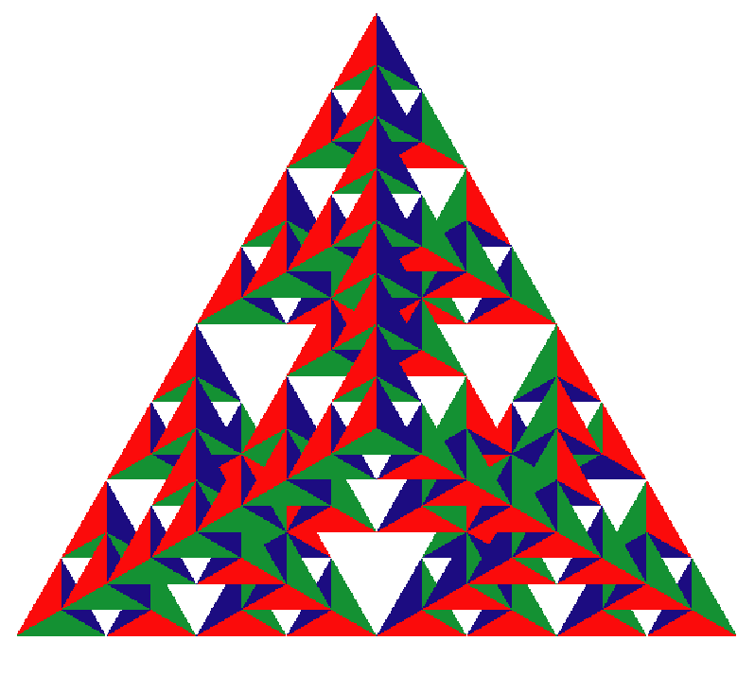
Volume Subdvision
What functions do we need?
  drawTetrahedron
  divideTetrahodron
Computer Graphics
Notes:
Computer Graphics - Newcastle University

Slide 17
Back-face culling
Determines whether a polygon of a graphical object is visible, depending on the position of the camera.
Tests whether the points in the polygon appear in clockwise or counter-clockwise order when projected onto the screen.
User specifies that front-facing polygons have a clockwise winding (or vice-versa), if the polygon projected on the screen has a counter-clockwise winding it has been rotated to face away from the camera and will not be drawn.
Makes rendering objects quicker and more efficient by reducing the number of polygons for the program to draw
Computer Graphics
Notes:
Computer Graphics - Newcastle University

Slide 18
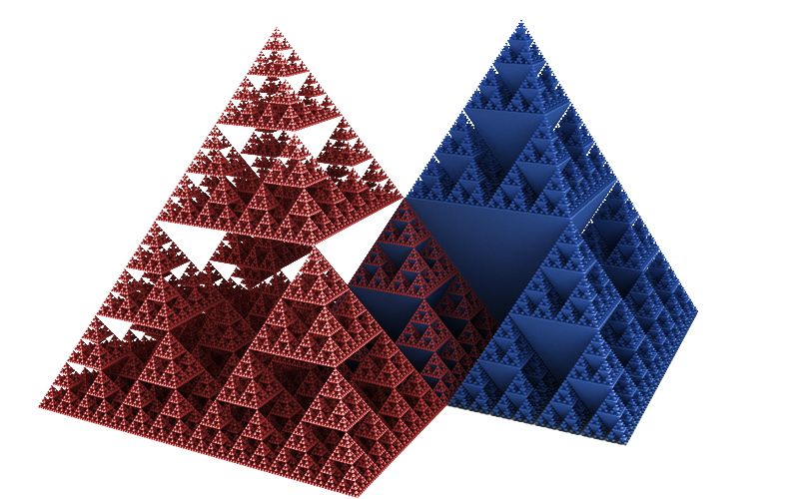
Square-based Sierpinski Gasket
A Sierpiński square-based pyramid and its 'inverse'
Computer Graphics
Notes:
Computer Graphics - Newcastle University

Slide 19
Another way of making Sierpinski gasket
Take 3 points in a plane, and form a triangle
Randomly select any point inside the triangle and move half the distance from that point to any of the 3 vertex points. Plot the current position.
Repeat from step 2.
Write some pseudo code to draw the above
Would this work well in openGL?
Computer Graphics
Notes:
Computer Graphics - Newcastle University

