Slide 1
Computer Graphics
Input and Interaction
Lecture 8
John Shearer
Culture Lab – space 2
john.shearer@ncl.ac.uk
http://di.ncl.ac.uk/teaching/csc3201/
Computer Graphics
Notes:
Computer Graphics - Newcastle University

Slide 2
Objectives
Introduce the basic input devices
  Physical Devices
  Logical Devices
  Input Modes
Event-driven input
Introduce double buffering for smooth animations
Computer Graphics
Notes:
Computer Graphics - Newcastle University

Slide 3
Project Sketchpad
Ivan Sutherland (MIT 1963) established the basic interactive paradigm that characterizes interactive computer graphics:
  User sees an object on the display
  User points to (picks) the object with an input device (light pen, mouse, trackball)
  Object changes (moves, rotates, morphs)
  Repeat
Computer Graphics
Notes:
Computer Graphics - Newcastle University

Slide 4
Graphical Input
Devices can be described either by
  Physical properties
    Mouse
    Keyboard
    Trackball
  Logical Properties
    What is returned to program via API
      A position
      An object identifier
Modes
  How and when input is obtained
    Request or event
Computer Graphics
Notes:
Computer Graphics - Newcastle University

Slide 5
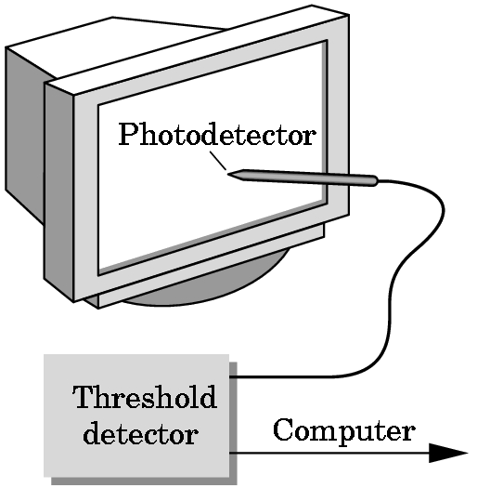
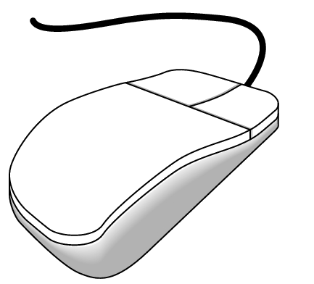
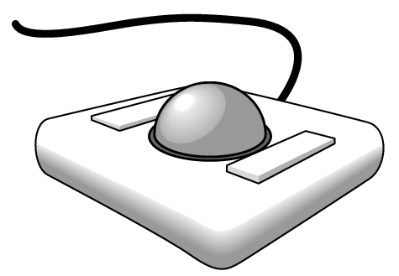
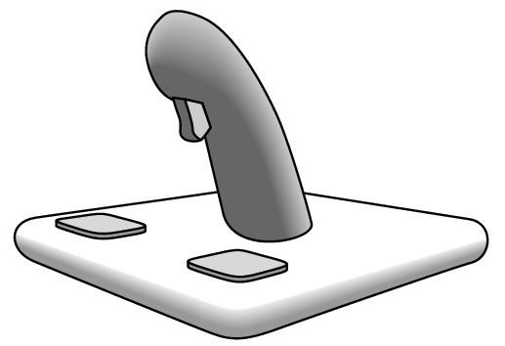
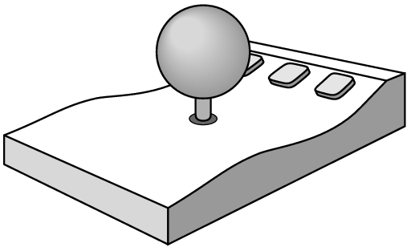
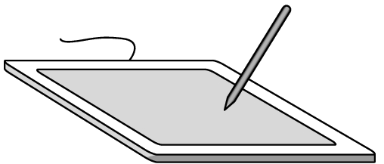
Physical Devices
mouse
trackball
light pen
data tablet
space ball
joystick
Computer Graphics
Notes:
Computer Graphics - Newcastle University

Slide 6
Incremental (Relative) Devices
Devices such as the data tablet return a position directly to the operating system
Devices such as the mouse, trackball, and joy stick return incremental inputs (or velocities) to the operating system
  Must integrate these inputs to obtain an absolute position
    Rotation of cylinders in mouse
    Roll of trackball
    Difficult to obtain absolute position
    Can get variable sensitivity
Computer Graphics
Notes:
Computer Graphics - Newcastle University

Slide 7
Logical Devices
Consider the C and C++ code
  C++: cin >> x;
  C: scanf (“%d”, &x);
What is the input device?
  Can’t tell from the code
  Could be keyboard, file, output from another program
The code provides logical input
  A number (an int) is returned to the program regardless of the physical device
Computer Graphics
Notes:
Computer Graphics - Newcastle University

Slide 8
Graphical Logical Devices
Graphical input is more varied than input to standard programs which is usually numbers, characters, or bits
Two older APIs (GKS, PHIGS) defined six types of logical input
  Locator: return a position
  Pick: return ID of an object
  Keyboard: return strings of characters
  Stroke: return array of positions
  Valuator: return floating point number
  Choice: return one of n items
Computer Graphics
Notes:
Computer Graphics - Newcastle University

Slide 9
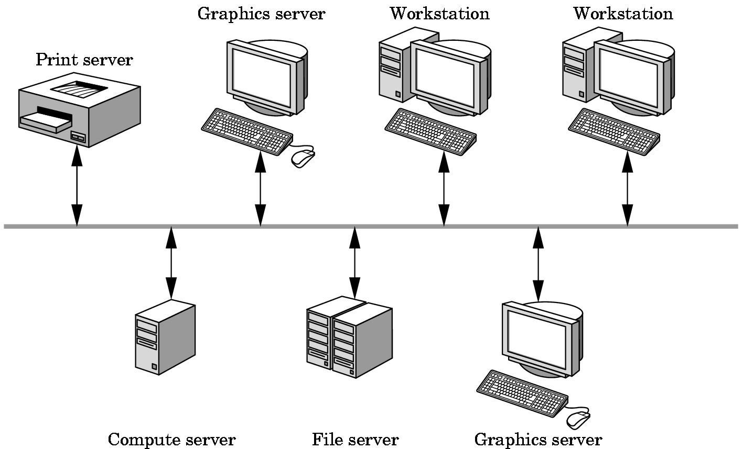
X Window Input
The X Window System introduced a client-server model for a network of workstations
  Client: OpenGL program
  Graphics Server: bitmap display with a pointing device and a keyboard
Computer Graphics
Notes:
Computer Graphics - Newcastle University

Slide 10
Input Modes
Input devices contain a trigger which can be used to send a signal to the operating system
  Button on mouse
  Pressing or releasing a key
When triggered, input devices return information (their measure) to the system
  Mouse returns position information
  Keyboard returns ASCII code
Computer Graphics
Notes:
Computer Graphics - Newcastle University

Slide 11
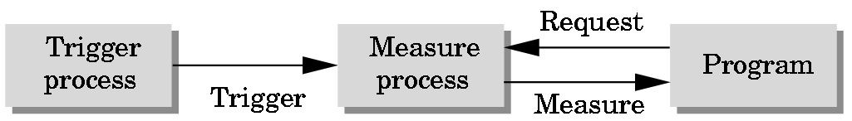
Request Mode
Input provided to program only when user triggers the device
Typical of keyboard input
  Can erase (backspace), edit, correct until enter (return) key (the trigger) is depressed
Computer Graphics
Notes:
Computer Graphics - Newcastle University

Slide 12
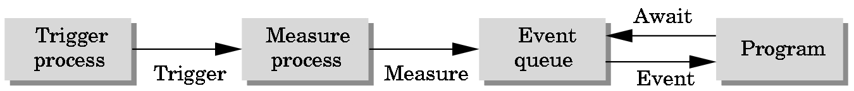
Event Mode
Most systems have more than one input device, each of which can be triggered at an arbitrary time by a user
Each trigger generates an event whose measure is put in an event queue which can be examined by the user program
Computer Graphics
Notes:
Computer Graphics - Newcastle University

Slide 13
Event Types
Window: resize, expose, iconify
Mouse: click one or more buttons
Motion: move mouse
Keyboard: press or release a key
Idle: nonevent
  Define what should be done if no other event is in queue
Computer Graphics
Notes:
Computer Graphics - Newcastle University

Slide 14
Callbacks
Programming interface for event-driven input
Define a callback function for each type of event the graphics system recognizes
This user-supplied function is executed when the event occurs
GLUT example: glutMouseFunc(mymouse)
GLFW: http://gpwiki.org/index.php/GLFW:Tutorials:Basics#Input
Computer Graphics
Notes:
Computer Graphics - Newcastle University

Slide 15
Input in LWJGL
Mouse and Keyboard can be accessed through their associated classes
  org.lwjgl.input.Keyboard (used to poll the current state of the keys, or read all the keyboard presses / releases since the last read)
  org.lwjgl.input.Mouse (used to poll the current state of the mouse buttons, and determine the mouse movement delta since the last poll)
Controllers API in LWJGL is based on Jinput
While JInput provides access to controllers including keyboard and mouse that LWJGL does not support access to the keyboard and mouse via the controllers API.
Computer Graphics
Notes:
Computer Graphics - Newcastle University

Slide 16
Animating a Display
When we redraw the display through the display callback, we usually start by clearing the window
  glClear()
then draw the altered display
Problem: the drawing of information in the frame buffer is decoupled from the display of its contents
  Graphics systems use dual ported memory (can be read while being written to)
so we can see partially drawn display (except glfw & lwjgl defaults to double buffered so we don’t see it, unless you force a single-buffered window)
Computer Graphics
Notes:
Computer Graphics - Newcastle University

Slide 17
Double Buffering
Instead of one colour buffer, we use two
  Front Buffer: one that is displayed but not written to
  Back Buffer: one that is written to but not displayed
glutInitDisplayMode(GL_RGB | GL_DOUBLE)
LWJGL defaults to double buffered
  Could we have other numbers of colour buffers? 3, 4, 5, 6 ??? When? Why?
At the end of the display callback buffers are swapped
  void mydisplay()
  {
  glClear(GL_COLOR_BUFFER_BIT|….)
  .
  /* draw graphics here */
  .
  glutSwapBuffers() // C++ (GLUT)
  glfwSwapBuffers() // C++ (GLFW)
  GL11.update() // Java calls GL11.SwapBuffers() on our behalf
  }
Computer Graphics
Notes:
Computer Graphics - Newcastle University

Slide 18
How might one animate a display?
What would be involved?
Can you think of any potential hazards?
Computer Graphics
Notes:
Computer Graphics - Newcastle University

