Slide 1
Computer Graphics
Better Interactive Programs
Lecture 9
John Shearer
Culture Lab – space 2
john.shearer@ncl.ac.uk
http://di.ncl.ac.uk/teaching/csc3201/
Computer Graphics
Notes:
Computer Graphics - Newcastle University

Slide 2
Objectives
Learn to build more sophisticated interactive programs using
  Picking
    Select objects from the display
    Three methods
  Rubberbanding
    Interactive drawing of lines and rectangles
  Display Lists
    Retained mode graphics
Computer Graphics
Notes:
Computer Graphics - Newcastle University

Slide 3
Picking
Identify a user-defined object on the display
In principle, it should be simple because the mouse gives the position and we should be able to determine to which object(s) a position corresponds
Practical difficulties
  Pipeline architecture is feed forward, hard to go from screen back to world
  Complicated by screen being 2D, world is 3D
  How close do we have to come to object to say we selected it?
Computer Graphics
Notes:
Computer Graphics - Newcastle University

Slide 4
Three Approaches
Hit list
  Most general approach but most difficult to implement
Use back or some other buffer to store object IDs as the objects are rendered
Rectangular maps
  Easy to implement for many applications
  See paint program in text
Computer Graphics
Notes:
Computer Graphics - Newcastle University

Slide 5
Rendering Modes
OpenGL can render in one of three modes selected by glRenderMode(mode)
  GL_RENDER: normal rendering to the frame buffer (default)
  GL_FEEDBACK: provides list of primitives rendered but no output to the frame buffer
  GL_SELECTION: Each primitive in the view volume generates a hit record that is placed in a name stack which can be examined later
Computer Graphics
Notes:
Computer Graphics - Newcastle University

Slide 6
Selection Mode Functions
glSelectBuffer(): specifies name buffer
glInitNames(): initializes name buffer
glPushName(id): push id on name buffer
glPopName(): pop top of name buffer
glLoadName(id): replace top name on buffer
id is set by application program to identify objects
Computer Graphics
Notes:
Computer Graphics - Newcastle University

Slide 7
Using Selection Mode
Initialize name buffer
Enter selection mode (using mouse)
Render scene with user-defined identifiers
Reenter normal render mode
  This operation returns number of hits
Examine contents of name buffer (hit records)
  Hit records include id and depth information
Computer Graphics
Notes:
Computer Graphics - Newcastle University

Slide 8
Selection Mode and Picking
As we just described it, selection mode won’t work for picking because every primitive in the view volume will generate a hit
Change the viewing parameters so that only those primitives near the cursor are in the altered view volume
  Use gluPickMatrix (see text for details)
Computer Graphics
Notes:
Computer Graphics - Newcastle University

Slide 9
Using Regions of the Screen
Many applications use a simple rectangular arrangement of the screen
  Example: paint/CAD program
Easier to look at mouse position and determine which area of screen it is in than using selection mode picking
tools
menus
drawing area
Computer Graphics
Notes:
Computer Graphics - Newcastle University

Slide 10
Using another buffer and colors for picking
For a small number of objects, we can assign a unique color (often in color index mode) to each object
We then render the scene to a color buffer other than the front buffer so the results of the rendering are not visible
We then get the mouse position and use glReadPixels() to read the color in the buffer we just wrote at the position of the mouse
The returned color gives the id of the object
Computer Graphics
Notes:
Computer Graphics - Newcastle University

Slide 11
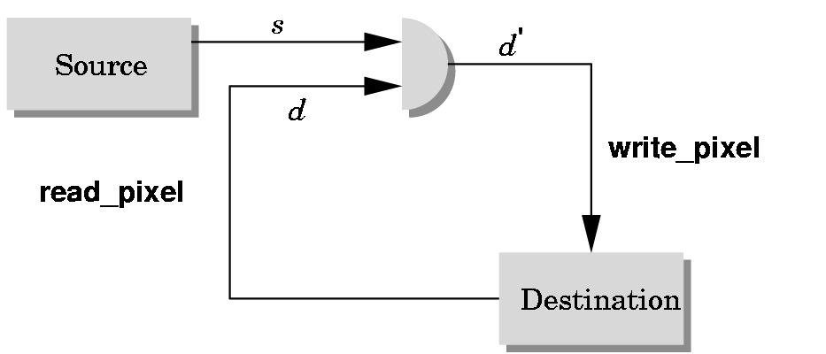
Writing Modes
application
bitwise logical operation
frame buffer
Computer Graphics
Notes:
Computer Graphics - Newcastle University

Slide 12
XOR write
Usual (default) mode: source replaces destination (d’ = s)
  Cannot write temporary lines this way because we cannot recover what was “under” the line in a fast simple way
Exclusive OR mode (XOR) (d’ = d ⊕ s)
  y ⊕ x ⊕ x =y
  Hence, if we use XOR mode to write a line, we can draw it a second time and line is erased!
Computer Graphics
Notes:
Computer Graphics - Newcastle University

Slide 13
Rubberbanding
Switch to XOR write mode
Draw object
  For line can use first mouse click to fix one endpoint and then use motion callback to continuously update the second endpoint
  Each time mouse is moved, redraw line which erases it and then draw line from fixed first position to to new second position
  At end, switch back to normal drawing mode and draw line
  Works for other objects: rectangles, circles
Computer Graphics
Notes:
Computer Graphics - Newcastle University

Slide 14
Rubberband Lines
second point
first point
initial display
draw line with mouse
in XOR mode
mouse moved to
new position
original line redrawn
with XOR
new line drawn
with XOR
Computer Graphics
Notes:
Computer Graphics - Newcastle University

Slide 15
XOR in OpenGL
There are 16 possible logical operations between two bits
All are supported by OpenGL
  Must first enable logical operations
    glEnable(GL_COLOR_LOGIC_OP)
  Choose logical operation
    glLogicOp(GL_XOR)
    glLogicOp(GL_COPY) (default)
Computer Graphics
Notes:
Computer Graphics - Newcastle University

Slide 16
A little more on glLogicOp
glLogicOp specifies a logical operation that, when enabled, is applied between the incoming color index or RGBA color and the color index or RGBA color at the corresponding location in the frame buffer.
Therefore, what ends up in the frame buffer is not necessarily the pixels we tried to draw –the frame buffer can be viewed as a form of memory, hence why one XOR followed by another has sufficient information to undo itself
Computer Graphics
Notes:
Computer Graphics - Newcastle University

Slide 17
A little more on glLogicOp 2
Computer Graphics
Notes:
Computer Graphics - Newcastle University

Slide 18
Immediate and Retained Modes
Recall that in a standard OpenGL program, once an object is rendered there is no memory of it and to redisplay it, we must re-execute the code for it
  Known as immediate mode graphics
  Can be especially slow if the objects are complex and must be sent over a network
Alternative is define objects and keep them in some form that can be redisplayed easily
  Retained mode graphics
  Accomplished in OpenGL via display lists
Computer Graphics
Notes:
Computer Graphics - Newcastle University

Slide 19
Display Lists
Conceptually similar to a graphics file
  Must define (name, create)
  Add contents
  Close
In client-server environment, display list is placed on server
  Can be redisplayed without sending primitives over network each time
Computer Graphics
Notes:
Computer Graphics - Newcastle University

Slide 20
Display List Functions
Creating a display list
  GLuint id;
  void init()
  {
  id = glGenLists( 1 );
  glNewList( id, GL_COMPILE );
  /* other OpenGL routines */
  glEndList();
  }
Call a display list
  void display()
  {
  glCallList( id );
  }
Computer Graphics
Notes:
Computer Graphics - Newcastle University

Slide 21
Display Lists and State
Most OpenGL functions can be put in display lists
State changes made inside a display list persist after the display list is executed
Can avoid unexpected results by using glPushAttrib and glPushMatrix upon entering a display list and glPopAttrib and glPopMatrix before exiting
Computer Graphics
Notes:
Computer Graphics - Newcastle University

Slide 22

Hierarchy and Display Lists
Consider model of a car
  Create display list for chassis
  Create display list for wheel
glNewList( CAR, GL_COMPILE );
glCallList( CHASSIS );
glTranslatef( … );
glCallList( WHEEL );
glTranslatef( … );
glCallList( WHEEL );
…
glEndList();
Computer Graphics
Notes:
Computer Graphics - Newcastle University

