Slide 1
Computer Graphics
Shading
Lecture 13
John Shearer
Culture Lab – space 2
john.shearer@ncl.ac.uk
http://di.ncl.ac.uk/teaching/csc3201/
Computer Graphics
Notes:
Computer Graphics - Newcastle University

Slide 2
Objectives
Learn to shade objects so their images appear three-dimensional
Introduce the types of light-material interactions
Build a simple reflection model---the Phong model--- that can be used with real time graphics hardware
Introduce modified Phong model
Consider computation of required vectors
Introduce the OpenGL shading functions
Discuss polygonal shading
  Flat
  Smooth
  Gouraud
Computer Graphics
Notes:
Computer Graphics - Newcastle University

Slide 3
Why we need shading
Suppose we build a model of a sphere using many polygons and color it with glColor. We get something like
But we want
Computer Graphics
Notes:
Computer Graphics - Newcastle University

Slide 4
Shading
Why does the image of a real sphere look like
Light-material interactions cause each point to have a different color or shade
Need to consider
  Light sources
  Material properties
  Location of viewer
  Surface orientation
Computer Graphics
Notes:
Computer Graphics - Newcastle University

Slide 5
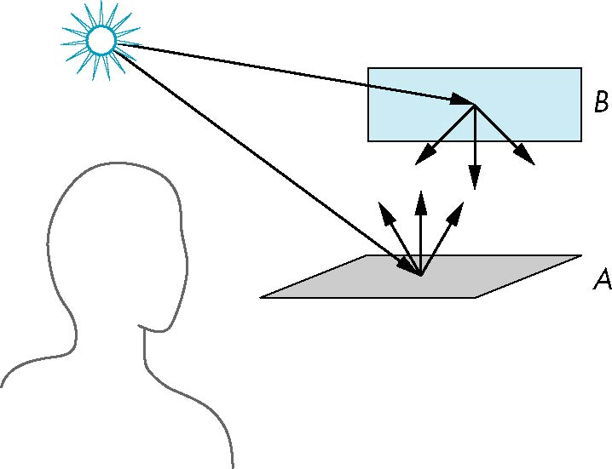
Scattering
Light strikes A
  Some scattered
  Some absorbed
Some of scattered light strikes B
  Some scattered
  Some absorbed
Some of this scattered
light strikes A
and so on
Computer Graphics
Notes:
Computer Graphics - Newcastle University

Slide 6
Rendering Equation
The infinite scattering and absorption of light can be described by the rendering equation
  Cannot be solved in general
  Ray tracing is a special case for perfectly reflecting surfaces
Rendering equation is global and includes
  Shadows
  Multiple scattering from object to object
Computer Graphics
Notes:
Computer Graphics - Newcastle University

Slide 7
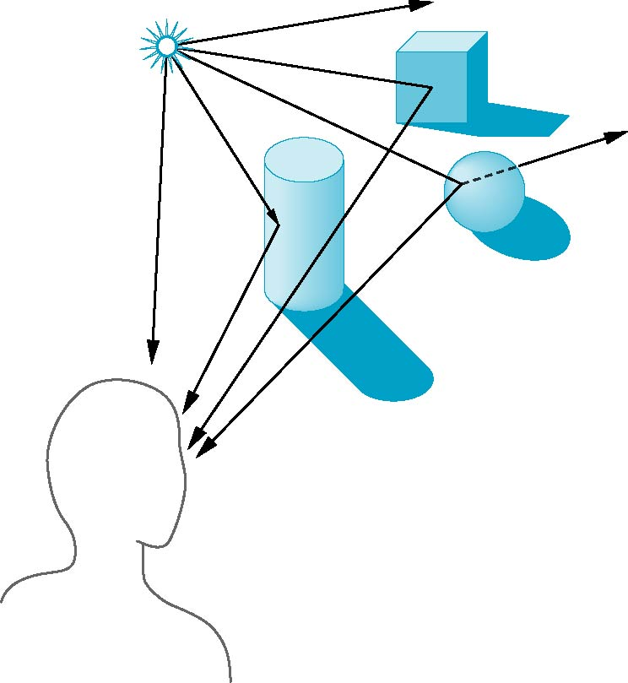
Global Effects
shadow
multiple reflection
translucent surface
Computer Graphics
Notes:
Computer Graphics - Newcastle University

Slide 8
Local vs Global Rendering
Correct shading requires a global calculation involving all objects and light sources
  Incompatible with pipeline model which shades each polygon independently (local rendering)
However, in computer graphics, especially real time graphics, we are happy if things “look right”
  Exist many techniques for approximating global effects
Computer Graphics
Notes:
Computer Graphics - Newcastle University

Slide 9
Light-Material Interaction
Light that strikes an object is partially absorbed and partially scattered (reflected)
The amount reflected determines the color and brightness of the object
  A surface appears red under white light because the red component of the light is reflected and the rest is absorbed
The reflected light is scattered in a manner that depends on the smoothness and orientation of the surface
Computer Graphics
Notes:
Computer Graphics - Newcastle University

Slide 10
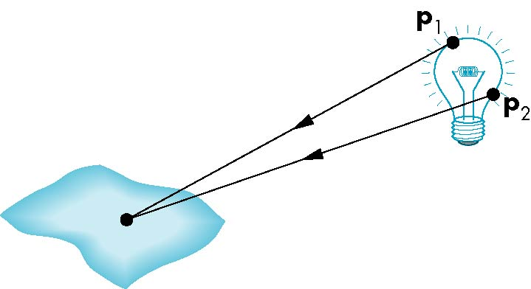
Light Sources
General light sources are difficult to work with because we must integrate light coming from all points on the source
Computer Graphics
Notes:
Computer Graphics - Newcastle University

Slide 11
Simple Light Sources
Point source
  Model with position and color
  Distant source = infinite distance away (parallel)
Spotlight
  Restrict light from ideal point source
Ambient light
  Same amount of light everywhere in scene
  Can model contribution of many sources and reflecting surfaces
Computer Graphics
Notes:
Computer Graphics - Newcastle University

Slide 12
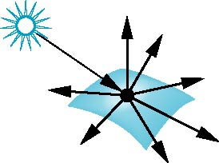
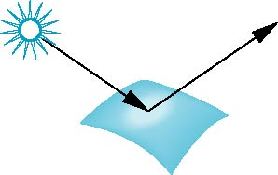
Surface Types
The smoother a surface, the more reflected light is concentrated in the direction a perfect mirror would reflected the light
A very rough surface scatters light in all directions
smooth surface
rough surface
Computer Graphics
Notes:
Computer Graphics - Newcastle University

Slide 13
Phong Model
A simple model that can be computed rapidly
Has three components
  Diffuse
  Specular
  Ambient
Uses four vectors
  To source
  To viewer
  Normal
  Perfect reflector
Computer Graphics
Notes:
Computer Graphics - Newcastle University

Slide 14
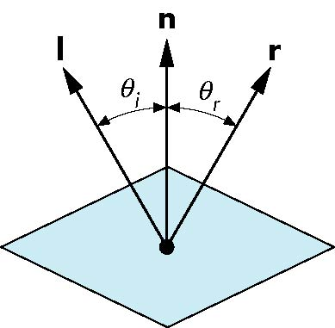
Ideal Reflector
Normal is determined by local orientation
Angle of incidence = angle of relection
The three vectors must be coplanar
r = 2 (l · n ) n - l
Computer Graphics
Notes:
Computer Graphics - Newcastle University

Slide 15
Lambertian Surface
Perfectly diffuse reflector
Light scattered equally in all directions
Amount of light reflected is proportional to the vertical component of incoming light
  reflected light ~cos θ_{i}
  cos θ_{i} = l · n if vectors normalized
  There are also three coefficients, k_{r}, k_{b}, k_{g} that show how much of each color component is reflected
Computer Graphics
Notes:
Computer Graphics - Newcastle University

Slide 16
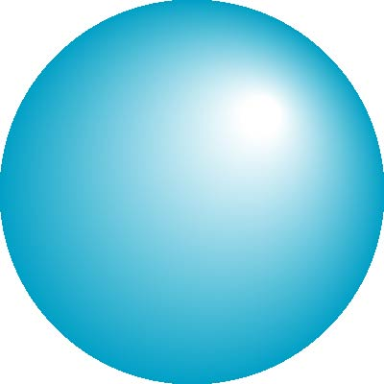
Specular Surfaces
Most surfaces are neither ideal diffusers nor perfectly specular (ideal reflectors)
Smooth surfaces show specular highlights due to incoming light being reflected in directions concentrated close to the direction of a perfect reflection
specular
highlight
Computer Graphics
Notes:
Computer Graphics - Newcastle University

Slide 17
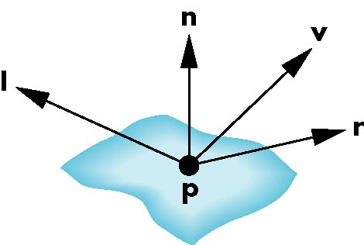
Modeling Specular Relections
Phong proposed using a term that dropped off as the angle between the viewer and the ideal reflection increased
I_{r} ~ k_{s} I cos^{α}φ
φ
reflected
intensity
shininess coef
incoming intensity
absorption coef
Computer Graphics
Notes:
Computer Graphics - Newcastle University

Slide 18
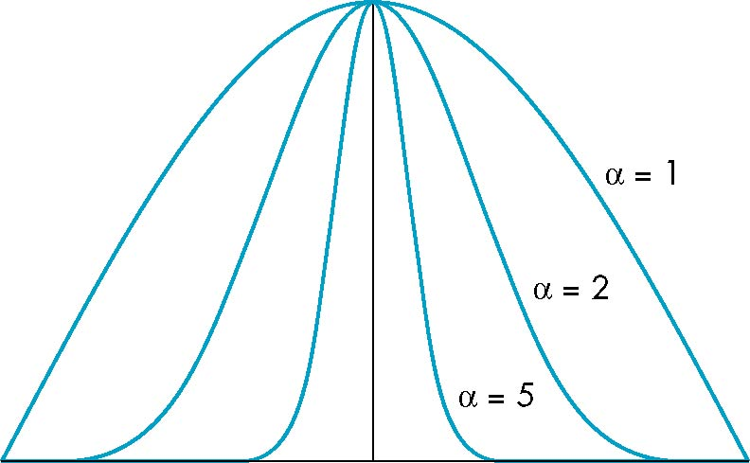
The Shininess Coefficient
Values of α between 100 and 200 correspond to metals
Values between 5 and 10 give surface that look like plastic
cos^{α} φ
-90
φ
90
Computer Graphics
Notes:
Computer Graphics - Newcastle University

Slide 19
Ambient Light
Ambient light is the result of multiple interactions between (large) light sources and the objects in the environment
Amount and color depend on both the color of the light(s) and the material properties of the object
Add k_{a} I_{a} to diffuse and specular terms
reflection coef
intensity of ambient light
Computer Graphics
Notes:
Computer Graphics - Newcastle University

Slide 20
Distance Terms
The light from a point source that reaches a surface is inversely proportional to the square of the distance between them
We can add a factor of the
form 1/(a + bd +cd²) to
the diffuse and specular
terms
The constant and linear terms soften the effect of the point source
Computer Graphics
Notes:
Computer Graphics - Newcastle University

Slide 21
Light Sources
In the Phong Model, we add the results from each light source
Each light source has separate diffuse, specular, and ambient terms to allow for maximum flexibility even though this form does not have a physical justification
Separate red, green and blue components
Hence, 9 coefficients for each point source
  I_{dr}, I_{dg}, I_{db}, I_{sr}, I_{sg}, I_{sb}, I_{ar}, I_{ag}, I_{ab}
Computer Graphics
Notes:
Computer Graphics - Newcastle University

Slide 22
Material Properties
Material properties match light source properties
  Nine absorbtion coefficients
    k_{dr}, k_{dg}, k_{db}, k_{sr}, k_{sg}, k_{sb}, k_{ar}, k_{ag}, k_{ab}
  Shininess coefficient α
Computer Graphics
Notes:
Computer Graphics - Newcastle University

Slide 23
Adding up the Components
For each light source and each color component, the Phong model can be written (without the distance terms) as
I =k_{d} I_{d} l · n + k_{s} I_{s} (v · r )^{α} + k_{a} I_{a}
For each color component
we add contributions from
all sources
Computer Graphics
Notes:
Computer Graphics - Newcastle University

Slide 24
Modified Phong Model
The specular term in the Phong model is problematic because it requires the calculation of a new reflection vector and view vector for each vertex
Blinn suggested an approximation using the halfway vector that is more efficient
Computer Graphics
Notes:
Computer Graphics - Newcastle University

Slide 25
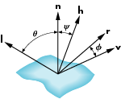
The Halfway Vector
h is normalized vector halfway between l and v
h = ( l + v )/ | l + v |
Computer Graphics
Notes:
Computer Graphics - Newcastle University

Slide 26
Using the halfway vector
Replace (v · r )^{α} by (n · h )^{β}
β is chosen to match shineness
Note that halway angle is half of angle between r and v if vectors are coplanar
Resulting model is known as the modified Phong or Blinn lighting model
  Specified in OpenGL standard
Computer Graphics
Notes:
Computer Graphics - Newcastle University

Slide 27
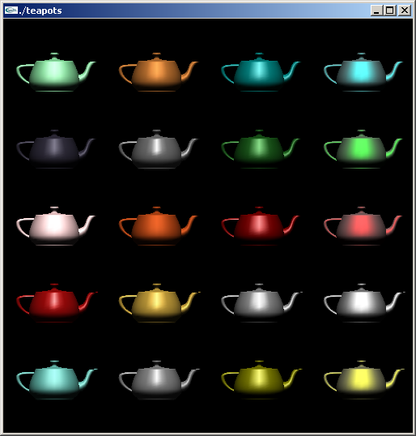
Example
Only differences in
these teapots are
the parameters
in the modified
Phong model
Computer Graphics
Notes:
Computer Graphics - Newcastle University

Slide 28
Computation of Vectors
l and v are specified by the application
Can computer r from l and n
Problem is determining n
For simple surfaces is can be determined but how we determine n differs depending on underlying representation of surface
OpenGL leaves determination of normal to application
  Exception for GLU quadrics and Bezier surfaces (Chapter 11)
Computer Graphics
Notes:
Computer Graphics - Newcastle University

Slide 29
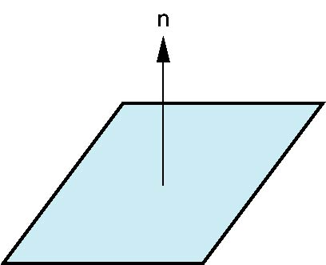
Plane Normals
Equation of plane: ax+by+cz+d = 0
From Chapter 4 we know that plane is determined by three points p₀, p₂, p₃ or normal n and p₀
Normal can be obtained by
n = (p₂-p₀) × (p₁-p₀)
Computer Graphics
Notes:
Computer Graphics - Newcastle University

Slide 30

Normal to Sphere
Implicit function f(x,y.z)=0
Normal given by gradient
Sphere f(p)=p·p-1
n = [∂f/∂x, ∂f/∂y, ∂f/∂z]^{T}=p
Computer Graphics
Notes:
Computer Graphics - Newcastle University

Slide 31
Parametric Form
For sphere
Tangent plane determined by vectors
Normal given by cross product
x=x(u,v)=cos u sin v
y=y(u,v)=cos u cos v
z= z(u,v)=sin u
∂p/∂u = [∂x/∂u, ∂y/∂u, ∂z/∂u]T
∂p/∂v = [∂x/∂v, ∂y/∂v, ∂z/∂v]T
n = ∂p/∂u × ∂p/∂v
Computer Graphics
Notes:
Computer Graphics - Newcastle University

Slide 32
General Case
We can compute parametric normals for other simple cases
  Quadrics
  Parameteric polynomial surfaces
    Bezier surface patches (Chapter 11)
Computer Graphics
Notes:
Computer Graphics - Newcastle University

Slide 33
Steps in OpenGL shading
Enable shading and select model
Specify normals
Specify material properties
Specify lights
Computer Graphics
Notes:
Computer Graphics - Newcastle University

Slide 34
Normals
In OpenGL the normal vector is part of the state
Set by glNormal*()
  glNormal3f(x, y, z);
  glNormal3fv(p);
Usually we want to set the normal to have unit length so cosine calculations are correct
  Length can be affected by transformations
  Note that scaling does not preserved length
  glEnable(GL_NORMALIZE) allows for autonormalization at a performance penalty
Computer Graphics
Notes:
Computer Graphics - Newcastle University

Slide 35
Normal for Triangle
n
plane n ·(p - p₀ ) = 0
p₂
p
p₁
normalize n ← n/ |n|
p₀
Note that right-hand rule determines outward face
Computer Graphics
Notes:
Computer Graphics - Newcastle University

Slide 36
Enabling Shading
Shading calculations are enabled by
  glEnable(GL_LIGHTING)
  Once lighting is enabled, glColor() ignored
Must enable each light source individually
  glEnable(GL_LIGHTi) i=0,1…..
Can choose light model parameters
  glLightModeli(parameter, GL_TRUE)
    GL_LIGHT_MODEL_LOCAL_VIEWER do not use simplifying distant viewer assumption in calculation
    GL_LIGHT_MODEL_TWO_SIDED shades both sides of polygons independently
Computer Graphics
Notes:
Computer Graphics - Newcastle University

Slide 37
Defining a Point Light Source
For each light source, we can set an RGBA for the diffuse, specular, and ambient components, and for the position
  GL float diffuse0[]={1.0, 0.0, 0.0, 1.0};
  GL float ambient0[]={1.0, 0.0, 0.0, 1.0};
  GL float specular0[]={1.0, 0.0, 0.0, 1.0};
  Glfloat light0_pos[]={1.0, 2.0, 3,0, 1.0};
  glEnable(GL_LIGHTING);
  glEnable(GL_LIGHT0);
  glLightv(GL_LIGHT0, GL_POSITION, light0_pos);
  glLightv(GL_LIGHT0, GL_AMBIENT, ambient0);
  glLightv(GL_LIGHT0, GL_DIFFUSE, diffuse0);
  glLightv(GL_LIGHT0, GL_SPECULAR, specular0);
Computer Graphics
Notes:
Computer Graphics - Newcastle University

Slide 38
Distance and Direction
The source colors are specified in RGBA
The position is given in homogeneous coordinates
  If w =1.0, we are specifying a finite location
  If w =0.0, we are specifying a parallel source with the given direction vector
The coefficients in the distance terms are by default a=1.0 (constant terms), b=c=0.0 (linear and quadratic terms). Change by
  a= 0.80;
  glLightf(GL_LIGHT0, GLCONSTANT_ATTENUATION, a);
Computer Graphics
Notes:
Computer Graphics - Newcastle University

Slide 39
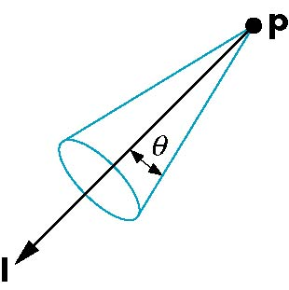
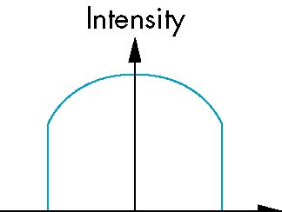
Spotlights
Use glLightv to set
  Direction GL_SPOT_DIRECTION
  Cutoff GL_SPOT_CUTOFF
  Attenuation GL_SPOT_EXPONENT
    Proportional to cos^{α}φ
−θ
φ
θ
Computer Graphics
Notes:
Computer Graphics - Newcastle University

Slide 40
Global Ambient Light
Ambient light depends on color of light sources
  A red light in a white room will cause a red ambient term that disappears when the light is turned off
OpenGL also allows a global ambient term that is often helpful for testing
  glLightModelfv(GL_LIGHT_MODEL_AMBIENT, global_ambient)
Computer Graphics
Notes:
Computer Graphics - Newcastle University

Slide 41
Moving Light Sources
Light sources are geometric objects whose positions or directions are affected by the model-view matrix
Depending on where we place the position (direction) setting function, we can
  Move the light source(s) with the object(s)
  Fix the object(s) and move the light source(s)
  Fix the light source(s) and move the object(s)
  Move the light source(s) and object(s) independently
Computer Graphics
Notes:
Computer Graphics - Newcastle University

Slide 42
Material Properties
Material properties are also part of the OpenGL state and match the terms in the modified Phong model
Set by glMaterialv()
  GLfloat ambient[] = {0.2, 0.2, 0.2, 1.0};
  GLfloat diffuse[] = {1.0, 0.8, 0.0, 1.0};
  GLfloat specular[] = {1.0, 1.0, 1.0, 1.0};
  GLfloat shine = 100.0
  glMaterialf(GL_FRONT, GL_AMBIENT, ambient);
  glMaterialf(GL_FRONT, GL_DIFFUSE, diffuse);
  glMaterialf(GL_FRONT, GL_SPECULAR, specular);
  glMaterialf(GL_FRONT, GL_SHININESS, shine);
Computer Graphics
Notes:
Computer Graphics - Newcastle University

Slide 43
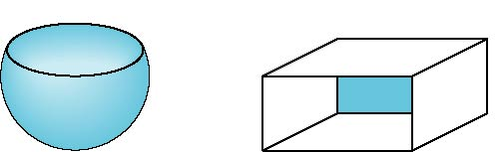
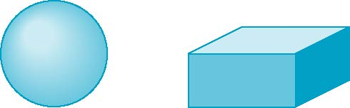
Front and Back Faces
The default is shade only front faces which works correctly for convex objects
If we set two sided lighting, OpenGL will shade both sides of a surface
Each side can have its own properties which are set by using GL_FRONT, GL_BACK, or GL_FRONT_AND_BACK in glMaterialf
back faces not visible
back faces visible
Computer Graphics
Notes:
Computer Graphics - Newcastle University

Slide 44
Emissive Term
We can simulate a light source in OpenGL by giving a material an emissive component
This component is unaffected by any sources or transformations
  GLfloat emission[] = 0.0, 0.3, 0.3, 1.0);
  glMaterialf(GL_FRONT, GL_EMISSION, emission);
Computer Graphics
Notes:
Computer Graphics - Newcastle University

Slide 45
Transparency
Material properties are specified as RGBA values
The A value can be used to make the surface translucent
The default is that all surfaces are opaque regardless of A
Later we will enable blending and use this feature
Computer Graphics
Notes:
Computer Graphics - Newcastle University

Slide 46
Efficiency
Because material properties are part of the state, if we change materials for many surfaces, we can affect performance
We can make the code cleaner by defining a material structure and setting all materials during initialization
  typedef struct materialStruct {
  GLfloat ambient[4];
  GLfloat diffuse[4];
  GLfloat specular[4];
  GLfloat shineness;
  } MaterialStruct;
We can then select a material by a pointer
Computer Graphics
Notes:
Computer Graphics - Newcastle University

Slide 47
Polygonal Shading
Shading calculations are done for each vertex
  Vertex colors become vertex shades
By default, vertex shades are interpolated across the polygon
  glShadeModel(GL_SMOOTH);
If we use glShadeModel(GL_FLAT); the color at the first vertex will determine the shade of the whole polygon
Computer Graphics
Notes:
Computer Graphics - Newcastle University

Slide 48
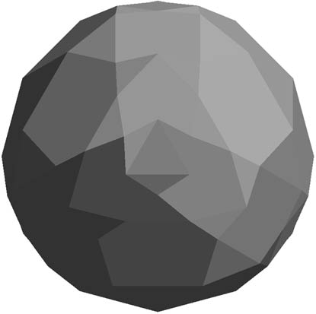
Polygon Normals
Polygons have a single normal
  Shades at the vertices as computed by the Phong model can be almost same
  Identical for a distant viewer (default) or if there is no specular component
Consider model of sphere
Want different normals at
each vertex even though
this concept is not quite
correct mathematically
Computer Graphics
Notes:
Computer Graphics - Newcastle University

Slide 49
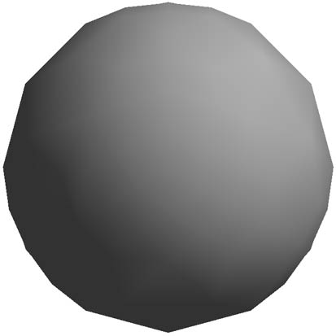
Smooth Shading
We can set a new normal at each vertex
Easy for sphere model
  If centered at origin n = p
Now smooth shading works
Note silhouette edge
Computer Graphics
Notes:
Computer Graphics - Newcastle University

Slide 50
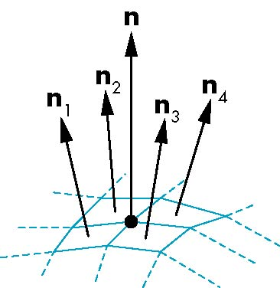
Mesh Shading
The previous example is not general because we knew the normal at each vertex analytically
For polygonal models, Gouraud proposed we use the average of the normals around a mesh vertex
n = (n₁+n₂+n₃+n₄)/ |n₁+n₂+n₃+n₄|
Computer Graphics
Notes:
Computer Graphics - Newcastle University

Slide 51
Gouraud and Phong Shading
Gouraud Shading
  Find average normal at each vertex (vertex normals)
  Apply modified Phong model at each vertex
  Interpolate vertex shades across each polygon
Phong shading
  Find vertex normals
  Interpolate vertex normals across edges
  Interpolate edge normals across polygon
  Apply modified Phong model at each fragment
Computer Graphics
Notes:
Computer Graphics - Newcastle University

Slide 52
Comparison
If the polygon mesh approximates surfaces with a high curvatures, Phong shading may look smooth while Gouraud shading may show edges
Phong shading requires much more work than Gouraud shading
  Until recently not available in real time systems
  Now can be done using fragment shaders (see Chapter 9)
Both need data structures to represent meshes so we can obtain vertex normals
Computer Graphics
Notes:
Computer Graphics - Newcastle University

