Slide 1
Computer Graphics
Implementation III
Lecture 17
John Shearer
Culture Lab – space 2
john.shearer@ncl.ac.uk
http://di.ncl.ac.uk/teaching/csc3201/
Computer Graphics
Notes:
Computer Graphics - Newcastle University

Slide 2
Objectives
Survey Line Drawing Algorithms
  DDA
  Bresenham
Computer Graphics
Notes:
Computer Graphics - Newcastle University

Slide 3
Rasterization
Rasterization (scan conversion)
  Determine which pixels that are inside primitive specified by a set of vertices
  Produces a set of fragments
  Fragments have a location (pixel location) and other attributes such color and texture coordinates that are determined by interpolating values at vertices
Pixel colors determined later using color, texture, and other vertex properties
Computer Graphics
Notes:
Computer Graphics - Newcastle University

Slide 4
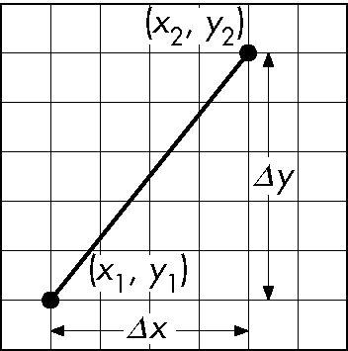
Scan Conversion of Line Segments
Start with line segment in window coordinates with integer values for endpoints
Assume implementation has a write_pixel function
y = mx + h
Computer Graphics
Notes:
Computer Graphics - Newcastle University

Slide 5
DDA Algorithm
Digital Differential Analyzer
  DDA was a mechanical device for numerical solution of differential equations
  Line y=mx+ h satisfies differential equation
  dy/dx = m = Δy/Δx = y₂-y₁/x₂-x₁
Along scan line Δx = 1
  for(x=x1; x<=x2,ix++) {
  y+=m; // Floating point addition
  write_pixel(x, round(y), line_color)
  }
Computer Graphics
Notes:
Computer Graphics - Newcastle University

Slide 6
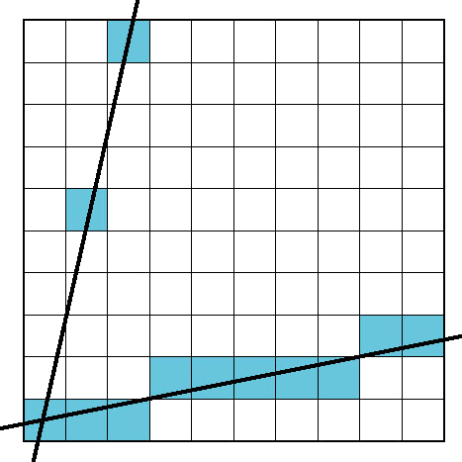
Problem
DDA = for each x plot pixel at closest y
  Problems for steep lines
Computer Graphics
Notes:
Computer Graphics - Newcastle University

Slide 7
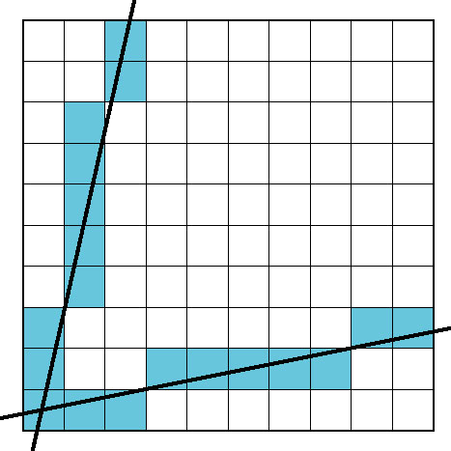
Using Symmetry
Use for 1 ≥ m ≥ 0
For m > 1, swap role of x and y
  For each y, plot closest x
Computer Graphics
Notes:
Computer Graphics - Newcastle University

Slide 8
Bresenham’s Algorithm
DDA requires one floating point addition per step
We can eliminate all fp through Bresenham’s algorithm
Consider only 1 ≥ m ≥ 0
  Other cases by symmetry
Assume pixel centers are at half integers
If we start at a pixel that has been written, there are only two candidates for the next pixel to be written into the frame buffer
Computer Graphics
Notes:
Computer Graphics - Newcastle University

Slide 9
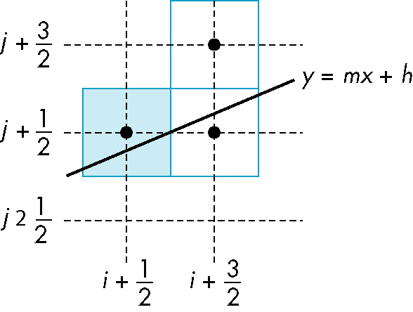
Candidate Pixels
1 ≥ m ≥ 0
candidates
last pixel
Note that line could have
passed through any
part of this pixel
Computer Graphics
Notes:
Computer Graphics - Newcastle University

Slide 10
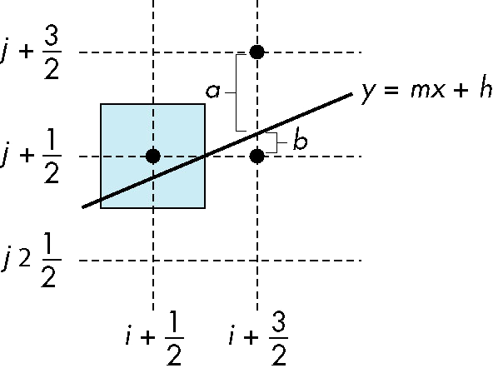
Decision Variable
d = Δx(b-a)
d is an integer
d > 0 use upper pixel
d < 0 use lower pixel
Computer Graphics
Notes:
Computer Graphics - Newcastle University

Slide 11
Incremental Form
More efficient if we look at d_{k}, the value of the decision variable at x = k
    dk+1= dk –2Dy, if dk <0
    dk+1= dk –2(Dy- Dx), otherwise
For each x, we need do only an integer addition and a test
Single instruction on graphics chips
Computer Graphics
Notes:
Computer Graphics - Newcastle University

Slide 12

Polygon Scan Conversion
Scan Conversion = Fill
How to tell inside from outside
  Convex easy
  Nonsimple difficult
  Odd even test
    Count edge crossings
odd-even fill
Computer Graphics
Notes:
Computer Graphics - Newcastle University

Slide 13
Filling in the Frame Buffer
Fill at end of pipeline
  Convex Polygons only
  Nonconvex polygons assumed to have been tessellated
  Shades (colors) have been computed for vertices (Gouraud shading)
  Combine with z-buffer algorithm
    March across scan lines interpolating shades
    Incremental work small
Computer Graphics
Notes:
Computer Graphics - Newcastle University

Slide 14
Using Interpolation
C₁ C₂ C₃ specified by glColor or by vertex shading
C₄ determined by interpolating between C₁ and C₂
C₅ determined by interpolating between C₂ and C₃
interpolate between C₄ and C₅ along span
C₁
C₄
C₂
scan line
C₅
span
C₃
Computer Graphics
Notes:
Computer Graphics - Newcastle University

Slide 15
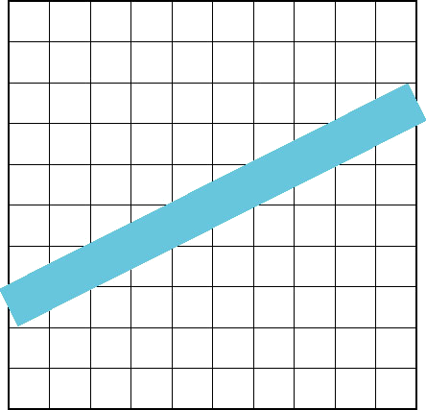
Aliasing
Ideal rasterized line should be 1 pixel wide
Choosing best y for each x (or visa versa) produces aliased raster lines
Computer Graphics
Notes:
Computer Graphics - Newcastle University

Slide 16
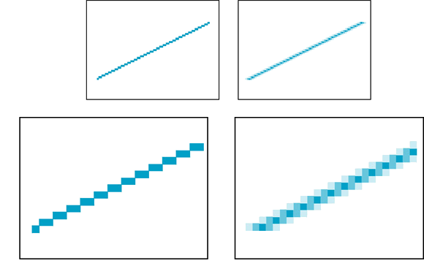
Antialiasing by Area Averaging
Color multiple pixels for each x depending on coverage by ideal line
original
antialiased
magnified
Computer Graphics
Notes:
Computer Graphics - Newcastle University

Slide 17
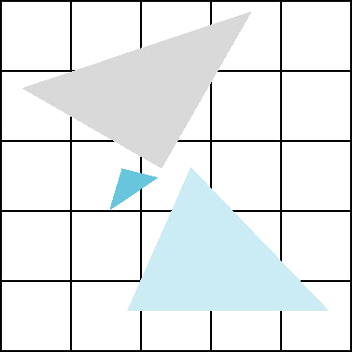
Polygon Aliasing
Aliasing problems can be serious for polygons
  Jaggedness of edges
  Small polygons neglected
  Need compositing so color
  of one polygon does not
  totally determine color of
  pixel
All three polygons should contribute to color
Computer Graphics
Notes:
Computer Graphics - Newcastle University

Slide 18
Computer Graphics
Notes:
Computer Graphics - Newcastle University

Slide 19
Computer Graphics
Notes:
Computer Graphics - Newcastle University

