Slide 1

Faculty of Engineering · Computer Engineering (Ingeniería Civil Informática)
Heuristic Approaches for the
k-Traveling Salesman Problem
A Reproducible Comparison of Ten Methods
Author: Nicolás Barrientos
Advisor: Dr. Gustavo Gatica
Undergraduate thesis · Paper submitted to Optima 2025 · Santiago de Chile, 2026

Slide 2
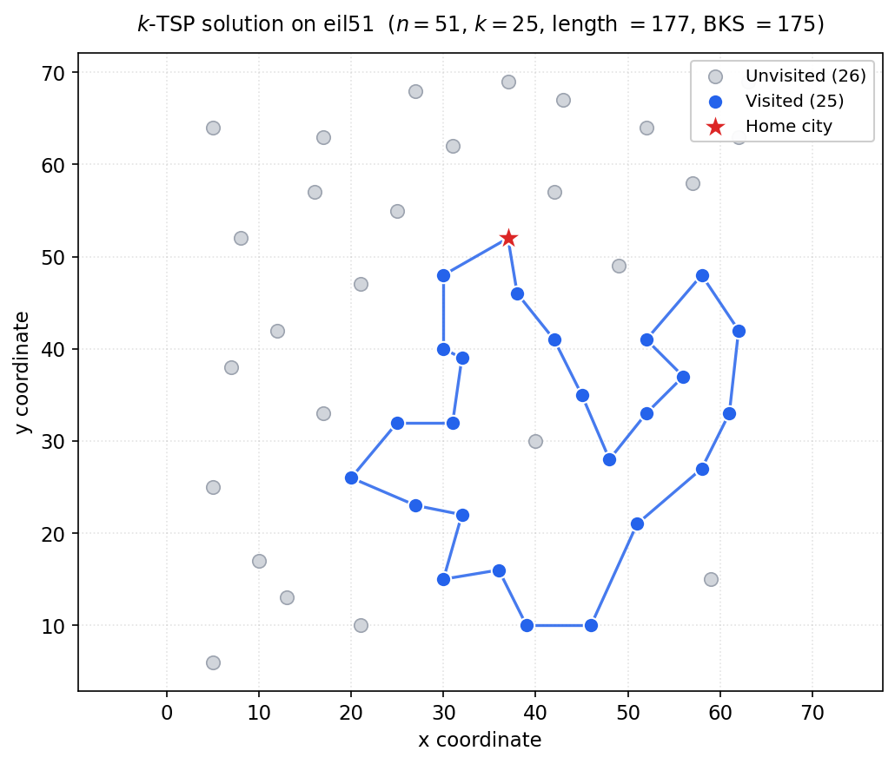
1 · CONTEXT
Context and Motivation
Route optimization drives logistics, transportation, surveillance and resource planning.
The Traveling Salesman Problem (TSP) is the canonical model: a minimum-length closed tour visiting every city.
Many real tasks visit only a SUBSET of sites under a budget on the number of stops.
That is the k-TSP: choose k of n cities (with a depot) and order them into one minimum-length closed tour.
Applications: selective sampling, prize-collecting routing, limited-visit surveillance, resource-constrained logistics.
A k-TSP tour: only the selected k nodes form the loop.
2

Slide 3
2 · OBJECTIVES
General and Specific Objectives
General objective. Develop a reproducible repository that models, solves and compares k-TSP instances on standard TSPLIB and synthetic benchmarks, evaluating heuristics and metaheuristics against LKH-3 best-known values.
Specific objectives
Implement the k-TSP model mathematically (node selection, degree and subtour-elimination constraints).
Implement ten techniques: Greedy, GRASP, GA, Nearest Neighbor, Nearest / Farthest / Random Insertion, Simulated Annealing, Tabu Search, and the proposed DCIH.
Evaluate solution quality (relative GAP) against LKH-3 best-known values on 38 TSPLIB instances × three values of k.
Complement with anytime benchmarking (progress, ERT, ECDF, global ranking) on a machine-independent time axis.
Release everything so every table and figure regenerates with a single command.
3

Slide 4
3 · METHODOLOGY
Work Methodology
a
Data design
Uniform ADTs for TSPLIB and synthetic instances; tour-based encoding of the k selected nodes.
b
Mathematical model
Single-tour, node-selection formulation with total-length objective and MTZ subtour elimination.
c
Heuristic resolution
Ten methods over a shared core of vectorized primitives (2-opt, in/out exchange, cheapest insertion).
d
Experimental evaluation
38 TSPLIB instances × 3 values of k; full trajectory logged for the anytime analysis.
Tools & reproducibility: Python 3.10 (numpy, pandas, matplotlib), Visual Studio Code, private GitHub repository, LKH-3 compiled locally; machine-independent distance-evaluation metric.
4

Slide 5
4 · DISSEMINATION
Conference Submission — Optima 2025
The core of this thesis was written up as a scientific paper and submitted to Optima 2025.
The paper condenses the mathematical model, the ten solution techniques and the experimental comparison.
It constitutes the main scientific contribution of the work and is reproduced as a chapter of the thesis.
OPTIMA 2025
Venue: Universidad Católica del Norte, Chile
Submitted: November 30, 2025
Status: Under review (submitted)
5

Slide 6
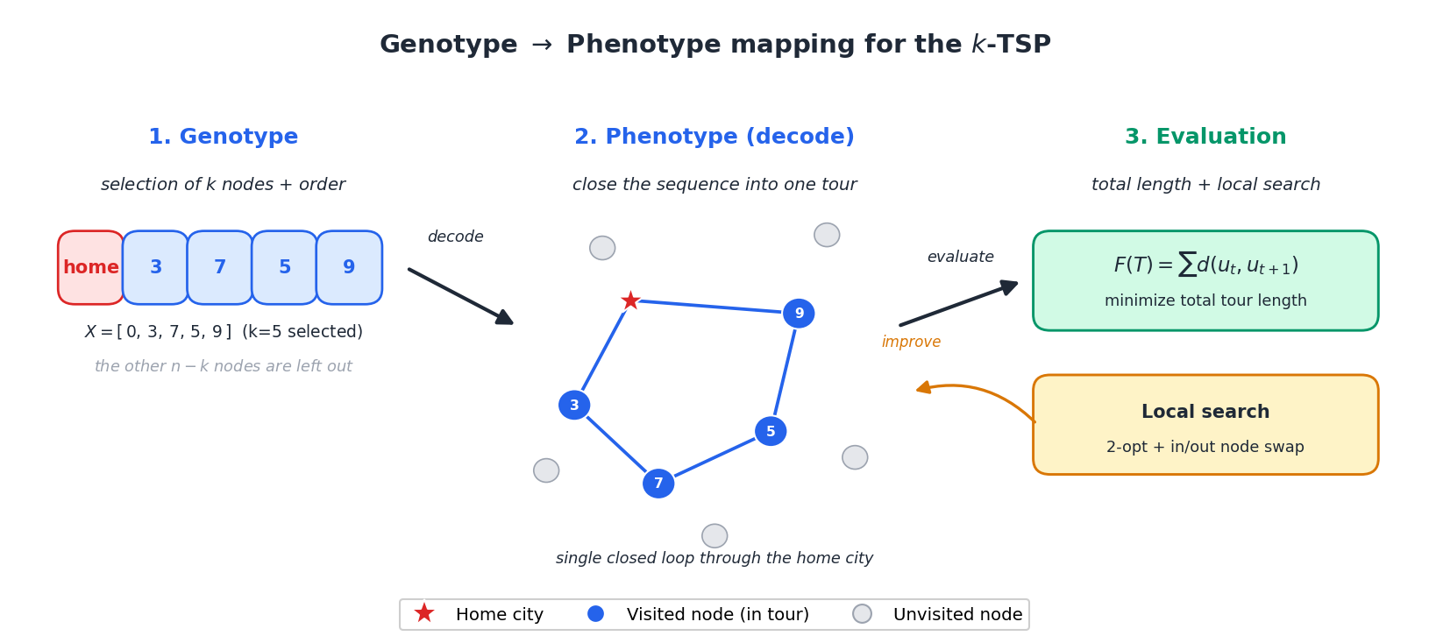
5 · RESEARCH PROBLEM
The k-TSP: Selection + Ordering
Given n cities with a depot and a fixed k (1 < k ≤ n), find one closed tour of minimum length visiting exactly k cities.
Two coupled decisions: WHICH k nodes to visit and IN WHICH ORDER.
Candidate subsets: C(n-1, k-1), each with (k-1)!/2 tours → exhaustive search is intractable.
It is the unit-prize Quota TSP, within the TSP-with-profits / selective-routing family.
Reference (near-optimal): LKH-3 best-known values (BKS) on the Pandiri & Singh benchmark.
Genotype → phenotype: selected subset + order map to one closed loop.
6

Slide 7
6 · OVERVIEW
Reference Result: Average GAP vs LKH-3
Method | Q1 GAP% | Q2 GAP% | Q3 GAP%
Greedy | 7.57 | 15.26 | 14.95
GRASP | 18.03 | 19.57 | 17.39
GA | 29.74 | 22.50 | 15.60
NN | 22.38 | 20.04 | 15.56
NI | 20.47 | 21.74 | 21.66
FI | 98.23 | 55.67 | 31.63
RI | 48.74 | 28.18 | 16.11
SA | 15.72 | 17.81 | 17.89
TS | 9.36 | 13.63 | 14.48
DCIH | 19.83 | 23.19 | 20.36
38 TSPLIB instances × three values of k, vs LKH-3 BKS.
Greedy and Tabu Search give the lowest average GAP.
GA improves for large k (Q3).
Farthest Insertion is clearly the weakest.
Q1: k≈n/4 Q2: k≈n/2 Q3: k≈3n/4 · lower is better
7

Slide 8
7 · METHODS (1/3)
Construction Heuristics
Greedy (cheapest insertion)
Insert the node of smallest marginal cost until k; 2-opt refinement; deterministic restarts.
Nearest Neighbor (NN)
Extend the tour to the nearest unvisited node until k; then local search.
Nearest / Farthest Insertion
Insert the node closest to (NI) or farthest from (FI) the tour at its cheapest position.
Random Insertion (RI)
Multi-start insertion with the next node chosen at random; local search each restart.
All share a common core: 2-opt, in/out exchange and cheapest insertion → a fair comparison.
8

Slide 9
8 · METHODS (2/3)
Metaheuristics
GRASP / multi-start
Randomized greedy construction + local search; best over many restarts.
Genetic Algorithm (GA)
Encodes subset + order; tournament, subset-aware crossover, mutation, elitism, 2-opt.
Simulated Annealing (SA)
Accepts worsening moves with probability exp(-Δ/T); geometric cooling escapes local optima.
Tabu Search (TS)
Best non-tabu move each step; tabu list with tenure and aspiration criterion (memory-guided).
Tabu Search is the best of the metaheuristics in average GAP.
9

Slide 10
9 · METHODS (3/3)
DCIH — the Proposed Heuristic
Deterministic Cheapest-Insertion Heuristic
Attacks both k-TSP decisions with a single criterion: marginal insertion cost.
Differs from Greedy: one deterministic construction (ties by index) + iterated 2-opt & in/out exchange.
Prioritizes correctness and reproducibility over winning by chance.
Quality comparable to GRASP and the insertion heuristics.
Phase 1 — Selection + ordering:
pick the k nodes and their positions by minimum marginal insertion cost, ties broken by node index.
Phase 2 — Refinement:
iterate 2-opt and an in/out exchange until no improvement.
Same data ⇒ exactly the same tour: fully reproducible, no random seed.
10

Slide 11
10 · RESULTS (1/2)
End-of-Run Comparison
≈12.5%
1st
10
best avg GAP
most frequent
winner (large k)
methods compared
Greedy & Tabu Search
Genetic Algorithm
vs LKH-3 BKS
Greedy cheapest-insertion is the most robust on average; Tabu Search essentially ties it as best metaheuristic.
The genetic algorithm closes the gap for large k (Q3) and wins on many individual instances.
Farthest Insertion is the weakest: selecting distant nodes conflicts with the node-selection objective.
DCIH is a deterministic, reproducible alternative of comparable quality.
11

Slide 12
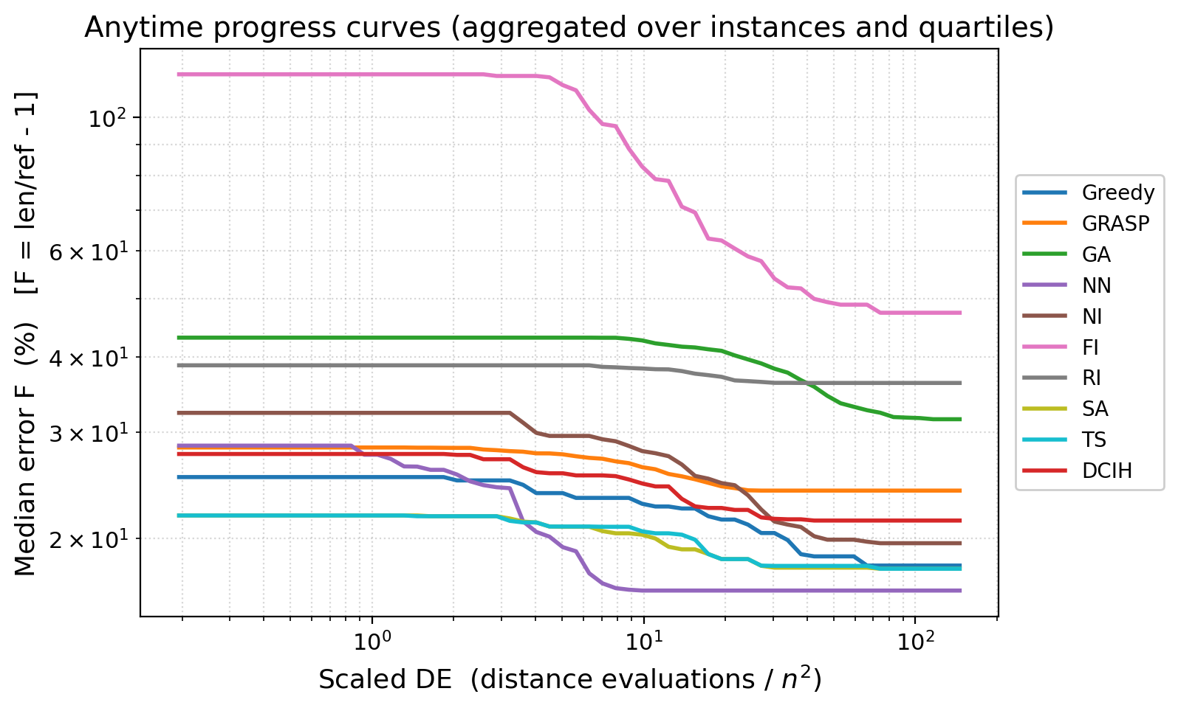
11 · RESULTS (2/2)
Anytime Evaluation (Weise et al.)
Machine-independent time = distance evaluations (scaled by n²).
All methods over a common budget; early-converging methods appear flat.
Global ranking (4 criteria): NN 1st, Greedy 2nd, TS 3rd, SA 4th, DCIH 5th.
NN is fastest to a good tour but only mid-ranked in final quality — speed ≠ best.
12

Slide 13
12 · CONCLUSIONS
Conclusions and Future Work
Conclusions
Future work
Greedy and Tabu Search are the most robust; TS is the best metaheuristic.
GA wins for large k; Farthest Insertion is the weakest for the k-TSP.
DCIH: deterministic, reproducible, competitive quality.
Anytime view separates 'fast' (NN) from 'best' (Greedy/TS).
Stronger / hybrid metaheuristics (ACO, VNS, memetic TS+GA).
Per-instance parameter tuning (tenure, cooling, population).
Dedicated node-selection rules beyond insertion cost.
Larger instances and related selective-routing problems.
Reproducible repository: every table and figure regenerates with a single command.

Slide 14
13 · REFERENCES
Selected References
Pandiri & Singh (2020). The k-TSP benchmark. OPSEARCH.
Helsgaun (2017). LKH-3: an extension of the Lin–Kernighan–Helsgaun TSP solver.
Weise, Chiong, Lässig, Tang, Tsutsui, Chen, Michalewicz & Yao (2014). Benchmarking optimization algorithms: an open-source framework for the TSP. IEEE CIM.
Rosenkrantz, Stearns & Lewis (1977). An analysis of several heuristics for the TSP. SIAM J. Computing.
Feo & Resende (1995). GRASP. J. of Global Optimization.
Kirkpatrick, Gelatt & Vecchi (1983). Optimization by simulated annealing. Science.
Glover (1986); Glover & Laguna (1997). Tabu Search.
Full bibliography (50 references) in the thesis and paper.
14

