Slide 1
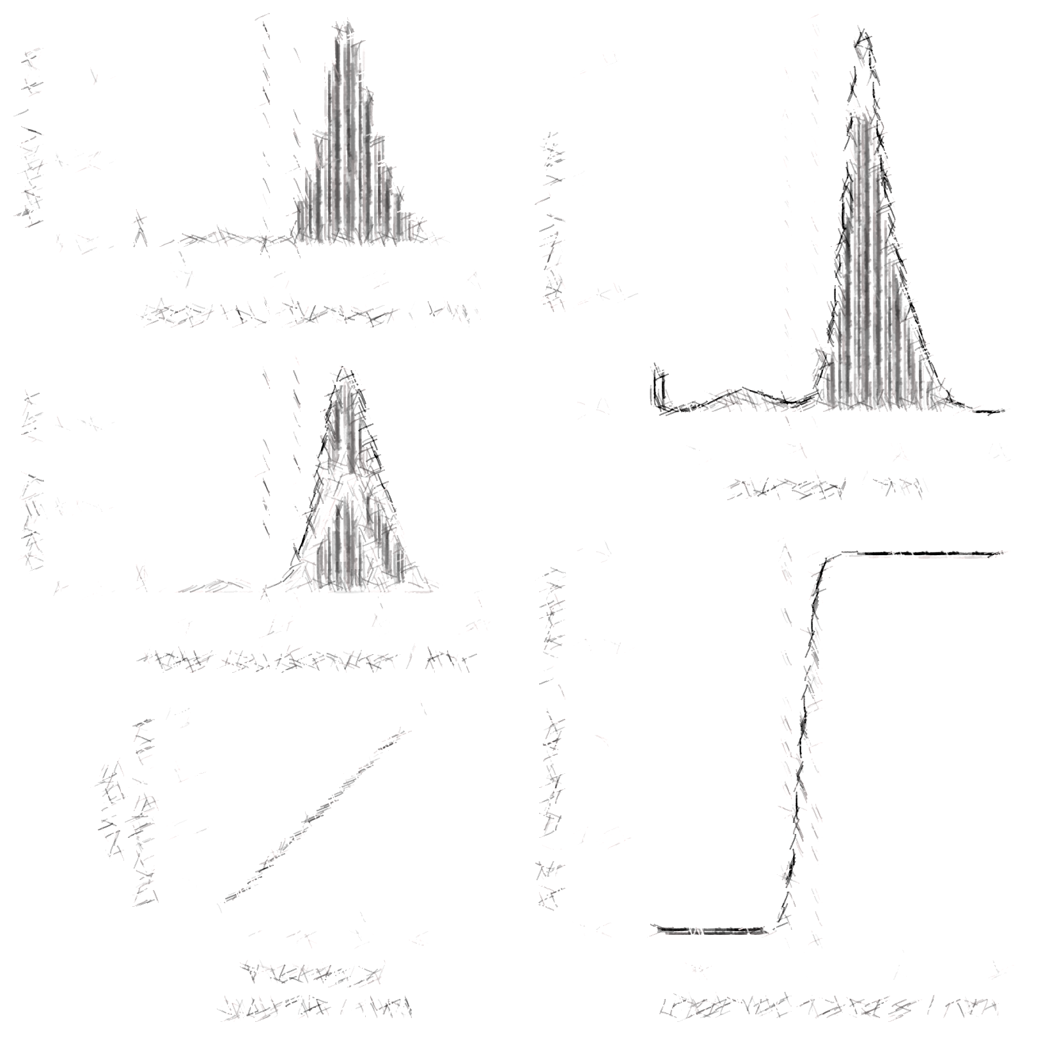
Forecast Probabilities
19.09.2016
Nicolas Blöchliger, Institute of Medical Microbiology, University of Zurich

Slide 2
Outline
Motivation
Data
Model
Results
Conclusion

Slide 3
1. Motivation
Complement AST categorizations with a measure of technical uncertainty
Example:
We measure an inhibition zone diameter of 15 mm.
The CBPs for R and S are both 14 mm.
What is the probability, that our measurement is above the CBP “just by chance”, i.e. due to methodological (technical) error?

Slide 4
2. Data
Data preprocessed by Giorgia Valsesia
CBPs: EUCAST, v. 6.0 (13.05.2016)
No CBPs available for 6 antibiotics
→ 18 antibiotics in total
class | #antibiotics | species | #strains
β-lactams | 14 | E. coli | 9766
Aminoglycosides | 3 | E. coli | 3521
quinolones | 4 | E. coli | 9761
tetracyclines | 3 | E. coli | 10662

Slide 5
3. Model
X = true diameter, unknown
Y = observed diameter, known
Y = X + E, where E = methodological error

Slide 6
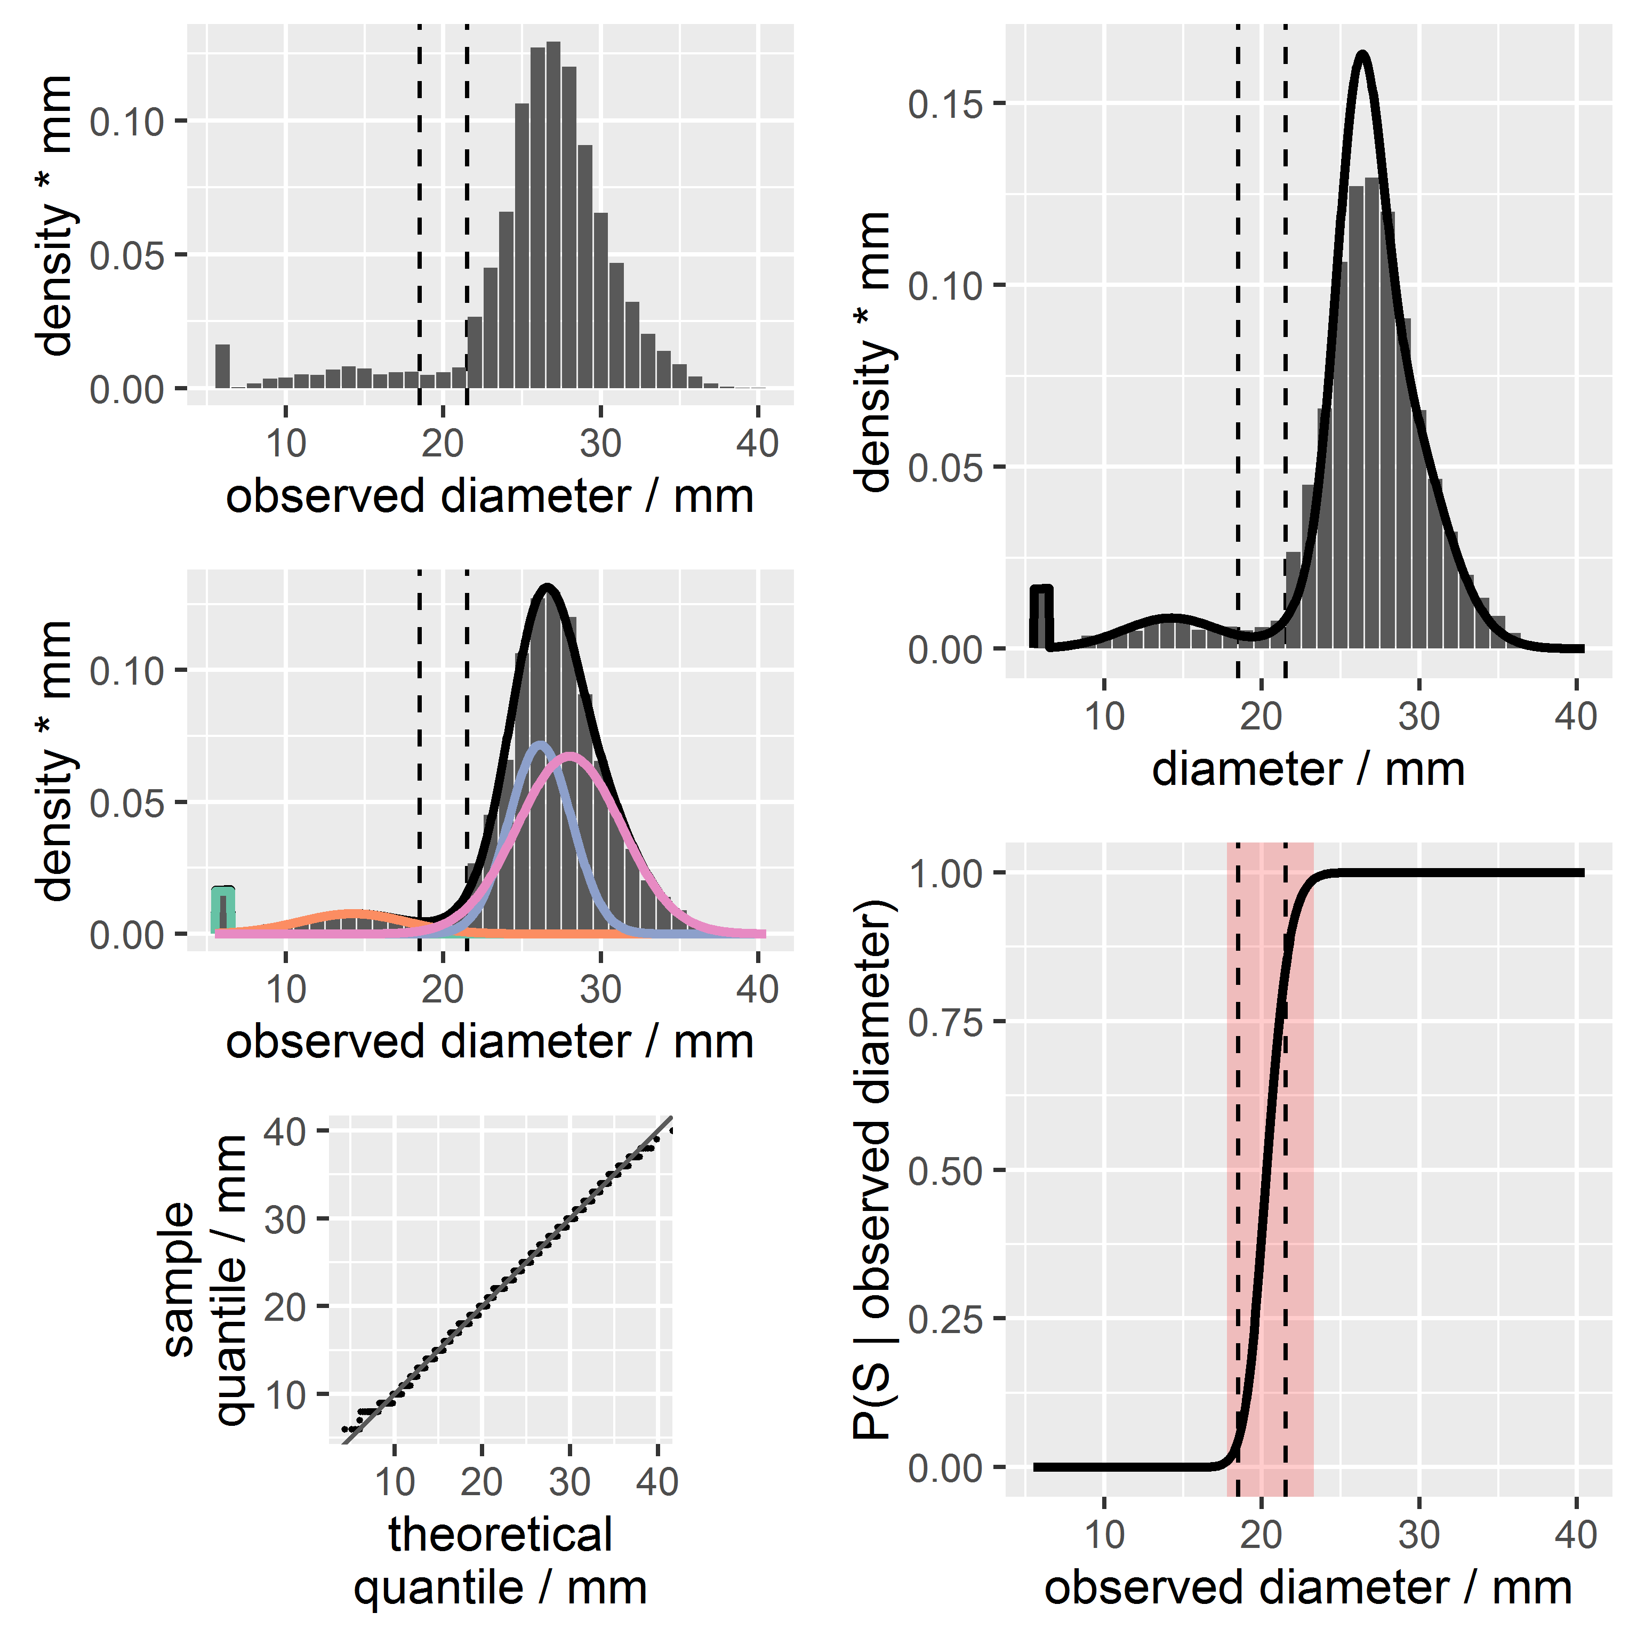
3. Model: true diameter X
The distribution of the true diameter X is a mixture of normally distributed components
Strains with x = 6 mm are treated differently

Slide 7
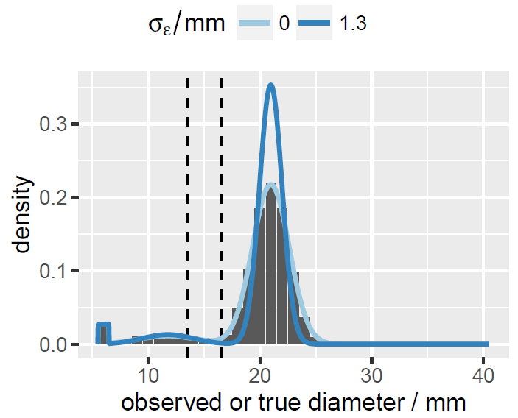
3. Model: technical error E
For strains with x = 6 mm: E = 0
Otherwise:
E is normally distributed
μ_{E} = 0
σ_{E} = constant,
i.e. independent of X

Slide 8
3. Model fitting
Take histogram of observed diameters from database
Fit mixture of normal distributions → Y
Estimate technical error → E
Substract technical error → X
Compute forecast probabilities: p_S(y)=(X>= z_S|Y=y)
Define ZMU: p_S in [0.025, 0.975]
Compute probabilities for misclassification errors

Slide 9
4. Results: CAZ
Zone of methodological uncertainty (ZMU)

Slide 10
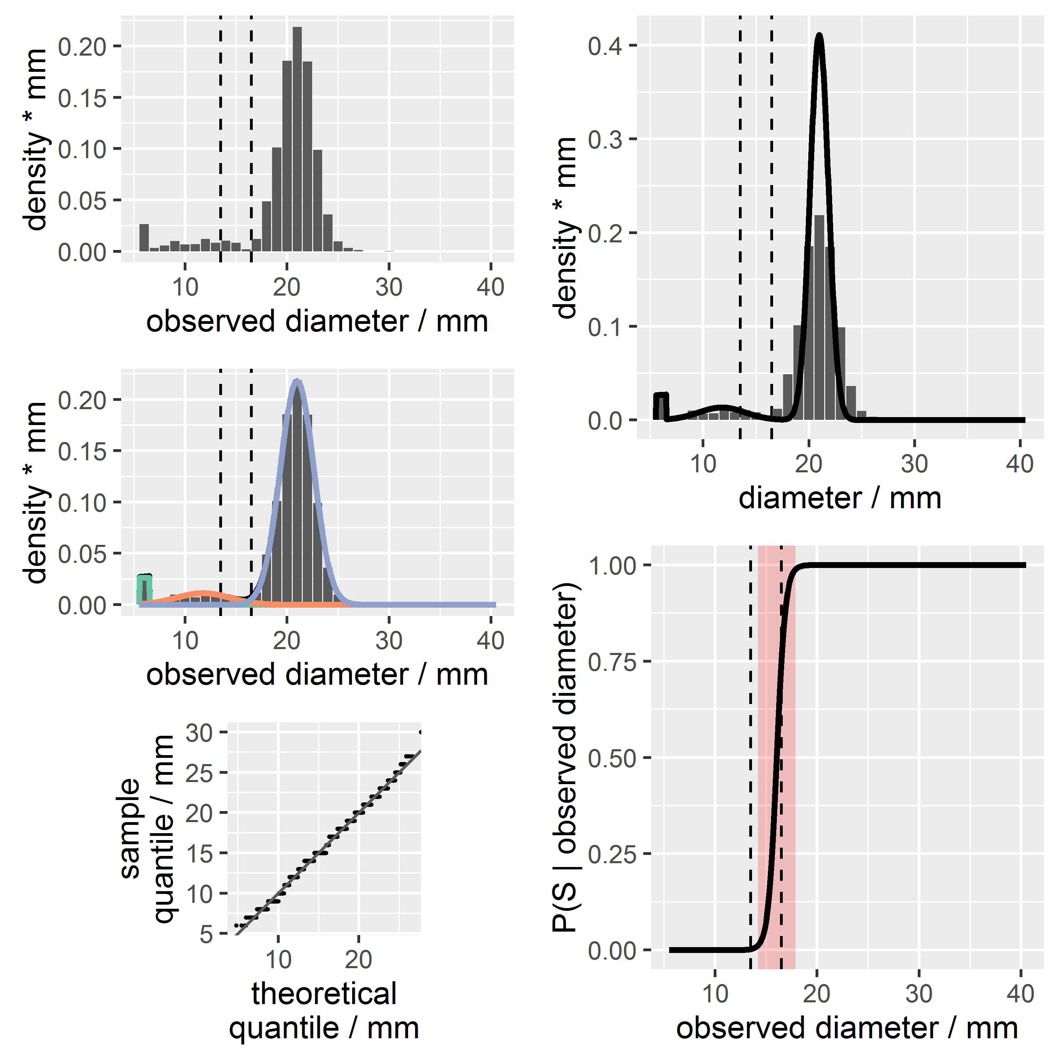
4. Results: TOB
Zone of methodological uncertainty (ZMU)

Slide 11
4. Results
Modelling fails for:
ETP and MEM due to too few strains with observed diameters below CBP for R (53 and 3 out of 9766, respectively)
GEN → next slide

Slide 12
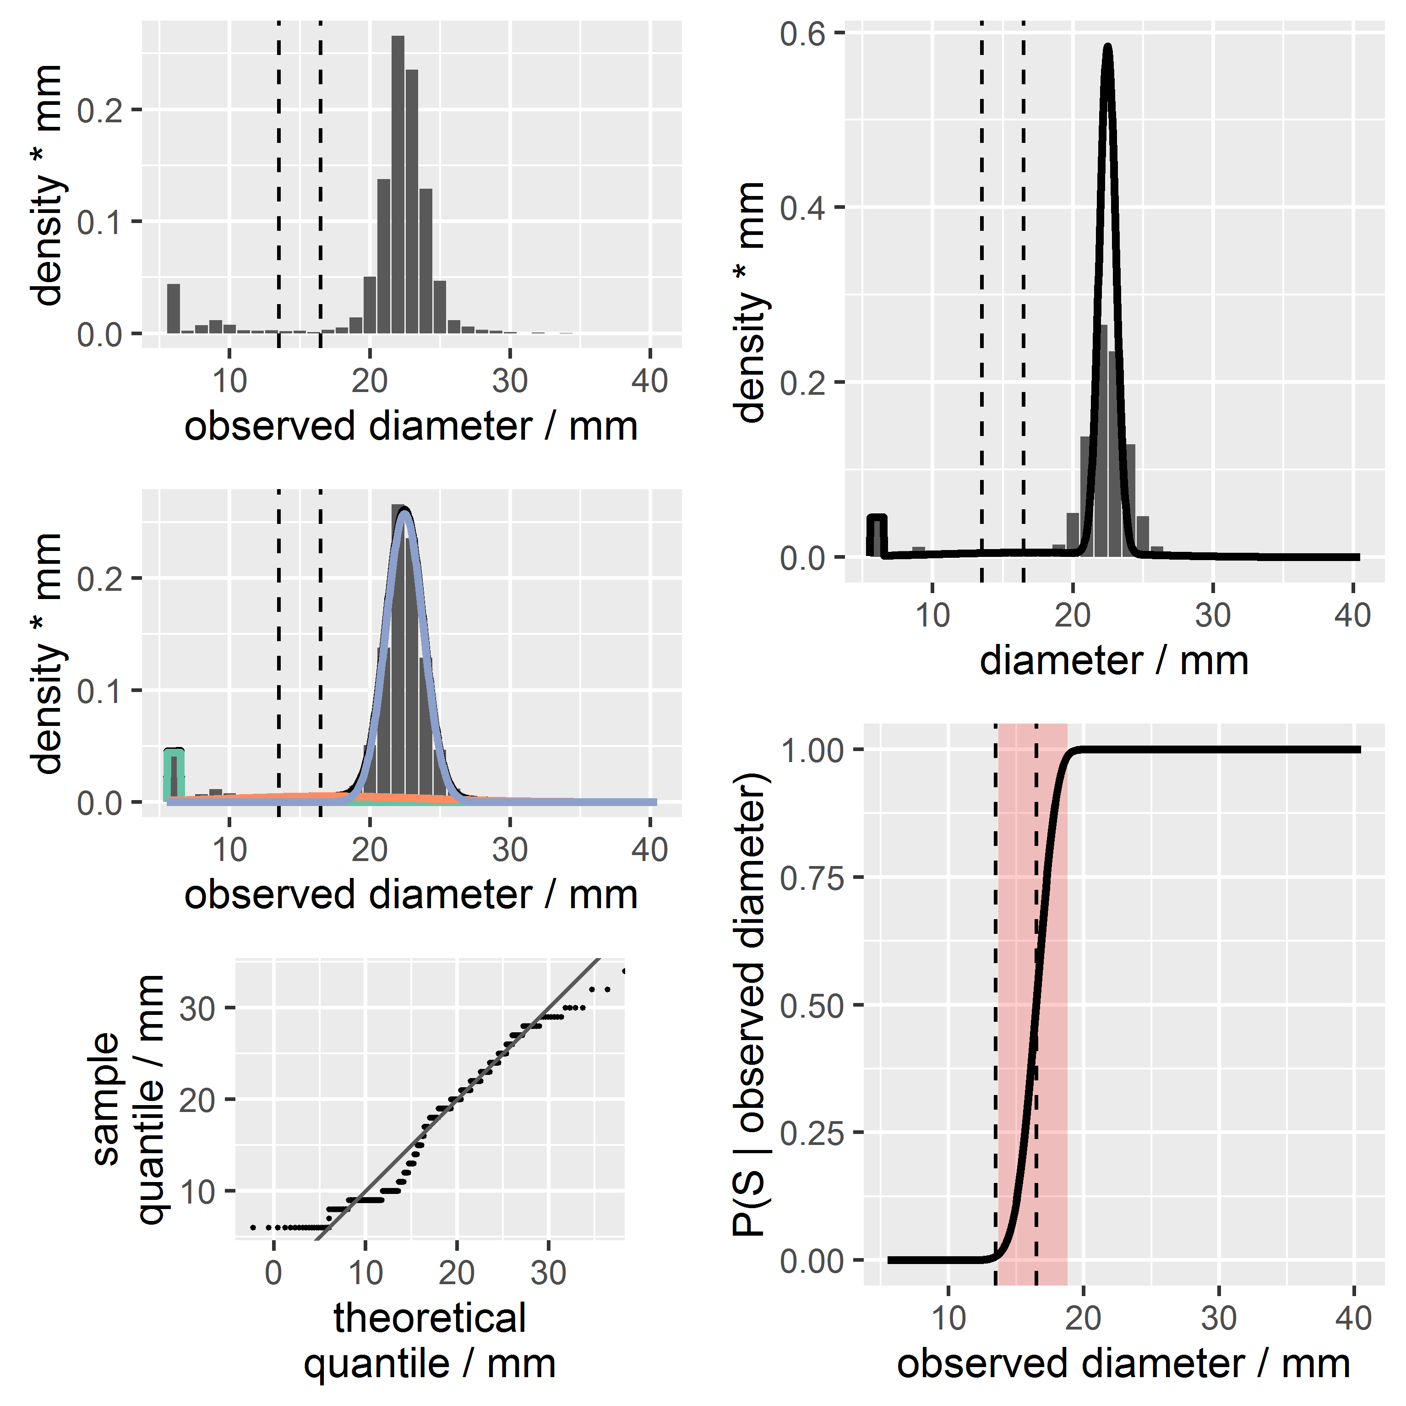
4. Results: GEN

Slide 13
4. Results
Forecast probabilities can be used to compute the probabilities of methodological misclassification errors:
Very major methodological misclassification error:
X < CBP_{R} and Y ≥ CBP_{S}
Major methodological misclassification error:
X ≥ CBP_{S} and Y < CBP_{R}

Slide 14
4. Results
no intermediate zone ↔ methodological error rates > 1E-03!

Slide 15
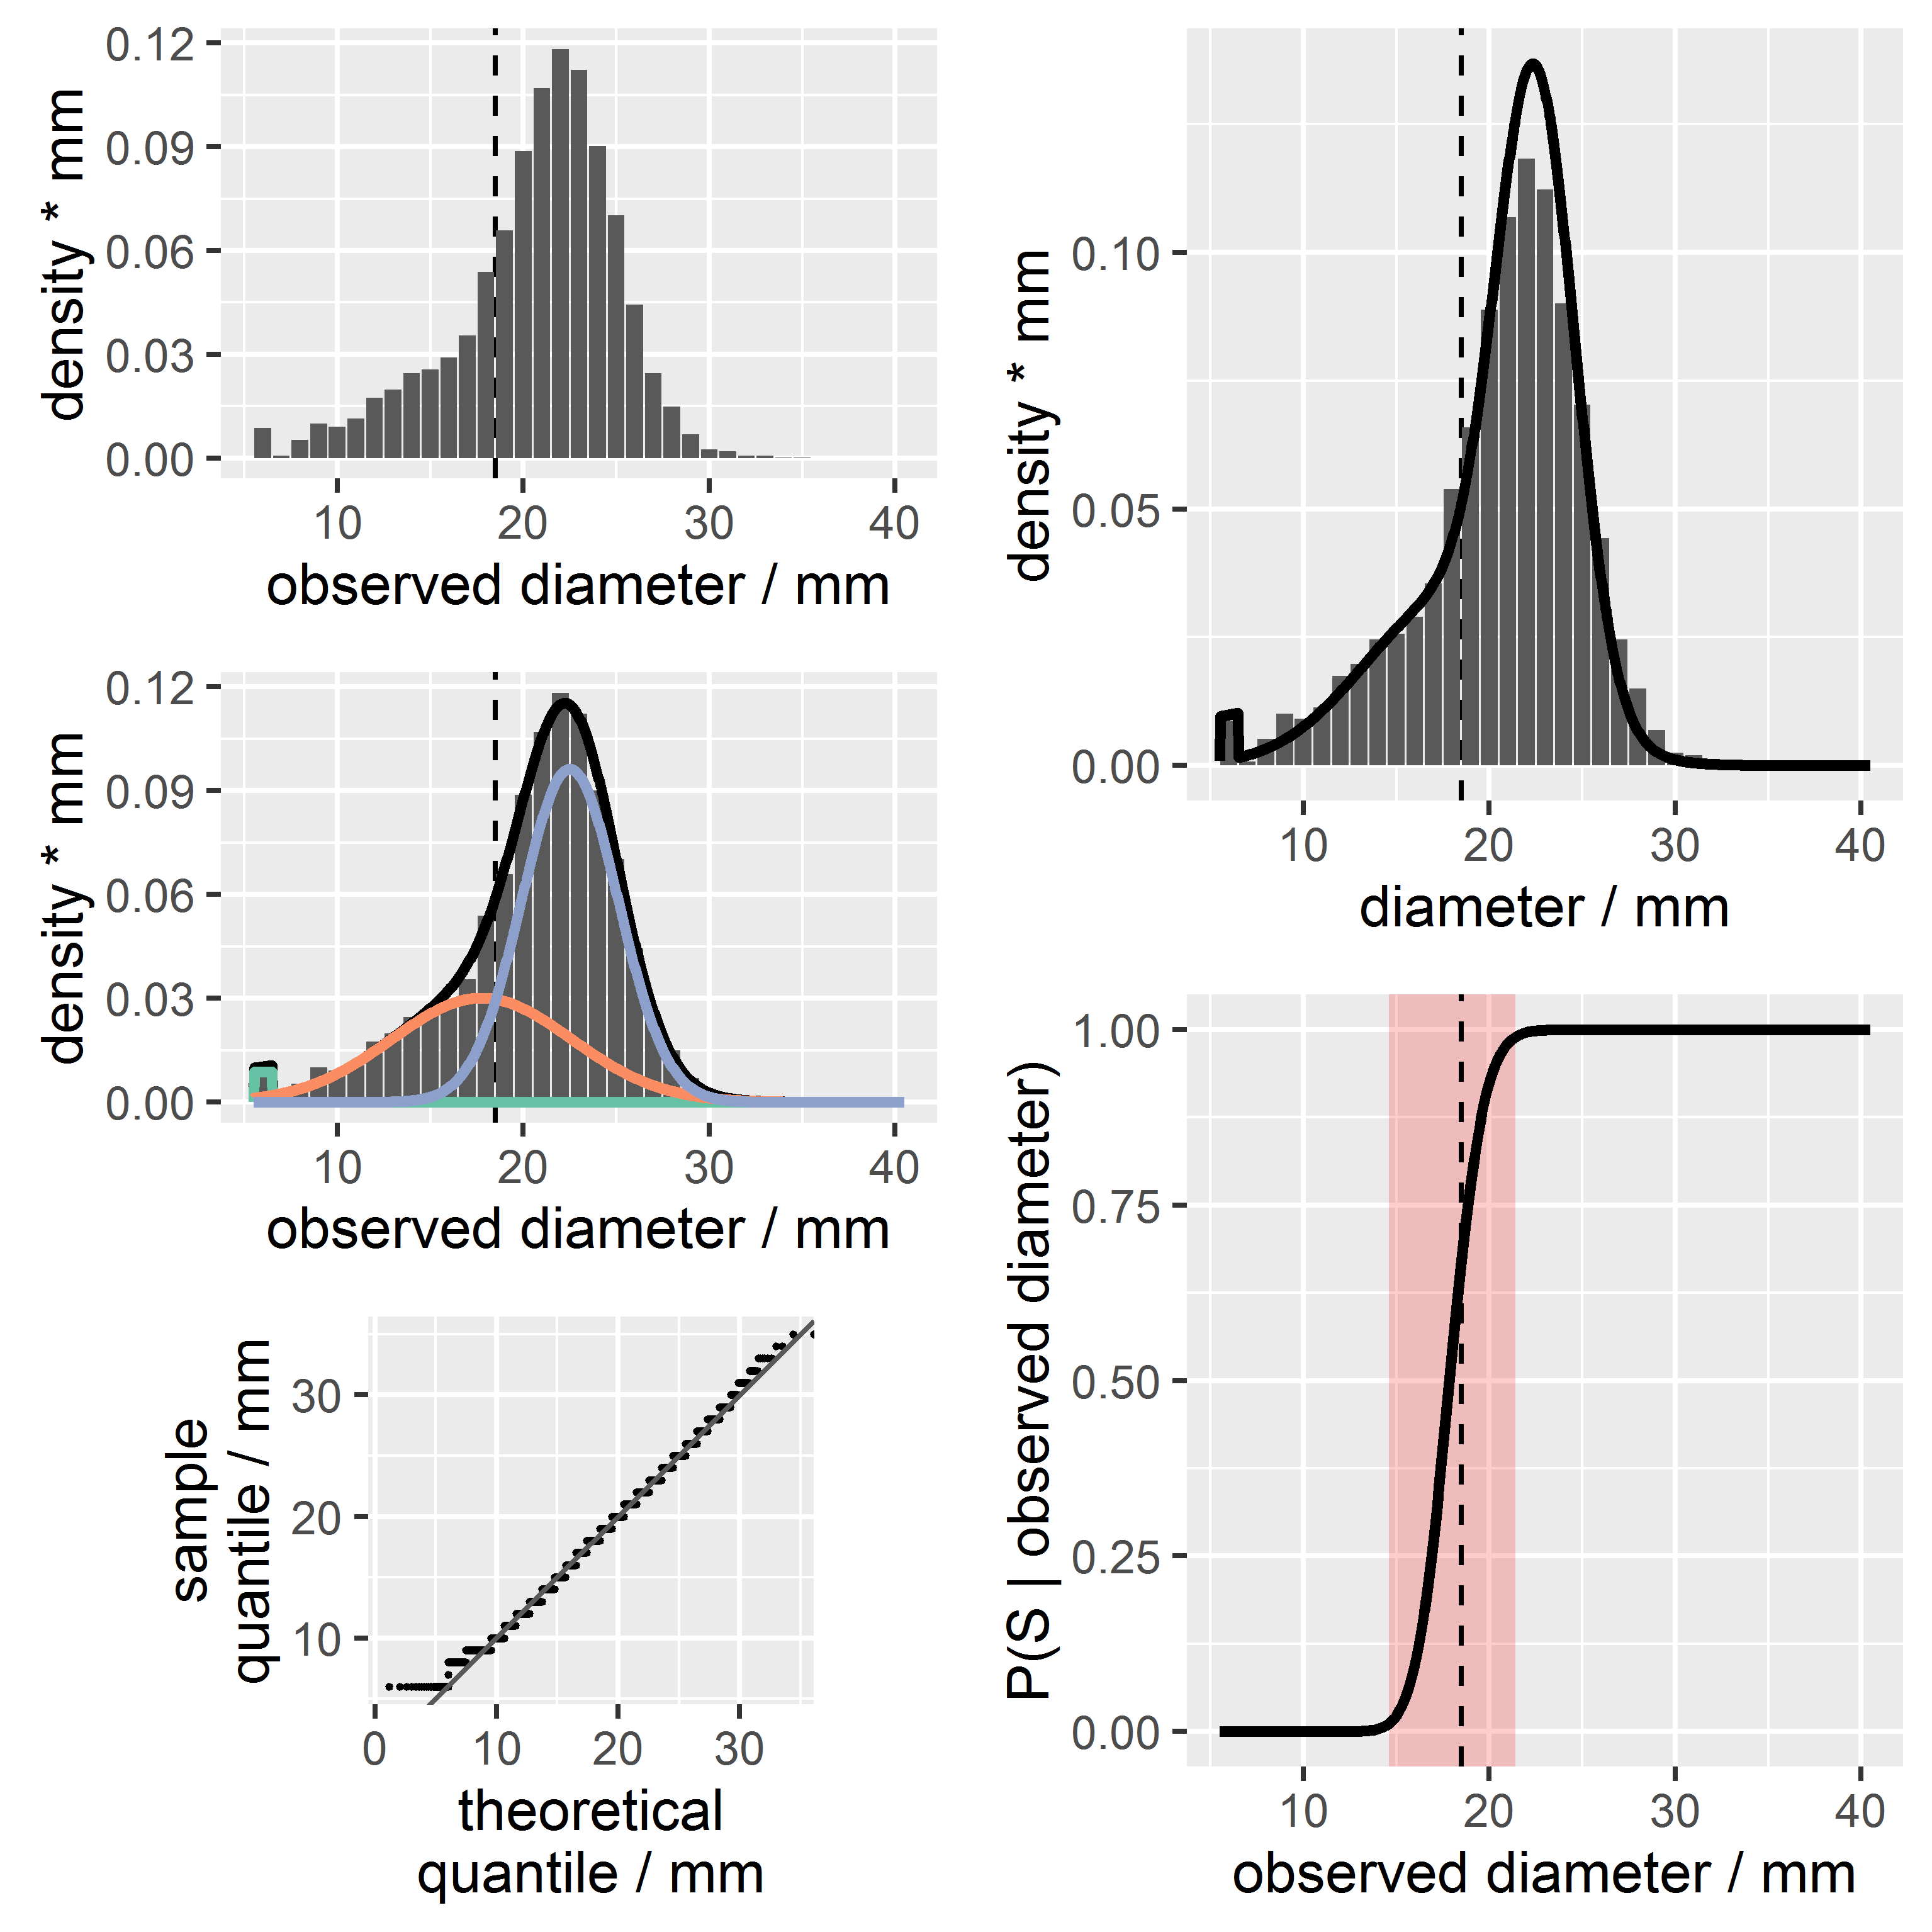
4. Results: AMC

Slide 16
5. Conclusions
The model is simple and it works
We can add forecast probabilities to AST categorizations
We can compute the rates of methodological misclassification errors and thus quantify the effect of changes in CBPs

Slide 17
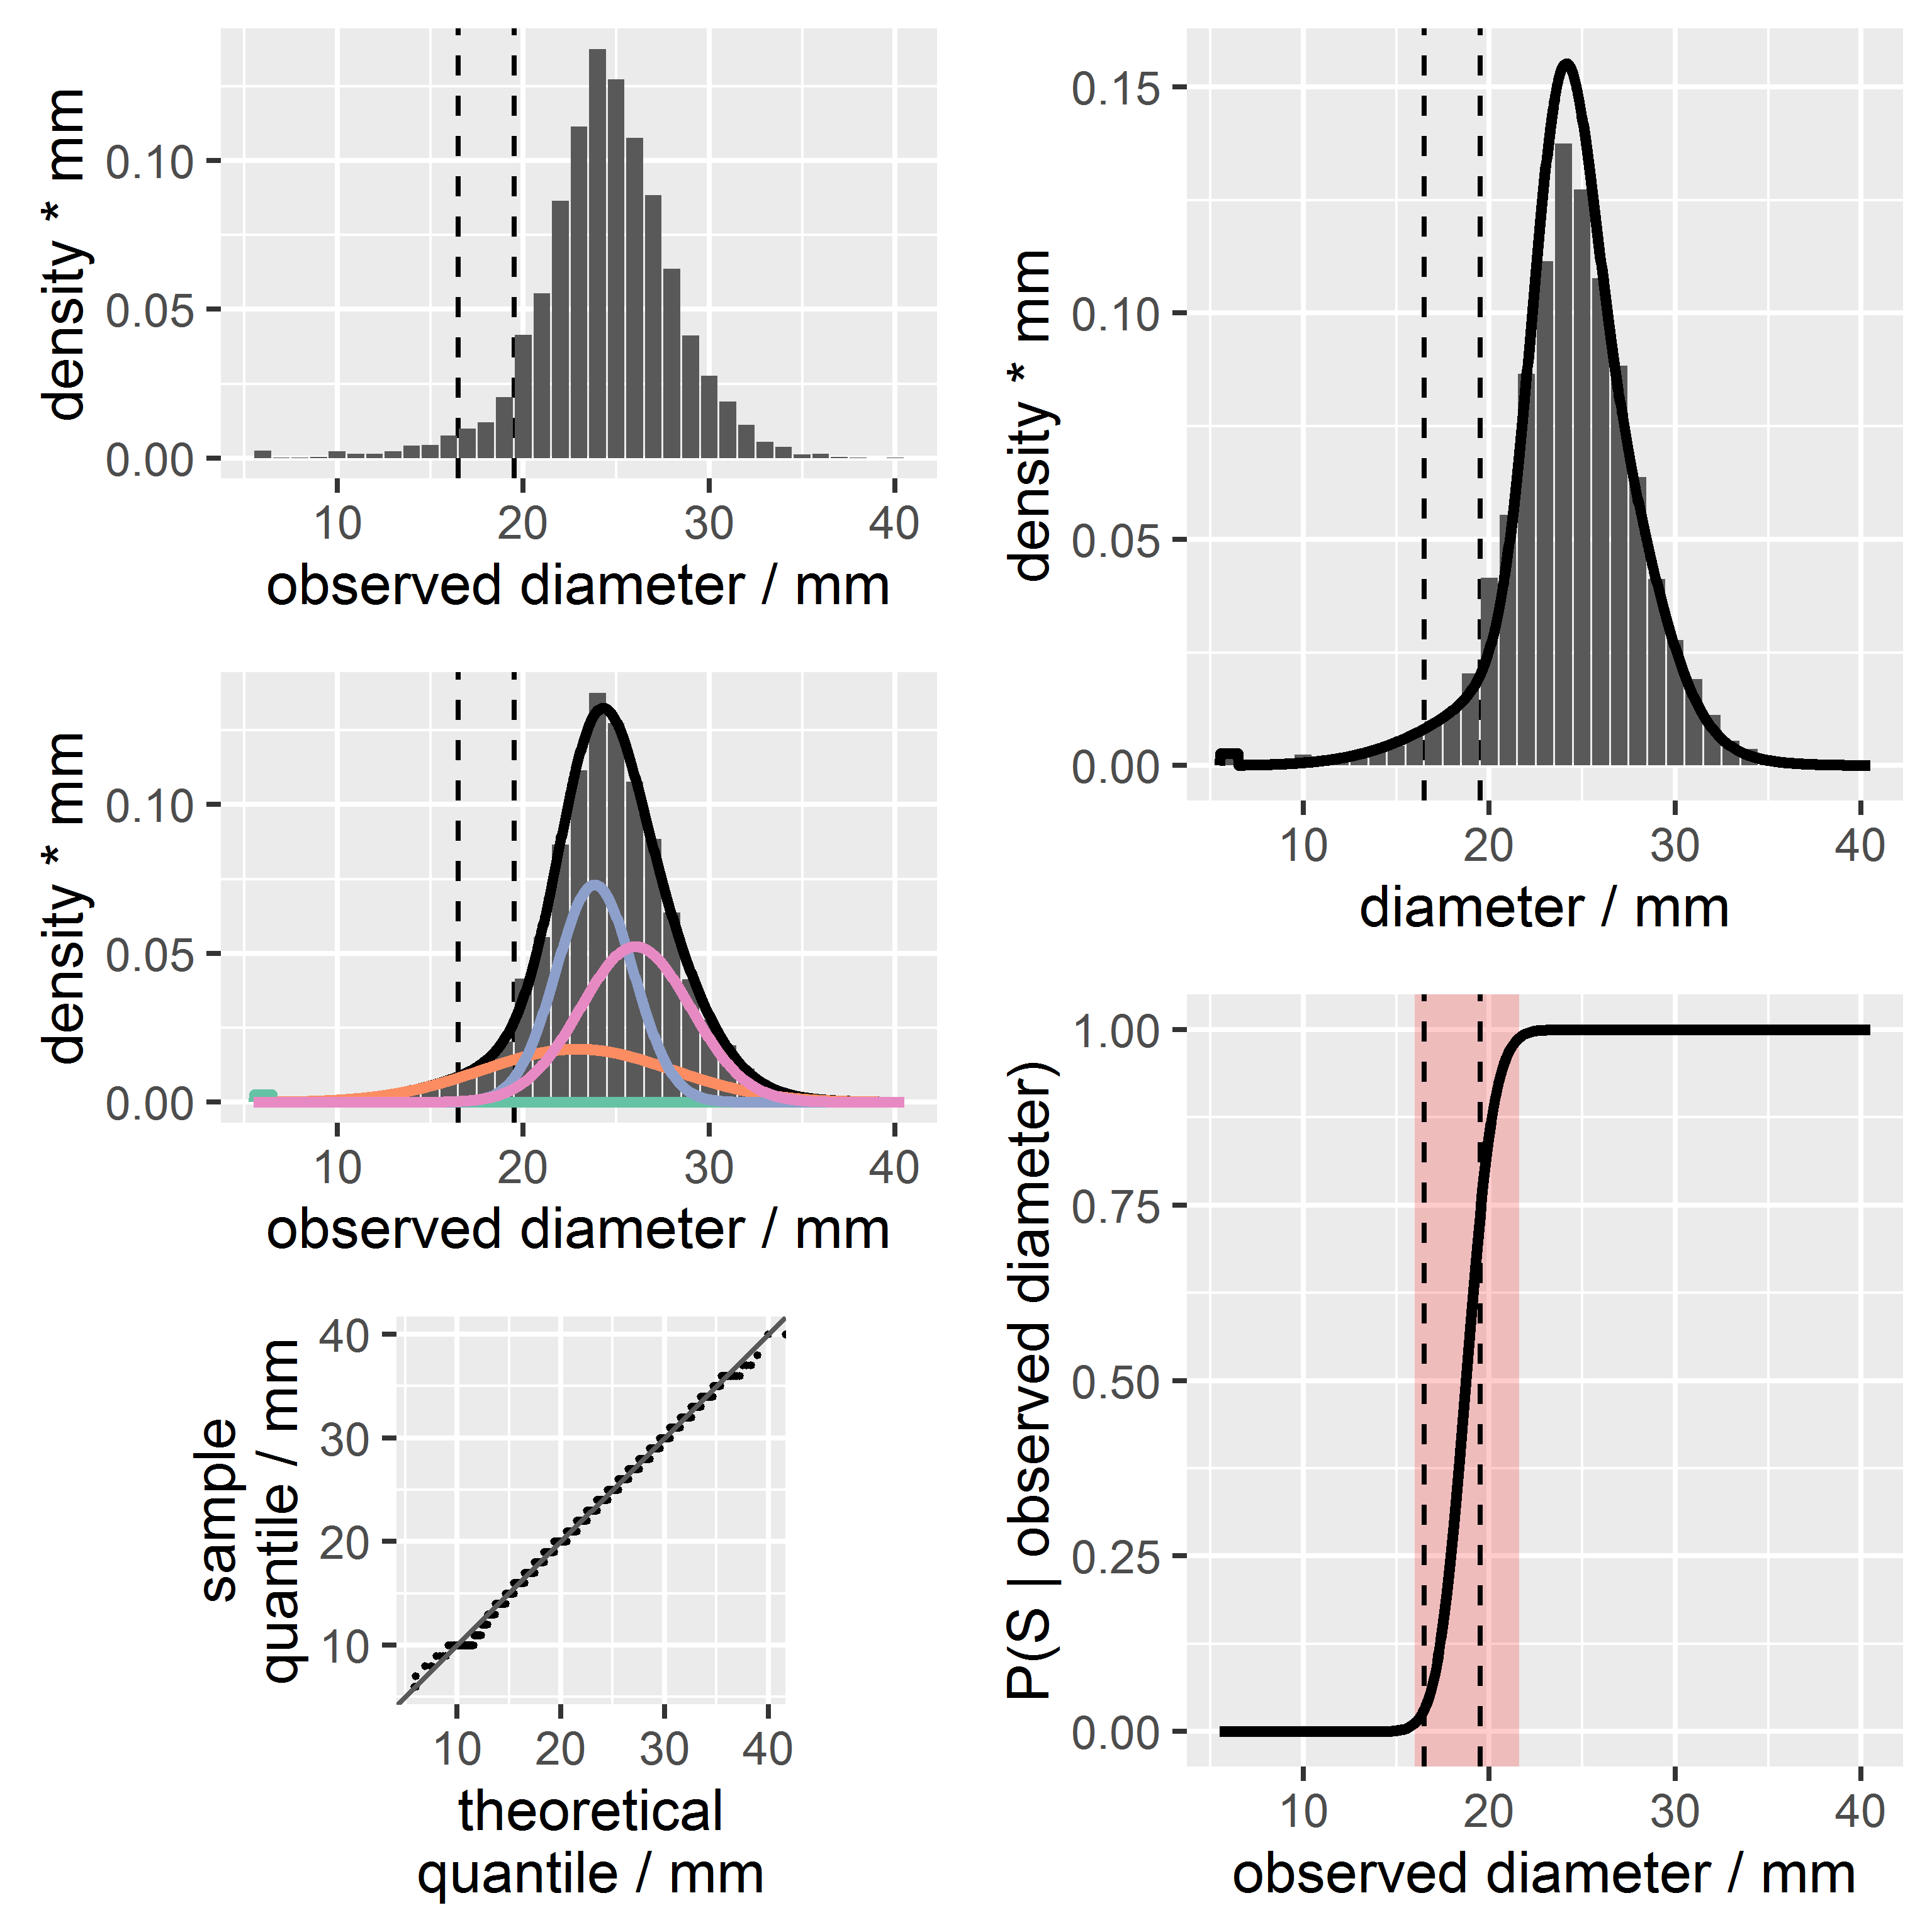
4. Results: TPZ

