Slide 1
Some new results Next measurements + ToDos
We should see what we measure next week.
I feel like some results are important for this discussion, so I added as many as I could this week.
The full analysis is still coming but needs a bit more time.

Slide 2
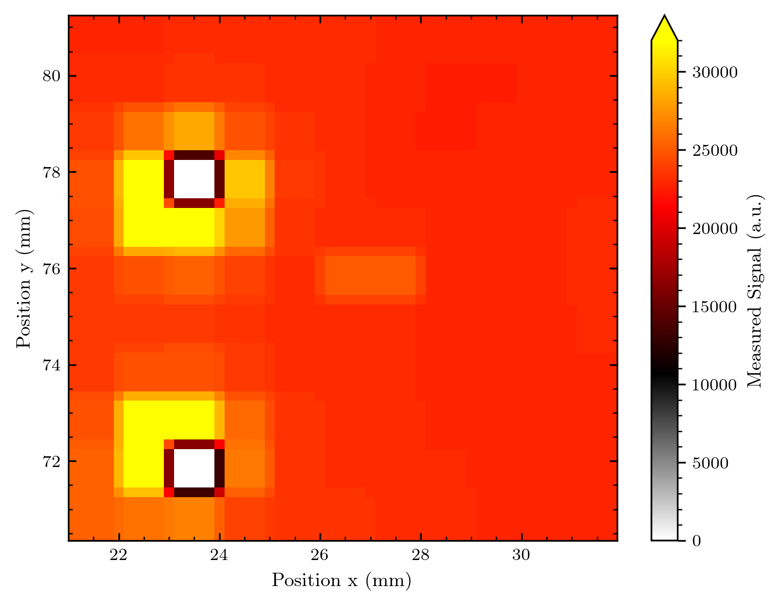
Some context 2D array (pre-release from full analysis)
This is a map from the middle of the beam, the beam
is diffused by the 200-um diffuser
The signal should thus be homogeneous!
(The signal level is much higher than before, but we have an active area of 0.8x0.8 mm^2 instead of 0.4x0.4 mm^2 – thus we expect 4 times more signal) – comparison at different voltages coming
There are 2 dead diodes. The signal is homogeneous, except around the dead diodes (and this is in the direction of bonding pads = more wire overlay)
There could be something going on here, we should check this e.g. at different voltages!

Slide 3
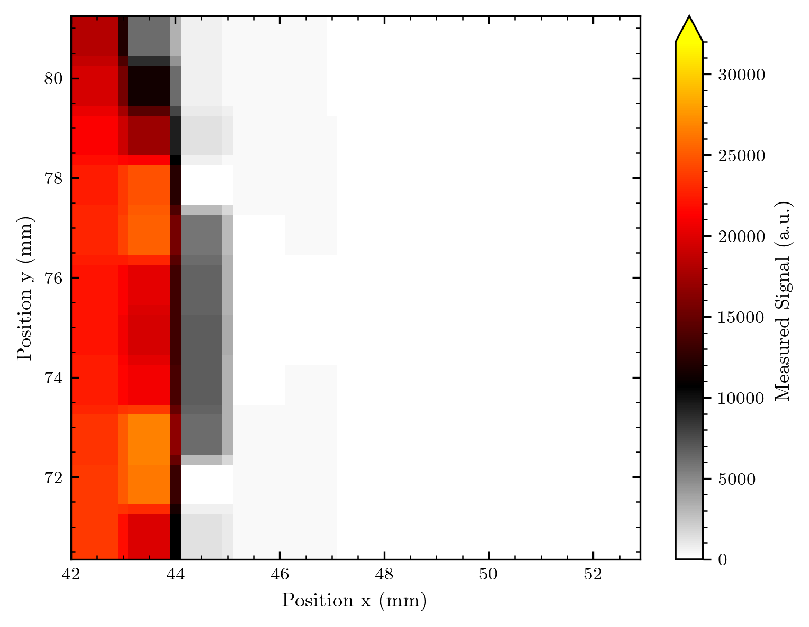
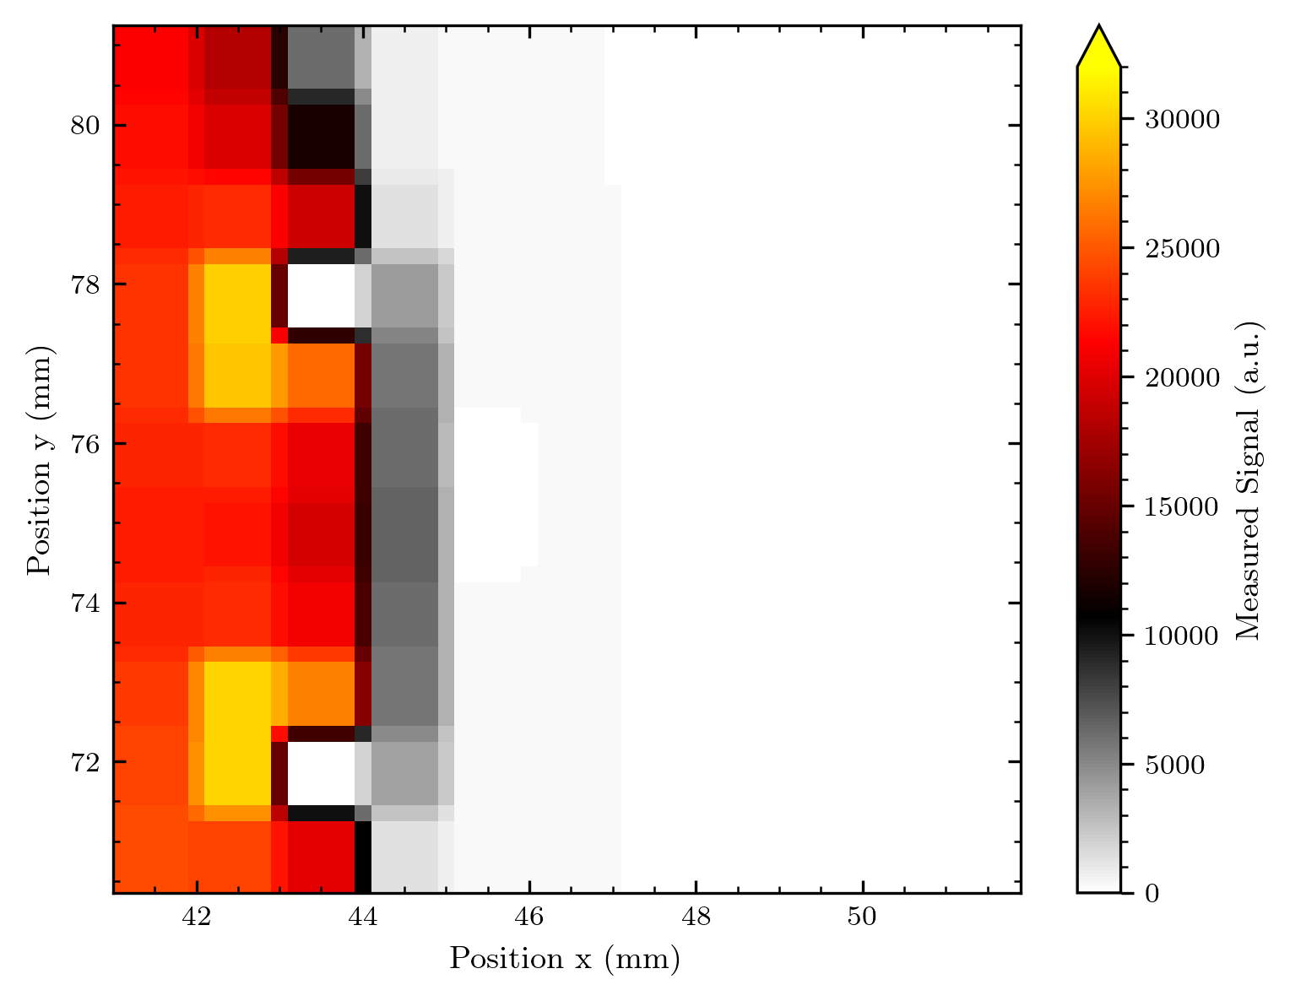
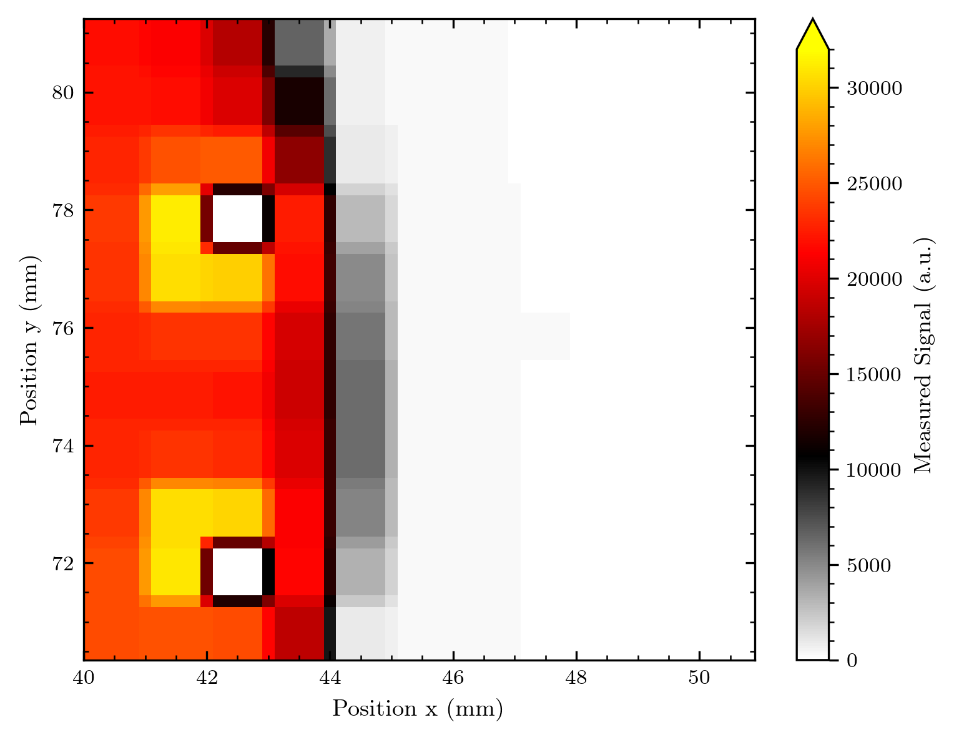
(Good) news from x/y-movement
Seems like the shape of the edge is ok – but the amount of overlying wiring could be a thing!

Slide 4
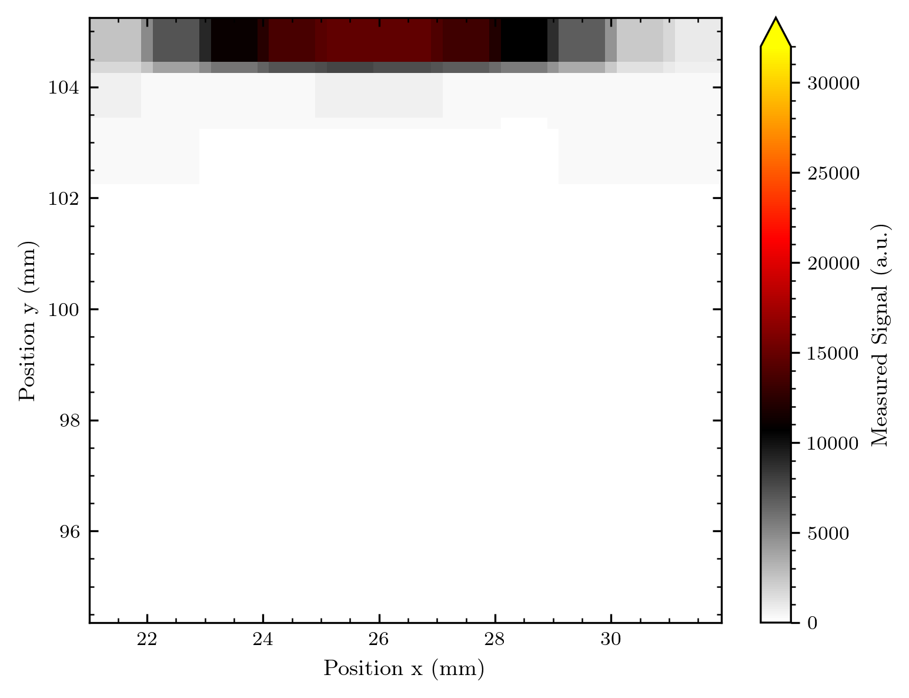
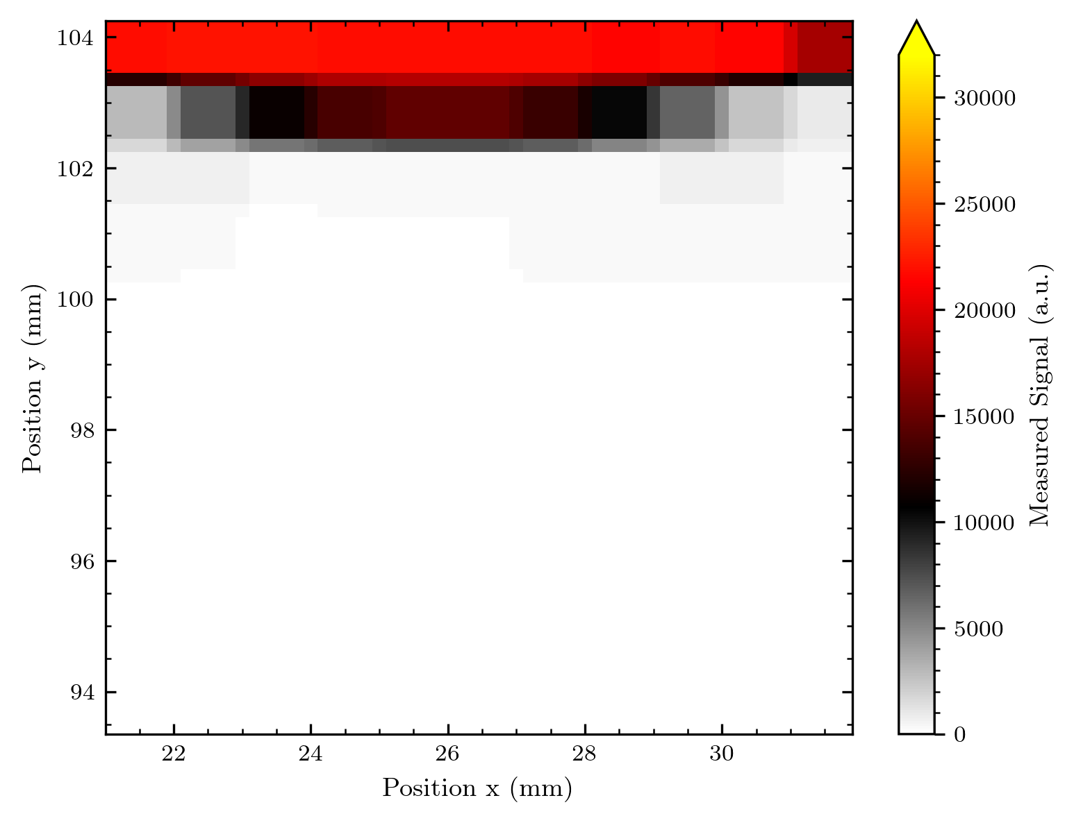
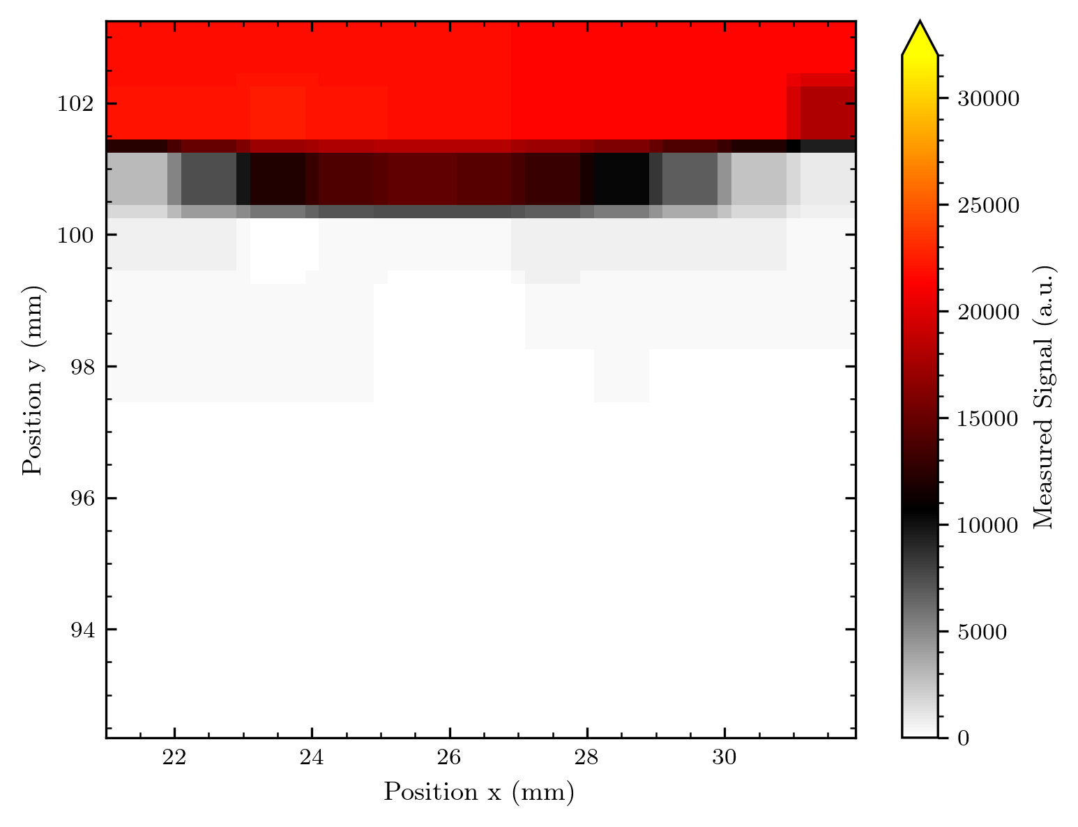
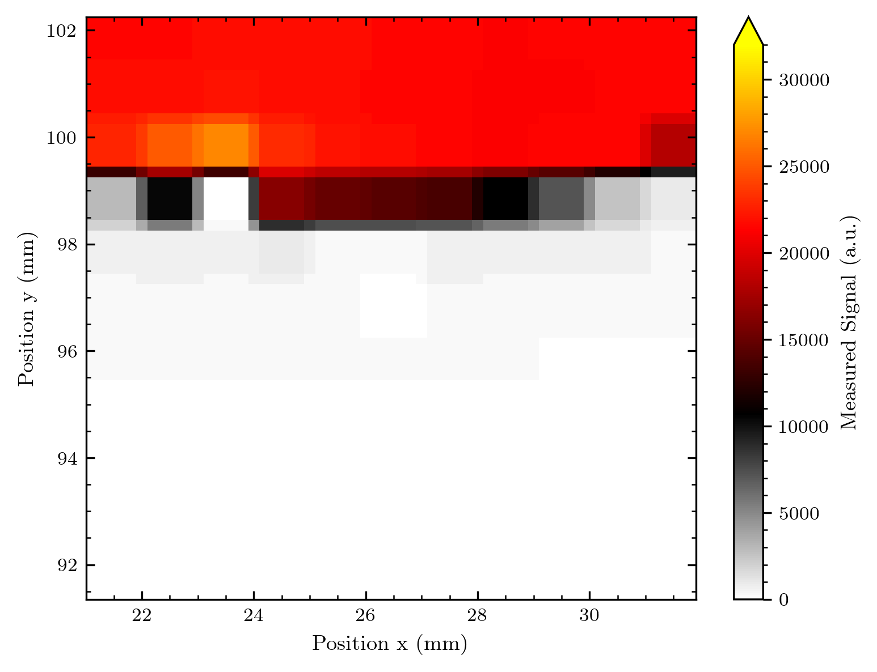
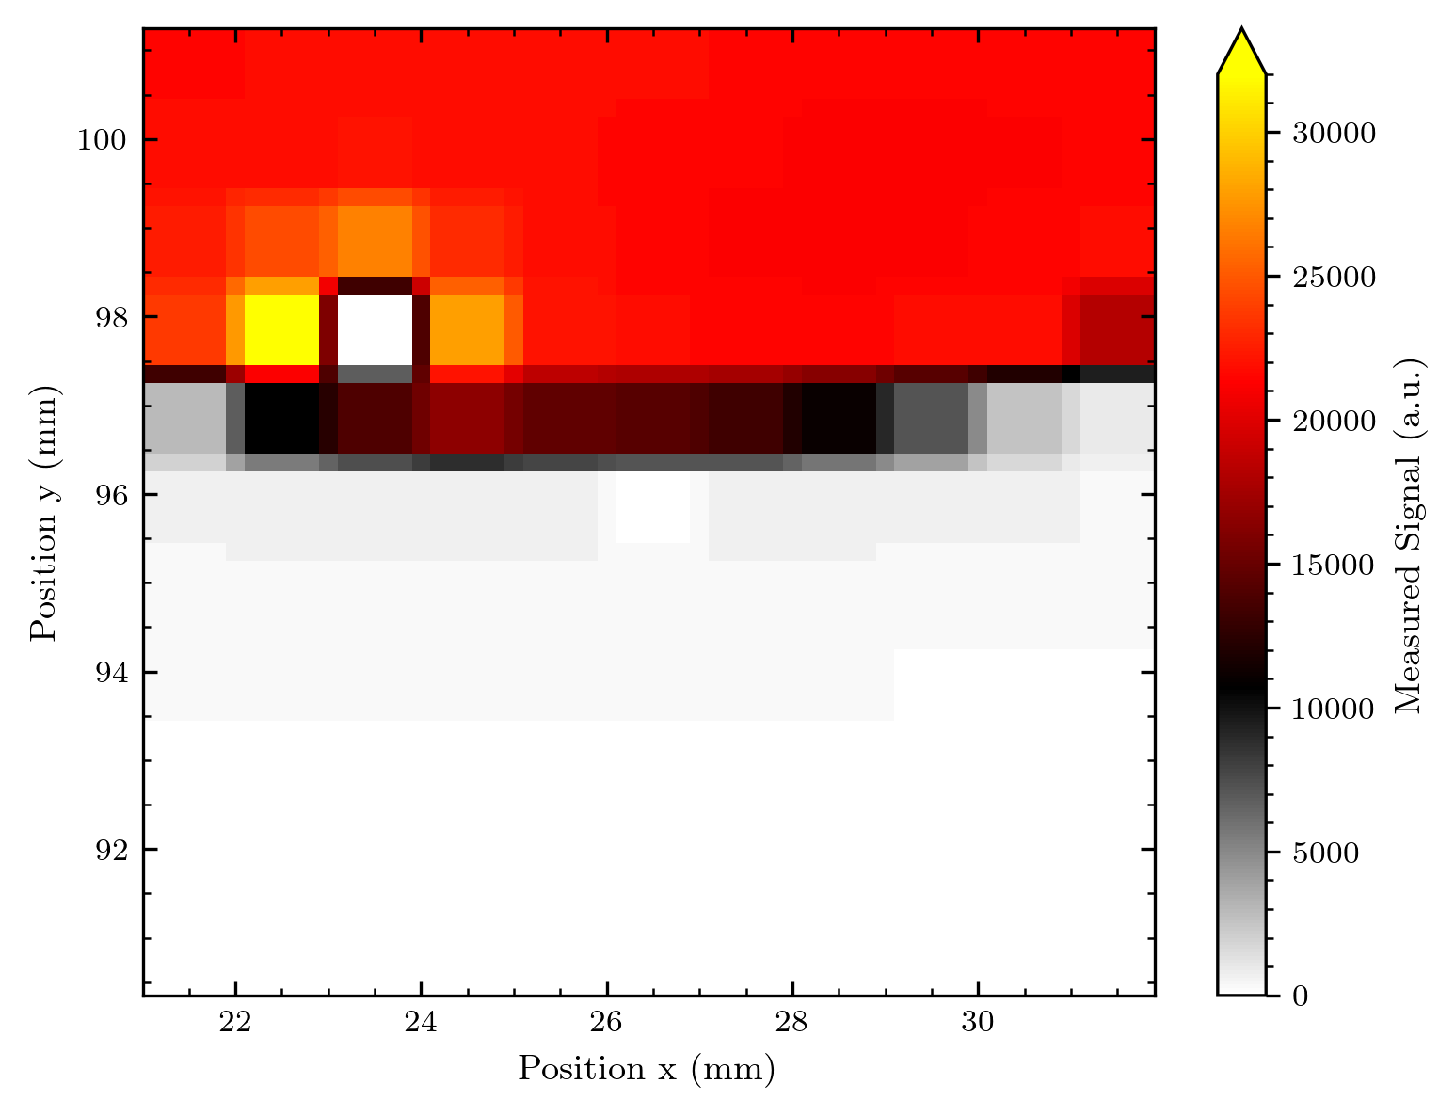
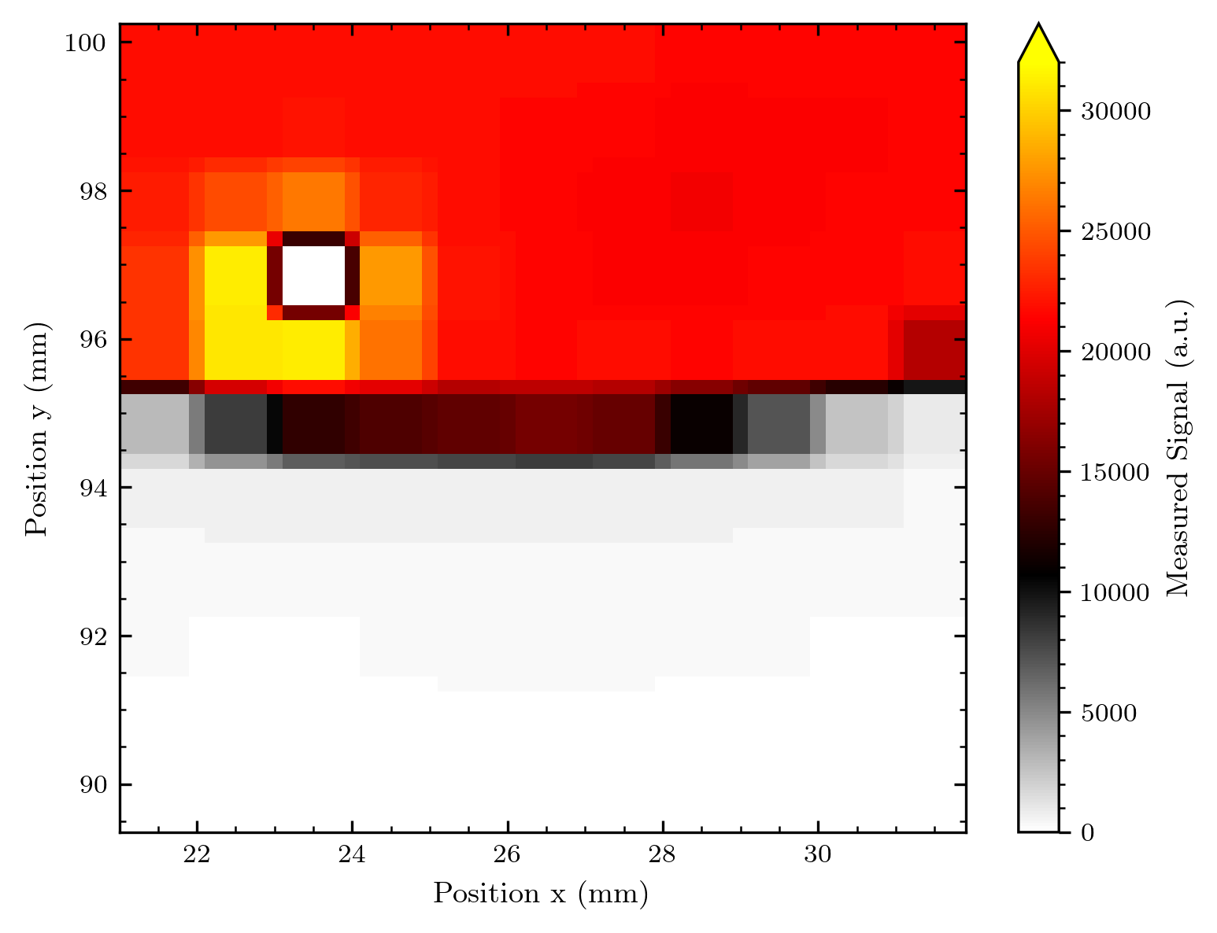

Slide 5
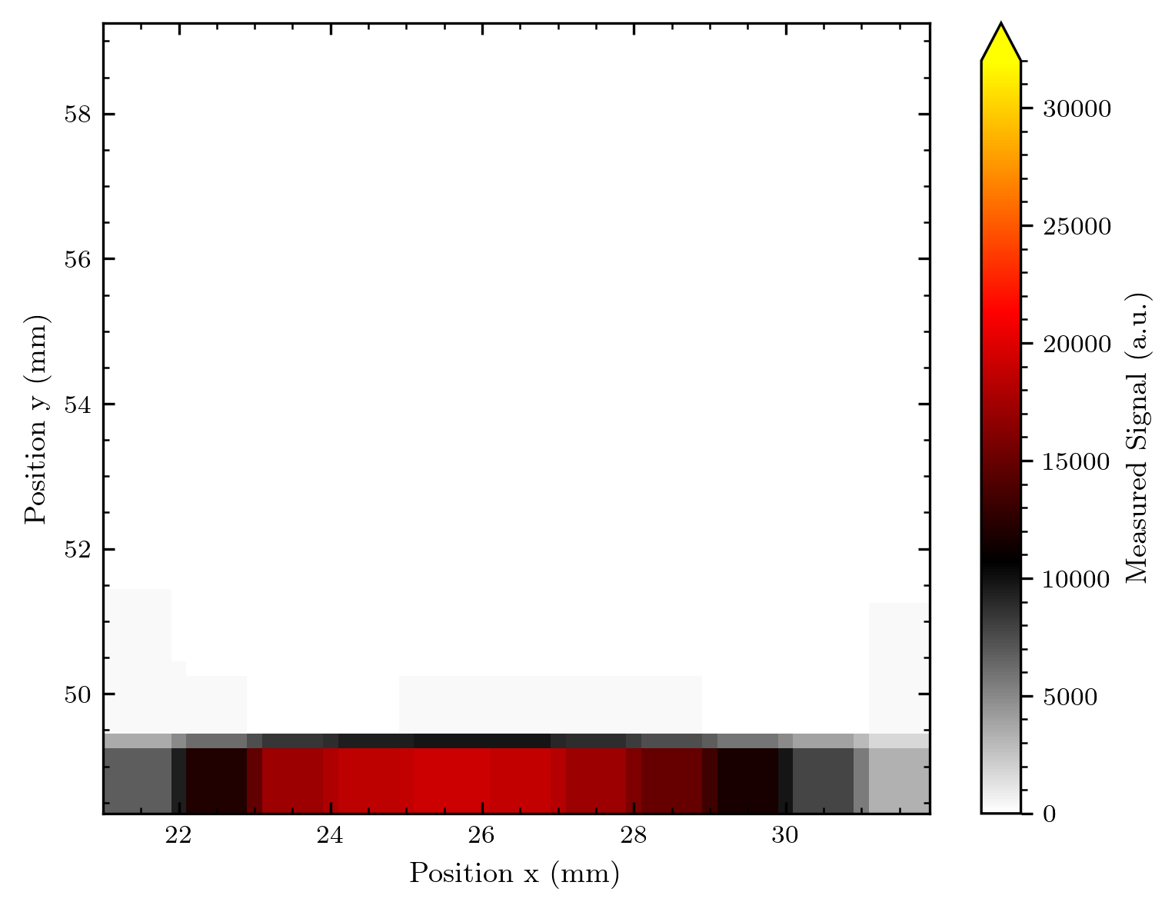
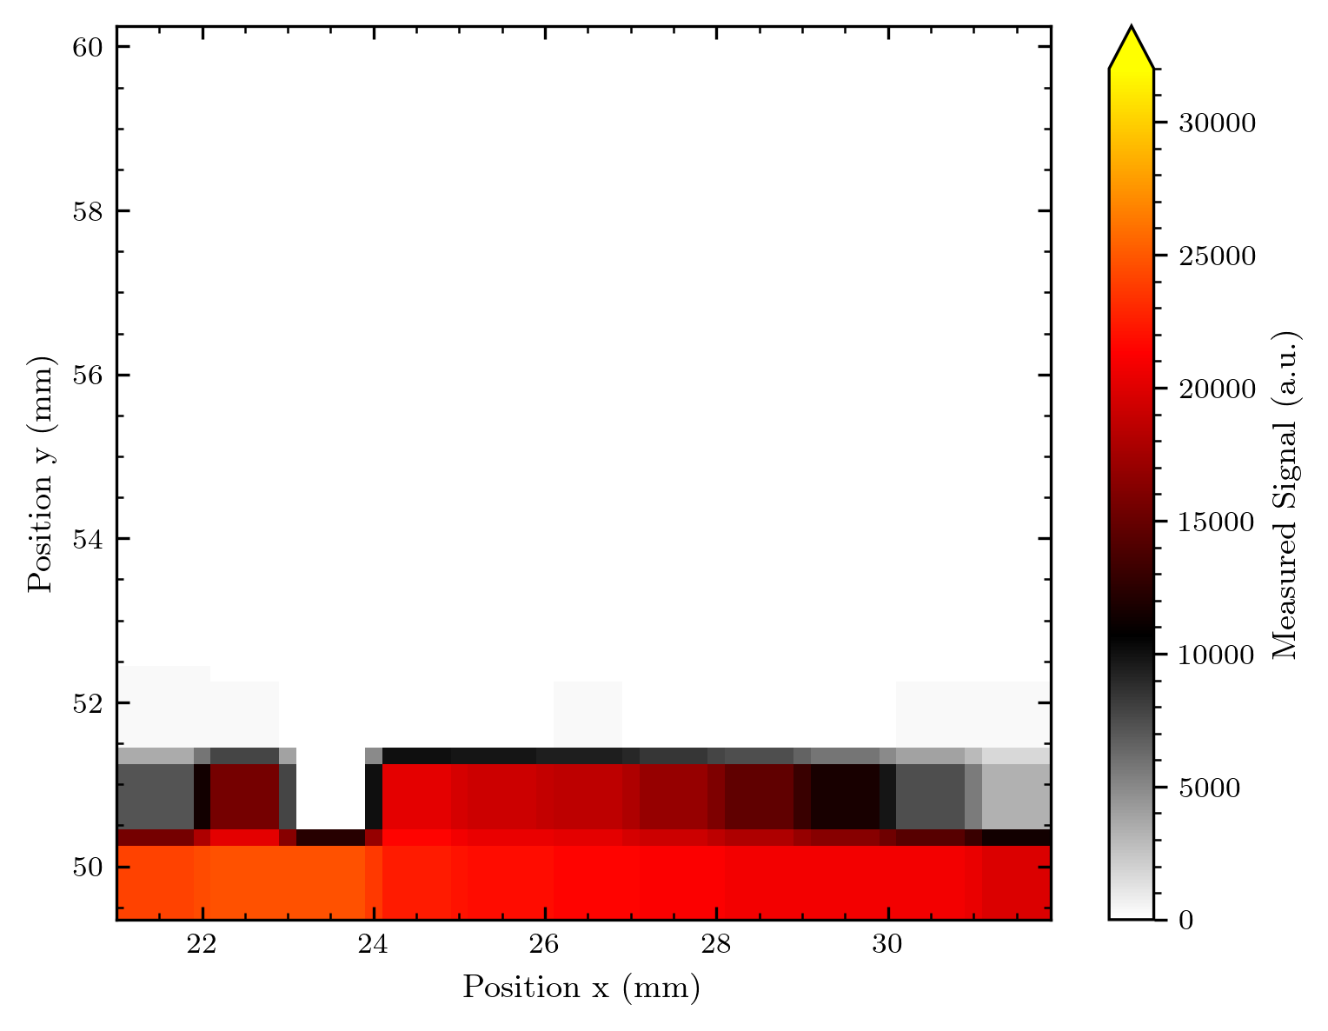
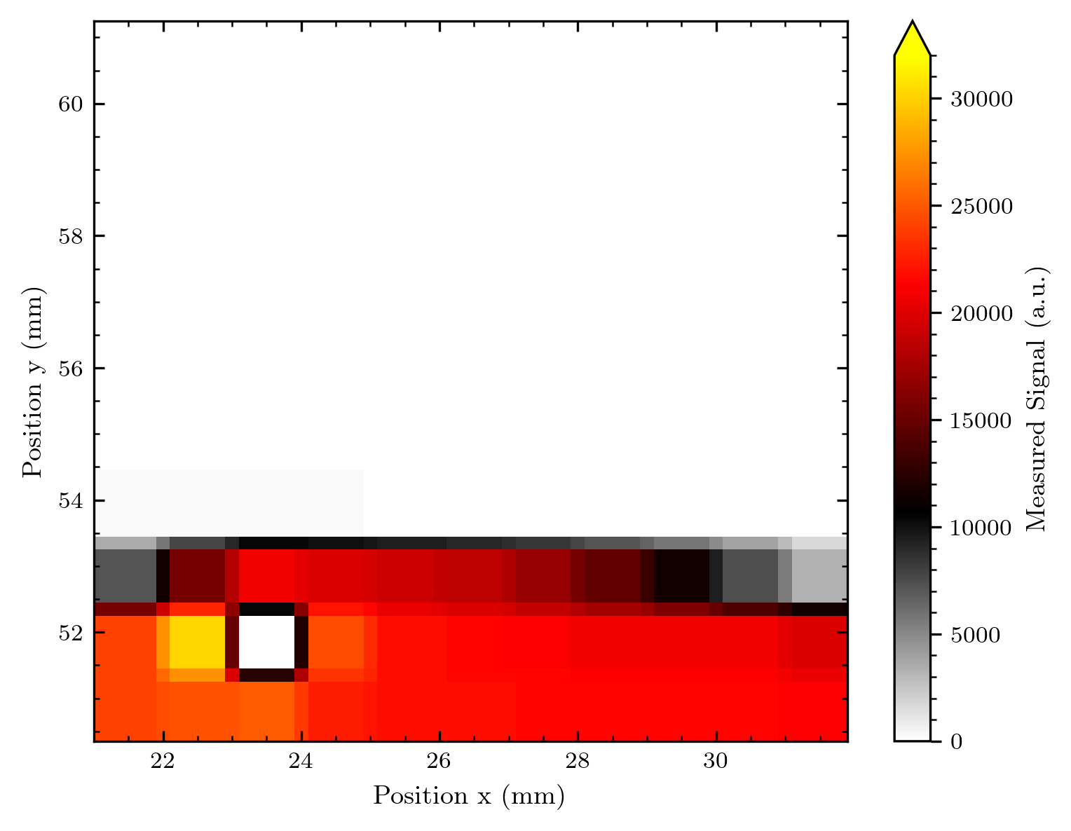
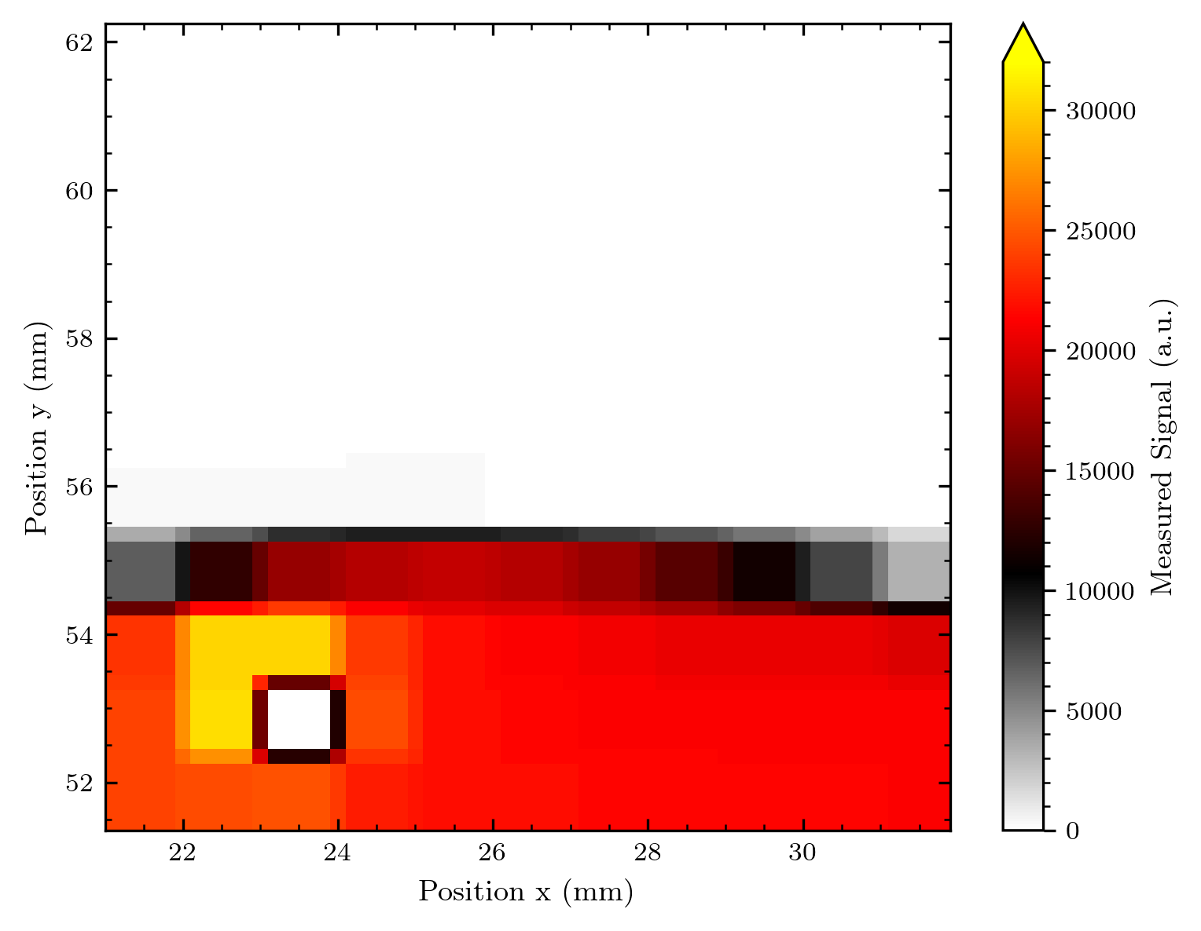
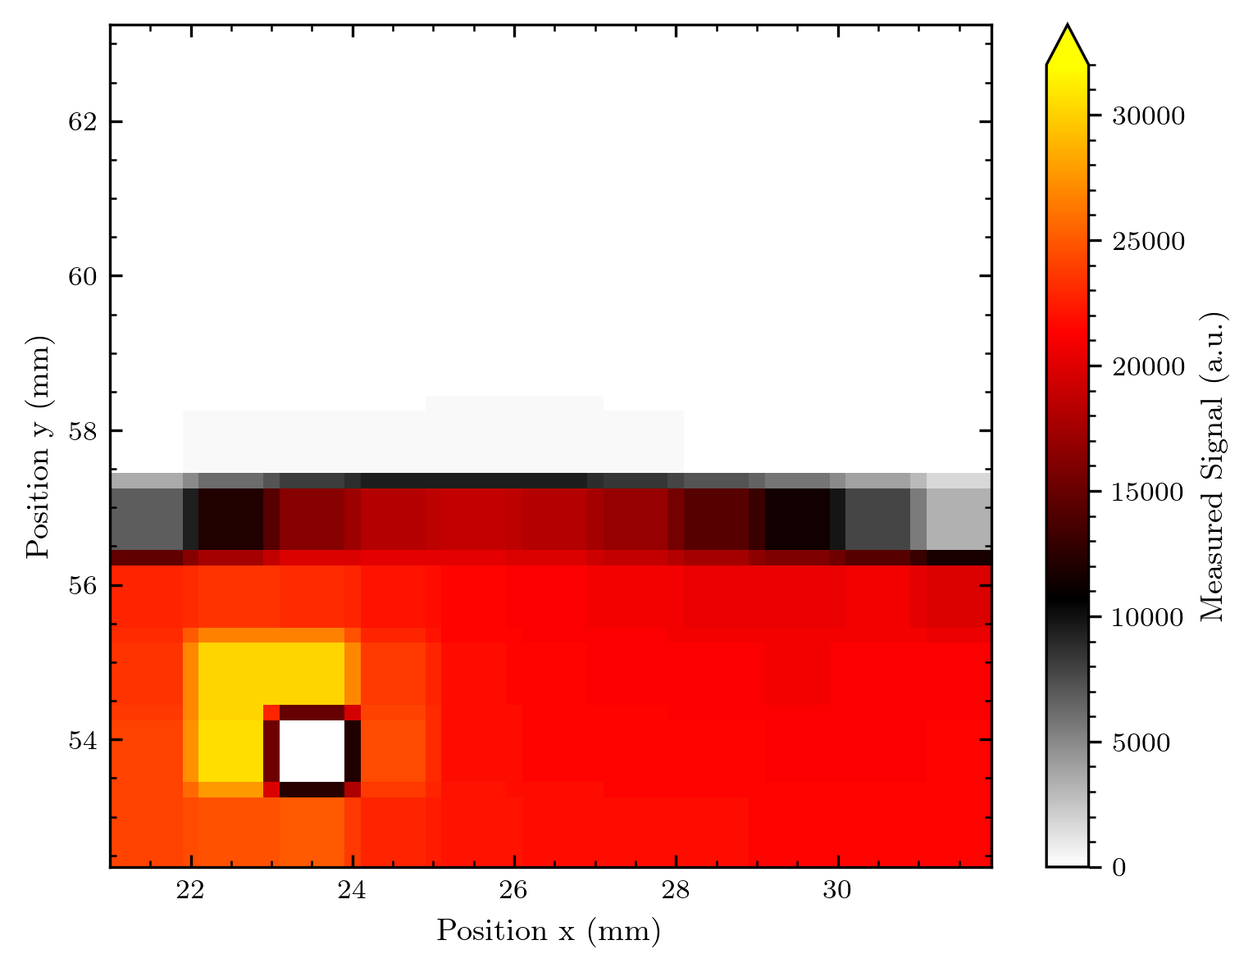
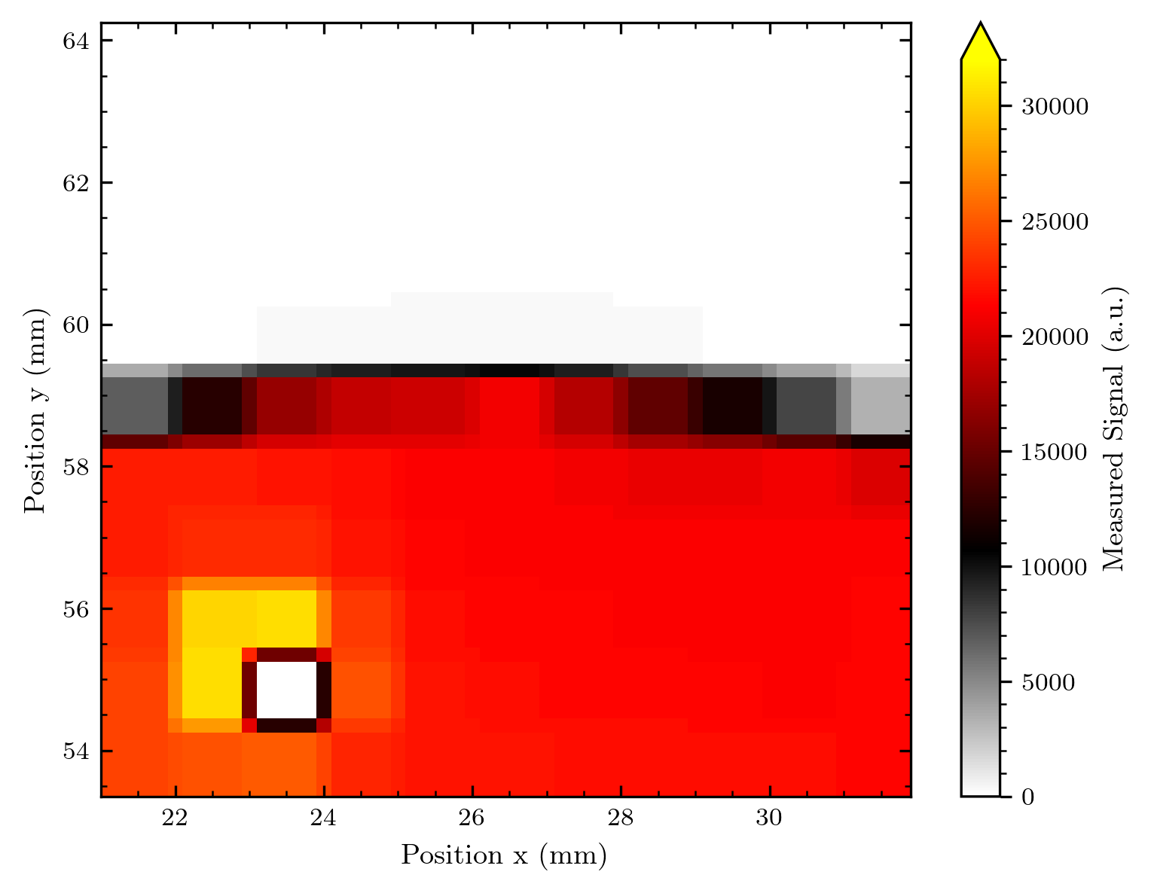

Slide 6
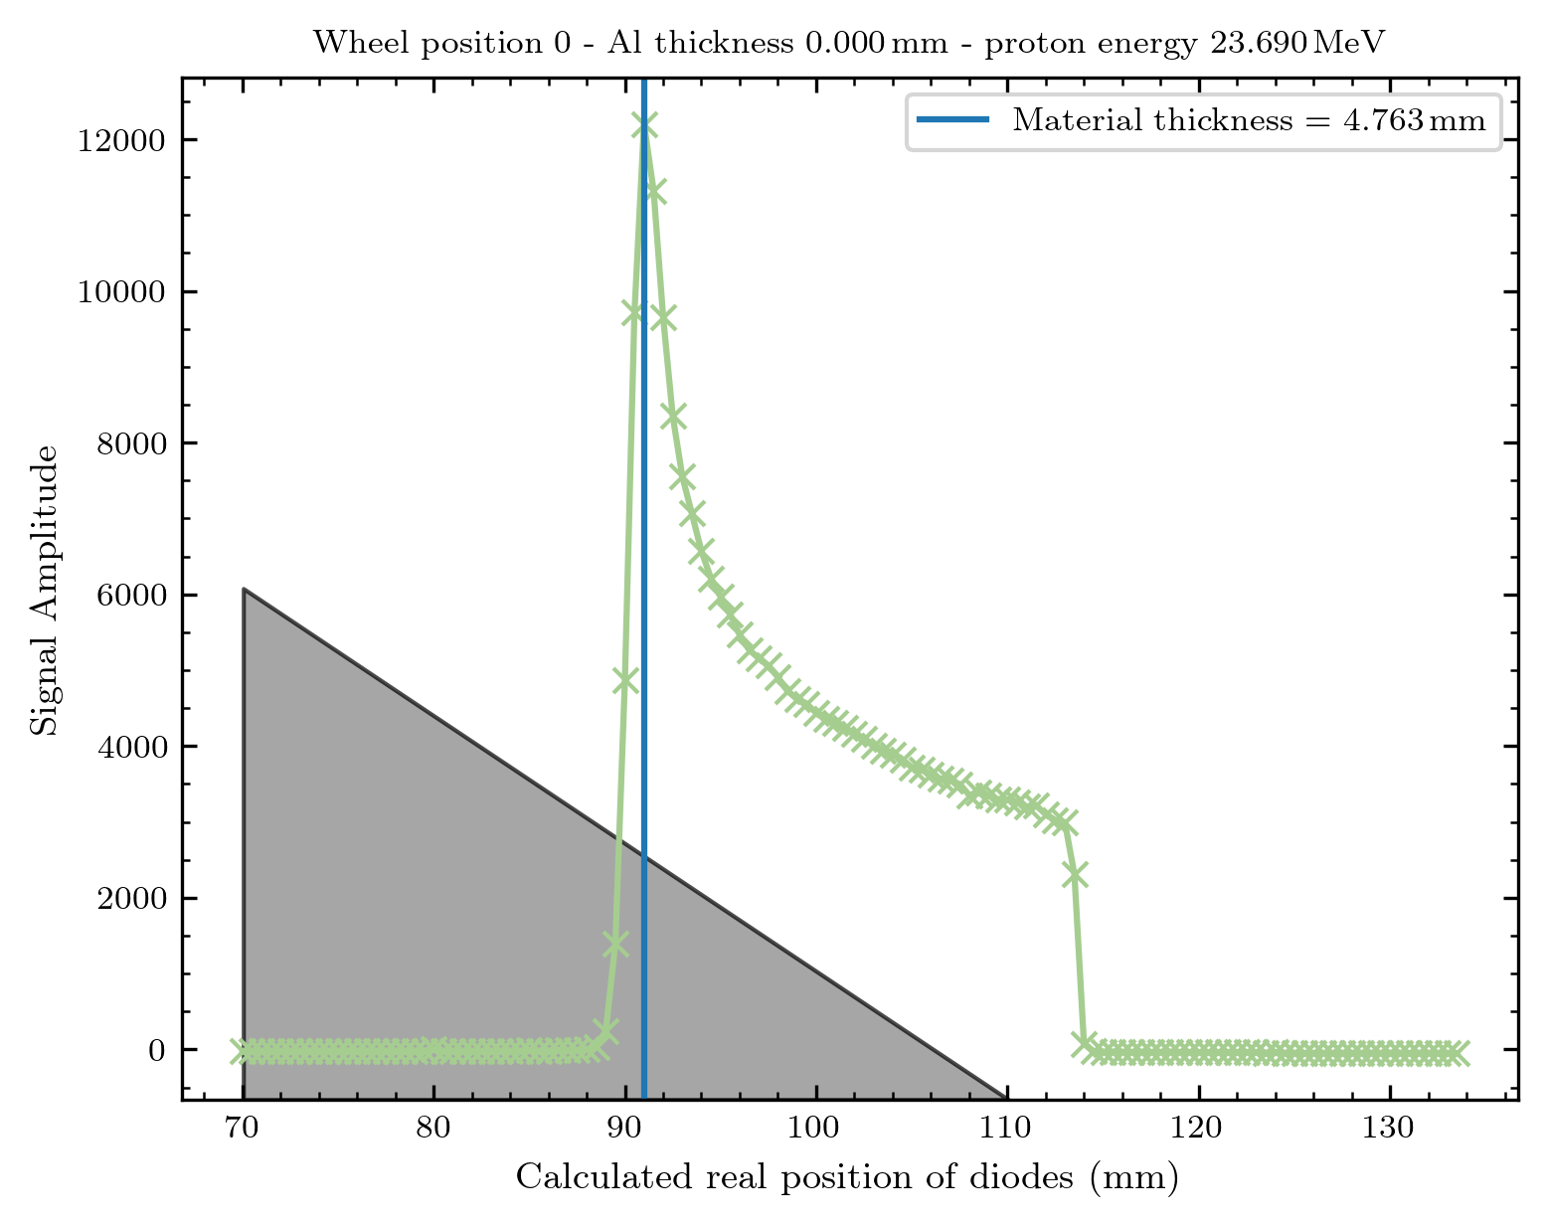
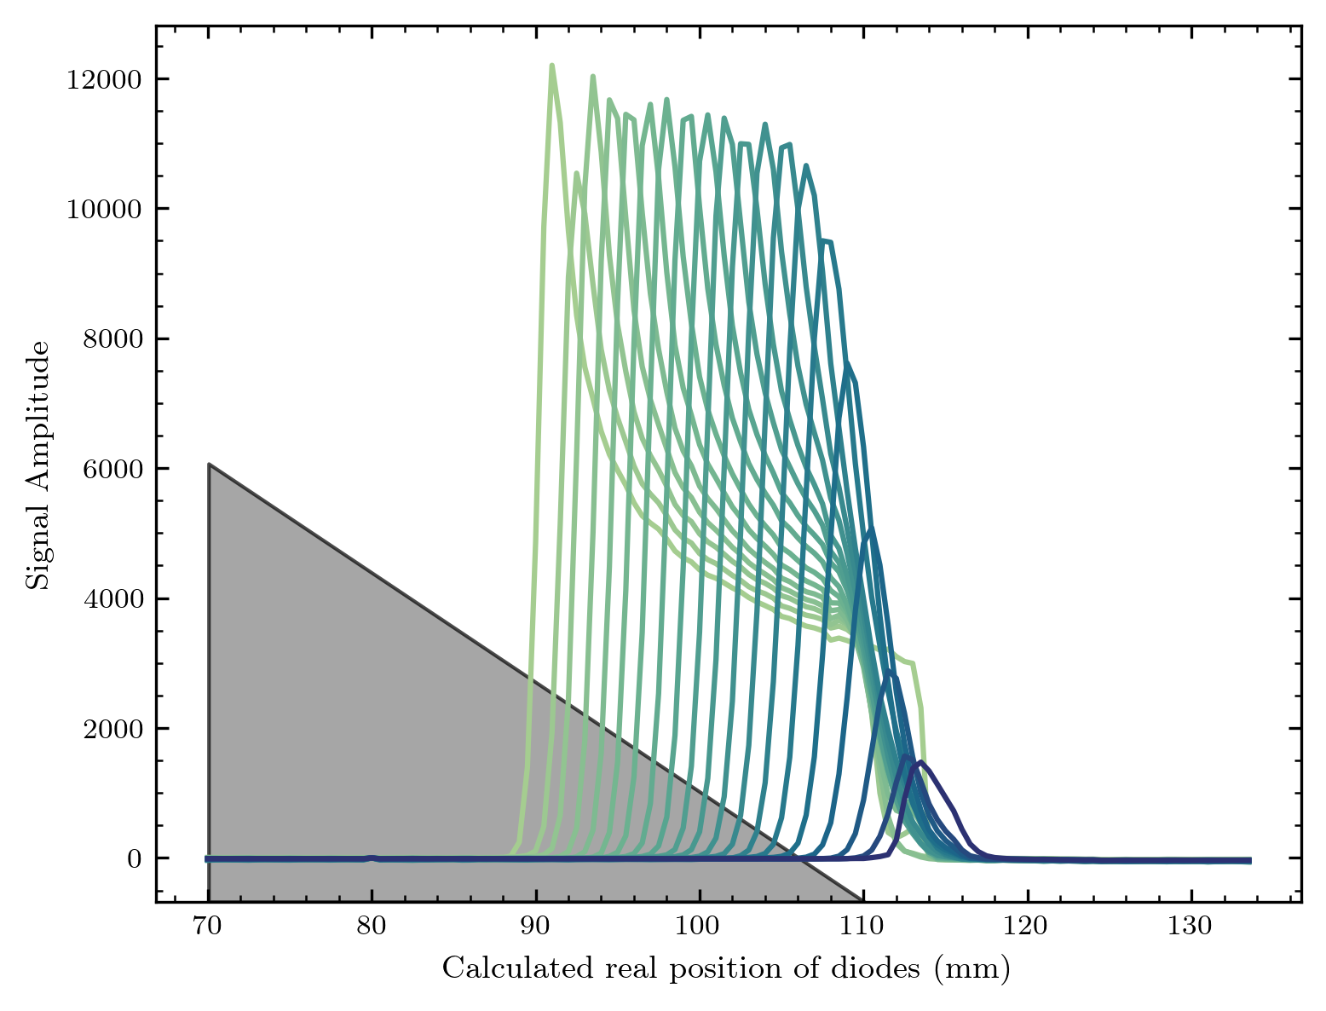
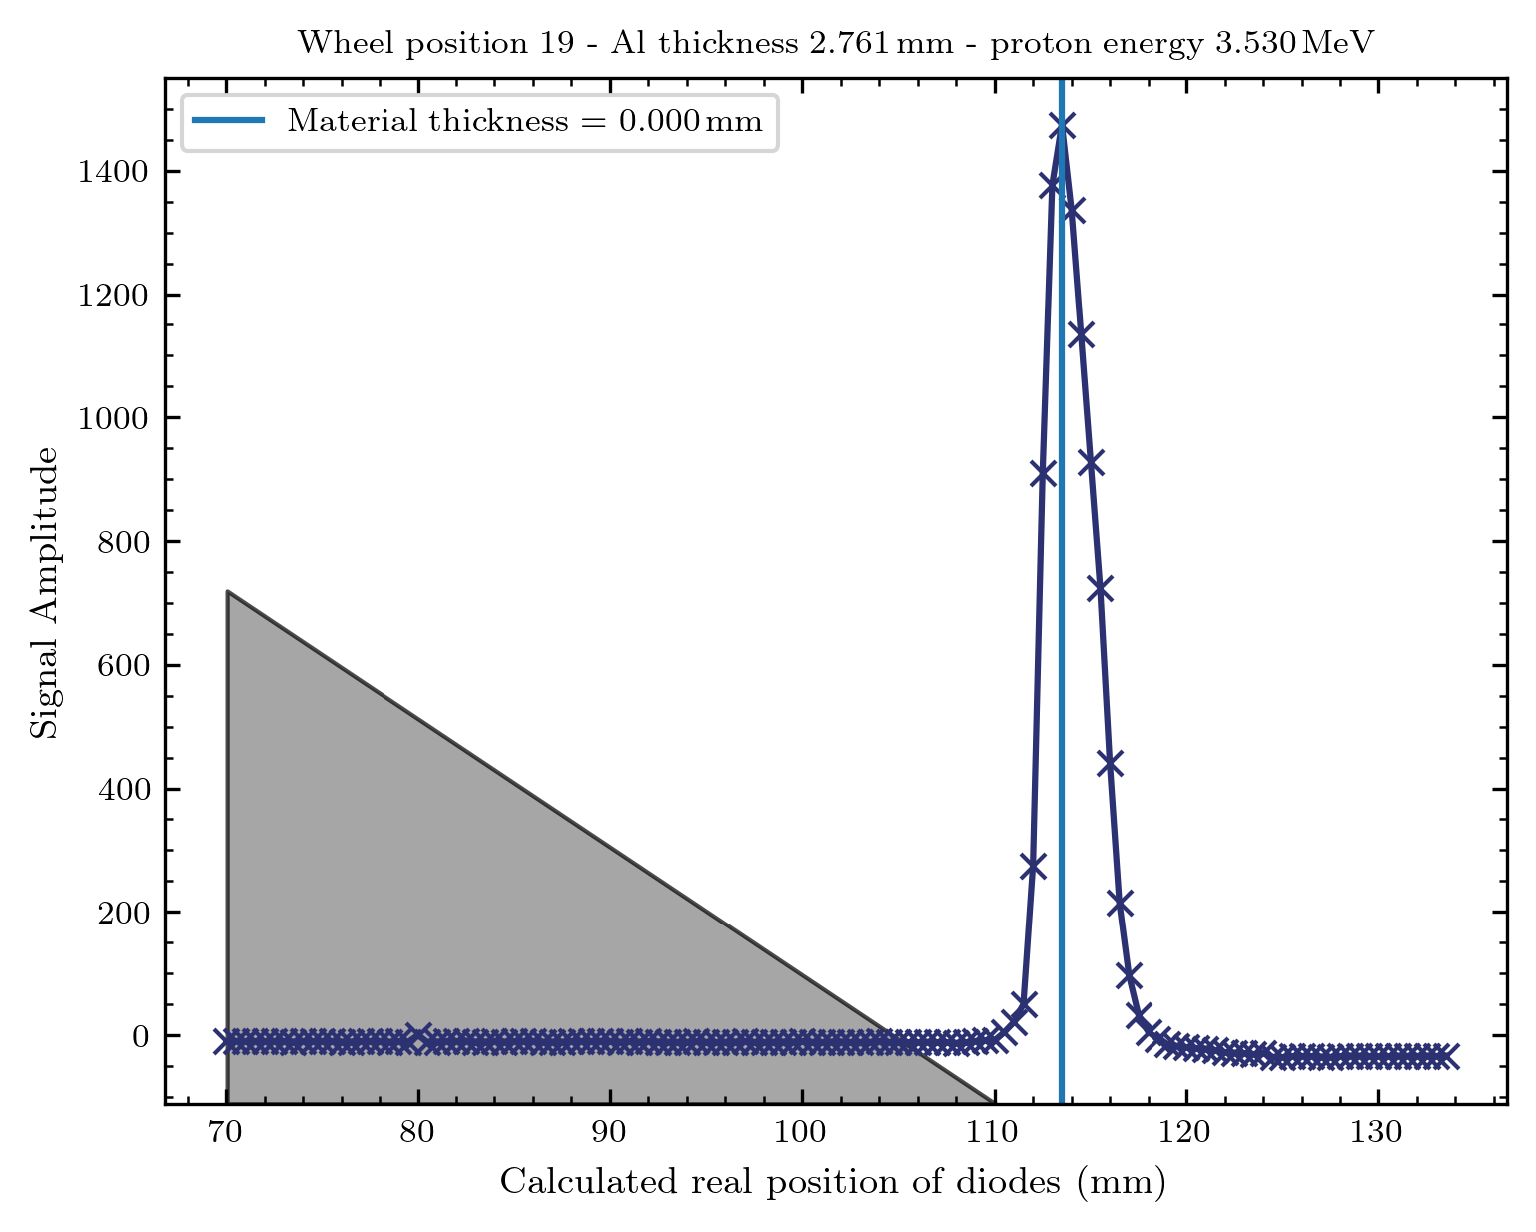
Bragg on wedge
Worked as we wanted! Although I need to have a deeper look into the exact
positioning – next time we should add / align to a reference when looking through the telescope

Slide 7
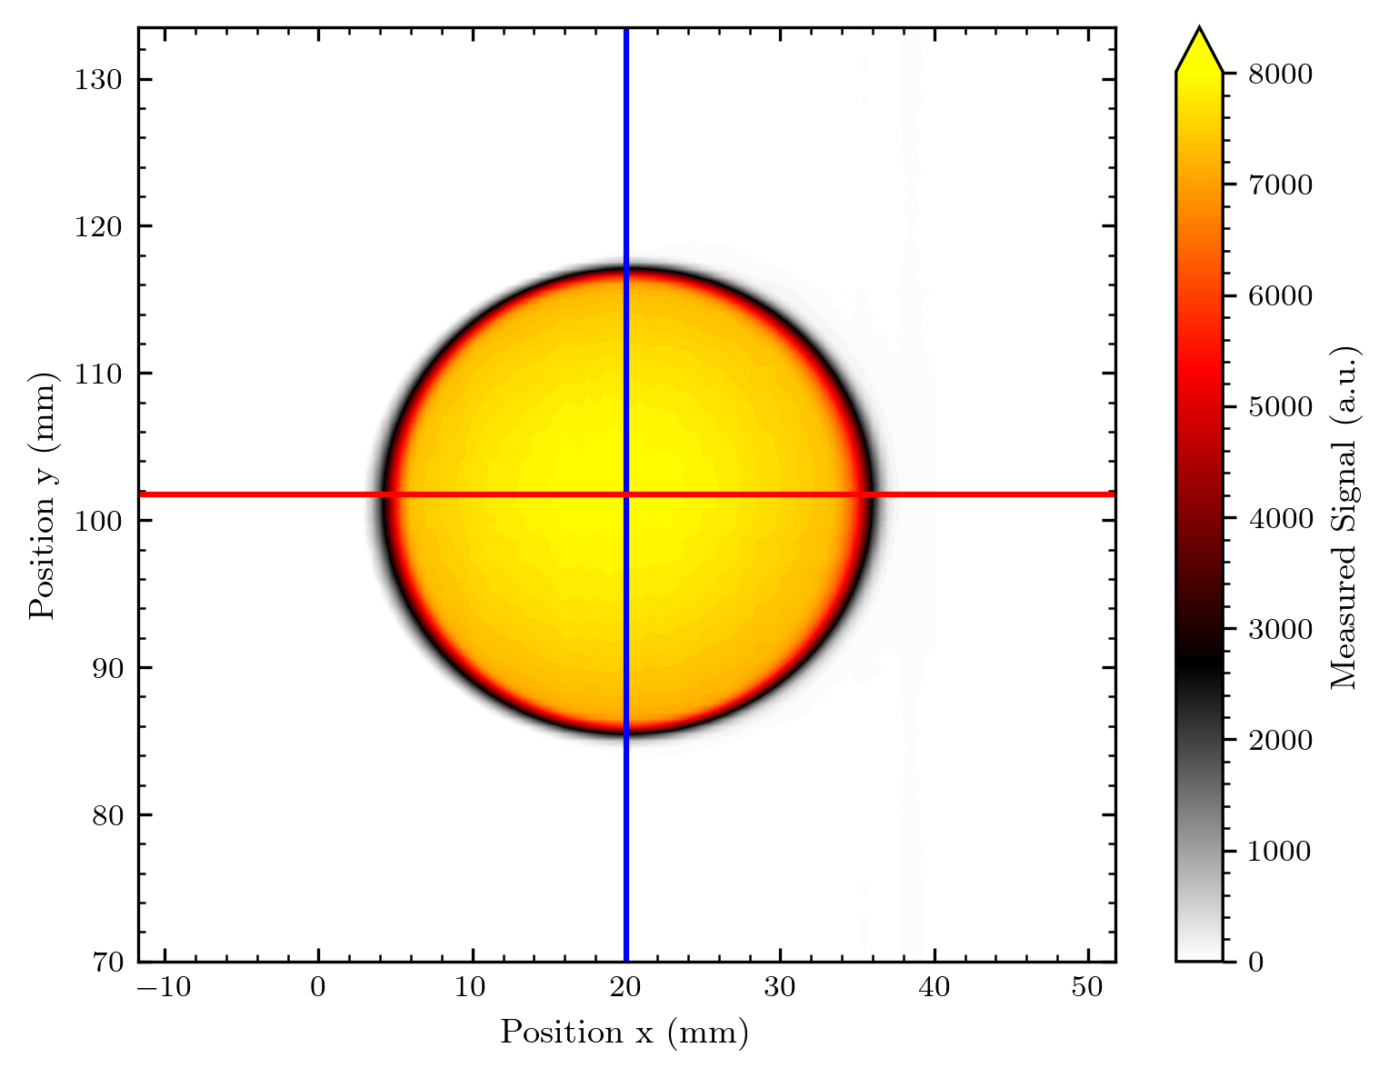
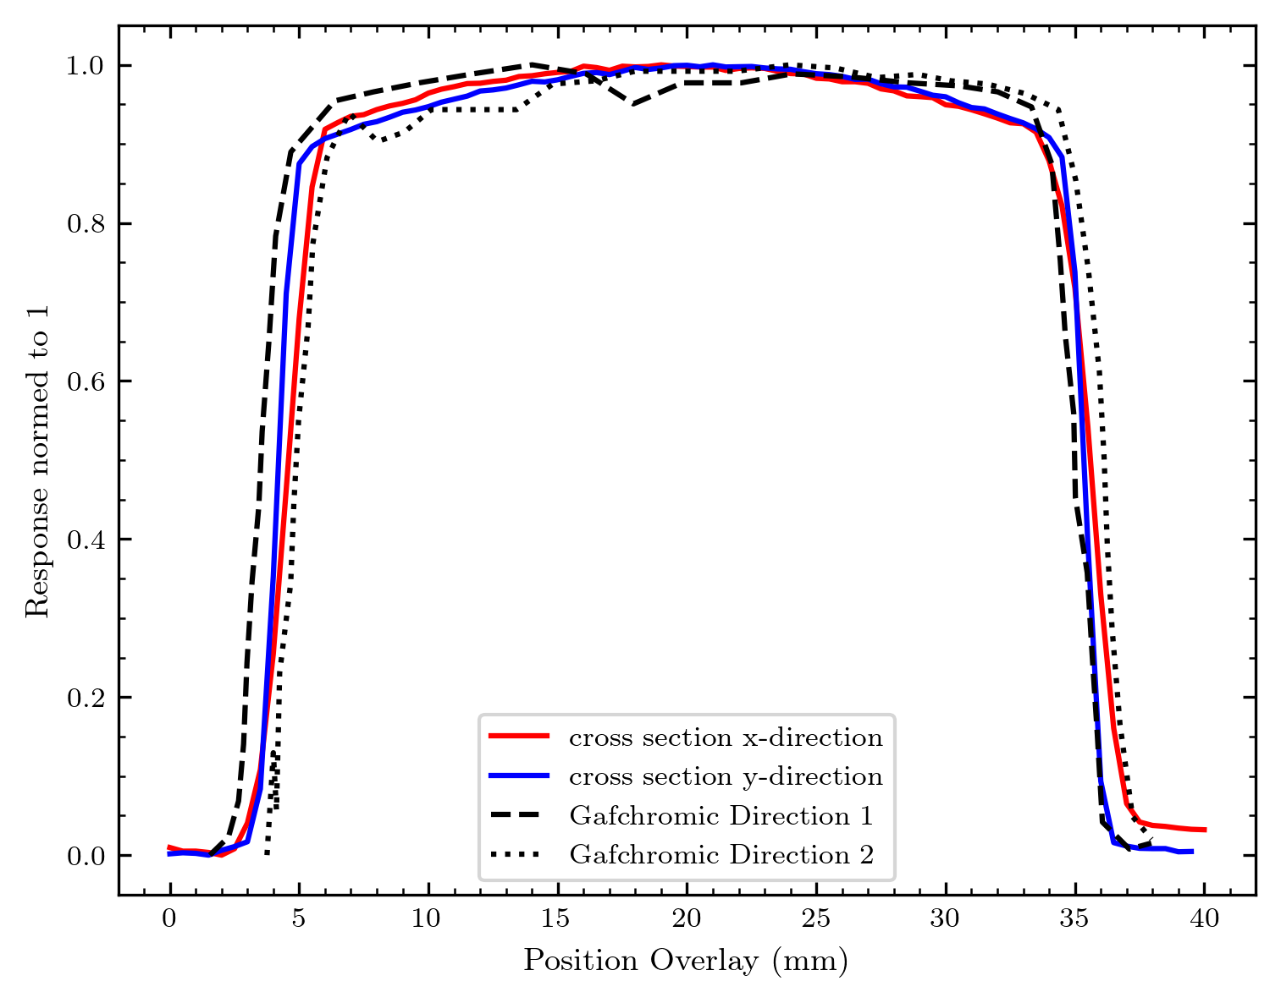
What worked really nice
Beam video – especially from the 2D Matrix array with 0.7 fps for ~ 30 minutes.
Comparison with Gafchromic for 200 um diffuser – rest coming

Slide 8
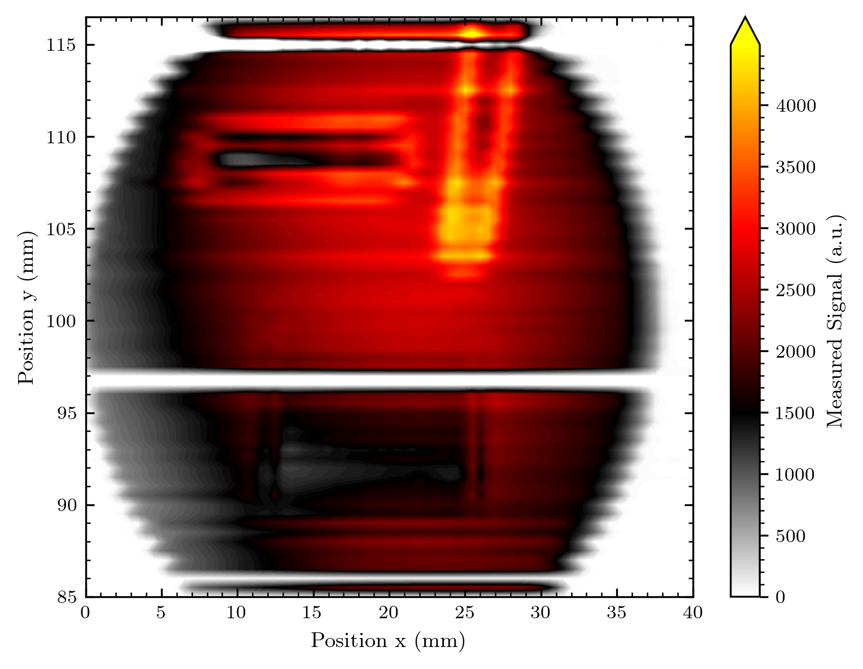
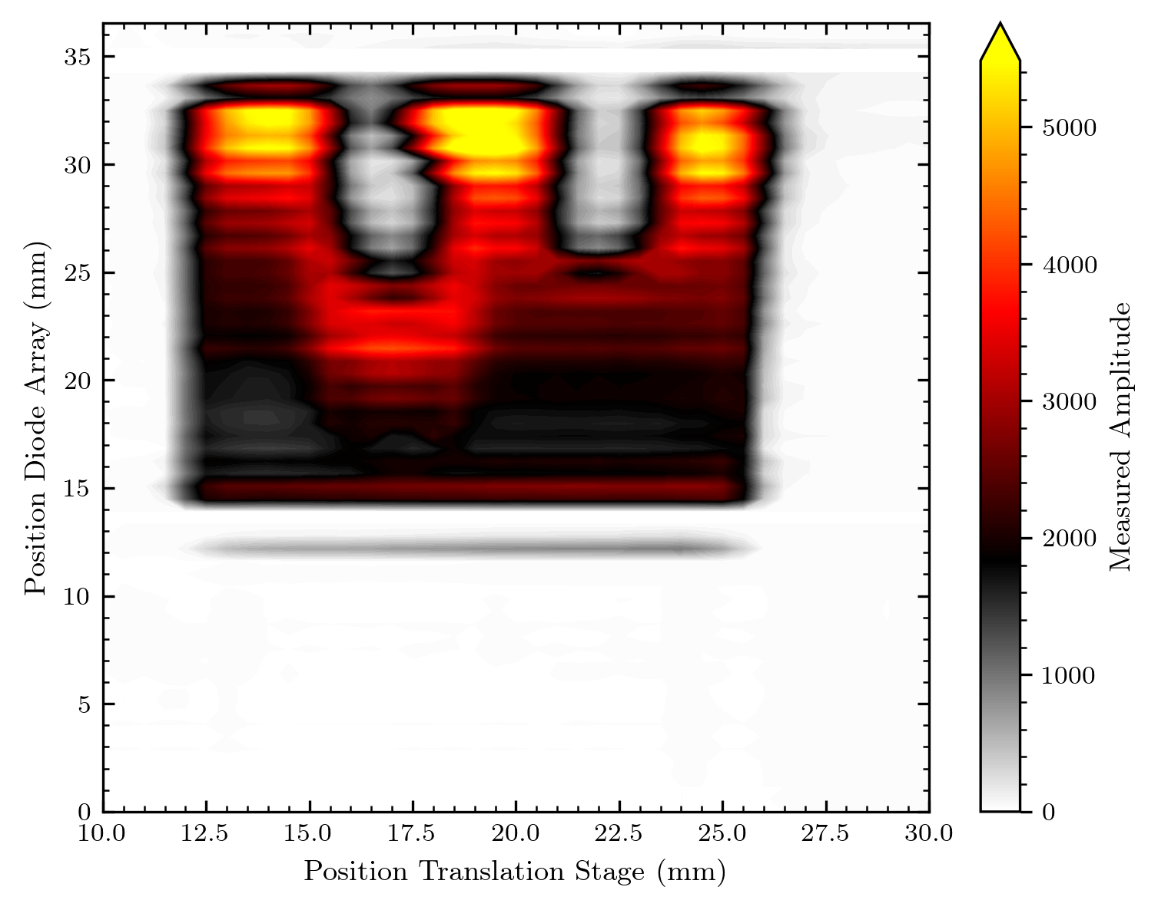
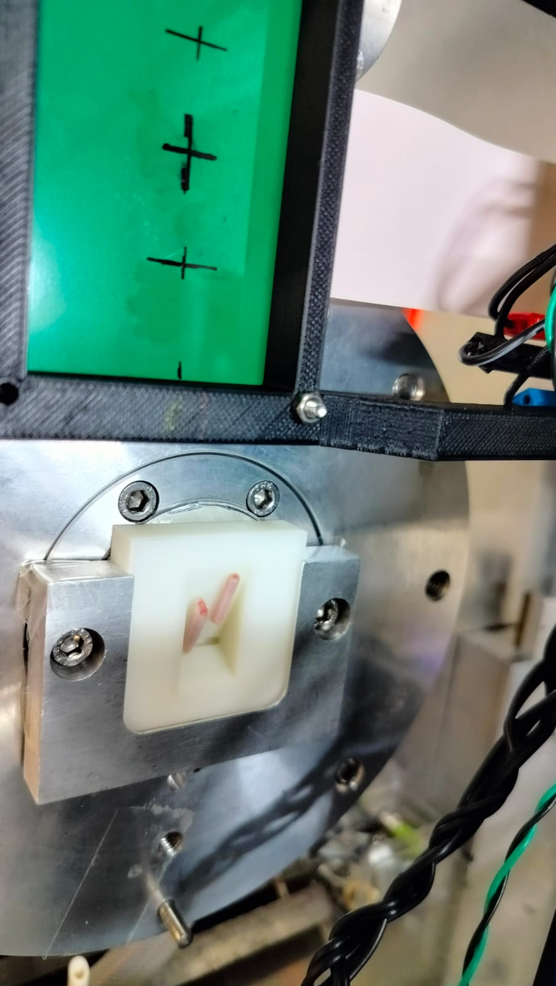
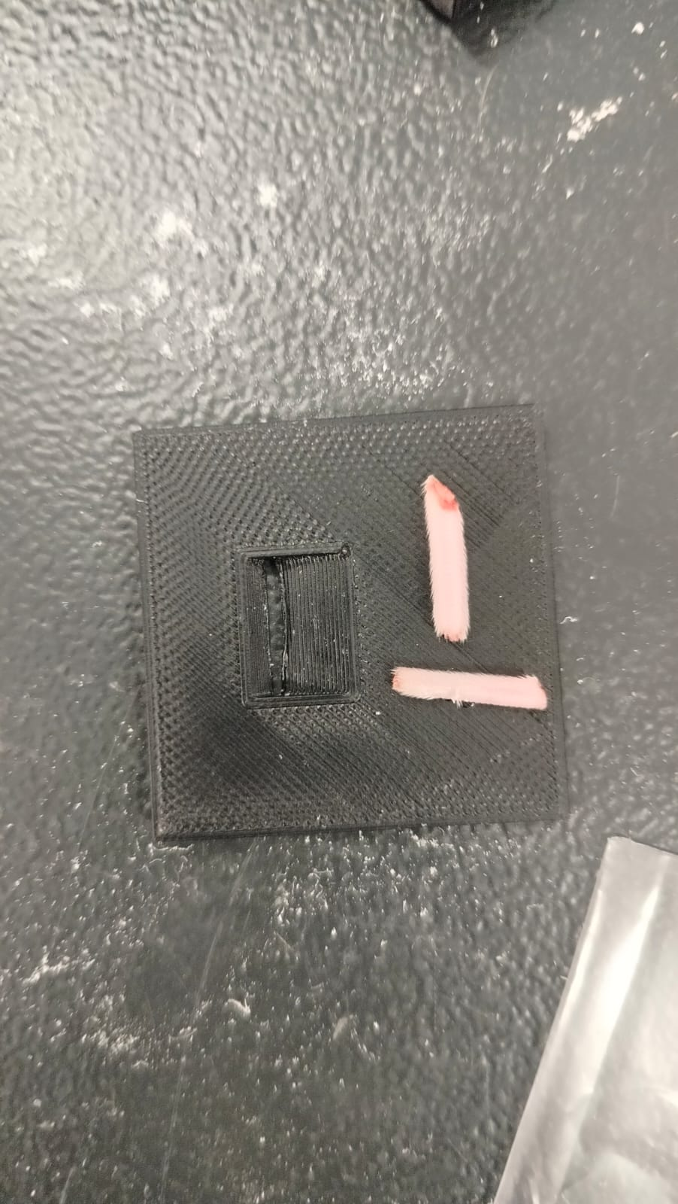
What we did – and maybe should redo
Imaging of biological objects: rat tails

Slide 9
My ToDo‘s in analysis (red = highest priority)
General:
I observed some pattern on the signal with the samples live (meaning every second sample was lower –
we have 1000 samples per second, meaning the pattern resembles a frequency in the ~ kHz regime)
Was it always there? If not: For which measurements and for which not?
Where could this come from: Readout circuit? Overwave of the ~MHz pulsed proton beam
-> A pattern in this regime is highly interesting concerning the feedback time of our system (diodes + readout)
How many samples are necessary to reduce the noise - plot signal std / dark std vs number of samples
make a meta-study for different arrays / different measurement conditions
1D Array measurements:
Exact positioning of the wedge in the beam…
The comparisons with the Gafchromic scans (read in bitmaps, convert to comparable format, picture alignment)
Translated y scan throgh (instable) beam from normalisation?
2D matrix:
Voltage scans
x and y-shifted scans: Normalisation
XY scan: Map generation from this, comparison to Gafchromic

Slide 10
Ideas for next measurements
Interesting:
Other 2D array (smaller diodes) – more diodes working?
Images with 2D array at different voltages (fast done)
More beam filming ?! (maybe we can increase the speed?)
Radiation hardness tests (maybe better with a more stable beam?)
We can anyway come up with some reasonable minimum doses for our results
X or Y-translated scan before and after long irradiation (e.g. beam movie)
2D array with Bragg shape and maybe wheel (needs y-scan, but maybe there is some effect visible connected to the amount of wiring?)
Imaging biological objects / filming with beam / etc.
Continuing with Gafchromic comparisons – can we maybe also take a Gaf image of the logo / Bragg wedge / biological objects?
Less interesting/new in terms of research – but nice to have:
We still have the 3rd 128 diode array not measured
Logo with 2D array as „ultimate prove of concept“ ☺
More high resolution measurements (0.5x0.25 array)
Linearity with 2D array (and/or before/after high dose ?)
128 diode array Gafchromic comparison for 400 um diffuser – since there was a problem in this measurement

