Slide 1
On line meeting
November 19, 2024
1-General information
2-Communication, publications, conferences
3-Last results obtained at CAL at low proton currents (Jean-Yves)
4-Last detector arrays: design, processing (Matilde)
5-Results on imaging based on 1D and 2D arrays at IPHC Strasbourg (Nico).
6-Results obtained at WPE on individual diodes (Luisa)
7- Next actions, including active 2D arrays, Analog Devices (all)

Slide 2
Consortium agreement
Laurianne in charge
Feedback received from RUB
Other partners: please do it as soon as possible

Slide 3
Data management plan
Due by end of 2024
Action: JYD
Will include the repository developed by Nico

Slide 4
Publications
Paper to be submitted soon by Matilde on the individual detector choice (APL)
Paper to be submitted by jean-Yves on the response at low positive bias (see next) (Nature)
Paper to be submitted in 2025 by Maxime
Likely a few papers to come in 2025 on imaging (see results by Nico)

Slide 5
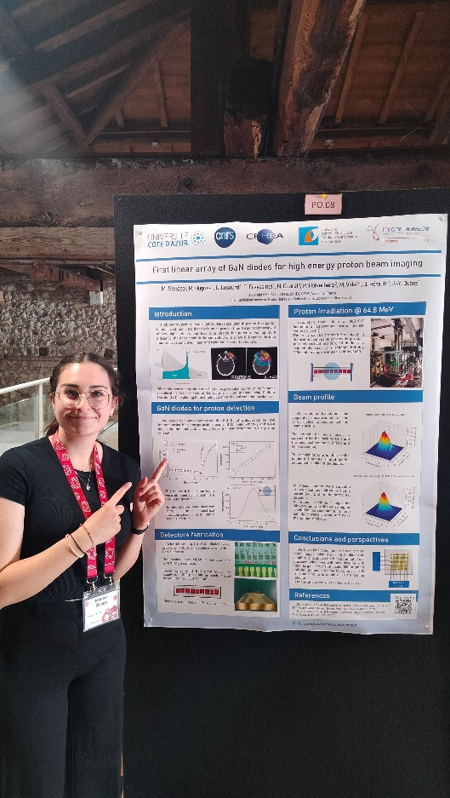
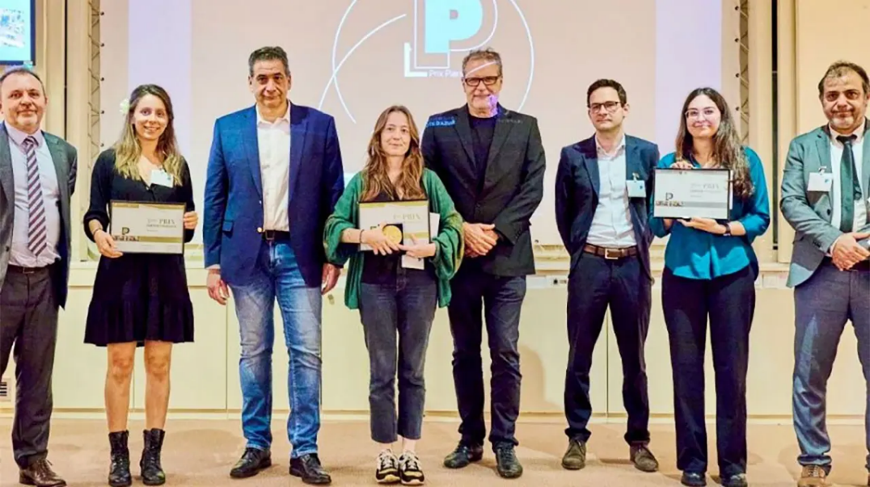
Conferences and prizes
GaN marathon (Verona)
Best poster prize (Matilde)
Conference (CSW, Sweden): Matilde
2 presentations in IWN 2024
-general presentation of GaN for
proton-therapy by Maxime
-response at low positive bias, by JYD
Pierre Laffite PhD Prize, Sophia Antipolis (Matilde)

Slide 6


New photoresponse mode
Jean-Yves Duboz

Slide 7
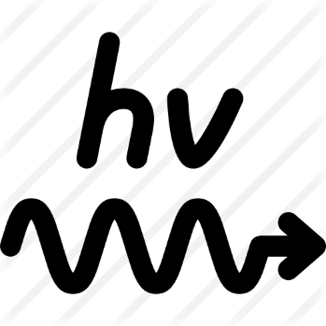



Small positive bias below the turn on bias
Photovoltaic current
Photoconductive current
e
e
V>0
$$⊕$$
$$⊕$$
$$⊕$$
h
h
0 < V < V_{turn on} ∼ 1 V for GaN Schottky diode

Slide 8
Sensitivity: minimum detectable proton current
Schottky diode 1µm
Can detect 0.7 pA/cm² at 0V = in the photovoltaic mode ☺

Slide 9
Sensitivity: minimum detectable proton current
Diode with the largest proton beam / dark current ratio
Schottky diode : L=4 µm
Choose this bias

Slide 10
Sensitivity: minimum detectable proton current
OFF
ON
OFF
Can detect 0.5 fA/cm² in the new mode ☺ ☺
× 1000 more sensistive than photovoltaic

Slide 11
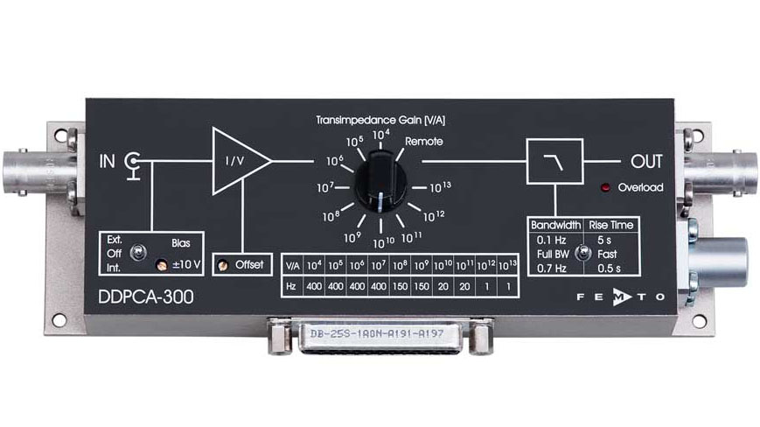
Perspectives
0.5fA/cm2 =20 protons /s/diode
Try and reach the photon/s range ??
The current limit is the noise of the set up, including the Keithley.
We will insert a low noise high gain current amplifier, and redo the measurement at CAL at very low proton current

