Slide 1
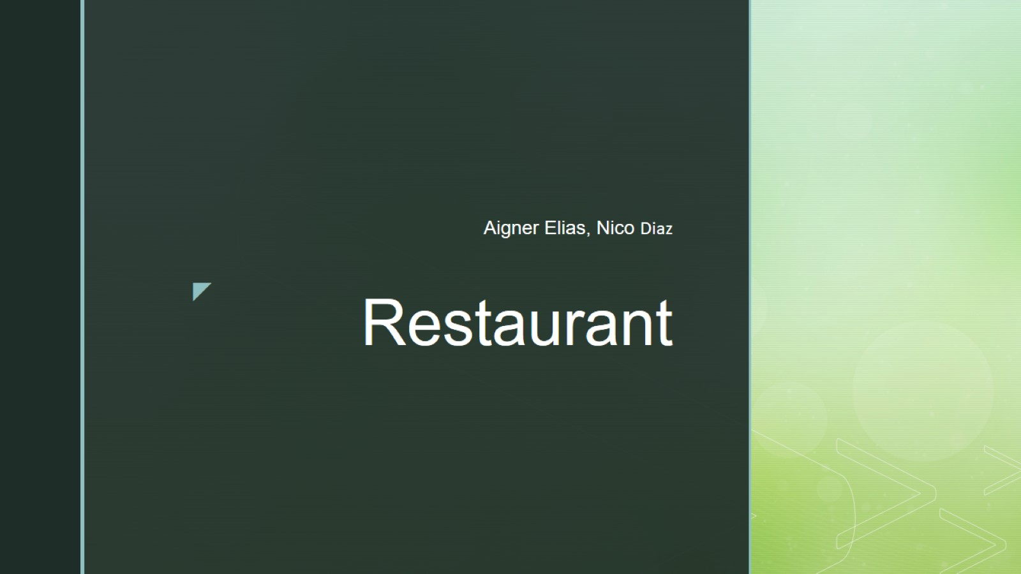
Restaurant

Slide 2

ERD

