Slide 1

Deploying MongoDB Sharded Clusters with OpenStack, Terraform, Kubernetes and Helm
Nico Döbele, Robin Fink, Faraan Choudhry and Jianbang Zhuang
Cloud & Big Data Technologies

Slide 2
Agenda
Introduction
Motivation
MongoDB
Initial Concept
Implementation
Kubernetes
MongoDB
Helm
Terraform
Tough nuts to crack
Example Application Twutter
Appendix: MongoDB Load Testing

Slide 3
Introduction

Slide 4
Introduction
Goal: Production-ready, distributed MongoDB sharded cluster
Focus: Automated deployment, data distribution, high availability
Tools: MongoDB, Kubernetes, Helm, Terraform, OpenStack
No pre-made Helm Chart: We want to create our own configuration
Example-App: „Twutter“ as a realistic test environment

Slide 5
Motivation

Slide 6
Motivation - Why a distributed database?
Data too large: No longer fits on a single machine
Slow response times: The database becomes a bottleneck
Scalability: Scale horizontally instead of just upgrading hardware
Learning goal: Understand sharding and failover in a cloud environment
Cloud deployment: Use Terraform and Kubernetes to distribute data on CloudStack
Leverage CloudStack features: Apply real infrastructure capabilities
Learn data distribution: Understand how data is actually spread across shards
Kubernetes experience: Explore and experiment as much as possible
Mongos / Router
Shard A
Shard B
Shard C

Slide 7
Motivation - Cluster Architecture
Distributed architecture with config servers, shards, and mongos
Mongos router as the entry point for applications
Data distributed across multiple shards (sharding)
Each shard as a ReplicaSet (high availability)
Managed and orchestrated via Kubernetes & Helm
Application
Config Server (Replica Set)
Mongos / Router
Shard A
Shard B
Shard C

Slide 8
Motivation - Why Own Helm-Chart?
Standard-Charts: Often to unflexible
Our Helm-Chart:
Resources and replicas configurable per function
Volumes defined per function
Automatic sharding and replication
Authentication via secrets
Safe upgrades and idempotency
Learning everything from scratch

Slide 9
MongoDB

Slide 10
MongoDB
NoSQL

Slide 11
MongoDB
Not Only SQL

Slide 12
MongoDB
Nicht relationale Datenbank

Slide 13

Relational Database

Slide 14
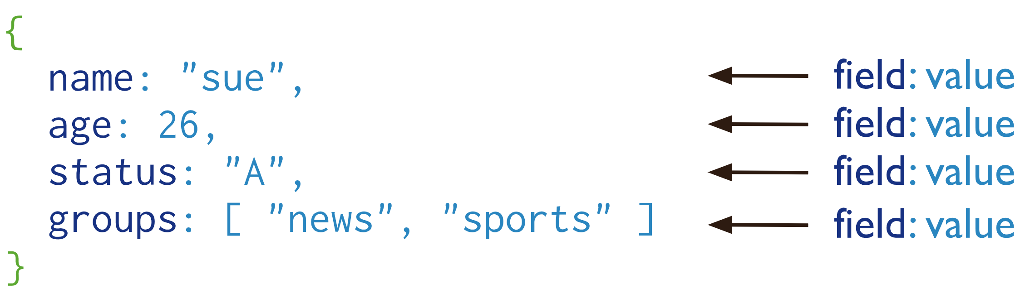
MongoDB – Document
A record in MongoDB is a document, which is a data structure composed of field and value pairs.
Basically a JSON

Slide 15
MongoDB – Document
A record in MongoDB is a document, which is a data structure composed of field and value pairs.
BSON

Slide 16
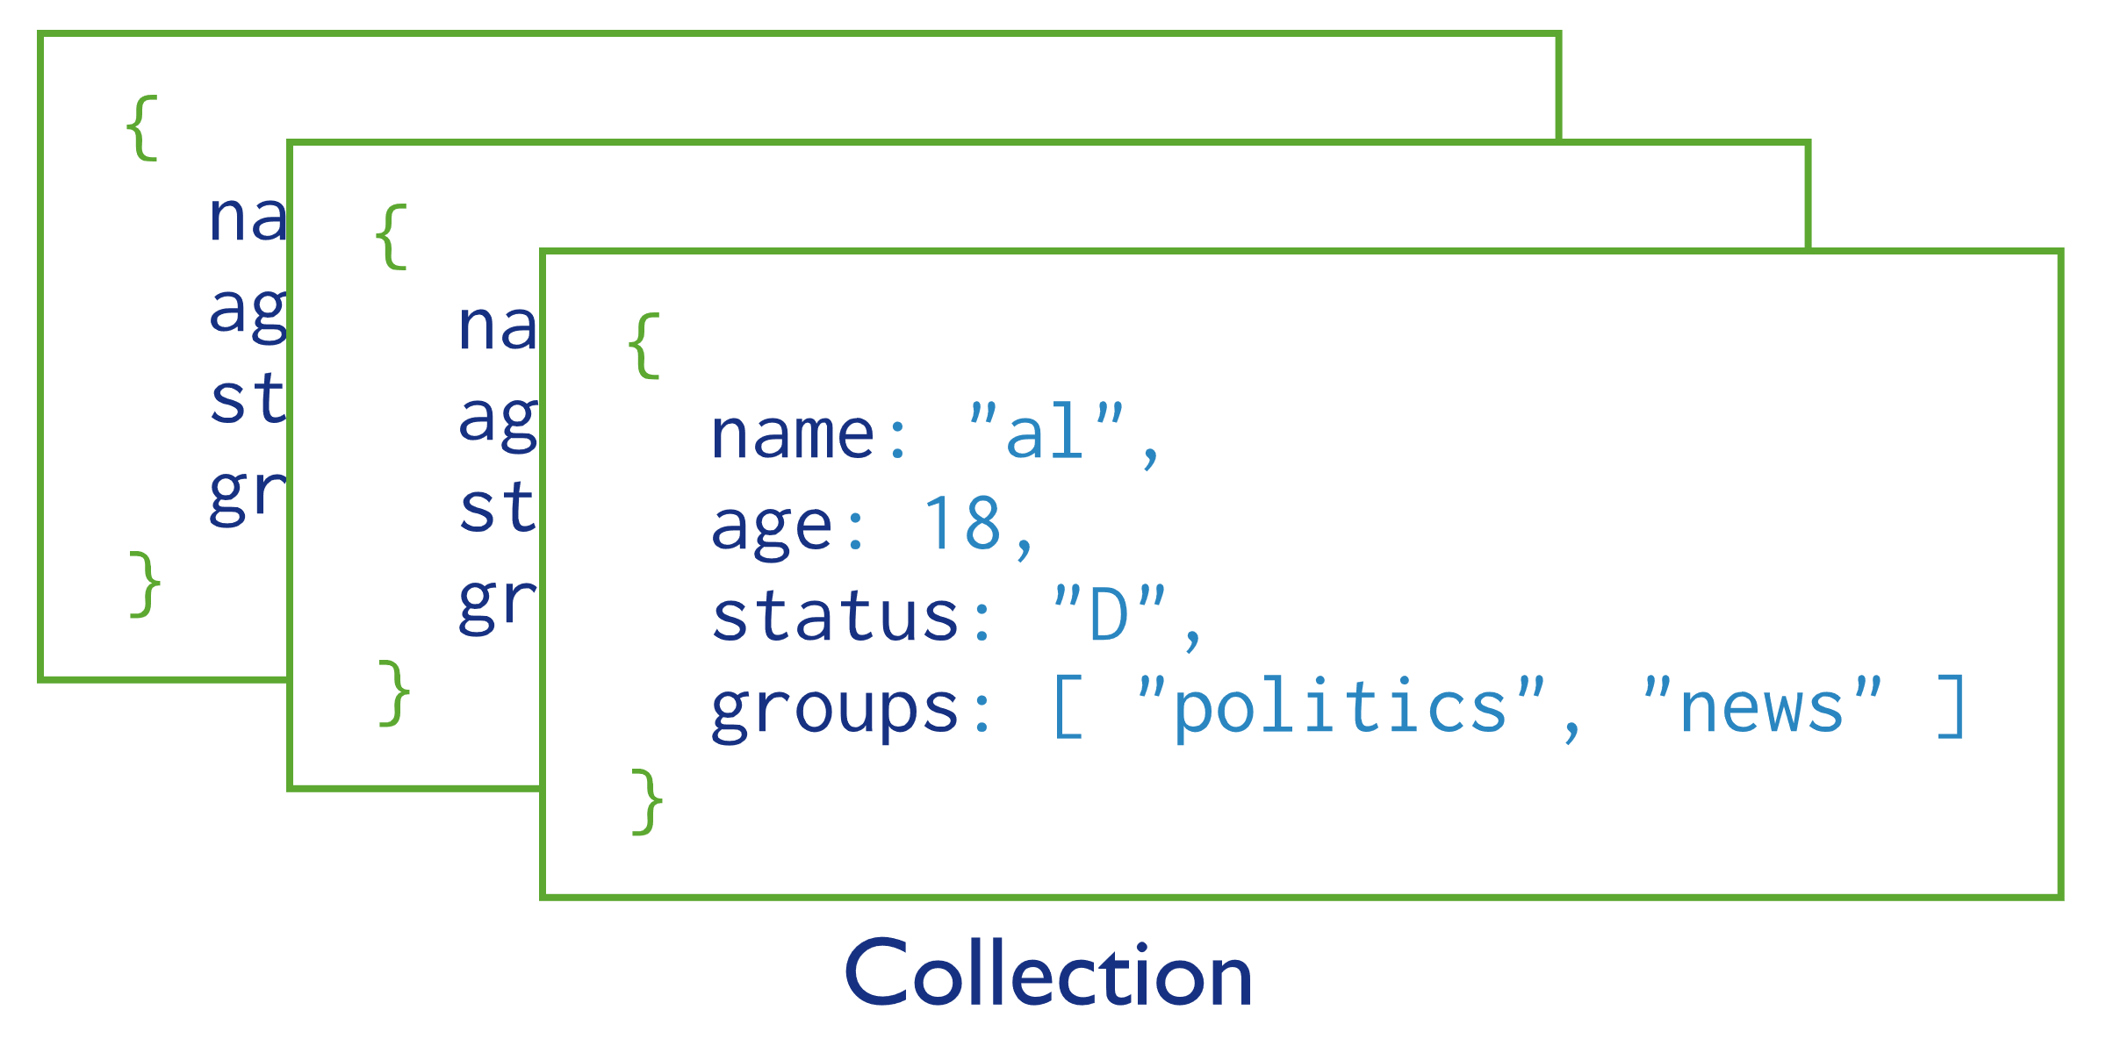
MongoDB - Collections
Documents are stored in Collections
Comparable to tables in relational databases

Slide 17
MongoDB - Database
Database

Slide 18
Relational vs No Relational DB

Slide 19
MongoDB - Server Types
Application
Config Server (Replica Set)
Mongos / Router
Shard A
Shard B
Shard C

Slide 20
MongoDB – Replica Set
Replica Set
Group of servers that maintain the same data set

Slide 21
MongoDB – Replica Set
Replica Set
Increasing data availability
Providing redundancy
(fault tolerance)
Group of servers that maintain the same data set

Slide 22
MongoDB – Replica Set
Replica Set
Primary
Replication
Replication
Secondary
Heartbeat
Secondary
(every 10 sec)

Slide 23
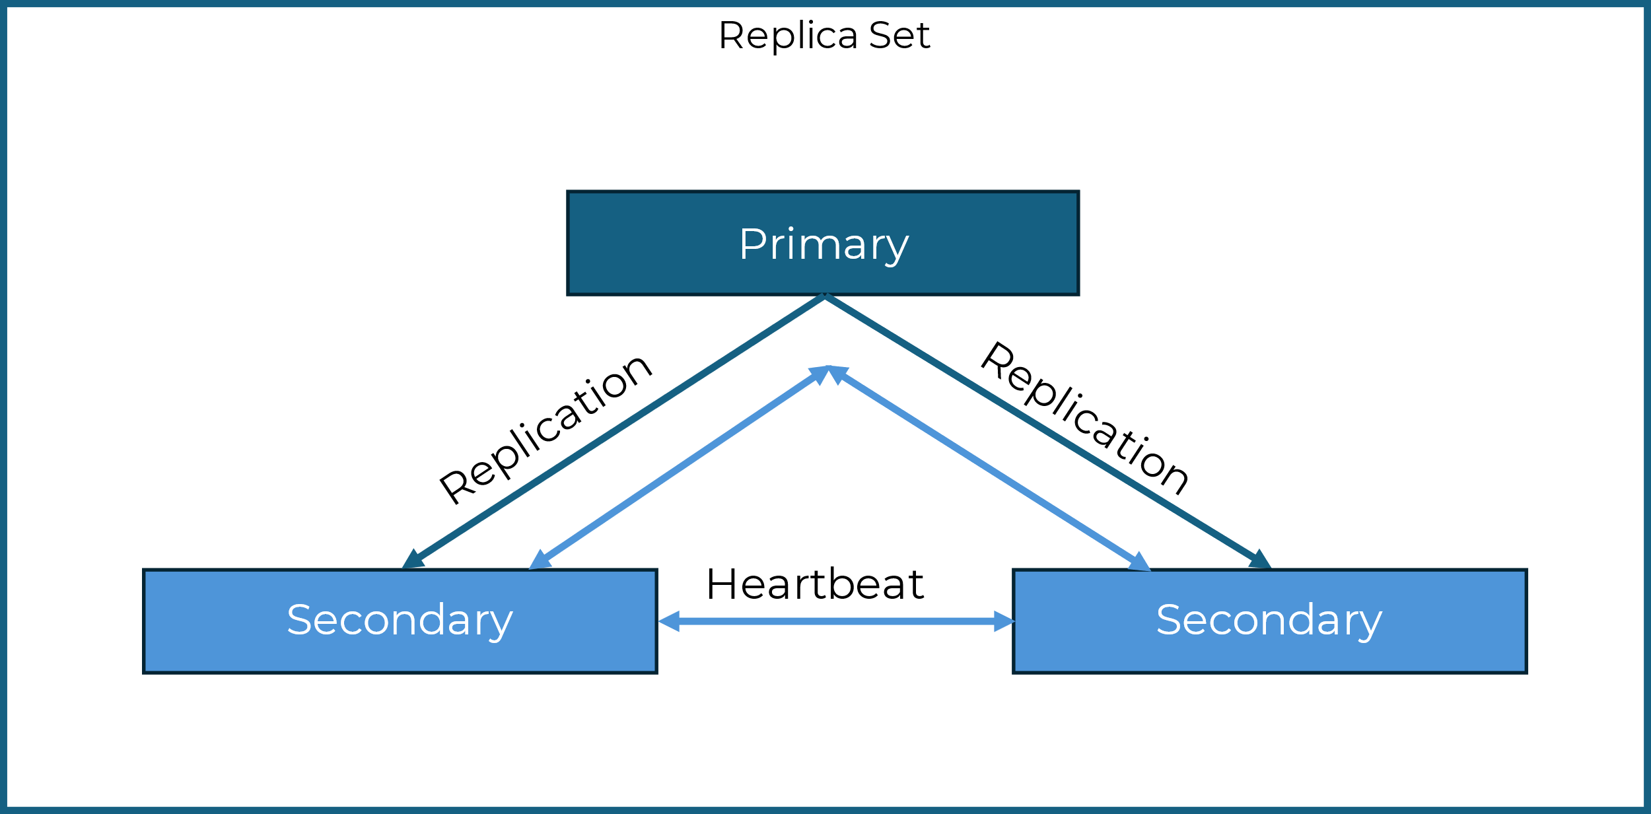
MongoDB – Replica Set
Application
Mongos / Router
Writes
Reads

Slide 24
MongoDB – Replica Set (Arbiter)
Replica Set
Primary
Replication
Secondary
Heartbeat
Arbiter (votes only)
(every 10 sec)

Slide 25
MongoDB – Config Server
Config Server
Stores Meta Data for shared clusters

Slide 26
MongoDB - Server Types
Application
Config Server (Replica Set)
Mongos / Router
Shard A
Shard B
Shard C

Slide 27
MongoDB - Sharding Strategies
Why do I need sharding?
Mongos / Router
Shard A
Shard B
Shard C

Slide 28
MongoDB - Sharding Strategies
Why do I need sharding?
Mongos / Router
Config Server (Replica Set)
Shard A
Shard B
Shard C

Slide 29
MongoDB - Sharding Strategies
Why do I need sharding?
Mongos / Router
Shard A
Shard B
Shard C
Data is bigger than one server can handle!
“…very large data sets and high throughput operations”

Slide 30
MongoDB - Sharding Strategies
Why do I need sharding?
Increase Storage capacity
Additional disks increas a single clusters size
Linear scaling reads and writes increase the througput
Parallel processing
Latency decreases (for reads and writes)
More RAM improves system performance
Disaster Recovery gets more efficent
Restores can be parallelised

Slide 31
MongoDB – Sharding
Application
Mongos / Router
Shard A
Shard B
Shard C

Slide 32
MongoDB – Shard Key
Application
Config Server (Replica Set)
Mongos / Router
Shard A
Shard B
Shard C

Slide 33

MongoDB – Shard Key
Application
Config Server (Replica Set)
Shard Key
User_id
Mongos / Router
Shard A
Shard B
Shard C
{user_id:min}->{user_id:100}
{user_id:300}->{user_id:350}
{user_id:500}->{user_id:600}
{user_id:100}->{user_id:200}
{user_id:350}->{user_id:400}
{user_id:600}->{user_id:700}
{user_id:200}->{user_id:300}
{user_id:400}->{user_id:500}
{user_id:700}->{user_id:max}

Slide 34
MongoDB – Ranged Sharding
Application
Config Server (Replica Set)
Shard Key
User_id
Mongos / Router
Shard A
Shard B
Shard C
{user_id:min}->{user_id:100}
{user_id:300}->{user_id:350}
{user_id:500}->{user_id:600}
{user_id:100}->{user_id:200}
{user_id:350}->{user_id:400}
{user_id:600}->{user_id:700}
{user_id:200}->{user_id:300}
{user_id:400}->{user_id:500}
{user_id:700}->{user_id:max}

Slide 35
MongoDB – Hashed Sharding
Application
Config Server (Replica Set)
Shard Key
User_id
Mongos / Router
Key gets hashed
Shard A
Shard B
Shard C
{hashMinKey}->{X}
{X}->{Y}
{Y}->{hashMaxKey}

Slide 36
MongoDB – Hashed Sharding
Hashed sharding uses a hashed value as the shard key
Even data distribution across shards
Even read / write workload distribution
Range queries can get very compute intense

Slide 37
MongoDB – Ranged Sharding
Application
Config Server (Replica Set)
Shard Key
User_id
Mongos / Router
Shard A
Shard B
Shard C
{user_id:min}->{user_id:100}
{user_id:300}->{user_id:350}
{user_id:500}->{user_id:600}
{user_id:100}->{user_id:200}
{user_id:350}->{user_id:400}
{user_id:600}->{user_id:700}
{user_id:200}->{user_id:300}
{user_id:400}->{user_id:500}
{user_id:700}->{user_id:max}

Slide 38
MongoDB – Ranged Sharding
Queries can read target documents within a contiguous range
Ideal for targeted operations
MaxKey shard receives majority of incoming writes
Reduces advantage of distributed writes in a shared cluster

Slide 39
MongoDB – Ranged Sharding (Balancer)
Application
Config Server (Replica Set)
Shard Key
User_id
Mongos / Router
Shard A
Shard B
Shard C
{user_id:min}->{user_id:100}
{user_id:300}->{user_id:350}
{user_id:500}->{user_id:600}
{user_id:800}->{user_id:900}
{user_id:100}->{user_id:200}
{user_id:350}->{user_id:400}
{user_id:600}->{user_id:700}
{user_id:900}->{user_id:max}
{user_id:200}->{user_id:300}
{user_id:400}->{user_id:500}
{user_id:700}->{user_id:800}

Slide 40
MongoDB – Ranged Sharding (Balancer)
Application
Config Server (Replica Set)
“In an attempt to achieve an even distribution of data across all shards in the cluster, a balancer runs in the background to migrate ranges across the shards.” MongoDB
Shard Key
User_id
Mongos / Router
Shard A
Shard B
Shard C
{user_id:min}->{user_id:100}
{user_id:300}->{user_id:350}
{user_id:500}->{user_id:600}
{user_id:800}->{user_id:900}
{user_id:100}->{user_id:200}
{user_id:350}->{user_id:400}
{user_id:600}->{user_id:700}
{user_id:900}->{user_id:max}
{user_id:200}->{user_id:300}
{user_id:400}->{user_id:500}
{user_id:700}->{user_id:800}

Slide 41
MongoDB – Query example
Application
1
Client makes request
1
Config Server (Replica Set)
Mongos / Router
Shard A
Shard B
Shard C

Slide 42
MongoDB – Query example
Application
1
Client makes request
2
Mongos determines on which shards the data is available (A & B)
1
Config Server (Replica Set)
2
Mongos / Router
Shard A
Shard B
Shard C

Slide 43
MongoDB – Query example
Application
1
Client makes request
2
Mongos determines on which shards the data is available (A & B)
1
Config Server (Replica Set)
2
3
Mongos routes request to shard A and B
Mongos / Router
Shard A
Shard B
Shard C
3
3

Slide 44
MongoDB – Query example
Application
1
Client makes request
2
Mongos determines on which shards the data is available (A & B)
1
Config Server (Replica Set)
2
3
Mongos routes request to shard A and B
Mongos / Router
4
Mongos waits for response and merges the results
4
Shard A
Shard B
Shard C
3
3

Slide 45
MongoDB – Query example
Application
1
Client makes request
2
Mongos determines on which shards the data is available (A & B)
5
1
Config Server (Replica Set)
2
3
Mongos routes request to shard A and B
Mongos / Router
4
Mongos waits for response and merges the results
4
5
Merged and sorted result is sent to user
Shard A
Shard B
Shard C
3
3

Slide 46
Initial Concept

Slide 47
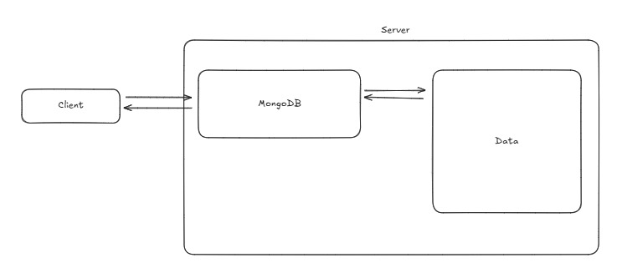
Initial Concept

Slide 48
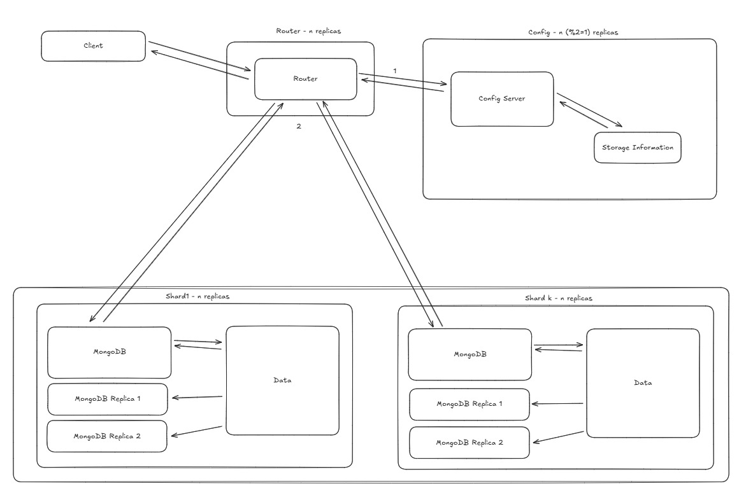
Initial Concept

Slide 49
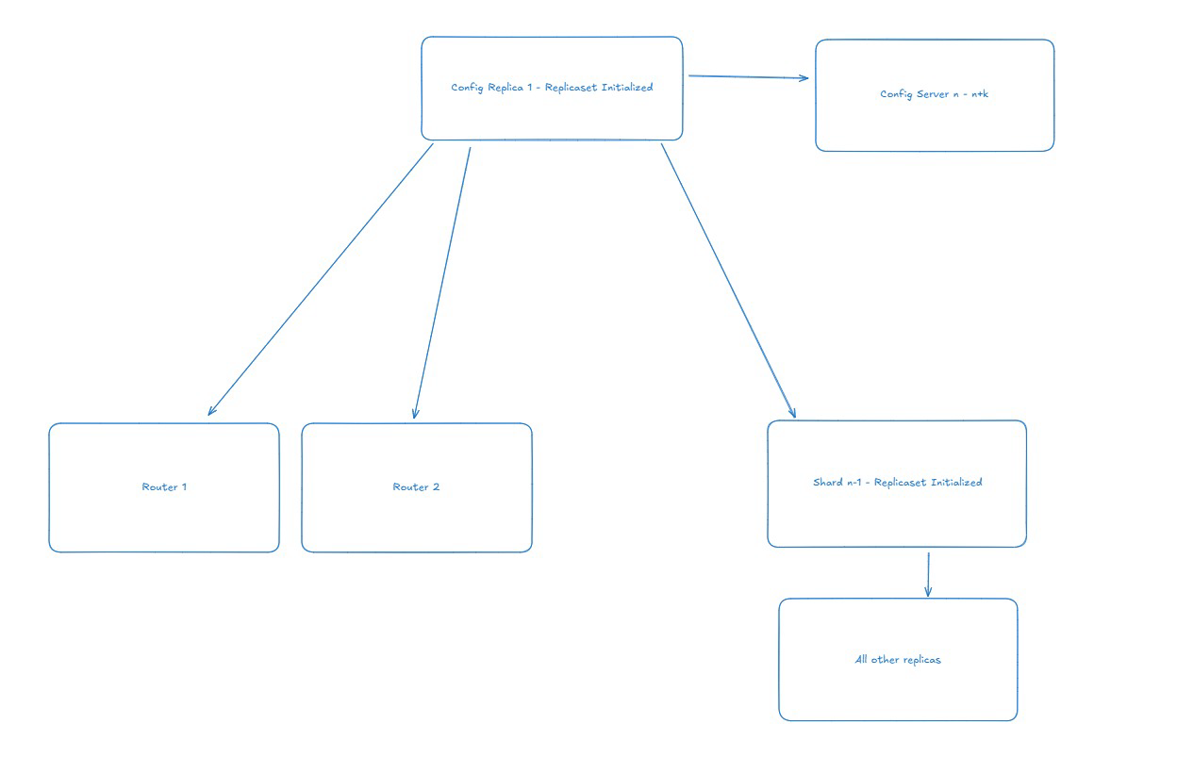
Initial Concept

Slide 50
Implementation

Slide 51
K3s Deployment
K3s Setup
1 Master Node
n Worker Nodes (2 used in this deployment)
Instances
Rocky Linux 9.4
m1.large (4 vCPUs, 8GB RAM)
Kubernetes Cluster
Master Node
Worker Node 1
Worker Node 2
Worker Node n
K3s API Server
K3s Agent
K3s Agent
K3s Agent

Slide 52
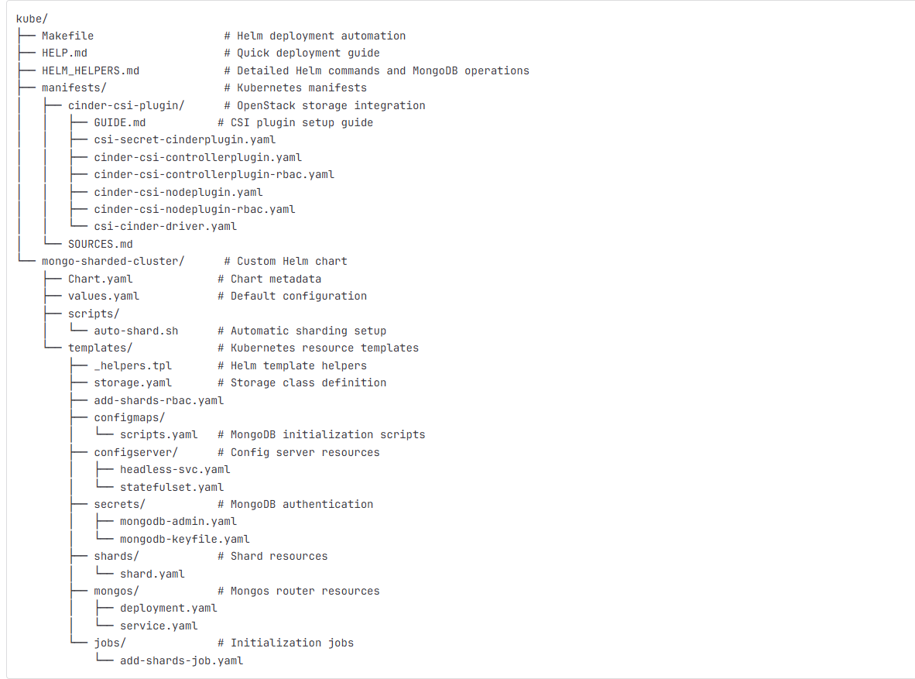
OUR Helm Chart
This custom helm chart includes
Default configuration
Chart metadata
Helpers
Fully customizable values including:
Pod and service metadata per function
Resource allocation per function
Volume allocation and settings per function
Cluster count
Replica counts per function
Safe Roll-Overs
Idempotence (can upgrade shard count, replicas…)
Consistent storage
Automatic sharding configuration and scripts
Different headless services per function
Authentication using secrets and private keys
Usage of the Cinder CSI Plugin for volume mounts
Fully dynamic setup and workflow scripts
Healthiness probes
Node port for reachability (load balancer alternative)
and more…

Slide 53
MongoDB
Config Server (n=3 replicas)
Shards (n=2 shards, k=3 replicas each)
Configserver-1
Configserver-2
Configserver-n
Shard1-1
Shard1-2
Shard 1-k
Cinder
Volume
Cinder
Volume
Cinder
Volume
Cinder
Volume
Cinder
Volume
Cinder
Volume
Shard2-1
Shard2-2
Shard2-k
Mongos Server (n=2 replicas)
Cinder
Volume
Cinder
Volume
Cinder
Volume
Mongos-xxxx
Mongos-xxxx
Shardn-1
Shardn-2
Shardn-k
Cinder
Volume
Cinder
Volume
Cinder
Volume

Slide 54
MongoDB Deployment ‘Phases’
Phase 1:
Config Servers
Phase 2:
Shards Init
Phase 3:
Mongos & Sharding
Config stateful set starts
Init script runs on first instance
Replica set is formed
Master is elected
Admin user is created
Next config servers is created
Each pod is responsible for adding the new pod to the existing replica set via admin credentials
Wait for first config server to run
Shard stateful sets start
Init script runs on the last replica
Last replica creates a replica set with all instances
Master is elected
Wait for first config server to run
Mongos deployment runs
The add-shards job is run
Each shard is added to the config servers via admin credentials
Optional: the auto-shard script is run

Slide 55
Storage Layer
OpenStack Cinder
OpenStack integrated ‘Cinder’ volumes
Created persistently in OpenStack
Mounted to Kubernetes pods by plugin controller
Persisted and remounted through uninstall
Cinder CSI Plugin
Master
Worker 1
Worker 2
Controller
Node Plugin
Node Plugin

Slide 56
Twutter Deployment
Twutter is published via Docker automatically
GitLab push to main
Workflow is triggered
Docker image is built and pushed to GitLab registry
(If deployment is already running, update)
Twutters Docker container is deployed automatically
Deployment deploys multiple replicas
Image is pulled and started with terraform env variables
Terraform run starts

Slide 57
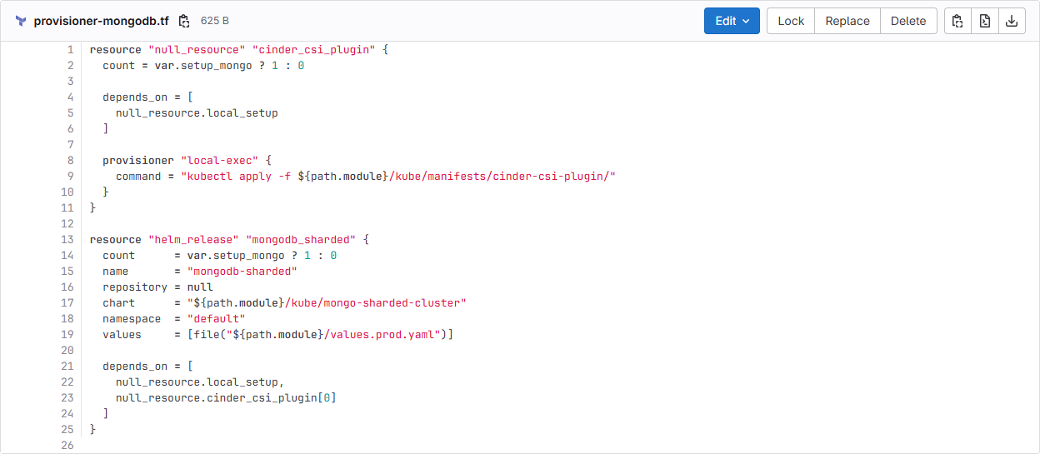
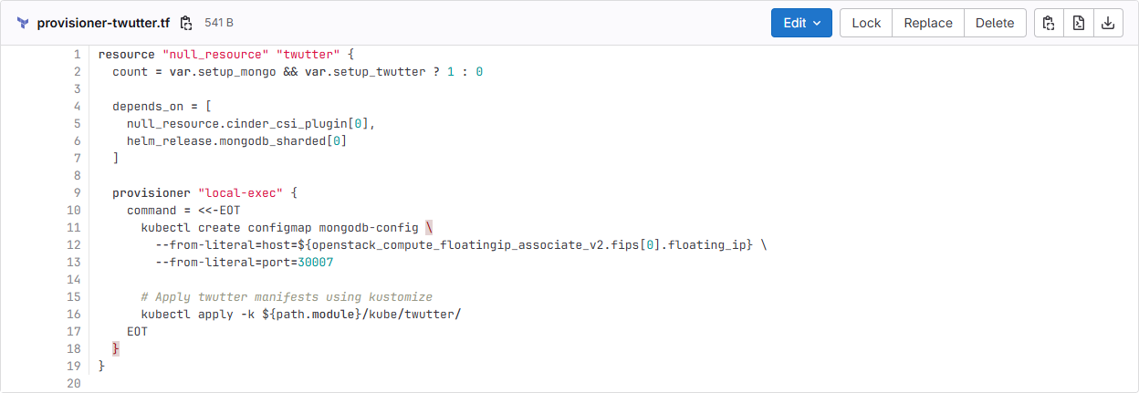
Terraform Additions
Automatic Helm and Plugin deployment
Local exec starts the Cinder CSI Plugin
Hashicorp helm provider starts the helm chart
Local exec starts Twutter deployment
Automation can be disabled
Variable ‘setup_mongo’ toggles mongo deployment
Variable ‘setup_twutter’ toggles twutter deployment
Makefile can be used to deploy manually

Slide 58
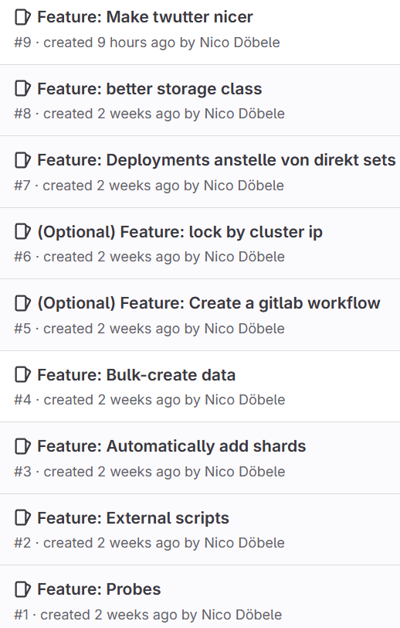
(Scratched) Considerations
Create a GitLab pipeline
⇢ Databases handle important data so a pipelines automatically scaling this type of application would require great care, especially when removing shards. This process alone can take days on large datasets.
Also, we cannot create enough resources to enable staging, so testing would become very hard.
Lock connections by cluster IP
⇢ This feature did turn out to be practically useless as the functions each use their own headless service. Because of this external IPs cannot connect anyways.
Store secrets in a secret manager
⇢ This was scratched since it does not add value by itself. This could help with workflows or larger organizations. For us simply sharing the Kubernetes secrets directly made more sense.
Add a dashboard with statistics
⇢ Everything we want to show can be shown via the shell. Dashboard could be added but would only be interesting once the databases have been running for a couple of days.

Slide 59
Dashboard / Monitoring options
Paywall
Open-Source
MongoDB Atlas
MongoDB Ops Manager
Percona Monitoring and Management (PMM)
Graphana and Prometheus
Easy to use and configure, real-time performance, data explorer functionality
Self-Hosted management, topology visualization, performance dashboards
Open-Source, detailed dashboards, Kubernetes-friendly, made for database analytics
Open-Source, Complete customizability, real-time metrics
Only runs on MongoDB Atlas hosted instances
Requires licensing, created for enterprises
Less customizability, advanced features require use of percona’s MongoDB modification (image)
Requires a lot of additional setup, only some templates come out of the box, “jack of all trades” master of none

Slide 60
Tough nuts to crack

Slide 61
Tough nuts to crack
Admin user can only be created after the ReplicaSet is initialized → The setup has to wait for the correct timing
Admin user can only be created on the primary node → The primary must be identified and specifically targeted
Cinder volumes require a CSI plugin to work with Kubernetes → Without the plugin, volume mounting is not possible
Local resources were no longer sufficient → Transition to cloud infrastructure was necessary
Kubernetes config gets created on dev machine on apply
→ CI/CD deployment needs to happen on the same machine that starts terraform

Slide 62
Twutter
Our Application

Slide 63
Why did we choose a social network?
Social platforms involve rich interactions: users, posts, comments, timelines – and those create great opportunities to explore real-world challenges in distributed systems, like horizontal scaling and NoSQL data modeling.
⇢ It’s the ideal playground to test bulk operations, and performance under high load.

Slide 64
General scenario
In our MongoDB setup, the three key collections are:
users: stores profiles
posts: the main content users create
comments: user-generated replies tied to posts
The project uses Next.js both for the frontend and backend logic (via API routes). On the frontend, we use React and built-in fetch methods to communicate with our APIs. Each API route directly talks to MongoDB, performing CRUD operations.

Slide 65
Why did we shard certain collections the way we did?
Posts
Wir haben posts per Hash geshardet (z. B. über _id)
Alternative wäre Sharding nach author
Warum Hash?
→ Feed-Abfragen rufen viele verschiedene Autoren ab
→ Hash verteilt die Daten gleichmäßig
→ Vermeidet Überlastung einzelner Shards
Comments
Comments sind nach postId geshardet
Alle Kommentare zu einem Beitrag liegen auf demselben Shard
Gut für: Post-Ansichten und Kommentar-Zählungen
Users
Auch users wurde per Hash geshardet
Vorteil: gleichmäßige Verteilung der Nutzer über alle Shards
Diese Konfiguration wurde bewusst für unser Testszenario gewählt. In produktiven Systemen kann je nach Zugriffsmuster ein anderer Shard-Key sinnvoll sein.

Slide 66
Live demo

Slide 67
MongoDB Load Testing
Appendix

Slide 68
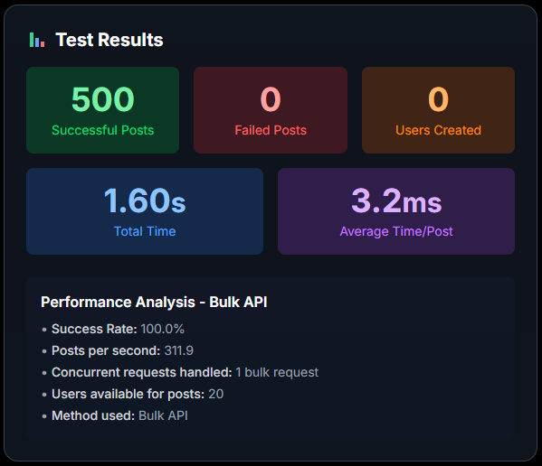
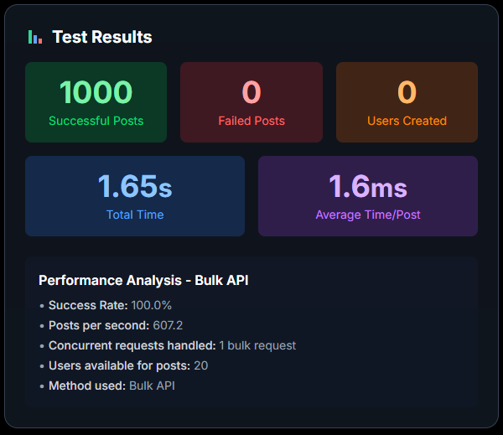
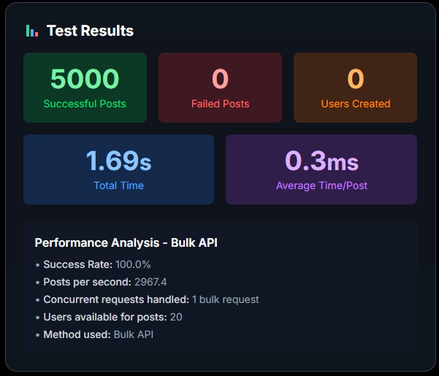
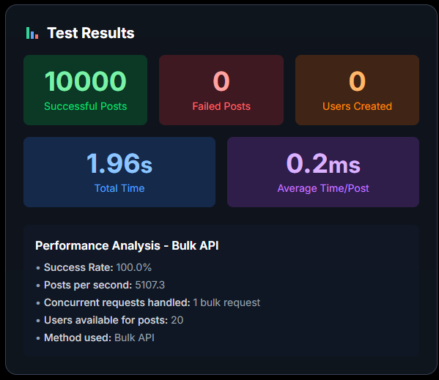
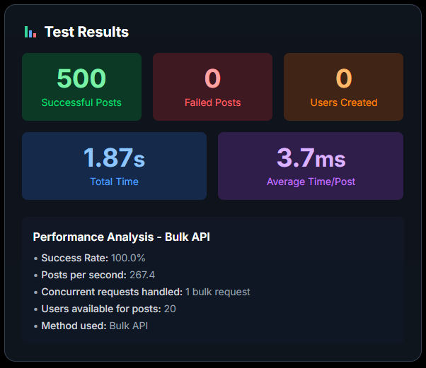

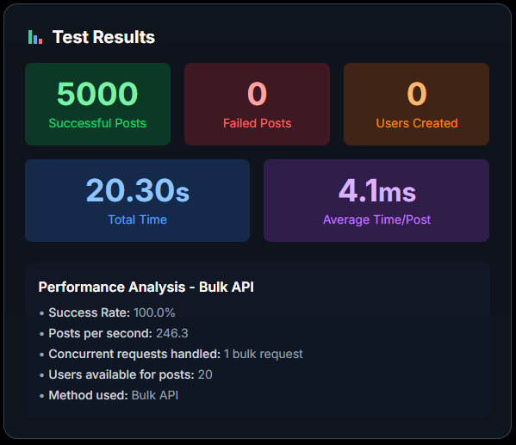

Load Tests - Bulk
Local
Sharded

Slide 69
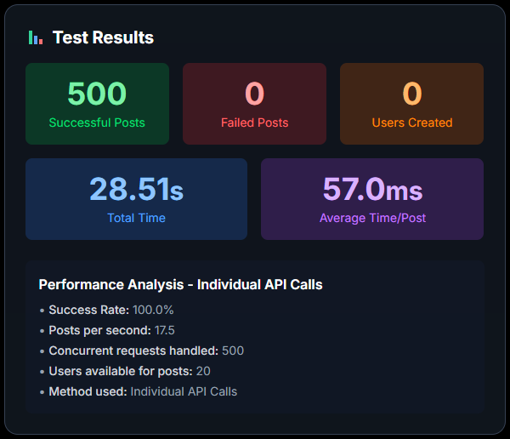
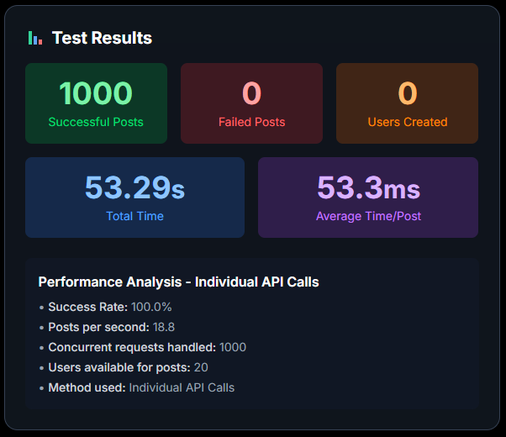
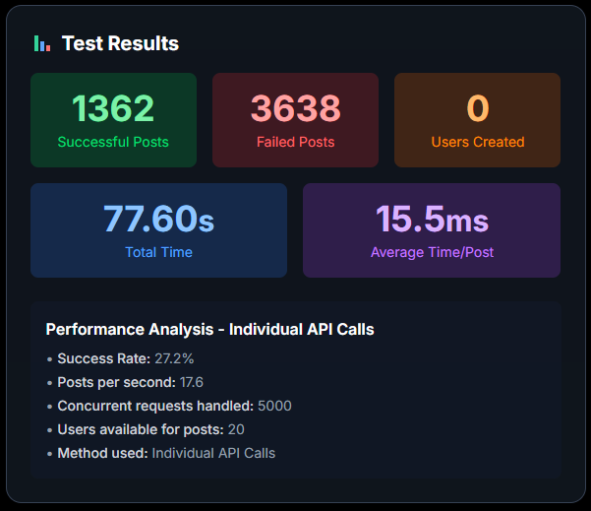
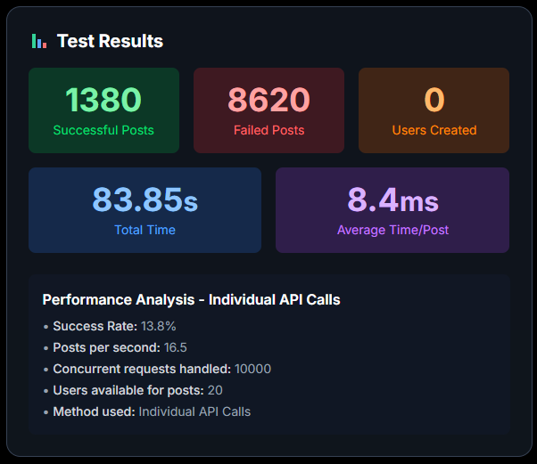
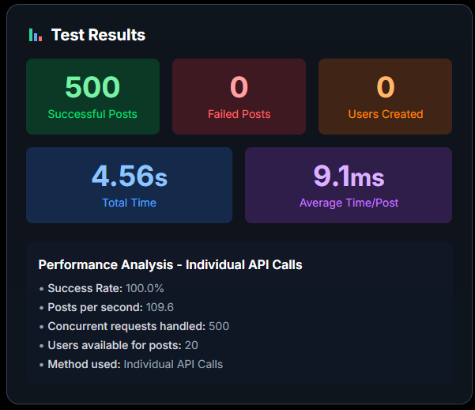


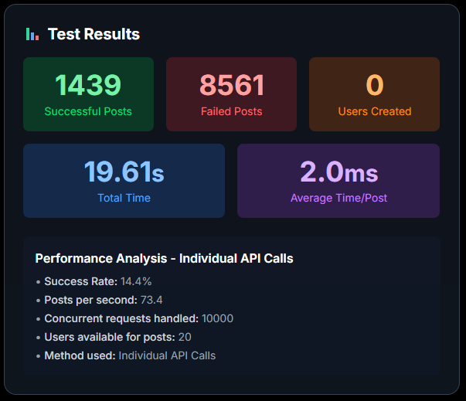
Load Tests - Individual
Local
Sharded

Slide 70
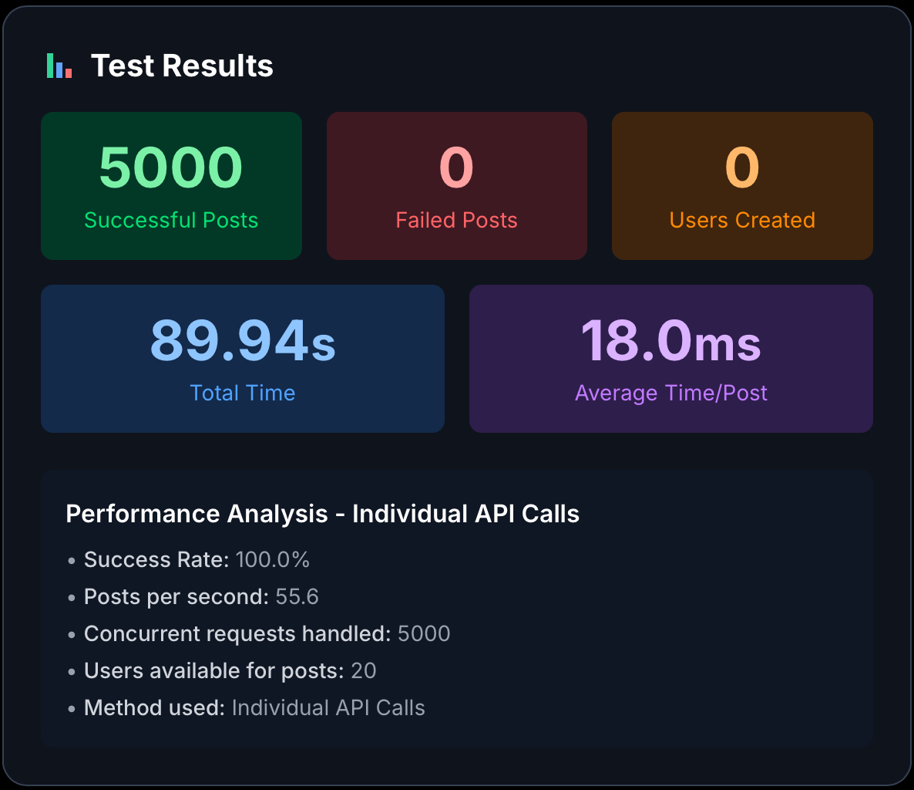

Load Tests Sharded - Individual
Backoff
Single Attempt

Slide 71
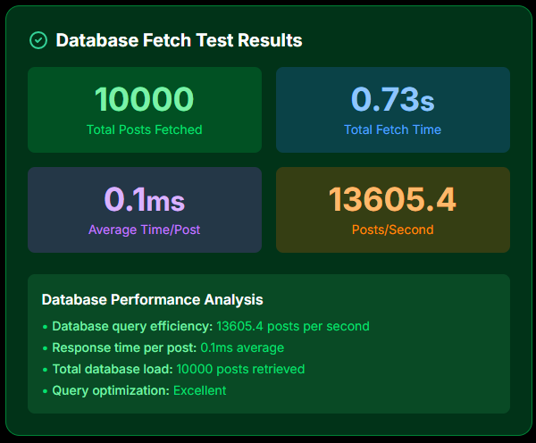
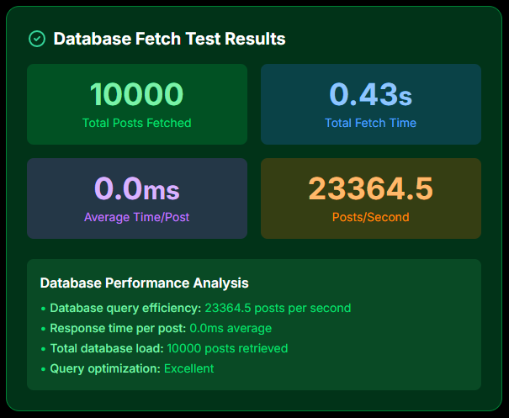
Fetching
Sharded
Local

Slide 72
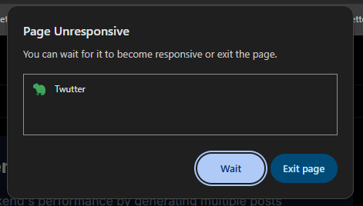
10000 requests local + individual

Slide 73
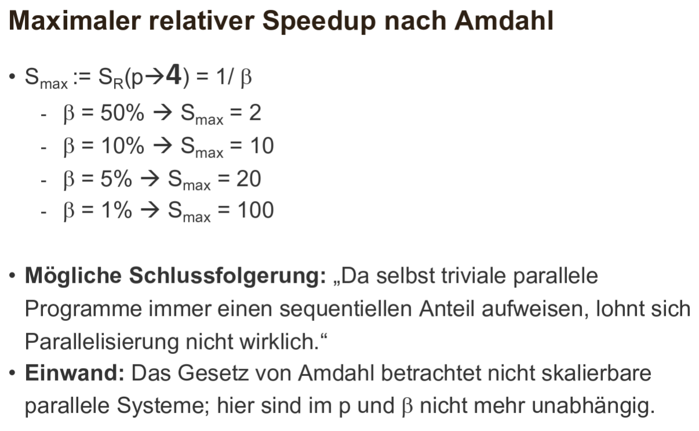
Amdahl
-> Das Ziel ist nicht die Laufzeitoptimierung bei kleinen Datenmengen, sondern die Ermöglichung der Handhabung von großen Datenmengen.

