Slide 1
Full Hash Algorithm V1 (AES S-Box)
Master's Degree in Cybersecurity
University of Pisa – A.Y. 2024/2025

Slide 2
Project Overview
Hashing function transforming messages into 64-bit digests.
Two main phases: message processing and finalization.
Uses AES S-box, XOR and circular shifts.

Slide 3
Hardware Design Requirements
Asynchronous active-low reset.
valid_in flag to validate input bytes.
digest_ready signal to indicate valid output.
Internal message byte counter for finalization.

Slide 4
Implementation Plan
1. High-Level Python Model (golden reference).
2. RTL Design in SystemVerilog.
3. Functional Simulation and Verification.
4. FPGA Implementation (Cyclone V).

Slide 5
High-Level Python Model
Reference model for functional correctness.
Processes each byte with 36 rounds and AES S-box.
Finalization depends on message length (8-byte counter).

Slide 6
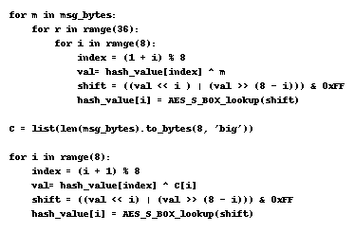

Slide 7
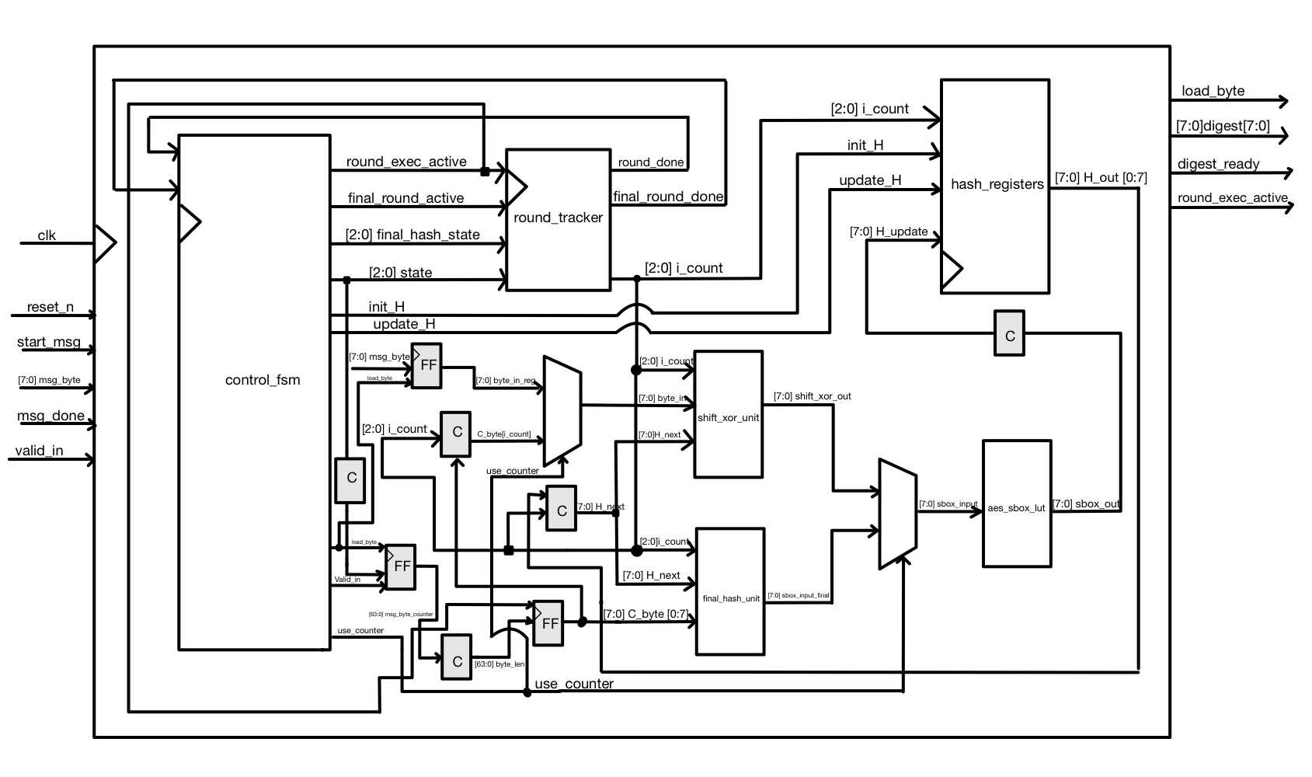
RTL Design in SystemVerilog.

Slide 8
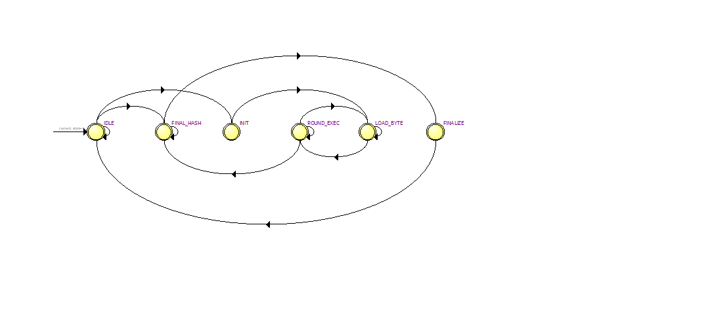
FSM Overview

Slide 9
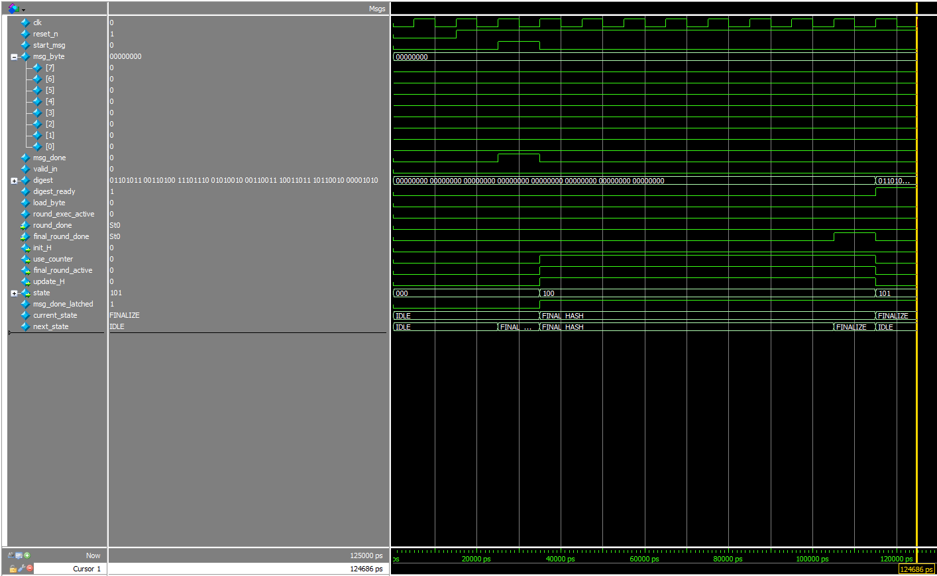
Waveform Analysis

Slide 10
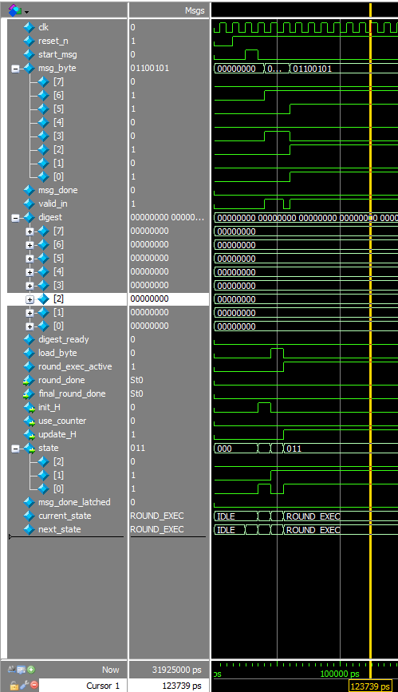
Waveform Analysis

Slide 11
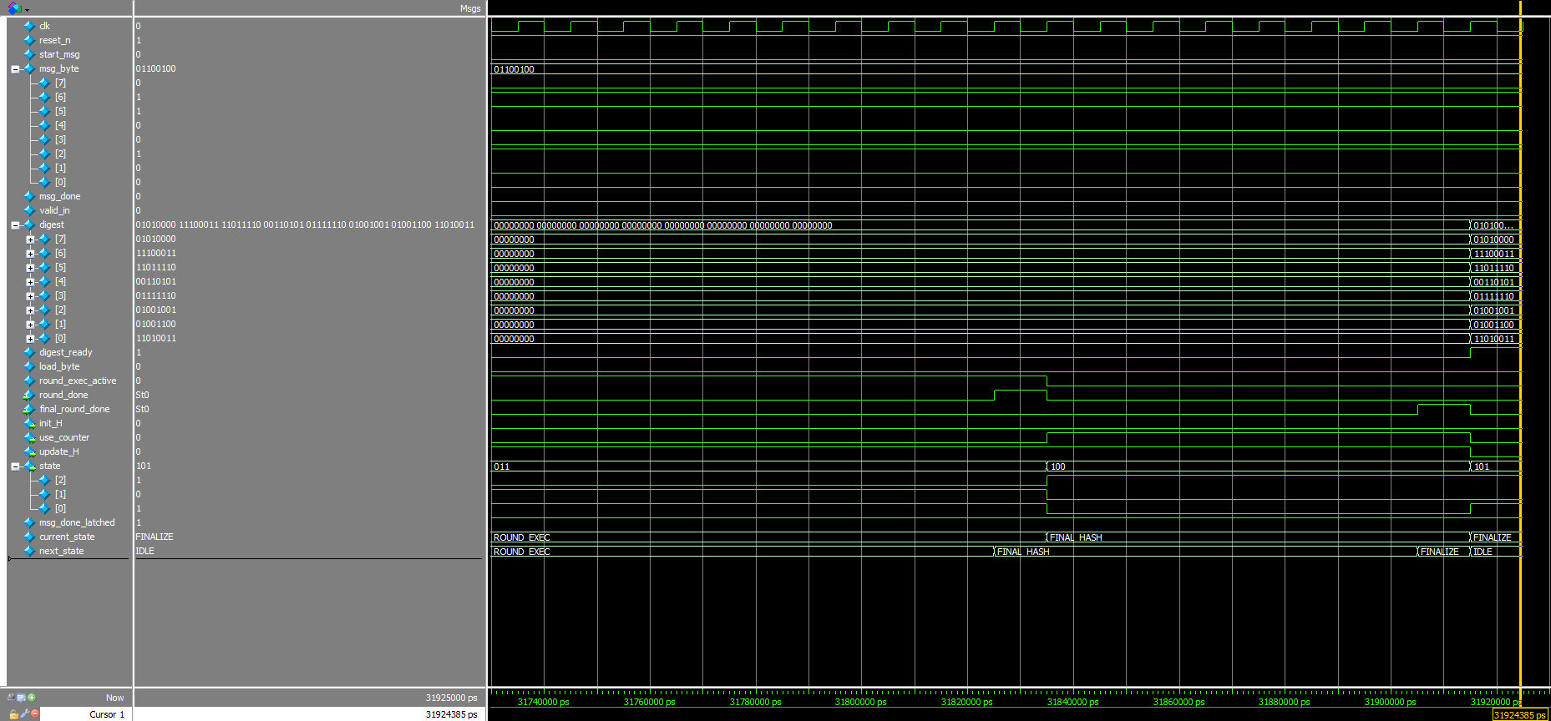
Waveform Analysis

Slide 12
FPGA Implementation Results
Target: Intel Cyclone V (5CGXFC9D6F27C7).
Refactored S-box to ROM to avoid warnings.
Meets timing at 9.7 ns (≈103 MHz).

Slide 13
Conclusion
Design is functionally correct and stable.
Timing met after slight adjustments.
Further optimization requires architectural redesign.

