Slide 1
Semester project: Formal Verification of Real-time Networks with Coq Proof Assistant
Andrea Gilot
BA5 SC

Slide 2
Problem
Critical applications must ensure delay guarantees.
Network Calculus provides bounds on network delays but relies on pen and paper proofs.
Some applications must go through certifications.

Slide 3
Coq proof assistant
Proof assistant developed by INRIA.
Formal verification [1] and theorem prover [2].
Dependently typed and functional.
References:
[1] Paulin-Mohring, Christine. (2012). Introduction to the Coq Proof-Assistant for Practical
Software Verication. 10.1007/978-3-642-35746-6 3.
[2] Georges Gonthier, Formal Proof - The Four-Color Theorem, 2008
Notes:
Coq is a proof assistant developed by INRIA. It is mainly use for two types of applications. First, for formal verification, thanks to Gallina, a language that verifies the correctness of theorems, programs, compiler etc... In addition, Coq provides ltac, a language used to code proof techniques that can be used to demonstrate theorems or part of them. Even though it is not very popular, it has been used to write the formal proof of the four color theorems and CompCert a compiler for the C language whose correctness has also been checke in Coq. It is both dependently typed and functional meaning that on one hand proving a statement is equivalent to create a new type. On the other hand, we can use functions to go from a theorem to another making them equivalent to implications.

Slide 4
FORMAL VERIFICATION OF REAL TIME NETWORKS
Authors in [1] have formalized a subset of the theory in Coq.
They defined min-plus and dioid algebra in addition to basic network calculus definitions and theorem.
This allowed them to provide a delay and backlog certification for a simple case study.
References:
[1] Lucien Rakotomalala, Marc Boyer, Pierre Roux. Formal Verication of Real-time Net-
works. JRWRTC2019, Junior Workshop RTNS 2019, Nov 2019, TOULOUSE, France.

Slide 5
PAPER DRAWBACKS
The source code is not available.
For an AFDX network [1] for instance, a packetizer and scheduler, such as non-preemptive static priority, should be defined.
If the topology of the network changes, the code needs to be changed manually.
References:
[1] Anaïs Finzi, Ahlem Mifdaoui, Fabrice Frances, Emmanuel Lochin. Network Calculus-based Timing Analysis of AFDX networks with Strict Priority and TSN/BLS Shapers. 13th International Symposium on Industrial Embedded Systems (SIES 2018), Jun 2018, Graz, Austria. pp.1-10.

Slide 6
MY Solution
Rewrite basic mathematics and network calculus definitions and theorems, in Coq.
Formally define a packetizer and prove theorems about its impact, in Coq.
Formally define a non-preemptive static priority scheduler with 2 inputs, in Coq.
Generalization to n inputs and on-demand based certification are left for further studies.
Notes:
My project is an extension of the paper of ….. They defined many network calculus definitions in Coq and proved theorems about them. This allowed them to perform a simple case study. However, many servers are still not defined in Coq. Another problem is that the code can only be modified by a Coq expert. Thus, if a proof is written for a given network topology, then changing this network implies that we need to rewrite the proof as well. My goal in this project is thus to define a packetizer and a non preemptive static scheduler with two inputs in Coq. The generalization for more than 2 inputs and the automation of the proof process is left to further studies

Slide 7
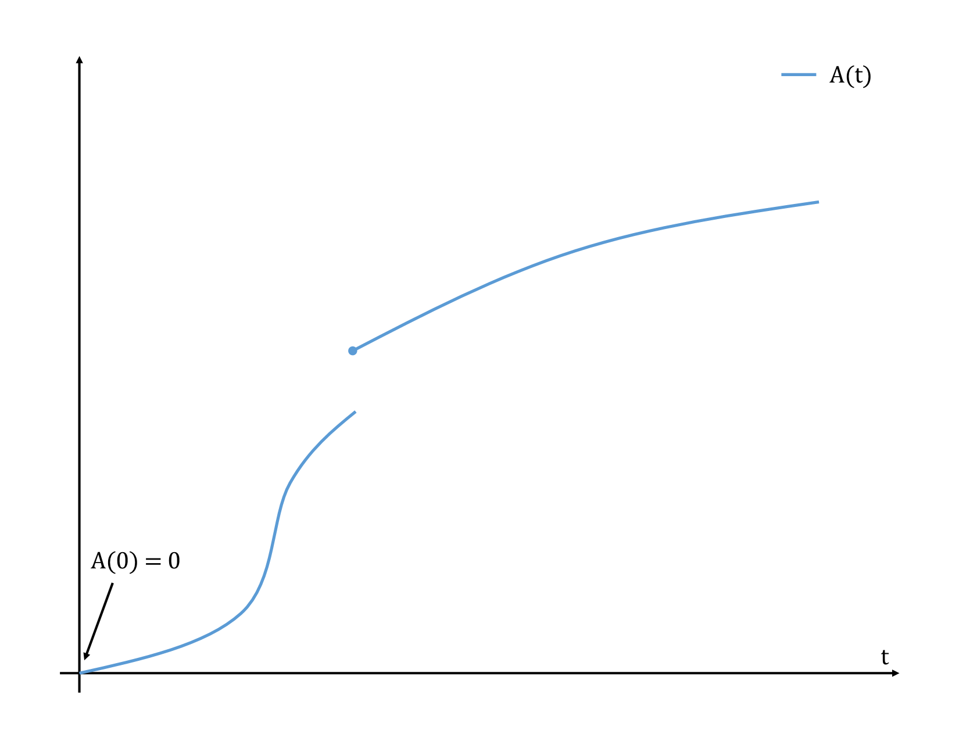
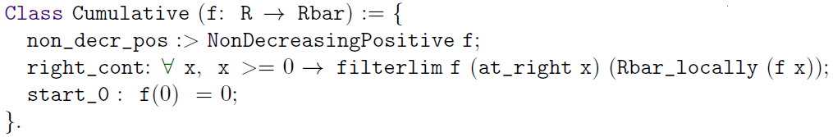
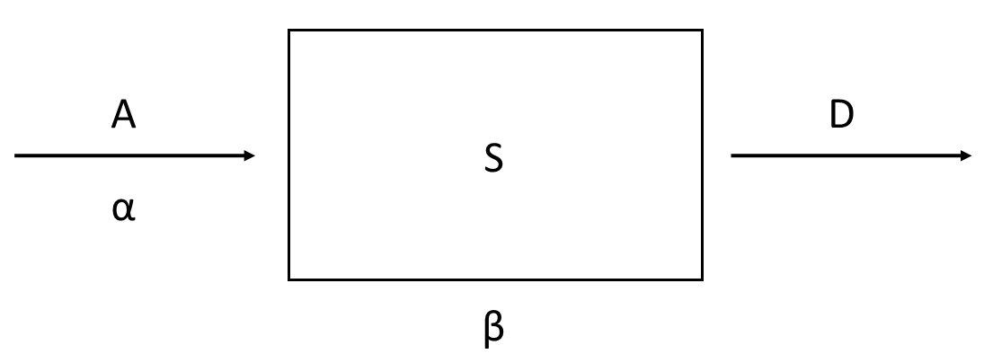

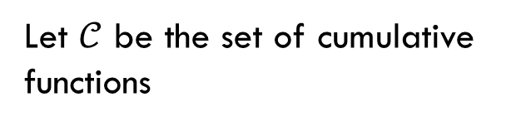

NETWORK CALCULUS BASICS
Let $𝒞$ be the set of cumulative functions
A$(0) = 0$
A$∈𝒞↔$
A is non-decreasing
A is right continuous

Slide 8
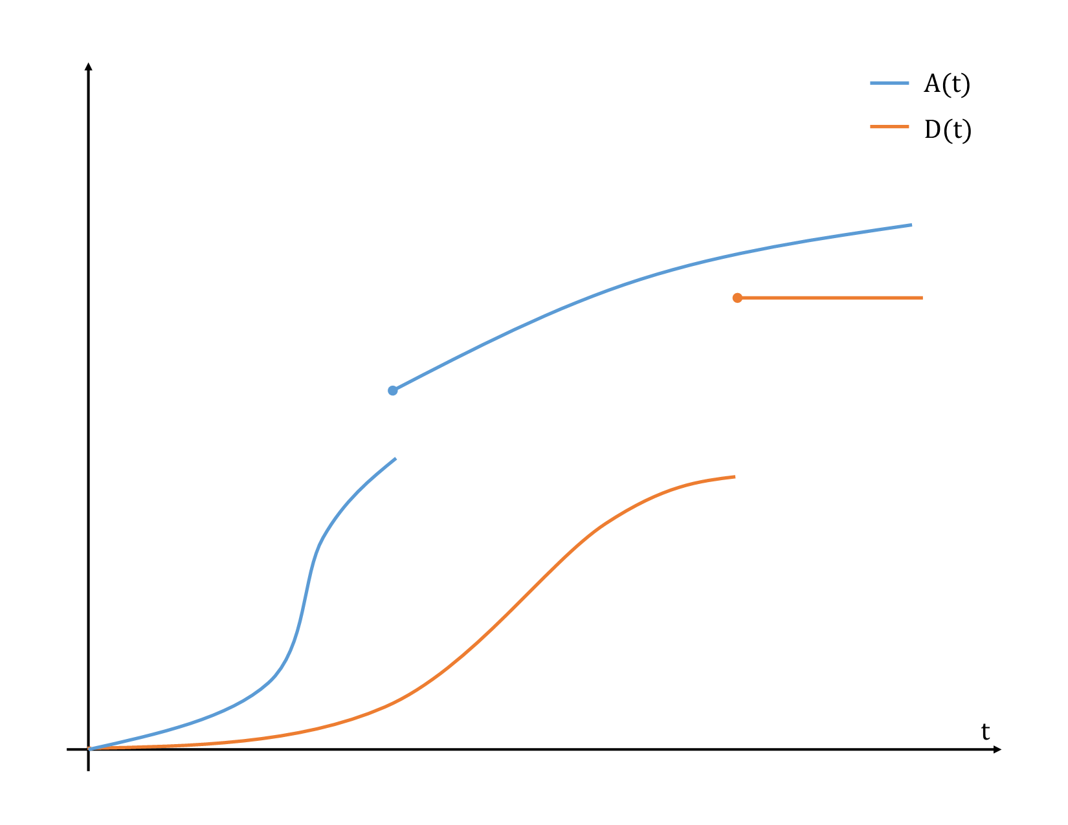
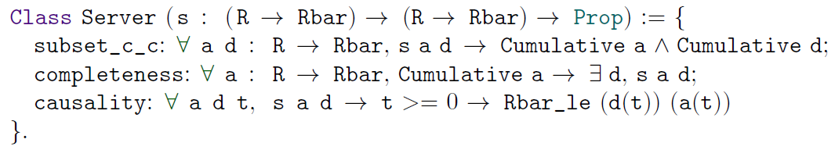
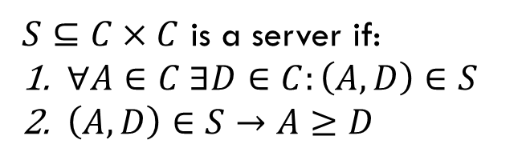
NETWORK CALCULUS BASICS
$S⊆C×C$ is a server if:
$∀A∈C ∃D∈C:\left(A, D\right)∈S$
$\left(A, D\right)∈S→A≥D$

Slide 9
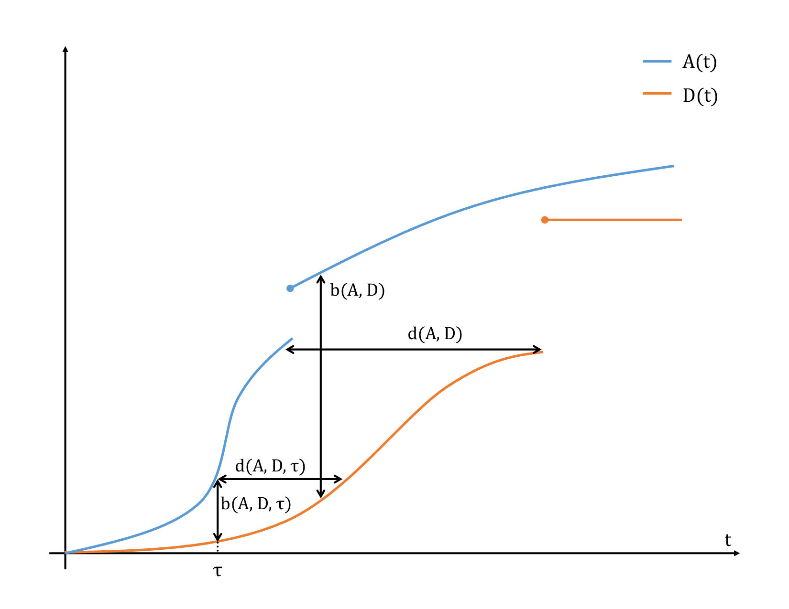

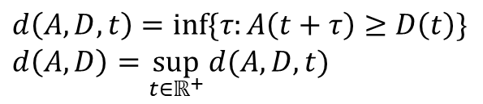
NETWORK CALCULUS BASICS
$$b\left(A, D, t\right)=A\left(t\right)−D\left(t\right)$$
$$b\left(A, D\right)=\sup_{t∈ℝ^{+}}{b(A, D, t)}$$
$$d\left(A, D, t\right)=\inf{\{τ:A\left(t+τ\right)≥D\left(t\right)\}}$$
$$d\left(A, D\right)=\sup_{t∈ℝ^{+}}{d(A, D, t)}$$

Slide 10



NETWORK CALCULUS BASICS
$$A≤A⊗α$$
An arrival curve α is a function that gives an upper bound on the arrival flow.
$$A⊗β≤D$$
A service curve β is a function that gives a lower bound on the departure flow.
$$\left(f⊗g\right)\left(t\right)=\inf_{s≥0}{(f\left(s\right)+g\left(t−s\right))}$$

Slide 11
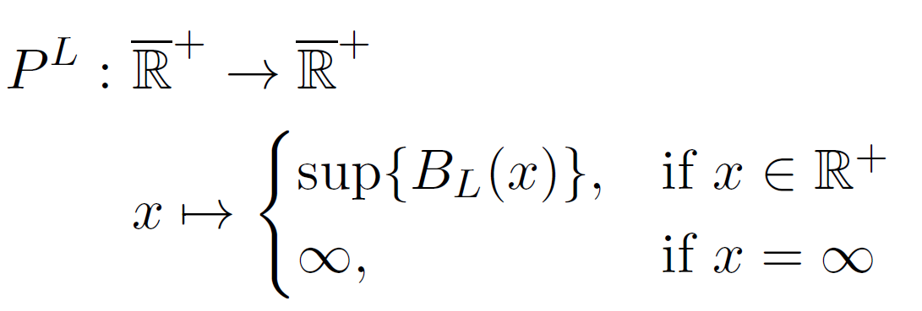
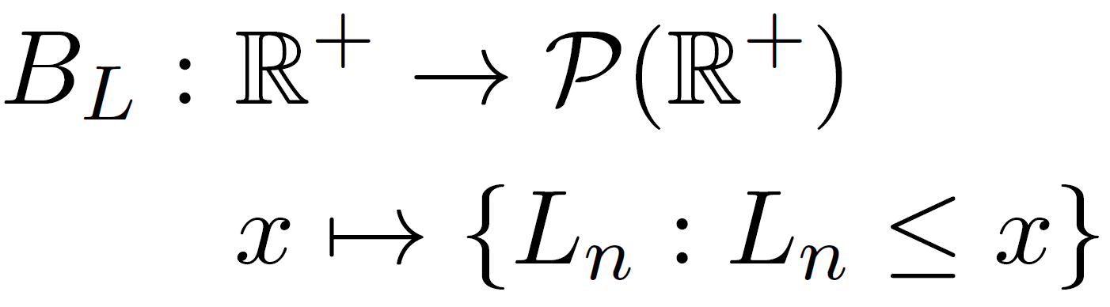
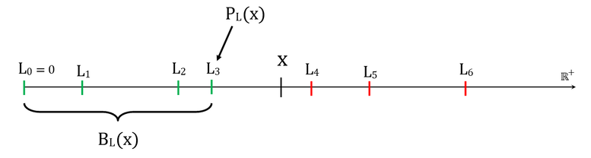
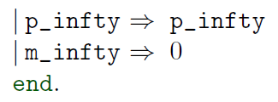
Introducing PL

Slide 12
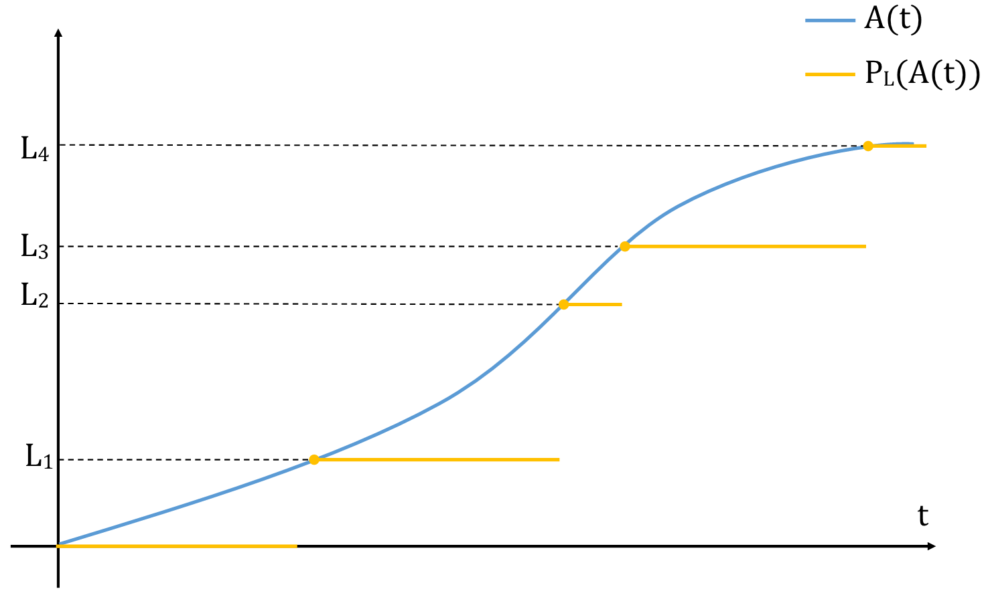

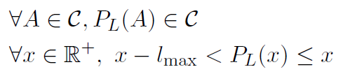
L-packetizer

Slide 13
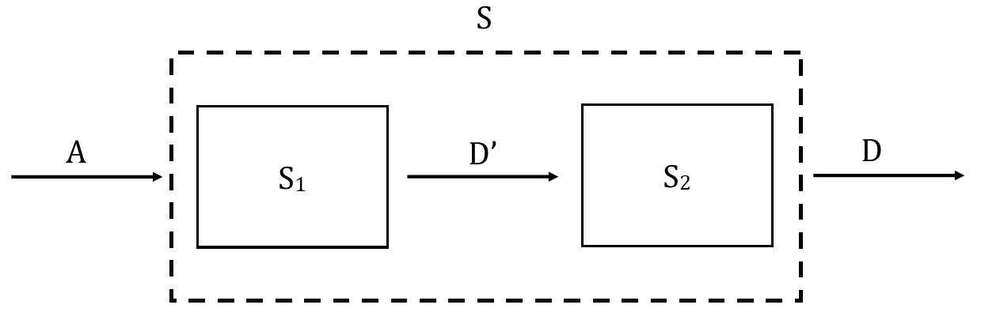
Combined Systems

Slide 14
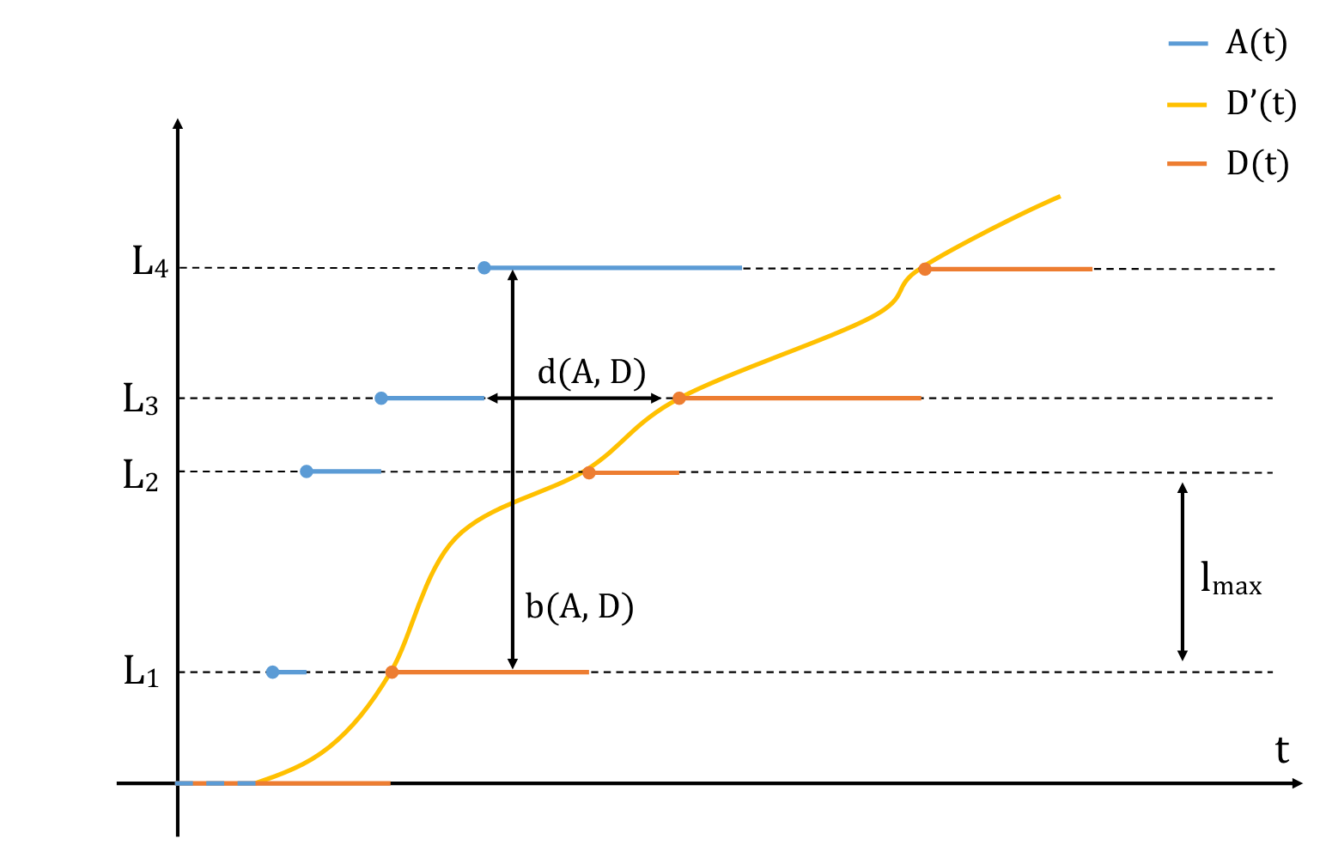
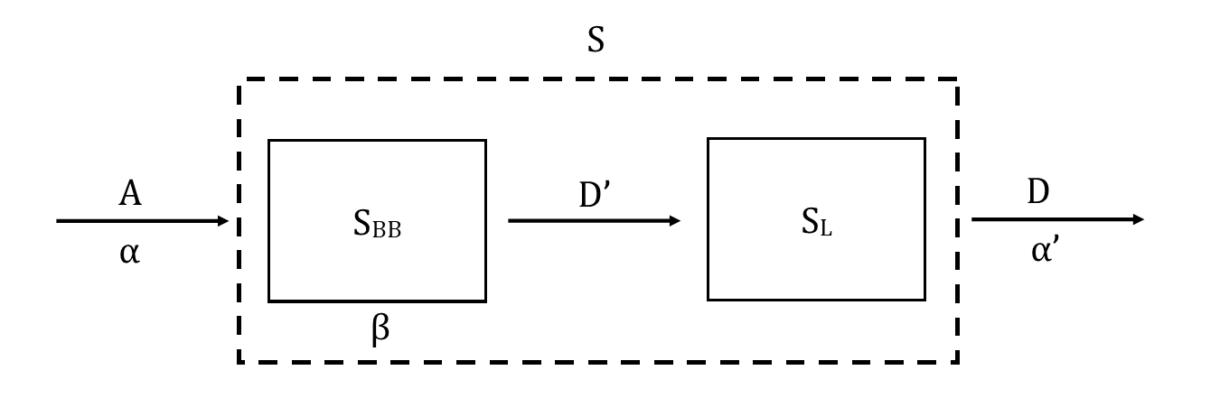
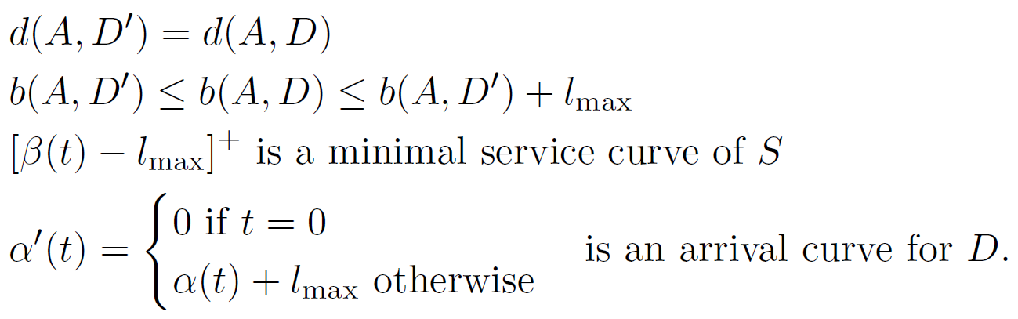
Impact of the packetizer

Slide 15
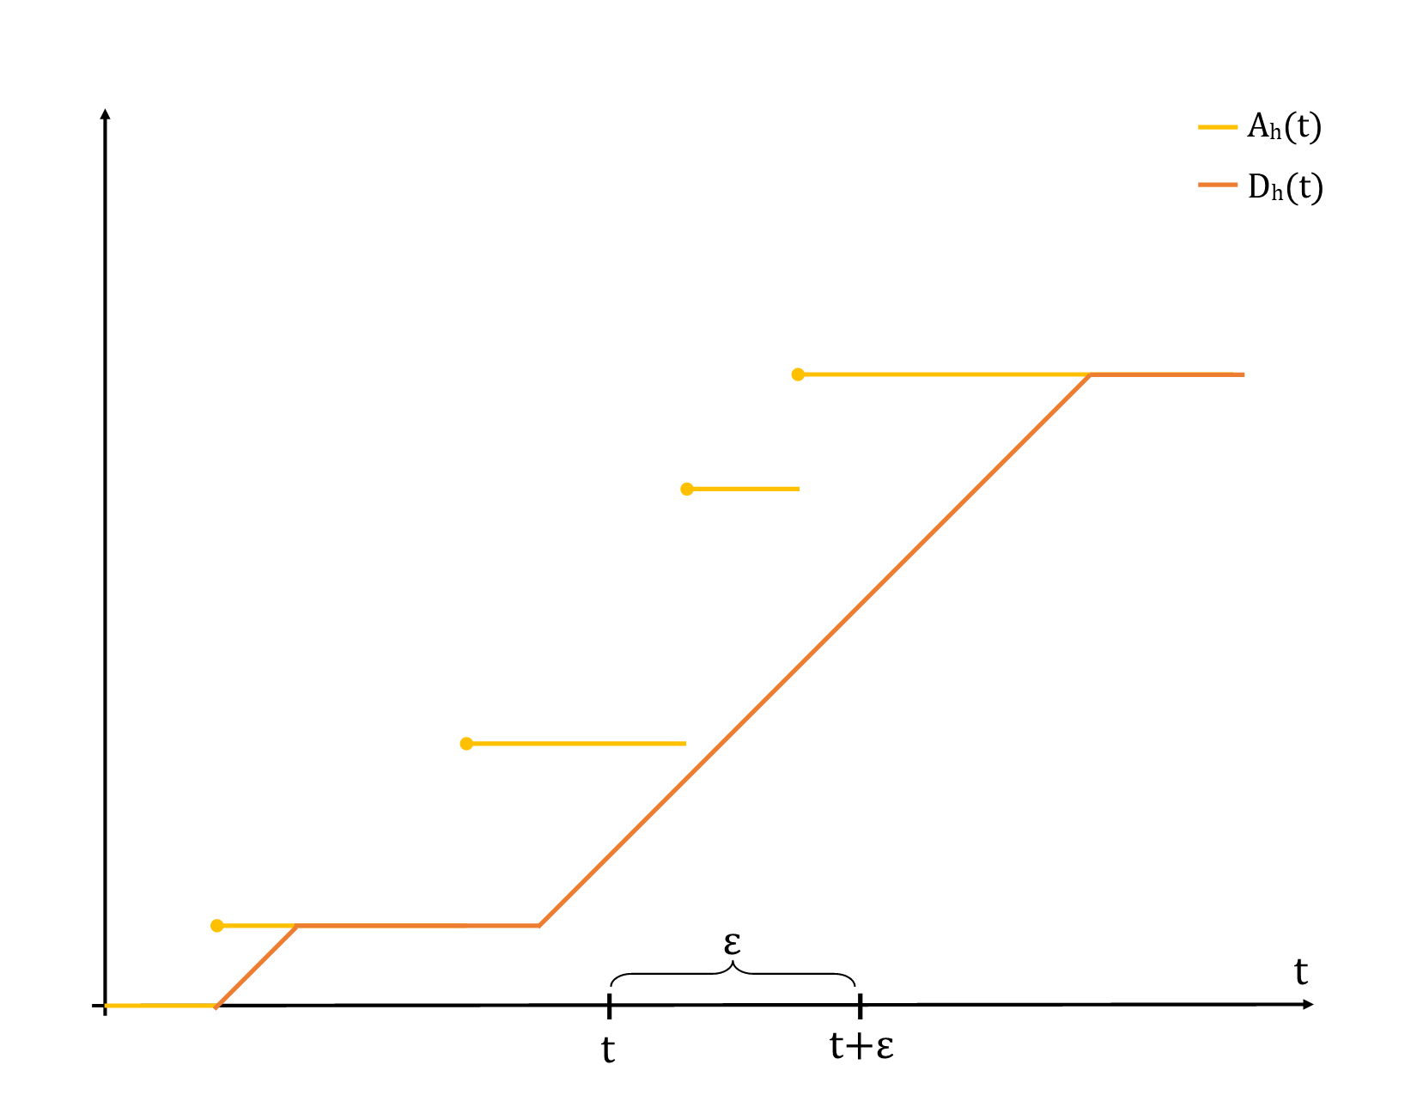

NP-SP scheduler

Slide 16
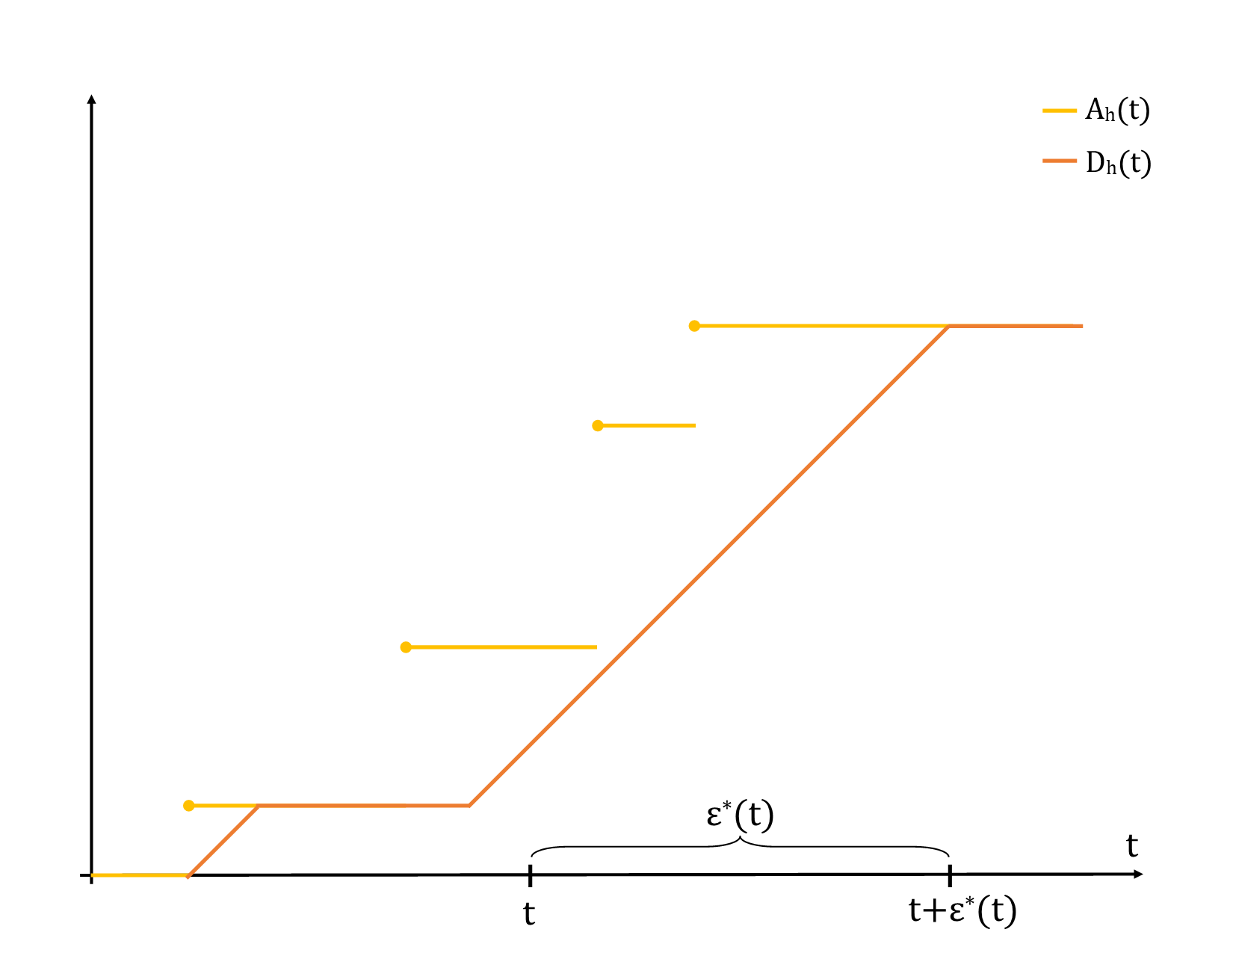
NP-SP scheduler

Slide 17
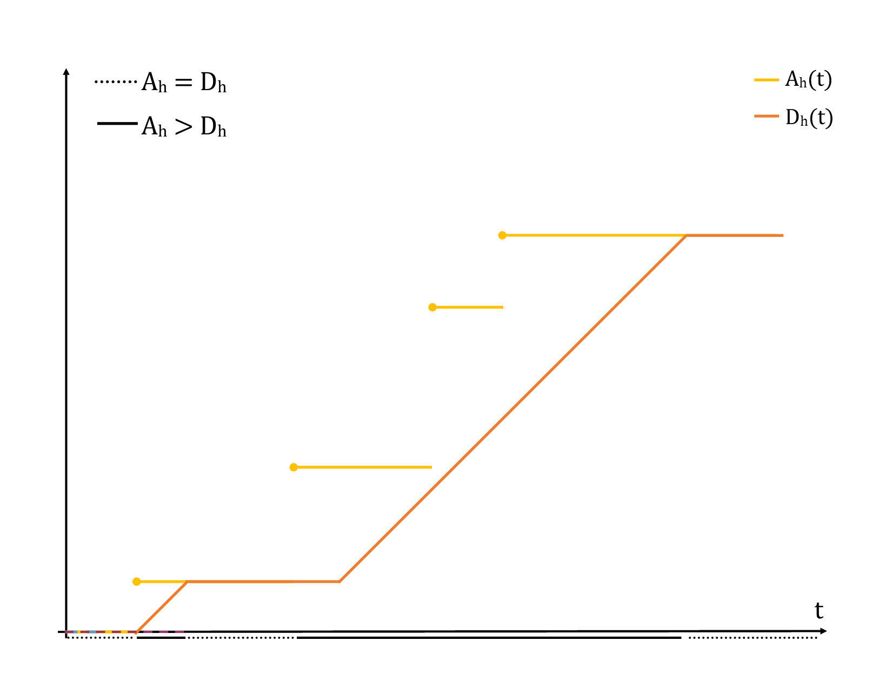
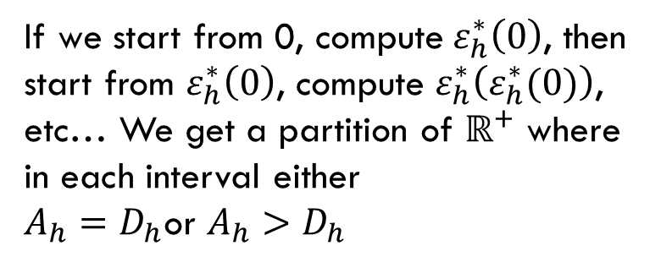
NP-SP scheduler
If we start from 0, compute $ε_{h}^{∗}\left(0\right)$, then start from $ε_{h}^{∗}\left(0\right)$, compute $ε_{h}^{∗}\left(ε_{h}^{∗}(0)\right)$, etc… We get a partition of $ℝ^{+}$ where in each interval either
$A_{h}=D_{h}$or $A_{h}>D_{h}$

Slide 18
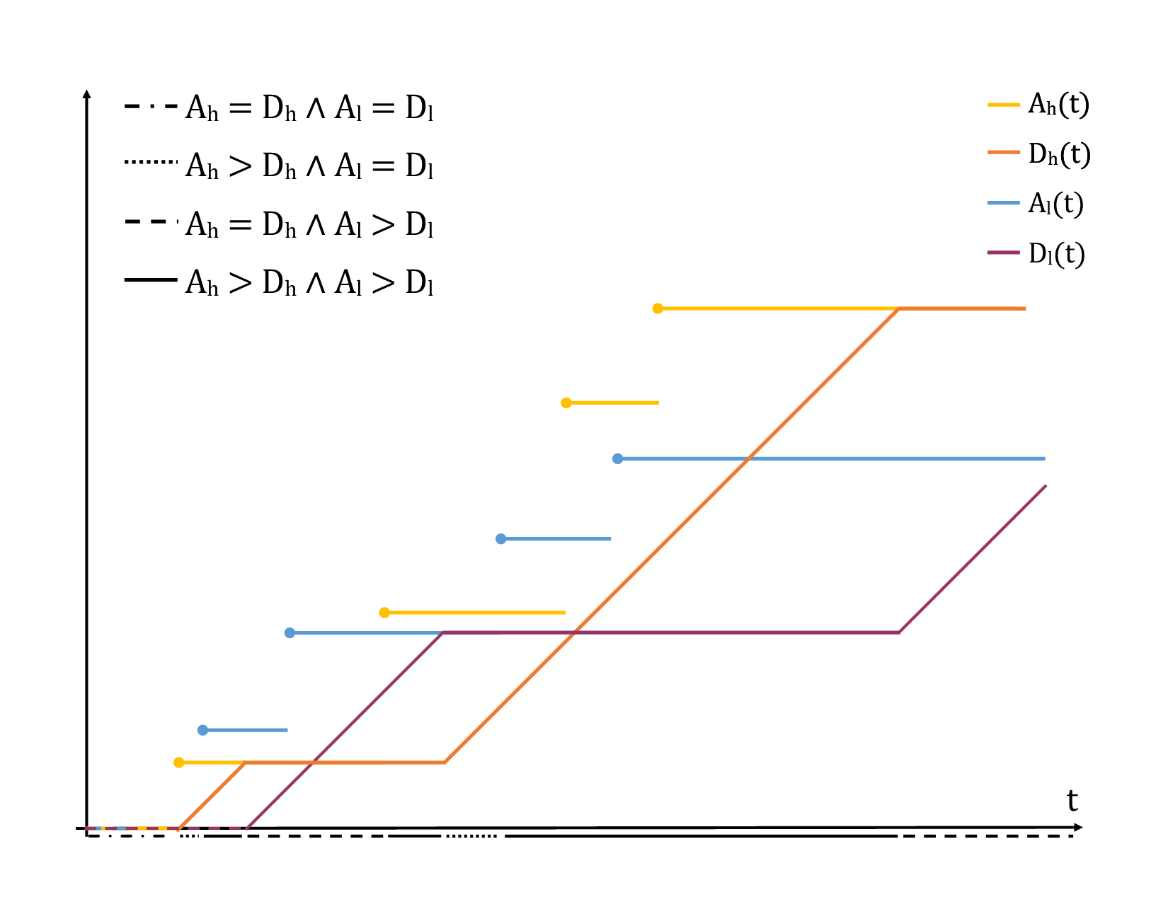
NP-SP scheduler
This time we repeat the same process but with 4 functions

Slide 19
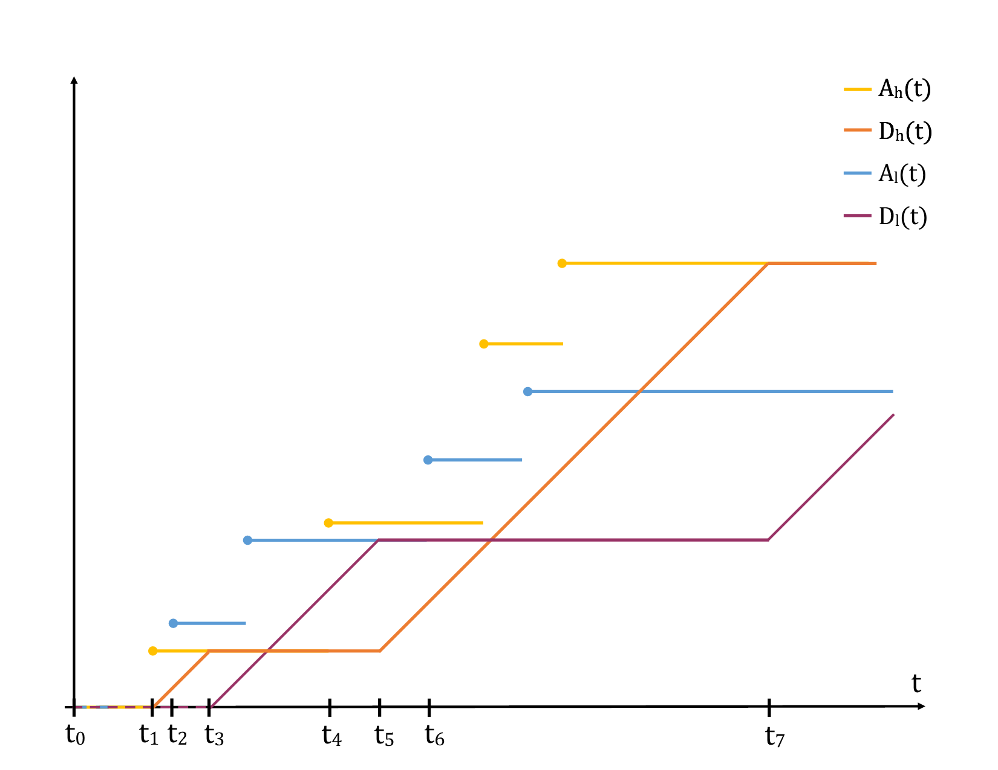
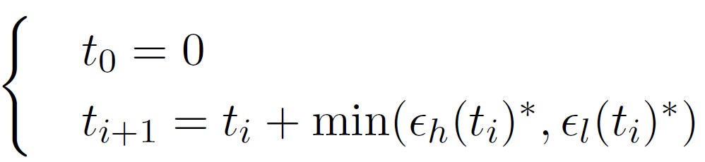
NP-SP scheduler

Slide 20
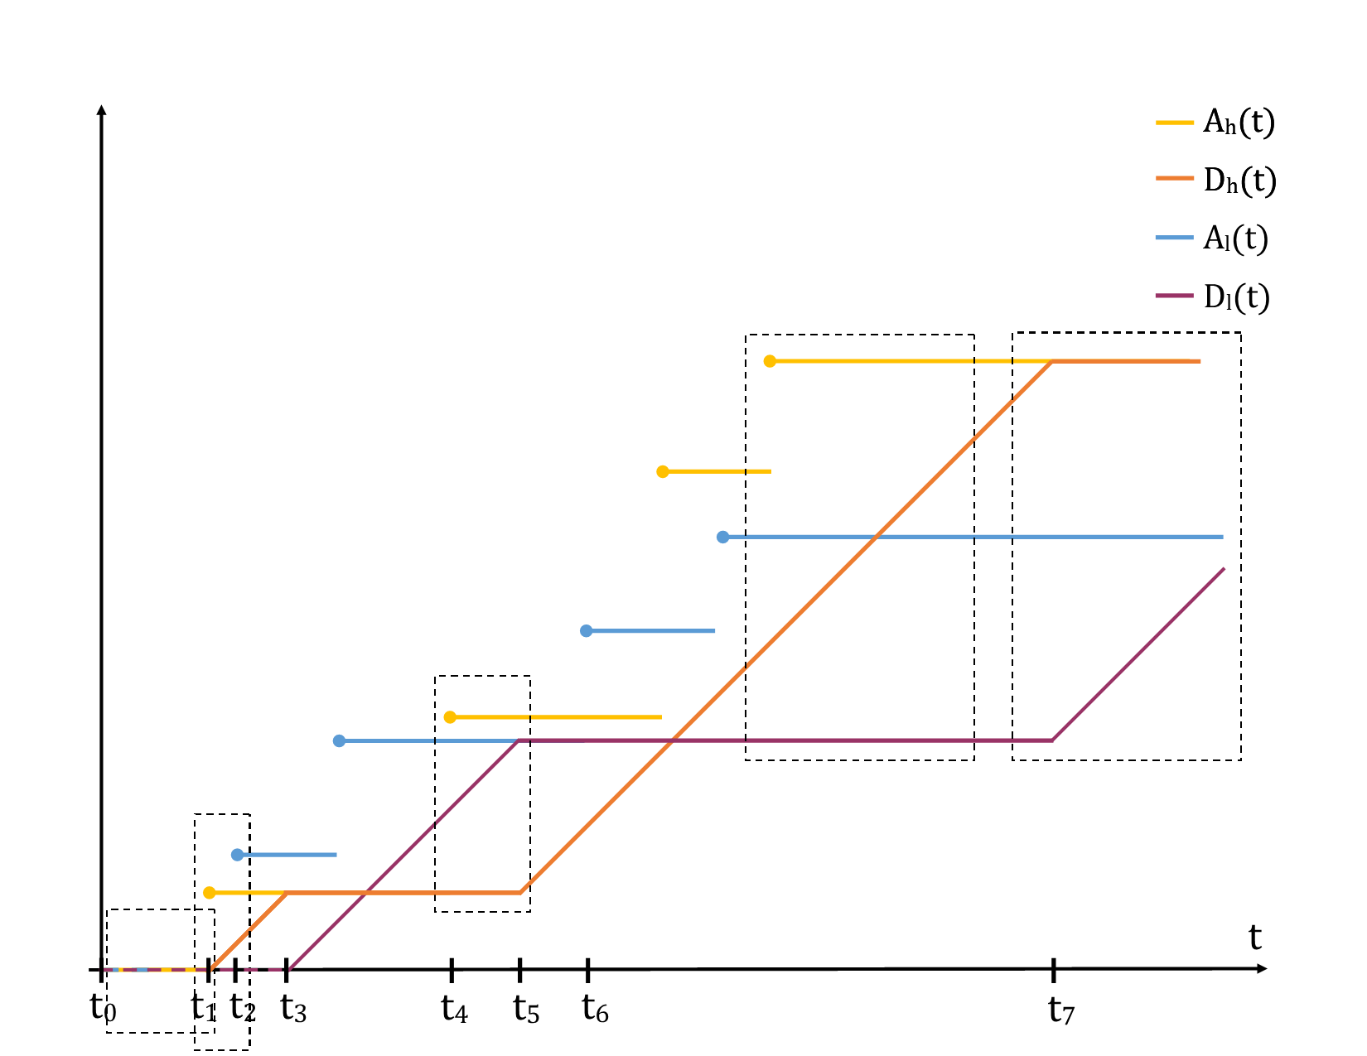


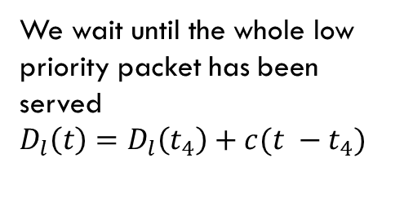
NP-SP scheduler
Low priority packets are being served:
$$D_{l}\left(t\right)=D_{l}\left(t_{7}\right)+c(t −t_{7})$$
High priority packets are being served
$$D_{h}\left(t\right)=D_{h}\left(t_{i}\right)+c(t −t_{i})$$
We wait until the whole low priority packet has been served
$$D_{l}\left(t\right)=D_{l}\left(t_{4}\right)+c(t −t_{4})$$
No packet is being served

Slide 21
Conclusion
Formally defined a packetizer in Coq and proved theorems about it
Formally defined a NP-SP scheduler with 2 inputs but did not verified its correctness
Generalization to n inputs and on demand certification left for further studies

Slide 22
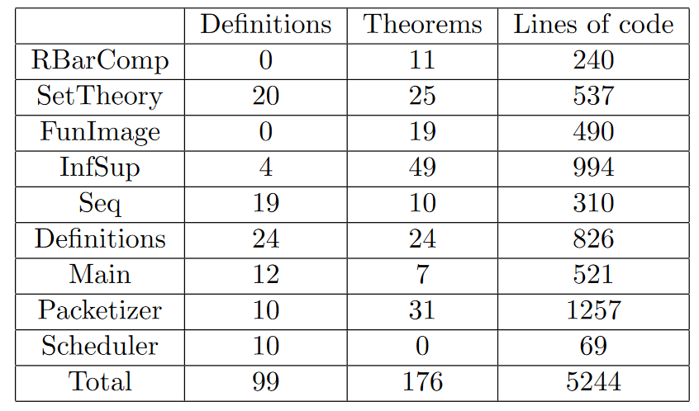
Achievements

Slide 23
SKILLS ACQUIRED BY THE PROJECT
Mathematical rigor and analysis of corner cases.
Learnt to program in Coq.
Expanded my mathematical knowledge and discovered Network Calculus.

Slide 24
Major events
Get familiar with Coq, Network Calculus and the paper
Basic definitions and maths in Coq
Packetizer
Scheduler

Slide 25
Self assessment
Learnt Coq quickly and got results.
Did not familiarize myself with libraries.

Slide 26
Conclusion
Formally defined a packetizer in Coq and proved theorems about it.
Formally defined a NP-SP scheduler with 2 inputs but did not verified its correctness.
Generalization to n inputs and on demand certification left for further studies.

