Slide 1
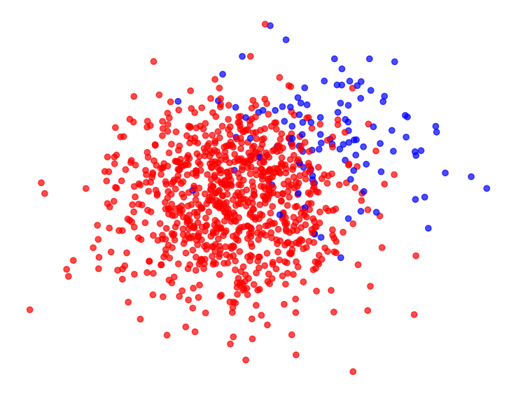
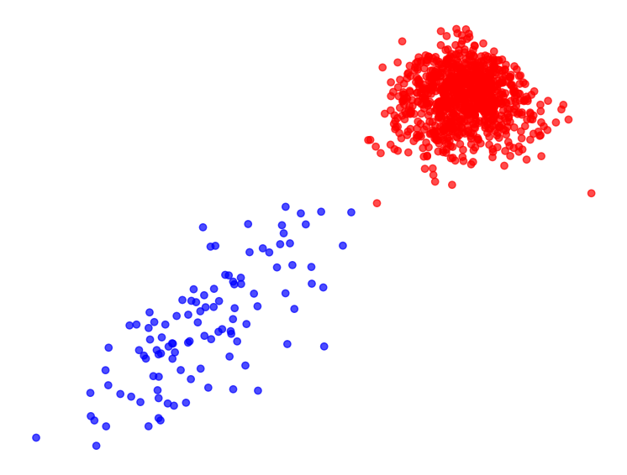
Improving Spectral Clustering through Edge Weight Transformations
Professor: Patrick Thiran
Assistant: Daichi Kuroda Maximilien Dreveton
Student: Nicolas Gonzalez
Notes:
Good morning
I’m Nicolas, and I’m here to present my project “Improving Spectral Clustering through Edge Weight Transformations”

Slide 2
Table of contents
Introduction
Theoretical background
WSBM
Spectral Clustering
Weight Transformation
Separability Measure
Experimentation
Experimental Setup
Results
Preliminary observations
What’s next
INDY
Notes:
My presentation is structured as follows
We will go through some Theoretical background, and then talk about the Experimentation

Slide 3

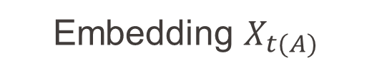

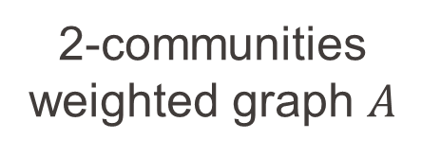
Introduction
2-communities weighted graph $A$
Weight transform $A↦t(A)$
Embedding $X_{A}$
Embedding $X_{t(A)}$
INDY
Notes:
Spectral clustering can sometimes fail when the underlying distributions of data points are not clearly distinguishable
[1] By applying some edge weight transformation, we aim to amplify the differences between these distributions,
thereby improving the separation of communities in the embedded space

Slide 4
Theoretical Background
INDY
Notes:
Quick overview of the theoretical objects used in the project

Slide 5
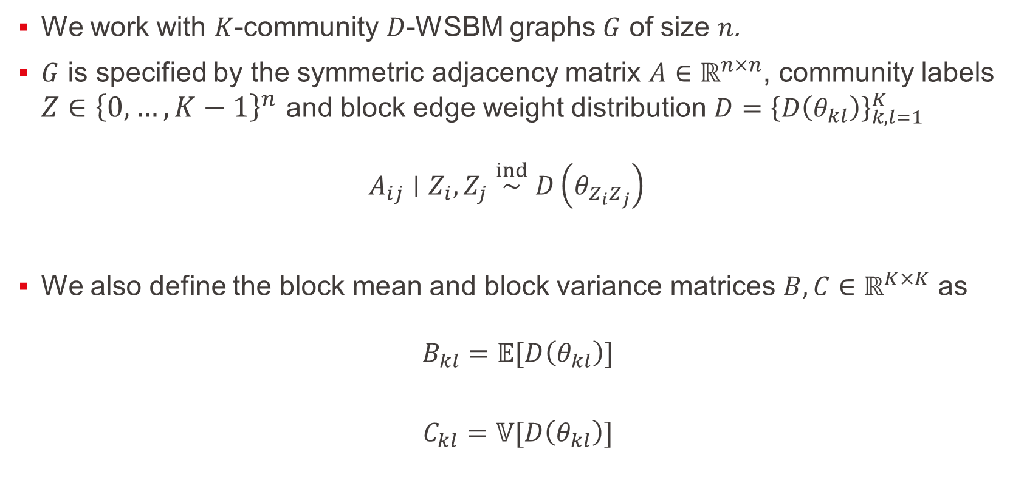
Weighted Stochastic Block Model
We work with $K$-community $D$-WSBM graphs $G$ of size $n$.
$G$ is specified by the symmetric adjacency matrix $A∈ℝ^{n×n}$, community labels $Z∈{\left\{0, …, K−1\right\}}^{n}$ and block edge weight distribution ${D=\left\{D\left(θ_{kl}\right)\right\}}_{k,l=1}^{K}$ $A_{ij}∣Z_{i},Z_{j}\overset{ind}{∼}D\left(θ_{Z_{i}Z_{j}}\right)$
We also define the block mean and block variance matrices $B,C∈ℝ^{K×K}$ as
$$B_{kl}=𝔼[D\left(θ_{kl}\right)]$$
$$C_{kl}=𝕍[D\left(θ_{kl}\right)]$$
INDY
Notes:
We will test our transformations on $K$-community Weighted Stochastic Block Model
[1] A graph following such a model, is specified by its weight matrix $A$ and community labels $Z$.
Between each community pair $k,l$, the edge weight distribution is set with specific parameters depending on $k,l$
[2] We gather the respective mean and variance of these distributions in block matrices $B$ and $C$

Slide 6
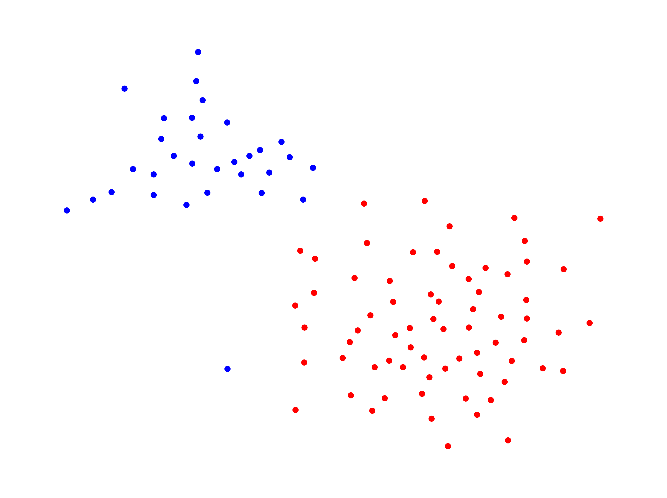
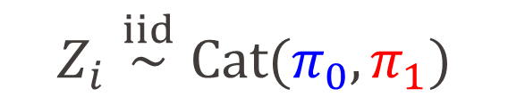
Weighted Stochastic Block Model
$$Z_{i}\overset{iid}{∼}Cat(π_{0},π_{1})$$
INDY
Notes:
So, what does it look like?
[1] Suppose labels are drawn as such. That is, $Z_{i}$ takes value 0 with probability $π_{0}$ and 1 with probability $π_{1}$
[2] Producing this label assignment

Slide 7
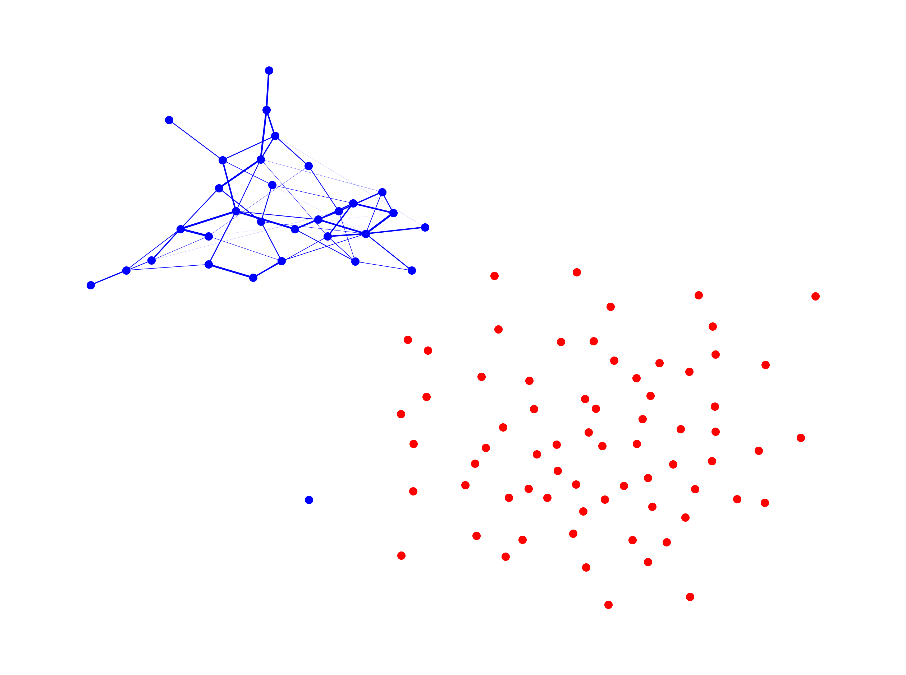


Weighted Stochastic Block Model
$$A_{ij}∣Z_{i}=0,Z_{j}=0\overset{ind}{∼}D\left(θ_{0,0}\right)$$
$$Θ=\left(\begin{matrix}θ_{0,0} & θ_{0,0} \\ θ_{0,0} & θ_{0,0}\end{matrix}\right)$$
INDY
Notes:
Then, edges between nodes belonging to community $0$ are drawn from distribution $D$ theta 00

Slide 8
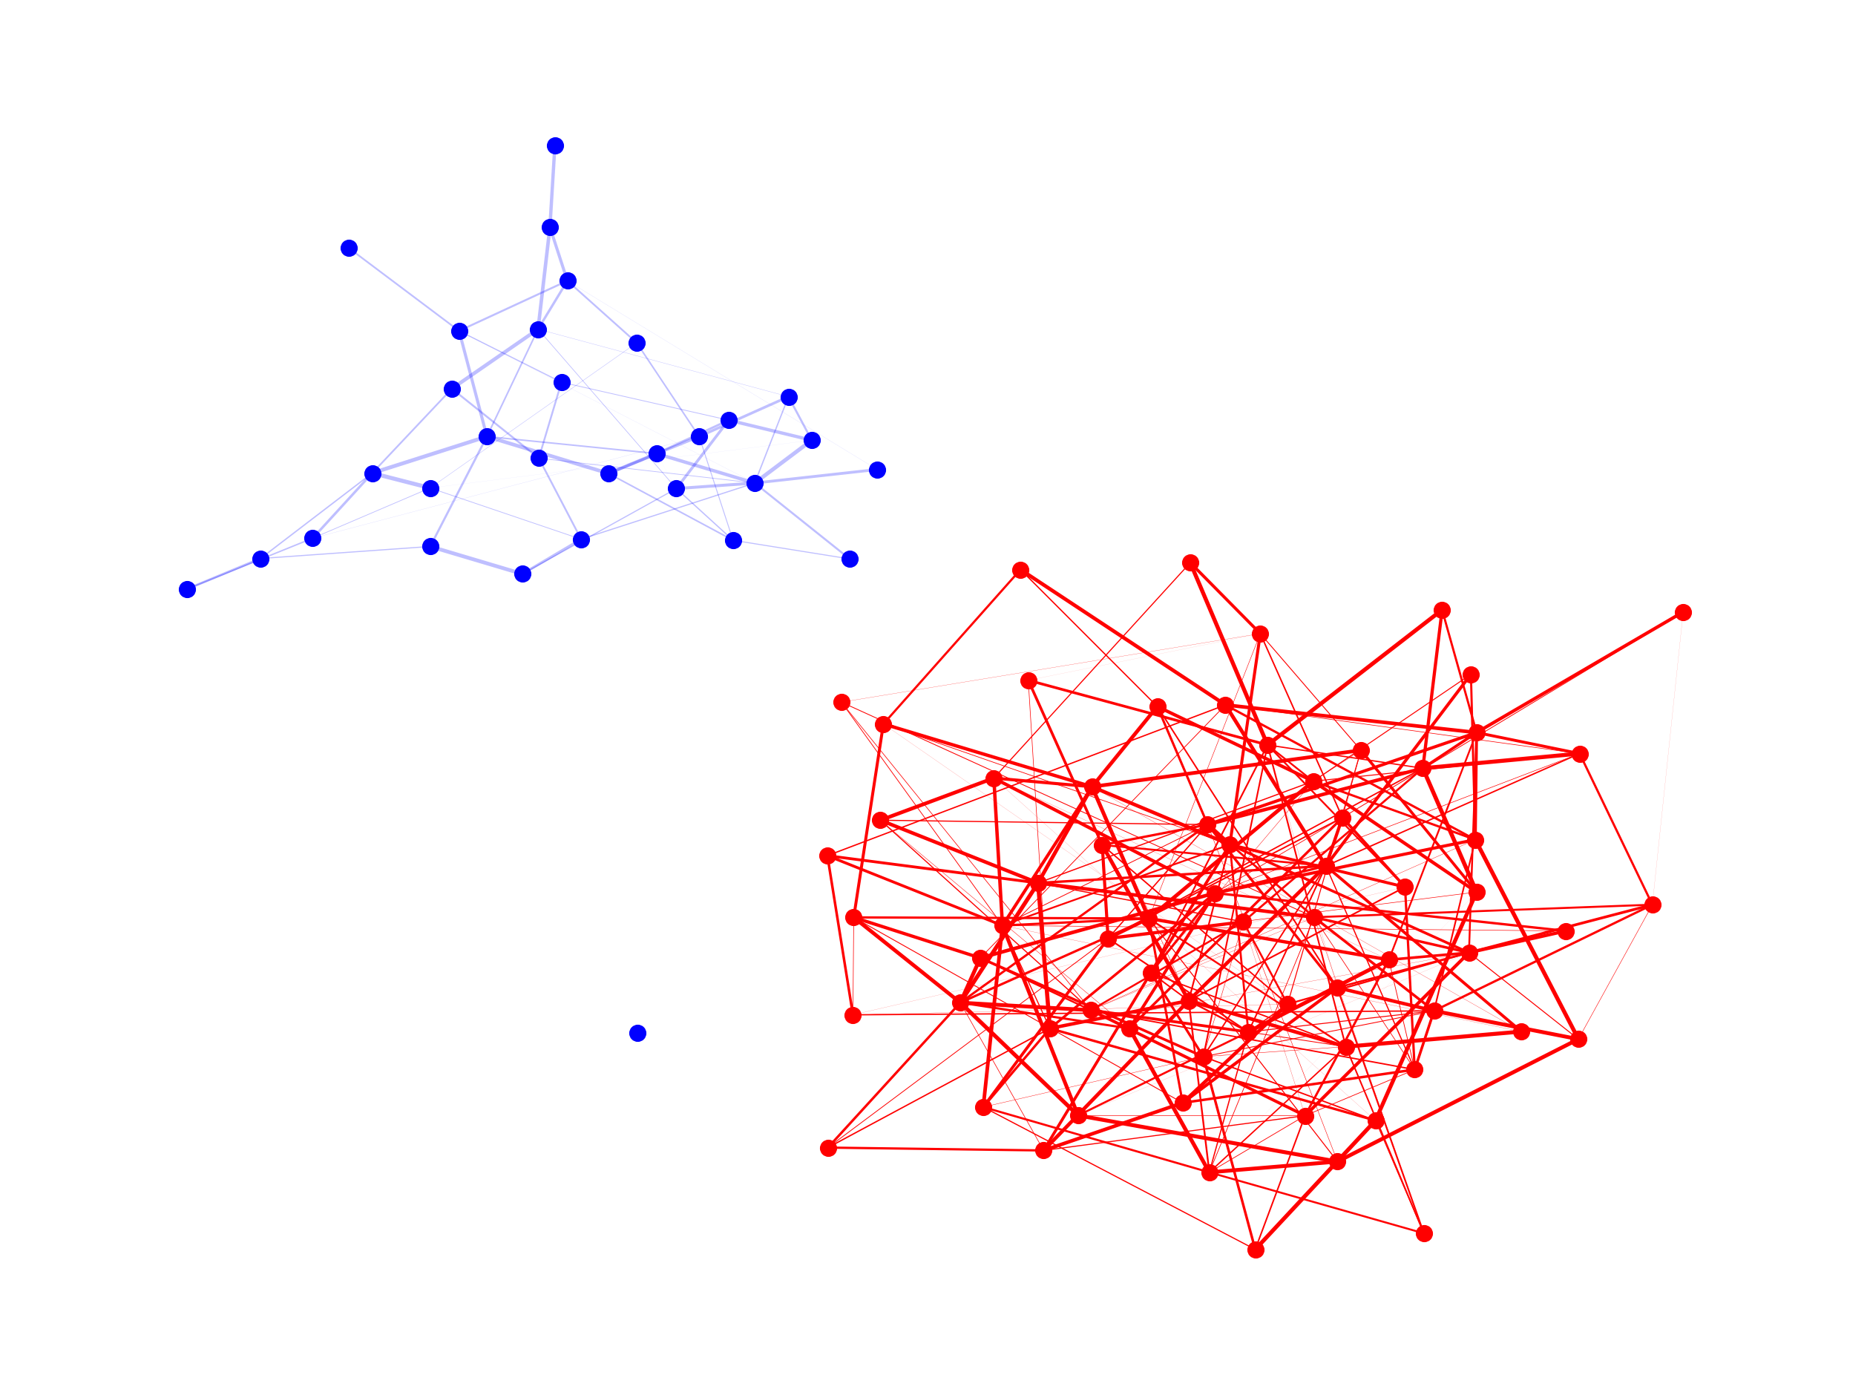


Weighted Stochastic Block Model
$$A_{ij}∣Z_{i}=1,Z_{j}=1\overset{ind}{∼}D\left(θ_{1,1}\right)$$
$$Θ=\left(\begin{matrix}θ_{0,0} & θ_{0,0} \\ θ_{0,0} & θ_{1,1}\end{matrix}\right)$$
INDY
Notes:
Those belonging to community $1$ are drawn from distribution $D$ theta 11

Slide 9
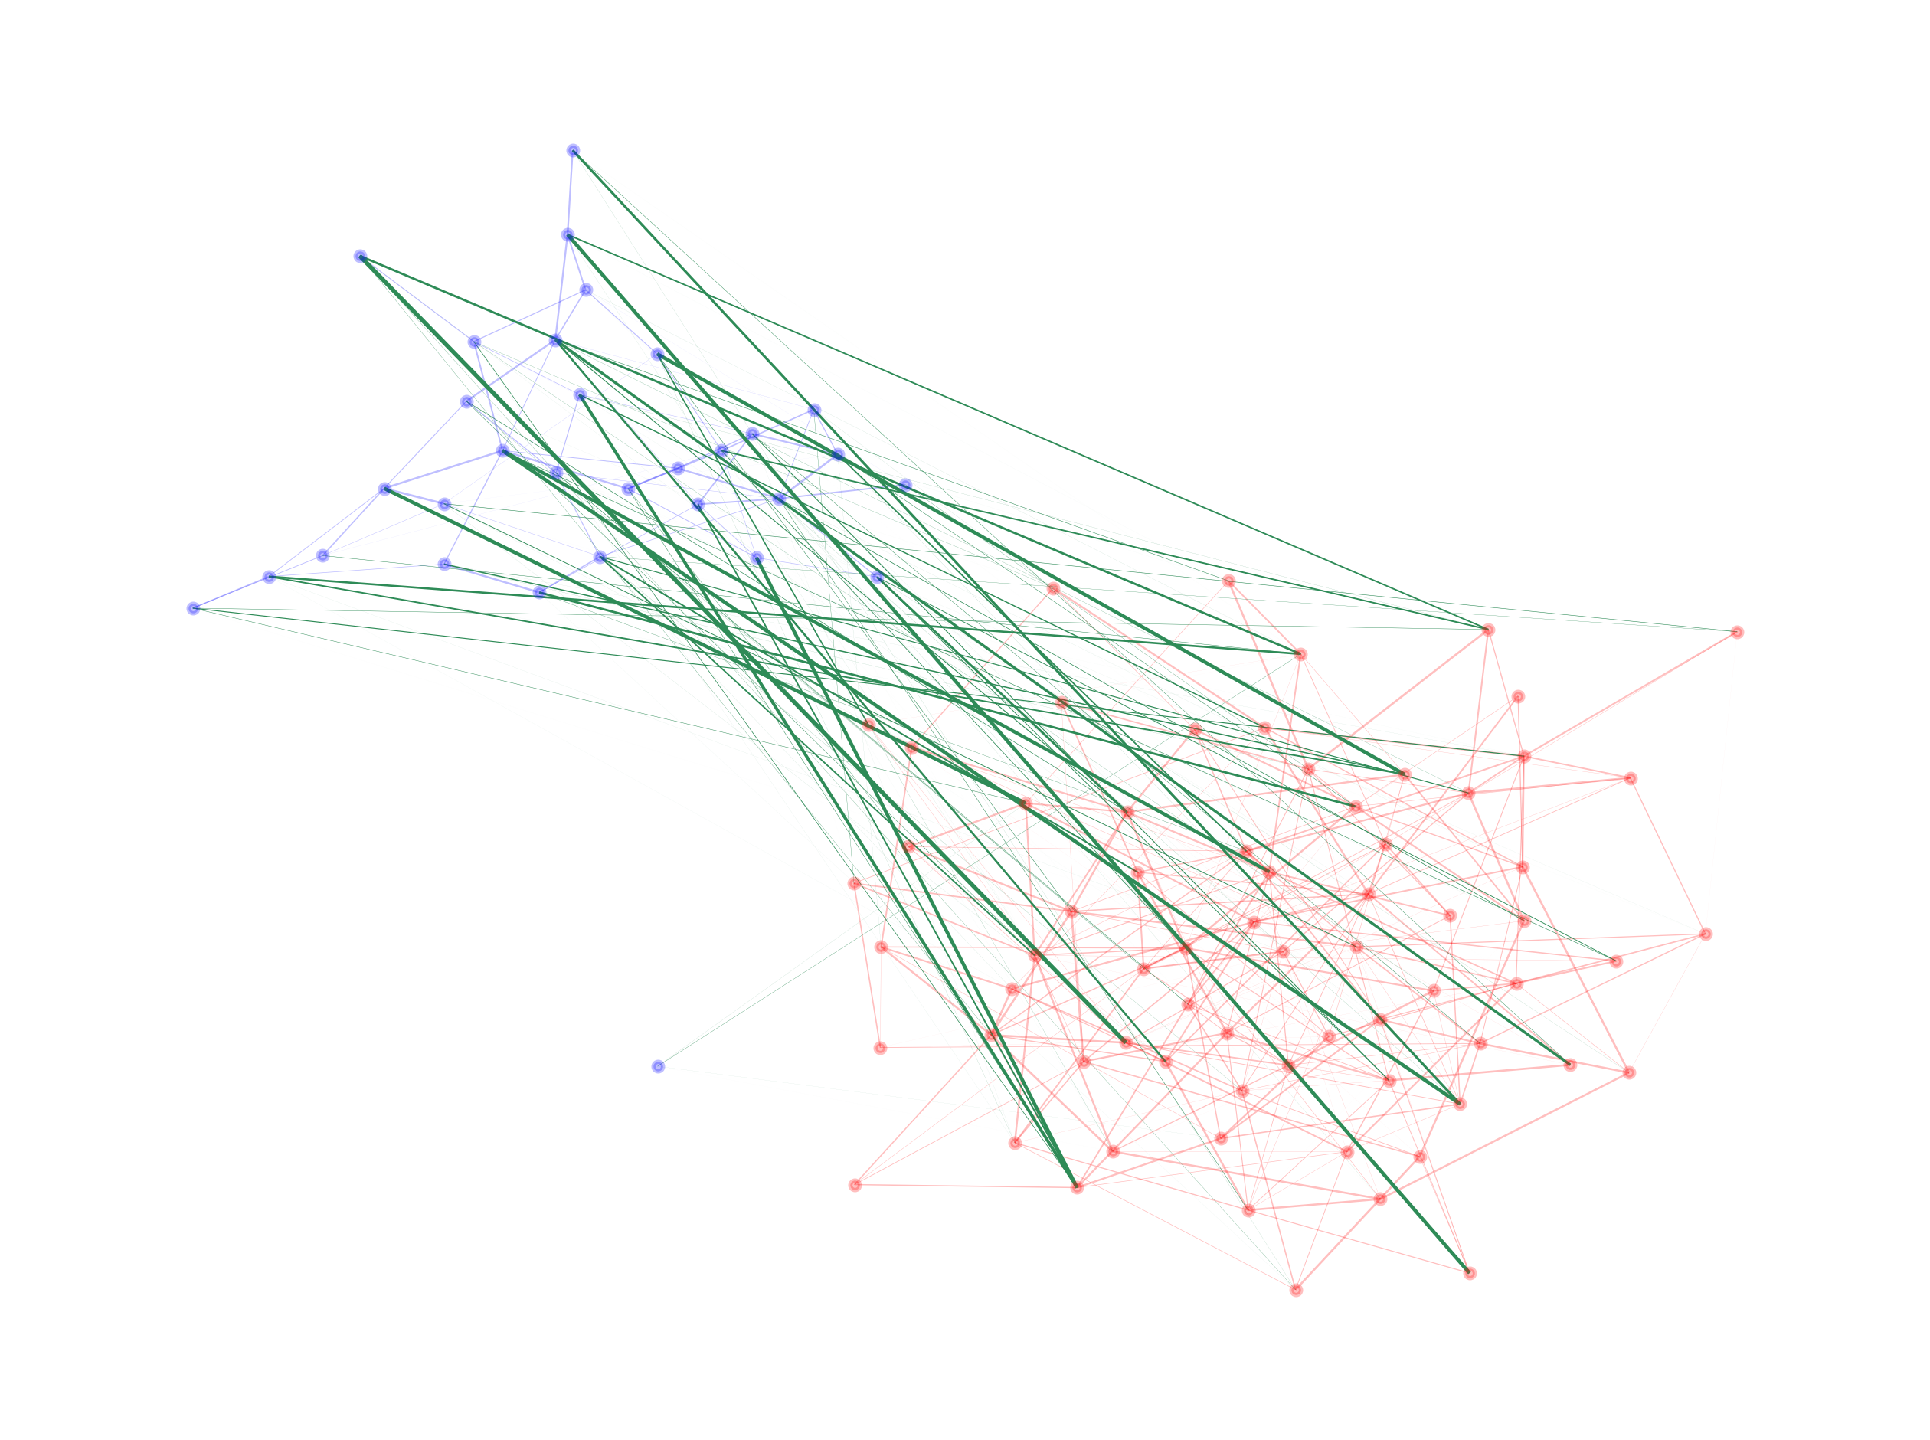


Weighted Stochastic Block Model
$$A_{ij}∣Z_{i}=0, Z_{j}=1\overset{ind}{∼}D\left(θ_{0,1}\right)$$
$$Θ=\left(\begin{matrix}θ_{0,0} & θ_{0,1} \\ θ_{1,0} & θ_{1,1}\end{matrix}\right)$$
INDY
Notes:
Whereas cross-community edges are controlled by parameter theta 01
In plain terms, the model is ideal for community modelling

Slide 10
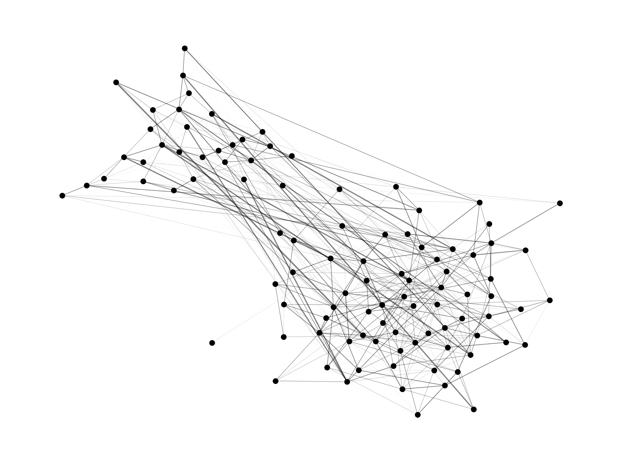
Weighted Stochastic Block Model
INDY
Notes:
Now, obviously, in testing or real-world settings, the parameters and community labels won’t necessarily be known

Slide 11

When only $A$ is observed, how can we recover the labelling $Z$?
INDY
Notes:
So how could we recover labelling $Z$ from weight matrix $A$ alone?

Slide 12
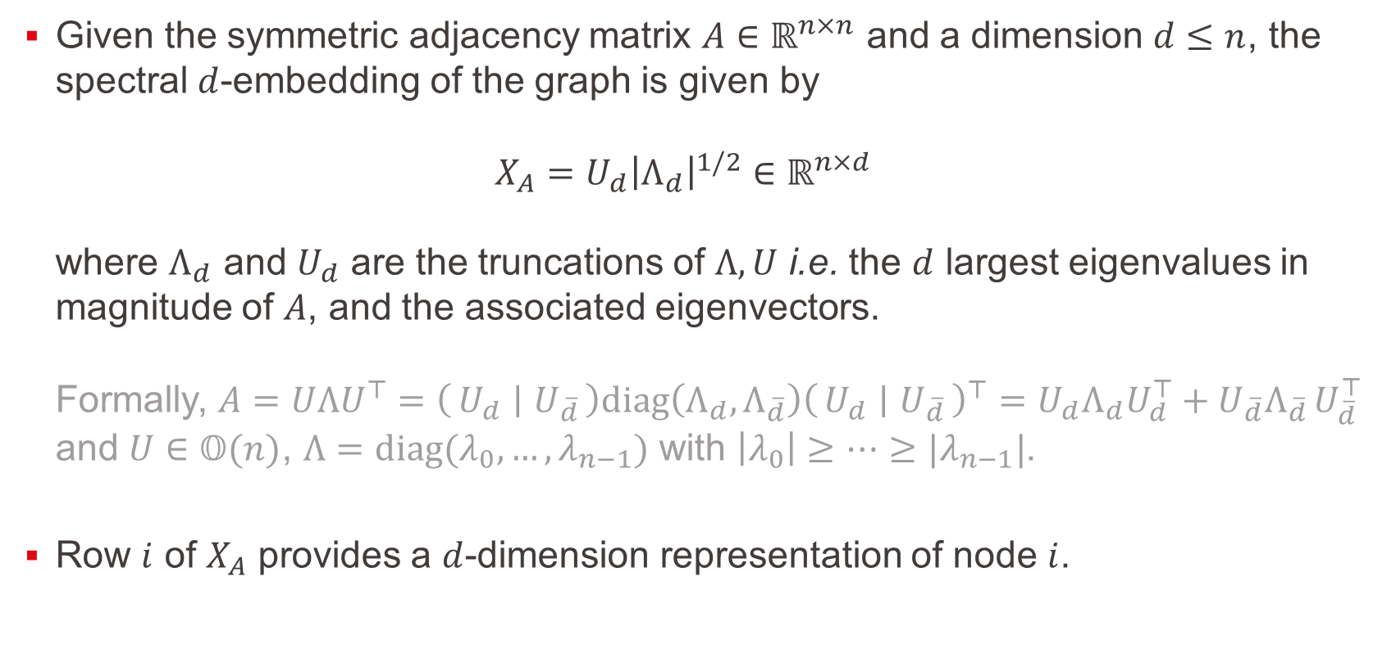
Spectral Embedding
Given the symmetric adjacency matrix $A∈ℝ^{n×n}$ and a dimension $d≤n$, the spectral $d$-embedding of the graph is given by $X_{A}=U_{d}{\left|Λ_{d}\right|}^{1/2}∈ℝ^{n×d}$ where $Λ_{d}$ and $U_{d}$ are the truncations of $Λ,U$ i.e. the $d$ largest eigenvalues in magnitude of $A$, and the associated eigenvectors. Formally, $A=UΛU^{⊤}=\left(U_{d} ∣ U_{\overline{d}}\right)diag\left(Λ_{d},Λ_{\overline{d}}\right){\left(U_{d} ∣ U_{\overline{d}}\right)}^{⊤}=U_{d}Λ_{d}U_{d}^{⊤}+U_{\overline{d}}Λ_{\overline{d} }U_{\overline{d}}^{⊤}$ and $U∈𝕆(n)$, $Λ=diag(λ_{0}, …, λ_{n−1})$ with $\left|λ_{0}\right|≥…≥|λ_{n−1}|$.
Row $i$ of $X_{A}$ provides a $d$-dimension representation of node $i$.
INDY
Notes:
One-way to do that is through Spectral Clustering
[1] We define the embedding of the graph as such. We consider the $d$ largest eigenvalues in magnitude of $A$,
and set the $d$-embedding to be the $d$ associated eigenvectors
[2] Row $i$ of $X_{A}$ provides a $d$-dimension representation of node $i$

Slide 13
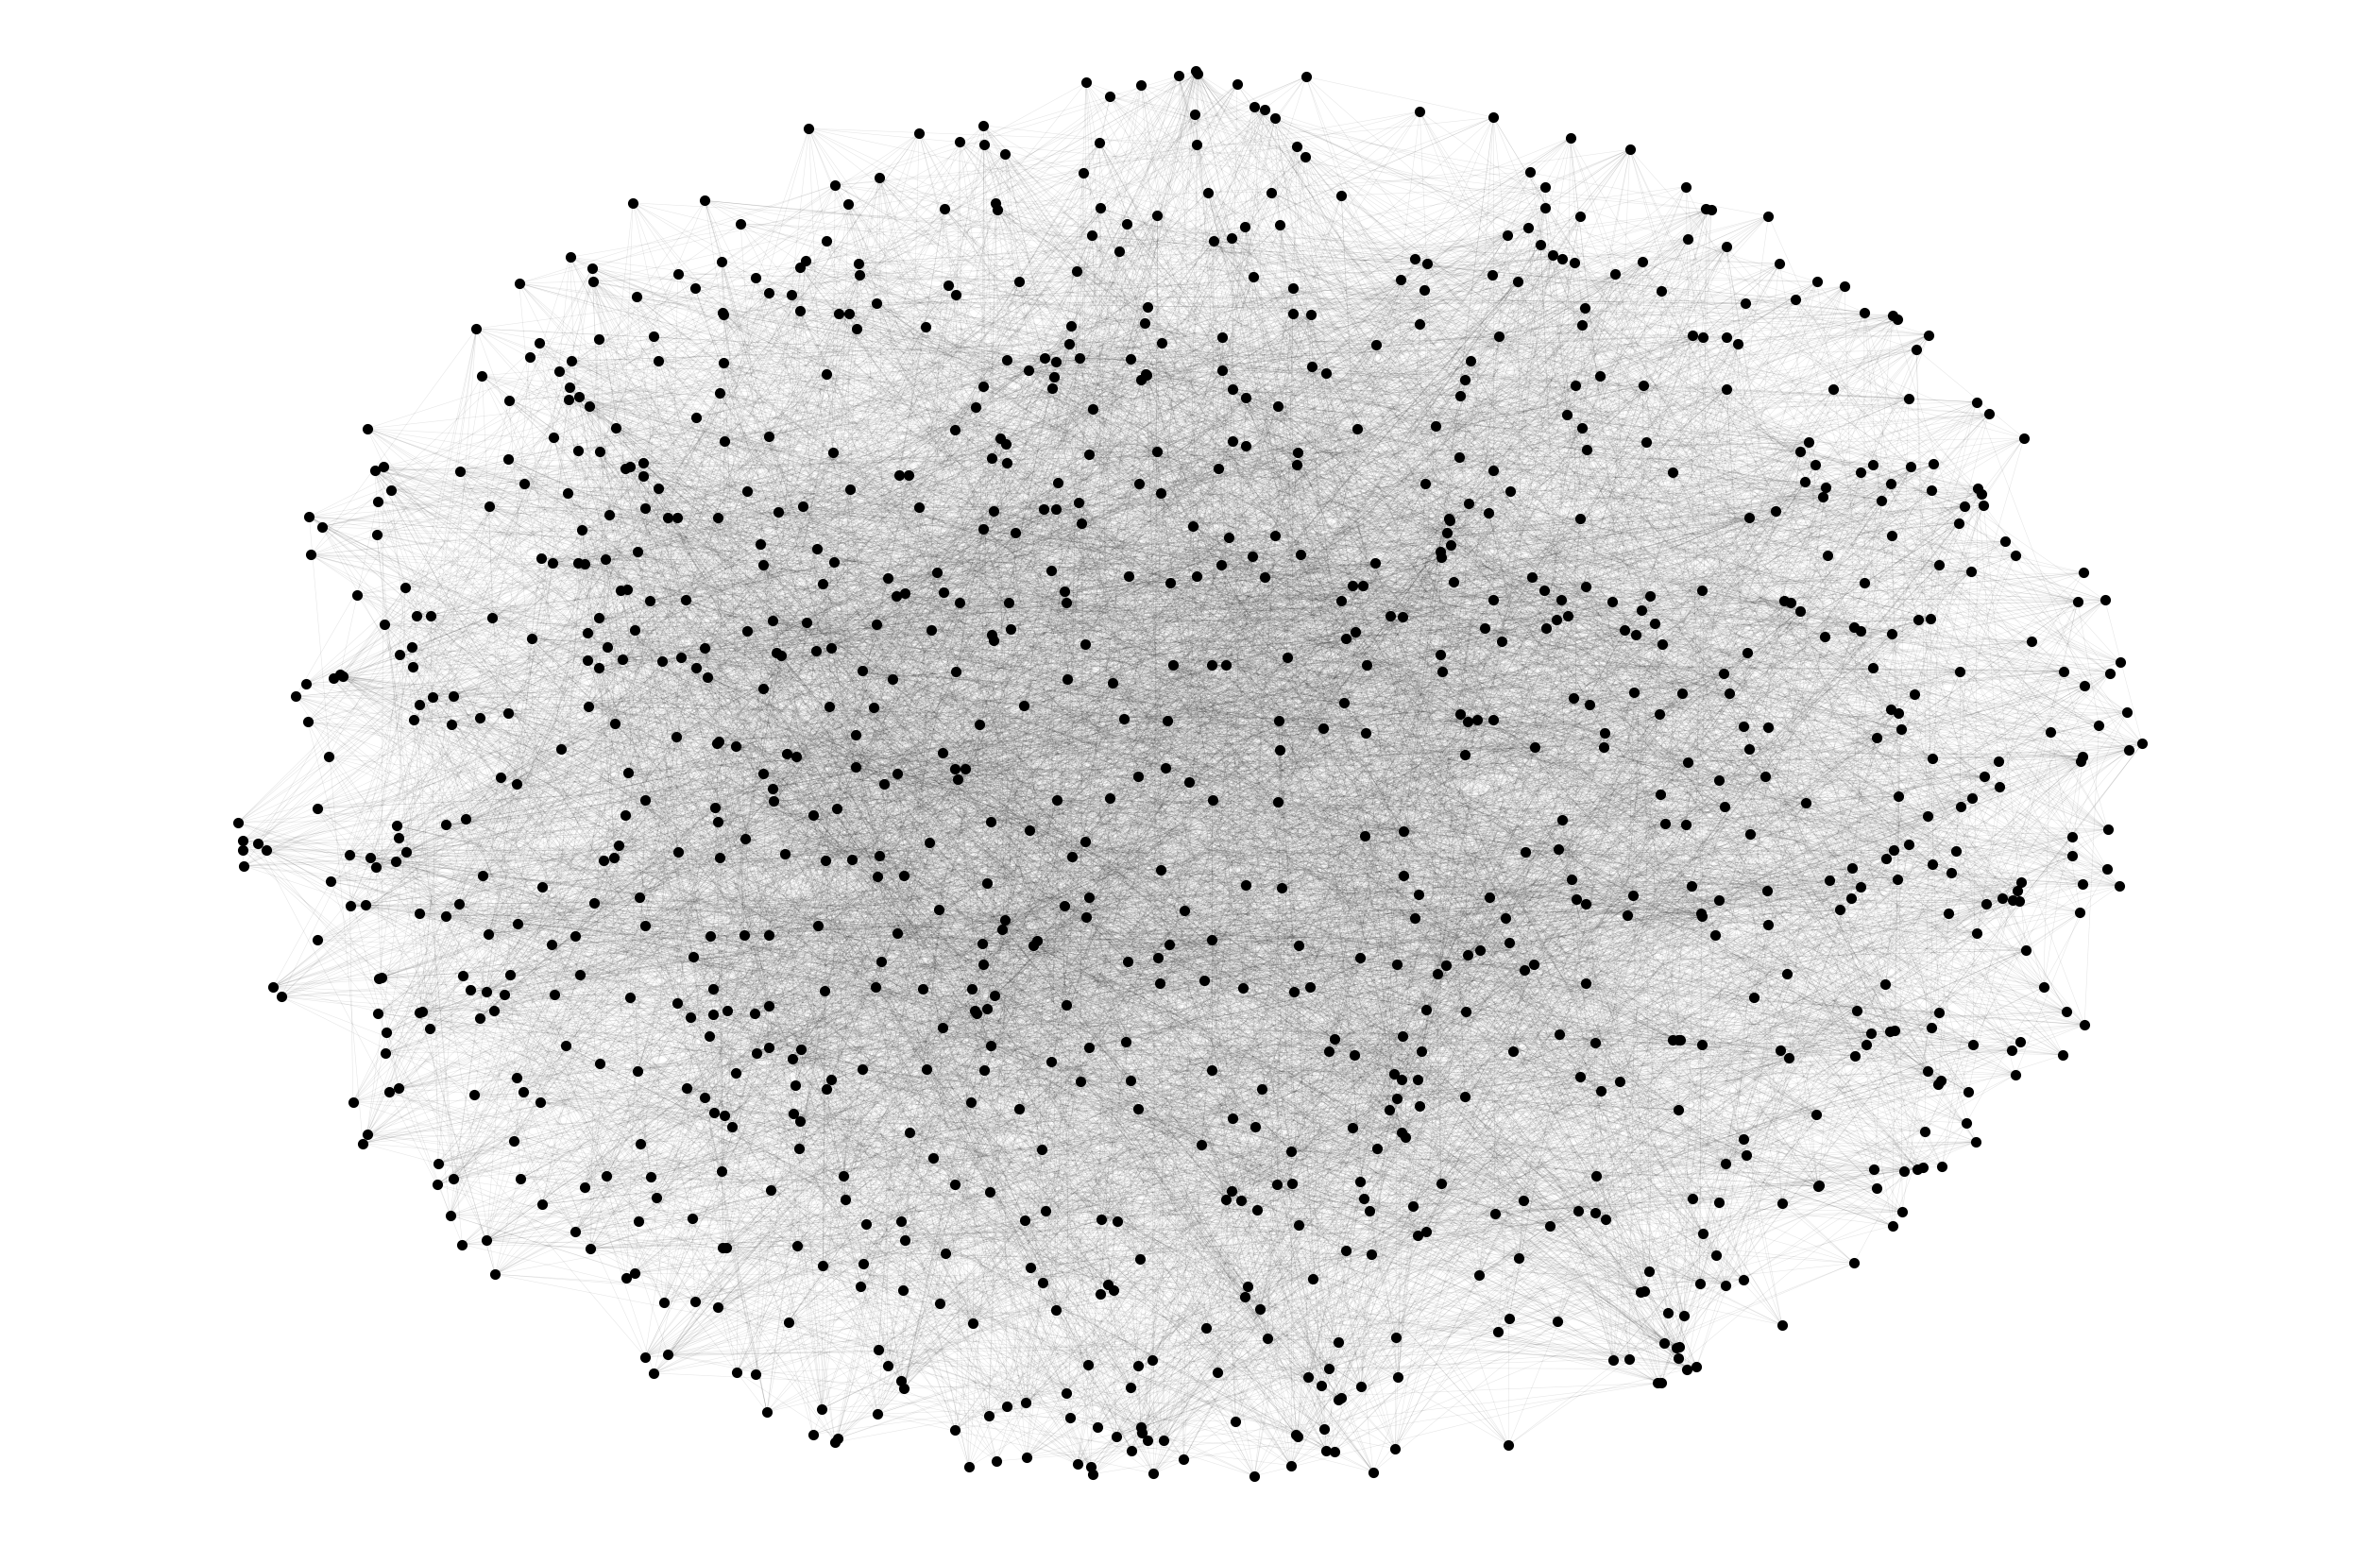

Spectral Embedding
$$A∈ℝ^{n×n}$$
INDY
Notes:
For example, if we consider this graph
by the way, quite hard to visualize as such, due to its size

Slide 14
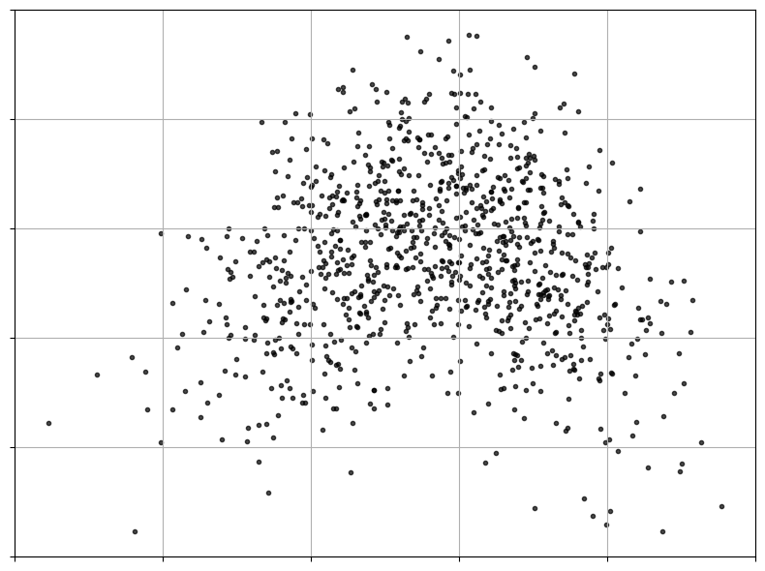


Spectral Embedding
$$X_{A}∈ℝ^{n×d}$$
INDY
$$ℝ^{d=2}$$
Notes:
Then, its spectral 2D embedding would like this
Strongly connected nodes map to nearby positions in the embedded space

Slide 15
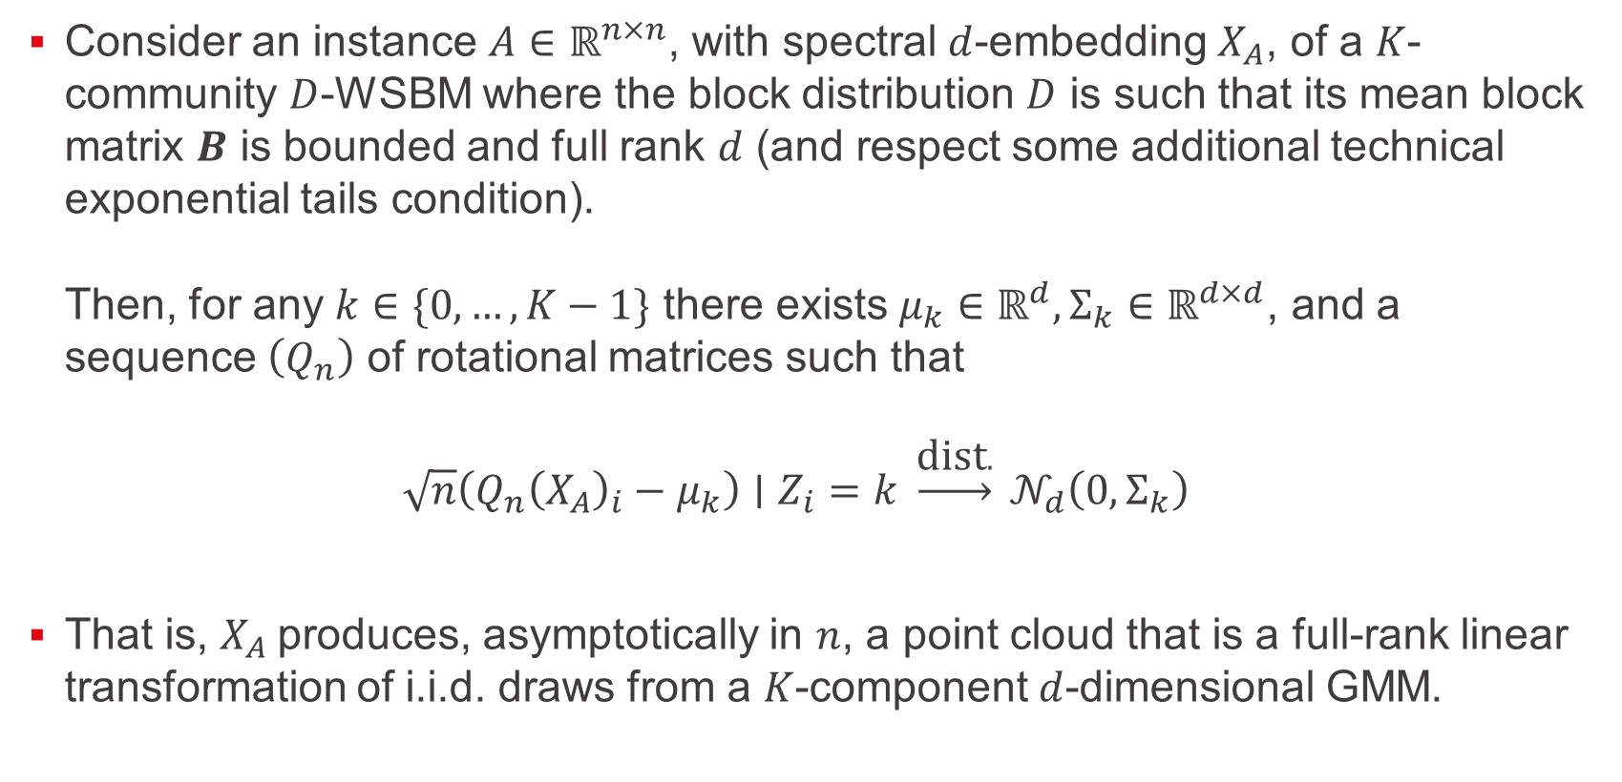
Central Limit Theorem – Corollary
Consider an instance $A∈ℝ^{n×n}$, with spectral $d$-embedding $X_{A}$, of a $K$-community $D$-WSBM where the block distribution $D$ is such that its mean block matrix $B$ is bounded and full rank $d$ (and respect some additional technical exponential tails condition). Then, for any $k∈\{0, …, K−1\}$ there exists $μ_{k}∈ℝ^{d}, Σ_{k}∈ℝ^{d×d}$, and a sequence $\left(Q_{n}\right)$ of rotational matrices such that $\sqrt{n}\left(Q_{n}{\left(X_{A}\right)}_{i}−μ_{k}\right)∣Z_{i}=k \underset{→}{\text{dist}.} 𝒩_{d}\left(0,Σ_{k}\right)$
That is, $X_{A}$produces, asymptotically in $n$, a point cloud that is a full-rank linear transformation of i.i.d. draws from a $K$-component $d$-dimensional GMM.
INDY
Notes:
Central Limit Theorem Corollary
[1] For nice block distribution $D$, the $d$-embedding of nodes belonging to the same community $k$
follow, asymptotically, a $d$-dimensional Gaussian distribution
[2] That is, the embedding $X_{A}$produces a point cloud
that is a full-rank linear transformation of i.i.d. draws from a $K$-component Gaussian Mixture Model

Slide 16
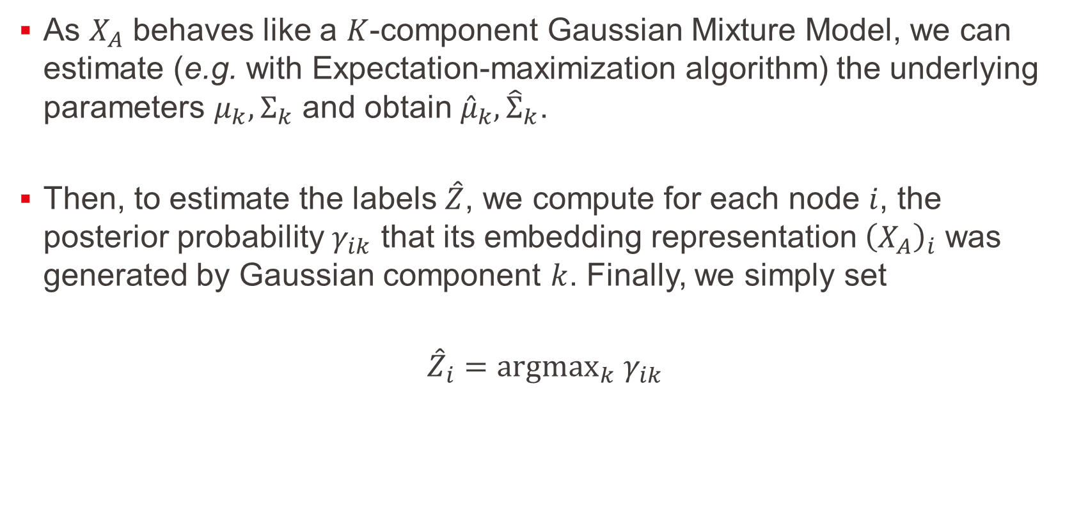
Spectral Clustering – GMM fitting
As $X_{A}$ behaves like a $K$-component Gaussian Mixture Model, we can estimate (e.g. with Expectation-maximization algorithm) the underlying parameters $μ_{k},Σ_{k}$ and obtain ${\hat{μ}}_{k},{\hat{Σ}}_{k}$.
Then, to estimate the labels $\hat{Z}$, we compute for each node $i$, the posterior probability $γ_{ik}$ that its embedding representation ${\left(X_{A}\right)}_{i}$ was generated by Gaussian component $k$. Finally, we simply set
$${\hat{Z}}_{i}={argmax}_{k} γ_{ik}$$
INDY
Notes:
We can empirically estimate the parameters $μ_{k},Σ_{k}$ from the point cloud $X_{A}$
[1] Then, to estimate the labels $\hat{Z}$, we compute for each node,
the posterior probability that its embedding representation was generated by Gaussian component $k$
And we choose as its label the community maximizing this probability

Slide 17
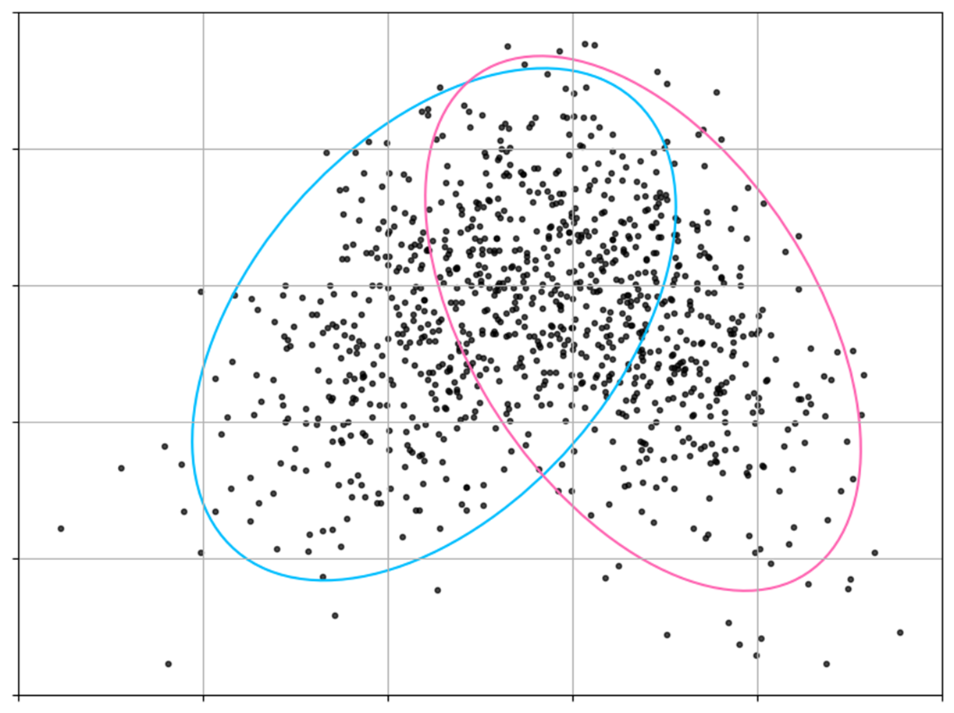
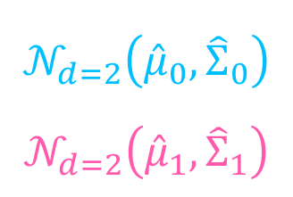
Spectral Clustering – GMM fitting
$$𝒩_{d=2}\left({\hat{μ}}_{0},{\hat{Σ}}_{0}\right)$$
$$𝒩_{d=2}\left({\hat{μ}}_{1},{\hat{Σ}}_{1}\right)$$
INDY
Notes:
Going back to our example – the GMM fitting looks like this, with these 2 Gaussian components

Slide 18
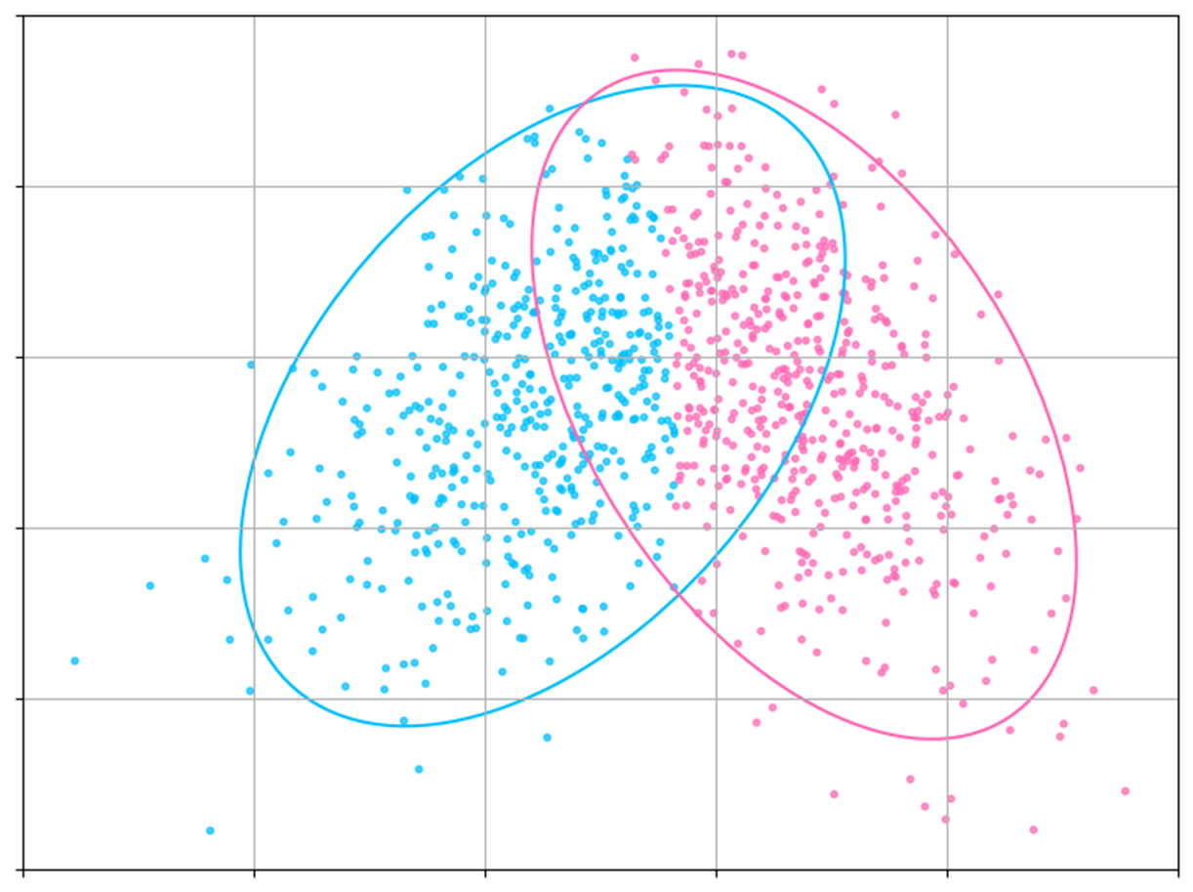
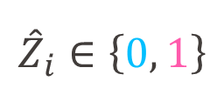
Spectral Clustering – GMM fitting
$${\hat{Z}}_{i}∈\left\{0, 1\right\}$$
INDY
Notes:
And the estimated labelling $\hat{Z}$ looks like this

Slide 19
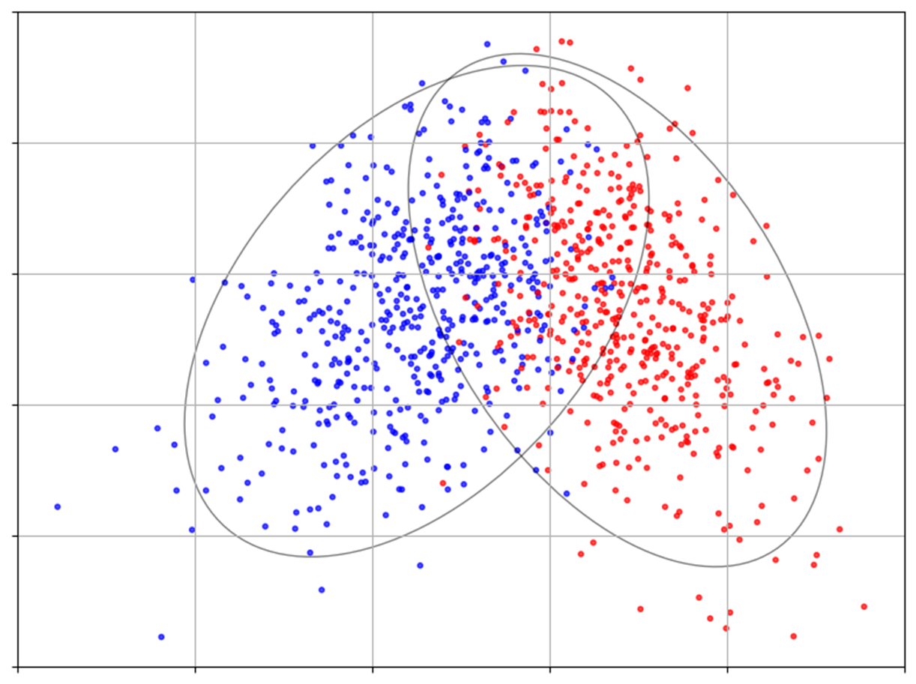
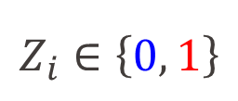
Spectral Clustering – GMM fitting
$$Z_{i}∈\left\{0, 1\right\}$$
INDY
Notes:
Which isn’t that bad, compared to the true labels

Slide 20
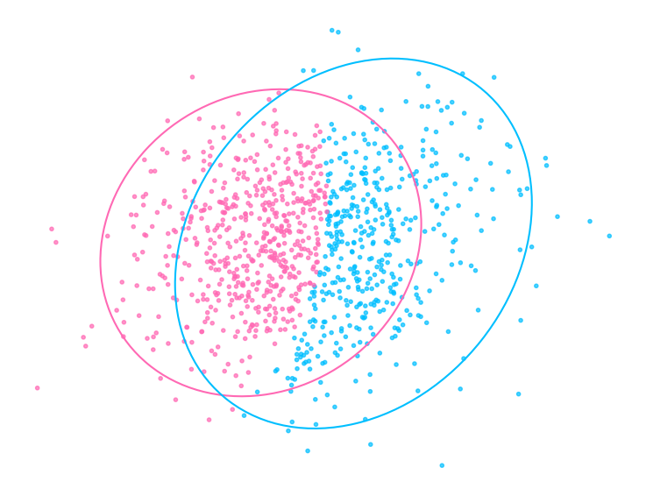
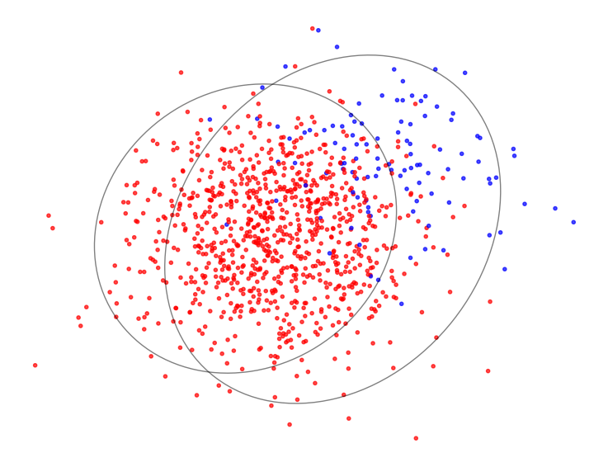


Spectral Clustering – GMM fitting
$$\hat{Z}$$
$$Z$$
INDY
Poor community separation and hence poor clustering Accuracy
Notes:
Obviously, it doesn’t always work
[1] Here the separation is not sufficient, and this leads to poor clustering Accuracy

Slide 21
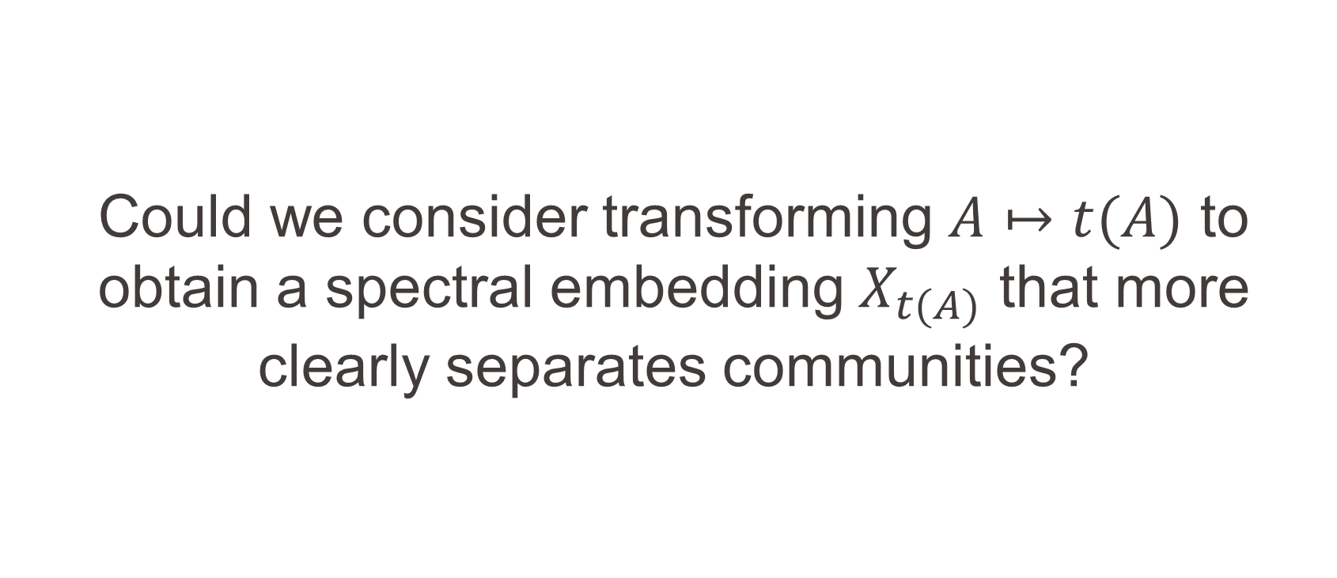
Could we consider transforming $A↦t(A)$ to obtain a spectral embedding $X_{t(A)}$ that more clearly separates communities?
INDY
Notes:
Could we consider transforming $A$ to obtain a spectral embedding that more clearly separates communities?

Slide 22
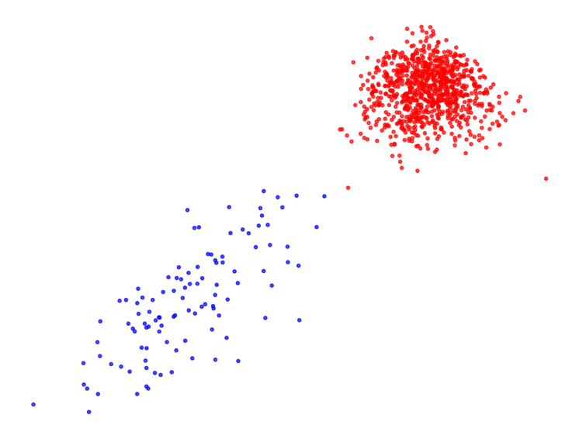
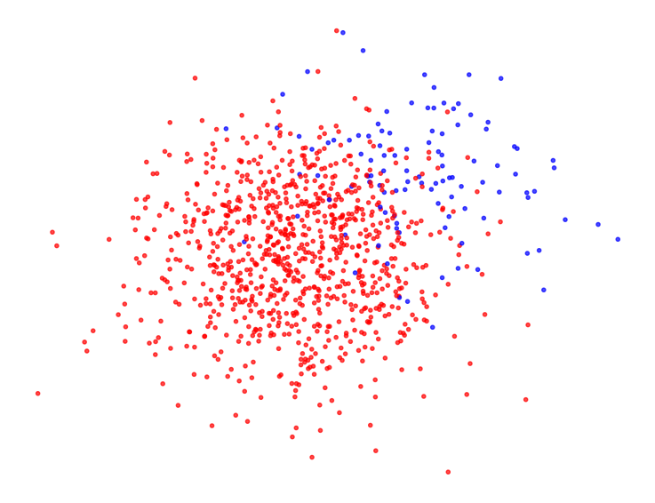




Weight Transformation
$t \text{: }A ↦\text{𝟙}(A≤τ)$
$$X_{t(A)}$$
$$X_{A}$$
INDY
Applying $t$ leads to a better community separation!
Notes:
Well. Sticking to our example,
[1] we can drastically improve community separation, by applying this Threshold transformation on $A$

Slide 23
How can we measure community separation?
INDY
Notes:
As we aim for a rigorous framework,
how can the concept of community separation be formally addressed?

Slide 24
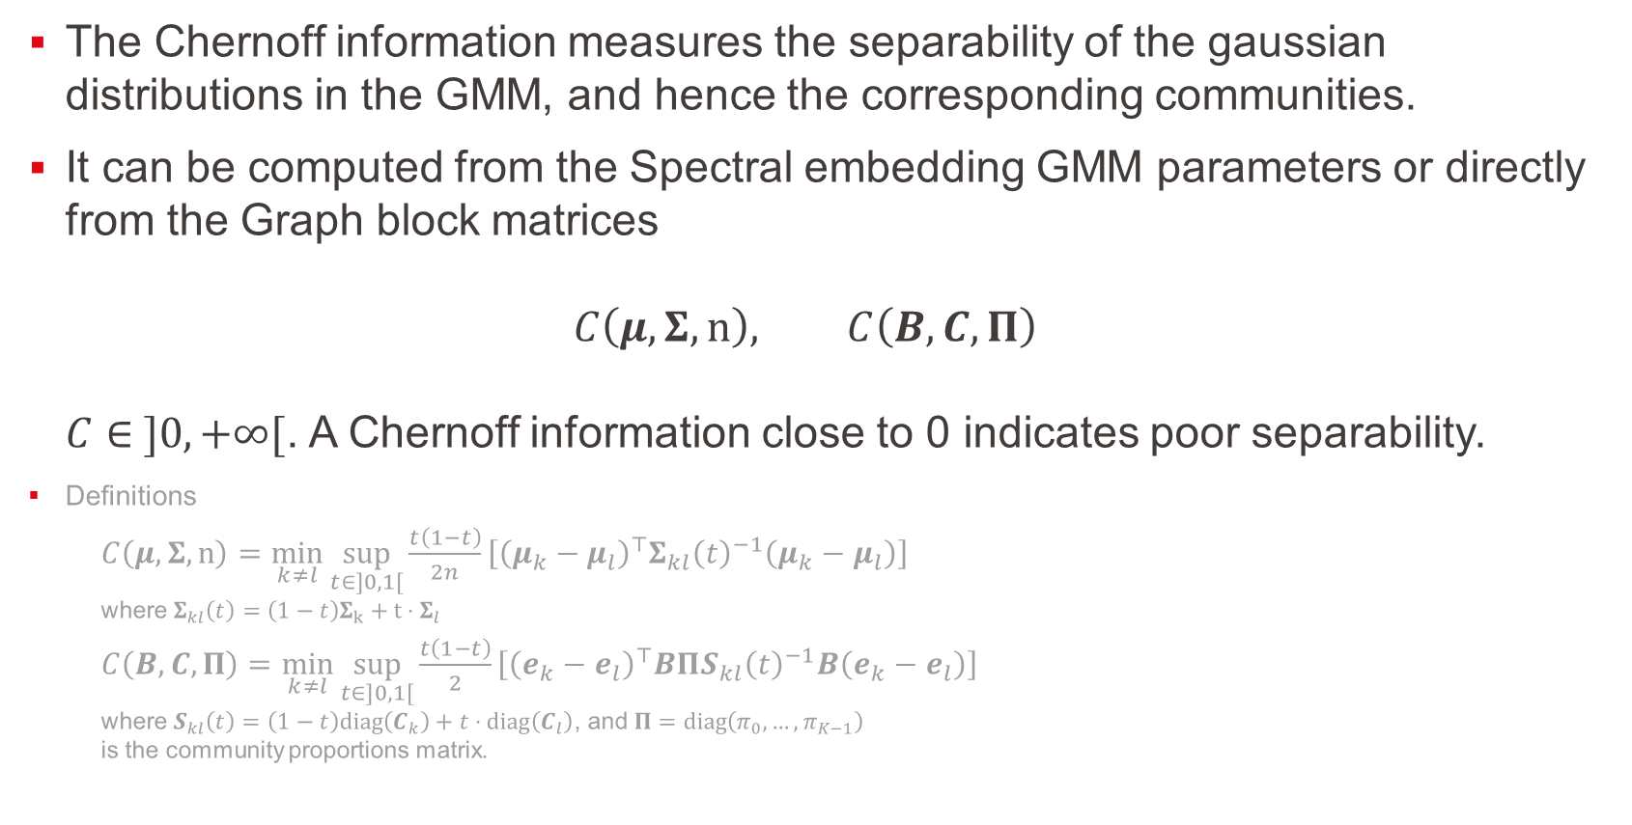
Separability measure – Chernoff Information
The Chernoff information measures the separability of the gaussian distributions in the GMM, and hence the corresponding communities.
It can be computed from the Spectral embedding GMM parameters or directly from the Graph block matrices $C\left(μ,Σ,n\right), C\left(B,C,Π\right)$ $C∈ ]0,+∞[$. A Chernoff information close to 0 indicates poor separability.
Definitions
$C\left(μ,Σ,n\right)=\min_{k≠l}{\sup_{t∈]0,1[}{\frac{t\left(1−t\right)}{2n}\left[{\left(μ_{k}−μ_{l}\right)}^{⊤}Σ_{kl}{\left(t\right)}^{−1}\left(μ_{k}−μ_{l}\right)\right]}}$ where $Σ_{kl}\left(t\right)=\left(1−t\right)Σ_{k}+t⋅Σ_{l}$
$C\left(B,C,Π\right)=\min_{k≠l}{\sup_{t∈]0,1[}{\frac{t\left(1−t\right)}{2}\left[{\left(e_{k}−e_{l}\right)}^{⊤}BΠS_{kl}{\left(t\right)}^{−1}B\left(e_{k}−e_{l}\right)\right]}}$ where $S_{kl}\left(t\right)=\left(1−t\right)diag\left(C_{k}\right)+t⋅diag\left(C_{l}\right)$, and $Π=diag\left(π_{0},…,π_{K−1}\right)$ is the community proportions matrix.
INDY
Notes:
Through Chernoff information!
[1] It measures the separability of the gaussian distributions in the GMM, and hence the corresponding communities
[2] It can be computed from the Spectral embedding GMM parameters or directly from the Graph block matrices
Chernoff information is non-negative. A value close to 0 indicates poor separability

Slide 25
Experimentation
INDY
Notes:
Now, regarding our testing

Slide 26
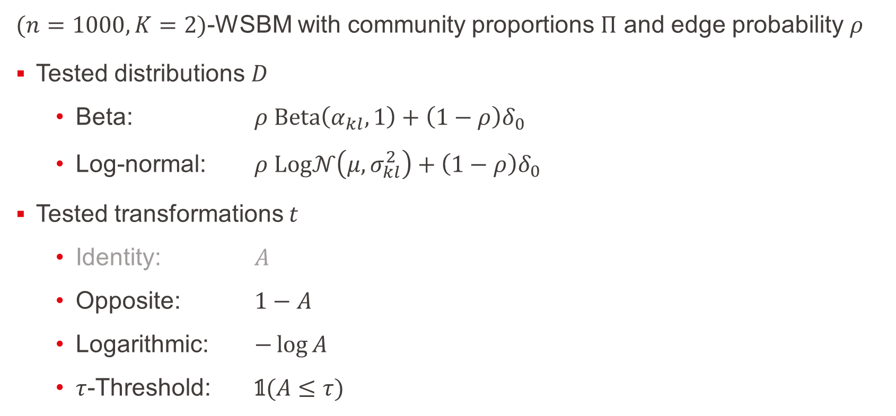
Experimental Setup
$(n=1000, K=2)$-WSBM with community proportions $Π$ and edge probability $ρ$
Tested distributions $D$
Beta: $ρ Beta\left(α_{kl},1\right)+\left(1−ρ\right)δ_{0}$
Log-normal: $ρ Log𝒩\left(μ,σ_{kl}^{2}\right)+\left(1−ρ\right)δ_{0}$
Tested transformations $t$
Identity: $A$
Opposite: $1−A$
Logarithmic: $−\log{A}$
$τ$-Threshold: $\text{𝟙}(A≤τ)$
INDY
Notes:
We initialized our 2 communities-WSBM with Beta and Log-normal edge distributions
[1] And analyzed the 3 following transformations: Opposite, Logarithmic and Threshold (as well as the Identity transformation)

Slide 27
Transformations accuracy analysis
Some results
INDY
Notes:
So,
what are the classification accuracies of our transformations for spectral clustering?

Slide 28
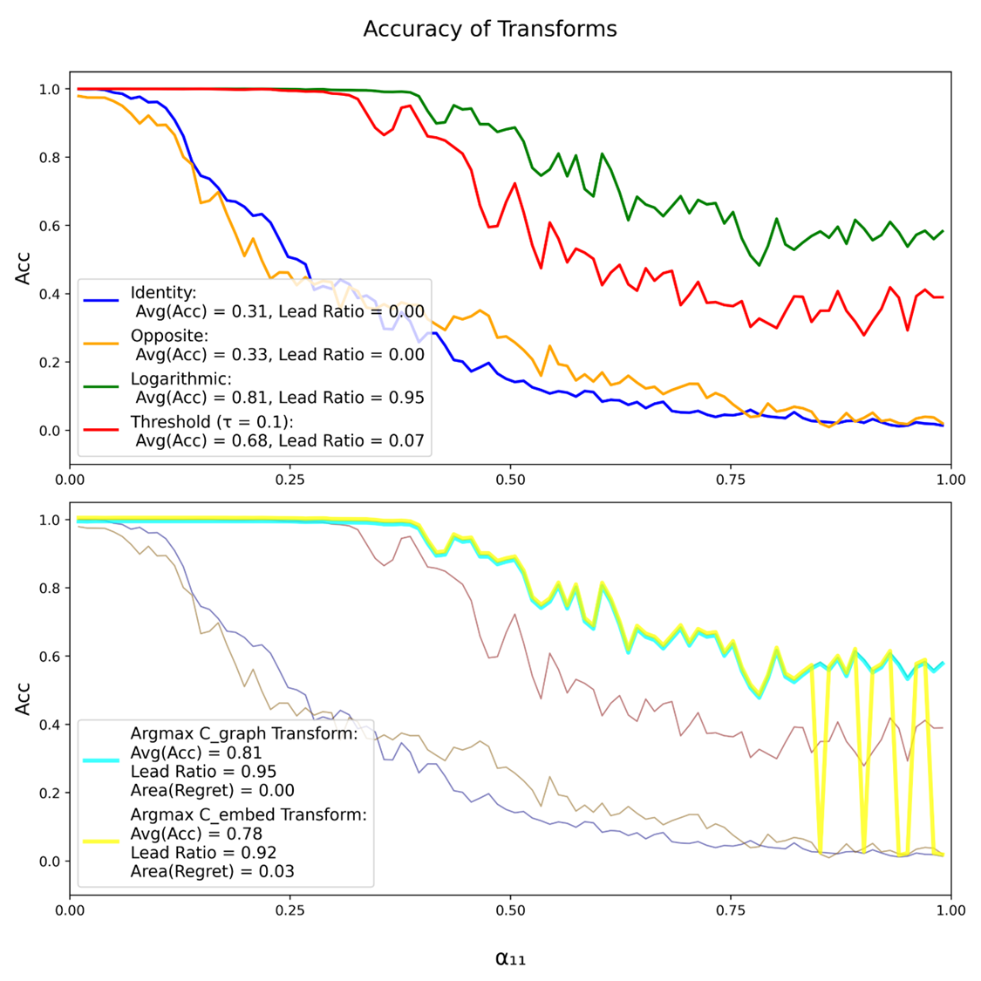
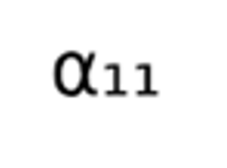
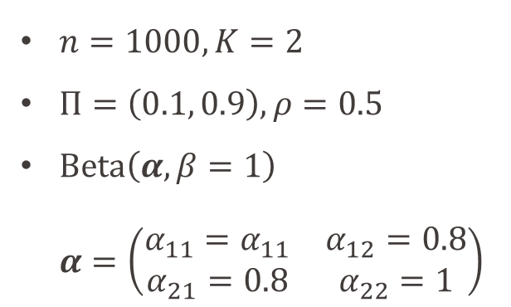

Transformations Accuracy
$n=1000, K=2$
$Π=\left(0.1, 0.9\right), ρ=0.5$
$Beta\left(α,β=1\right)$ $α=\left(\begin{matrix}α_{11}=α_{11} & α_{12}=0.8 \\ α_{21}=0.8 & α_{22}=1\end{matrix}\right)$
Avg of 20 samples $G∼WSBM({…;α}_{11})$
$α_{11}∈Linspace(0, 1, N=100)$
INDY
Notes:
First Example:
Here are plotted, for this Beta-Model, with fixed parameters, except for $α_{11}$ sliding between $[0, 1]$,
the clustering Accuracies of our 4 transformations
We see that the Threshold and Log transformations perform better than the Identity

Slide 29
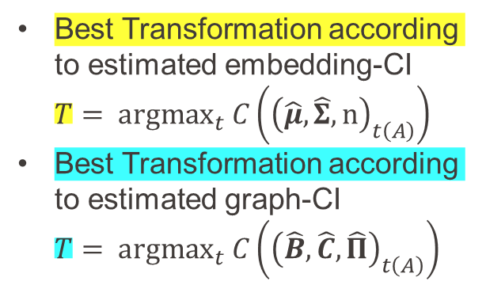
Transformations Accuracy
$n=1000, K=2$
$Π=\left(0.1, 0.9\right), ρ=0.5$
$Beta\left(α,β=1\right)$ $α=\left(\begin{matrix}α_{11}=α_{11} & α_{12}=0.8 \\ α_{21}=0.8 & α_{22}=1\end{matrix}\right)$
INDY
Best Transformation according to estimated embedding-CI $T= {argmax}_{t} C\left({\left(\hat{μ},\hat{Σ},n\right)}_{t\left(A\right)}\right)$
Best Transformation according to estimated graph-CI $T= {argmax}_{t} C\left({\left(\hat{B},\hat{C},\hat{Π}\right)}_{t\left(A\right)}\right)$
Notes:
We might also consider, dynamically, the Transformation yielding the best empirical Chernoff information
In yellow, is depicted the Transformation having the best Chernoff information, computed from the GMM estimated parameters,
while in blue, is the one with the best Chernoff information, computed from the empirical block mean and variance matrices

Slide 30
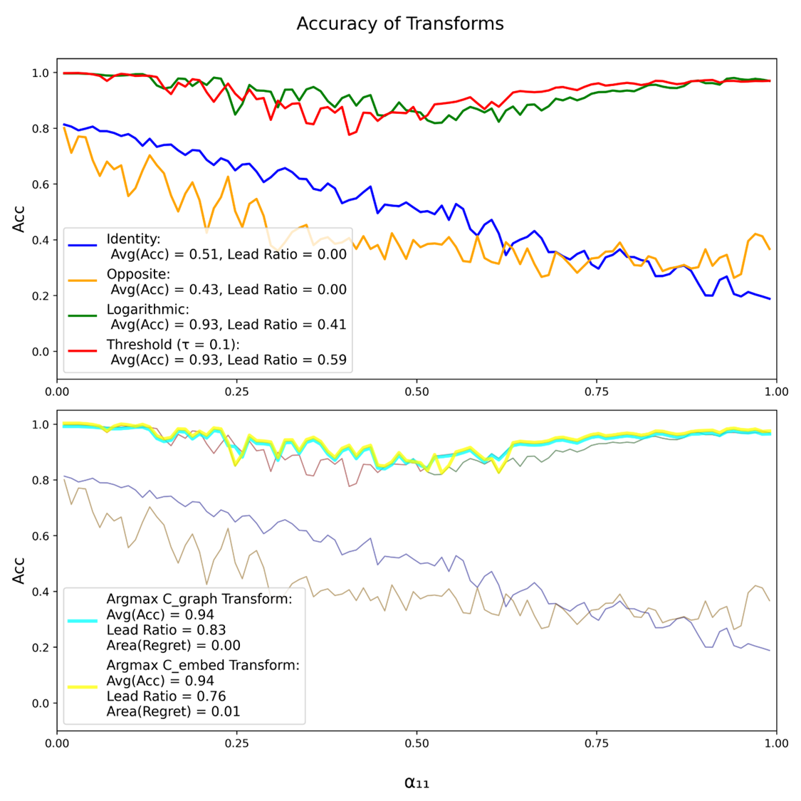
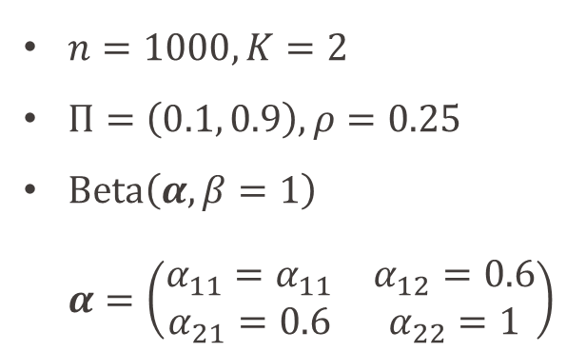
Transformations Accuracy
$n=1000, K=2$
$Π=\left(0.1, 0.9\right), ρ=0.25$
$Beta\left(α,β=1\right)$ $α=\left(\begin{matrix}α_{11}=α_{11} & α_{12}=0.6 \\ α_{21}=0.6 & α_{22}=1\end{matrix}\right)$
INDY
Notes:
In this other parameters setting (less edges and less variance in the cross-community edges),
the Threshold and Log transformations achieve Accuracy close to 1
significatively better than when no Transformation is applied

Slide 31
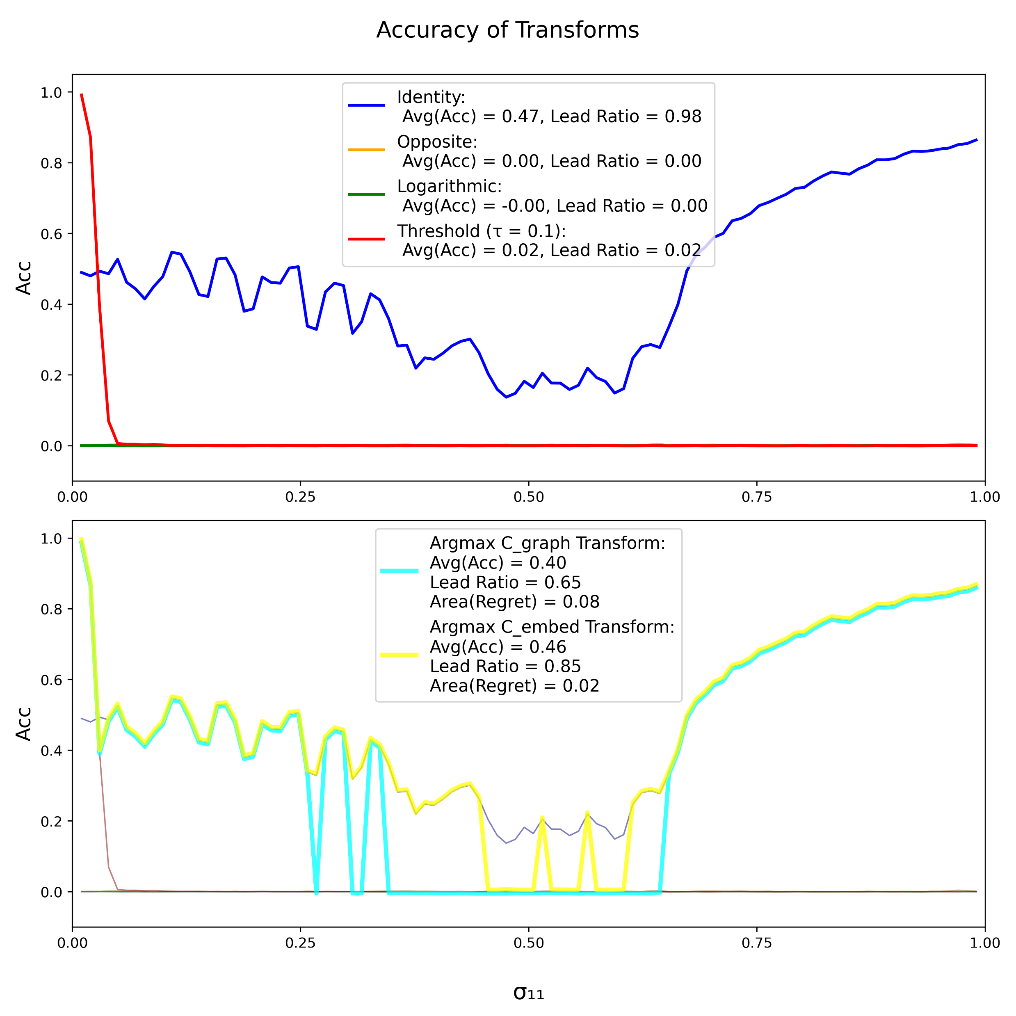
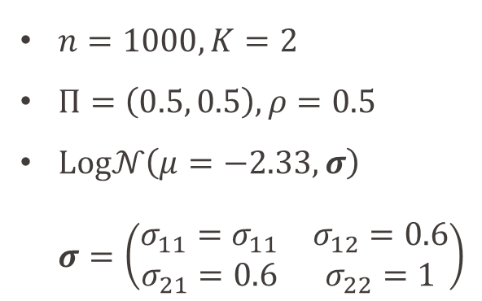
Transformations Accuracy
$n=1000, K=2$
$Π=\left(0.5, 0.5\right), ρ=0.5$
$Log𝒩\left(μ=−2.33, σ\right)$ $σ=\left(\begin{matrix}σ_{11}=σ_{11} & σ_{12}=0.6 \\ σ_{21}=0.6 & σ_{22}=1\end{matrix}\right)$
INDY
We may find models where the studied non-trivial transformations are not suited.
Notes:
Here, to the contrary, for the Log-normal Model with balanced community size
[1] applying a transformation, which is not the identity, worsens drastically the clustering Accuracy

Slide 32
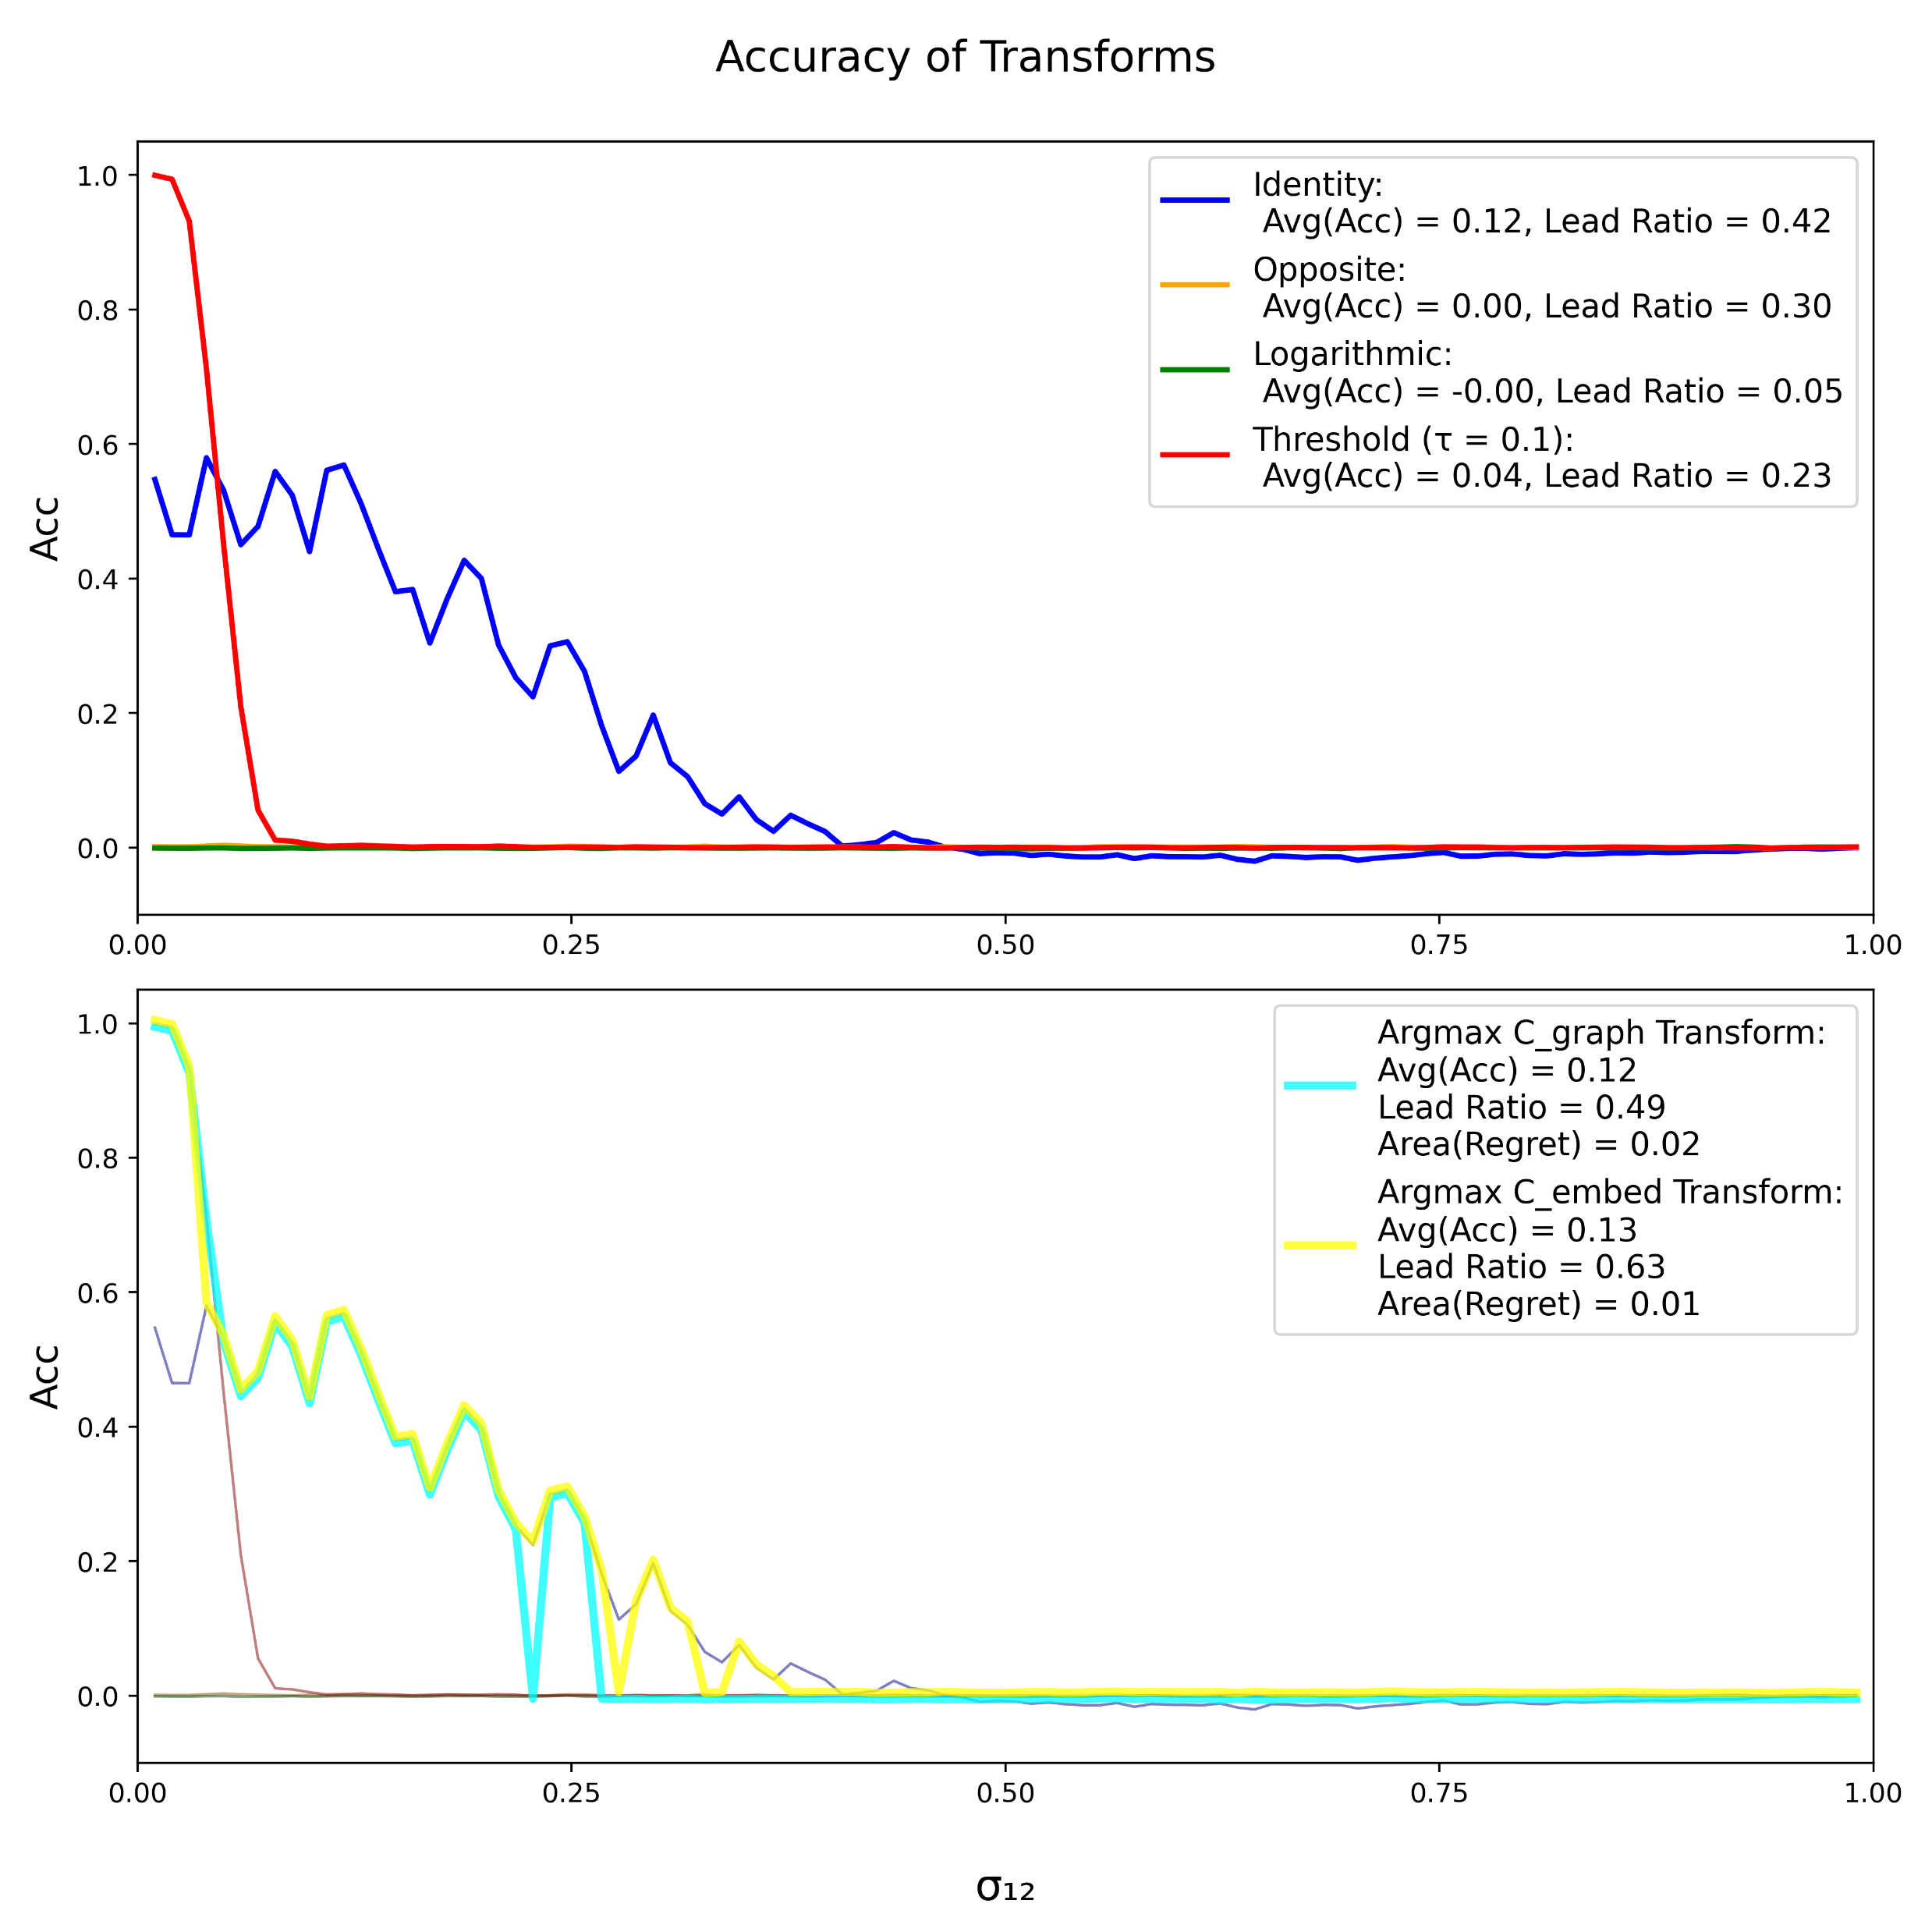
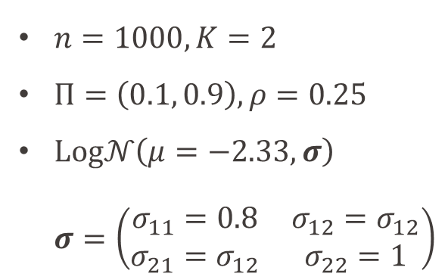
Transformations Accuracy
$n=1000, K=2$
$Π=\left(0.1, 0.9\right), ρ=0.25$
$Log𝒩\left(μ=−2.33, σ\right)$ $σ=\left(\begin{matrix}σ_{11}=0.8 & σ_{12}=σ_{12} \\ σ_{21}=σ_{12} & σ_{22}=1\end{matrix}\right)$
INDY
For some models, community separation seems intrinsically hard.
Notes:
For some models, community separation seems intrinsically hard As we can see, on the $[0.5, 1]$ segment, no Transformation seems to produce good accuracy

Slide 33
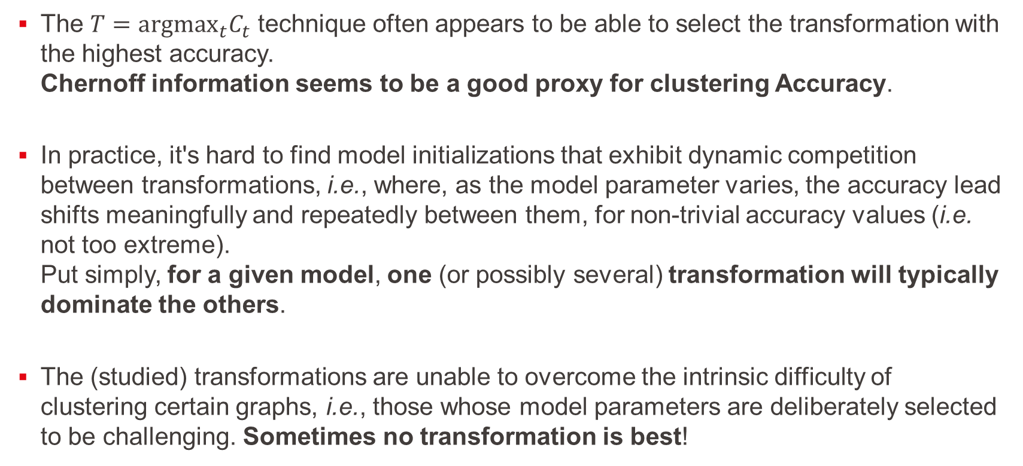
Preliminary observations
The $T={argmax}_{t}C_{t}$ technique often appears to be able to select the transformation with the highest accuracy. Chernoff information seems to be a good proxy for clustering Accuracy.
In practice, it's hard to find model initializations that exhibit dynamic competition between transformations, i.e., where, as the model parameter varies, the accuracy lead shifts meaningfully and repeatedly between them, for non-trivial accuracy values (i.e. not too extreme). Put simply, for a given model, one (or possibly several) transformation will typically dominate the others.
The (studied) transformations are unable to overcome the intrinsic difficulty of clustering certain graphs, i.e., those whose model parameters are deliberately selected to be challenging. Sometimes no transformation is best!
INDY
Notes:
Some observations [1] Chernoff information seems to be a good proxy for clustering Accuracy
[2] For a given model, one or possibly several transformations will typically dominate the others
[3] Some graphs remain hard to cluster and Transformations are of no use

Slide 34
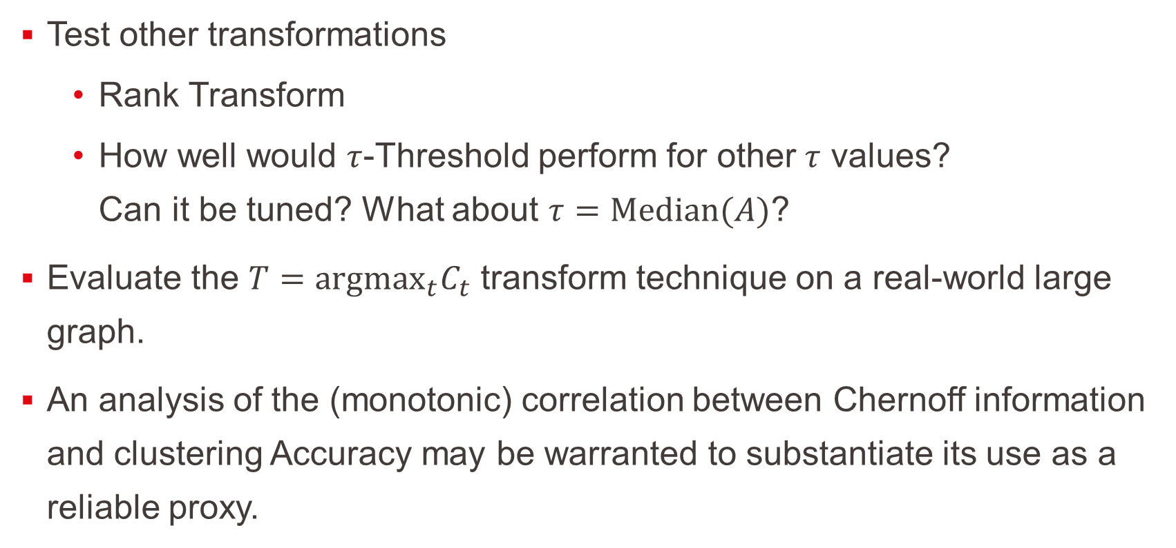
What’s next?
Test other transformations
Rank Transform
How well would $τ$-Threshold perform for other $τ$ values? Can it be tuned? What about $τ=Median(A)$?
Evaluate the $T={argmax}_{t}C_{t}$ transform technique on a real-world large graph.
An analysis of the (monotonic) correlation between Chernoff information and clustering Accuracy may be warranted to substantiate its use as a reliable proxy.
INDY
Notes:
What’s next?
[1] We might test other transformations. For example, the Threshold with other $τ$ initialization (or dynamic adaptation)
[2] We could try the Chernoff information argmax technique on a real-world large graph
[3] We may also inspect how well Chernoff information is correlated to clustering Accuracy

Slide 35
References
Ian Gallagher, Andrew Jones, Anna Bertiger, Carey E. Priebe & Patrick Rubin-Delanchy (2024) Spectral Embedding of Weighted Graphs, Journal of the American Statistical Association, 119:547, 1923-1932, DOI: 10.1080/01621459.2023.2225239
Joshua Cape, Xianshi Yu, & Jonquil Z. Liao (2024). Robust spectral clustering with rank statistics. arXiv preprint arXiv:2408.10136. https://doi.org/10.48550/arXiv.2408.10136
INDY
Notes:
Here are the main references

Slide 36
Thank you!
INDY
Notes:
And this concludes my presentation
Thank you

