Slide 1
Dataset
Historical Stock Prices: This data contains minute-level historical prices in the past 5 years for 86 companies.
News articles: This data contains 29630 news articles, each of which corresponds to a specific company (e.g., Apple Inc.). The news articles are categorized by company name. Each article includes four fields: “title”, “full text”, “URL” and “publish time”.
Notes:
Therefore in this project, we applied this method on our own dataset/
It includes two kinds of dataset
One is Historical Stock Prices from 86 companies.
And the other is their corresponsing news aticles.

Slide 2
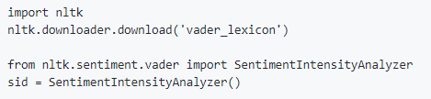
News Articles Preprocess
Feature engineering
Sentiment analysis using VADER
A sentiment lexicon is a list of lexical features (e.g., words) which are generally labelled according to their semantic orientation as either positive or negative.
Generate the sentiment score for each company per day.
Notes:
Of course, we need to preprocess these new articles.
First of all, we do some feature engineering, including filling the null data, and some stop words operation.
Then, as shamal introduces, we made
Sentiment Analysis, is a sub-field of Natural Language Processing (NLP) that tries to identify and extract opinions within a given text. The aim of sentiment analysis is to gauge the attitude, sentiments, evaluations, and emotions of a writer based on the computational treatment of subjectivity in a text.
VADER has been found to be quite successful when dealing with social media texts because VADER not only tells about the Positivity and Negativity score but also tells us about how positive or negative a sentiment is.
When you so sentiment abalysiis, you need to use the nltk packgage.

Slide 3
Objective
To compare how news articles from different companies contribute to the prediction of a specific company.
Boeing Company (BA) – 1365 days
BA Stock prediction with sentiment scores from BA
BA Stock prediction with sentiment scores from all 81 companies
BA Stock prediction without any sentiment score
BA Stock prediction with sentiment scores from BA - no noise
Notes:
In this project,
Specifically, we predict the stock price of boeing company.
We have four experiments in total.

Slide 4
Some other preprocess
Minute to days
Union sentiment analysis and stock price according to days
Add noise to the sentiment score -> improve the model robustness
Notes:
As the stock price is based on minutes, we choose the last day point as the close price for each day.
Something mentioned in this paper.

Slide 5
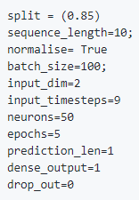
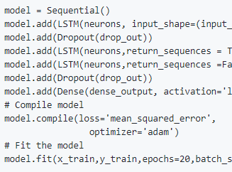
Model
Parameter details:
Model details:
Notes:
Basically, we have three LSTM layers, and one last dense layer,
and the optimizer is adam.
We use the same models for all three experiements

Slide 6
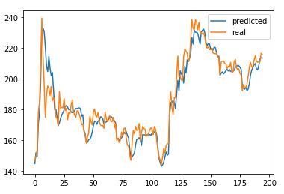
Result 1
On the testing dataset
MSE = 57.95
Mean error percent (MEP)= 0.028
Accuracy = 1 – MEP = 0.972
Conclusion 1: Good stock prediction by using the article news from that specific company.
Notes:
Result 1 that is to predici BA stock price using its historical stock price and its own article news.
We calculate MSE score, mean error percent and accuracy here.
The right image visualize the predicted stock price and the real stock price.

Slide 7
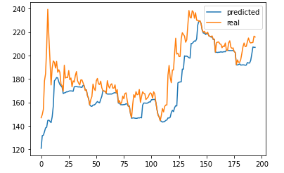
Result 2
On the testing dataset
MSE = 369.50
Mean error percent (MEP)= 0.065
Accuracy = 1 – MEP = 0.935
Conclusion 2: The article news from other companies didn’t help the predictions of a specific company
Notes:
Result 2 that is to predici BA stock price using its historical stock price and but with All the article news.
You can clearly see that the all metrics here are getting worse, which can also shown in the figure.
So we come to the second conclusion,….
We guess the reason that it may add more additional information to confuse the model.

Slide 8
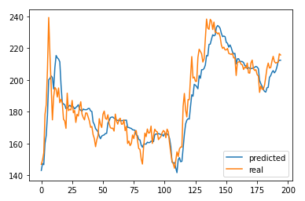
Result 3
On the testing dataset
MSE = 89.95
Mean error percent (MEP)= 0.037
Accuracy = 1 – MEP = 0.963
Conclusion 3. Adding sentiment analysis improves the prediction of stock price.
Notes:
Next,
Result 3 that is to predici BA stock price without using any article news but just with its historical price.

Slide 9
Result 4
On the testing dataset
MSE = 68.00
Mean error percent (MEP)= 0.028
Accuracy = 1 – MEP = 0.972
Conclusion 3. Adding noise to the sentiment score makes the model more robust.
Notes:
Finally, we add another experiment to see if adding noise to the sentiment scroes, will make the prediction better, Here are the results.

Slide 10
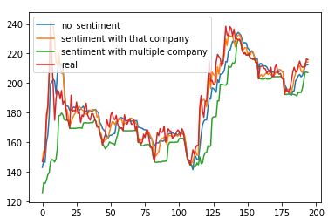
Comparison
 | Model 1 | Model 2 | Model 3
MSE | 57.95 | 369.50 | 89.95
ACC | 0.028 | 0.065 | 0.037
MEP | 0.972 | 0.935 | 0.963
Notes:
To better understand all these expriments, we compare them in this table and figure.
It shows that model 1 always gives the best prediction result.
In order to verify our results, we run all these experimenst on other 4 companies, FB, TSLA, nvidia and CVS, the results from these companies are in line with what we found before.

Slide 11
Conclusion
Sentiment and financial news can be used as additional information to improve the prediction of future stock prices.
Adding noise to the sentiment analysis makes the model more robust.
The news from other companies don’t contribute to the prediction of a specific company.
https://github.com/YunanWu2168/Stock_Prediction_Project
Notes:
We also make our codes public, if you are interested, please take a look.

