Slide 1


Exploring Wildland Fires through Data Science: Patterns, Predictive Models, and Insights

Slide 2

Overview
Problem
Solution
Impact
Wildland fires have the potential to be disastrous events
Kelowna, Tofino, Yellowknife, Pimicikamak Cree Nation Manitoba, Chibougamau in Quebec, Buffalo Narrows in Saskatchewan.
Data driven insights to anticipate severity of wiland land fires
Identify factors that could help reduce severe occurances
Reduction in fire supression costs
Biodiversity conservation
Carbon balance
Society and health

Slide 3
Dataset and workflow
Cleaning of fire and weather datasets
Univariate analysis on both datasets
Combining information
Bivariate analysis
Split, Scale, PCA, and SMOTE
Modeling

Slide 4

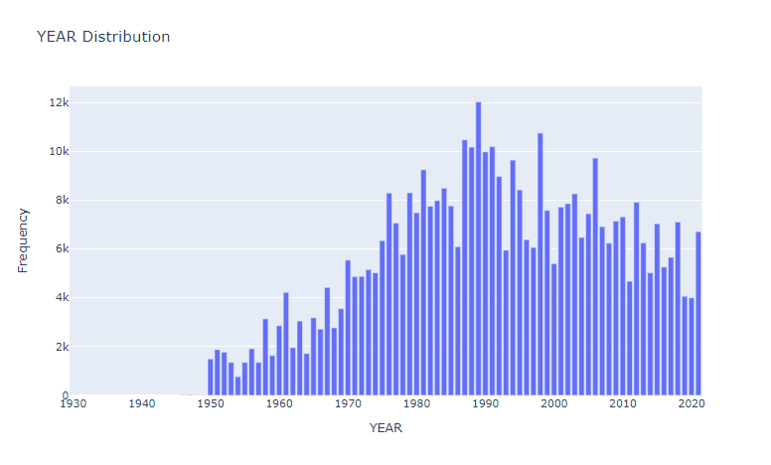

Occurances by Year
Peak in the late 1980s
Federal Forestry Act in 1985
Brundtland report in 1987
Department of Forestry established in 1989

Slide 5
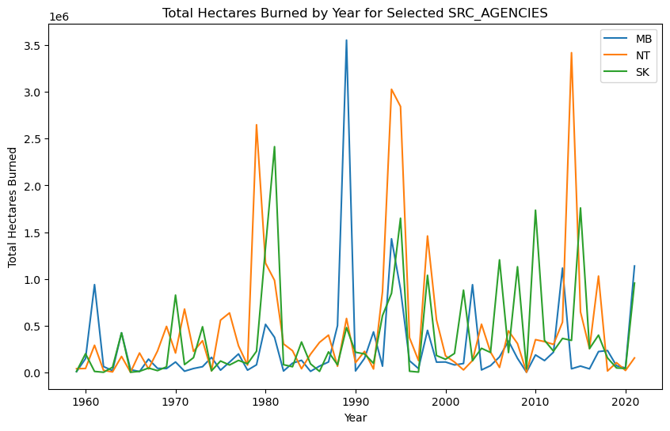
MB, NT, & SK
Doesn’t follow the overall pattern for hectares burned
Big difference between normal and peaks

Slide 6
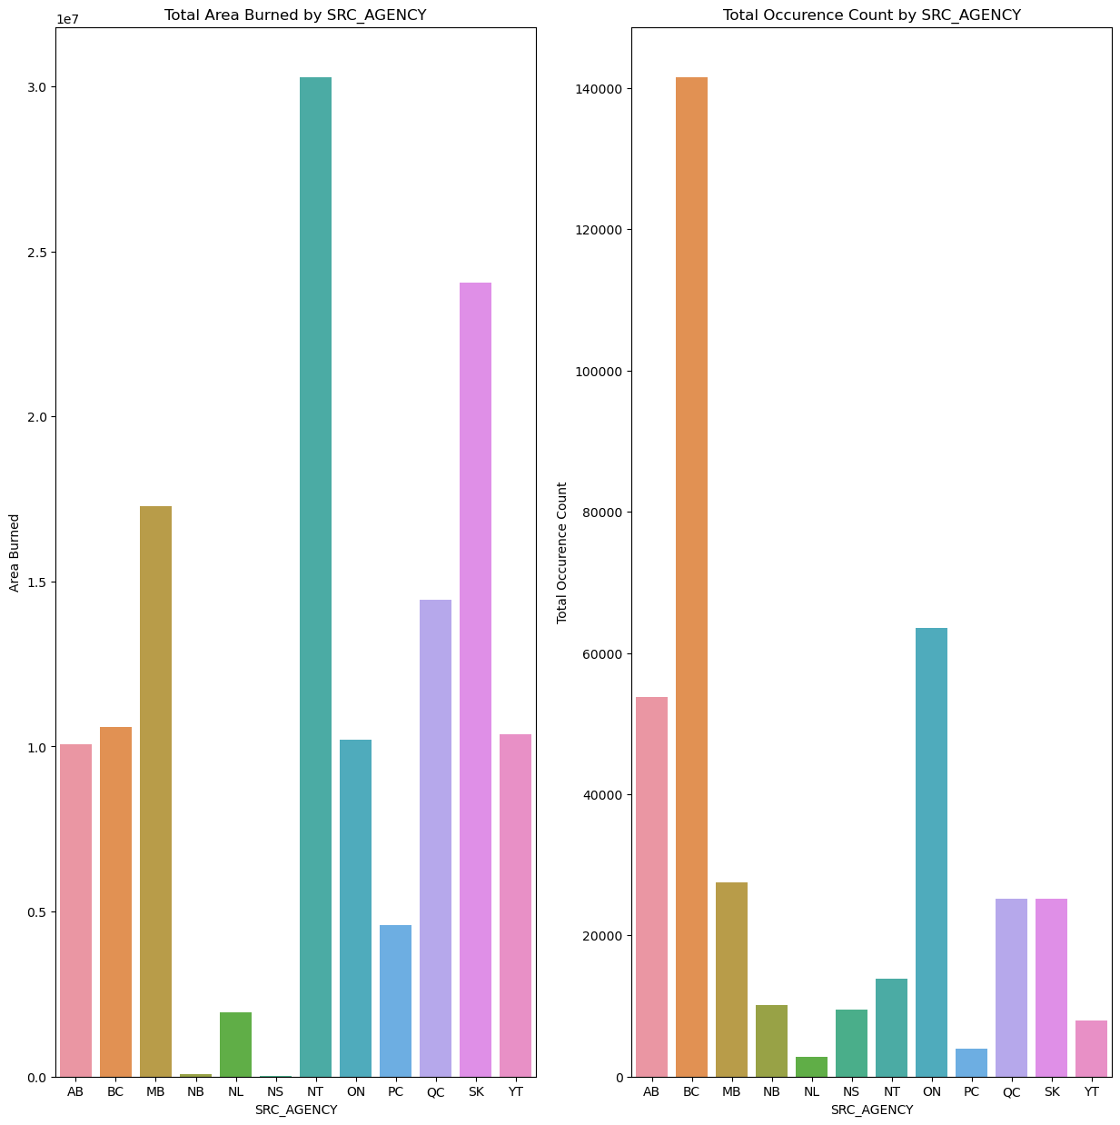
Total Hectares Burned
NT has one of the lower occurances but highest area burned
BC has one of the highest occurances but is about average on area burned

Slide 7
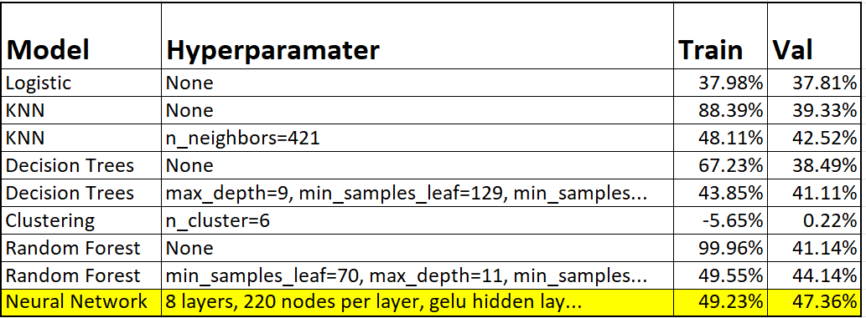
Models
6 different classification models
Top model: Neural Network

Slide 8
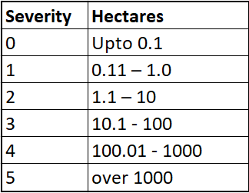
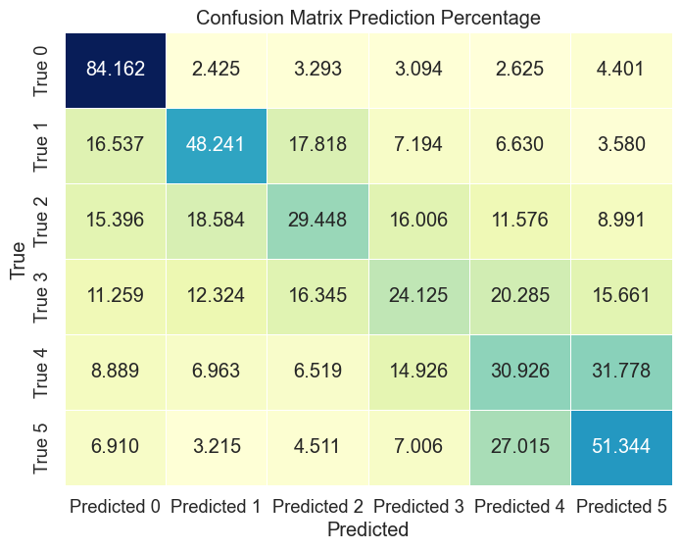
Neural Network
High accuracy for severity 0
Decent accuracy for severity 1 and 5
Difficulty in the middle

