Slide 1
CANADIAN WILDLAND FIRE

Slide 2
INTRODUCTION
Wildland fires have the potential to be extremly disastrous events. Their destruction and effects reach far beyond the area burned.
Total area burned in the past 25 years averages around 2.5 million hectars annualy

Slide 3
PROPOSED VISION
POTENTIAL IMPACT
FUEL SOURCES
$800 million to $1.5 billion a year spent for fire suppression
Wildfire smoke exposure can affect millions of people’s respiratory health
Risk to local flora and fauna
Studying fuel sources and the impact of presribed burns to control combustible material
WEATHER
Incorporating weather data to help predict locations of concern
OXYGEN, FUEL AND HEAT = WILDFIRE

Slide 4
THE DATA
SHAPE
FIRE SIZE
ECOZONES
DUPLICATES
UNUSABLE FEATURES
BRITISH COLUMBIA
26 Features
423,831 Occurances
75% of wildland fires are under 1 hectare
13 zones but most wildfire occurances happen in only 4
Features w/ Similar info Note columns included
Over half of the values in the FIRE TYPE and PROTZONE are missing
Accounts for 35% of all wildland fire occurances

Slide 5
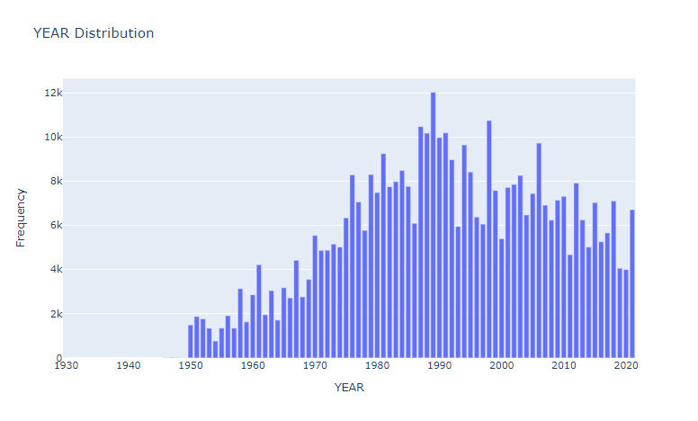
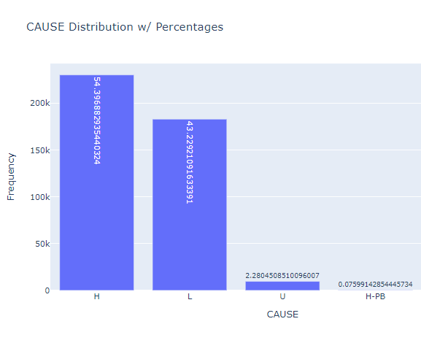
WILDLAND FIRES

Slide 6
NEXT STEPS
Clean and incorporate weather data
Look into scaling features such as fire size
Continue with multi-variate analysis
Start logistic regression to establish baseline modeling

