Slide 1


Exploring Wildland Fires through Data Science: Patterns, Predictive Models, and Insights

Slide 2

Overview
Problem
Solution
Impact
Wildland fires have the potential to disastrous events
2023: Kelowna, Tofino, Pimicikamak Cree Nation Manitoba, Yellowknife, Halifax, Chibougamau in Quebec, Buffalo Narrows in Saskatchewan
Data driven insights to anticiapte severity of wildland fires
Identify factors that could help reduce severe occurances
Reduce spending on fire supression
Biodiversity conservation
Carbon balance
Air quality and health

Slide 3
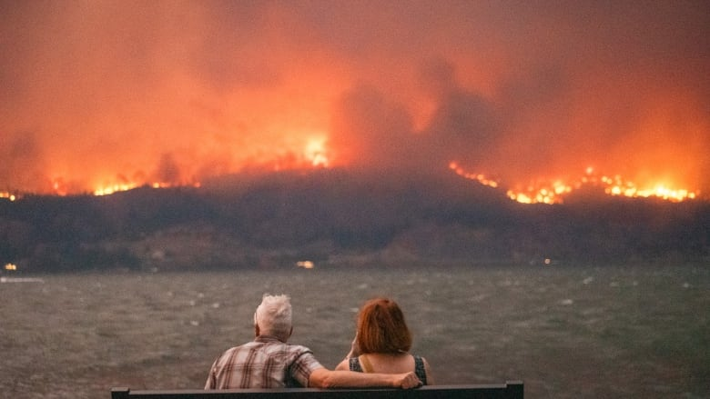

Slide 4
Overview
Problem
Solution
Impact
Wildland fires have the potential to disastrous events
2023: Kelowna, Tofino, Pimicikamak Cree Nation Manitoba, Yellowknife, Halifax, Chibougamau in Quebec, Buffalo Narrows in Saskatchewan
Data driven insights to anticiapte severity of wildland fires
Identify factors that could help reduce severe occurances
Reduce spending on fire supression
Biodiversity conservation
Carbon balance
Air quality and health

Slide 5
Dataset and preprocessing
Cleaning of fire and weather datasets
Univariate analysis on both datasets
Combining information
Bivariate analysis
Target Variable
Binarize and scale

Slide 6

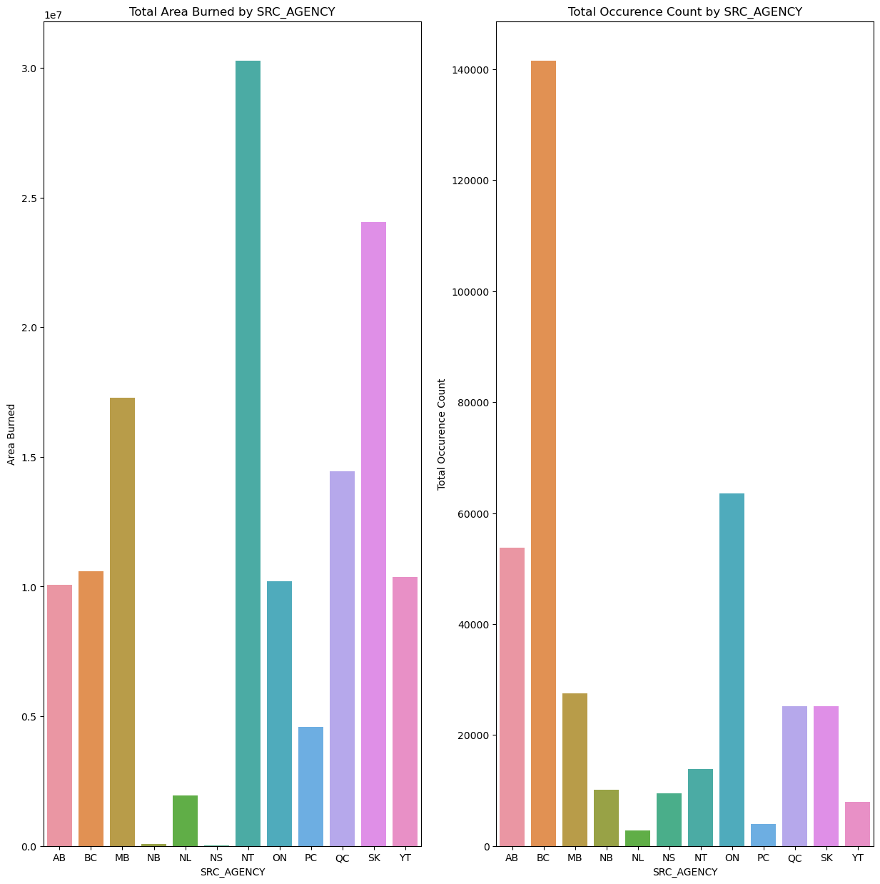

Total Hectares Burned
NT has one of the lower occurances but highest area burned
BC has one of the highest occurances but is about average on area burned

Slide 7
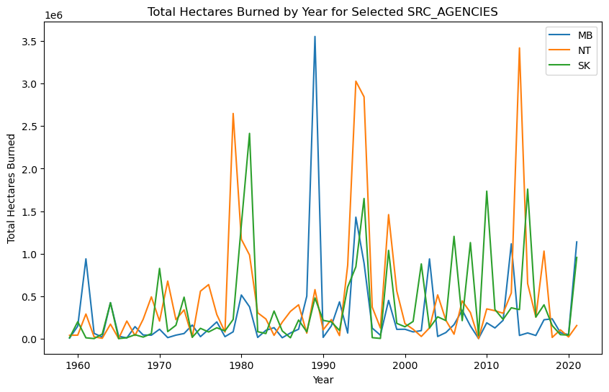
MB, NT, & SK
Doesn’t follow the overall pattern for hectares burned
Big difference between normal and peaks

Slide 8
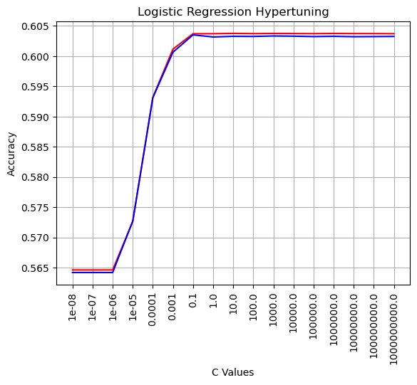
Baseline model
Logistic regression
60% accuracy in train and validation
No over/under fitting

Slide 9
Next Steps
Feature creation
Incorporate location and time data
Logistic regression
Fine tuning and undertanding results better
Decision Trees and Random Forest
Run more advanced models
Neural Networks
Run more advanced models

