Slide 1
https://github.com/NicoOrdax/SSF_Seminar
Download or clone/fork the repository to your laptops

Slide 2
Selection
Step
Functions
Combining the modelling of movement & selection processes

Slide 3
Day 2 – How do I fit an SSF?

Slide 4
Day 1: Take home messages
Movement and selection are tightly linked
SSFs allow them to be studied together
We try to understand why a step was chosen over others
SSFs give us how an animal selects features and how it moves with/without selection
Notes:
This is all stuff we will see the next 2 days
Often no clear cut answer

Slide 5
Day 2 – How do I fit an SSF?
Learning objectives:
Cleaning and preparing data for SSFs
Choosing how to model the movement component
Understanding the likelihood function of an SSF
Fitting a basic SSF
Interpreting the model coefficients

Slide 6
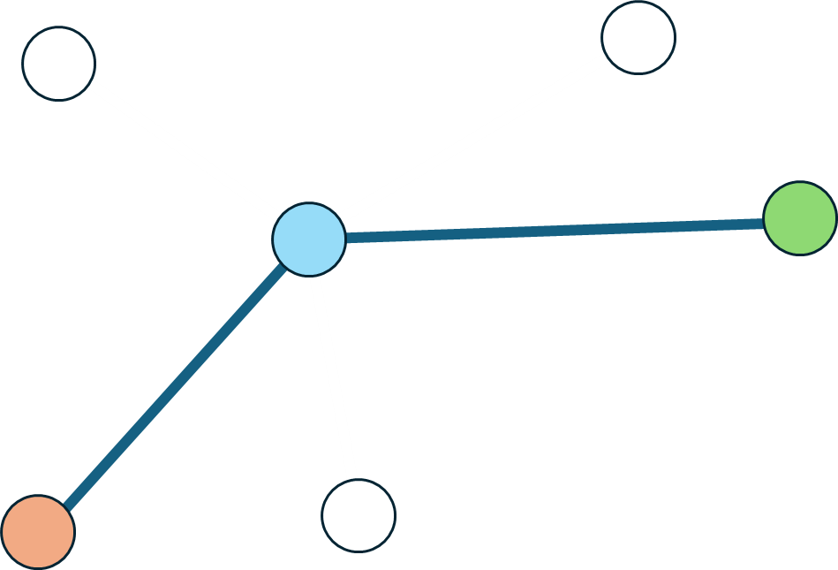
The goal of modeling with SSF
What is our question?
Why was the selected step chosen over all other possible steps?
Current
Observed
Previous

Slide 7
The goal of modeling with SSF
What is our question?
Simulated
Simulated
Why was the observed step chosen over the simulated ones?
Current
Observed
Previous
Simulated

Slide 8
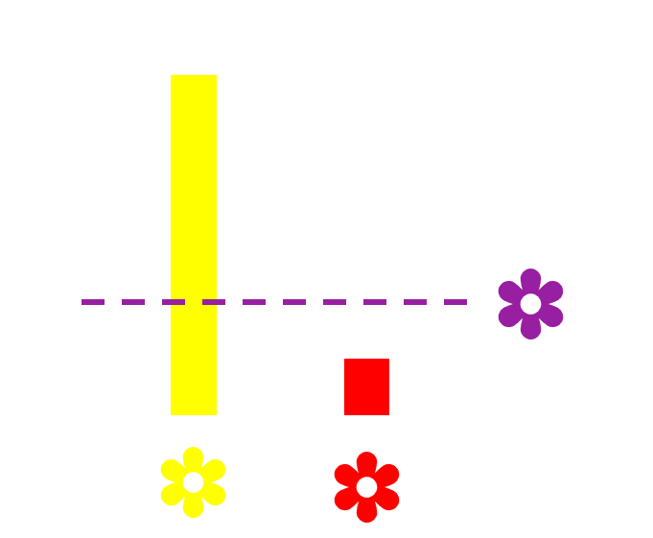
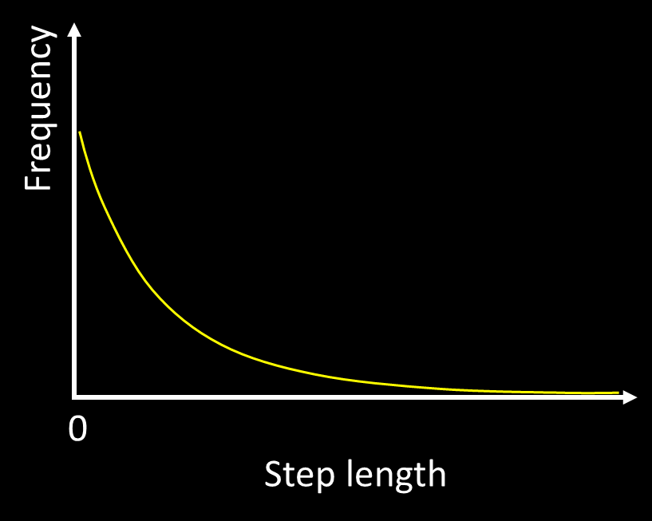
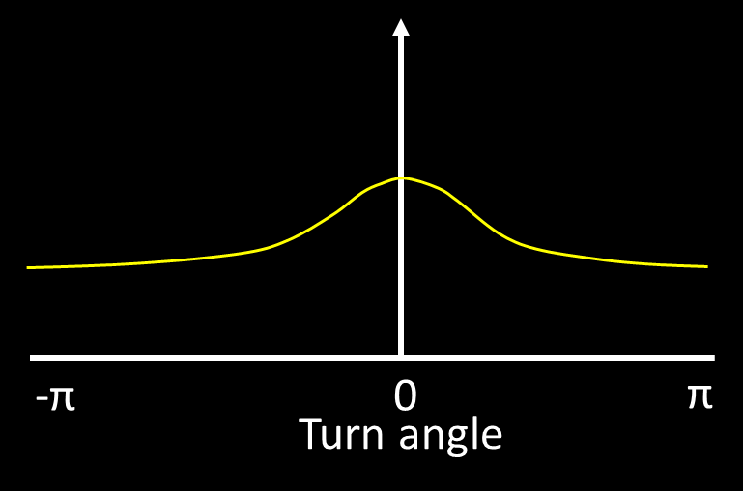
The goal of modeling with SSF
What are we trying to find?
λ
κ
RSS
Which values of the movement and selection parameters maximize the chance of choosing the observed step?

Slide 9




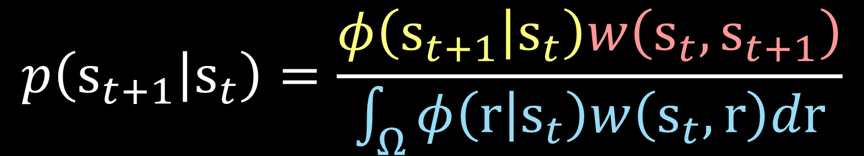
What is an SSF?
Movement kernel
The SSF
Selection kernel
$$p\left(s_{t+1} | s_{t}\right)=\frac{φ\left(s_{t+1} | s_{t}\right)w\left(s_{t},s_{t+1}\right)}{\int_{Ω}{φ\left(r | s_{t}\right)w\left(s_{t},r\right)dr}}$$
Probability of taking a step
Normalizing constant (availability)
Notes:
You don’t need to understand this equation to understand an SSF paper
But you should if you plan on writing one
Remember the selection kernel from the RSF?

Slide 10
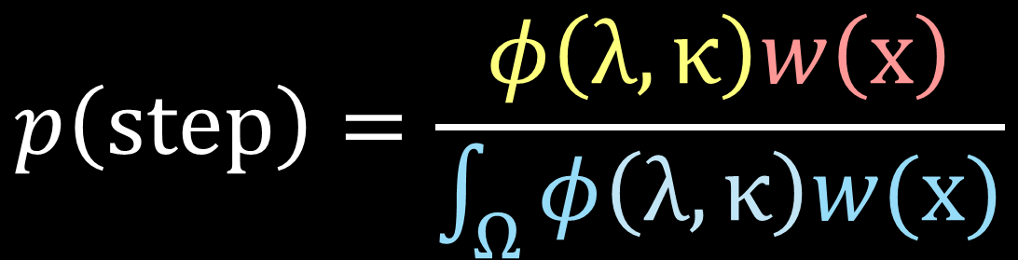
SSFs in practice
The likelikhood function of an SSF
$$p\left(step\right)=\frac{φ\left(λ,κ\right)w\left(x\right)}{\int_{Ω}{φ\left(λ,κ\right)w(x)}}$$
Notes:
What affects the probability of the observed and available steps?

Slide 11
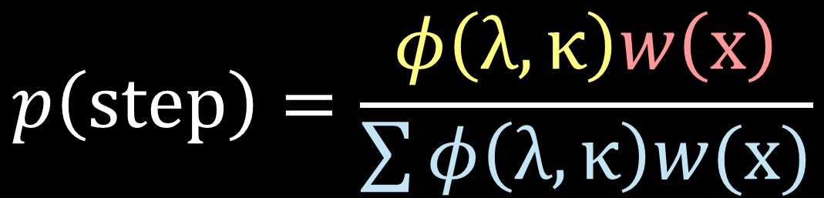
SSFs in practice
The likelikhood function of an SSF
$$p\left(step\right)=\frac{φ\left(λ,κ\right)w\left(x\right)}{\sum{φ\left(λ,κ\right)w(x)}}$$
Notes:
What affects the probability of the observed and available steps?

Slide 12
SSFs in practice
The likelikhood function of an SSF
$$p\left(step\right)=\frac{φ\left(λ,κ\right)w\left(x\right)}{\sum{φ\left(λ,κ\right)w(x)}}$$
Find the max!
Notes:
What affects the probability of the observed and available steps?

Slide 13

SSFs in practice
The likelikhood function of an SSF
$$p\left(step\right)=\prod_{1}^{N}{\frac{VMises\left(κ\right)Exp(λ)e^{β_{sel}}}{\sum_{1}^{k}{VMises\left(κ\right)Exp(λ)e^{β_{sel}}}}}$$
Notes:
What affects the probability of the observed and available steps?

Slide 14

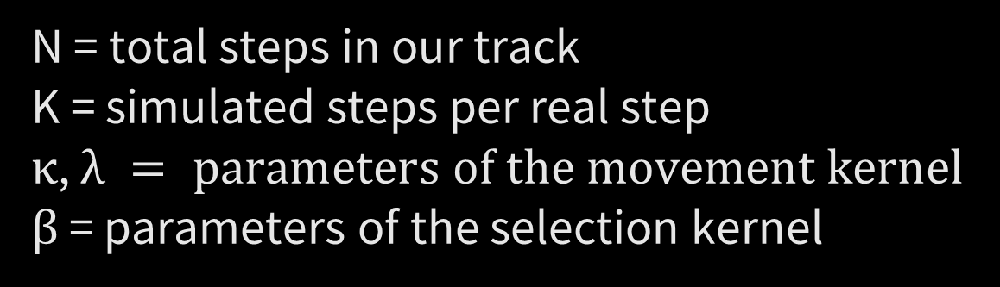
SSFs in practice
The likelikhood function of an SSF
$$p\left(step\right)=\prod_{1}^{N}{\frac{VMises\left(κ\right)Exp(λ)e^{β_{sel}}}{\sum_{1}^{k}{VMises\left(κ\right)Exp(λ)e^{β_{sel}}}}}$$
N = total steps in our track
K = simulated steps per real step
$κ$, $λ = parameters of the movement kernel$
$β$ = parameters of the selection kernel
Notes:
What affects the probability of the observed and available steps?

Slide 15
SSFs in practice
Or any other covariate that is selected
What we need to fit an SSF
Step | Step length | Turning angle | Case | Temperature
1 | 2.3 | - | TRUE | 8.6
1 | 2.5 | -0.24 | FALSE | 7.5
1 | 3.1 | 0.37 | FALSE | 2.3
2 | 1.8 | -1.10 | TRUE | 10.5
2 | 2.2 | 1.32 | FALSE | 6.2
2 | 1.9 | 0.75 | FALSE | 4.3
3 | 3.0 | -0.75 | TRUE | 9.8
3 | 4.0 | -0.96 | FALSE | 5.4
Notes:
What affects the probability of the observed and available steps?

Slide 16
SSFs in practice
What we have
x | y | Time
1.23 | 42.14 | 00:00
1.23 | 42.15 | 00:05
1.26 | 42.12 | 00:10
1.27 | 42.11 | 00:15
1.27 | 42.11 | 00:20
1.28 | 42.12 | 00:25
1.29 | 42.10 | 00:30
1.22 | 42.20 | 00:35
Notes:
What affects the probability of the observed and available steps?

Slide 17
The SSF modeling process
Main steps when working with SSFs

Slide 18
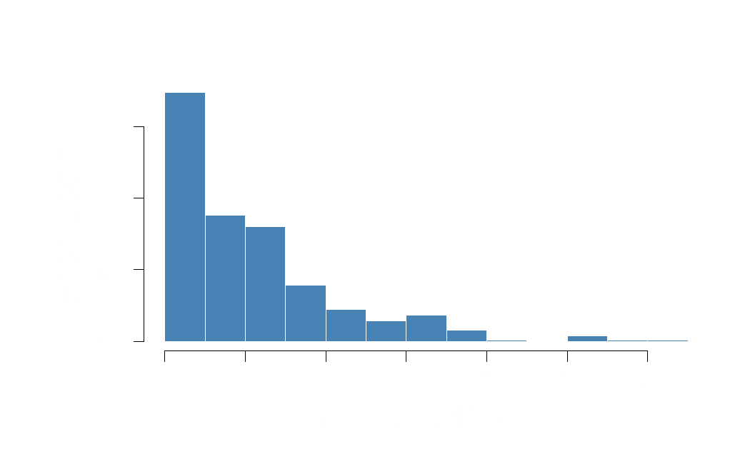
The SSF modeling process
Main steps when working with SSFs
Cleaning and visualizing data

Slide 19
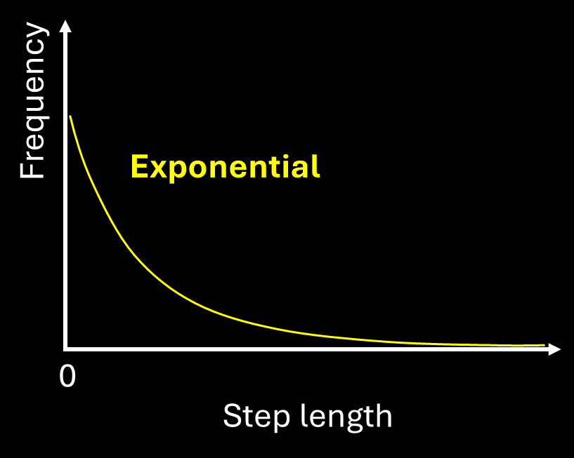
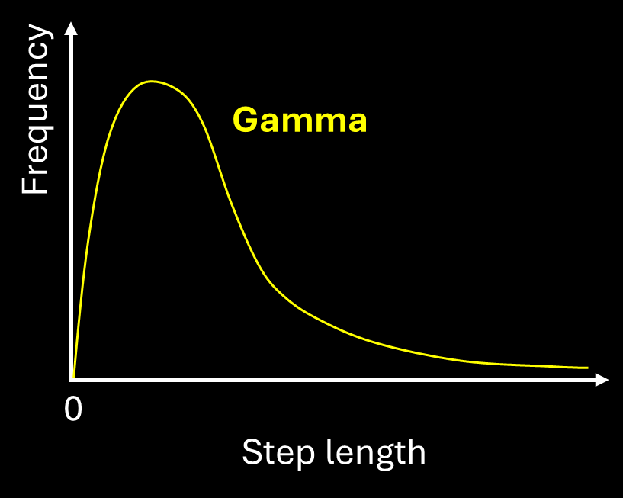
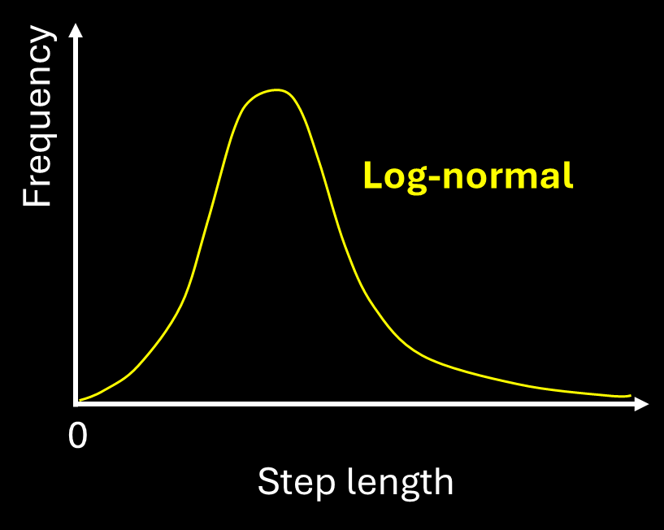
The SSF modeling process
Main steps when working with SSFs
Cleaning and visualizing data
Choose how to model movement

Slide 20
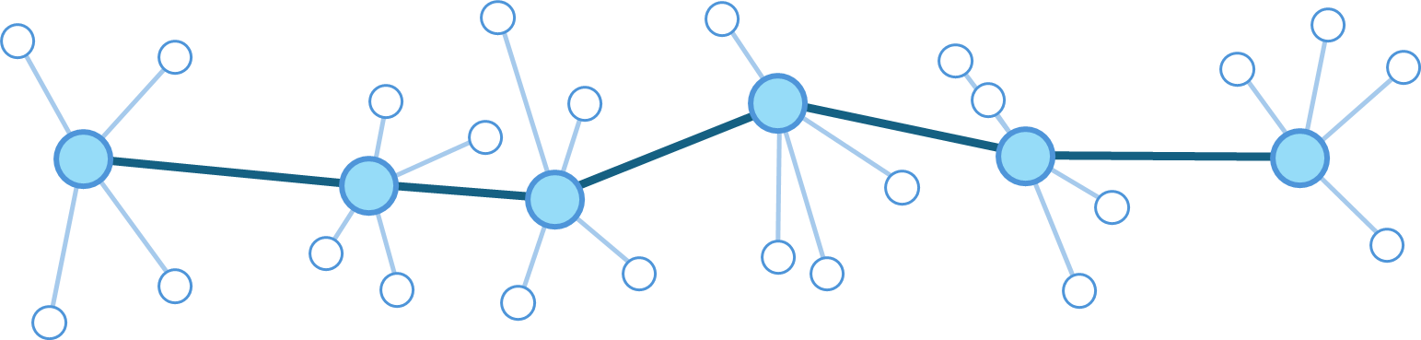
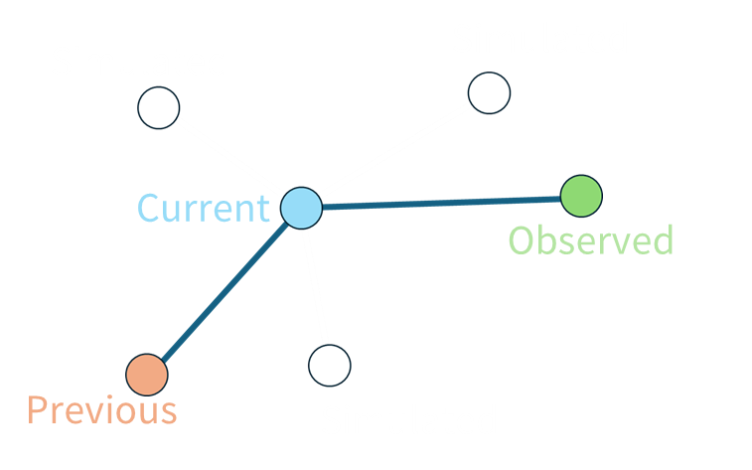
The SSF modeling process
Main steps when working with SSFs
Cleaning and visualizing data
Choose how to model movement
Generate random steps
Simulated steps
Observed steps

Slide 21

The SSF modeling process
Main steps when working with SSFs
Cleaning and visualizing data
Choose how to model movement
Generate random steps
Fit the model

Slide 22
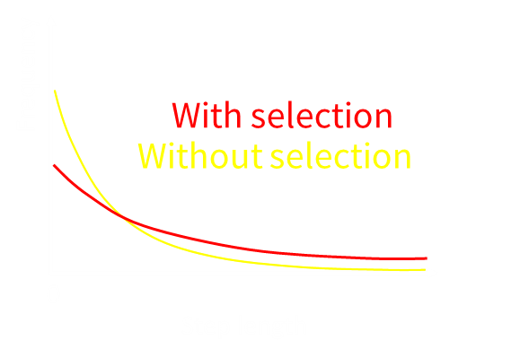
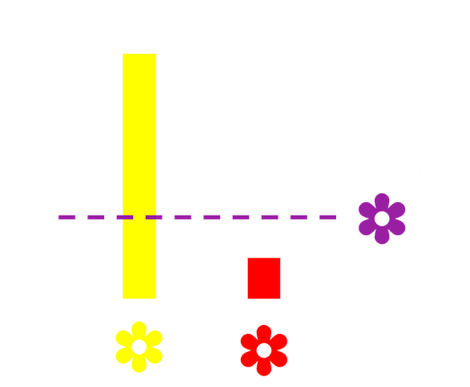
The SSF modeling process
Main steps when working with SSFs
Cleaning and visualizing data
Choose how to model movement
Generate random steps
Fit the model
Interpret model outputs

Slide 23
The SSF modeling process
Main steps when working with SSFs
Cleaning and visualizing data
Choose how to model movement
Generate random steps
Fit the model
Interpret model outputs

Slide 24
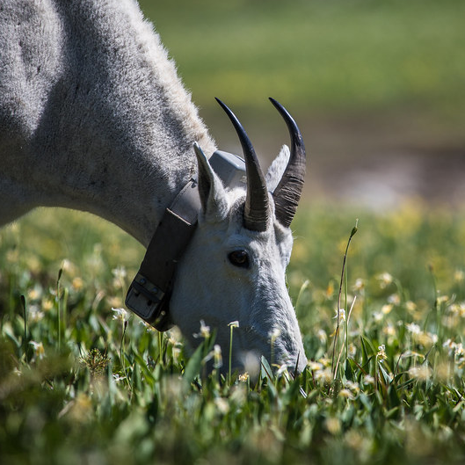
1. Cleaning & visualizing data
What kind of movement data can we use for SSF?
We typically use GPS, Argos or other satellite data for SSFs
Notes:
Typically GPS data
But any type of tracking that will give somewhat regularly spaced time intervals works!
In this course we focus on telemetry data
TRANSITION But what kind of covariates can we use?

Slide 25
1. Cleaning & visualizing data
What kind of environmental data can we use for SSF?
Anything
Notes:
Any possible covariate can be used, as long as it’s spatially structured

Slide 26
1. Cleaning & visualizing data
Coding time!

Slide 27
https://github.com/NicoOrdax/SSF_Seminar
Download or clone/fork the repository to your laptops

Slide 28


Coding time!
SSF_Workshop
SSF_Workshop.rproj
Open 1st
Slides
Documentation
Scripts
Coding_Practical.qmd
Open 2nd
Coding_Practical_Answers.qmd
…

Slide 29


Coding time!

Slide 30
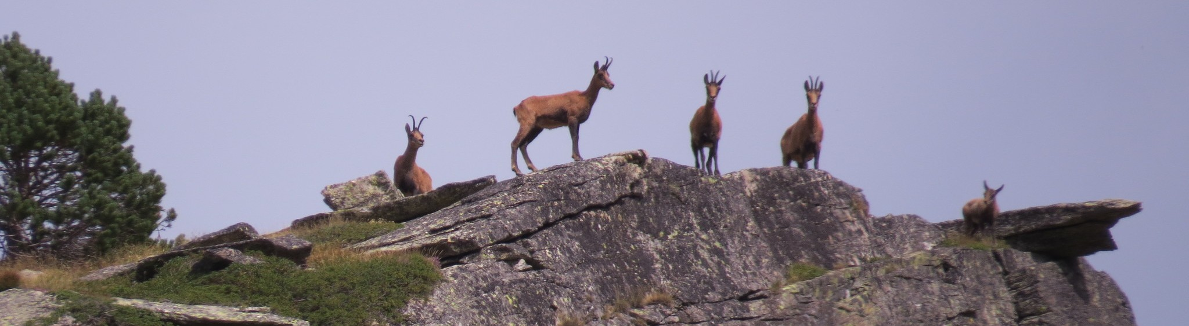
Coding time!
Photo: Yves Bas
The (simulated) dataset

Slide 31
Coding time!
Using Quarto

Slide 32
1. Cleaning & visualizing data

Slide 33
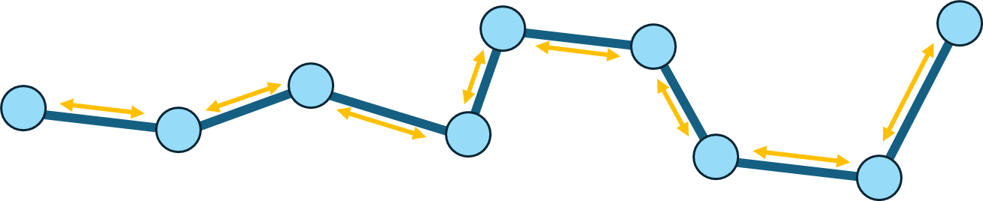
1. Cleaning & visualizing data
Main requirements for the data
3h
1h
2h
20h
7h
1h
4h
10h
All steps should have the same time interval

Slide 34



1. Cleaning & visualizing data
Main requirements for the data
GPS error
Sampling error shouldn’t exceed the scale at which selection is happening

Slide 35

1. Cleaning & visualizing data
Main requirements for the data
Habitat & movement data are at similar resolutions

Slide 36
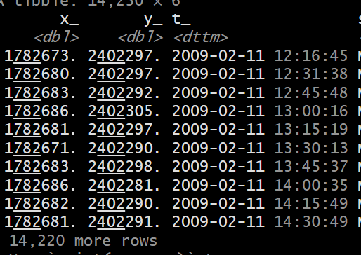
1. Cleaning & visualizing data
Exploring the data

Slide 37
1. Cleaning & visualizing data
Data cleaning
Start with your normal track cleaning process

Slide 38
1. Cleaning & visualizing data
Data cleaning: how to handle irregular sampling?
?
?
?
?
?
?
?
?
How bad are the irregularities?

Slide 39
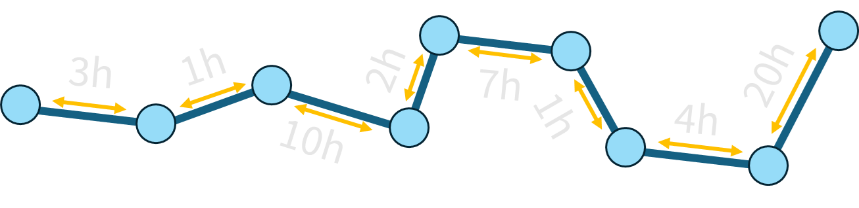
1. Cleaning & visualizing data
Data cleaning: how to handle irregular sampling?
Forget it

Slide 40
1. Cleaning & visualizing data
Data cleaning: how to handle irregular sampling?
10’
10’
10’
10’
9’
10’
20’
11’
We can work this out
Notes:
SHOW HOW

Slide 41
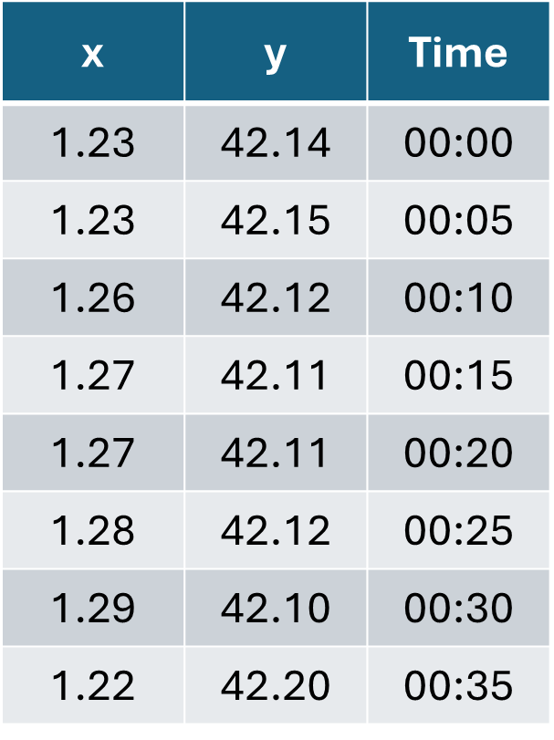
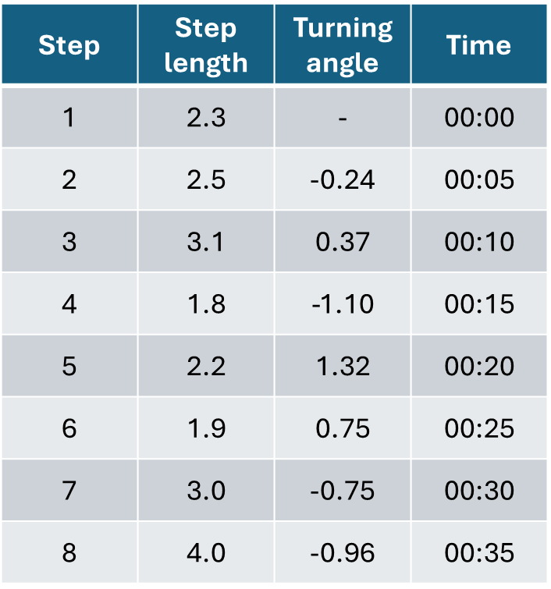
1. Cleaning & visualizing data
From locations to steps

Slide 42
2. Choosing the movement kernel
What does our step length distribution look like?

Slide 43
2. Choosing the movement kernel
Fit the selection biased movement kernel

Slide 44
3. Generate random steps

Slide 45
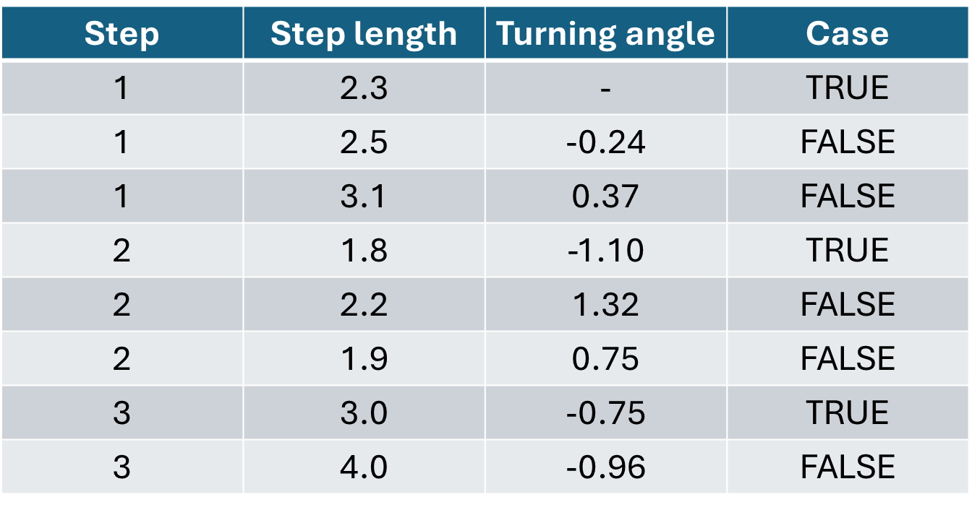
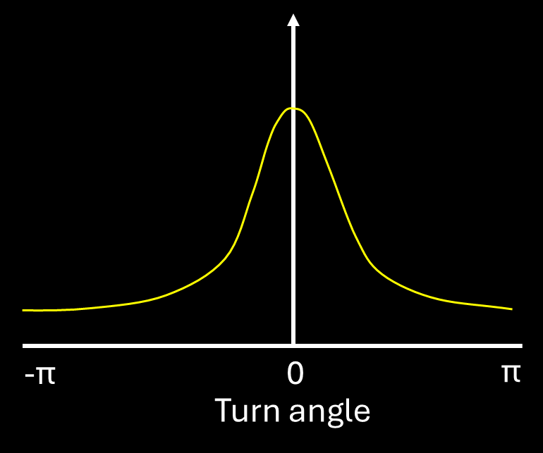
3. Generate random steps
Draw steps from the (biased) movement kernel

Slide 46
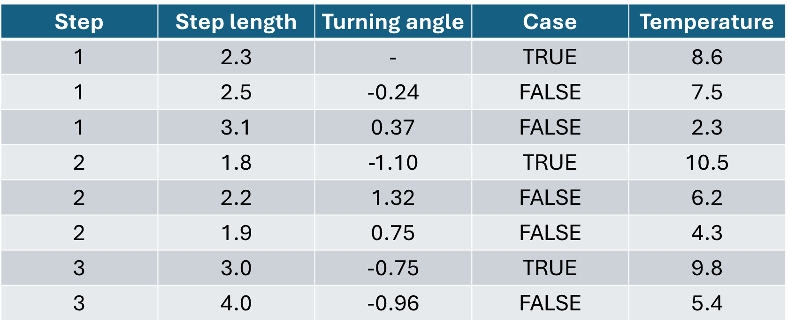
3. Generate random steps
Extract covariate data

Slide 47
4. Fit the model

Slide 48
4. Fit the model
The likelikhood function of an SSF
$$p\left(step\right)=\prod_{1}^{N}{\frac{VMises\left(κ\right)Exp(λ)e^{β_{sel}}}{\sum_{1}^{k}{VMises\left(κ\right)Exp(λ)e^{β_{sel}}}}}$$
N = total steps in our track
K = simulated steps per real step
$κ$, $λ = parameters of the movement kernel$
$β$ = parameters of the selection kernel
Notes:
What affects the probability of the observed and available steps?

Slide 49
4. Fit the model
The likelikhood function of an SSF
$$p\left(step\right)=\prod_{1}^{N}{\frac{VMises\left(κ\right)Exp(λ)e^{β_{sel}}}{\sum_{1}^{k}{VMises\left(κ\right)Exp(λ)e^{β_{sel}}}}}$$
The selection kernel is always exponential
Notes:
What affects the probability of the observed and available steps?

Slide 50
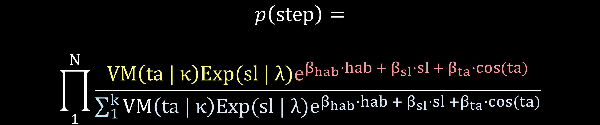
4. Fit the model
What the SSF actually looks like
$$p\left(step\right)=$$
$$\prod_{1}^{N}{\frac{VM\left(ta | κ\right)Exp(sl | λ)e^{β_{hab}·hab + β_{sl}·sl + β_{ta}·cos(ta)}}{\sum_{1}^{k}{VM\left(ta | κ\right)Exp(sl | λ)e^{β_{hab}·hab +{ β}_{sl}·sl +β_{ta}·cos(ta)}}}}$$
Notes:
What affects the probability of the observed and available steps?

Slide 51
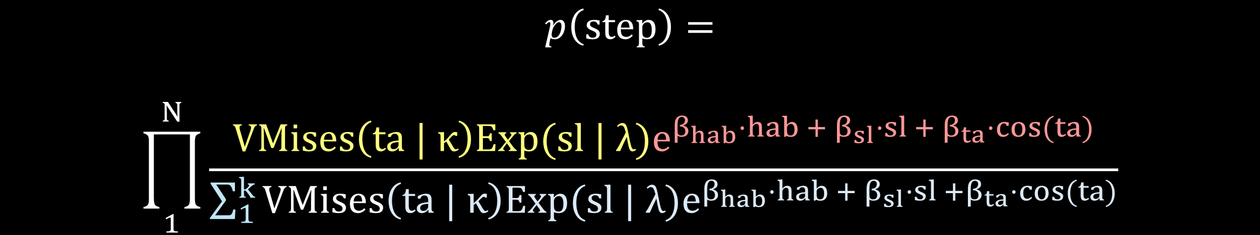
4. Fit the model
What the SSF actually looks like
What’s this???
What’s that???
$$p\left(step\right)=$$
$$\prod_{1}^{N}{\frac{VMises\left(ta | κ\right)Exp(sl | λ)e^{β_{hab}·hab + β_{sl}·sl + β_{ta}·cos(ta)}}{\sum_{1}^{k}{VMises\left(ta | κ\right)Exp(sl | λ)e^{β_{hab}·hab +{ β}_{sl}·sl +β_{ta}·cos(ta)}}}}$$
Notes:
What affects the probability of the observed and available steps?

Slide 52
4. Fit the model
Obtaining the unbiased movement kernel
$$VMises\left(κ\right)Exp(λ)e^{β_{hab} +{ β}_{sl} + β_{ta}}$$
=
$$VMises\left(κ{ + β}_{ta}\right)Exp(λ − β_{sl})e^{β_{hab}}$$
Notes:
What affects the probability of the observed and available steps?

Slide 53
4. Fit the model
Obtaining the unbiased movement kernel
Biased movement kernel
$$VMises\left(κ\right)Exp(λ)e^{β_{hab} +{ β}_{sl} +β_{ta}}$$
=
Unbiased movement kernel
$$VMises\left(κ{ + β}_{ta}\right)Exp(λ − β_{sl})e^{β_{hab}}$$
Notes:
What affects the probability of the observed and available steps?

Slide 54
4. Fit the model
Obtaining the unbiased movement kernel
$$κ_{unbiased}=κ_{biased}{ + β}_{ta}$$
=
$$λ_{unbiased} =λ_{biased}− β_{sl}$$
Notes:
What affects the probability of the observed and available steps?

Slide 55
4. Fit the model
Obtaining the unbiased movement kernel
$$κ_{unbiased}=κ_{biased}{ + β}_{ta}$$
Parameters can be adjusted as long as the step length and turning angle distributions belong to the exponential family
=
$$λ_{unbiased} =λ_{biased}− β_{sl}$$
Notes:
What affects the probability of the observed and available steps?

Slide 56
4. Fit the model
The model formula in R (amt)
case ~
cos(ta) +
sl +
covariate +
strata(step_id)
Notes:
What affects the probability of the observed and available steps?

Slide 57
4. Fit the model
The model formula in R (amt)
case ~
cos(ta) +
sl +
covariate +
strata(step_id)
What’s this???
What’s that???
Notes:
What affects the probability of the observed and available steps?

Slide 58
5. Interpret model outputs
Notes:
What affects the probability of the observed and available steps?

Slide 59
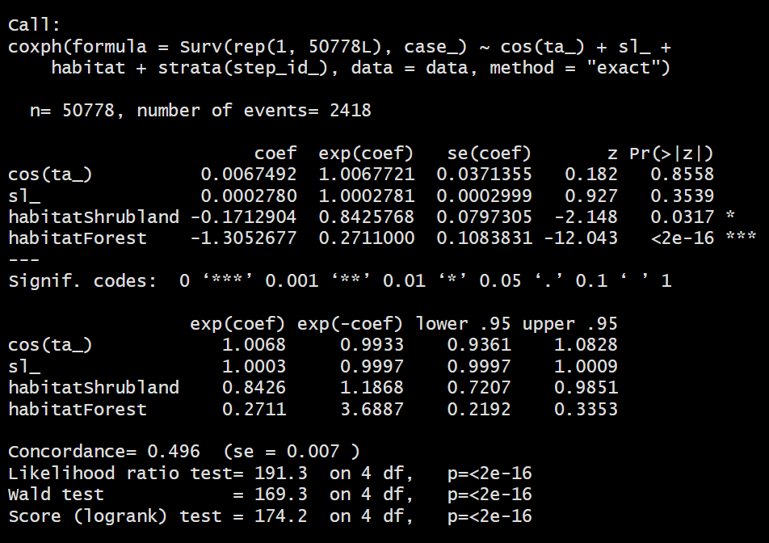
5. Interpret model outputs
Checking out the coefficients
Notes:
What affects the probability of the observed and available steps?

Slide 60
5. Interpret model outputs
Plotting
With selection
Without selection
Notes:
What affects the probability of the observed and available steps?

Slide 61
Take home messages
Fitting simple SSFs in R is not difficult
Formatting the data is what takes the most time
We can add selection terms for step length and turning angle to our model
These terms allow us to get selection-free movement coefficients
Notes:
This is all stuff we will see the next 2 days
Often no clear cut answer

