Slide 1

I HATE YOU: HATE SPEECH DETECTION PROJECT
Nicolò Pignatelli, 13831A
Text Mining and Sentiment Analysis (DSE)

Slide 2

THE PROJECT
The aims of the project are:
Build a model to classify text as hate speech, offensive or neither of the two;
Extract the relevant terminology for the choice of the classifier in order to determine significant aspects of hate speech

Slide 3
WHAT IS HATE SPEECH
There is no unique and unanimously shared definition
In this project:
“language that is used to expresses hatred towards a
targeted group or is intended to be derogatory, to humiliate, or to insult the members of the group”

Slide 4
STATE-OF-THE-ART
Best-in-class models usually reveal their weaknesses when they are asked to generalize on unseen data:
Difficult task per se
Methodology issues and data set biases
Lack of explainability

Slide 5
THE DATA SET #1
There is a useful website to consult (link)
Still, not easy to find the right data set:
usual problem (enough data, easy to retrieve, …)
Hate Speech is not the same for everyone, a lot of variability in the definition of the target variable
I chose a popular one, also because it is possible to compare the results with the related paper

Slide 6
THE DATA SET #2
Data are retrieved from Twitter making use of an English lexicon of hate speech
24k tweets, 3 categories:
Hate speech
Offensive speech
Neither of the two
Strong class imbalance, respectively 1430, 19190 and 4163 occurences

Slide 7
TEXT PREPROCESSING #1
Fundamental part to obtain high-quality results, I was guided by the indications found in the literature
Lowercase conversion
Hashtags handling
URLs handling
Mentions handling -> tokenization
Digits handling -> conversion to words

Slide 8
TEXT PREPROCESSING #2
6. Punctuation and special characters removal -> also emojis and emoticons
Character repetitions removal, but only if >2
Contractions expansion
Tokenization
Stopwords removal -> not always recommended
Stemming vs lemmatization

Slide 9
MACHINE LEARNING
Data are ready for implementing Machine Learning
Train and test set split -> only then, undersampling of the majority class
Pipeline choice: TF-IDF + XGBoost
common approach
Deep Learning approaches do not always perform better
less computationally intensive
more explicable

Slide 10
TF-IDF #1
Method that is used to measure the importance of a word to a document in a collection
Algorithm:
Construction of the vocabulary by identifying unique words
IDF computation: how common or rare is a word in the corpus
TF computation

Slide 11
TF-IDF #2
ML application:
Cannot be implemented on the whole data set -> data leakage
Should not be implemented separately on train and test, otherwise the outcome is also a measure of the goodness of the method + test smaller so worse estimate
Solution: implemented on the train and the resulting vocabulary and IDF estimates are used also for the test -> consistent evaluation of the model but if a word is present only in the test is not considered
+ cut-off (0.1%)

Slide 12
THE MODEL
XGBoost: ML algorithm based on decision trees that implements Gradient Boosting -> ensemble method, combines many models one after another where each new one is trained on the residuals of the previous
Definition of a custom function to maximize F1 Score (harmonic mean of precision and recall) for the class «hate»

Slide 13
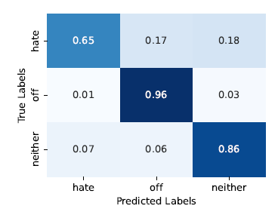
RESULTS
Better results, worse mistakes

Slide 14
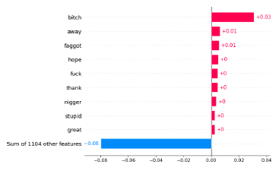
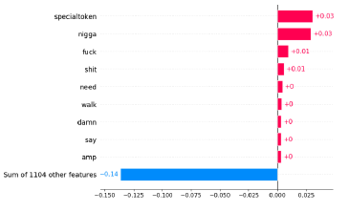
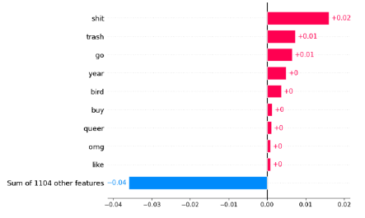
RELEVANT TERMINOLOGY #1
Hate speech
Offensive speech
Neither of the two

Slide 15
RELEVANT TERMINOLOGY #2
There are words that are noisy and words in unexpected positions (b*tch, queer)
Hate: harsh insults that target specific categories: women, black people, LGBT community
Offensive: 3 interesting insights
dichotomy n*gga vs n*gger
vulgar expressions but no targeting insults
mentions
Normal speech: there is only a vulgar expression not always associated with the purpose of offending (sh*t)

Slide 16
RELEVANT TERMINOLOGY #3
The lexicon extracted seems to depict a sort of pyramid of words of hate speech, where, from the top to the bottom, the degree of hate fades, still keeping in mind that a word can be associated with more than one kind of speech
Harsh insults with a target, usually minorities or women (e.g. f*ggot)
Vulgar expressions that can be directed at someone (e.g. f*ck)
Vulgar expressions (e.g. sh*t)

Slide 17
IDEAS FOR FUTURE WORK
While doing this project, I came up with some interesting ideas for future works:
Define what is hate speech once and for all
Provide user identification (user-overfitting problem)
Study the relation between hate speech and the change of language during time

Slide 18
THANK YOU!

