Slide 1
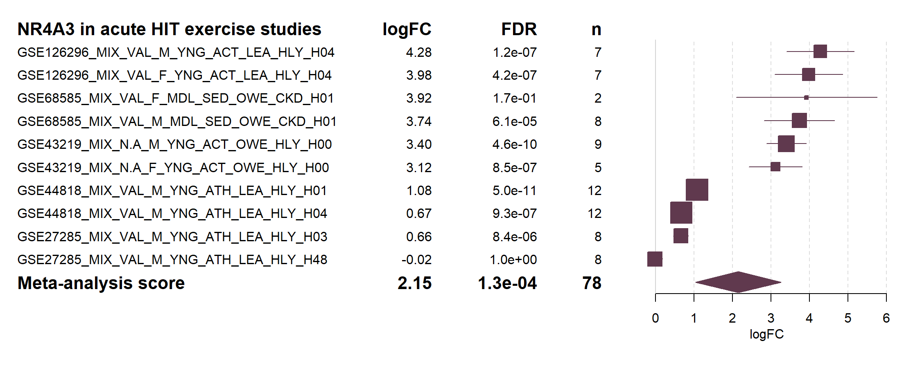
95% C.I.
Mean
Individual
studies
Mean ± 95% C.I.
Meta-analysis

Slide 2
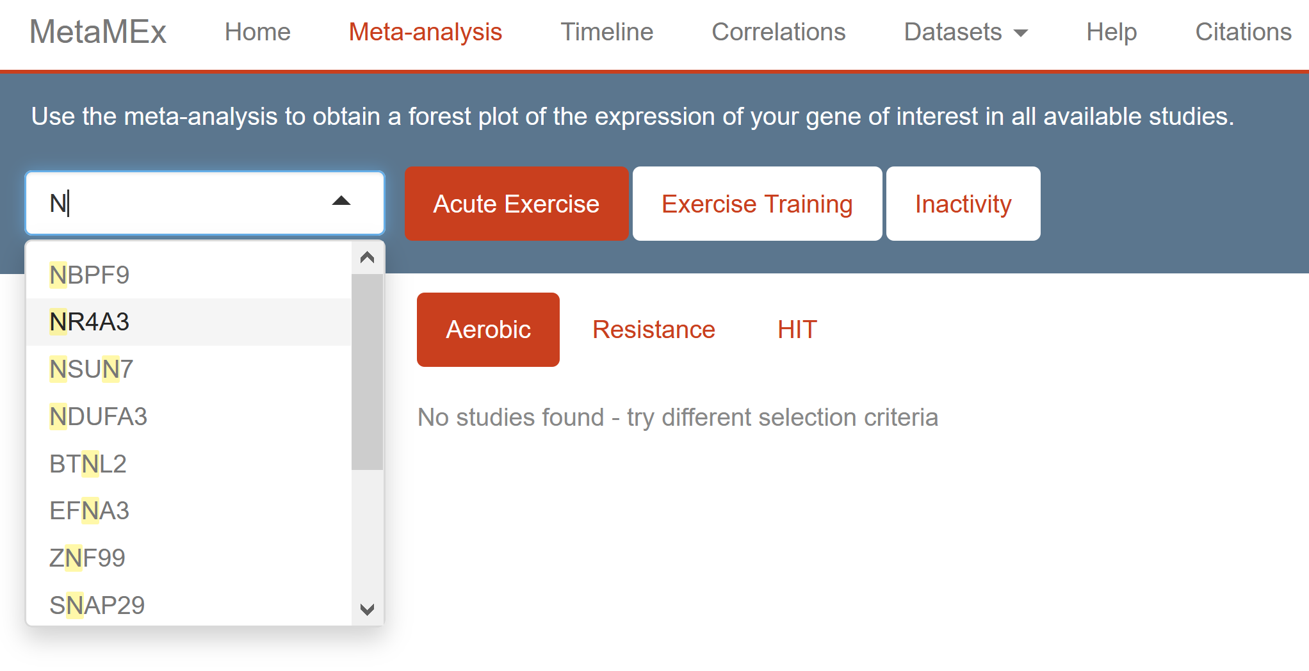

Slide 3
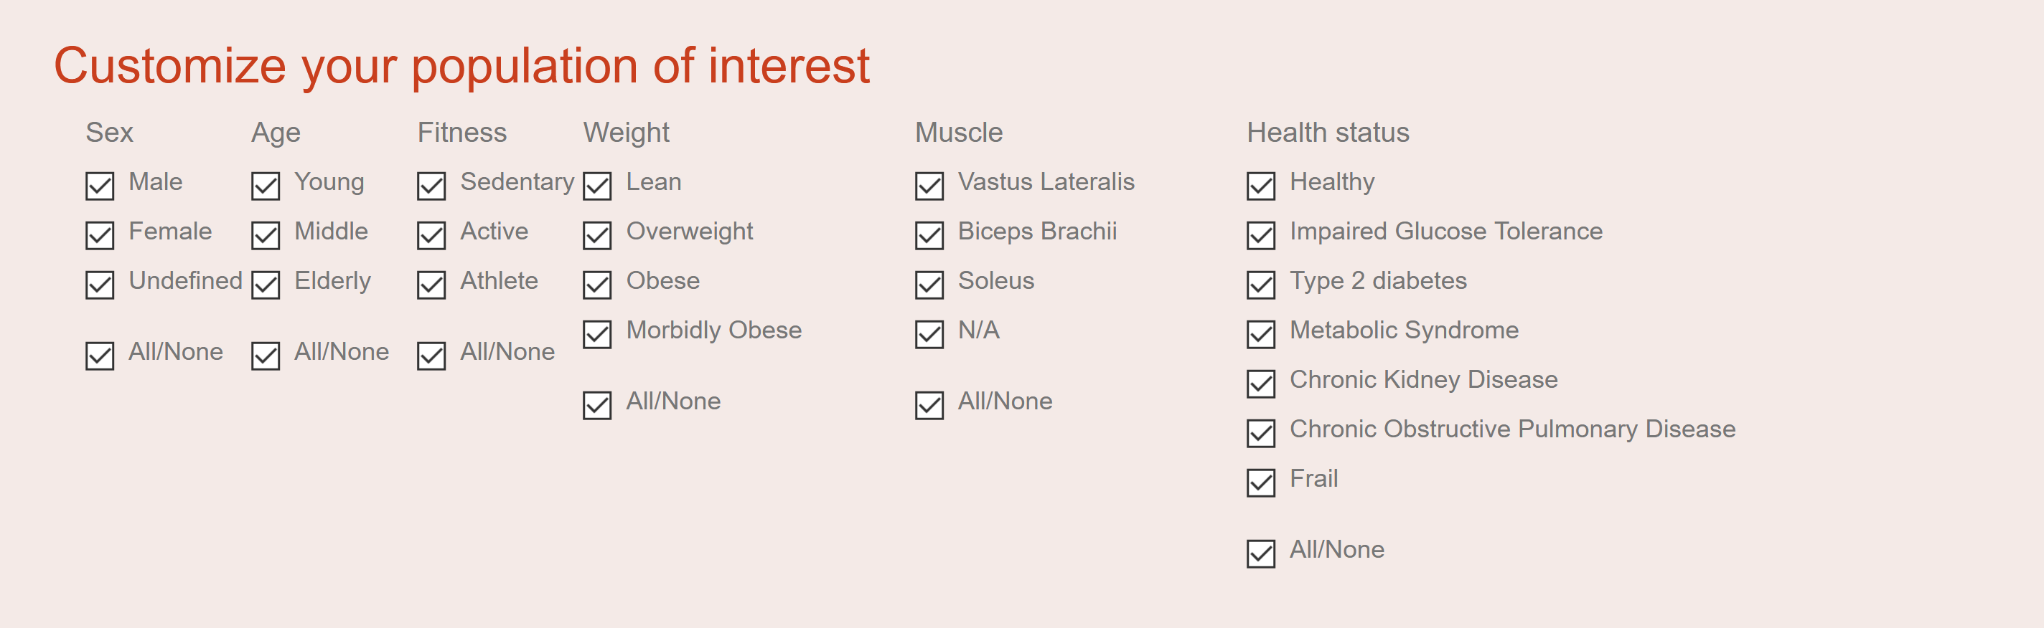

Slide 4
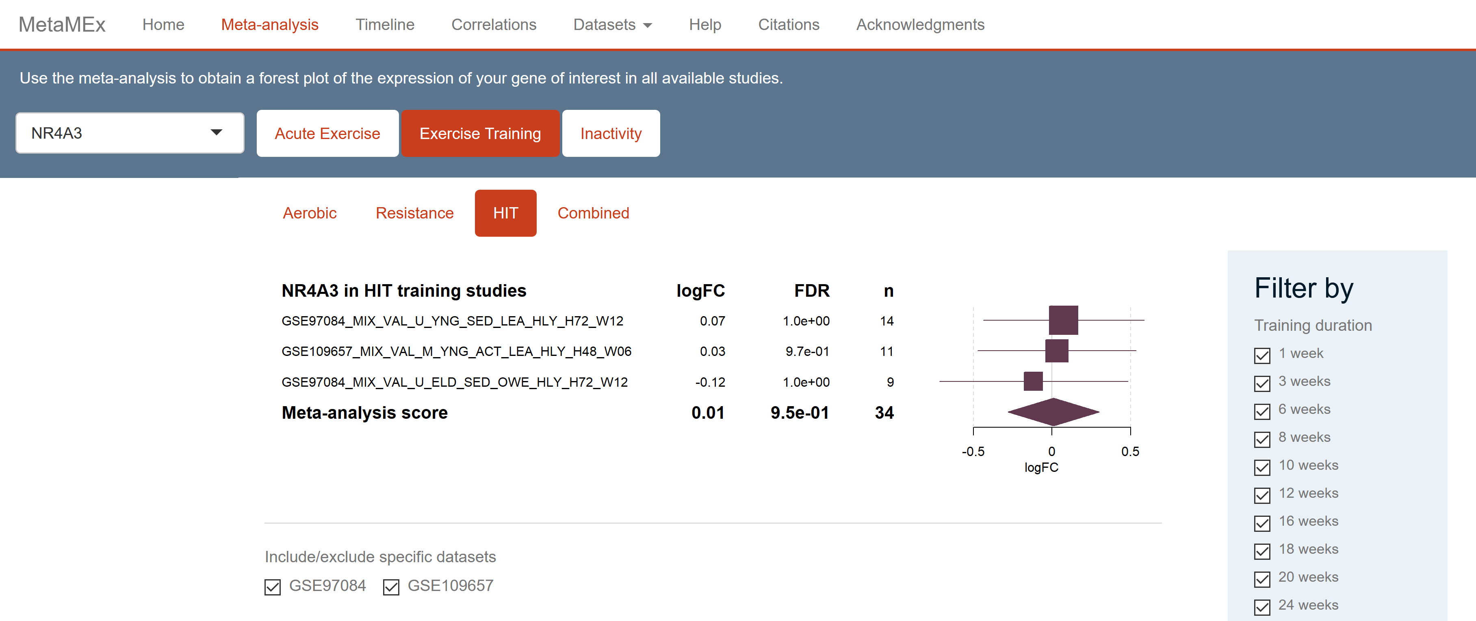

Slide 5
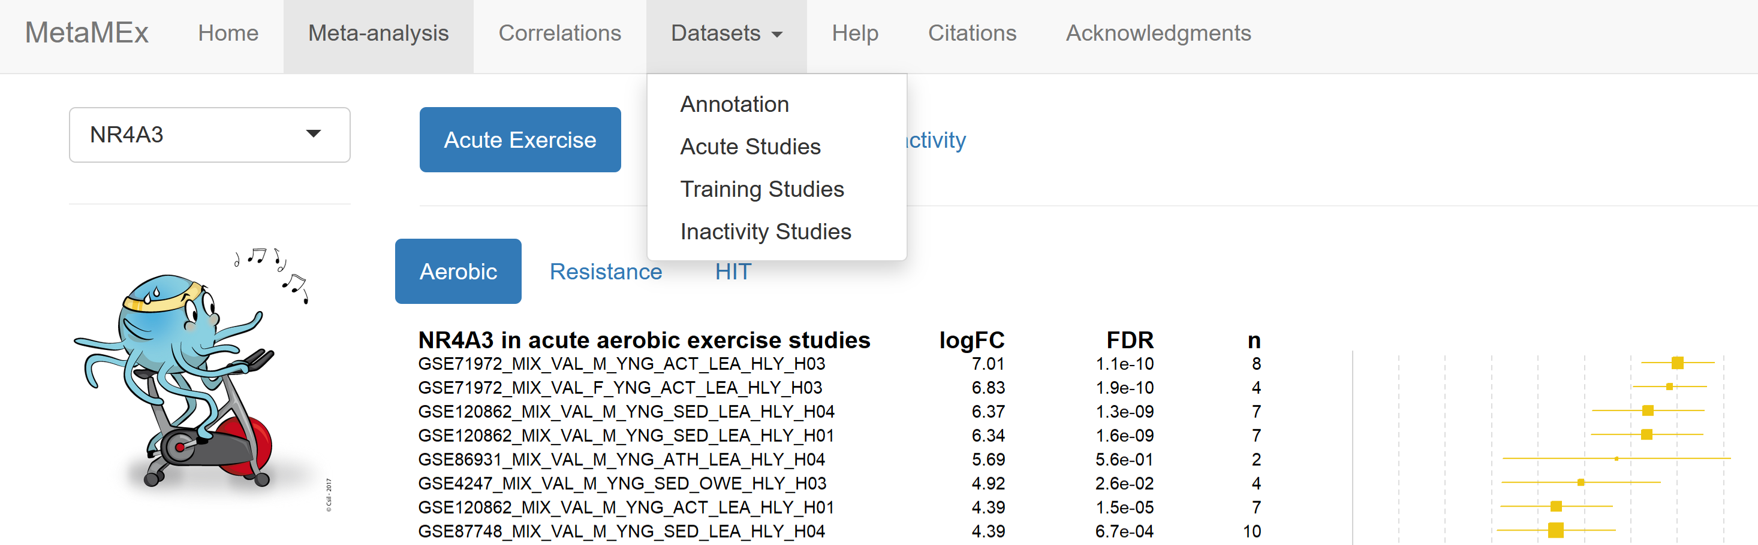
Mixed concentric and eccentric exercise
Male
Sedentary
Healthy
8 weeks of training
GSE59088_MIX_VAL_M_YNG_SED_LEA_HLY_H05_W08
GEO accession number
Vastus lateralis
Young
age < 35
Lean
Biopsy collected 5h after exercise

