Slide 1
Blockchain-Assisted Distributed AES Key Lifecycle
Management Framework for Secure Healthcare IoT
CS 793 – Major Project-I | First Round Continuous Evaluation
Niraj Kumar (Team Leader) • Piyush Kumar • Kanhaiya Kumar • Prashant Kumar
Supervisor: Dr. Bikramjit Sarkar, Professor, Dept. of CSE
JIS College of Engineering | Project ID: T4-2026-030 | 9th October 2026

Slide 2
Problem Statement
Healthcare IoT devices generate highly sensitive patient data (sensors, wearables, cloud servers).
AES-256 protects the data — but centralized management of the AES keys themselves is the weak point.
Centralized key management → single point of failure, insider threats, unauthorized modifications, poor auditability.
Goal: build a distributed, blockchain-assisted framework to manage the complete AES key lifecycle securely.

Slide 3
Objectives
Study existing centralized & blockchain-assisted key management approaches.
Design a layered architecture: AES-256 for data + blockchain-assisted layer for key governance.
Build a secure key-lifecycle engine: generation, protection, rotation, expiration, archival, recovery.
Implement authentication, RBAC, and audit logging for full accountability.
Evaluate modules through testing; assess blockchain overhead in a later phase.

Slide 4
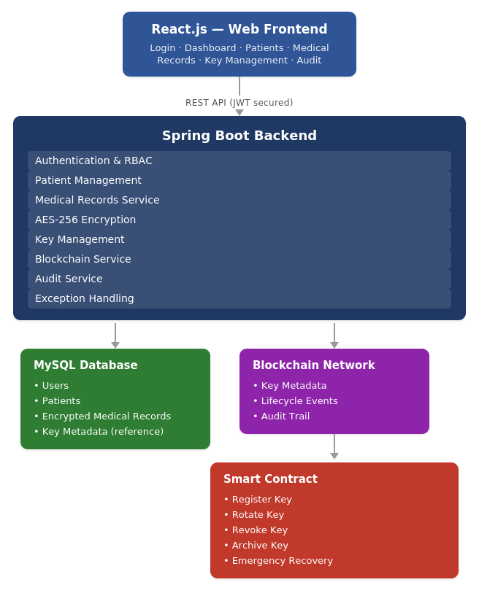
Proposed System Architecture
React.js frontend → Spring Boot backend → MySQL + Blockchain + Smart Contract

Slide 5
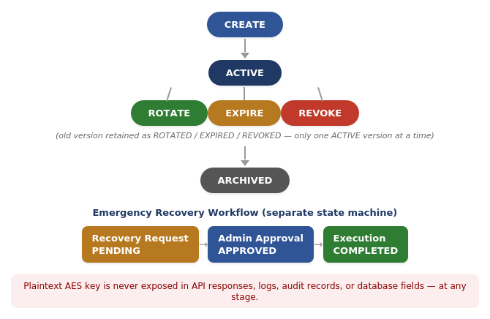
Key Lifecycle & Emergency Recovery Workflow
Complete state machine covering normal operation, expiration, archival, and controlled recovery

Slide 6
Technology Stack
Layer | Technology
Frontend (planned) | React.js
Backend | Java 17 + Spring Boot 3.x
Database | MySQL 8.x (JPA/Hibernate)
Security | Spring Security, JWT, BCrypt, AES-256-GCM
Blockchain (planned) | Private/Local Blockchain + Smart Contracts
Dev & Testing | Maven, Git/GitHub, Postman, JUnit

Slide 7
Implementation Status — Phases 1–14 (All Completed)
Phase | Module | Status
1–2 | Foundation & Core Setup | Completed
3 | AES Key Management (Base) | Completed
5–6 | Security Foundation & Key Protection | Completed
7, 11–13 | Full Key Lifecycle (Rotate/Expire/Archive/Recovery) | Completed
8 | Exception Architecture | Completed
9 | Authentication & Authorization (JWT, RBAC) | Completed
10 | Audit Logging | Completed
14 | Database Transactions | Completed

Slide 8
Experimental Results Summary
Test Area | Outcome
AES-256-GCM Encrypt/Decrypt | Passed — correct round-trip, unique ciphertext per operation
Authorization (No/USER/ADMIN JWT) | Passed — 401 / 403 / 200 exactly as expected
Key Rotation (DB verification) | Passed — v1→ROTATED, v2→ACTIVE, active count = 1
Key Expiration (scheduler) | Passed — expired keys auto-transitioned to EXPIRED
Key Archival (active-version guard) | Passed — archival of ACTIVE version correctly blocked
Emergency Recovery (invalid transitions) | Passed — invalid transitions rejected
Exception Handling | Passed — structured 404, not a stack trace

Slide 9
Security Improvements vs. Centralized Approach
Review 1 Limitation | Current Status
Single point of failure | Master-key-based key protection layer decouples raw key storage
Unauthorized key modifications | RBAC enforced & verified — non-admin JWTs rejected (403)
Poor auditability | Every key operation logged with actor, action, endpoint, timestamp, result
Manual/error-prone lifecycle | Fully automated state machine + scheduler-driven expiration

Slide 10
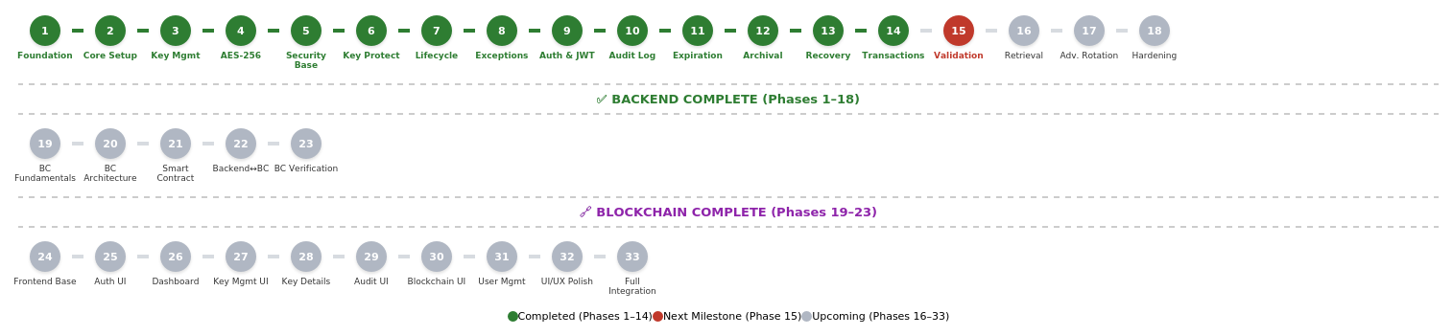
Overall Project Roadmap & Current Status
14 / 33 phases complete — full backend security core

Slide 11
Challenges Faced
Guaranteeing exactly one ACTIVE key version during rotation → solved with @Transactional + DB-level verification.
Preventing accidental key exposure → dedicated response DTOs structurally exclude key material.
Coordinating JWT auth with audit logging → correct filter ordering in the security chain.
Designing safe emergency recovery → independent RecoveryStatus state machine, not direct reactivation.

Slide 12
Future Work Plan
Stage | Phases | Focus
Before 2nd Round Evaluation | 15–18 | Validation, secure retrieval, advanced rotation, API docs, hardening
Subsequent Evaluations | 19–23 | Blockchain fundamentals, architecture, smart contracts, integration
Major Project-II (Sem-8) | 24–33 | Full React.js frontend, user management, UI/UX, full integration

Slide 13
Conclusion
Complete, independently verified AES key-lifecycle management engine built (14/14 planned phases).
Measurable security improvements demonstrated: RBAC enforcement, audit logging, transactional integrity.
Blockchain integration and frontend are next, building on this verified core.
Clear, phased roadmap in place through Major Project-II.

Slide 14
Thank You
Questions & Discussion

