Slide 1
General Setup
Assumptions
RL and RB have real sensors for real world
and virtual sensors for virtual world.
The simulator is able to model all the relevant evolutions of the world.
Software
Core software is domain independent.
Virtual sensors and LDL/LTL formulas are domain dependent.
Episode reset conditions
DFA state satisfy formula.
DFA state is failure.
Maximum number of action reached.
Algorithm Specifications
n-step SARSA algorithm.
Use of reward shaping for speed up.

Slide 2

Paper experiment: Sapientino
RL Agent
Restraining Bolt
Can have two configurations:
OMNI: up, down, left, right actions
DIFFERENTIAL: forwards, backwards, turn left, turn right
The state representation is given by the agent pose:
With this specification, the agent can just learn how to move in the grid, but it cannot match related concepts.
Two specifications:
Visit at least two cells per color for each color in a given order.
Visit all triplets of each color, given an order among colors.
For this two more features are needed:
Beep action has just been executed
Color of the current cell

Slide 3
Our experiment :Chess ( abstract)
RL Agent
General description of the game
Restraining Bolt

Slide 4
Chess : in detail
CODE (metodo update principalmente a grandi linee)
LTL 2 formule implementate (check colori e check ordine)

Slide 5
Chess: final results
FORMULA LTL
GRAFICO
VIDEO
After tuning …
….
Alpha ecc
The agent must…
Number of episodes
Training time
….

Slide 6
Pick and place for a robot end effector
RL Agent
Restraining Bolt

Slide 7
Pick and place
Pseudo code con state e reward assegnati
LTL formula

Slide 8
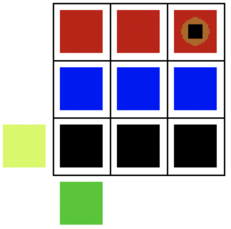
Pick and place
Screen e spiegazione
End effector with
the picked item
Video di quello reale col robot
Home
Item
location
Metodi implementabili….
Con piu tempo bla bla bla

Slide 9
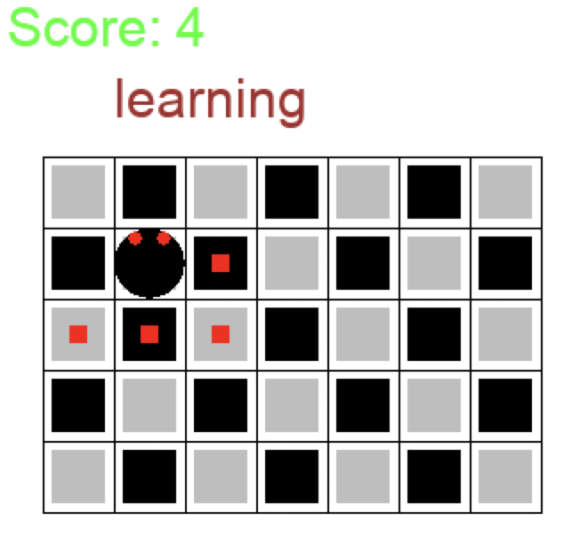
FUTURE WORKs
Chess completo dove il robot mette in pratica quanto imparato nel nostro lavoro, magari con una scacchiera piu grande e con altri learned agents

Slide 10

Conclusions
Results:
It is possible to perform RL with constraints by using RL techniques on associated MDPs
Features needed by the specifications can be kept separated from the agent ones
This work shares similarities with safety conditions satisfaction projects, but also differences:
Agent is considered as a black box
Hard satisfaction of RB specifications is not guaranteed, neither before nor after training
This would require a link between AG features and RB features
These are not needed for RL
Splitting components between AG and RB allows:
Modular robot to handle different tasks
Smaller, lighter, more efficient agents

