Slide 1
PARTE SPERIMENTALE: MANTOVANI e LORENZI
PRIMA PARTE
Esempi paper (veloci). BREAKOUT SAPIENTINO COCKTAIL PARTY
MAGARI SOLO DUE BASTANO, giusto per finire di esporre il paper
SECONDA PARTE
Esperimento principale: CHESS o simile
RL,RB, env. + breve CODE/training + Results and Video
TERZA PARTE
2,3 Esempi finali implementabili
RL,RB env. +. Spiegare come si potrebbe fare, o pseudo codice a riguardo
CONCLUSIONI E SVILUPPI FUTURI

Slide 2
Example Setup
Assumptions
RL and RB have real sensors for real world
and virtual sensors for virtual world.
The simulator is able to model all the relevant evolutions of the world.
Software
Core software is domain independent.
Virtual sensors and LDL/LTL formulas are domain dependent.
Episode reset conditions
DFA state satisfy formula.
DFA state is failure.
Maximum number of action reached.
Algorithm Specifications
n-step SARSA algorithm.
Use of reward shaping for speed up.

Slide 3

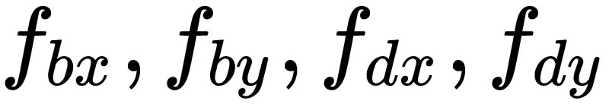
Breakout
RL Agent
Restraining Bolt
Can have two configurations:
MOVE
MOVE +FIRE
The state representation is given by:
Paddle position:
Ball position:
Ball direction of movement:
A matrix representing the states of the bricks.
Reward is given when a brick has been hit.
The bricks must be removed from left to right, so we need a representation of the status of each brick.

Slide 4
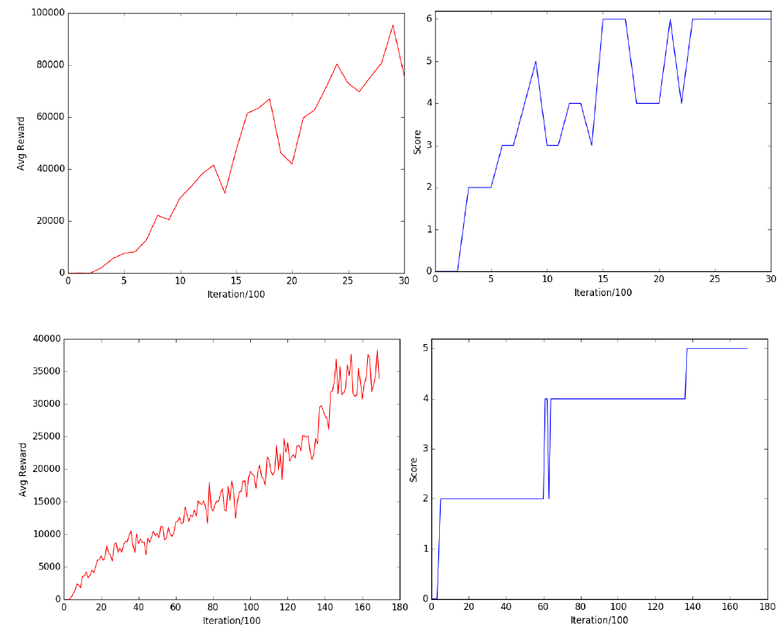
Implementation and Examples:
Breakout
Breakout with MOVE + FIRE action
4 x 6 blocks on screen
Training time: 5 minutes
Breakout with MOVE action
4 x 5 blocks on screen
Training time: 1 hour

Slide 5

Sapientino
RL Agent
Restraining Bolt
Can have two configurations:
OMNI: up, down, left, right actions
DIFFERENTIAL: forwards, backwards, turn left, turn right
The state representation is given by the agent pose:
With this specification, the agent can just learn how to move in the grid, but it cannot match related concepts.
Two specifications:
Visit at least two cells per color for each color in a given order.
Visit all triplets of each color, given an order among colors.
For this two more features are needed:
Beep action has just been executed
Color of the current cell

Slide 6
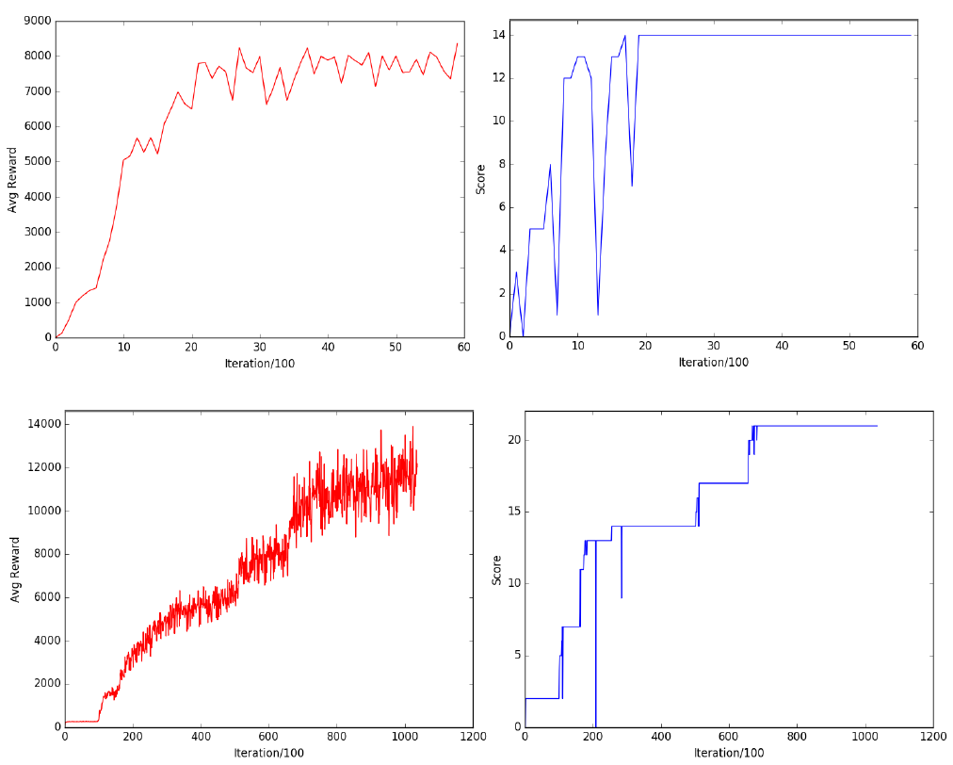
Implementation and Examples:
Sapientino
Sapientino OMNI
Training time: 3 minutes
Sapientino DIRECTIONAL
Training time: 1 hour

Slide 7
Cocktail Party
RL Agent
Restraining Bolt
Agent representation:
Agent’s pose.
Object’s pose.
People’s location.
The agent can move in the environment, grasp and deliver items to people, and get a reward when a delivery task is completed.
Two specifications:
Serve exactly one drink and one snack to each person.
Do not serve alcoholic drinks to minors.
For this three more features are needed:
People’s identity
People’s age
Received items
Simulation
Two people and 2 different kind of drinks and snacks.

Slide 8
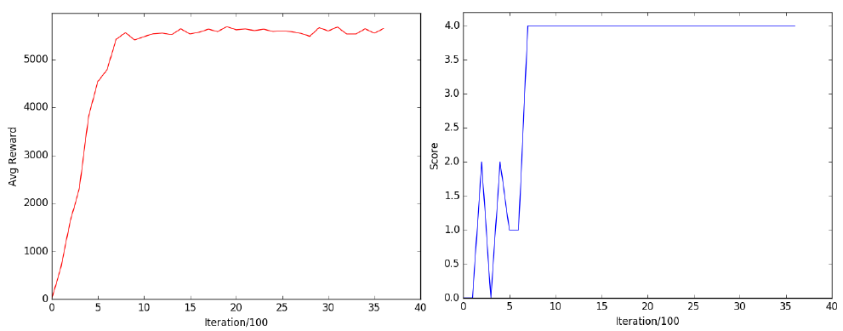
Implementation and Examples:
Cocktail Party
Score = 4 means that 2 people received 1 drink and 1 snack each
Training time: 1 minutes

Slide 9
MAIN EXPERIMENT -1
Description
ENV : RL e RB

Slide 10
MAIN EXPERIMENT -2
CODE and TRAINING

Slide 11
MAIN EXPERIMENT -3
Done
FORMULA LTL
GRAFICO
VIDEO
Hyperparams ecc…
….
Alpha ecc
The agent must…
Number of episodes
Training time
….

Slide 12
Other Possible Example 1
Sistema di parcheggio automatico automobile
Una limitazione potrebbe essere posta dalle strisce gialle/blu
O da un posto handicap
Quindi capire dove non fare learning
https://www.youtube.com/watch?v=VMp6pq6_QjI
RL AND RB

Slide 13
Other Possible Example 2
PSEUDO CODE

Slide 14
Other Possible Example 2
Braccio meccanico per una classica pick and place con varie restrizioni--→ per cosa potrebbe servire???
RL AND RB
Come per il primo anche qui si potrebbe implementare …

Slide 15
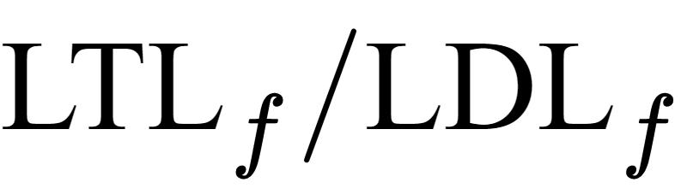
Conclusions AND FUTURE WORK
Results:
It is possible to perform RL with constraints by using RL techniques on associated MDPs
Features needed by the specifications can be kept separated from the agent ones
This work shares similarities with safety conditions satisfaction projects, but also differences:
Agent is considered as a black box
Hard satisfaction of RB specifications is not guaranteed, neither before nor after training
This would require a link between AG features and RB features
These are not needed for RL
Splitting components between AG and RB allows:
Modular robot to handle different tasks
Smaller, lighter, more efficient agents

