Slide 1
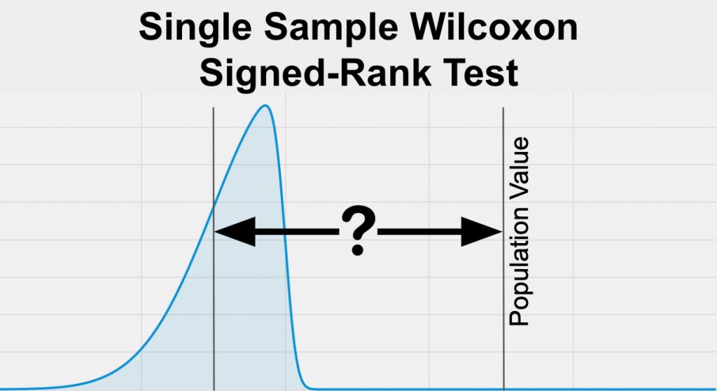
One-Sample Wilcoxon Test
The question that the test tries to answer
Testing a hypothesis about the median of that single group against a known or hypothesized value (like a population mean or median).
Assumptions on data, and other details
Continuous
Random Sample
The two samples are independent of one another
Ref: StatsTest.com

Slide 2

Example: You want to determine if the median male’s BMI at your small company is different than the median male’s BMI in Switzerland.
Hypotheses:
Null hypothesis (H₀​): The median of the sample is equal to the hypothesized median.
Working hypothesis (H₁​): The median of the sample is not equal to the hypothesized median.
Switzerland saw the lowest mean BMI (26.2kg/m2 for men, 23.8kg/m2 for women), which put the country in 170th place overall. France (115th), Denmark (152nd), Austria (146th), Italy (142nd) and Spain (141st) all came low down in the 200-country ranking with mean BMIs around 25.9 May 2019

Slide 3
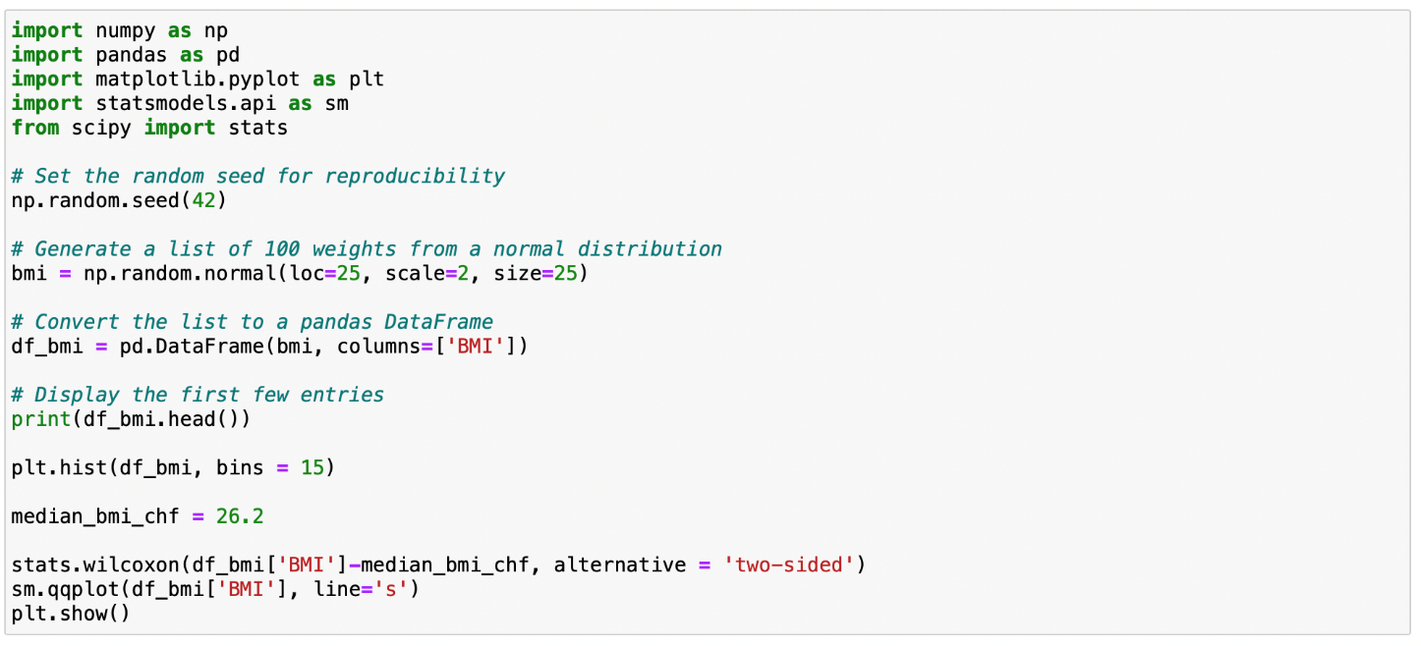
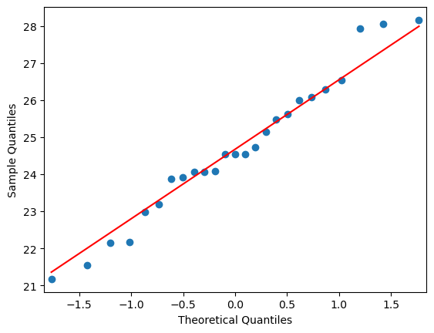
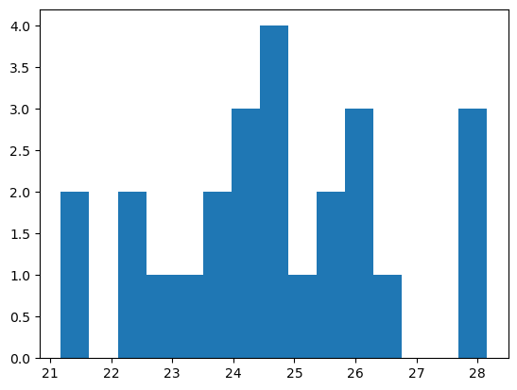
Script
WilcoxonResult(statistic=44.0, pvalue=0.000808)

Slide 4
How does it work?
Calculate difference of each observation minus the median
Cross out differences = 0
Rank absolute differences: rank 1 to the smallest value
Sign the rank: if difference < 0, add a minus sign to the rank value
Sum all positive rank values (T⁺)
Sum all negative rank values (T⁻)
Select the smallest value between absolute T⁺ and T⁻ (test statistic W)
Compare W with the critical value from the proper Wilcoxon table (in our case: 2-tail test, 5 % level, n = 25)

Slide 5
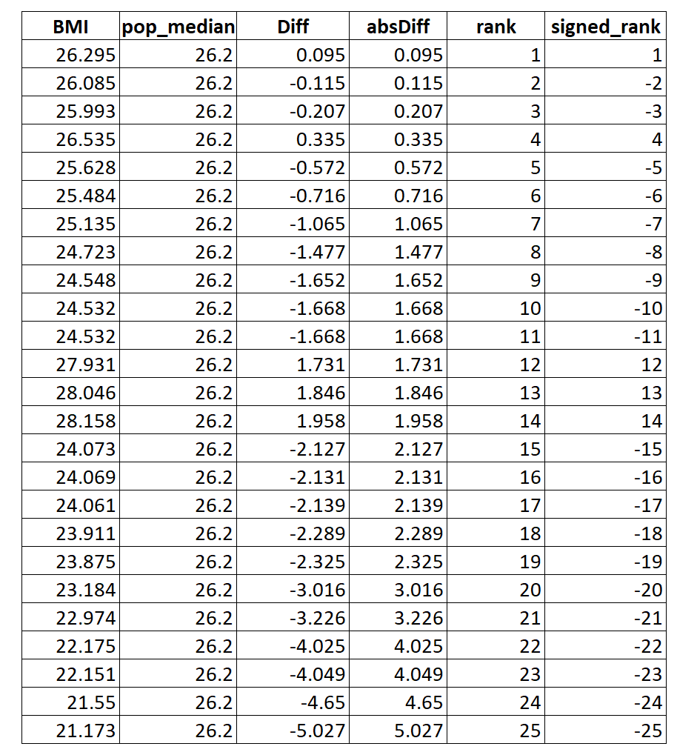
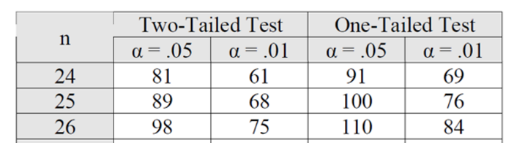

|T⁺| = 44 -> W
|T⁻| = 281
Critical value (CV):
If W ≤ CV reject H₀
W (44) < CV (89)
Your male colleagues’ BMI differ from the median Swiss males’ BMI!

