Slide 1
Mann-Whitney U test (=Wilcoxon rank-sum test)

Slide 2
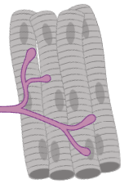
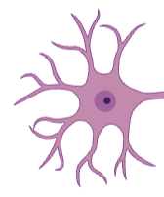

Mann-Whitney (Wilcoxon rank-sum) is a non-parametric ‘analog’ to unpaired t-test: it compares medians of two independent groups (while parametric test compares means)
What is Mann-Whitney U test?
Data: distribution of mRNA half-lives in different parts of neuronal cells: cell bodies and extensions (=neurites).
Cell body
Neurite
~ 25 μm
up to 1 meter

Slide 3
Mann-Whitney (Wilcoxon rank-sum) is a non-parametric ‘analog’ to unpaired t-test: it compares medians of two independent groups (while parametric test compares means)
What are the data for the test?
Cell body
Neurite
~ 25 μm
up to 1 meter
Data: distribution of mRNA half-lives (hl) in different parts of neuronal cells: cell bodies (=soma) and extensions (=neurites).
The mRNA half-life is the time required for the concentration of a specific mRNA molecule in a cell to decrease by half due to degradation processes. Simplified: values showing how long an mRNA molecule lives in cells before it’s degraded, measured in hours.

Slide 4
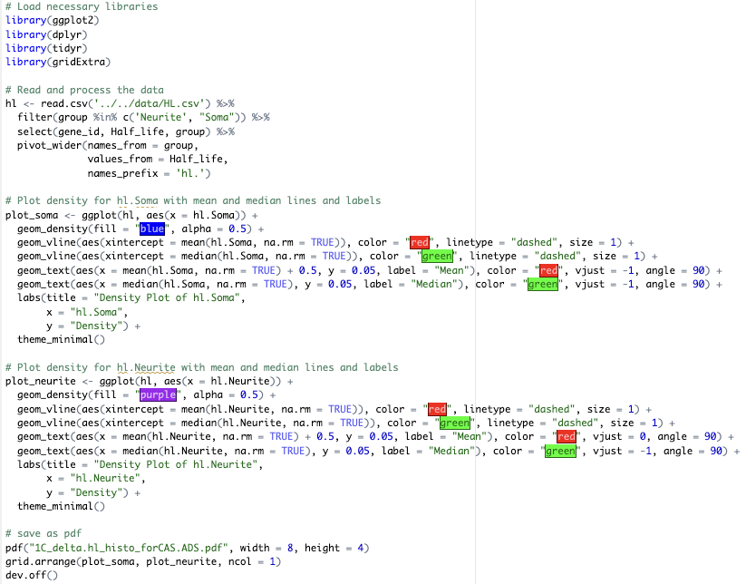
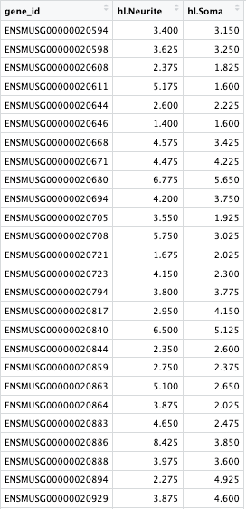
Code for loading and plotting the data as density plots

Slide 5
Density plots showing data distribution
Value distribution is skewed on the right for cell body sample → use non-parametric test
Samples are independent (i.e. not values before and after treatment) → unpaired
→ Use Mann-Whitney U test

Slide 6
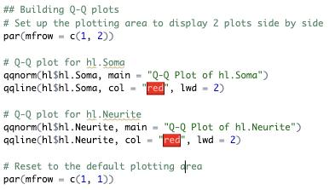
Checking for normality with Q-Q-plots
Code for plotting:
Q-Q plots also show deviation from normal distribution → Use Mann-Whitney U test

Slide 7
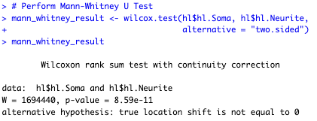
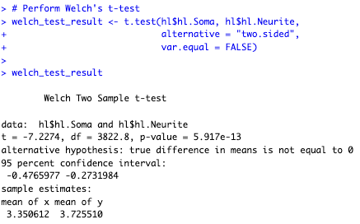
Code for Mann-Whitney U test

Slide 8
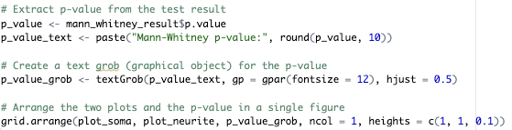
Code to add P value to the plots

Slide 9
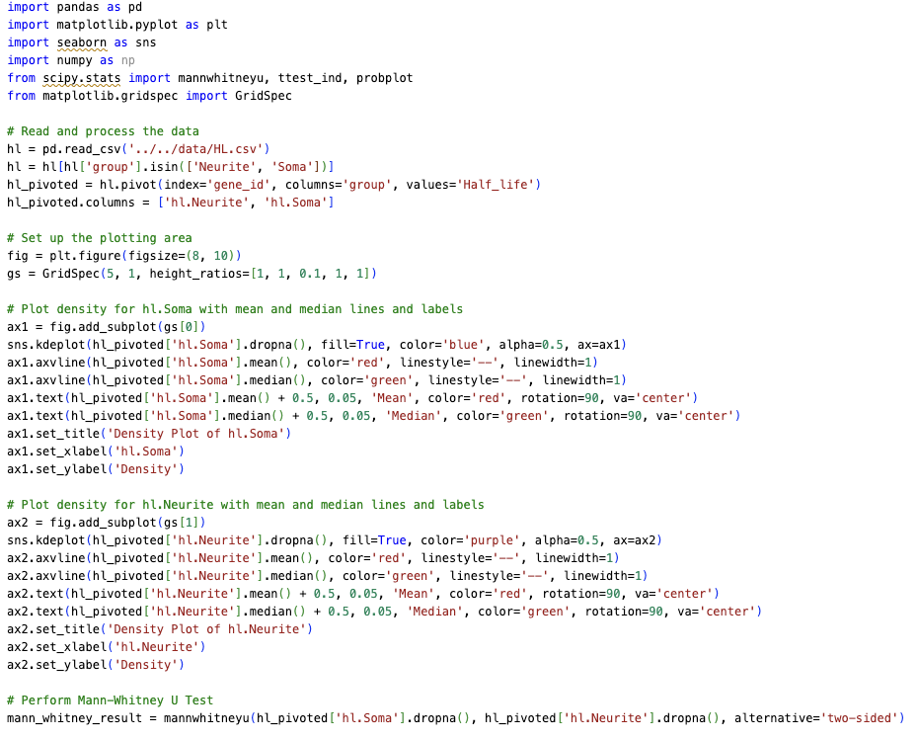
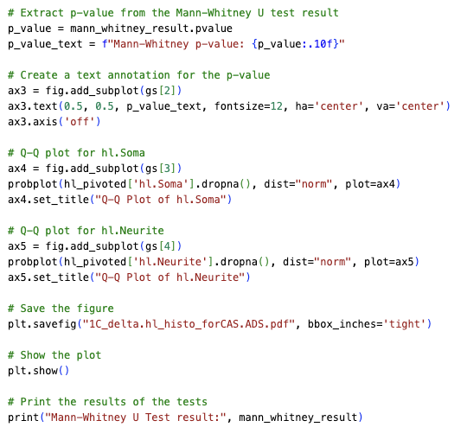
Mann-Whitney U test in python

