Slide 1
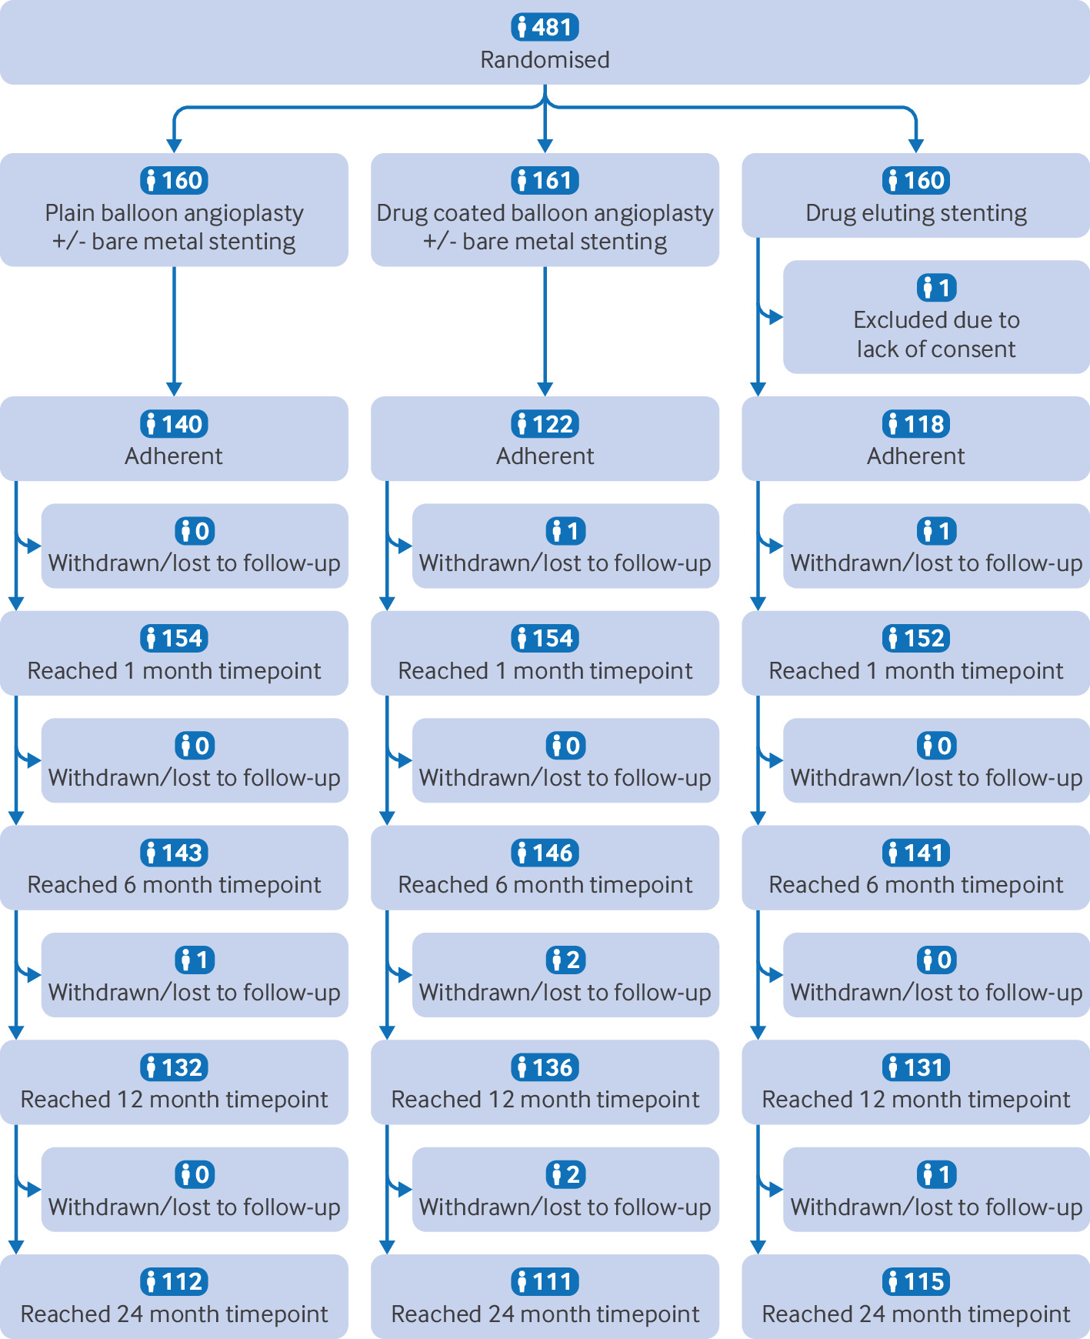
Fig 1 Consolidated standards of reporting trials (CONSORT) diagram. Assessment conducted refers to clinical review, not assessment of primary endpoint

Slide 2
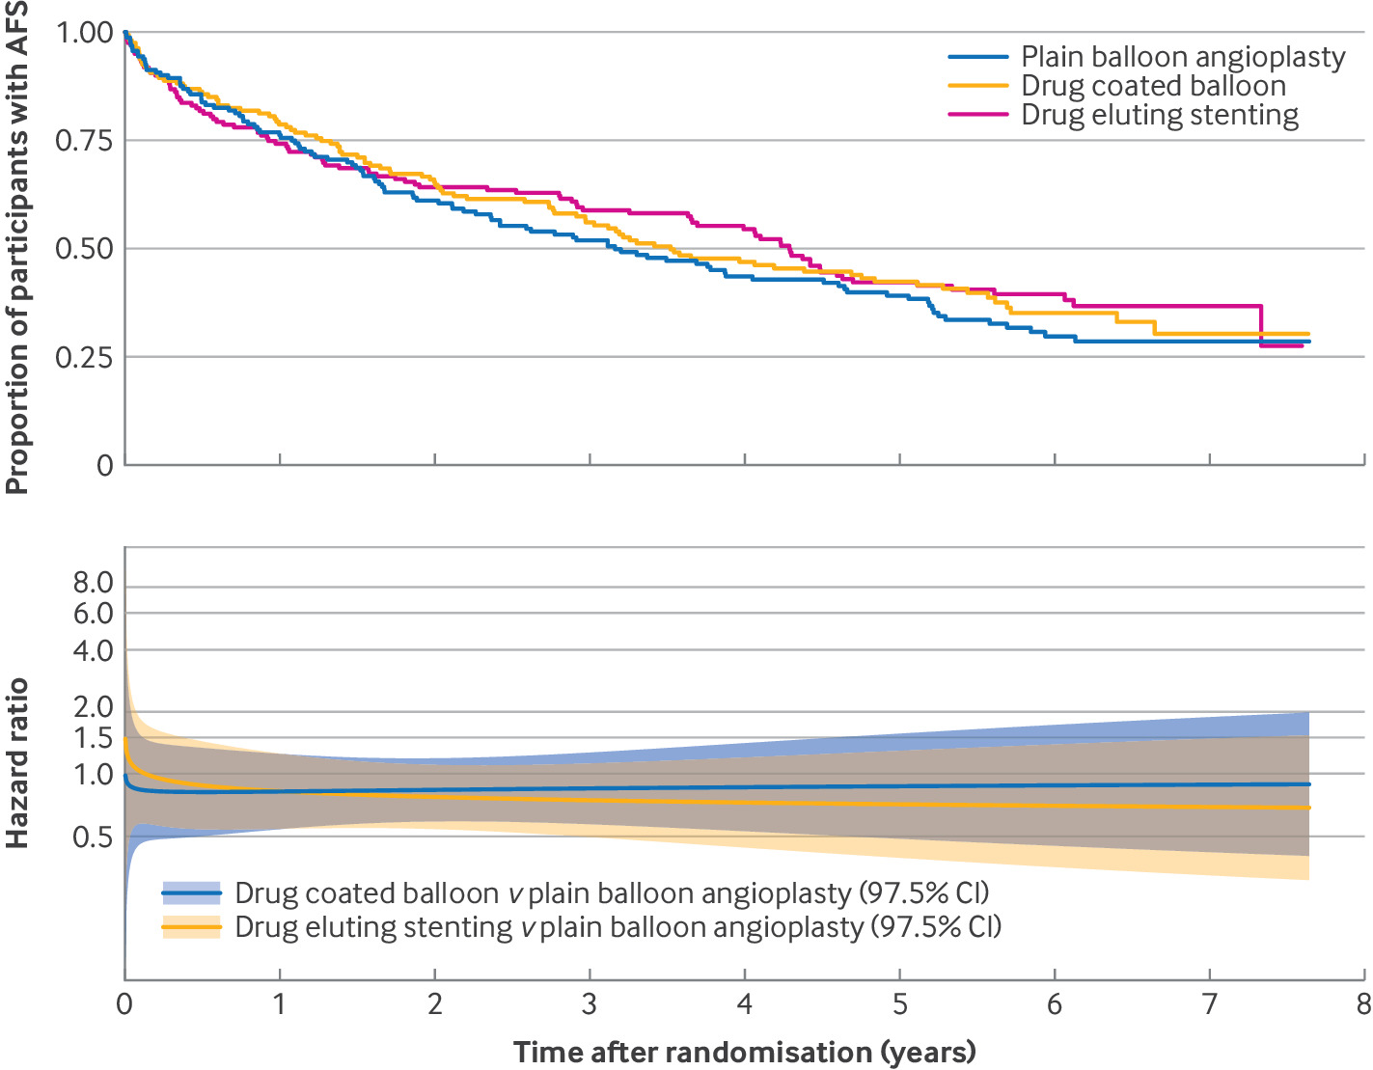
Fig 2 Amputation free survival (AFS) Kaplan-Meier plot and hazard ratio over time fitted assuming non-proportional hazards (intention-to-treat analysis). CI=confidence interval

